Slide 1
PowerDesigner 15 Lab by Sybase
BPA
CSUB
Yong Choi

Slide 2
Very First Step
Create your Sybase account
Then, log in as a registered user
Otherwise, you will not be able to try the PowerDesigner tutorial (LabSteps).

Slide 3
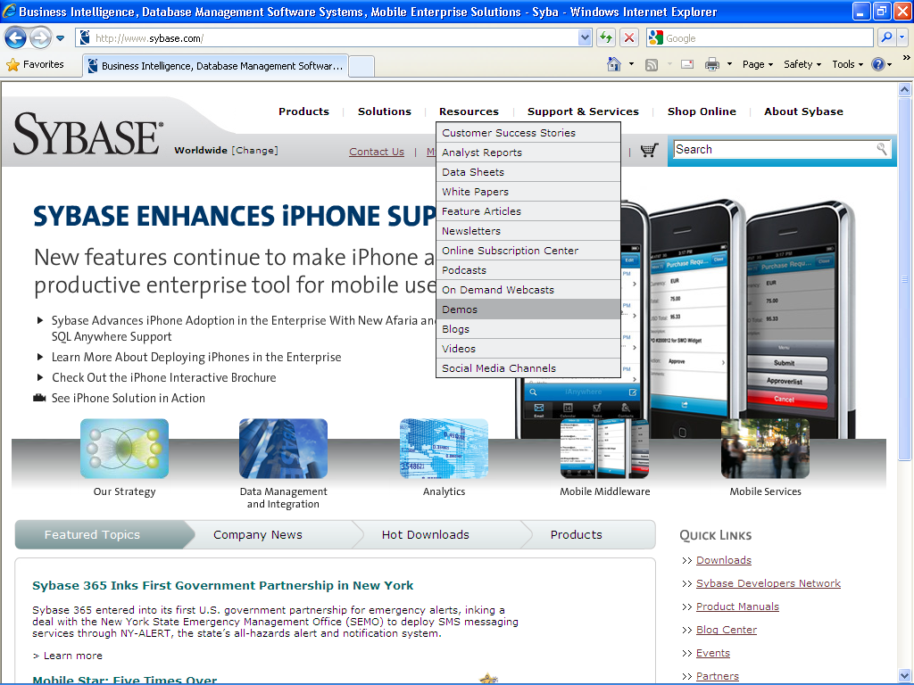
From “Resources”, select “Demos”.

Slide 4
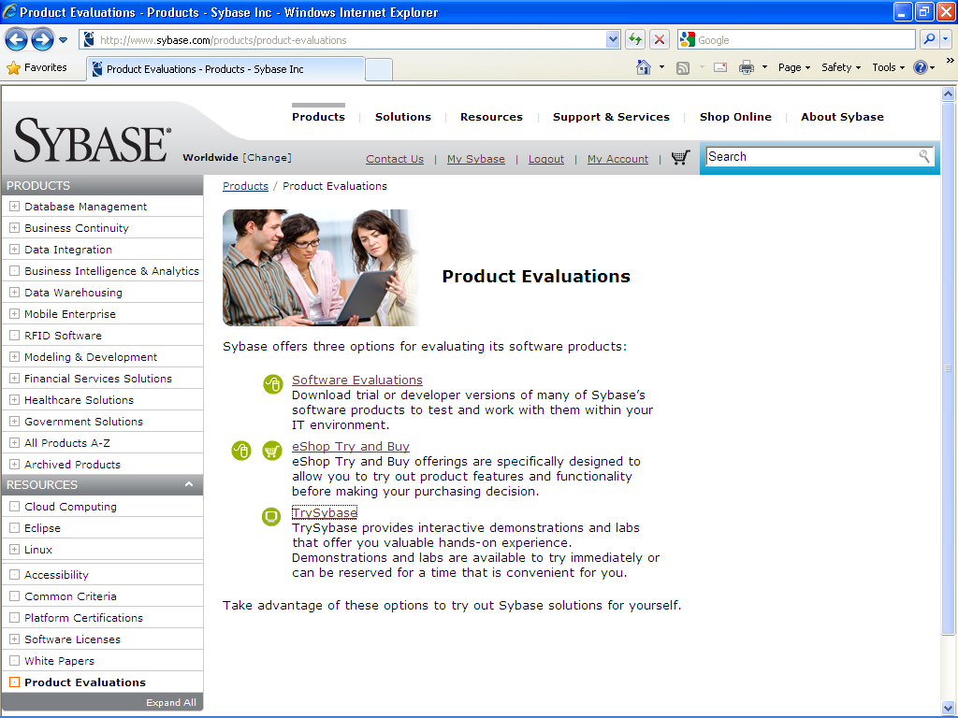
On the “Resources” page, select “TrySybase”.

Slide 5
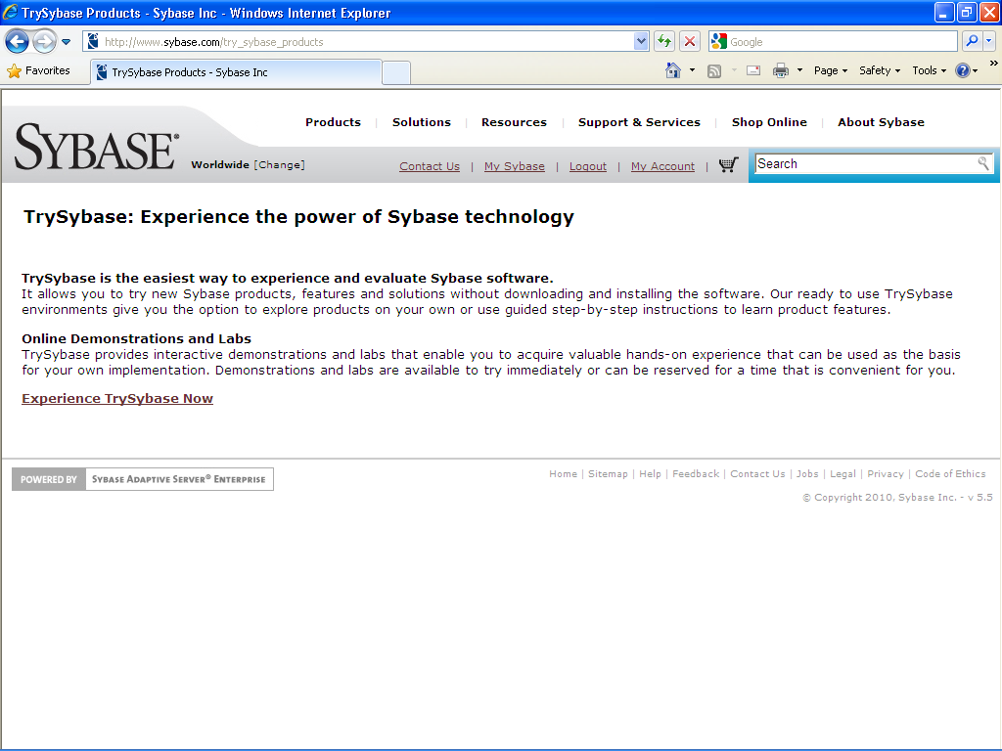
Click the Experience TrySybase Now” hyperlink

Slide 6
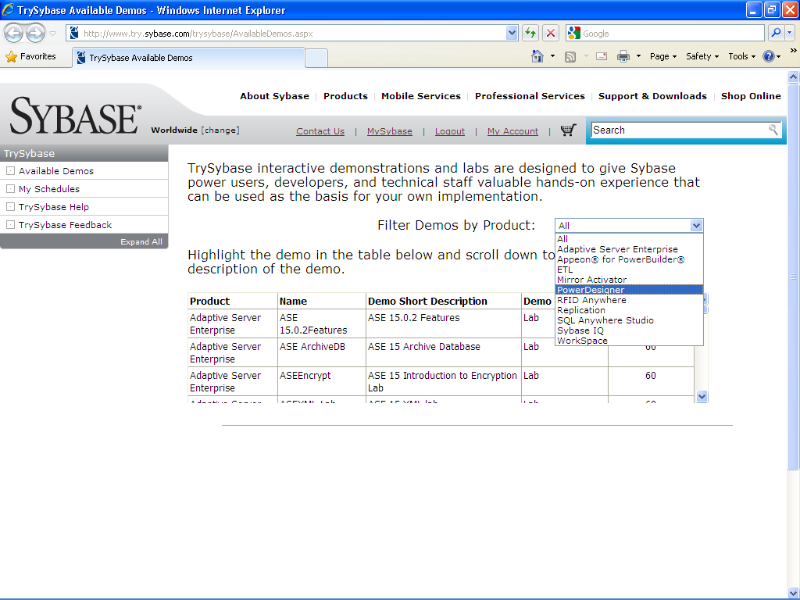
From the drop-down box, select “PowerDesigner”

Slide 7
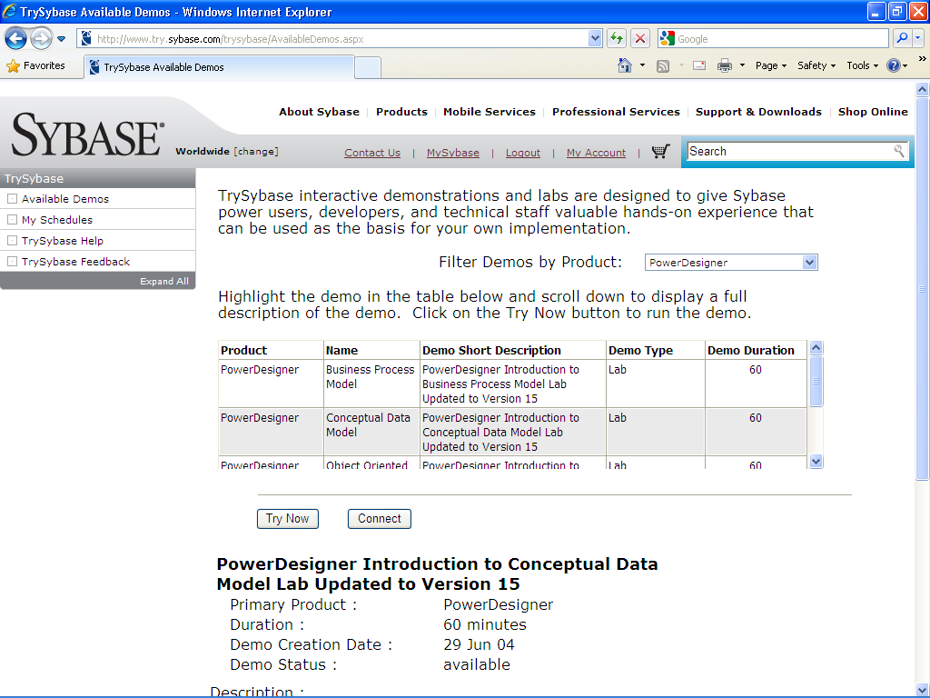
From the below table, click “PowerDesigner Conceptual Data Model” row. The row seems that it is not clickable but it will be highlighted as soon as you click the row. , then click the “Try Now” button

Slide 8
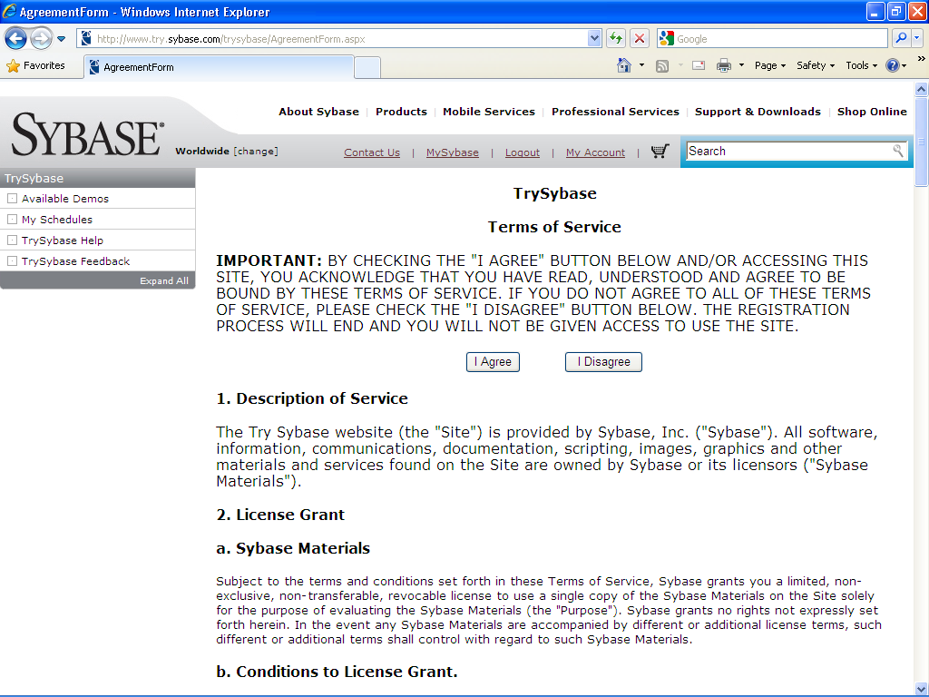
Click the “I Agree” button.

Slide 9
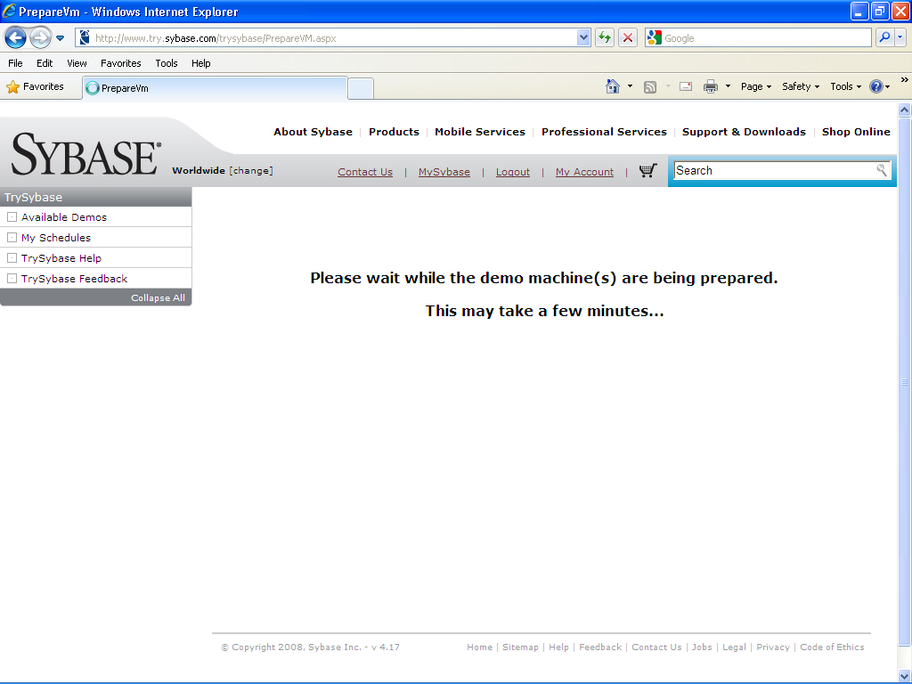
Wait ………

Slide 10
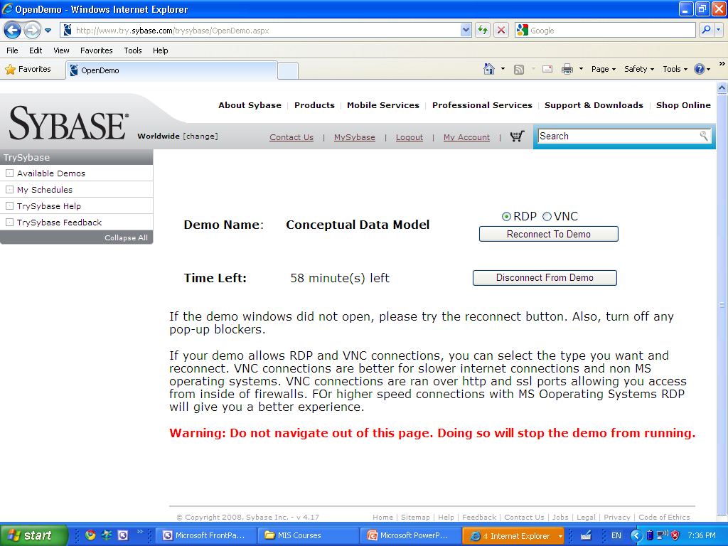
Select “RDP” and then click the “Connect to Demo” button ( since I am logging in again, mine is little bit different… ) or “Reconnect to Demo”.

Slide 11
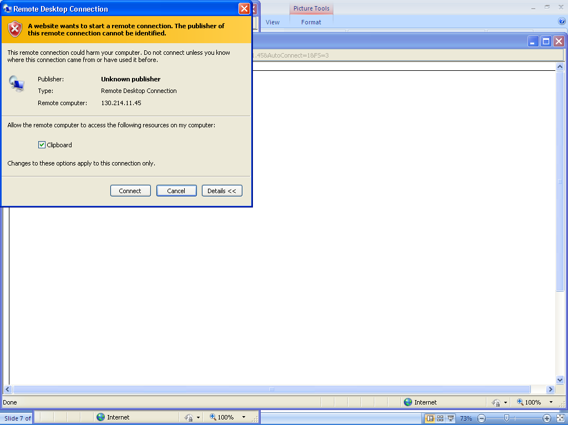
Click the “Connect” button

Slide 12
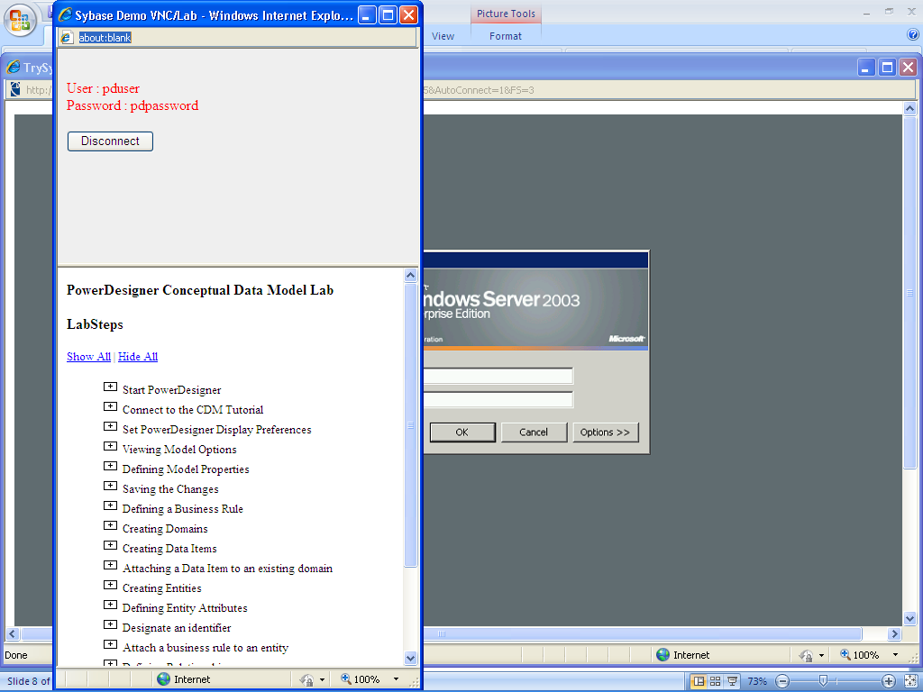
Type the red color username and password to the “log-in” window (behind window). Then, follow the tutorial below (LabsSeps).

Slide 13
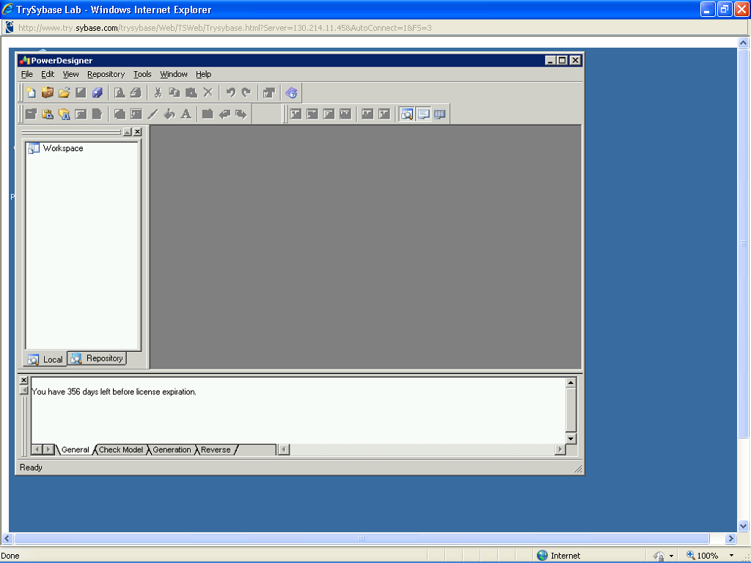
As soon as you double-click the “PowerDesigner” icon, your screen should look like below window.

