Slide 1
Data Modeling for Database Design
Yong Choi
School of Business
CSUB

Slide 2
Study Objectives
Understand concepts of data modeling and its purpose
Learn how relationships between entities are defined and refined, and how such relationships are incorporated into the database design process
Learn how ERD components affect database design and implementation
Learn how to interpret the modeling symbols
Learn how to define the business rules

Slide 3
Data Model
Read chapter 2 at least few times…
Model: an abstraction of a real-world object or event
Useful in understanding complexities of the real-world environment
Data model
A diagram (ERD) that displays a set of tables and the relationships between them
Next Slide: “Restaurant” Access data model

Slide 4
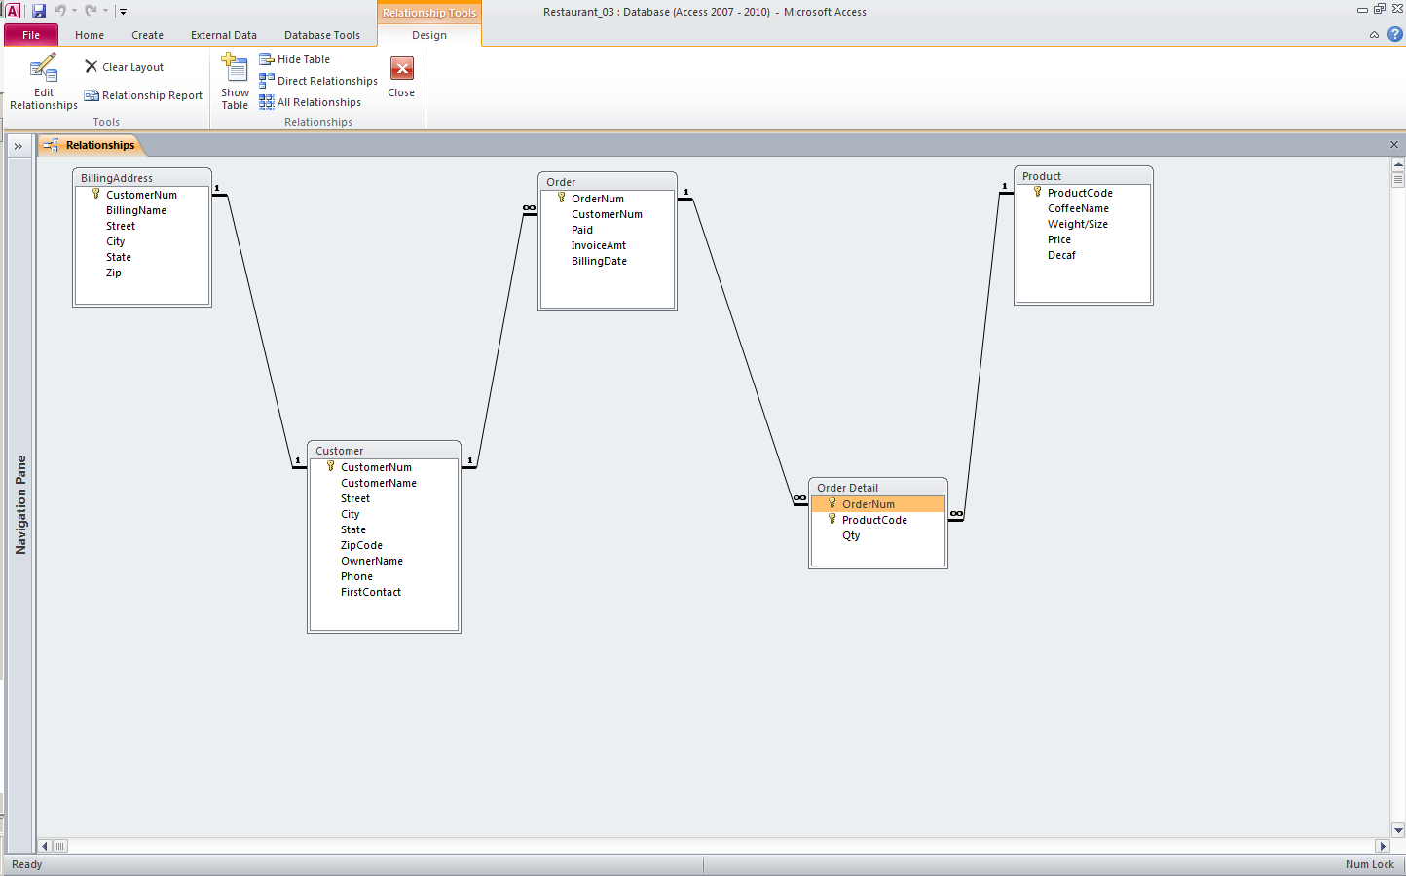
Data Model by Access: Entity Relationship Diagram (ERD)

Slide 5
Entity Relationship Diagram (ERD)
ERD is a data modeling methodology used in software engineering to produce a conceptual data model of a database system.
Our choice of methodology
Data Modeling Video (stop @ 9:20)
Basic overview of data modeling using ERD
No need to understand everything!
Introduction of essential ERD terms: entity, cardinality, business rules, etc

Slide 6
Data Modeling
The data modeling revolves around discovering and analyzing organizational and users (e.g., employees) data requirements.
The requirements for the model development must be based on policies, stakeholders (e.g., survey, discussion, observation, etc.), business procedures, system specifications, and so on.
Identify what data is important!
Identify what data should be maintained!
Notes:
7

Slide 7
Importance of Data Model
Blue print
Official documentation: “Blue Print of Architecture”
Data Model vs. list of “Excel” tables
Understandable w/o DB knowledge
Effective Communication Tool
Improve interaction among various stakeholders (senior managers, DB developers, and ordinary employees….)
DB Model = Actual DB
Example on the website

Slide 8
Data modeling by ERD
To construct a model, the first three major activities are identifying Entity, Attribute, and Relationship
Entity → table
Attribute → column (data item)
Relationship → line
Notes:
7

Slide 9
How to find entities?
Entity:
"...anything (people, places, objects, events, etc.) about which we need to store information (e.g., supplier, machine tool, employee, utility pole, airline seat, etc.).”
Tangible: customer, product
Intangible: order, account payable
Look for singular nouns (beginner)
BUT a proper noun is not a good candidate….

Slide 10
Entity Instance
A single occurrence of an entity (# of records).
Entity: student
Student ID | Last Name | First Name
2144 | Arnold | Betty
3122 | Taylor | John
3843 | Simmons | Lisa
9844 | Macy | Bill
2837 | Leath | Heather
2293 | Wrench | Tim
Six instances

Slide 11
How to find attribute?
Attribute:
Attributes are data objects that either identify or describe entities (property of an entity).
In other words, it is a descriptor whose values are associated with individual entities of a specific entity type
The process for identifying attributes: look for names that appear to be descriptive noun phrases.

Slide 12
How to find relationships?
Relationship:
Relationships identify and describe associations between entities.
Typically, a relationship is indicated by a verb connecting two or more entities.
Employees are assigned to projects
Relationships should be classified in terms of cardinality.
One-to-one, one-to-many, etc.

Slide 13
How to find cardinalities?
Cardinality:
The cardinality is the number of occurrences in one entity which are associated to the number of occurrences in another entity.
Cardinalities of Access ERD (next slide)
There are three basic cardinalities: one-to-one (1:1), one-to-many (1:M), and many-to-many (M:N)

Slide 14
Data Model by Access: Entity Relationship Diagram (ERD)

Slide 15
Identifier
“attributes that uniquely identify entity instances”
Becomes a PK in RDS
Composite identifiers (composite PK) are identifiers that consist of two or more attributes
Identifiers are usually represented by underlying the name of the attribute(s)
Employee (Employee_ID), student (Student_ID)
Notes:
18

Slide 16
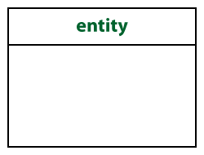
Crow’s Foot Notation
Known as IE (information engineering) notation
more intuitive than other notations
Entity:
Represented by a rectangle, with its name on the top. The name is singular (entity) rather than plural (entities).
Example: student,
Customer, etc.

Slide 17
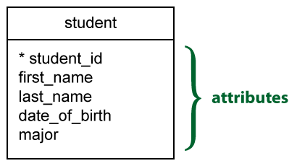
Attribute
Identifier(s) must be represented by underlying the name of the attribute(s)

Slide 18
Three Basic Cardinalities
1-to-1 relationship
1-to-M relationship
M-to-N relationship

Slide 19
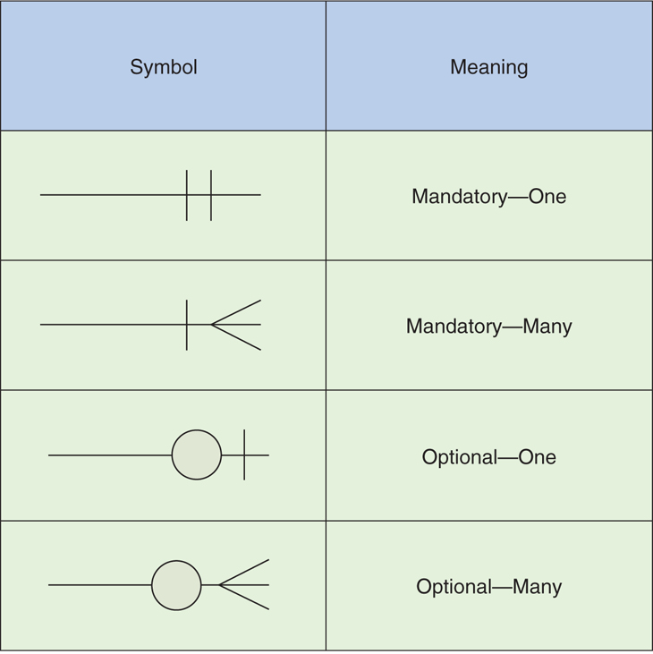
Cardinality con’t
Missing mandatory cardinality will not be penalized for the data modeling test.
Identical concept of “Or” operator. If either of cardinality is satisfied, then ok

Slide 20
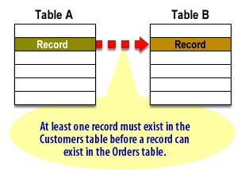
Mandatory Relationship
At least one record (instance) of one table (entity) must participate in a relationship with another table.
Table A (Customer), Table B (Order)

Slide 21
Mandatory Relationship con’t
No order can exist in a database unless it has first been placed by a customer.
Therefore, at least one record must exist in the Customer table before any records can be added to the Order table.
Source:
https://www.relationaldbdesign.com/relational-database-design/module6/mandatory-optionalRelationship-participation.php

Slide 22
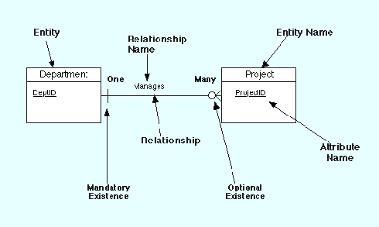
Very Simple Data Model Example

Slide 23
ERD Development Procedure 1
Understand “Business Rules (BR)”
BR determine (or dictate) how the organization data should be managed and controlled.
Example of Business Rules
A student may register for a section of a course only if a student has successfully completed the prerequisites for the course.
A preferred member hotel customer can reserve more than one hotel room at once but a regular customer is allowed to reserve one room at a time.

Slide 24
ERD Development Procedure 2
Sources of Business Rules (every where…)
Organizational documents: business transactions, personal manuals, policies, contracts, annual report, Mktg brochures, technical instructions, etc.
Various business-related input by stakeholders (e.g., survey, interview note, meeting minutes, etc)
Site visitations and observations of work process or procedure

Slide 25
Benefits of BR
Allow us to understand business processes, the nature, role and scope of the data.
Allow us to develop relationship participation rules (cardinality) and constraints to create a correct data model.
Help standardize the company’s view of the data.
A communication tool among stakeholders

Slide 26
ERD Development Procedure 3
Useful BR vs Useless BR
A valued customer qualifies for purchasing more than three products at once unless a customer has an over due account balance.
Friday is business casual dress day.
Iterative process……..
Move together until optimized….not finalized.
BR 1st, 2nd ,3rd ,4th…….
ERD 1st, 2nd ,3rd ,4th……
Will not be concerned with “Mandatory” cardinality (no penalty!)

Slide 27
Example of ERD and BR 1
Every student must be treated equally according our US Federal Government. That is, each full or part time student must be allowed to be enrolled in curriculums equally. Therefore, each curriculum should be available to all of our registered students.
Two entities (Student, Curriculum), Relationship, and cardinality

Slide 28
Example of ERD and BR 2
Official (optimized) Business Rule: bi-directional
A student has to be enrolled in many curriculums (cardinality: student to Curriculum). Each curriculum might be studied by many students (cardinality: Curriculum to student).
Whenever possible, Active & Passive for differentiation of bi-directional BR

Slide 29
Example 1
No Attributes!
A department (must, may) hires many employees. An employee (must be, can be) is hired by one department.

Slide 30
Example 2
No Attributes!
A manager manages one department. A department must be managed by at least one manager.

Slide 31
Example 3
No Attributes!
An author (must, may) writes many books. A book is (might be) written by many authors.

Slide 32
Practice 1
No Attributes!
A customer (can) orders multiple products. Each product must be ordered by one customer

Slide 33
Practice 2
No Attributes!
A faculty may teach multiple courses. A course must be taught by exactly one faculty.

Slide 34
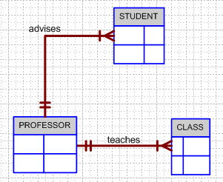
Example 4 (No Attributes)
Finalized (or optimized) business rules must be bi-directional.
Draft: one sentence
Finalized: two sentences
A professor must advise many students (professor to student). Each student has to be advised by one professor (student to professor).
A professor must teach many classes. Each class must be taught by one professor.

Slide 35
Practice 3 (No Attributes)
A sales representative must write many invoices. Each invoice should be written by one sales representative. Each department must have only one sales representative. Each sales representative is assigned to many departments. A customer may have many invoices. Each invoice must be generated for only one customer.

Slide 36
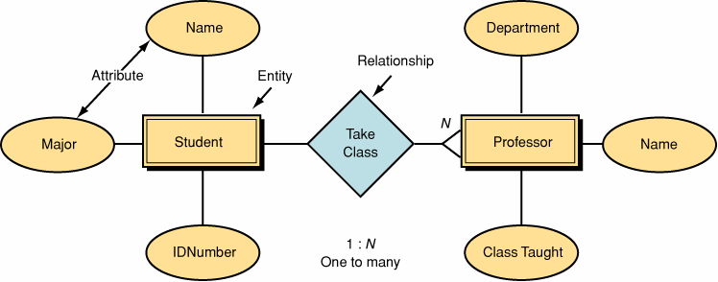
Data Model by Peter Chen’ Original Notation
1

Slide 37
Eliminate unnecessary information (No Attributes)
Each California State University campus should have a sufficient number of professors for teaching various courses. Each department must have at least one professor on each CSU campus. In some cases, a professor can be assigned to a department at all.

Slide 38
Practice 4
According to the policy of Mercy Hospital, a patient should have a patient record. Specifically, each patient may have one or more records. Each patient record can be assigned to one patient.

Slide 39
Practice 5
The California State University has changed the course schedule policy based upon feedback from professors and students. According to the changed policy, each course may have exactly one or more sections, or may not have a section at all. However, each section must be assigned to one course.

Slide 40
Practice 6
CSUB is the only 4 years comprehensive university in Kern County. Each class offered by CSUB may be taught by several professors. A particular class may always uses the same classroom. Because classes may held at different times or on different evenings, it is possible that each classroom is used by many different classes. By the way, A professor can teach several classes.

Slide 41
ERD Development Simulation
Using the original notation by Peter Chen
Some still prefer to use the original notation
Assume that draft BRs have been generated.
Entity
Attributes (as well as identifier)
Relationship
Cardinality

Slide 42
Entities???
Original Data Model Notation Used (Peter Chen)
ANG Laboratory has several chemists who work on one or more projects. Chemists also may use certain kinds of equipment on each project. The organization would like to store the chemist’s employee identification number, his/her name, up to three phone numbers, his/her project identification number and the date on which the project started. Every piece of equipment, the chemist uses, has a serial number and a cost.

Slide 43
Entities
Project
Chemist
Equipment

Slide 44
Entities’ Attributes???
ANG Laboratory has several chemists who work on one or more projects. Chemists also may use certain kinds of equipment on each project. The organization would like to store the chemist’s employee identification number, his/her name, up to three phone numbers, his/her project identification number and the date on which the project started. Every piece of equipment, the chemist uses, has a serial number and a cost.

Slide 45
entities, attributes and identifiers
Emp#
Phone#
Proj#
Start-Date
Chemist
Project
Equipment
Serial#
cost

Slide 46
Relationships ???
ANG Laboratory has several chemists who work on one or more projects. Chemists also may use certain kinds of equipment on each project. The organization would like to store the chemist’s employee identification number, his/her name, up to three phone numbers, his/her project identification number and the date on which the project started. Every piece of equipment, the chemist uses, has a serial number and a cost.

Slide 47
Entities/Relationships & their Attributes
Proj#
Start-Date
Works-On
Project
Emp#
Phone#
Chemist
Uses
Equipment
Serial#
cost

Slide 48
Cardinality
The organization would like to store the date the chemist was assigned to the project and the date an equipment item was assigned to a particular chemist working on a particular project. A chemist must be assigned at least to one project and one (or more) equipment. Projects and each equipment must be managed by only one chemist. A project need not be assigned an equipment and vice versa.

Slide 49
Complete ER Diagram using the Original Notation
Proj#
Start-Date
Works-On
1
N
Project
Emp#
Phone#
Chemist
Uses
1
N
Equipment
Serial#
cost

Slide 50
ERD Notation Practice
Redraw the Previous ERD using Crow’s Foot Notation
Entity – rectangle
Attributes
Identifier (underlined)
Relationship (no change)
Cardinality (very different)

Slide 51
Degree of Relationship
“Degree of Relationship” describes the number of entity participation
Unary (Recursive) Relationship: One instance related to another of the same entity type
Binary Relationship: Instances of two different entities related to each other
Ternary Relationship: Instances of three different types related to each other
Notes:
16

Slide 52
Degree of Relationship …
Notes:
8

Slide 53
Develop Data Model….
A senior manager supervises junior managers. A junior manager is supervised by a senior manager. A junior manager supervises department managers. A department manager is supervised by a junior manager. A department manager supervises supervisors. A supervisor is supervised by a manager. Each supervisor supervises various operational employees. Each operational employee is supervised by a supervisor.

Slide 54
Unary (recursive) Relationship
It is possible for an entity to have a relationship to itself
Is supervised by
Employee
supervises

Slide 55
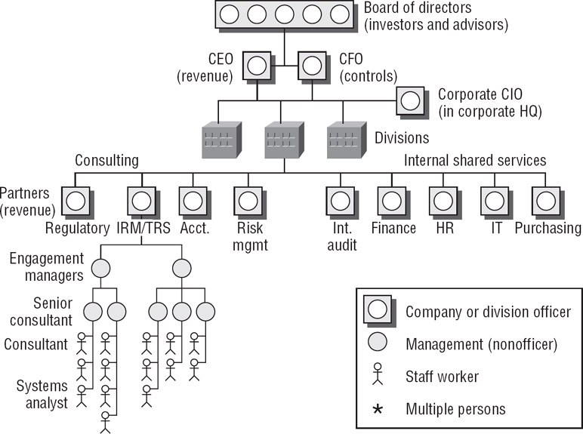
Organization Chart Example

Slide 56
Binary Relationship

Slide 57
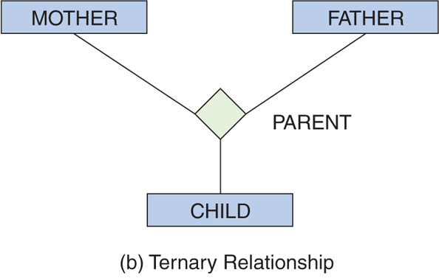
Ternary Relationship

Slide 58
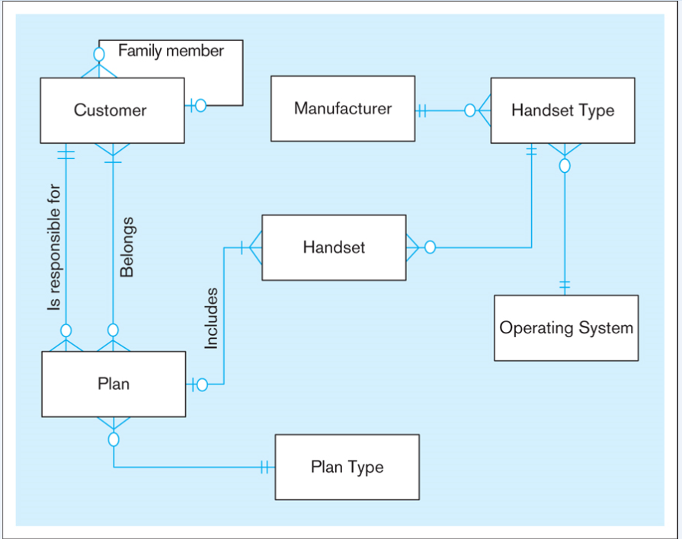
Textbook page 85 (ERD for Cellular Operator)

Slide 59
Weak Entity & Notation
A weak entity is an entity that cannot be uniquely identified and existed by itself alone.
Thus, a weak entity is an entity that exists only if it is related to a set of uniquely determined entities (owners of the weak entity).

Slide 60
Weak Entity relationship
Each employee might have none or multiple dependents. However, dependents must belong to at least one employee.
EMP
DEP
weak entity notation

Slide 61
Practice
Each employee can be identified by EmpNum (it’s like SS#) with salary and office phone number. Likewise, each departments also can identified by DeptNum (it’s like SS#) with deptname and budget. Each employee works for one department and a department is managed by an employee. Each child must be identified uniquely by last name and age when the parent (who is an employee; assume that only one parent works for the company) is known. We are not interested in information about a child once the parent leaves the company.

Slide 62
M:N relationship
Each student takes many classes, and a class must be taken by many students.
CLASS
STUDENT
IS_TAKEN_BY
TAKE
** Usually, not recommendable **

Slide 63
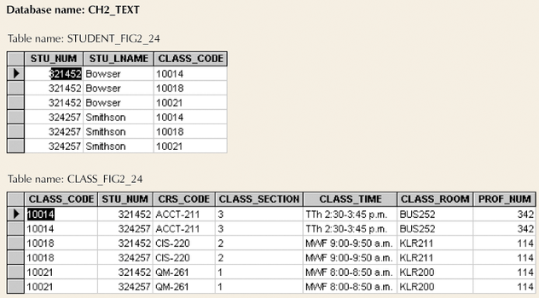
Example M:N Relationship
Table to represent Entity
3 to 3
300 to 300
30,000 to 30,000
300, 000 to 300, 000
30 million to 30 million
goes on…….

Slide 64
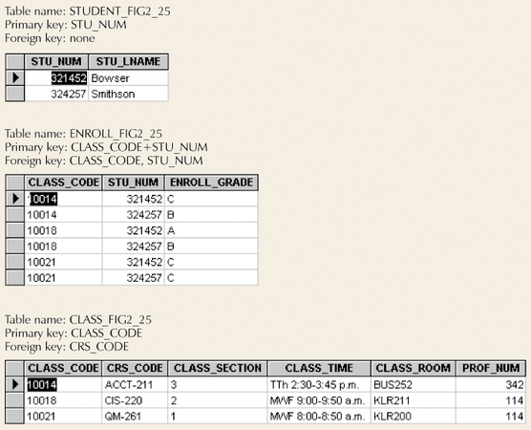
Converting M:N Relationship to Two 1:M Relationships
Bridge Entity

Slide 65
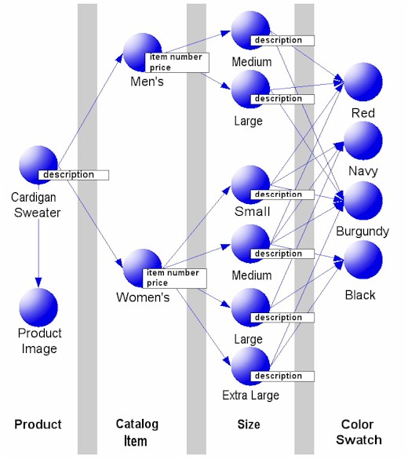
M:N using Swatch and Sweaters
Each color swatch can relate to many types of sweaters, and each type of sweater can have many color swatches.

Slide 66
Transformation of M:N
When transform to a relational model, many redundancies can be generated.
The relational operations become very complex and are likely to cause system efficiency errors and output errors.
Break the M:N down into 1:N and N:1 relationships using bridge entity (weak entity).
CLASS
ENROLL
STUDENT

Slide 67
Bridge (Associative) Entity
ENROLL entity becomes a weak entity of both STUDENT entity and CLASS entity
MUST have a composite (unique) identifier
STU_NUM (from STUDENT entity) and CLASS_CODE (from CLASS entity)
Another MUST know M:N example on the textbook page 63 and 64

Slide 68
M:N with optionality on both side
A employee might or might not work for an employer, but could certainly moonlight for multiple employers. An employer might have no employees, but could have any number of them.
Employee
Employer
Notes:
This is a M:M (many to many) optional relationship. Conceptually, it means that
Again, not hard to visualize, but hard to implement. Most solutions of this situation involve creating a third "Associative Entity" to resolve the M:M into two 0:M relationships. This might be an entity called employee because it does link the person to the employer the person works for.

Slide 69
Practice
Business Rule (bi-directional)?
What if “Optionality” on both sides.

Slide 70
CASE tool
Computer Assisted Software Engineering (CASE)
ERD by CASE Tool
See the ERD using a CASE tool example on the class website
Popular CASE tools
Powerdesigner by SAP
Data Modeler by Orcale

Slide 71
Attributes
“Describe detail information about an entity ”
Entity: Employee
Attributes:
Employee-Name
Address (composite)
Phone Extension
Date-Of-Hire
Job-Skill-Code
Salary
Notes:
18

Slide 72
Classes of attributes
Simple attribute
Composite attribute
Derived attributes
Single-valued attribute
Multi-valued attribute
Notes:
5

Slide 73
Simple/Composite attribute
A simple attribute cannot be subdivided.
Examples: Age, Gender, and Marital status
A composite attribute can be further subdivided to yield additional attributes.
Examples:
ADDRESS --→ Street, City, State, Zip
PHONE NUMBER --→ Area code, Exchange number
Notes:
22

Slide 74
Derived attribute
is not physically stored within the database
instead, it is derived by using an algorithm.
Example: an employee’s age, EMP_AGE, may be found by computing the integer value of the difference between the current date and the birth date of the employee
Formula for Access: int(Date() – Emp_Dob)/365)
Notes:
22

Slide 75
Single-valued attribute
can have only a single (atomic) value.
Examples:
A person can have only one social security number.
A manufactured part can have only one serial number.
A single-valued attribute is not necessarily a simple attribute.
Part No: CA-08-02-189935
Location: CA, Factory#:08, shift#: 02, part#: 189935
Notes:
23

Slide 76
Multi-valued attributes
can have many values.
Examples:
A person may have several college degrees.
A household may have several phones with different numbers
A car color
Notes:
23

Slide 77
Example - “Movie Database”
Entity:
Movie Star
Attributes:
SS#: “123-45-6789” (single-valued)
Phone: “(661)123-4567, (661)234-5678, (661) 567-1234” (multi-valued)
Name: “Harrison Ford” (composite)
Address: “123 Main Str., LA, CA” (composite)
Gender: “Male” (simple)
Age: 24 (derived)

Slide 78
Practice 9
More excise questions from the textbook
Exercise 2 on page 85 and 86
Exercise 10 on page 87

Slide 79
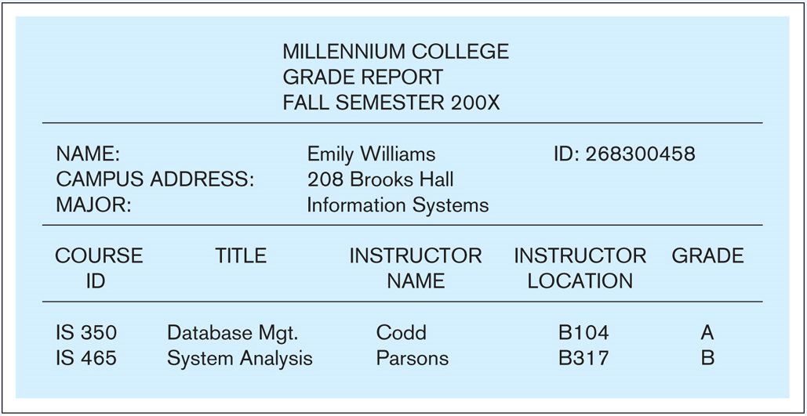

Slide 80
Review of ERD
ERD tutorial by lucidchart.com
https://www.youtube.com/watch?v=QpdhBUYk7Kk
Try ERD practice on the class website

