Slide 1
Database 2
Database Creation and Management

Slide 2
Creating a Order table
Barbara wants to track each order data, which has been placed by each restaurant customer. This data includes each order’s billing date and invoice amount. Barbara is asking you to create a second table in the Restaurant 1 database to store the order data and the table name should be “Order.”

Slide 3
Creating a Order table
Use “Design View”
“Datasheet View” for entering data.
Case sensitive
NUMBER, number, and Number.
When entering data in datasheet view, must enter sequentially
Otherwise, start over…
Use tap key

Slide 4
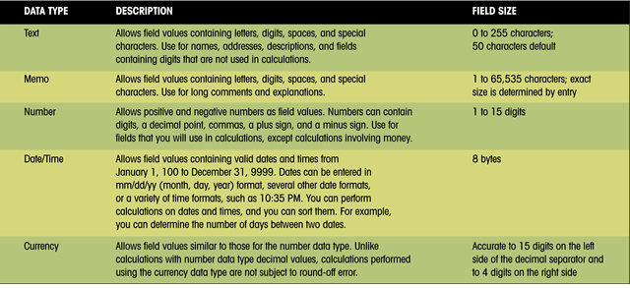
Access data (field) type
Make certain the field type you select matches the data to be held in that field.

Slide 5
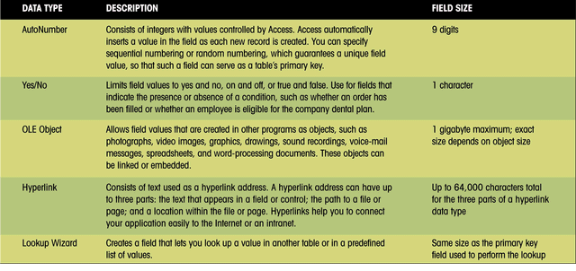
Access data (field) type (con’t)
Additional Access field types.

Slide 6
Creating the Order table
Camel-back writing!
Field Name | Data Type | Description | Field Properties
OrderNum | Short Text | primary key | Field size (3), Required (Yes)
CustomerNum | Short Text | foreign key | Field size (3)
BillingDate | Date/Time
PlacedBy | Long Text | person who placed order
InvoiceAmt | Currency

Slide 7
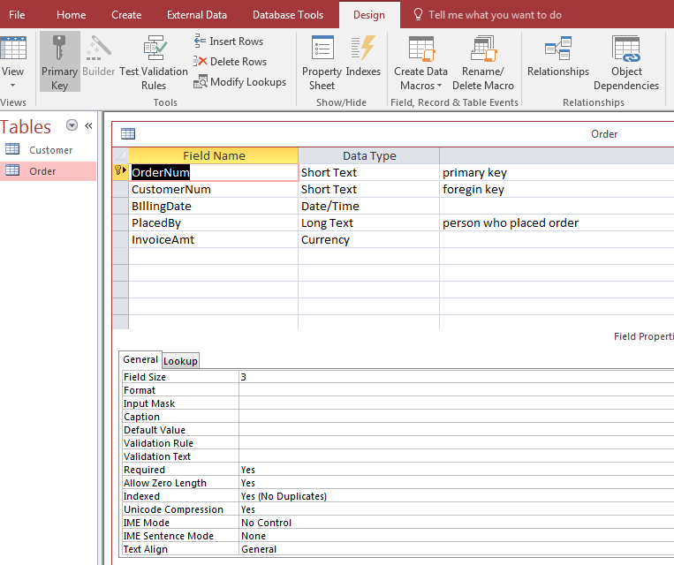

Slide 8
Primary Key
is a key in a relational database system that is unique for each record (or row) and for a table as well.
Unique identifier of each record and a table.
Examples: SS#, driver license number, vehicle identification number (VIN).
In a relational database system, there must be a primary key all the time.

Slide 9
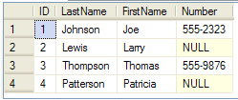
Rule for Primary Key 1
No “null” value can be allowed.
Null value is not equal to zero.
OK to have “null” value for non PK field

Slide 10
Adding Records to a Table
Enter data sequentially in Datasheet view
Do not jump from field to field
Use tab key to enter data
OrderNum
CustomerNum
BillingDate
PlacedBy
InvoiceAmt
323
624
02/15/2013
Mike Smith
$1,986.00
201
107
01/15/2013
Matt Davis
$854.00

Slide 11
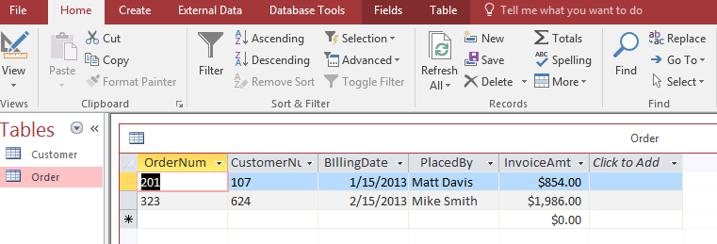
Adding Records to the Order table

Slide 12
Modifying a Table
From the Order table
Delete the PlacedBy field
Move the BillingDate field to the end of the table
Insert the Paid as a new field between CustomerNum and InvoiceAmt (position) fields
data type: Yes/No
default value: No (means “unpaid”)
Add following data to each filed: 211, 201, paid (mark the check box using space bar), $703.50, 01/15/2013

Slide 13
Table Practice: Creating Table
Barbara needs a database to track the coffee products offered by Valle Coffee. She asks you to create the database by completing the following:
In the initial Microsoft Access dialog box, click the blank Access database option button, and then click OK button. Click the Create button the new database.
YOUR LAST NAME DB file name
Display the Table window in Design view (if necessary), and then create a table using the table design shown in the next slide.

Slide 14
Table Practice: Creating Table
Field Name | Data Type | Description | Field Properties
ProductCode | Short Text | Primary Key | Field size (4), Required: Yes
CoffeeCode | Short Text | Foreign Key | Field size (4)
Price | Currency | Price for this product
Decaf | Short Text | D if decaf, Null if regular | Field size (1), Default Value: D
BackOrdered | Yes/No | back-ordered from supplier? | Default Value: No
Specify ProductCode as the primary key, and then save the table as Product.
Add the product records shown in next slide table to the Product table. (Hint: You must type the decimal point when entering the Price field values.)

Slide 15
Table Practice: Creating Table
ProductCode
CoffeeCode
Price
Decaf
BackOrdered
2316
JRUM
8.99
Yes
9754
HAZL
40.00
D
Yes
9309
COCO
9.99
D
No
Add a new field between the CoffeeCode and Price fields, using these properties;
Field Name: WeightCode
Data Type: Short Text
Description: foreign key
Field Size: 1
Move the Decaf field so that it appears between the WeightCode and Price fields.

Slide 16
Table Practice: Creating Table
Enter these WeightCode values for the three records: A for ProductCode 2316, A for ProductCode 9309, and E for ProductCode 9754.
Add a record to the Product datasheet with these field values:
ProductCode: 9729
CoffeeCode: COLS
WeightCode: E
Decaf: D
Price: 39.75
BackOrdered: Yes

Slide 17
Rule for Primary Key 2
No two records can have the same primary key.
No two CSUB students can have same ID number.
PK can be “composite key”
More than one field (or column) can be defined as a ONE SINGLE Primary Key
Example on the class website.
“Composite PK Example”
CSUB: student ID + SS#

Slide 18
Foreign Key
A foreign key is a field in one table that uniquely identifies a row of another table.
Looks like PK migrated to another table (next silde!)
Between two tables….
Primary Table: table with PK
Related Table: table with FK
That is, the foreign key is defined in a second table (Related Table), but it refers to the primary key in the first table (Primary Table).

Slide 19
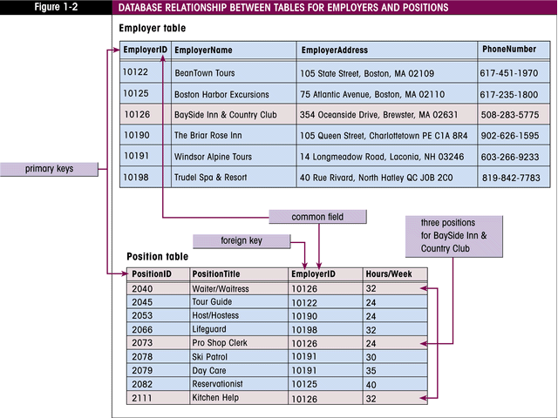
Relating tables using PK and FK
Only on Access, the Employer table is called “Primary” table because it includes the primary key.
Only on Access, the Position table is called “Related” table. Because it includes the foreign key.

Slide 20
PK as FK
Duality of primary key
A PK also can be used as a FK (next slide).
Another example on the class website
“PK as FK” there are two tables…
Primary table: customer table
Related table: Shipping Address table

Slide 21
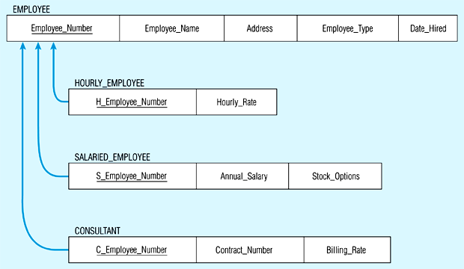

Relating tables between “parent or super” table and “child or sub” table
Driven from the Employee table

Slide 22
Access is RDS (Relational database system)
Access allows users to form relationships between the tables; that’s why it’s called a relational database system.
The simplest way to create a relationship using Access (i.e., enterprise level)
Look for identical field names between tables.
Tables can be joined in three ways; one-to-one, one-to-many, and many-to-many.

Slide 23
1:1 relationship in set notation

Slide 24
A one-to-one relationship
A one-to-one relationship exists when one table has one record associated with only one record of another table (rare especially using Microsoft Access).
Previous PK as FK database….
Shipping Address table is an related table.
Primary table: customer table

Slide 25
1:M relationship in set notation

Slide 26
M:N relationship in set notation (Not Possible using Access)

Slide 27
Importing External Access Table and Excel Worksheet
Very common practice in real world.
Almost any data type (i.e., text)
Barbara also wants you to include the Product and Order Detail tables from the FineFood database in the Restaurant database.
Download and Review design view of FineFood DB first

Slide 28
Importing External Access Table and Excel Worksheet (con’t)
And she wants you to include the Billing Address Excel worksheet as a Access table in the Restaurant database.
Before try to import the excel file, review it first
Use Excel column headings for Access table
PK: CustomerNum
Specify in the description area of Design View that CutomerNum is not only primary key of BillingAddress table but also a foreign key of Customer table.

Slide 29
Enforcing referential integrity
Referential integrity makes sure to maintain the integrity and consistency between related tables.
If you choose to enforce referential integrity, you can insure that you will not have records that have no matching record in the primary table.
That is, when updating or deleting a record (PK) in the primary table, a matching record (FK) in the related record must be updated or deleted.

Slide 30
Two Ways: Cascade Update & Cascade Delete
In Access referential integrity, there are two options.
If you choose Cascaded Update, making a change in a field that is common to two related tables will cause the update to be made in both tables.
If you delete a field that is common to two tables, the deletion will take place in both tables.
Try Referential Integrity Example DB on the class web page.

Slide 31
Creating Relationship (1 of 3)
Download Restaurant2 file from the class web
Create relationships using 5 table
In terms of creating a relationship between Customer and BillingAddress, start from the Customer table.
Enforce referential integrity
Primary key of the Order Detail table
Combination of OrderNum and ProductCode
Otherwise, a duplication of the quantity field in both the Order and Product tables.

Slide 32
Creating Relationship (2 of 3)
When creating relationships, make sure that “Relationship” tap is the only thing that is open.
Otherwise, Access will not let you create a relationship.
In other words, make sure that each table’s view (design or datasheet) is closed completely.

Slide 33
Creating Relationship (3 of 3)
In Access, name of primary key and foreign must be matched exactly.
Even though foreign key is not specified on “Design View”, finding foreign key is just a matter of finding exactly same name of primary key.
To create relationship using imported Excel files, take a primary key of each table.
And then, try to find an exactly same field name on the other table.
Do this step for each table

Slide 34
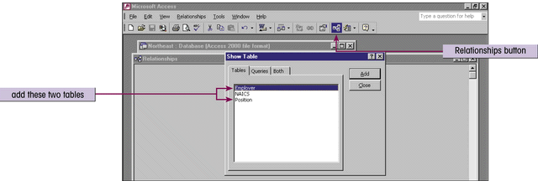
Selecting the tables for a relationship
To define a relationship, open the Show Table dialog box by clicking the Relationship button on the toolbar.
Select each table you want to be in the relationship and click the Add button.
When all tables are added, click the Close button.

Slide 35
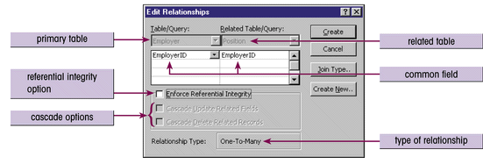
Setting relationship options
The Edit Relationships dialog box is where you can determine the type of relationship, and set referential integrity and cascade update/delete options.

Slide 36
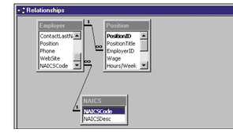
The Relationships window
You can see the tables, fields, and relationship types for any relationship in the Relationship window.
The lines indicate the common fields involved in each relationship.
The Employer table has two one-to-many relationships--one with the Positions table, and one with the NAICS table.
The symbols indicate the type of relationship.

Slide 37
Relationship Practice: Creating Relationship
Create a blank database (use any names you like) And then, import the three Excel Worksheets (Course, Instructor, and Membership) from the class web site into your Access database.
Define each imported table’s primary key using information below:
Course table: Class_Number
Instructor table: Employee_Number
Membership table: Member_Number

Slide 38
Relationship Practice: Creating Relationship
Establish relationship based on common fields.
And enforce referential integrity (apply both options) among three imported tables

