Slide 1
How to submit assignment/exam through Blackboard (BB)
Yong Choi
BPA
CSUB

Slide 2
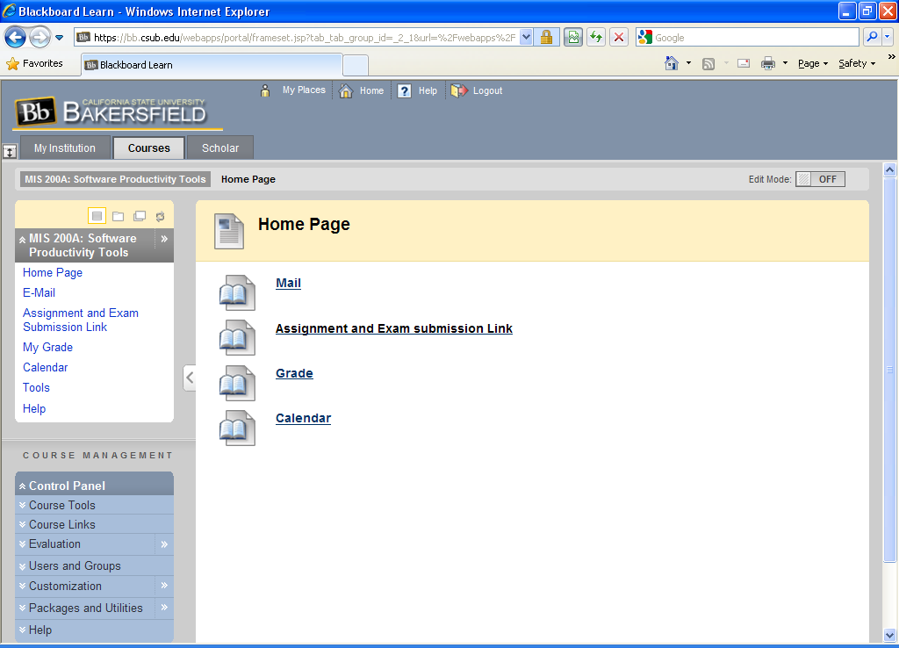
Below is our MIS 200A Blackboard page. From here, click “Assignment and Exam submission link”

Slide 3
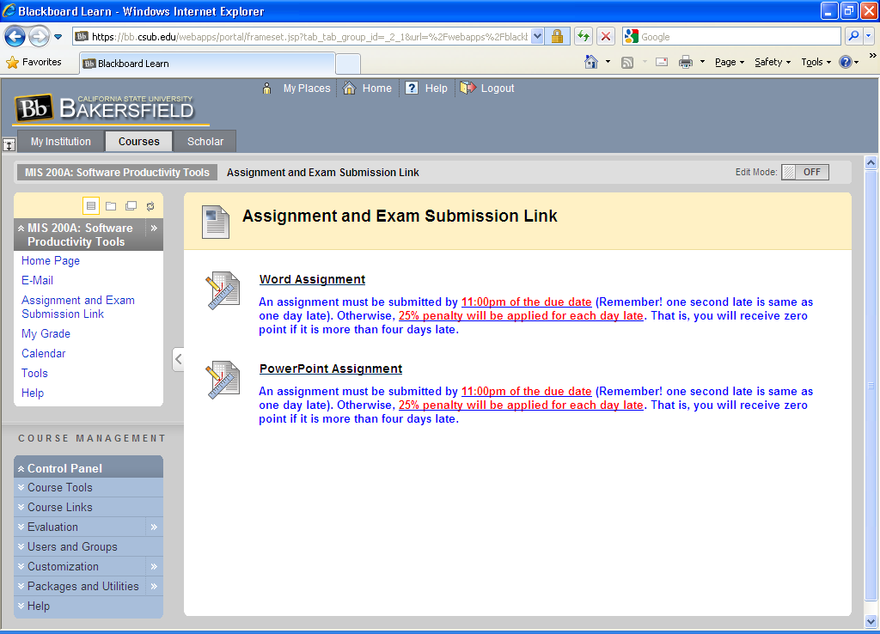
Click the appropriate link (i.e., Excel Assignment 1)

Slide 4
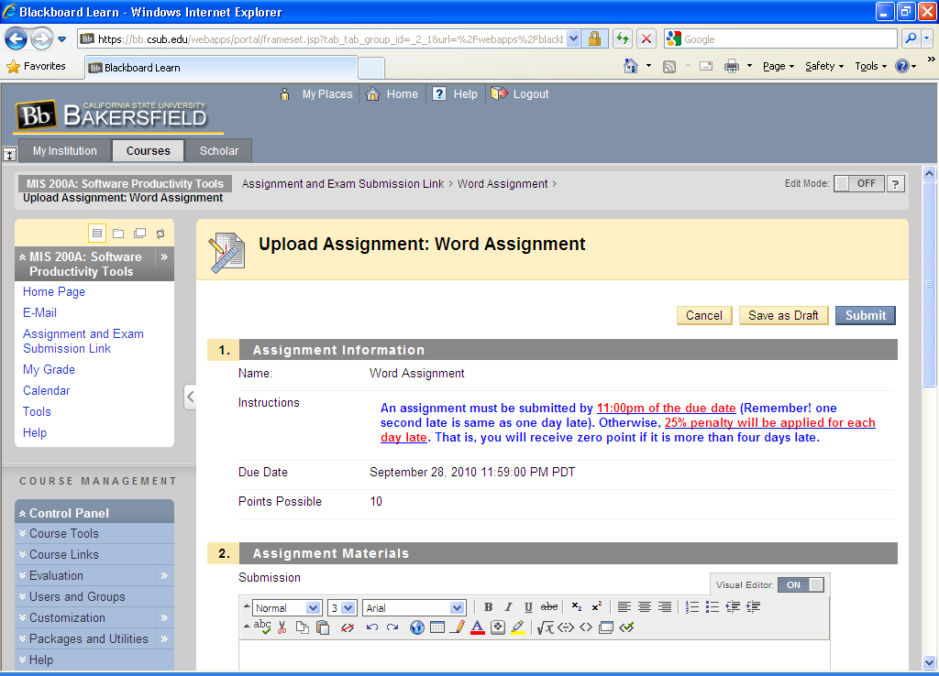
Top -half of the page looks like below. The next slide shows bottom-half of the page.

Slide 5
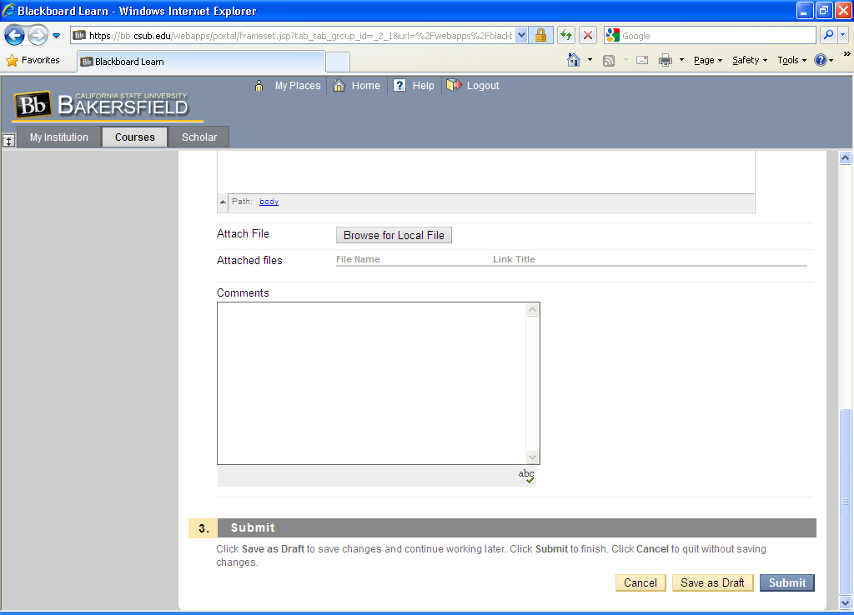
You need to attach (upload) your assignment or exam file and then, click submit button to submit your assignment or exam.

