Slide 1

Key Topics
Ch 1 & 2

Slide 2
Each lecture covers….
Only very important topics from chapters
  Not every topic in detail……
  Soft topics……Not a rocket science..
Other important topics from other sources
Relevant video clips for better understanding
Background information of cases
  Video clip, website, etc.

Slide 3
Focus of the Book
Managerial
Approach
Business
Ethics
Sustainability
Stakeholder
Management

Slide 4
Structure of the Book (1 of 2)
Part One: Business, Society, and Stakeholders
The Business and Society Relationship
Corporate Citizenship: Social Responsibility, Performance and Sustainability
The Stakeholder Approach to Business, Society, and Ethics
Part Two: Corporate Governance & Strategic Management Issues
Corporate Governance: Foundational Issues
Strategic Management and Corporate Public Policy
Issue, Risk and Crisis Management

Slide 5
Structure of the Book (2 of 2)
Part Three: Business Ethics and Management
Business Ethics Fundamentals
Personal and Organizational Ethics
Business Ethics and Technology
Ethical Issues in the Global Arena
Part Four: External Stakeholder Issues
Business, Government, and Regulation
Business Influence on Government and Public Policy
Consumer Stakeholders: Information Issues and Responses
Consumer Stakeholders: Product and Service Issues
Sustainability and the Natural Environment
Business and Community Stakeholders

Slide 6
Organization and Flow of the Book
Part Five: Internal Stakeholder Issues
Employee Stakeholders and Workplace Issues
Employee Stakeholders: Privacy, Safety, and Health
Employment Discrimination and Affirmative Action
Cases

Slide 7
Key Topics
Overview of Business & Society
Corporate Social Responsibility
  Corporate social responsiveness
  Corporate social performance
Corporate citizenship
The Body Shop (A) Case Study

Slide 8
Business and Society
Business -
the collection of private, commercially oriented organizations.
Society -
a community, a nation, or a broad group of people with common traditions, values, institutions, and collective activities and interests.
Desirable Relationship between Business and Society (1:40)

Slide 9
Business and Society
And society can be considered as the macroenvironment in which businesses operate.
Macroenvironment -
the environment outside business (or the corporation)
  The comprehensive societal context in which the organization resides.
Consist of four segments

Slide 10
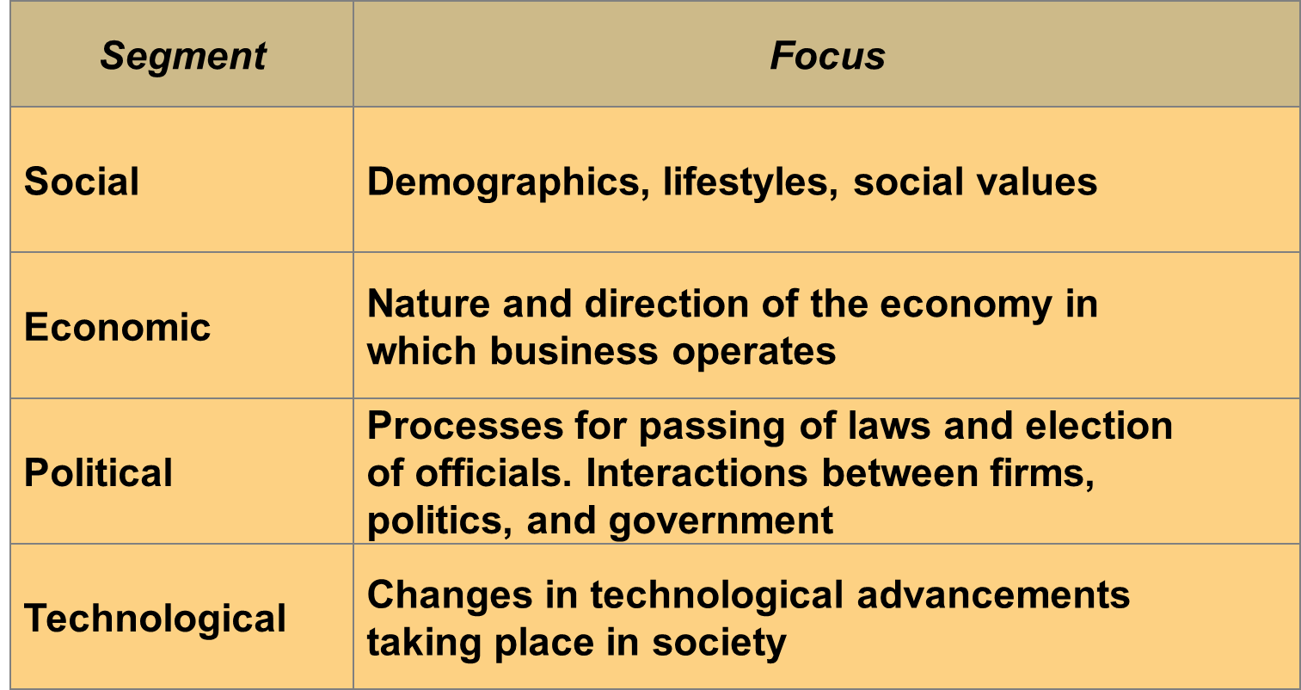
Segments of the Macroenvironment

Slide 11
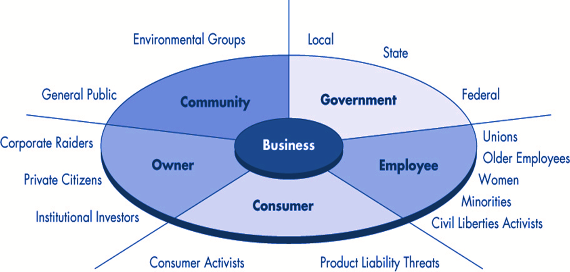
Along with macroenvironment, business must deal with many different type of stakeholders in society

Slide 12
Stakeholders (chapter 3 in detail)
Individuals or groups with which business interacts and who have a vested interest in the company.
Two Type:
  External stakeholders, such as government, consumers, the natural environment, community members
  Internal stakeholders, such as employees, those involved in corporate governance, and others.

Slide 13
Shareholder vs. Stockholder
….is any person, company or other institution that owns at least one share of a company’s stock.
  Stakeholders are not always shareholders
  Usually not personally liable for the company's debts and other financial obligations.

Slide 14
In reality, developing “Desirable Relationship” between two is not a easy task. The fact of matter is that “Social Problem (gap)” is increasing. Why?
Society’s
Expectations
of Business
Performance
Social Problem
Social Performance: Expected and Actual
Social Problem
Business’s Actual Social Performance
1960s 2010s
Time
Industrial age
Information age

Slide 15
Because of Paradigm Shift
Information Age
  Paradigm shift as a primary reason
  Much more complex than previous paradigm
    Fast life cycle of mots businesses, Life style, social behavior (e.g., SNS), social concerns, stakeholders, regulations, etc.
  More interaction with various stakeholders using many different type of IT tools
    Population of “facebook.com” : 1.71 billion active user
    Population of China: 1.357 billion

Slide 16
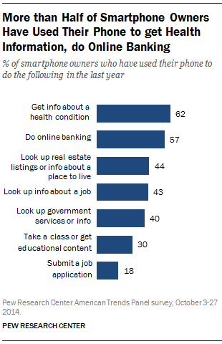
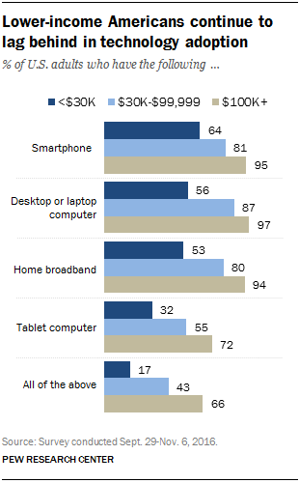

Slide 17
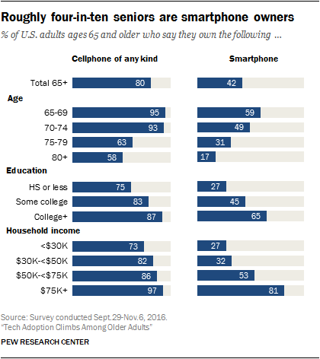

Slide 18
Last Class…
W/O Smart Phone
the future of grocery store
  Amazon Go (1:49)

Slide 19
Effect of Information Age (few examples)
Globalization
  e.g., global social problem
Change of Structure
  Traditional middle management : collect, process, store and distribute information for decision makings
  Expansion of task boundary (e.g., secretary)
New Business Culture
  Cross functional (project based – virtual team or virtual organization)
  Complex interaction with various stakeholders

Slide 20
What is CSR?
What is CSR? (2:00)
  Good introduction
  refers to business practices involving initiatives that benefit society
    from giving away a portion of a company's proceeds to charity, to implementing "greener" business operations.
  CSR encompasses the economic, legal, ethical, and philanthropic expectations that society has of organizations at a given point in time.

Slide 21
Review of The Four Components of CSR
Responsibility
Societal
Expectation
Examples
Economic
Required
Be profitable. Maximize sales,
minimize costs.
Legal
Required
Obey laws, adhere to
regulations
Ethical
Expected
Avoid questionable practices.
Do what is right, fair, and just
Philanthropic
Desired/
Expected
Be a good corporate citizen.
Give back. (e.g., smile.amazon.com)

Slide 22
The Pyramid of CSR
Philanthropic Responsibilities
Be a good corporate citizen.
Ethical Responsibilities
Be ethical.
Legal Responsibilities
Obey the law.
Economic Responsibilities
Be profitable.

Slide 23
Economic Responsibility
It is at the bottom, because it is the foundation upon which all others rest.
  No profit → no business → no CSR
Example: Several companies in both the automotive (e.g., Oldsmobile) and airline (e.g, AA in 2011 and exit 2013) industries struggled to meet their economic responsibilities and landed in bankruptcy as a result.

Slide 24
Legal Responsibility
Society requires corporations to follow the law.
  Law → codified ethics
Examples of abusive practices (especially, last decade)
  dishonest and unfair reporting of financial operations mainly by executives.
  E.g, Enron, Arthur Andersen (best until 2001), WorldCom, etc.
Law does not capture everything
  Emerging matters (e.g., crime thru email and SNS), almost always behind (e.g., AA reservation system), and may only reflect special group’s interests (e.g., DC lobbyist)

Slide 25
Ethical Responsibility
Society expects ethical behavior of companies.
  Growing phenomenon because of information availability by Internet (e.g., SNS)
Two-sides
  Negative-side: If this expectation is violated, the executives can face criminal charges (e.g., Enron).
  Positive-side: companies may find themselves recognized for their ethical activities (e.g., Starbucks).
    Pay premium price (exceed market price)
    Funded health center & farm schools

Slide 26
Philanthropic Responsibility
stands to be a good corporate citizen and improve the quality of life for the society.
  usually, corporations in developed countries.
Ethics in Practice, page 43
  Toms: shoe company
  www.toms.com – how would you assess Toms’ CSR using the four part CSR definition?

Slide 27
The CSR Equation
Economic Responsibilities
Legal Responsibilities
Ethical Responsibilities
Philanthropic Responsibilities
=
Total
Corporate CSR
+
+
+

Slide 28
Top 20 Activities or Characteristics of
Socially Responsible Companies
Makes products that are safe.
Does not pollute air or water.
Obeys the law in all aspects of business.
Promotes honest or ethical employee behavior.
Commits to safe workplace ethics.
Does not use misleading or deceptive advertising.
Upholds stated policy banning discrimination.
Utilizes “environmentally friendly” packaging.
Protects employees against sexual harassment.
Recycles within company.
Shows no past record of questionable activity.
Responds quickly to customer problems.
Maintains waste reduction program.
Provides or pays portion of medical costs.
Promotes energy conservation program.
Helps displaced workers with placement.
Gives money toward charitable or educational causes.
Utilizes only biodegradable or recyclable materials.
Employs friendly or courteous or responsive personnel
Tries continually to improve quality.

Slide 29
Corporate Social Responsiveness
CSR only focuses on accountability or obligation to meet certain minimum duties.
Corporate social responsiveness is a more proactive and action oriented concept
  Example: A firm providing perhaps the best child care benefits (e.g., SAS onsite child day care center) to its working parents (responding to the reality of issues faced by working families).
  https://www.sas.com/en_us/company-information/employee-retiree-services.html

Slide 30
Corporate Citizenship (CC)
Short: Corporate community relations
Long: the conduct of business in ways that reflect proactive, responsible behavior in business and in dealings with all constituents and with respect to communities, society, and natural environment more generally
World Without Corporate Citizenship (58)
Deutsch Bank Corporate Citizenship (1:50)

Slide 31
Drivers of Corporate Citizenship
Internal Motivators | External Pressures
Traditions and values | Customers and consumers
Reputation and image | Expectations in the communities
Business strategy | Laws and political pressures
Recruiting and retaining employees

Slide 32
Benefits of Corporate Citizenship-
Benefits to the business:
Improving employee relations (improves recruitment, retention, morale, loyalty, etc.)
Improving customer relationships (increases customer loyalty; a tiebreaker)
Improving business performance (positively impacts bottom-line returns, increases competitive advantage)
Enhancing marketing efforts ( helps create a positive company image)

Slide 33
Differences between CSR and CC
CC as the philanthropic part of CSR
  Especially in terms of a positive influence on society. (Corporate Giving, Corporate Volunteering, Corporate Community Investment)
CSR and CC as interchangeable terms
  Especially in practice.
CC as a democratic concept
  The company acts as active citizens in society and has a political role and the rights and obligations.

Slide 34
The Body Shop
Review the case assignment instruction
Enrich Not Exploit (0:50)
  Shows identity of corporation
  Anita Roddick passed away unexpectedly in 2007.
Review the company website
Review categories under “Our Commitment” at the bottom of the web page
Vs. Bath & Body Works
Skip case questions #2 and #8

