Slide 1
Sci1600 Introduction to Physics
Lectures
Dr. Alexander Dzyubenko
Science III Rm. 302
adzyubenko@csub.edu
© A.B. Dzyubenko 2003, 2004, 2008

Slide 2
Textbook:
Conceptual Physics
by Paul Hewitt
12th Ed. (2015)

Slide 3
About (Natural) Science
A process of discovering and explaining the order of Nature
Establishing regularities and relationships enables us to make PREDICTIONS
Advancement toward scientific method
Rational thinking Greece IV and III B.C.
Mathematics Arab Nations, Indians (0, ∞)
Charting stars Chinese
European Universities XIII A.D.

Slide 4
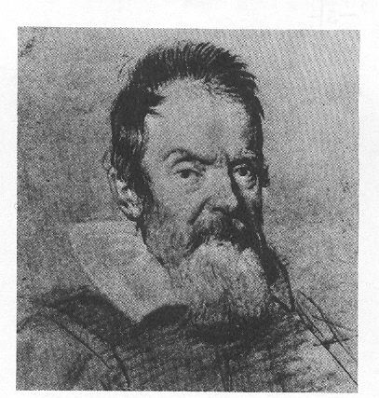
Modern Science
XVI A.D. Galileo used experiments
rather than speculation
He studied the laws
of accelerated motion

Slide 5
.
.
g
m
t
h
© A. Petrou 2003

Slide 6
Mathematics and Scientific Measurements
A dramatic discovery made only some four centuries ago: Nature can be analyzed and described mathematically
Math provides Quantification
Math is not a natural science
Math is a language, precise and exact
Why Math can describe Nature is a mystery
The scientific laws have unique beauty when expressed mathematically

Slide 7
The Scientific Method
Recognize a question or a problem
Make an educated guess – a hypothesis – as to the answer
Predict the consequences that should be
absent if not correct
observable if the hypothesis is correct
Perform experiments
Formulate the simplest general rule that organizes (i) hypothesis, (ii) predicted effects, and (iii) experimental findings

Slide 8
The Scientific Method, contd.
When a hypothesis has been tested over and over and has not been contradicted, it may become known as a law or a principle
A scientific theory is a synthesis of a large body of well-tested and verified hypothesis
Theory of Relativity, theory of Big Bang, theory of Superconductivity, theory of Chemical Bonding, Evolution Theory, …

Slide 9
The Scientific Method, contd.
Good science is not always done this way
(scientists are humans anyway ☺)
Trial and error
Experimentation without guessing
Plain accidental discovery
Trained observation and scientific attitude are essential!
Inquiry, experimentation, humility before the facts

Slide 10
Scientific Attitude
A scientific fact is a close agreement among competent observes studying the same phenomenon It’s a fact! ⬄ Is it always true?
Once a fact: the Universe is unchanging and permanent. Now: expanding Universe
Contradictive evidence to some hypothesis? Discard or revise it! (Hypothesis, not the evidence ☺)
Discovering truth = Science = is a process

Slide 11
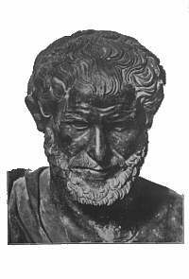
Experimental testing of theories
and hypothesis
Aristotle’s hypothesis (III B.C.):
an object falls at a speed
proportional to its weight
Held to be true for nearly 2000 yrs!
Until Galileo.

Slide 12
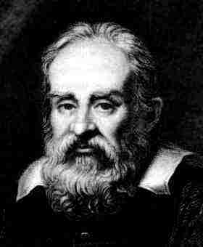

Galileo Galilei
(1564-1642)
He studied the laws of accelerated motion

Slide 13
Testing of hypothesis, contd.
All scientific hypothesis must be testable:
they must be susceptible to being proven wrong
An emphasis on determining possible wrongness
“Intelligent life exists on other planets somewhere in the Universe.”
A scientific hypothesis? Check if it can be proven wrong!

Slide 14
Scientific hypothesis?
Atoms are the smallest particles of matter.
Albert Einstein is the greatest physicist of the 20th century.
Better stock market decisions are made when the planets Venus, Earth, and Mars are aligned.
If “yes”, are they correct?

Slide 15
Science
Pseudoscience
Lack of evidence No test of wrongness
Technology
Art
Religion

Slide 16
Science
Physical Science
Life Science
Physics
Chemistry
Geology
Astronomy
Biology
Zoology
Botany
No strict borders
Chemical Physics
Biophysics
Physical Chemistry
Biochemistry

