Slide 1
Sci1600 Introduction to Physics
Part 5 Electricity and Magnetism
Chapter 24 Magnetism
© G. Dzyubenko 2016

Slide 2
This lecture will help you understand:
Magnetic Force
Magnetic Poles
Magnetic Field
Magnetic Domains
Electric Currents and Magnetic Fields
Magnetic Force on Moving Charged Particles
Magnetic Force on Current Carrying Wires
Earth’s Magnetic Field

Slide 3
Magnetism
The term magnetism comes from the name Magnesia, a coastal district of ancient Thessaly, Greece.
Unusual stones were found by the Greeks more than 2000 years ago.
These stones, called lodestones, had the intriguing property of attracting pieces of iron.
Magnets were first fashioned into compasses and used for navigation by the Chinese in the 12th century.

Slide 4
Magnetic Force
Magnetic force between a pair of magnets
Force of attraction or repulsion between a pair of magnets depends on which end of the magnet is held near the other.
Behavior similar to electrical forces.
Strength of interaction depends on the distance between the two magnets.

Slide 5
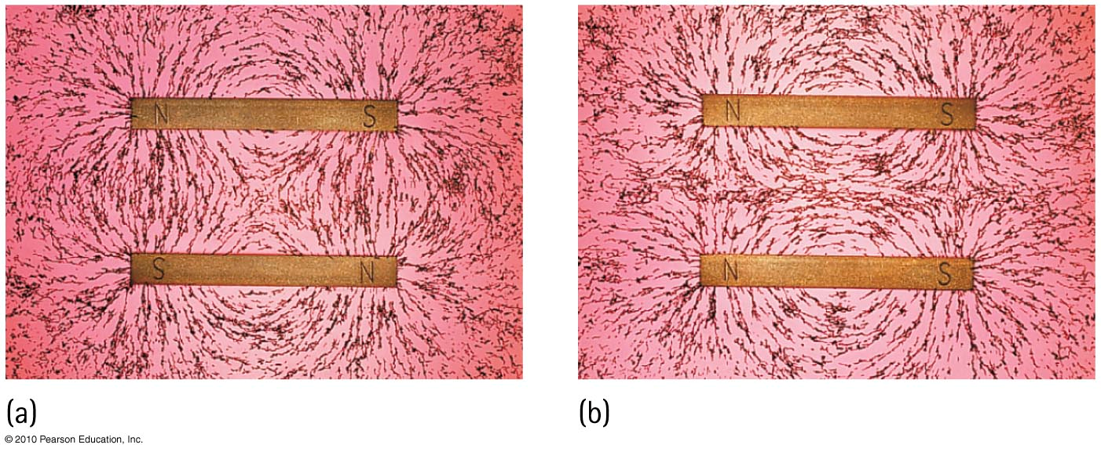
Magnetic Poles
Two types interacting with each other
north pole (north-seeking pole)
south pole (south-seeking pole)
Rule for magnetic forces between magnetic poles:
Like poles repel; opposite poles attract.

Slide 6
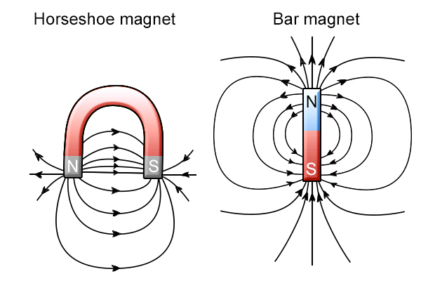
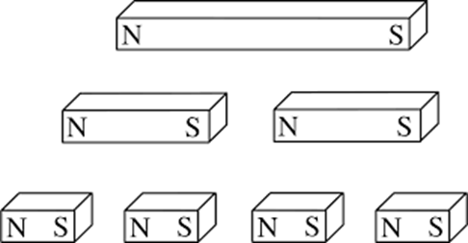
Magnetic Poles
In all magnets—can’t have one pole without the other
No single pole known to exist
Example:
simple bar magnet: poles at the two ends
horseshoe magnet: bent U shape - poles at ends

Slide 7
A weak and strong magnet repel each other. The greater repelling force is by the
Magnetic Poles
CHECK YOUR NEIGHBOR
A. stronger magnet.
weaker magnet.
Both the same.
None of the above.
Notes:
C. Both the same

Slide 8
A weak and strong magnet repel each other. The greater repelling force is by the
Magnetic Poles
CHECK YOUR ANSWER
A. stronger magnet.
weaker magnet.
Both the same.
None of the above.
Explanation:
Remember Newton’s third law!
Notes:
C. Both the same

Slide 9
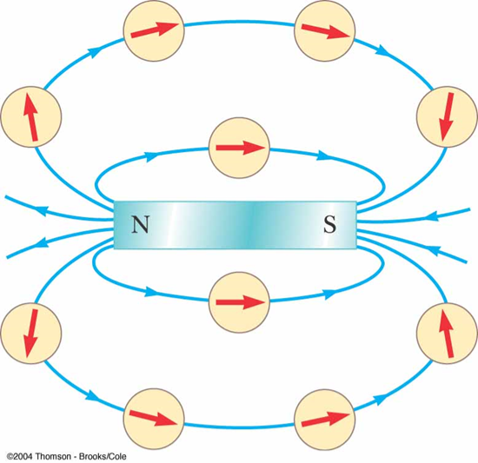
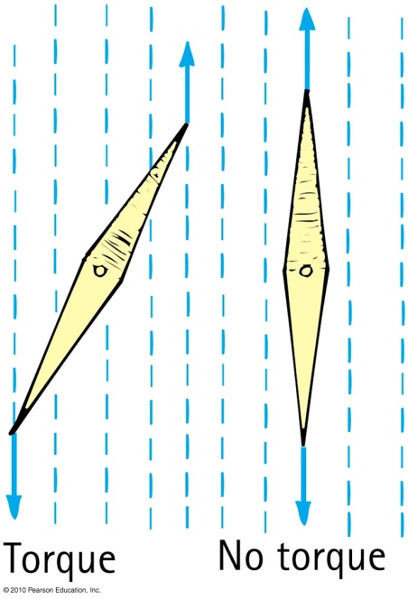
Magnetic Field
Region of magnetic influence surrounding magnet
Magnetic field lines are closed loops
By convention, direction is from the north pole to the south pole, produced by motions of electric charge in atoms

Slide 10
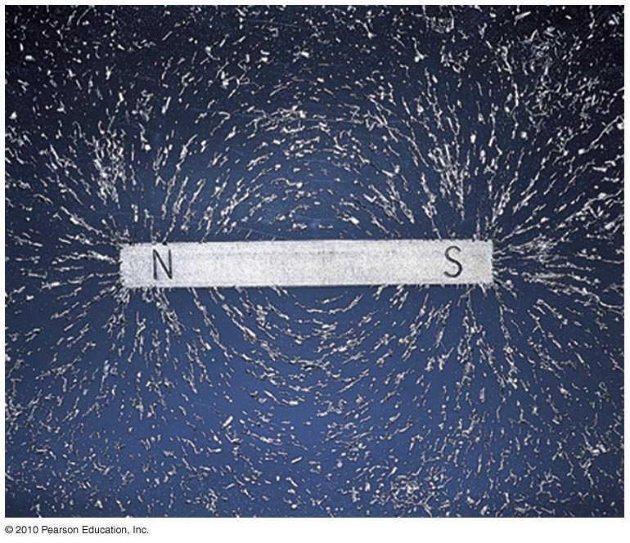
Magnetic Field
Strength indicated by closeness of the lines
lines close together → strong magnetic field
lines farther apart → weak magnetic field

Slide 11
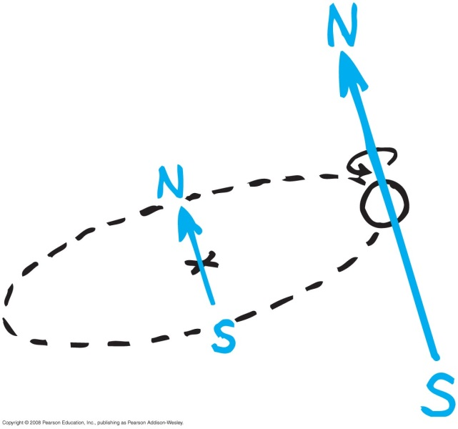
Magnetic Field
Produced by two kinds of electron motion
electron spin
main contributor to magnetism
pair of electrons spinning in same direction creates a stronger magnet
pair of electrons spinning in opposite direction cancels magnetic field of the other
electron revolution

Slide 12
The source of all magnetism is
Magnetic Fields
CHECK YOUR NEIGHBOR
A. electrons rotating around an atomic nucleus.
electrons spinning around internal axes.
either or both A and B.
tiny bits of iron.
Notes:
C. Either or both of these.

Slide 13
The source of all magnetism is
Magnetic Fields
CHECK YOUR ANSWER
A. electrons rotating around an atomic nucleus.
electrons spinning around internal axes.
either or both A and B.
tiny bits of iron.
Notes:
C. Either or both of these.

Slide 14
Where magnetic field lines are more dense, the field there is
Magnetic Fields
CHECK YOUR NEIGHBOR
A. weaker.
stronger.
Both A and B.
Neither A nor B.
Notes:
B. stronger.

Slide 15
Where magnetic field lines are more dense, the field there is
Magnetic Fields
CHECK YOUR ANSWER
A. weaker.
stronger.
Both A and B.
Neither A nor B.
Notes:
B. stronger.

Slide 16
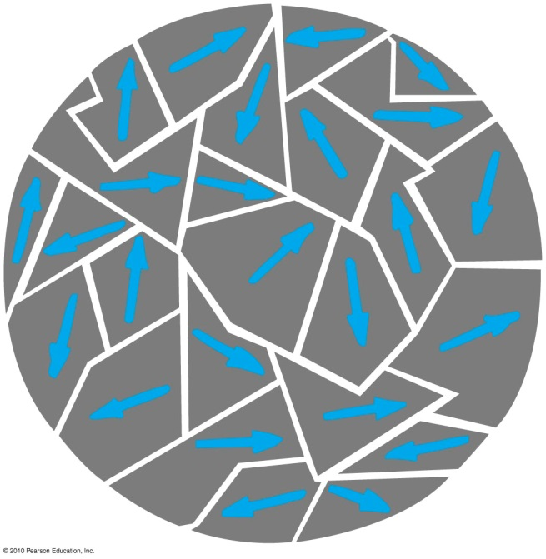
Magnetic Domains
Magnetized clusters of aligned magnetic atoms
Permanent magnets made by
placing pieces of iron or similar magnetic materials in a strong magnetic field.
stroking material with a magnet to align the domains.

Slide 17
Magnetic Domains
Difference between permanent magnet and temporary magnet
Permanent magnet
alignment of domains remains once external magnetic field is removed
Temporary magnet
alignment of domains returns to random arrangement once external magnetic field is removed

Slide 18
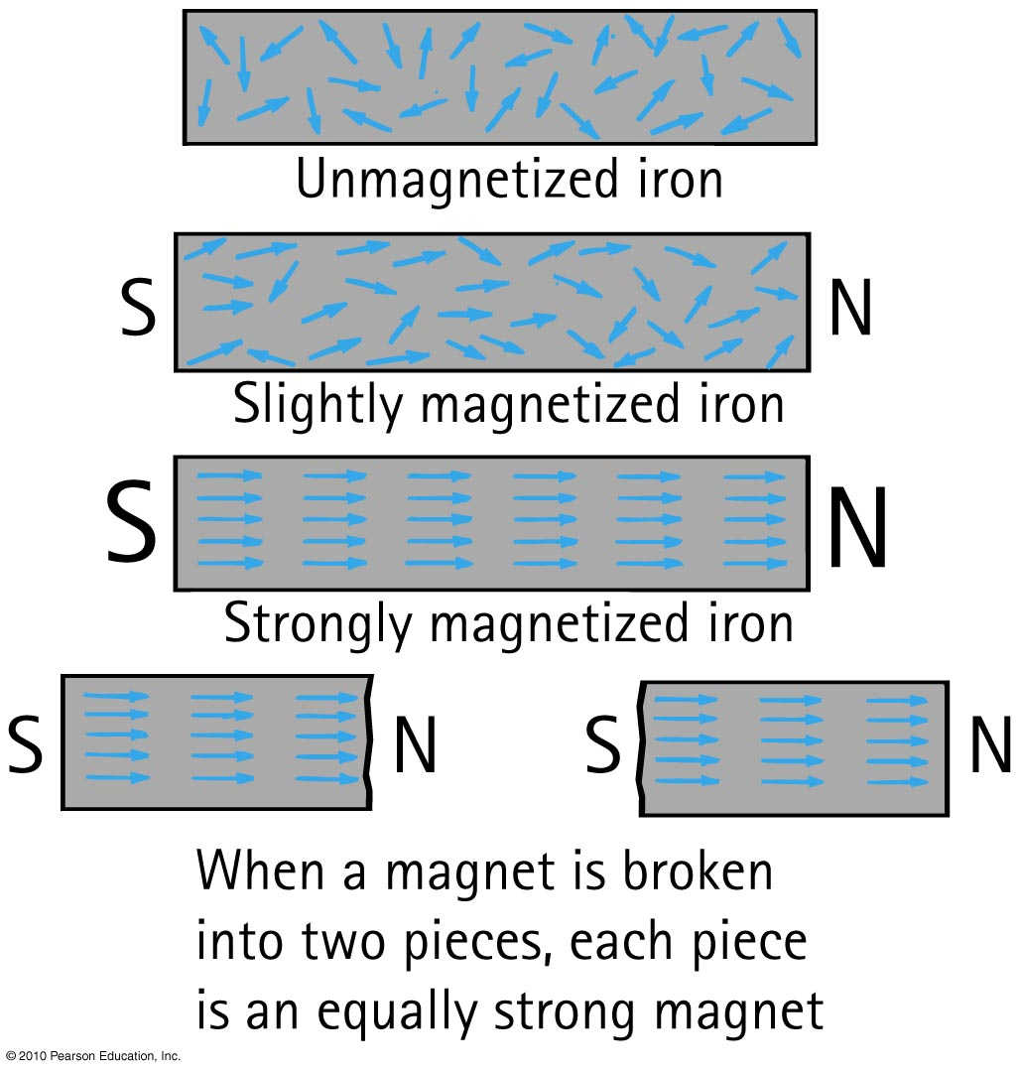
Magnetic Domains

Slide 19
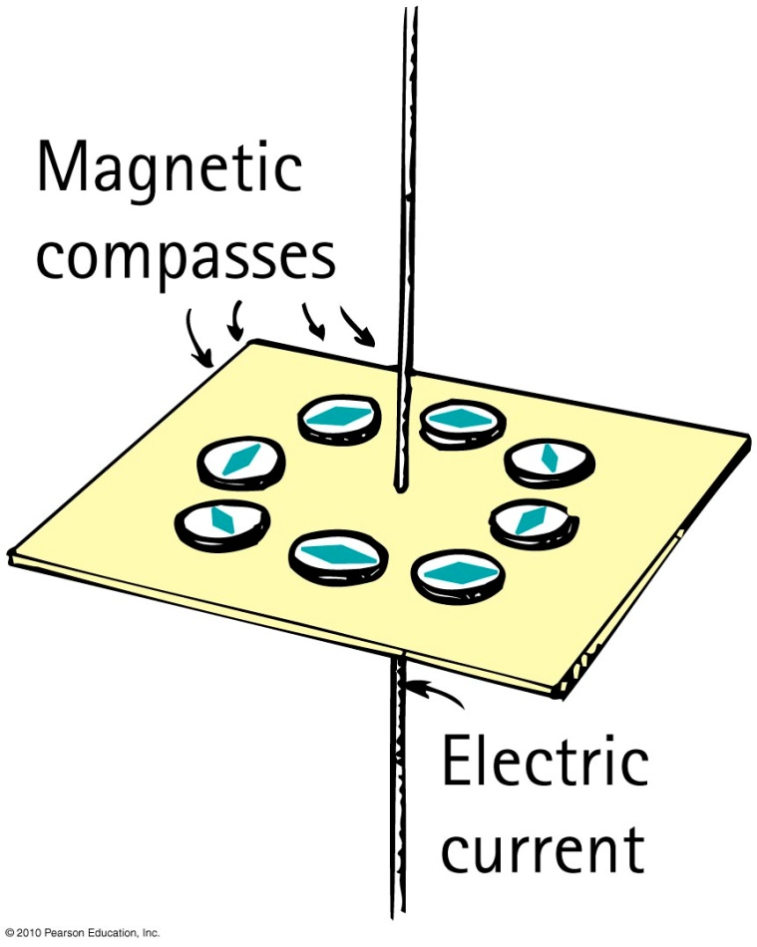
Electric Current and Magnetic Field
Connection between electricity and magnetism
Electric current creates magnetic field
Magnetic field forms a pattern of concentric circles around a current-carrying wire.
When current reverses direction,
the direction of the field lines
reverse.

Slide 20
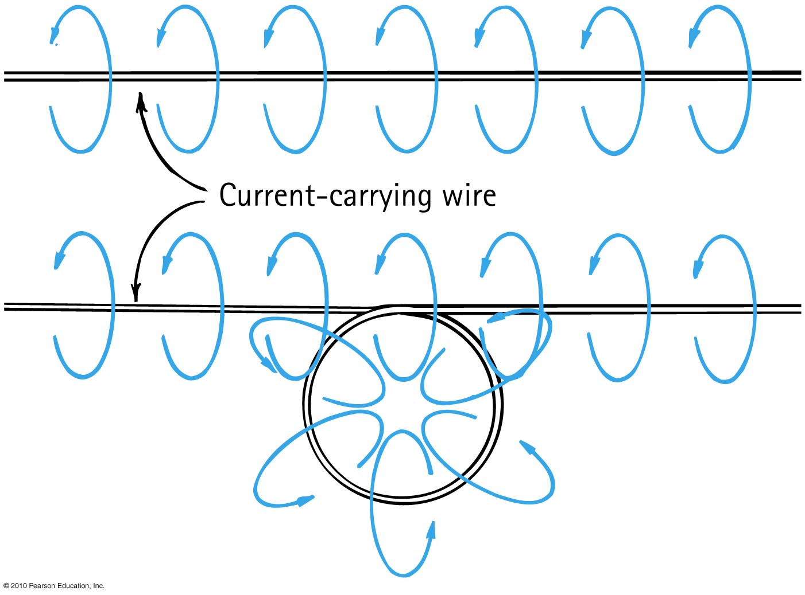
Electric Current and Magnetic Field
If the wire is bent into a loop, the magnetic field lines become bunched up inside the loop

Slide 21
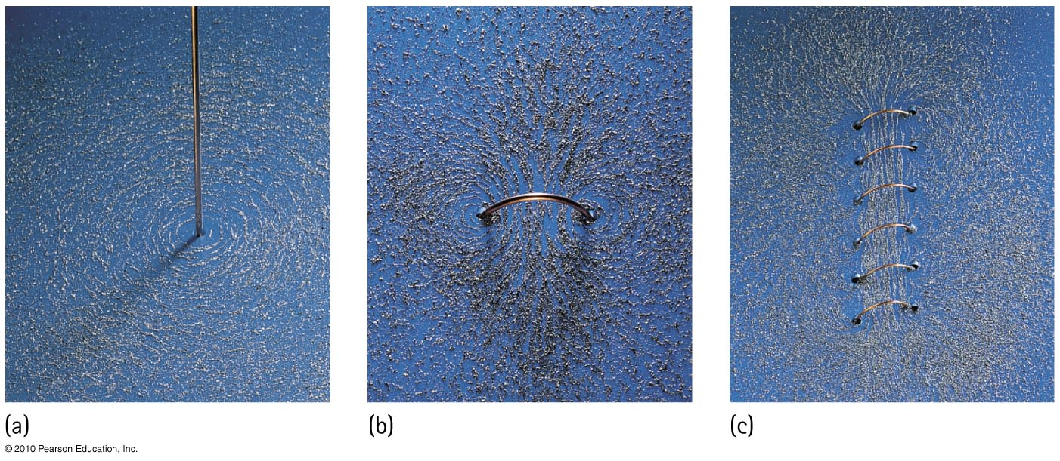
Electric Current and Magnetic Field
Magnetic field intensity
increases as the number of loops increase in a current-carrying coil temporary magnet.

Slide 22
Magnetic Force on Moving Charge
Moving charges in a magnetic field experience a deflecting force.
Greatest force
particle movement in direction perpendicular to the magnetic field lines
Least force
particle movement other than perpendicular to the magnetic field lines
No force
particle movement parallel to the magnetic field lines

Slide 23
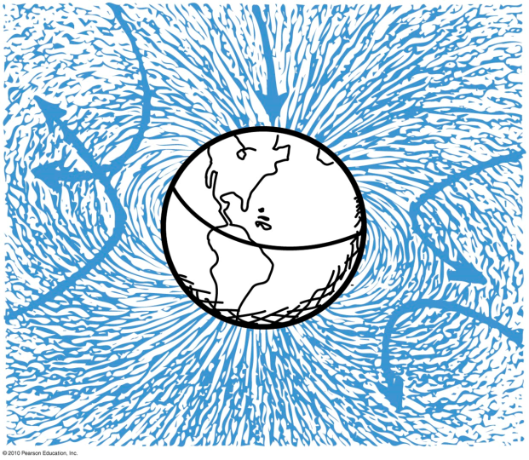
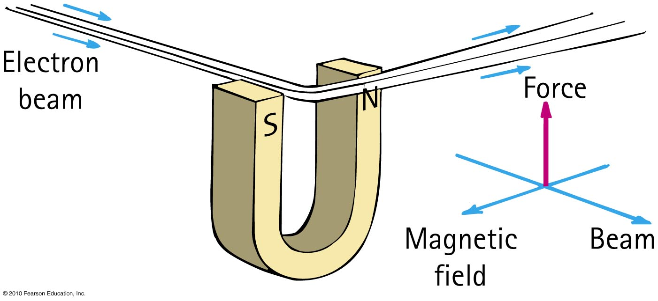
Magnetic Force on Moving Charges
Moving charges in a magnetic field experience a deflecting force

Slide 24
The reason that an electron moving in a magnetic field doesn’t pick up speed is
Magnetic Force on Moving Charges
CHECK YOUR NEIGHBOR
A. magnets only divert them.
only electric fields can change the speed of a charged particle.
the magnetic force is always perpendicular to its motion.
All of the above.
Notes:
C. the magnetic force is always perpendicular to its motion.

Slide 25
The reason that an electron moving in a magnetic field doesn’t pick up speed is
Magnetic Force on Moving Charges
CHECK YOUR ANSWER
A. magnets only divert them.
only electric fields can change the speed of a charged particle.
the magnetic force is always perpendicular to its motion.
All of the above.
Explanation:
Although all statements are true, the reason is given only by C. With no component of force in the direction of motion, speed doesn’t change.
Notes:
C. the magnetic force is always perpendicular to its motion.

Slide 26
The magnetic force on a moving charged particle can change the particle’s
Magnetic Force on Moving Charges
CHECK YOUR NEIGHBOR
A. speed.
direction.
Both A and B.
Neither A nor B.
Notes:
B. direction.

Slide 27
The magnetic force on a moving charged particle can change the particle’s
Magnetic Force on Moving Charges
CHECK YOUR ANSWER
A. speed.
direction.
Both A and B.
Neither A nor B.
Notes:
B. direction.

Slide 28
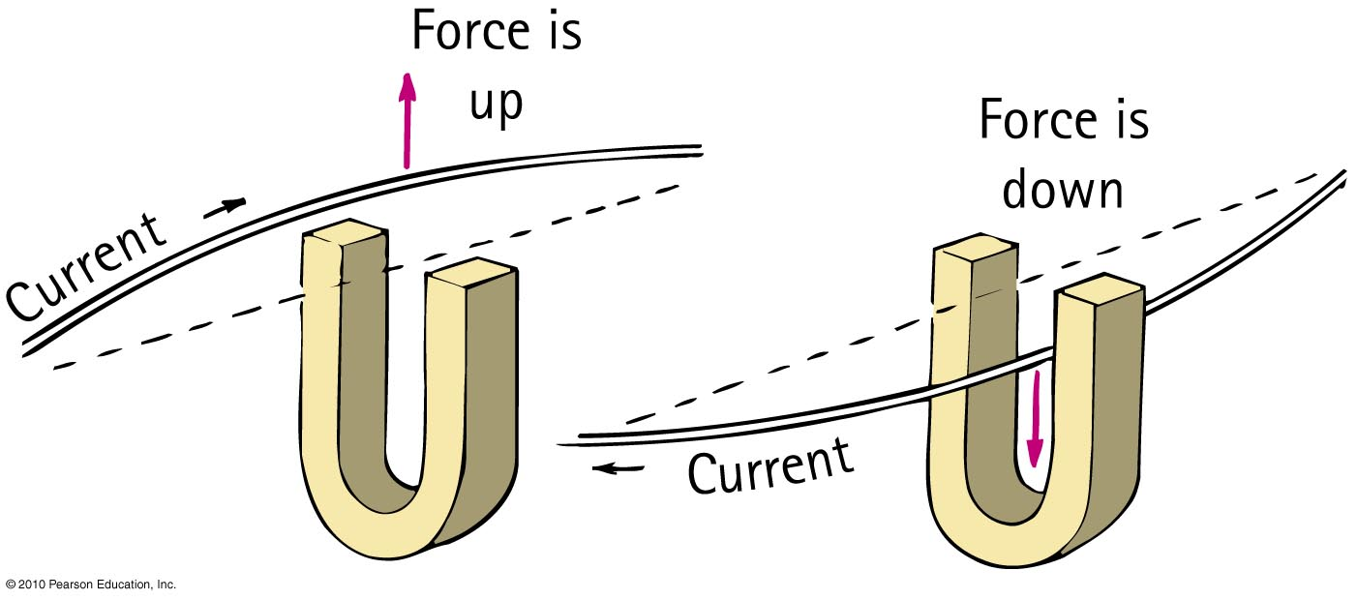
Magnetic Force on Current- Carrying Wires
Current of charged particles moving through a magnetic field experiences a deflecting force.
Direction is perpendicular to both magnetic field lines and current (perpendicular to wire).
Strongest when current is perpendicular to the magnetic field lines.

Slide 29
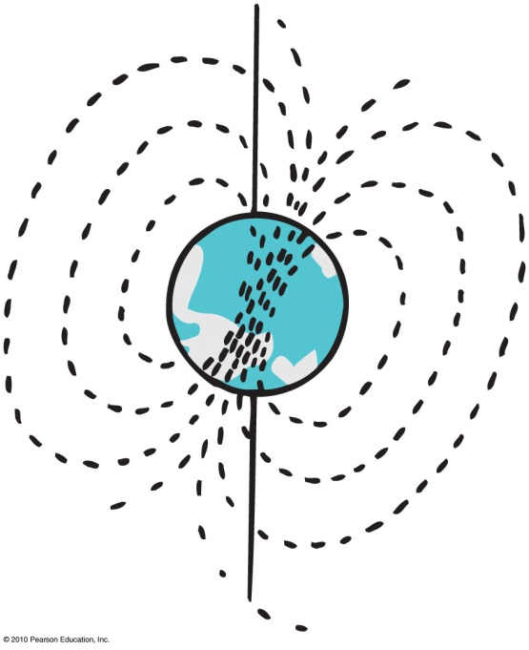
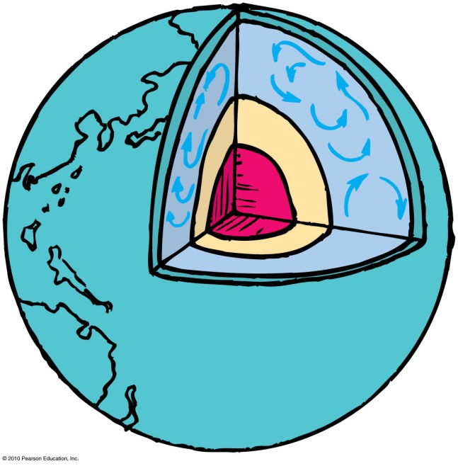
Earth’s Magnetic Field
Earth is itself a huge magnet.
The magnetic poles of Earth are widely separated from the geographic poles.
The magnetic field of Earth is not due to a giant magnet in its interior—it is due to electric currents.
Most Earth scientists think that moving charges looping around within the molten part of Earth create the magnetic field.
Earth’s magnetic field reverses direction: 20 reversals in last 5 million years.

Slide 30
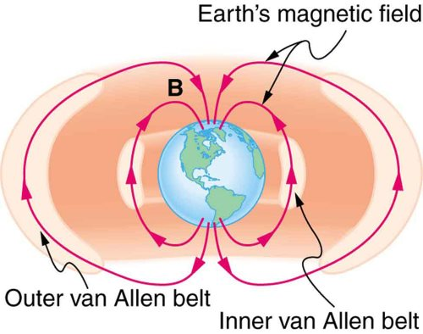
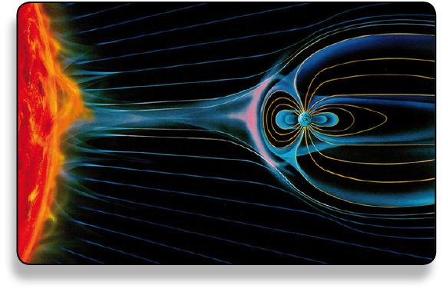
Earth’s Magnetic Field
Universe is a shooting gallery of charged particles called cosmic rays.
Cosmic radiation is hazardous to astronauts.
Cosmic rays are deflected away from Earth by Earth’s magnetic field.
Some of them are trapped in the outer reaches of Earth’s magnetic field and make up the Van Allen radiation belts

Slide 31
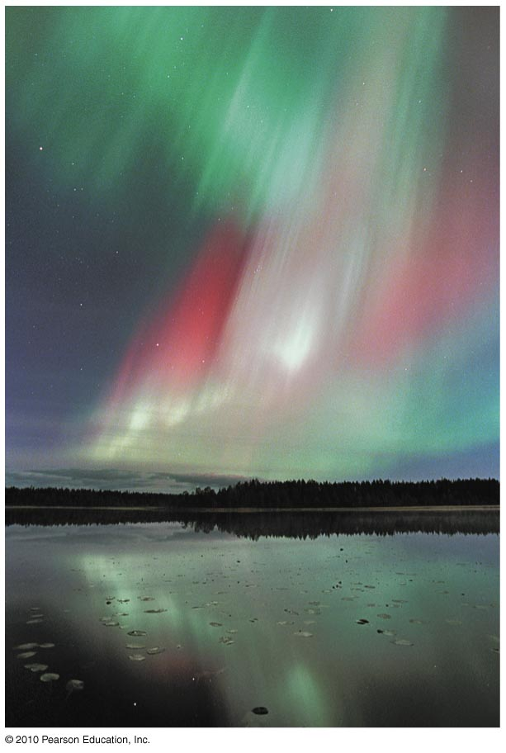
Earth’s Magnetic Field
Storms on the Sun hurl charged particles out in great fountains, many of which pass near Earth and are trapped by its magnetic field. The trapped particles follow corkscrew paths around the magnetic field lines of Earth and bounce between Earth’s magnetic poles high above the atmosphere.
Disturbances in Earth’s field often allow the ions to dip into the atmosphere, causing it to glow like a fluorescent lamp. Hence the aurora borealis or aurora australis.

Slide 32
Sci1600 Introduction to Physics
Part 5 Electricity and Magnetism
Chapter 25 Electromagnetic Induction
© G. Dzyubenko 2016

Slide 33
This lecture will help you understand:
Electromagnetic Induction
Faraday’s Law
Generators and Alternating Current

Slide 34
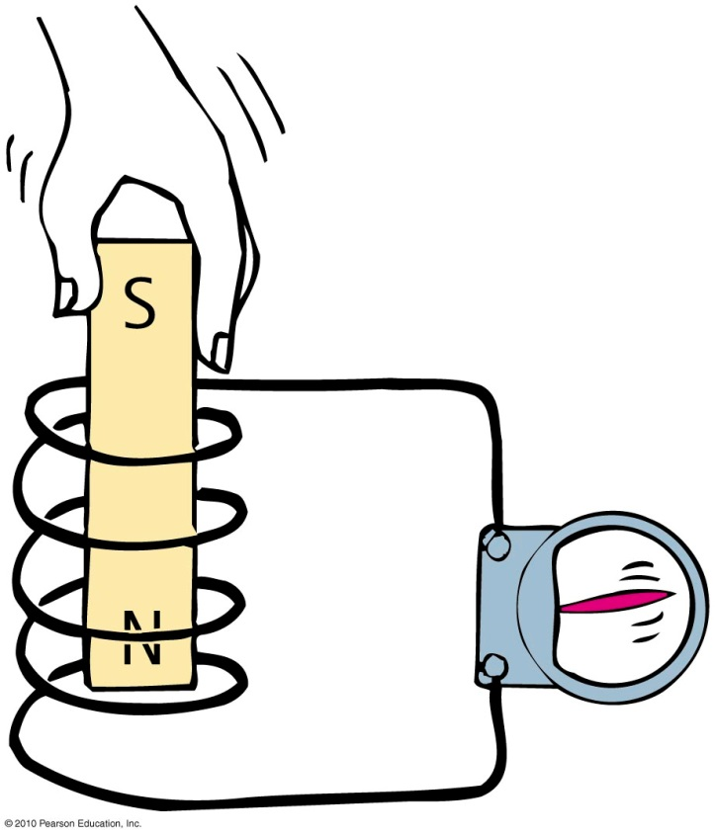
Electromagnetic Induction
Discovered by Faraday and Henry
Induces voltage by changing the magnetic field strength in a coil of wire

Slide 35
Electromagnetic Induction
Induced voltage can be increased by
increasing the number of loops of wire in a coil.
increasing the speed of the magnet entering and leaving the coil.
Slow motion produces hardly any voltage.
Rapid motion produces greater voltage.

Slide 36
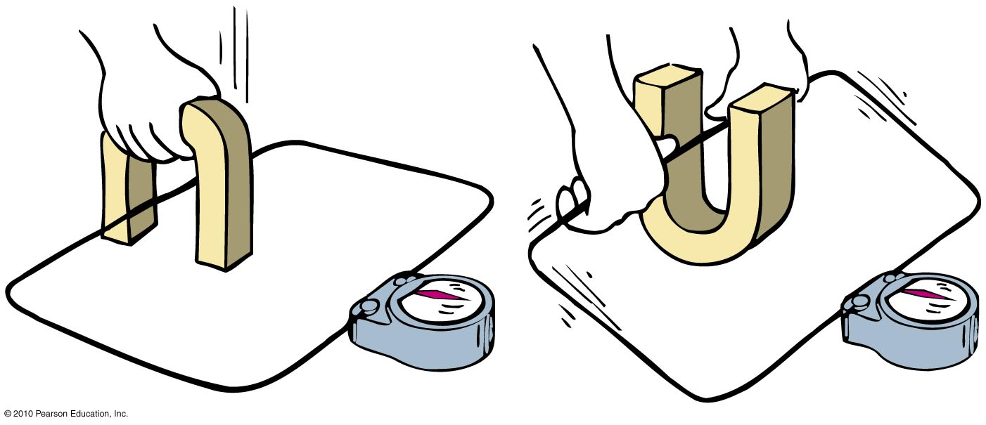
Electromagnetic Induction
Voltage is induced in the wire loop whether the magnetic field moves past the wire or the wire moves through the magnetic field.

Slide 37
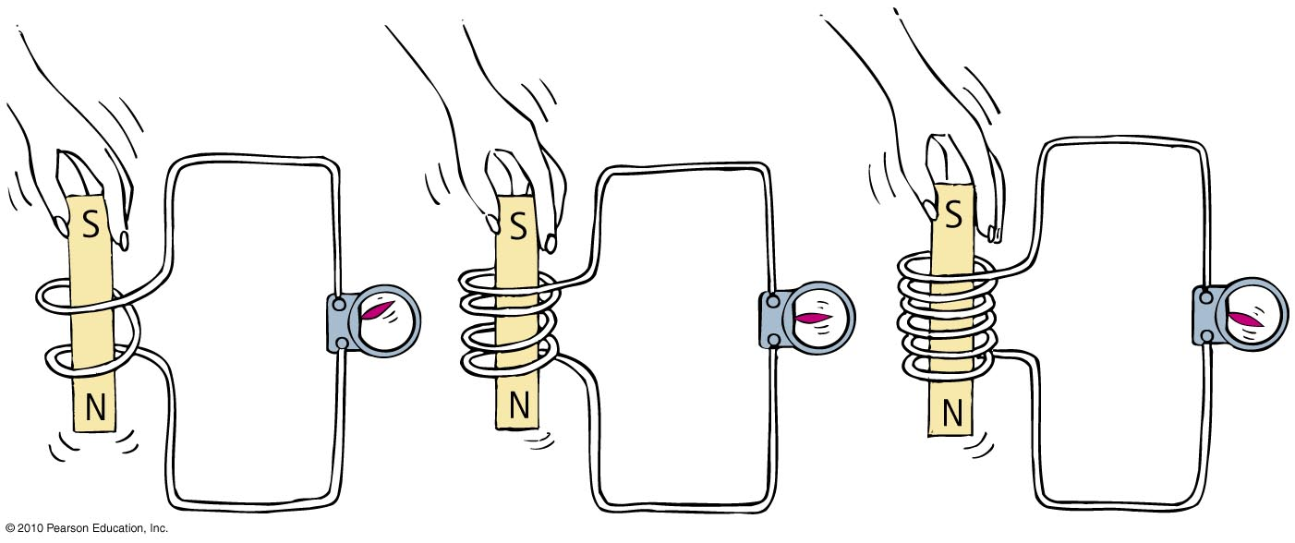
Electromagnetic Induction
When a magnet is plunged into a coil with twice as many loops as another, twice as much voltage is induced.
If the magnet is plunged into a coil with 3 times as many loops, 3 times as much voltage is induced.

Slide 38
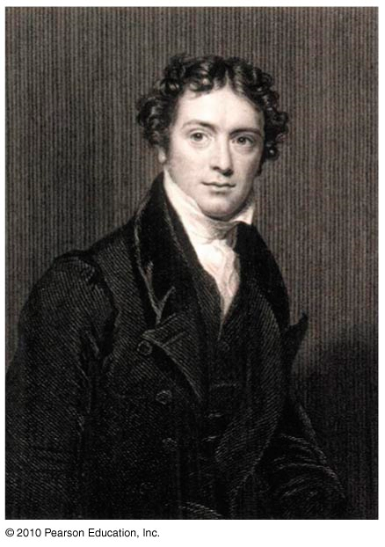
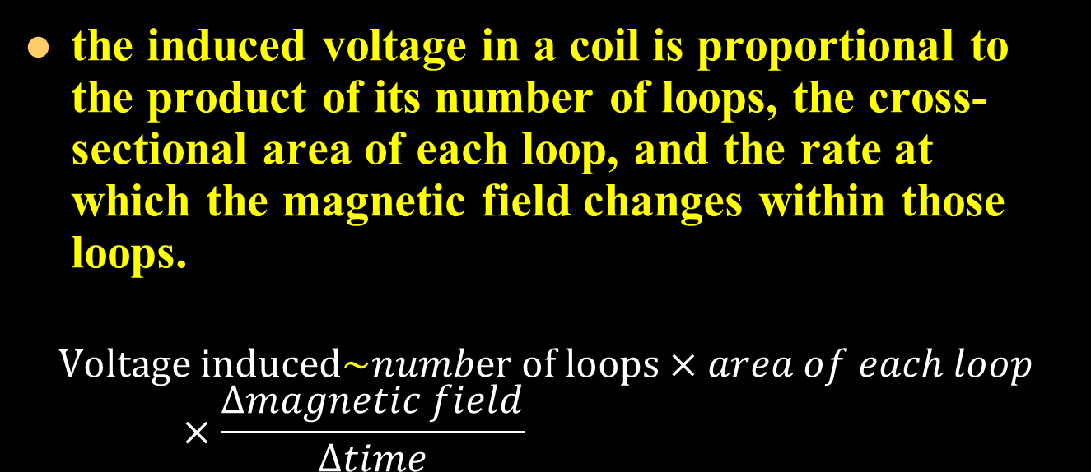
Faraday’s Law
the induced voltage in a coil is proportional to the product of its number of loops, the cross-sectional area of each loop, and the rate at which the magnetic field changes within those loops.
$$Voltage induced\sim number of loops×area of each loop×\frac{∆magnetic field}{∆time}$$

Slide 39
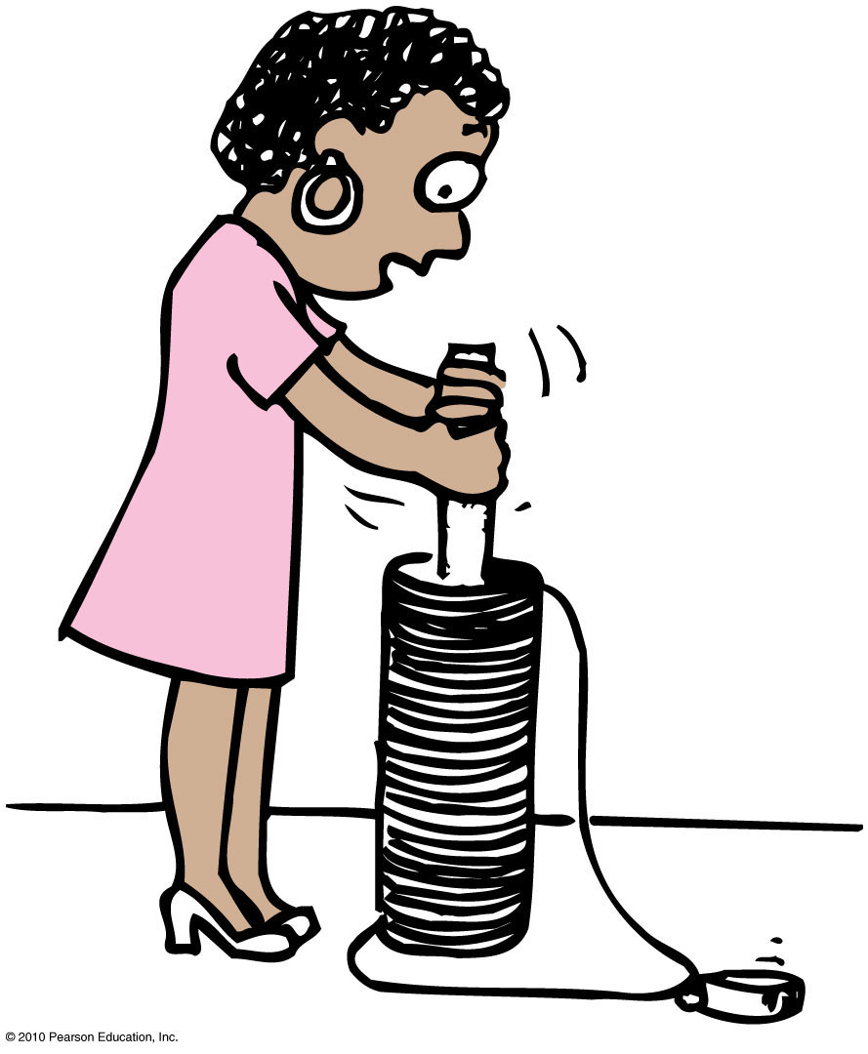
Faraday’s Law
It is more difficult to push the magnet into a coil with many loops because the magnetic field of each current loop resists the motion of the magnet.

Slide 40
The resistance you feel when pushing a piece of iron into a coil involves
Faraday’s Law
CHECK YOUR NEIGHBOR
A. repulsion by the magnetic field you produce.
energy transfer between the iron and coil.
Newton’s third law.
resistance to domain alignment in the iron.
Notes:
A. repulsion by the magnetic field you produce.

Slide 41
The resistance you feel when pushing a piece of iron into a coil involves
Faraday’s Law
CHECK YOUR ANSWER
A. repulsion by the magnetic field you produce.
energy transfer between the iron and coil.
Newton’s third law.
resistance to domain alignment in the iron.
Notes:
A. repulsion by the magnetic field you produce.

Slide 42
Faraday’s Law
Voltage induced in a wire requires changing magnetic field in the loop by
moving the loop near a magnet,
moving a magnet near a loop,
changing the current in a nearby loop.

Slide 43
Faraday’s Law
Application of Faraday’s law
Activation of traffic lights by a car moving over underground coils of wire
Triggering security system at the airport by altering magnetic field in the coils as one walks through
Scanning magnetic strips on back of credit cards
Recording of sound on tape
Electronic devices in computer hard drives, iPods

Slide 44
More voltage is induced when a magnet is thrust into a coil
Faraday’s Law
CHECK YOUR NEIGHBOR
A. more quickly.
more slowly.
Both A and B.
Neither A nor B.
Notes:
A. more quickly.

Slide 45
More voltage is induced when a magnet is thrust into a coil
Faraday’s Law
CHECK YOUR ANSWER
A. more quickly.
more slowly.
Both A and B.
Neither A nor B.
Notes:
A. more quickly.

Slide 46
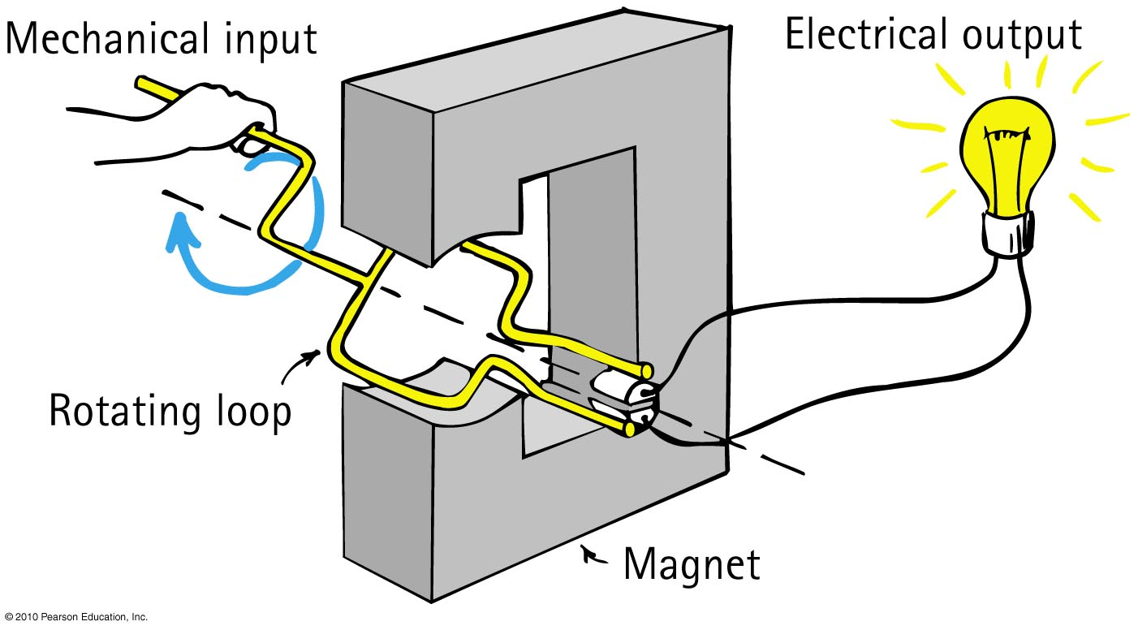
Generators and Alternating Current
Generator
Converts mechanical energy into electrical energy via coil motion
Produces alternating voltage and current

Slide 47
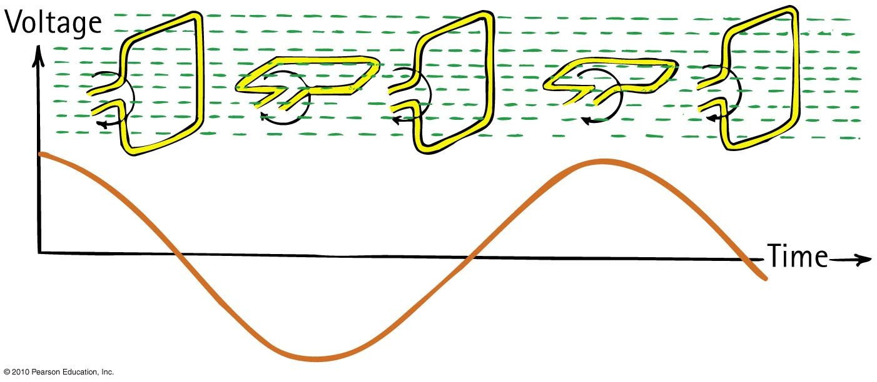
Generators and Alternating Current
The frequency of alternating voltage induced in a loop is equal to the frequency of the changing magnetic field within the loop.

