Slide 2
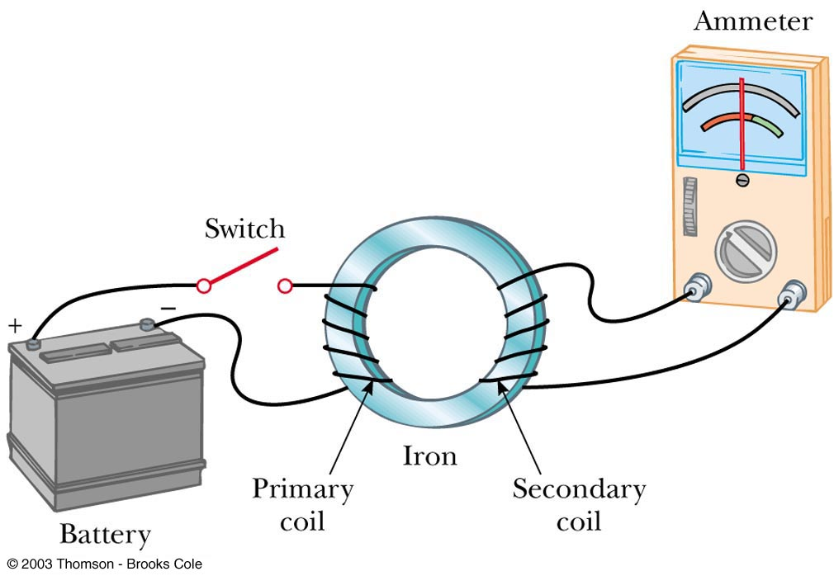
Induced emf
A current can be produced by a changing magnetic field
First shown in an experiment by Michael Faraday
A secondary coil is connected to an ammeter
A primary coil is connected
to a battery

Slide 3

Faraday’s Experiment
The purpose of the secondary circuit is to detect current that is produced by the magnetic field
When the switch is closed, the ammeter deflects
in one direction and then returns to zero
When the switch is opened, the ammeter deflects in the opposite direction and then returns to zero
When there is a steady current in the primary circuit, the ammeter reads zero

Slide 4
Faraday’s Conclusions
An electrical current is produced
by a changing magnetic field
The secondary circuit acts as if a source of emf were connected to it for a short time
It is customary to say that an induced emf
is produced in the secondary circuit
by the changing magnetic field

Slide 5
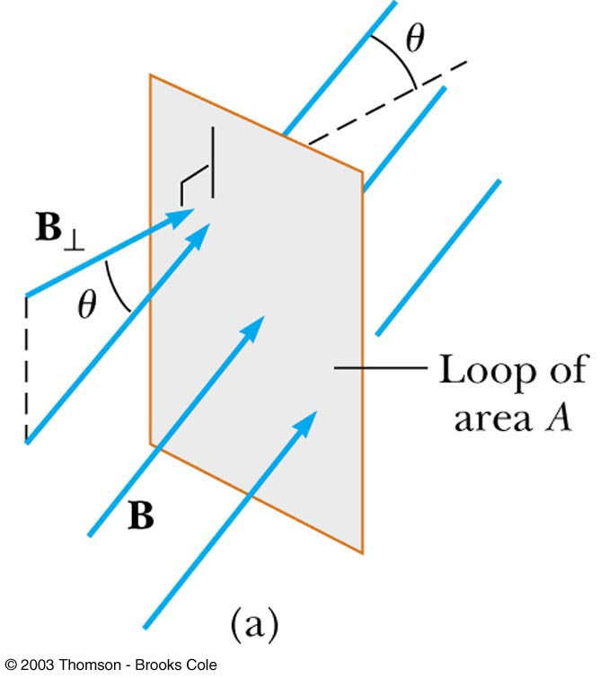
Magnetic Flux
The emf is actually induced by a change
in the quantity called the magnetic flux
rather than simply by a change
in the magnetic field
Magnetic flux is defined
similar to that of electrical flux
Magnetic flux is proportional to the strength of the magnetic field passing through the plane of a loop
of wire and the area of the loop

Slide 6
Magnetic Flux
The magnetic flux through a loop of wire with area A is
where B┴ is the component of B perpendicular to the plane of the loop and θ is the angle between B and the normal (perpendicular) to the plane of the loop
The unit of magnetic flux is a Weber (Wb): 1 Wb = 1 T· m²

Slide 7
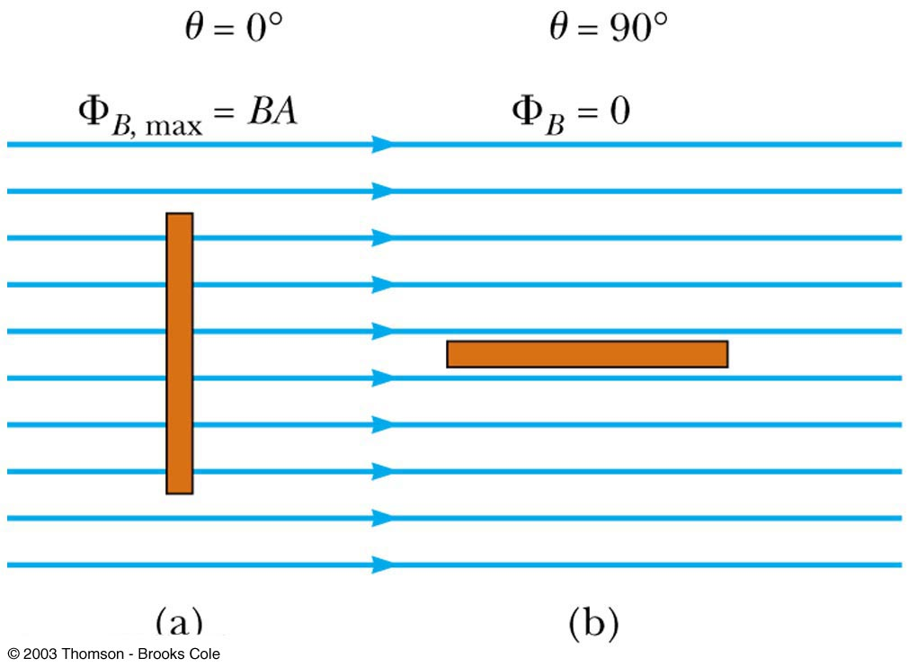
Magnetic Flux
When the field is perpendicular to the plane of the loop θ = 0 and Φ_{B} = Φ_{B, max} = BA
When the field is parallel to the plane of the loop θ = 90° and
Φ_{B} = 0
    The flux can be negative, for example, if θ = 180°
    Φ_{B} = - BA

Slide 8

Magnetic Flux
The flux can be visualized with respect to magnetic field lines
  The value of the magnetic flux is proportional to the total number of lines passing through the loop
When the area is perpendicular to the lines,
the maximum number of lines pass through
the area and the flux is a maximum
When the area is parallel to the lines,
no lines pass through the area and the flux is 0

Slide 9
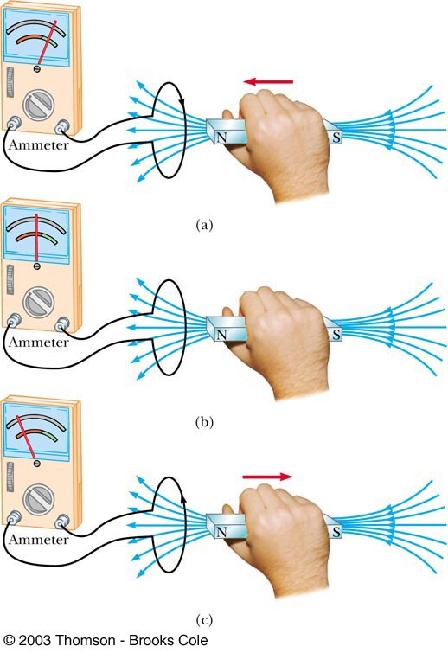
Electromagnetic Induction –
An Experiment
(a) When a magnet moves toward a loop of wire, the ammeter shows the presence of a current
(b) When the magnet is held stationary, there is no current
(c) When the magnet moves away from the loop, the ammeter shows a current in the opposite direction
If the loop is moved instead of the magnet, a current is also detected

Slide 10
Electromagnetic Induction – Results of the Experiment
A current is set up in the circuit as long as there is relative motion between the magnet and the loop
    The same experimental results are found whether the loop moves or the magnet moves
The current is called an induced current because is it produced by an induced emf

Slide 11
Faraday’s Law and Electromagnetic Induction
The instantaneous emf induced in a circuit equals
the negative of the rate of change of magnetic flux with respect to time through the circuit
If a circuit contains N tightly wound loops and the flux changes by ΔΦ_{B} during a time interval Δt, the average emf induced is given by Faraday’s Law:

Slide 12
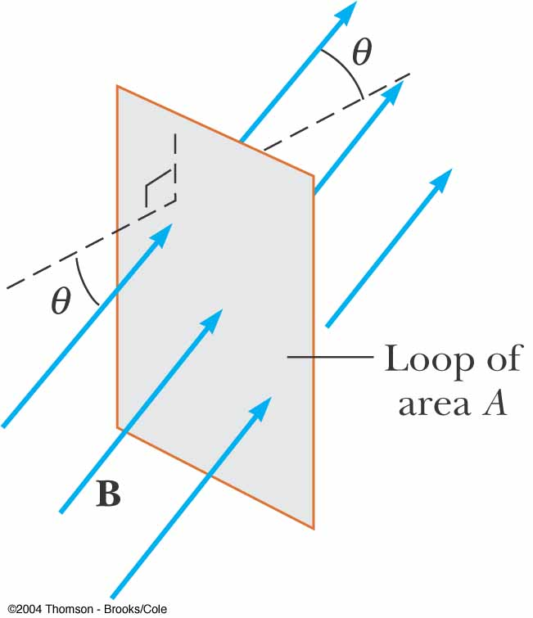
The Ways to Induce emf
The emf induced in the loop of area A is
An emf can be induced in the circuit in several ways:
The magnitude of B can change with time
The area enclosed by the loop can change with time
The angle θ between B and the normal to the loop can change with time
Any combination of the above can occur

Slide 13
Lenz’s Law
Faraday’s law indicates that induced emf and the change in flux have opposite algebraic signs
The physical interpretation of this statement is known as Lenz’s law:
The induced current travels in the direction that creates a magnetic field with flux opposing the change in original magnetic flux through the circuit
    That is, the induced current tends to maintain the original flux through the circuit

Slide 14
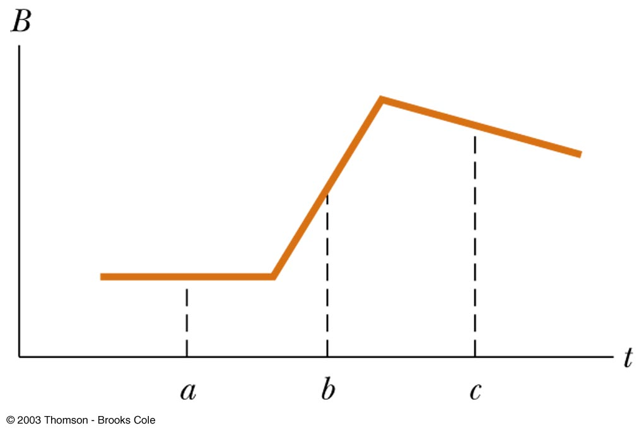
The figure below is a graph of magnitude B versus time t for a magnetic field that passes through a fixed loop and is oriented perpendicular to the plane of the loop. Rank the magnitudes of the emf generated in the loop at the three instants indicated (a, b, c), from largest to smallest.
QUICK QUIZ 20.1

Slide 15
(b), (c), (a). At each instant, the magnitude of the induced emf is proportional to the rate of change of the magnetic field (hence, proportional to the slope of the curve shown on the graph).
QUICK QUIZ 20.1 ANSWER

Slide 16
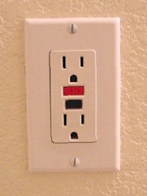
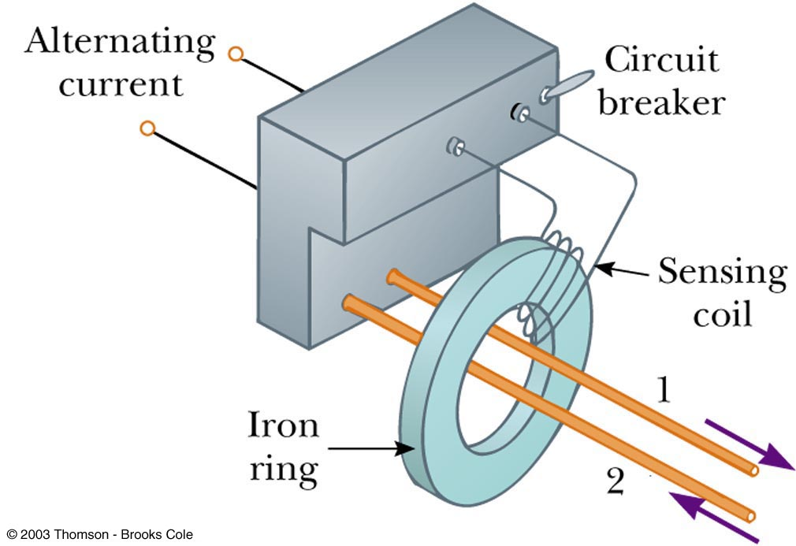
Applications of Faraday’s Law – Ground Fault Interrupters
The ground fault interrupter (GFI) is a safety device that protects against electrical shock
    The iron ring confines the magnetic field, which is generally 0
    If a leakage occurs, the field is no longer 0 and the induced voltage triggers a circuit breaker shutting off the current
  Wire 1 leads from the wall outlet to the appliance
  Wire 2 leads from the appliance back to the wall outlet

Slide 17
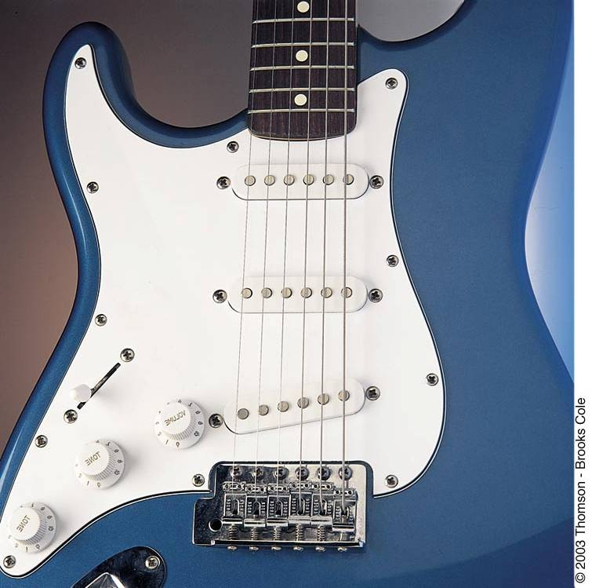
Electric Guitar

Slide 18
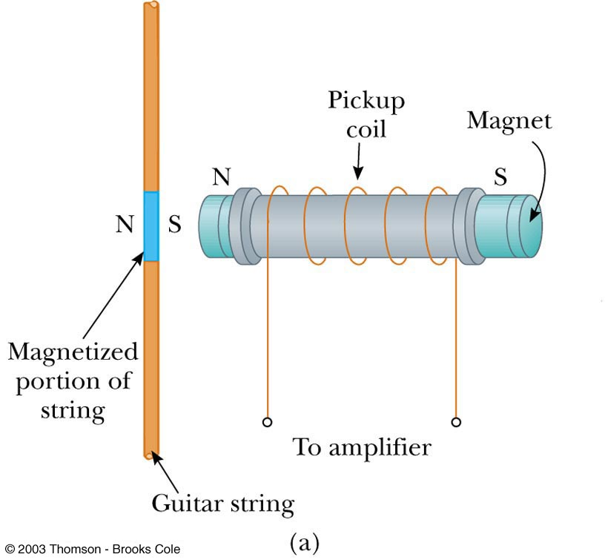
Applications of Faraday’s Law – Electric Guitar
A vibrating string induces an emf in a coil
A permanent magnet inside the coil magnetizes a portion of the string nearest the coil
As the string vibrates at some frequency, its magnetized segment produces a changing flux through the pickup coil
The changing flux produces an induced emf that is fed to an amplifier

Slide 19
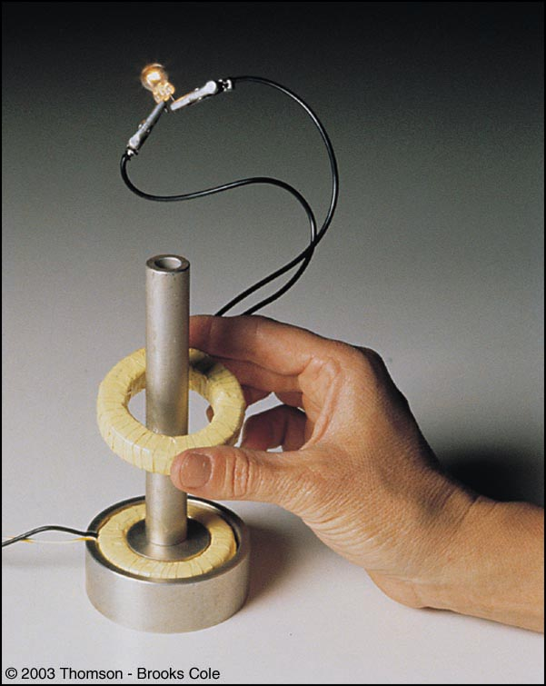
Motional emf

Slide 20
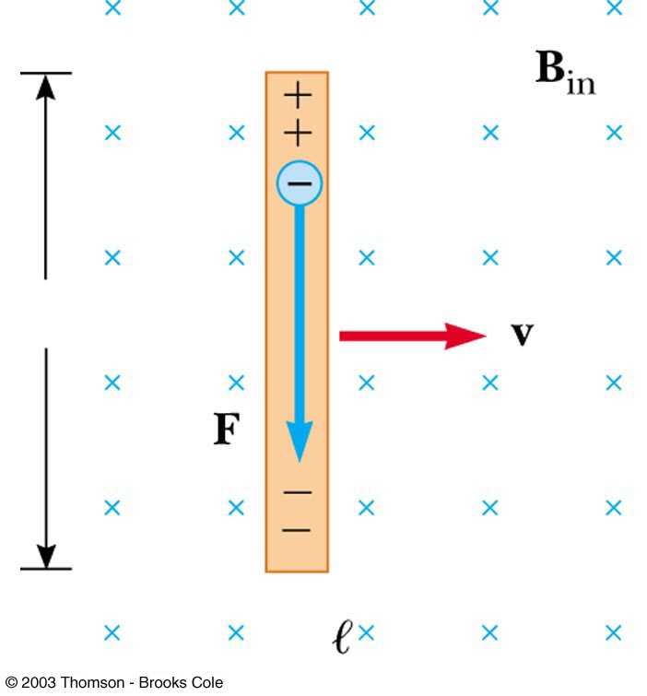
Motional emf
A straight conductor of length ℓ moves ( under the influence of some external agent) with constant velocity v perpendicularly through a uniform magnetic field B
The electrons in the conductor experience a magnetic force:
B
The electrons tend to move to the lower end of the conductor

Slide 21
Motional emf
As the negative charges accumulate at the base, a net positive charge exists at the upper end of the conductor
As a result of this charge separation, an electric field E is produced in the conductor
Charges build up at the ends of the conductor until
the downward magnetic force is balanced by the upward electric force

Slide 22
Motional emf
There is a potential difference between the upper and lower ends of the conductor
The upper end is at a higher potential than the lower end
A potential difference is maintained across the conductor as long as there is motion through the field
    If the motion is reversed, the polarity of the potential difference is also reversed

Slide 23
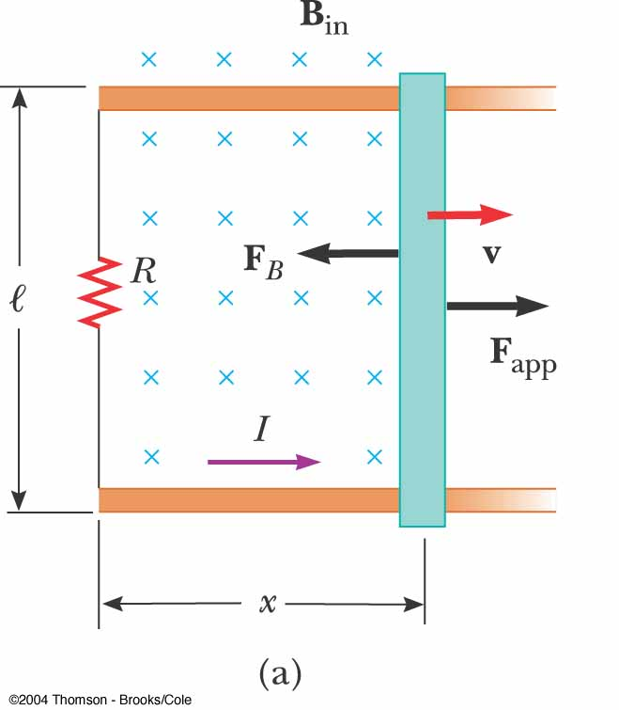
Motional emf in a Circuit
A circuit consists of a conducting bar of length ℓ sliding along two fixed parallel conducting rails
Assume the moving bar has zero resistance
As the bar is pulled to the right with constant velocity v under the influence of an applied force, F_{app}, the free charges experience a magnetic force along the length of the bar
This force sets up an induced current because the charges are free to move in the closed path

Slide 24
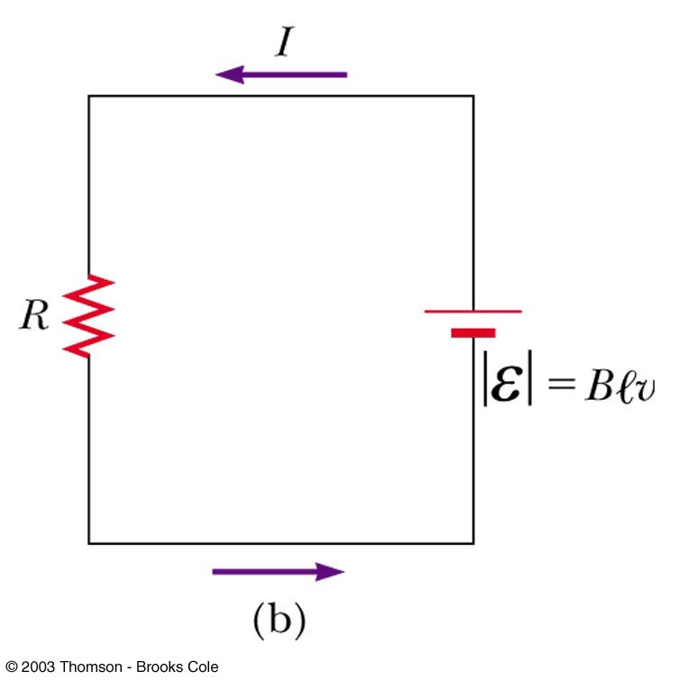
Motional emf in a Circuit
    The magnetic flux through the area is
Use Faraday’s law:
The induced, motional emf, acts like a battery in the circuit
The magnitude of induced current is

Slide 25
As an airplane flies due north from Los Angeles to Seattle, it cuts through Earth's magnetic field. As a result, an emf is developed between the wing tips. Which wing tip is positively charged?
QUICK QUIZ

Slide 26
The left wingtip on the west side of the airplane. The magnetic field of the Earth has a downward component in the northern hemisphere. As the airplane flies northward, the right-hand rule indicates that positive charge experiences a force to the left side of the airplane. Thus, the left wingtip becomes positively charged and the right wingtip negatively charged.
QUICK QUIZ ANSWER

Slide 27
You wish to move a rectangular loop of wire into a region of uniform magnetic field at a given speed so as to induce an emf in the loop. The plane of the loop must remain perpendicular to the magnetic field lines. In which orientation should you hold the loop while you move it into the region of magnetic field in order to generate the largest emf? (a) With the long dimension of the loop parallel to the velocity vector; (b) With the short dimension of the loop parallel to the velocity vector. (c) Either way—the emf is the same regardless of orientation.
QUICK QUIZ 20.3

Slide 28
(b). According to Equation 20.3, because B and v are constant, the emf depends only on the length of the wire moving in the magnetic field. Thus, you want the long dimension moving through the magnetic field lines so that it is perpendicular to the velocity vector. In this case, the short dimension is parallel to the velocity vector. From a more conceptual point of view, you want the rate of change of area in the magnetic field to be the largest, which you do by thrusting the long dimension into the field.
QUICK QUIZ 20.3 ANSWER

Slide 29
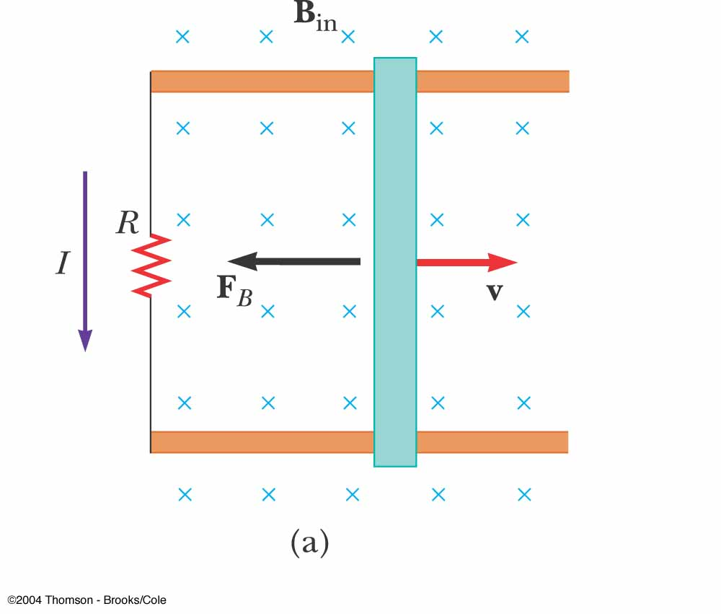
Lenz’ Law, Bar Example
The flux due to the external field in increasing into the page
The flux due to the induced current must be out of the page
Therefore the current must be counterclockwise when the bar moves to the right

Slide 30
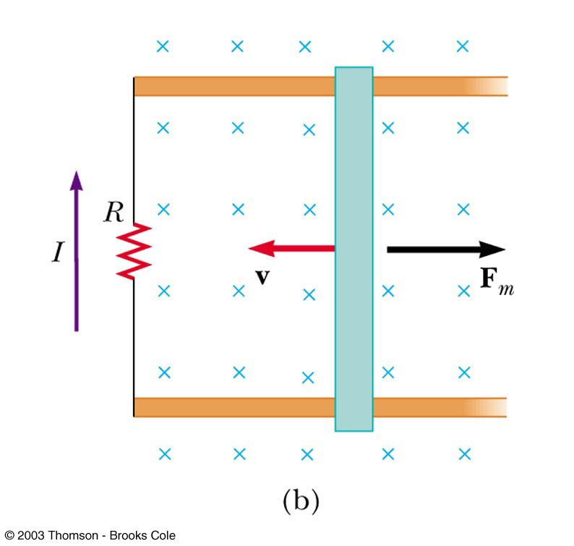
Lenz’ Law, Bar Example
The bar is moving toward the left
The magnetic flux through the loop is decreasing with time
The induced current must be clockwise to to produce its own flux into the page

Slide 31
Lenz’ Law Revisited, Conservation of Energy
Assume the bar is moving to the right
Assume the induced current is clockwise (opposite the direction required by Lenz’s law)
    The magnetic force on the bar would be to the right
    The force would cause an acceleration of the bar and the velocity would increase
    This would cause the flux to increase and the current to increase and the velocity to increase…
This would violate Conservation of Energy and so therefore, the current must be counterclockwise

Slide 32
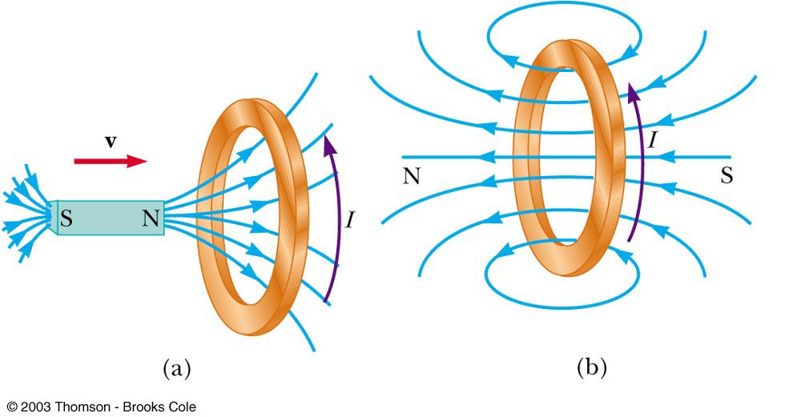
Lenz’ Law, Moving Magnet Example
(a) A bar magnet is moved to the right toward a stationary loop of wire. As the magnet moves, the magnetic flux increases with time
(b) The induced current produces a flux to the left, so the current is in the direction shown

Slide 33
Lenz’ Law, Final Note
When applying Lenz’ Law, there are two magnetic fields to consider
    The external changing magnetic field that induces the current in the loop
    The magnetic field produced by the current in the loop

Slide 34
A bar magnet is falling through a loop of wire with constant velocity with the north pole entering first. Viewed from the same side of the loop as the magnet, as the north pole approaches the loop, the induced current will be in what direction? (a) clockwise (b) zero (c ) counterclockwise (d) along the length of the magnet
QUICK QUIZ 20.4

Slide 35
(c). In order to oppose the approach of the north pole, the magnetic field generated by the induced current must be directed upward. An induced current directed counterclockwise around the loop will produce a field with this orientation along the axis of the loop.
QUICK QUIZ 20.4 ANSWER

Slide 36
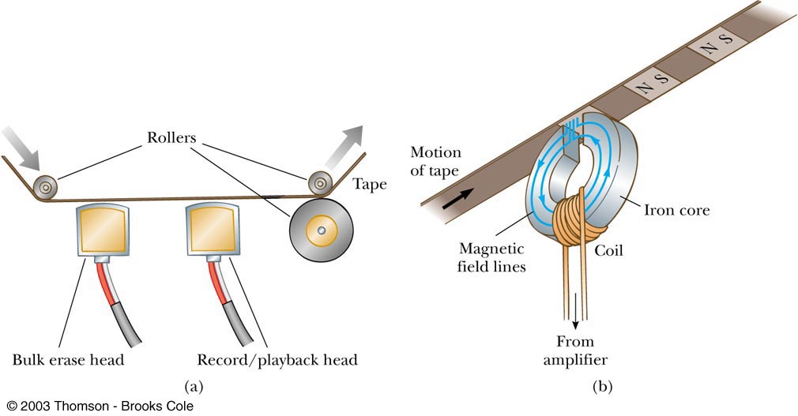
Application – Tape Recorder

Slide 37
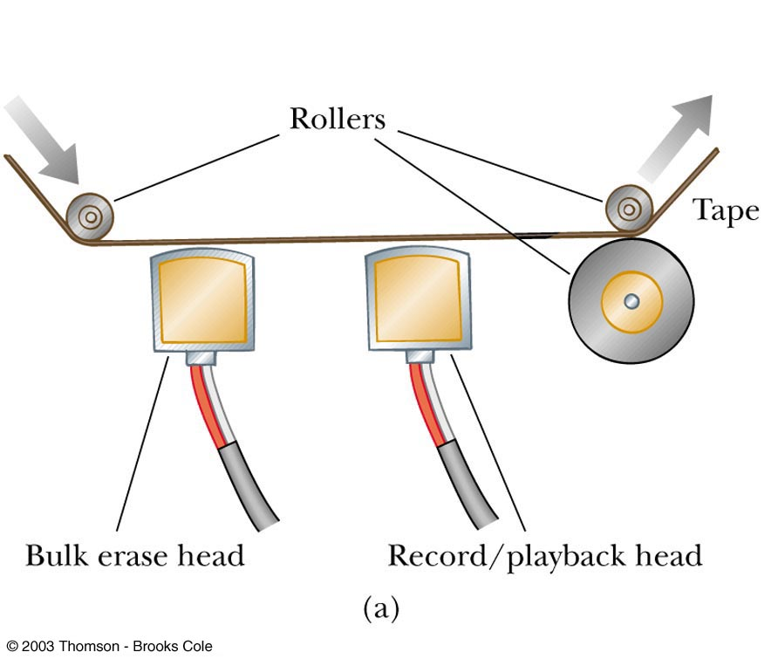
Application – Tape Recorder
A magnetic tape moves past a recording and playback head
    The tape is a plastic ribbon coated with iron oxide or chromium oxide
To record, the sound is converted to an electrical signal which passes to an electromagnet that magnetizes the tape in a particular pattern
To playback, the magnetized pattern is converted back into an induced current driving a speaker

Slide 38
Generators
Alternating Current (AC) generator
  Converts mechanical energy to electrical energy
  Consists of a wire loop rotated by some external means
  There are a variety of sources that can supply the energy to rotate the loop
    These may include falling water, heat by burning coal to produce steam

Slide 39
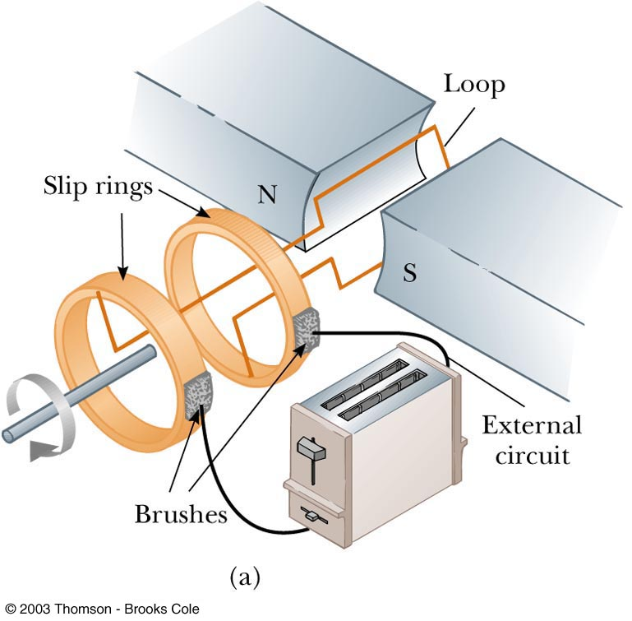
AC Generators
Basic operation of the generator
    As the loop rotates, the magnetic flux through it changes with time
    This induces an emf and a current in the external circuit
    The ends of the loop are connected to slip rings that rotate with the loop
    Connections to the external circuit are made by stationary brushed in contact with the slip rings

Slide 40
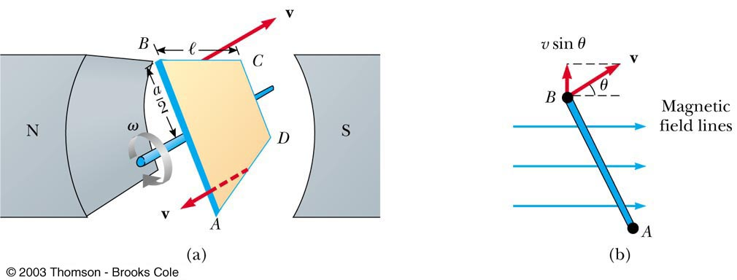
AC Generators

Slide 41
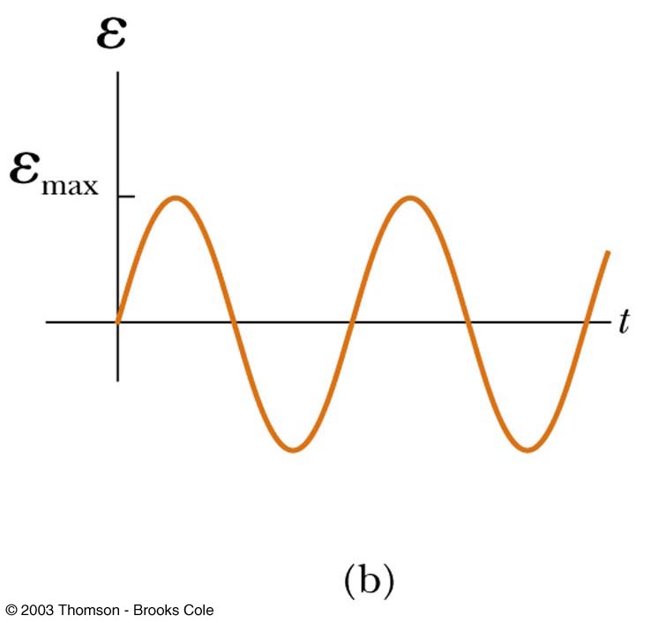
AC Generators
The emf generated by the rotating loop can be found by
If the loop rotates with a constant angular speed, ω, and N turns
  ε = N B A ω sin ω t
ε = ε_{max} when loop is parallel to the field
ε = 0 when when the loop is perpendicular to the field

Slide 42
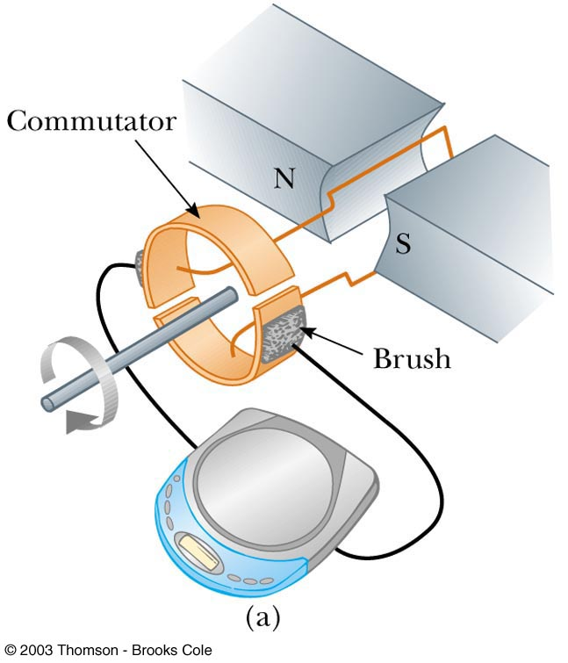
DC Generators
Components are essentially the same as that of an AC generator
The major difference is the contacts to the rotating loop are made by a split ring, or commutator

Slide 43
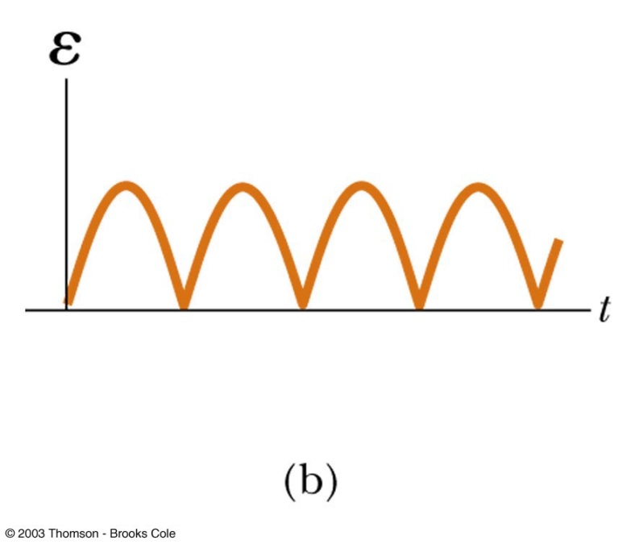
DC Generators
The output voltage always has the same polarity
The current is a pulsing current
To produce a steady current, many loops and commutators around the axis of rotation are used
    The multiple outputs are superimposed and the output is almost free of fluctuations

Slide 44
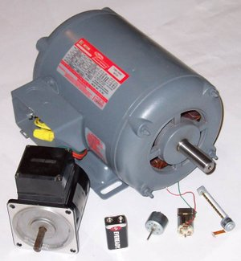
Motors
Motors are devices that convert electrical energy into mechanical energy
    A motor is a generator run in reverse
A motor can perform useful mechanical work when a shaft connected to its rotating coil is attached to some external device

Slide 45
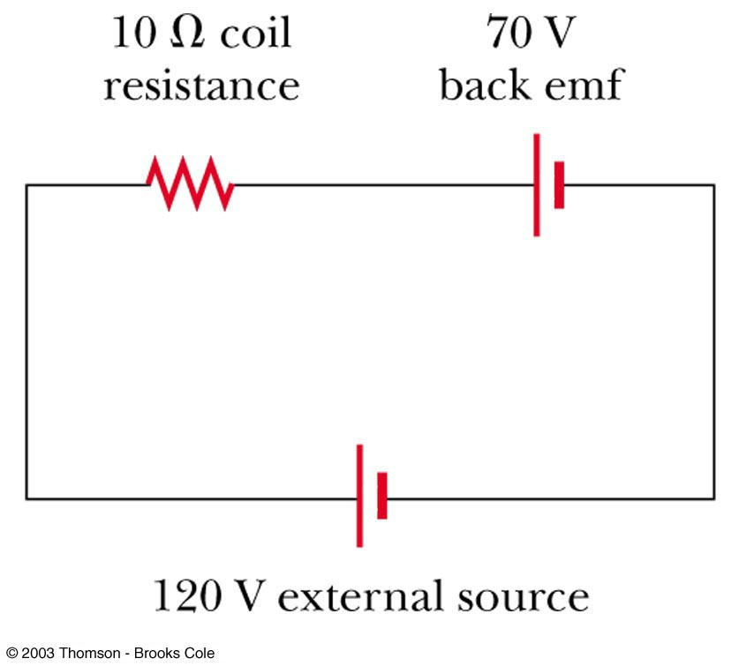
Motors and Back emf
The phrase back emf is used for an emf that tends to reduce the applied current
When a motor is turned on, there is no back emf initially
The current is very large because it is limited only by the resistance of the coil

Slide 46
Motors and Back emf
As the coil begins to rotate, the induced back emf opposes the applied voltage
The current in the coil is reduced
The power requirements for starting a motor and for running it under heavy loads are greater than those for running the motor under average loads

Slide 47
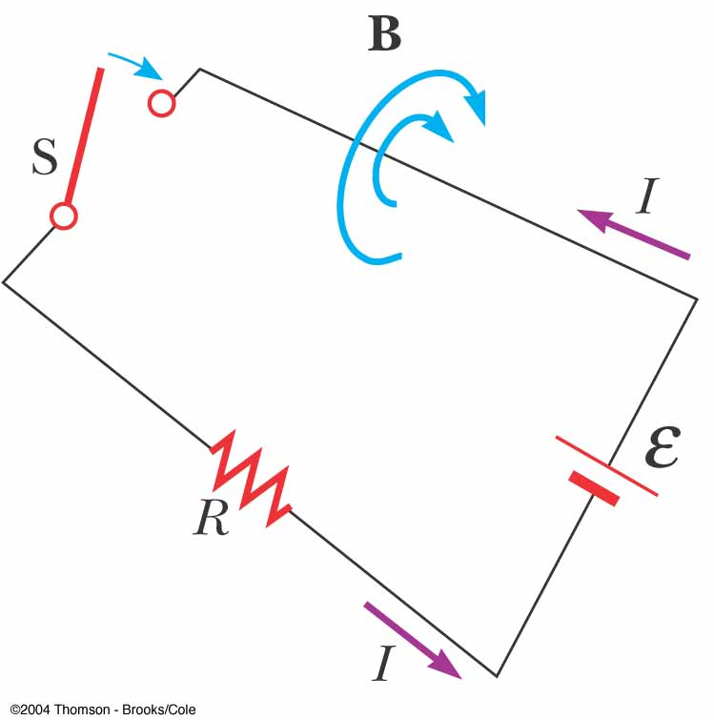
Self-Inductance
Consider a circuit: when the switch is thrown to its closed position, the current does not immediately jump from zero to its maximum value ε/R
As the current increases, the magnetic flux through a loop due to this current also increases
The increasing flux induces an emf that opposes the current
This opposing emf results in a gradual increase of the current

Slide 48
Self-Inductance
This effect is called self-inductance because the changing flux through the circuit and resultant induced emf arise from the circuit itself
The emf ε_{L} set up in this case is called a self-induced emf

Slide 49
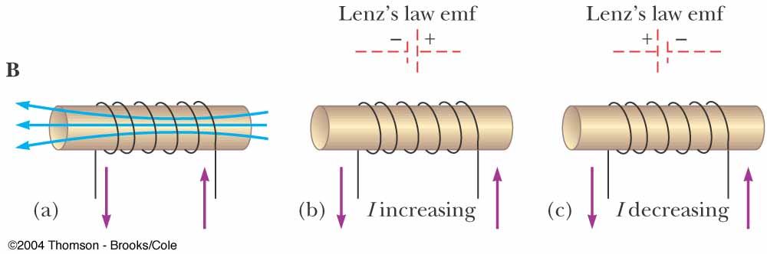
An Example of Self-Inductance
(a) A current in the coil produces a magnetic field directed to the left
(b) If the current increases, the increasing magnetic flux creates an induced emf in the coil having the polarity shown by the dashed battery
(c) The polarity of the induced emf reverses if the current decreases

Slide 50
Self-Inductance
The self-induced emf must be proportional to the time rate of change of the current
    L is a proportionality constant called the inductance of the device
    The negative sign indicates that a changing current induces an emf in opposition to that change

Slide 51
Self-Inductance
The inductance of a coil depends on geometric factors
The SI unit of self-inductance is the Henry
    1 H = 1 V · s / A
The expression for L is

Slide 52
Inductance of a Solenoid
Let the solenoid have N turns and length l
L depends on the geometric factors l and A and on μ₀ and is proportional to the square of the number of turns

Slide 53
Inductance of a Solenoid
Can be also expressed in the form
where V=Al is the volume of the solenoid

Slide 54
Inductor in a Circuit
Inductance can be interpreted as a measure of opposition to the rate of change in the current
    Remember resistance R is a measure of opposition to the current
As a circuit is completed, the current begins to increase, but the inductor produces an emf (back emf) that opposes the increasing current
    Therefore, the current doesn’t change from 0 to its maximum instantaneously

Slide 55
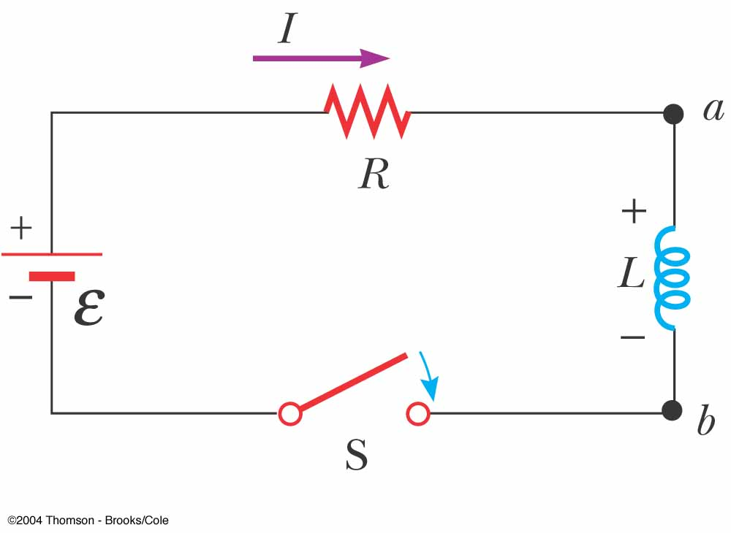
RL Circuits
A series RL circuit: the elements connected to the battery are a resistor R and an inductor L

Slide 56
RL Circuit
Suppose the switch is closed at t = 0: the current in the circuit begins to increase, and a back emf is induced in the inductor
Apply Kirchhoff’s loop rule to calculate the current in the circuit:
A mathematical solution of this equation represents the current in the circuit as a function of time:

Slide 57
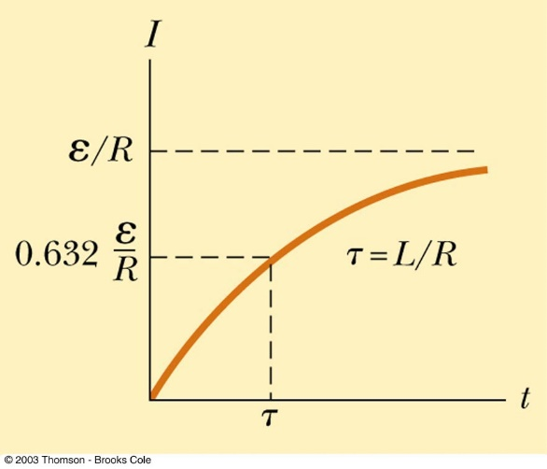
RL Circuit
We can rewrite this expression as
where τ is the time constant of the RL circuit:
When the switch is closed, the current increases to its equilibrium value ε /R according to an exponential function

Slide 58
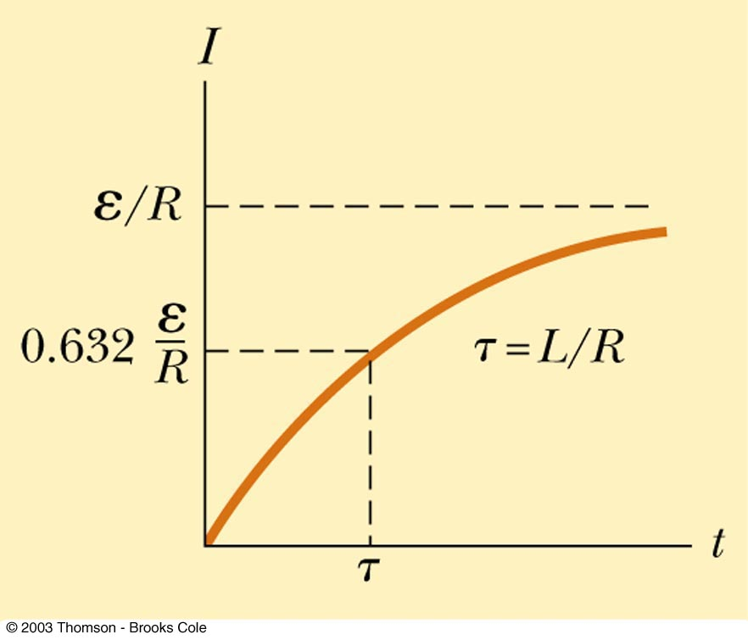
RL Circuit
When the current reaches its maximum, the rate of change and the back emf are zero
The time constant, τ, for an RL circuit is the time required for the current in the circuit to reach 63.2% of its final value

Slide 59
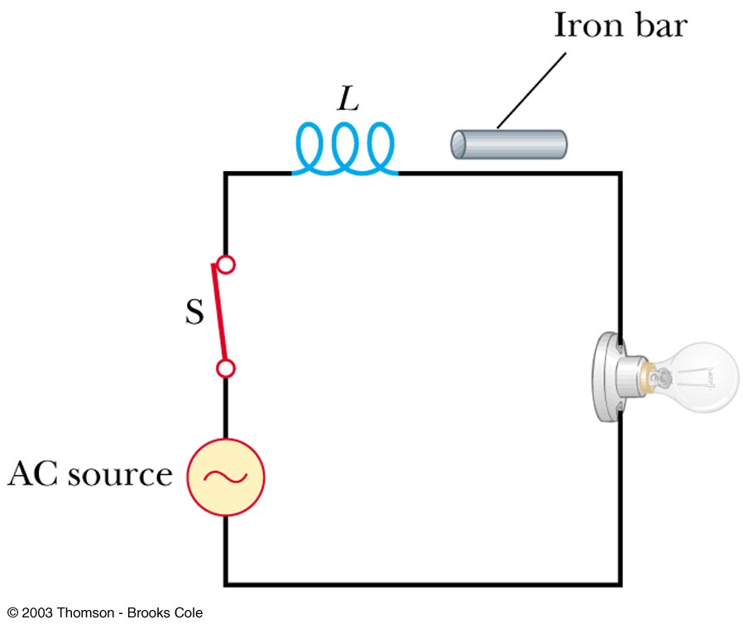
The switch in the circuit shown in the figure below is closed and the lightbulb glows steadily. The inductor is a simple air-core solenoid. An iron rod is inserted into the interior of the solenoid, which increases the magnitude of the magnetic field in the solenoid. As the rod is inserted into the solenoid, the brightness of the lightbulb (a) increases, (b) decreases, or (c) remains the same.
QUICK QUIZ 20.5

Slide 60
(b). When the iron rod is inserted into the solenoid, the inductance of the coil increases. As a result, more potential difference appears across the coil than before. Consequently, less potential difference appears across the bulb and its brightness decreases.
QUICK QUIZ 20.5 ANSWER

Slide 61
Energy Stored in a Magnetic Field
The emf induced by an inductor prevents a battery from establishing an instantaneous current in a circuit
The battery has to do work to produce a current
    This work can be thought of as energy stored by the inductor in its magnetic field
    The energy stored in a charged capacitor

