Slide 2
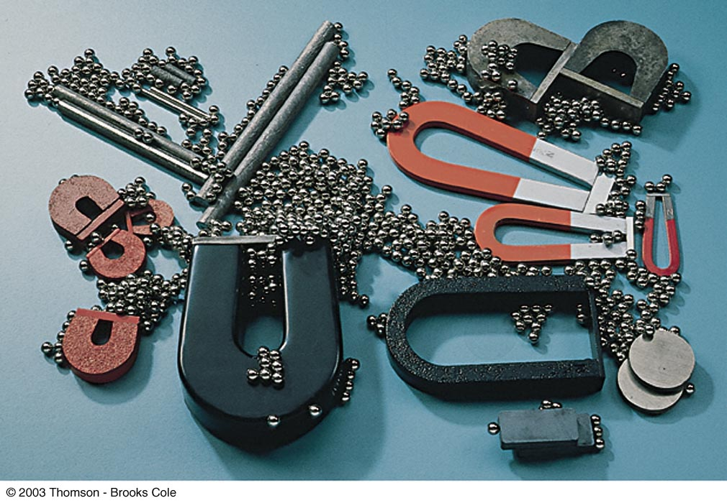

Slide 3
Magnets
Poles of a magnet are the ends where objects are most strongly attracted
Two poles, called north and south
Like poles repel each other and unlike poles attract each other
Similar to electric charges
Magnetic poles cannot be isolated
If a permanent magnet is cut in half repeatedly, it will still have a north and a south pole
This differs from electric charges

Slide 4
More About Magnetism
An unmagnetized piece of iron can be magnetized by stroking it with a magnet
Somewhat like stroking an object to charge an object
Magnetism can be induced
If a piece of iron, for example, is placed near a strong permanent magnet, it will become magnetized

Slide 5
Types of Magnetic Materials
Soft magnetic materials, such as iron, are easily magnetized
They also tend to lose their magnetism easily
Hard magnetic materials, such as cobalt and nickel, are difficult to magnetize
They tend to retain their magnetism

Slide 6
Magnetic Fields
A vector quantity
Symbolized by B
Direction is given by the direction a north pole of a compass needle points in that location
Magnetic field lines can be used to show how the field lines, as traced out by a compass, would look

Slide 7
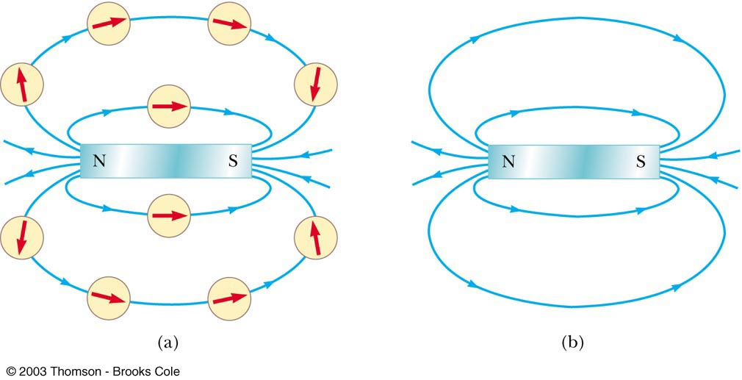
Magnetic Field Lines
A compass can be used to show the direction of the magnetic field lines (a)
A sketch of the magnetic field lines (b)

Slide 8
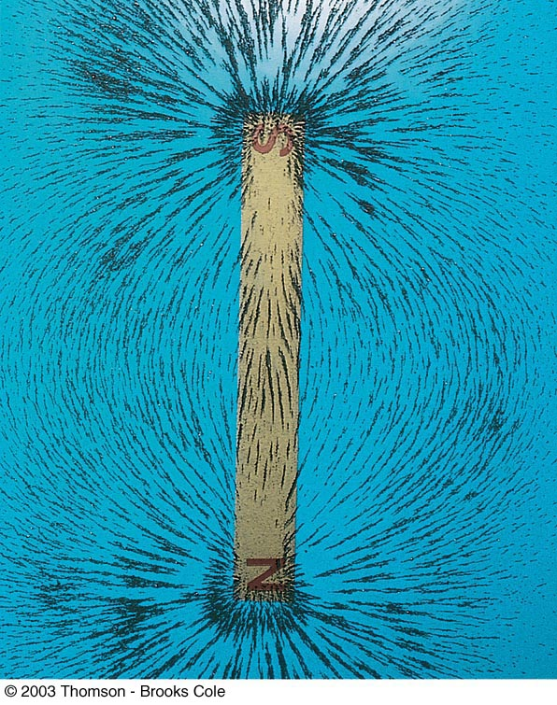
Magnetic Field Lines Bar Magnet
Iron filings are used to show the pattern of the electric field lines
The direction of the field is the direction a north pole would point

Slide 9
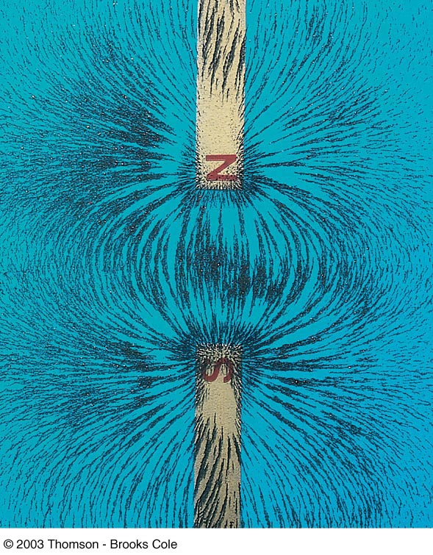
Magnetic Field Lines Unlike Poles
The direction of the field is the direction a north pole would point
Compare to the electric field produced by an electric dipole

Slide 10
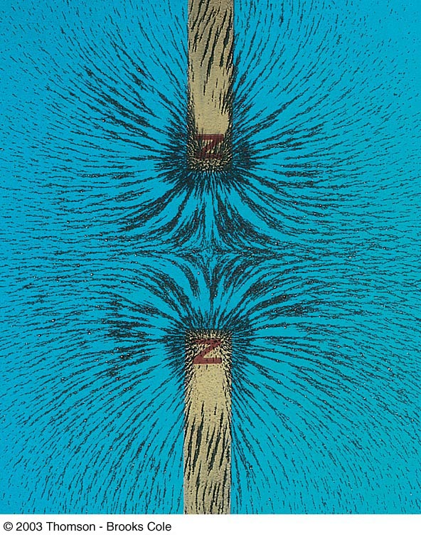
Magnetic Field Lines Like Poles
The direction of the field is the direction a north pole would point
Compare to the electric field produced by like charges

Slide 11
Magnetic and Electric Fields
An electric field surrounds any stationary electric charge
A magnetic field surrounds any moving electric charge
A magnetic field surrounds any magnetic material

Slide 12
Earth’s Magnetic Field
The Earth’s geographic North Pole corresponds to a magnetic south pole
The Earth’s geographic South Pole corresponds to a magnetic north pole
Strictly speaking, a north pole should be a “north-seeking” pole and a south pole a “south-seeking” pole

Slide 13
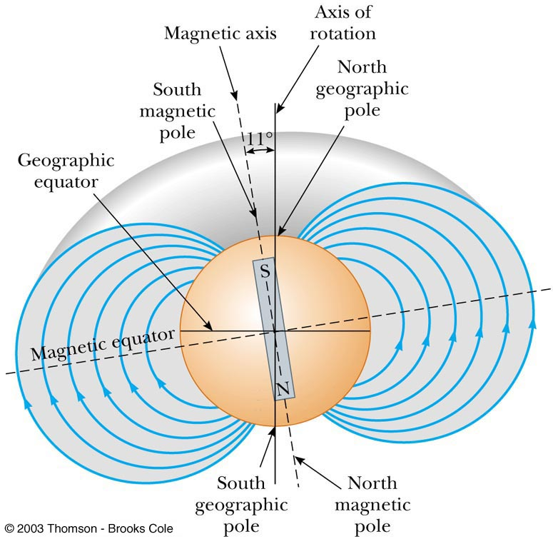
Earth’s Magnetic Field
The Earth’s magnetic field resembles that achieved by burying a huge bar magnet deep in the Earth’s interior

Slide 14
Dip Angle of Earth’s Magnetic Field
If a compass is free to rotate vertically as well as horizontally, it points to the Earth’s surface
The angle between the horizontal and the direction of the magnetic field is called the dip angle
The farther north the device is moved, the farther from horizontal the compass needle would be
The compass needle would be horizontal at the equator and the dip angle would be 0°
The compass needle would point straight down at the south magnetic pole and the dip angle would be 90°

Slide 15
More About the Earth’s Magnetic Poles
The dip angle of 90° is found at a point just north of Hudson Bay in Canada
This is considered to be the location of the south magnetic pole
The magnetic and geographic poles are not in the same exact location
The difference between true north, at the geographic north pole, and magnetic north is called the magnetic declination
The amount of declination varies by location on the Earth’s surface

Slide 16
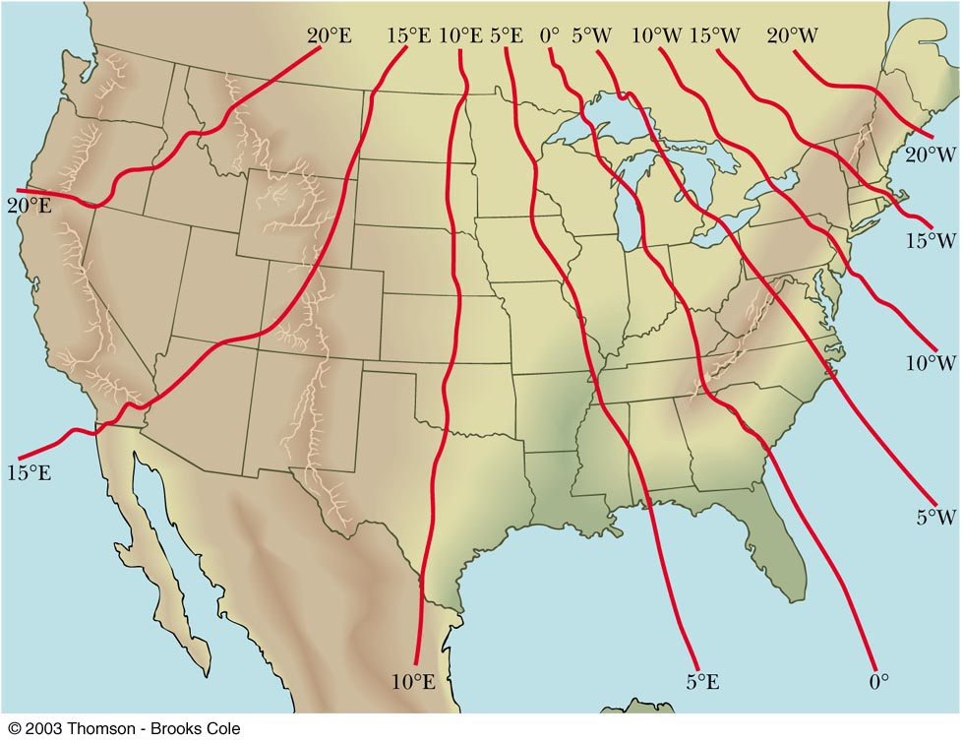
Earth’s Magnetic Declination

Slide 17
Source of the Earth’s Magnetic Field
There cannot be large masses of permanently magnetized materials since the high temperatures of the core prevent materials from retaining permanent magnetization
The most likely source of the Earth’s magnetic field is believed to be electric currents in the liquid part of the core

Slide 18
Reversals of the Earth’s Magnetic Field
The direction of the Earth’s magnetic field reverses every few million years
Evidence of these reversals are found in basalts resulting from volcanic activity
The origin of the reversals is not understood

Slide 19
Magnetic Fields
When moving through a magnetic field, a charged particle experiences a magnetic force
This force has a maximum value when the charge moves perpendicularly to the magnetic field lines
This force is zero when the charge moves along the field lines

Slide 20
Magnetic Fields
One can define a magnetic field in terms of the magnetic force exerted on a test charge
Similar to the way electric fields are defined

Slide 21
Units of Magnetic Field
The SI unit of magnetic field is the Tesla (T)
Wb is a Weber
The CGS unit is a Gauss (G)
1 T = 10⁴ G

Slide 22
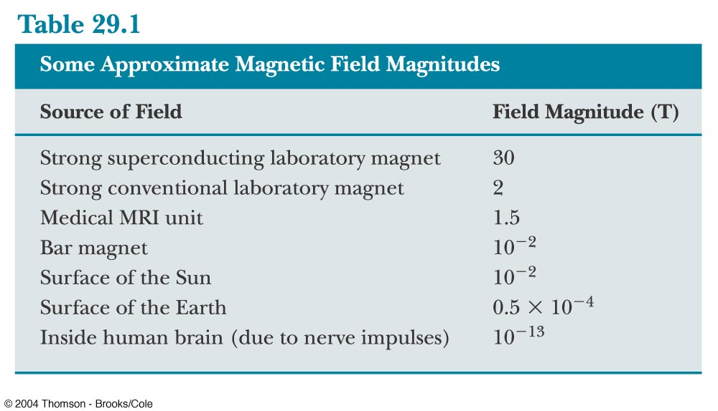
A Few Typical B Values

Slide 23
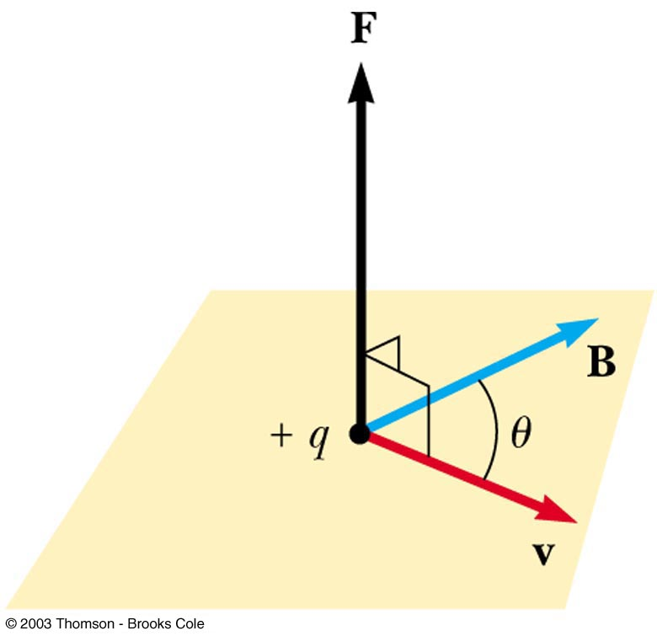
Finding the Direction of Magnetic Force
Experiments show that the direction of the magnetic force is always perpendicular to both v and B
F_{max} occurs when v is perpendicular to B
F = 0 when v is parallel to B

Slide 24
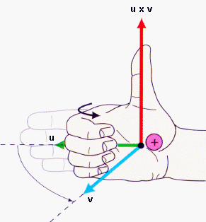
Right Hand Rule
Point the fingers of your right hand in the direction of the velocity v
Curl the fingers in the direction of the magnetic field B, moving through the smallest angle
Your thumb is now pointing in the direction of the magnetic force F exerted on a positive charge
F
v
F
B

Slide 25
The north-pole end of a bar magnet is held near a stationary positively charged piece of plastic. Is the plastic (a) attracted, (b) repelled, or (c) unaffected by the magnet?
QUICK QUIZ 19.2

Slide 26
(c). The magnetic force exerted by a magnetic field on a charge is proportional to the charge’s velocity relative to the field. If the charge is stationary, as in this situation, there is no magnetic force.
QUICK QUIZ 19.2 ANSWER

Slide 27
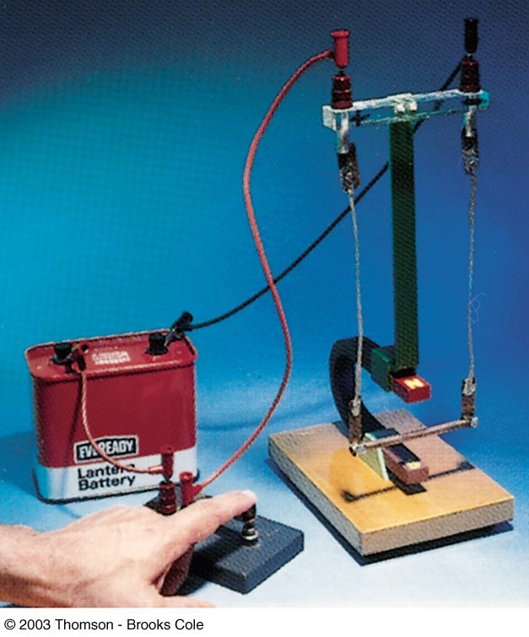
Magnetic Force Acting on a Current-Carrying Conductor

Slide 28
Magnetic Force on a Current Carrying Conductor
A force is exerted on a current-carrying wire placed in a magnetic field
The current is a collection of many charged particles in motion
The direction of the force is given by right hand rule

Slide 29
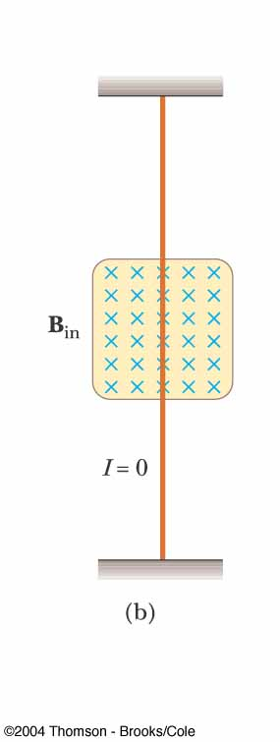
Force on a Wire
The blue x’s indicate the magnetic field B is directed into the page
The x represents the tail of the arrow
Blue dots would be used to represent the field B directed out of the page
The • represents the head of the arrow
In this case, there is no current, so there is no force

Slide 30
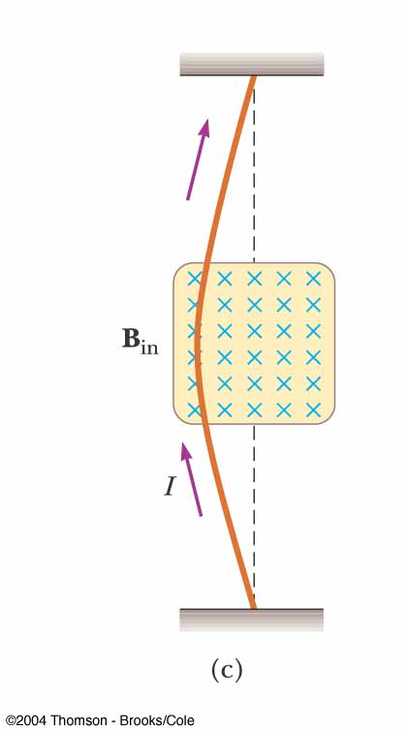
Force on a Wire
B is into the page
The current is up the page
The force is to the left

Slide 31
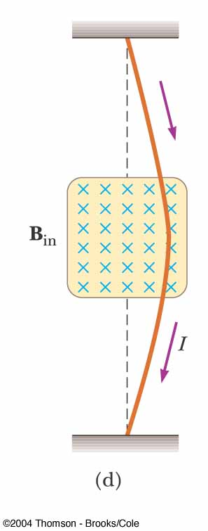
Force on a Wire
B is into the page
The current is down the page
The force is to the right

Slide 32
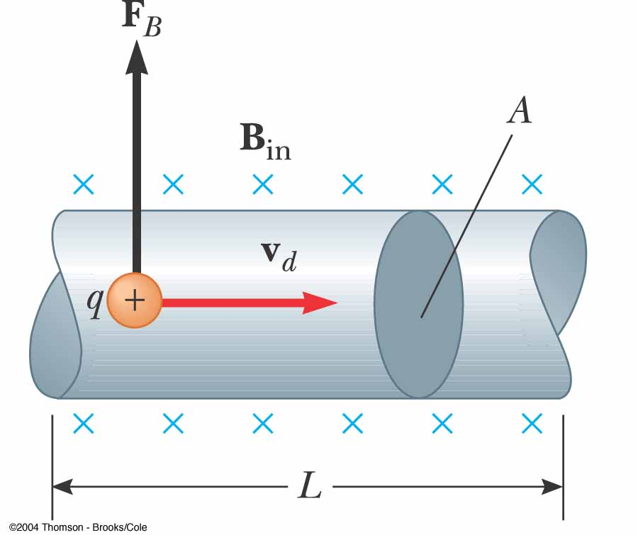
Force on a Wire
The total force is the sum of all the magnetic forces on all the individual charges producing the current
The magnetic force is exerted on each moving charge in the wire

Slide 33
Force on a Wire, equation
Total force = force on each charge carrier x total number of carriers
This equation can be used only when the current and magnetic field are at right angles to each other

Slide 34
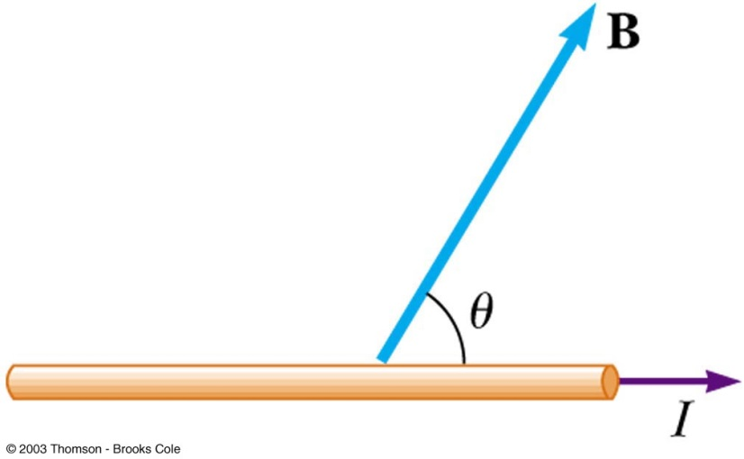
Force on a Wire, equation
If the wire is not perpendicular to the field the magnitude of the magnetic force on the wire is
θ is the angle between B and I
When the current is either in the direction of the field or opposite the direction of the field, the magnetic force on the wire is zero

Slide 35
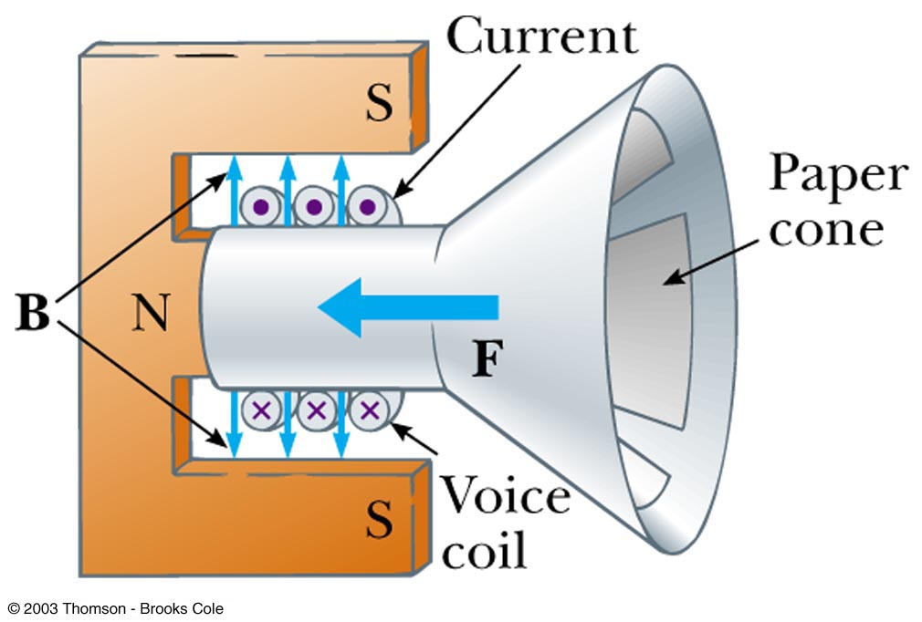
A Diagram of a Loudspeaker

Slide 36
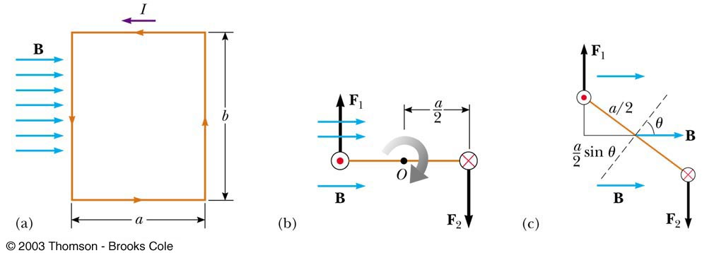
Torque on a Current Loop

Slide 37
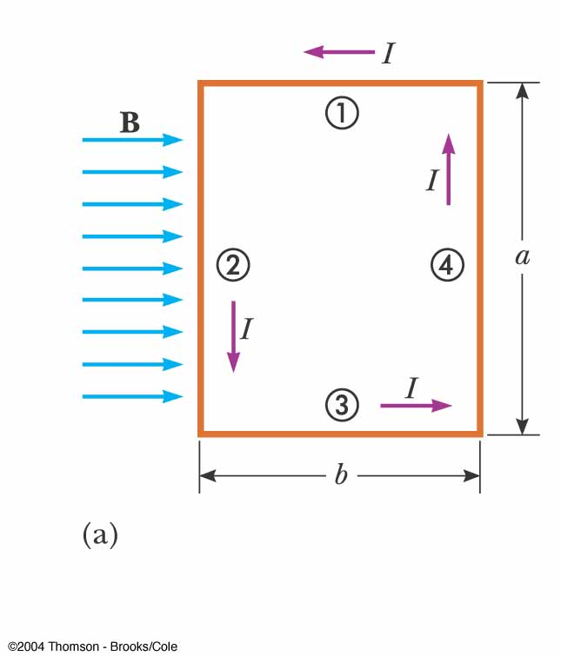
Torque on a Current Loop in a Uniform Magnetic Field
A rectangular ( A=ab )loop carrying a current I is located in a uniform magnetic field B
Magnetic field B is parallel to the plane of the loop
No magnetic force act on sides 1 and 3 because wires are parallel to field B

Slide 38
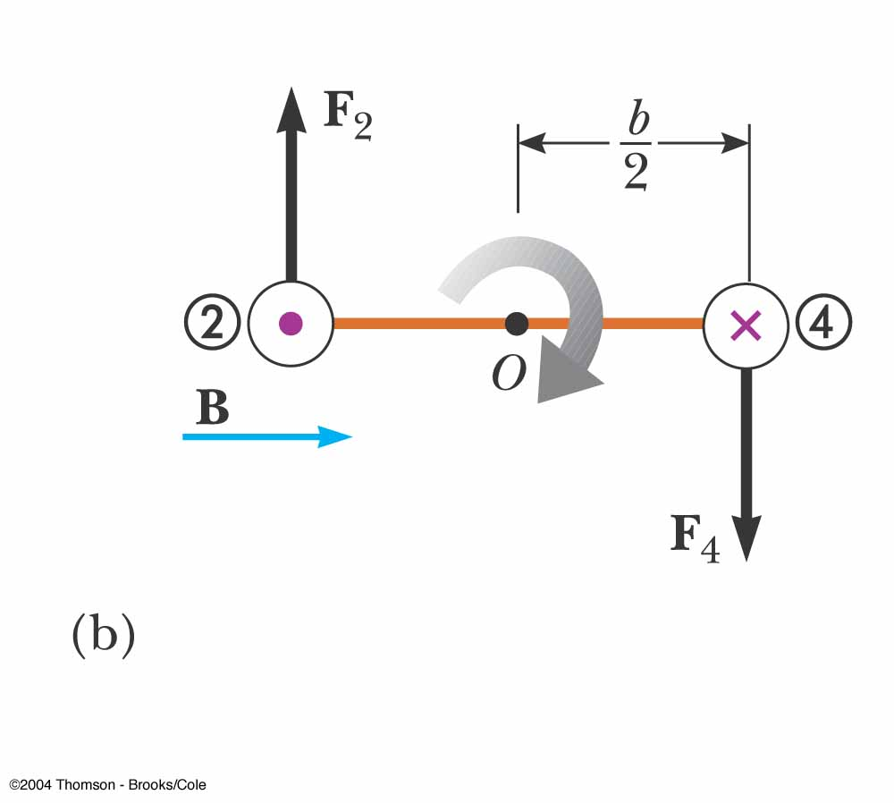
Torque on a Current Loop in a Uniform Magnetic Field
Magnetic forces do act on sides 2 and 4 because they are perpendicular to the field
Two magnetic forces F₂ and F₄ point in opposite directions but are not directed along the same line of action
Two forces F₂ and F₄ produce about O a torque τ that rotates the loop clockwise

Slide 39
Torque on a Current Loop in a Uniform Magnetic Field
b/2 is the moment arm about O for each force
This maximum-torque result is valid only when magnetic field B is parallel to the plane of the loop
If the current direction were reverse, the rotational tendency would be counterclockwise

Slide 40
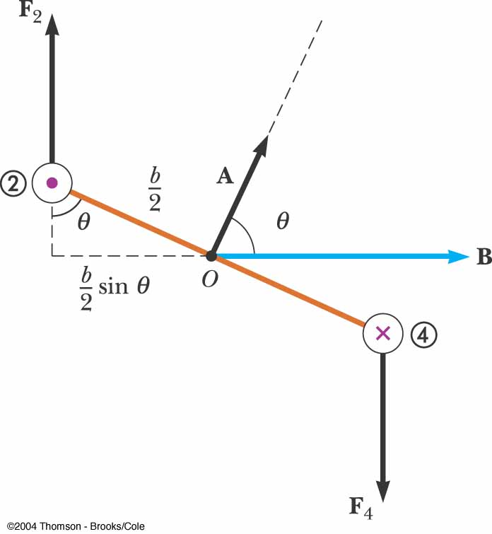
Torque on a Current Loop in a Uniform Magnetic Field
The uniform magnetic field B makes an angle θ < 90° with a line perpendicular to the plane of the loop
The net torque τ about O is
the normal to the plane of the loop rotates toward the direction of the magnetic field

Slide 41
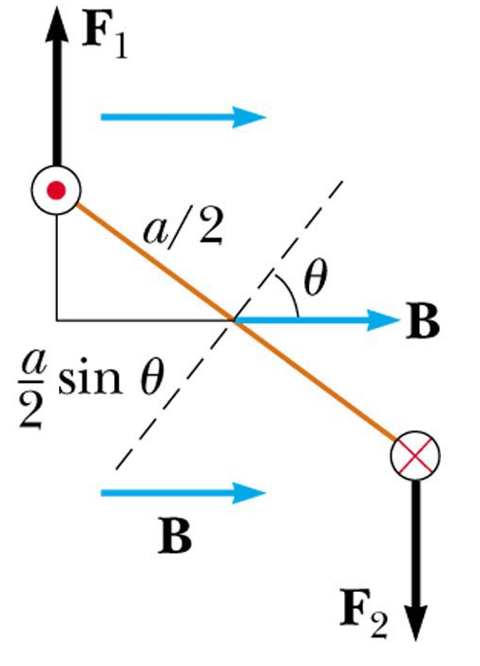
Torque on a Current Loop
μ
Applies to any shape loop
The torque on the coil with N turns is
Define the magnetic moment of the coil as vector μ which direction is perpendicular to the plane of the loop and the magnitude is

Slide 42
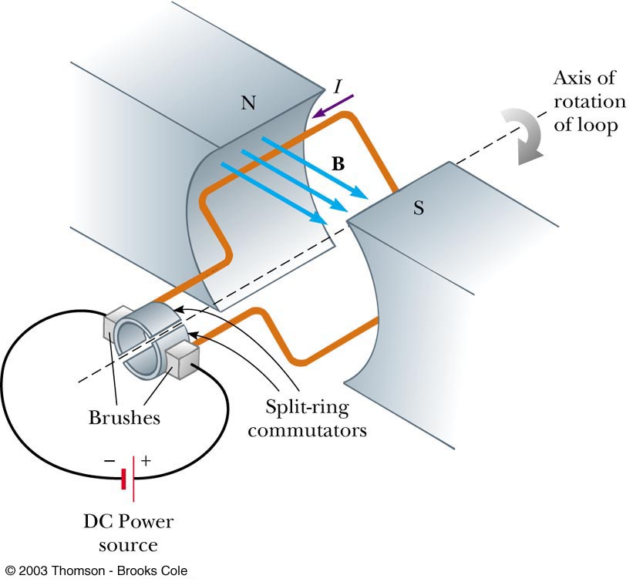
Electric Motor
An electric motor converts electrical energy to mechanical energy
The mechanical energy is in the form of rotational kinetic energy
An electric motor consists of a rigid current-carrying loop that rotates when placed in a magnetic field

Slide 43
Electric Motor, 2
The torque acting on the loop will tend to rotate the loop to smaller values of θ until the torque becomes 0 at θ = 0°
If the loop turns past this point and the current remains in the same direction, the torque reverses and turns the loop in the opposite direction

Slide 44
Electric Motor, 3
To provide continuous rotation in one direction, the current in the loop must periodically reverse
In AC motors, this reversal naturally occurs
In DC motors, a split-ring commutator and brushes are used
Actual motors would contain many current loops and commutators

Slide 45
Electric Motor, final
Just as the loop becomes perpendicular to the magnetic field and the torque becomes 0, inertia carries the loop forward and the brushes cross the gaps in the ring, causing the current loop to reverse its direction
This provides more torque to continue the rotation
The process repeats itself

Slide 46
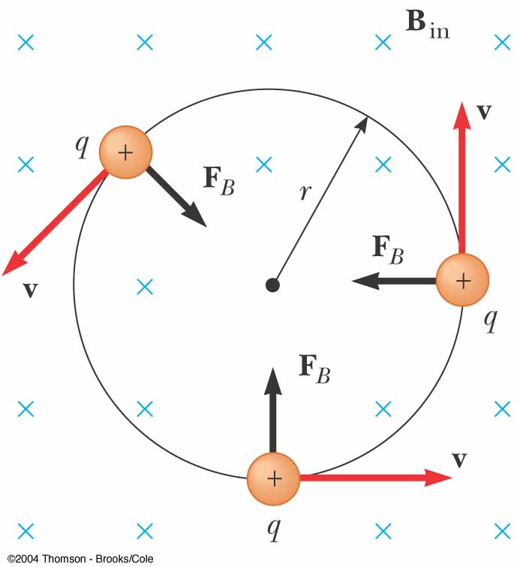
Motion of a Charged particle in a Uniform Magnetic field
Consider a particle moving in an external magnetic field B so that its velocity v is perpendicular to the field
The force F_{B} is always directed toward the center of the circular path
The magnetic force F_{B} causes a centripetal acceleration, changing the direction of the velocity of the particle

Slide 47
Motion of a Charged particle in a Uniform Magnetic field
The particle moves in a circle: F_{B} ⊥ v and F_{B} ⊥ B
The radius r of the path is
r is proportional to the momentum of the particle and inversely proportional to the magnetic field
The angular speed ω (cyclotron frequency) of the particle is

Slide 48
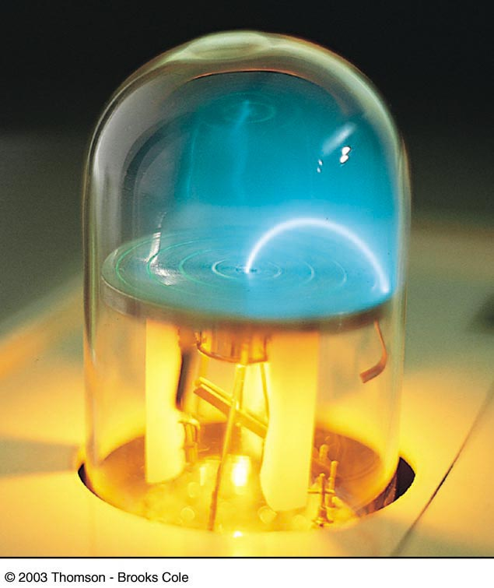
Bending an Electron Beam in an External Magnetic Field

Slide 49
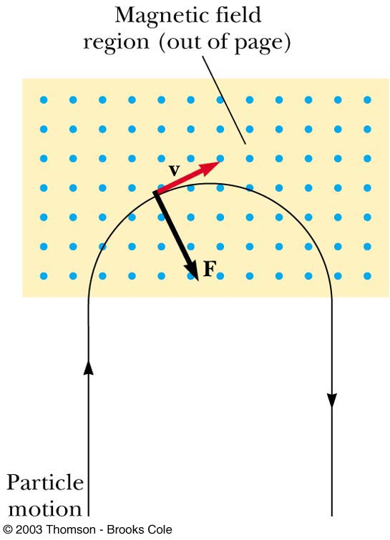
Bending an
Electron Beam

Slide 50
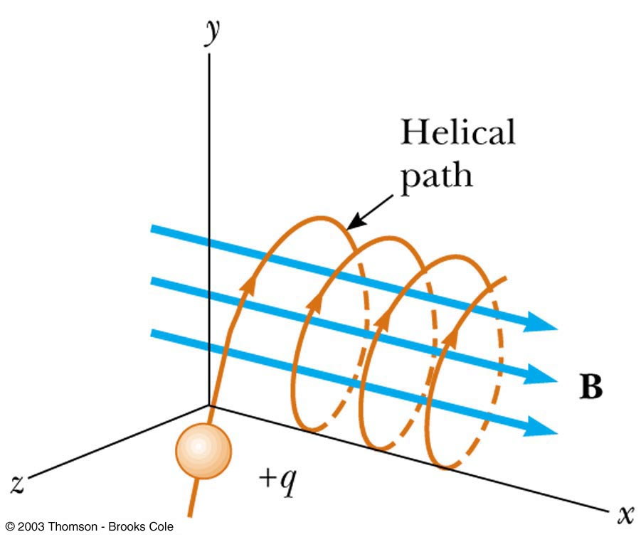
Particle Moving in an External Magnetic Field
If the particle’s velocity is not perpendicular to the field, the path followed by the particle is a spiral
The spiral path is called a helix

Slide 51
As a charged particle moves freely in a circular path in the presence of a constant magnetic field applied perpendicular to the particle's velocity, its kinetic energy (a) remains constant, (b) increases, or (c) decreases.
QUICK QUIZ 19.3

Slide 52
(a). The magnetic force acting on the particle is always perpendicular to the velocity of the particle, and hence to the displacement the particle is undergoing. Under these conditions, the force does no work on the particle and the particle’s kinetic energy remains constant.
QUICK QUIZ 19.3 ANSWER

Slide 53
Two charged particles are projected into a region in which a magnetic field is perpendicular to their velocities. After they enter the magnetic field, you can conclude that (a) the charges are deflected in opposite directions, (b) the charges continue to move in a straight line, (c) the charges move in circular paths, or (d) the charges move in circular paths but in opposite directions.
QUICK QUIZ 19.4

Slide 54
(c). Anytime the velocity of a charged particle is perpendicular to the magnetic field, it will follow a circular path. The two particles will move in opposite directions around their circular paths if their charges have opposite signs, but their charges are unknown so (d) is not an acceptable answer.
QUICK QUIZ 19.4 ANSWER

Slide 55
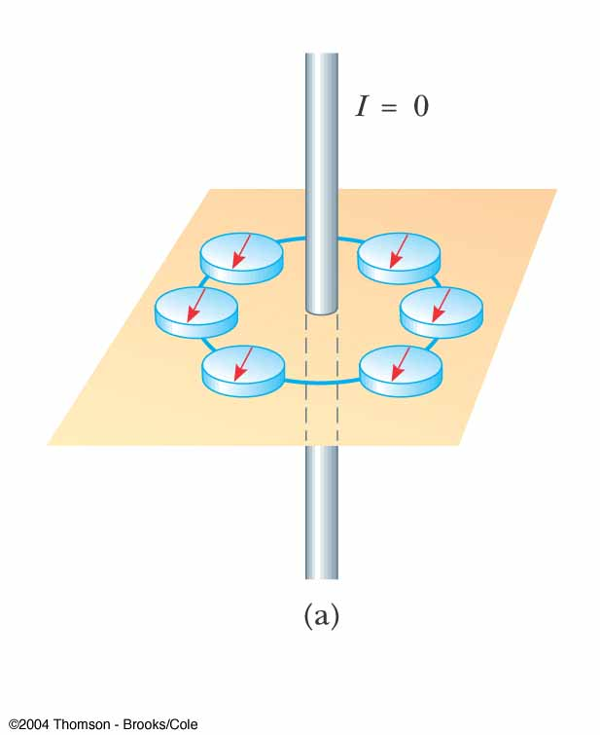
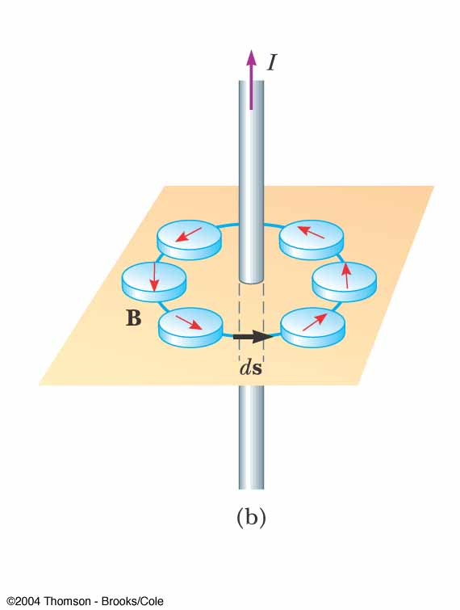
Magnetic Field of a Long Straight Wire
Oersted’s 1819 discovery about deflected compass needles demonstrates that a current-carrying conductor produces a magnetic field
When the wire carries a current, the compass needles deflect in the direction tangent to the circle, which is the direction of the magnetic field created by the current

Slide 56
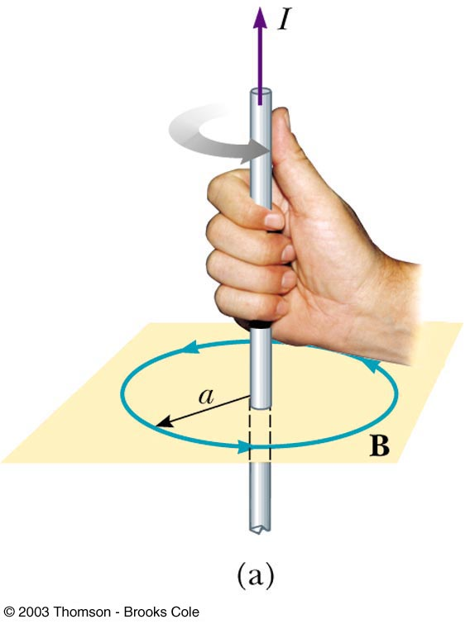
Direction of the Field of a Long Straight Wire
Right Hand Rule #2
Grasp the wire in your right hand
Point your thumb in the direction of the current
Your fingers will curl in the direction of the field B

Slide 57
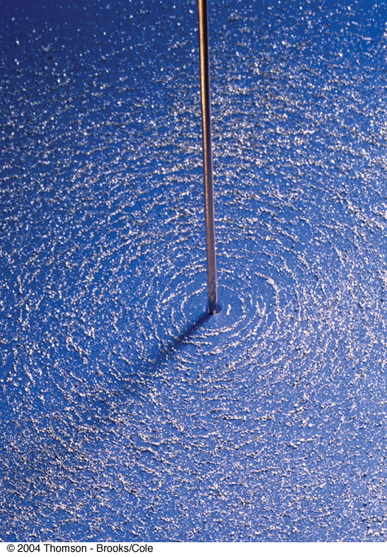
Magnetic Field – Long Straight Wire
A long straight wire carrying a current is a source of a magnetic field
The magnetic field lines are circles concentric with the wire and lie in the planes perpendicular to the wire

Slide 58
Magnitude of the Field of a Long Straight Wire
The magnitude of the field at a distance r from a wire carrying a current of I is
µ_{o} = 4π x 10⁻⁷ T m / A
µ_{o} is called the permeability of free space

Slide 59
Ampère’s Law
André-Marie Ampère found a procedure for deriving the relationship between the current in a arbitrarily shaped wire and the magnetic field produced by the wire
Ampère’s Circuital Law
where B|| is the component of B parallel to the segment of length Δl

Slide 60
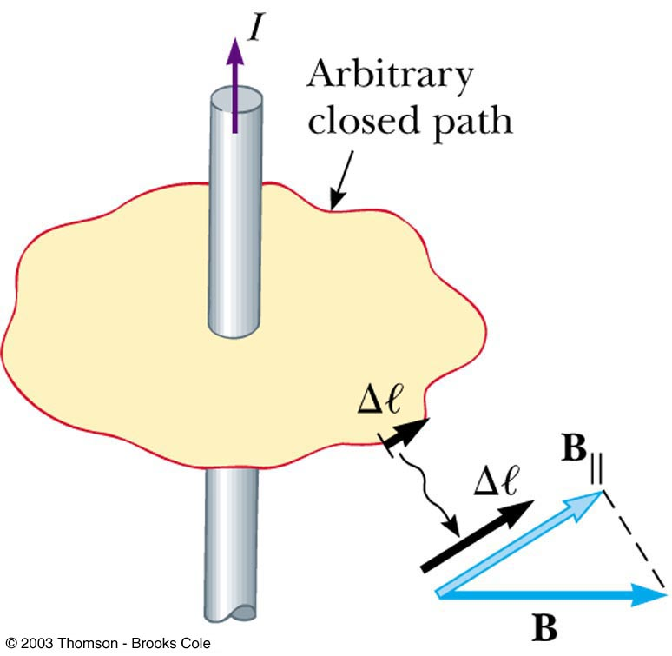
Ampère’s Law
Choose an arbitrary closed path around the current
Sum all the products of B|| Δℓ around the closed path

Slide 61
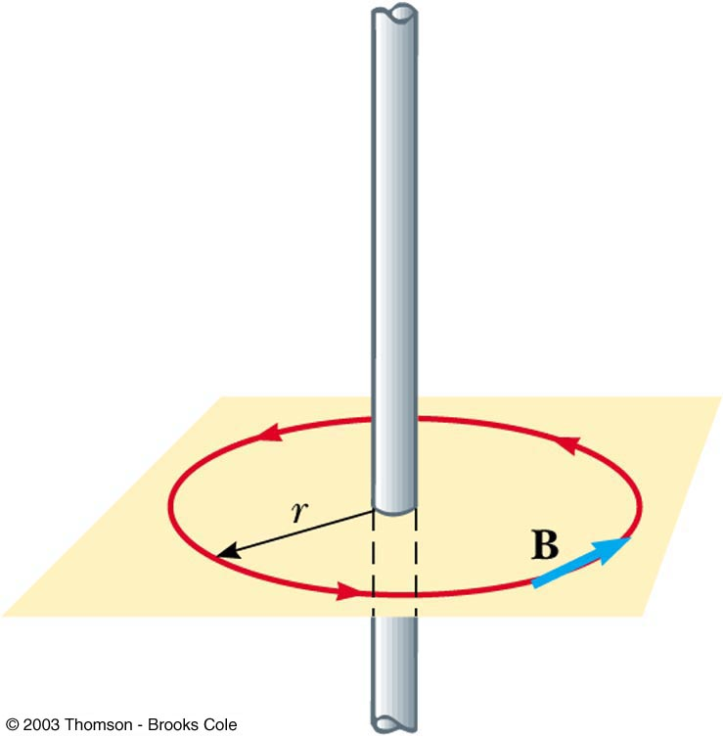
Ampère’s Law to Find B for a Long Straight Wire
Use a closed circular path
The circumference of the circle is 2πr

Slide 62
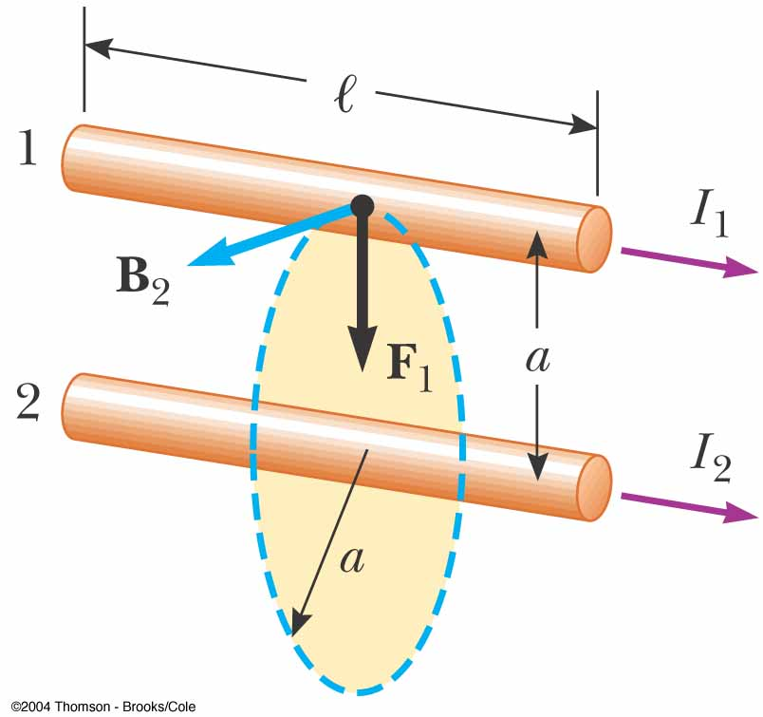
The Magnetic Force Between Two parallel Conductors
Consider two long, straight, parallel wires separated by a distance a and carrying currents I₁ and I₂ in the same direction
d
Determine the force exerted on one wire due to the magnetic field set up by the other wire

Slide 63
The Magnetic Force Between Two parallel Conductors
Wire 2 creates a magnetic field B₂ at the location of wire 1 (test wire)
The magnetic force F₁ acting on a length l of wire 1 is
d
The direction of F₁ is toward wire 2
F₁= - F₂
The direction of F₂ is toward wire 1

Slide 64
The Magnetic Force Between Two parallel Conductors
Parallel conductors carrying currents in the same direction attract each other, and parallel conductors carrying currents in opposite directions repel each other
Because the magnitudes of the forces are the same on both wires, denote the magnitude of the magnetic force between the wires as simply F_{B}
The force per unit length is:

Slide 65
Definition of the Ampere
When the magnitude of the force per unit length between two long parallel wires that carry identical currents and are separated by 1 m is 2 x 10 ⁻⁷ N/m, the current in each wire is defined to be 1 A

Slide 66
Definition of the Coulomb
The SI unit of charge, the Coulomb, is defined in terms of the Ampere:
When a conductor carries a steady current of 1 A, the quantity of charge that flows through a cross section of the conductor in 1 s is 1 C

Slide 67
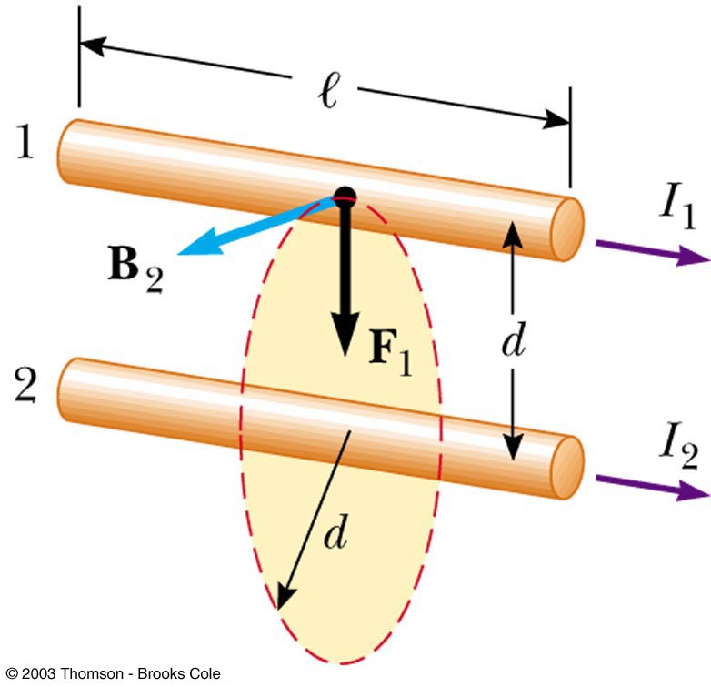
If I₁ = 2 A and I₂ = 6 A in the figure below, which of the following is true: (a) F₁ = 3F₂, (b) F₁ = F₂, or (c) F₁ = F₂/3?
QUICK QUIZ 19.5

Slide 68
(b). The two forces are an action-reaction pair. They act on different wires, and have equal magnitudes but opposite directions.
QUICK QUIZ 19.5 ANSWER

Slide 69
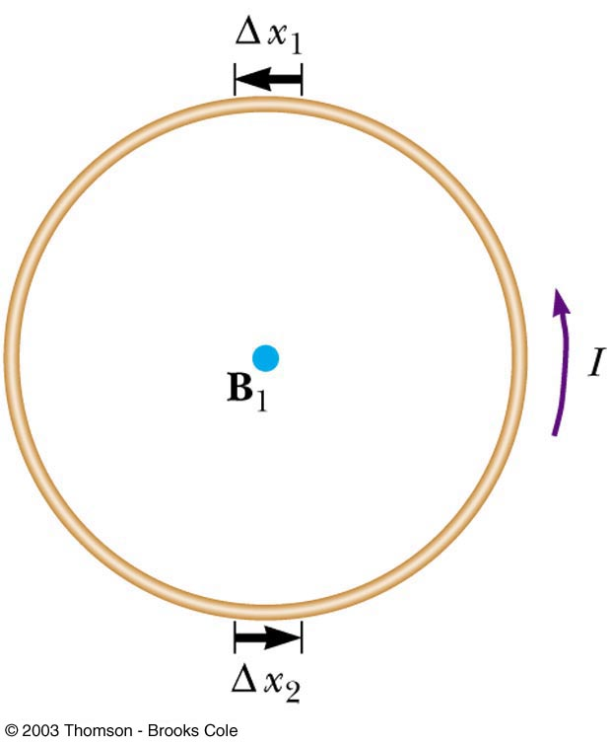
Magnetic Field of a Current Loop
The strength of a magnetic field produced by a wire can be enhanced at a specific location by forming the wire into a loop
All the segments, Δx, contribute to the field at the center of the loop, increasing its strength
R
When the coil has N loops,
each carrying current I

Slide 70
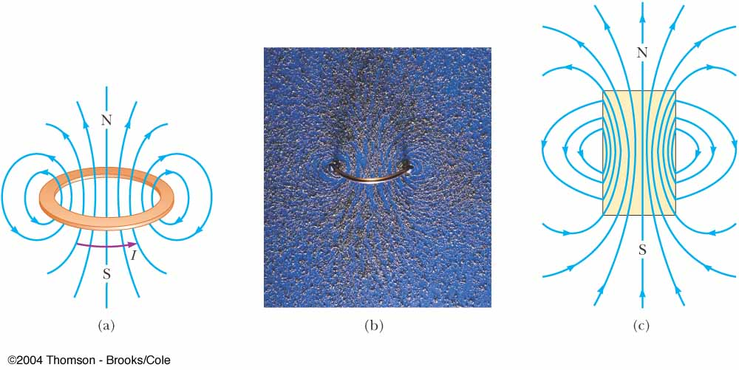
Magnetic Field – Circular Current Loop
(a),(b) magnetic field lines surrounding a current loop
(c) magnetic field lines surrounding a bar magnet
Note similarity between line pattern of (a),(b) and (c)

Slide 71
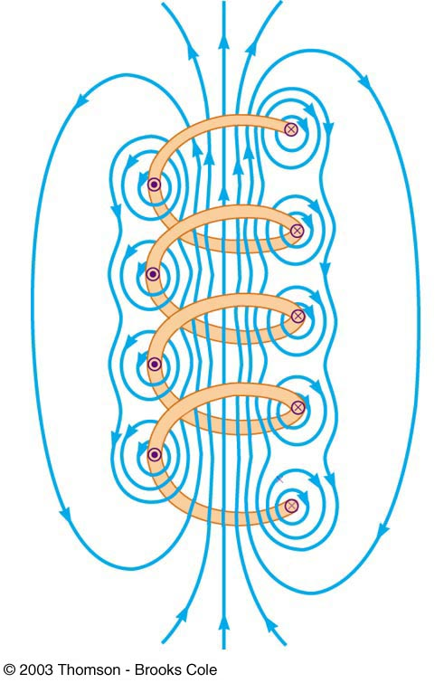
Magnetic Field of a Solenoid
If a long straight wire is bent into a coil of several closely spaced loops, the resulting device is called a solenoid
It is also known as an electromagnet since it acts like a magnet only when it carries a current

Slide 72
Magnetic Field of a Solenoid
The field lines inside the solenoid are nearly parallel, uniformly spaced, and close together
This indicates that the field inside the solenoid is nearly uniform and strong
The exterior field is nonuniform, much weaker, and in the opposite direction to the field inside the solenoid

Slide 73
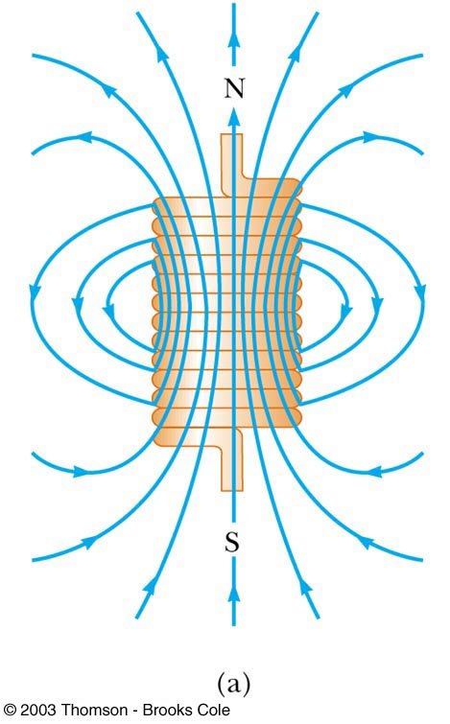
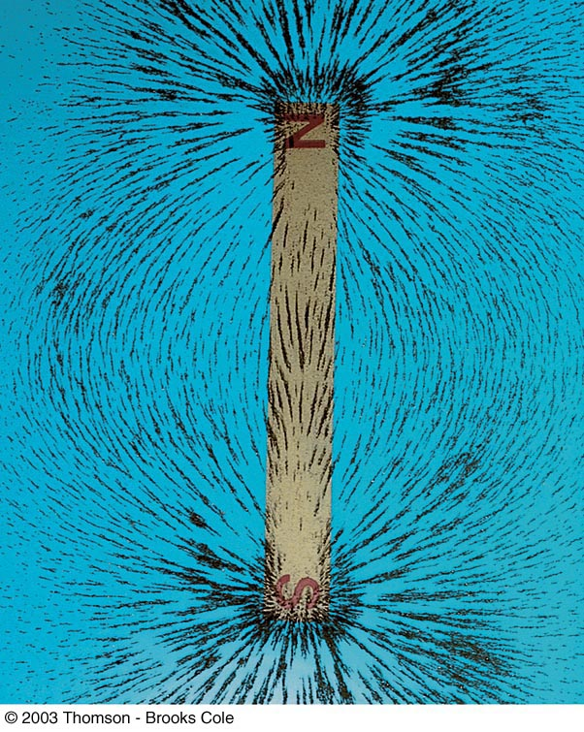
Magnetic Field in a Solenoid
The field lines of the solenoid resemble those of a bar magnet

Slide 74
Magnetic Field in a Solenoid
The magnitude of the field inside a solenoid is constant at all points far from its ends
B = µ_{o} n I
n = N / ℓ is the number of turns per unit length

Slide 75
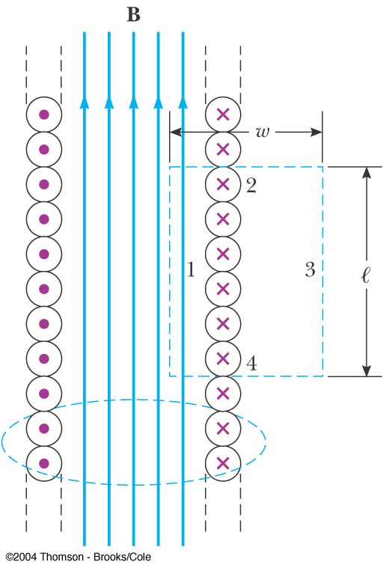
Magnetic Field in a Solenoid from Ampère’s Law
A cross-sectional view of an ideal solenoid
If the solenoid is long compared to its radius, an ideal solenoid, the magnetic field inside is uniform and outside is close to zero
Apply Ampère’s Law to the dashed rectangle

Slide 76
Magnetic Field in a Solenoid from Ampère’s Law
If N is the number of turns in the length L, the total current through the rectangle is NI
where n = N/l is the number of turns per unit length
This equation is valid only for points far from the ends of a very long solenoid

Slide 77
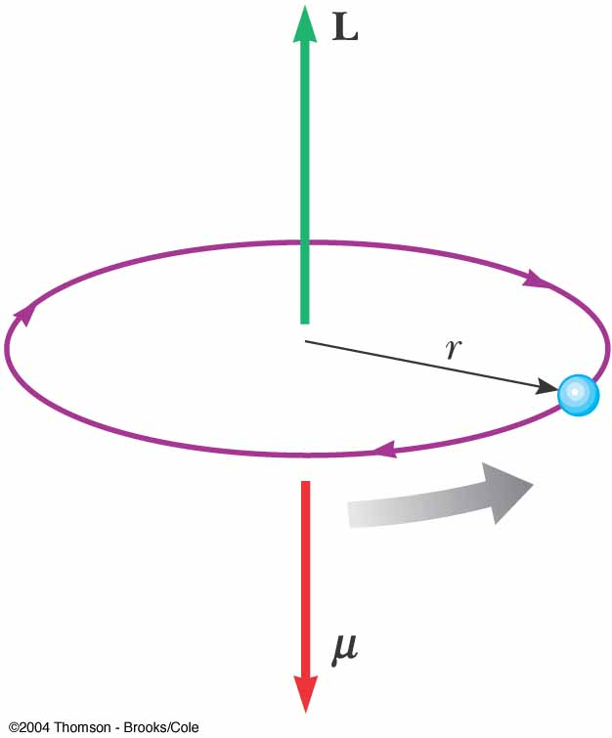
Magnetism in Matter The Magnetic Moments in Atoms
A classical model of the atom: electrons move in circular orbits around massive nucleus
Orbital
moment
current
An electron has charge –e < 0 => a moving electron gives rise to the electric current opposite to its instantaneous velocity
Magnetic moment μ is opposite to the orbital moment L:
Magnetic
moment
velocity

Slide 78
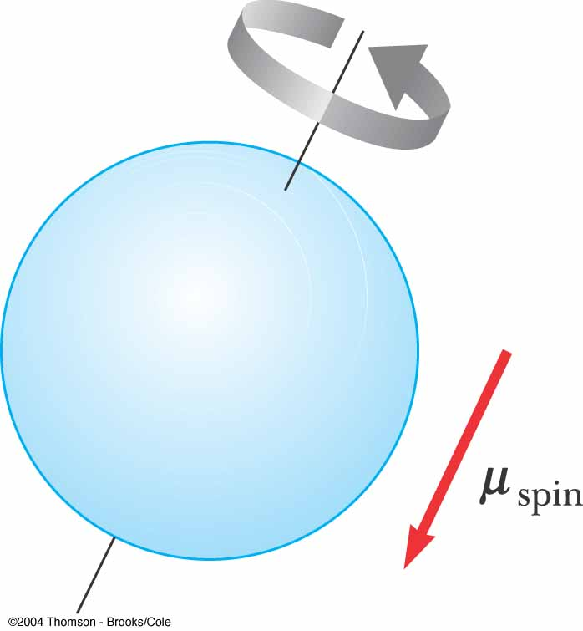
Magnetism in Matter Spin of an Electron
An electron has an intrinsic property called spin that also contributes to its magnetic moment
It is actually a relativistic and quantum effect
A classical model: electron can spin about its axis
The spinning electron represents a charge in motion that produces a magnetic field

Slide 79
Magnetic Effects of Electrons – Spins
The field due to the spinning is generally stronger than the field due to the orbital motion
Electrons usually pair up with their spins opposite each other, so their fields cancel each other
That is why most materials are not naturally magnetic

Slide 80
Magnetic Effects of Electrons -- Domains
In some materials, the spins do not naturally cancel
Such materials are called ferromagnetic
Large groups of atoms in which the spins are aligned are called domains
When an external field is applied, the domains that are aligned with the field tend to grow at the expense of the others
This causes the material to become magnetized

Slide 81
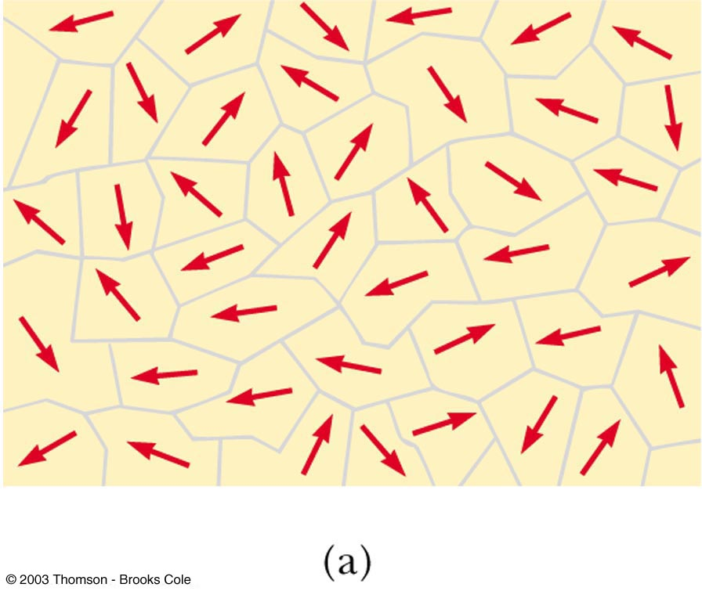
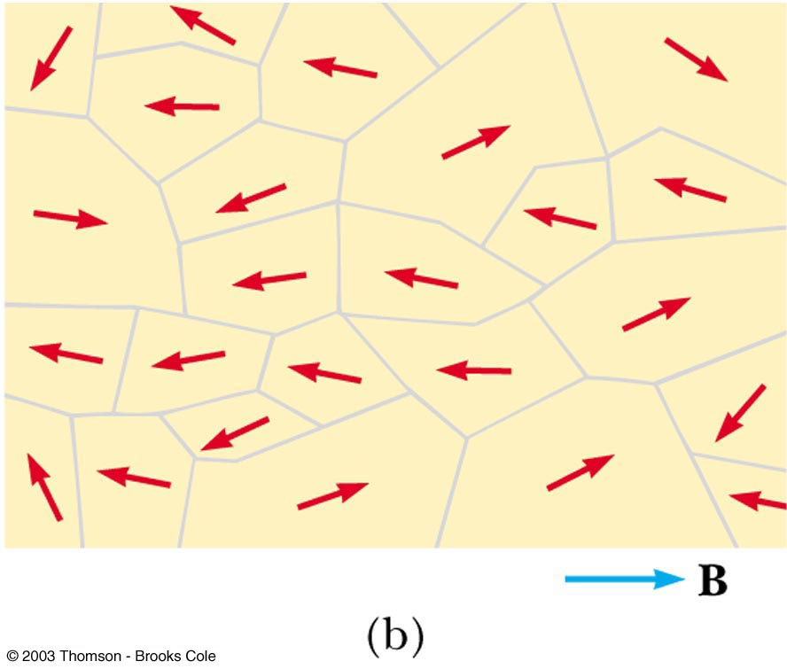
Domains
Random alignment, (a), shows an unmagnetized material
When an external field is applied, the domains aligned with B grow,( b)

Slide 82
Domains and Permanent Magnets
In hard magnetic materials, the domains remain aligned after the external field is removed
The result is a permanent magnet
In soft magnetic materials, once the external field is removed, thermal agitation cause the materials to quickly return to an unmagnetized state
With a core in a loop, the magnetic field is enhanced since the domains in the core material align, increasing the magnetic field

