Slide 1
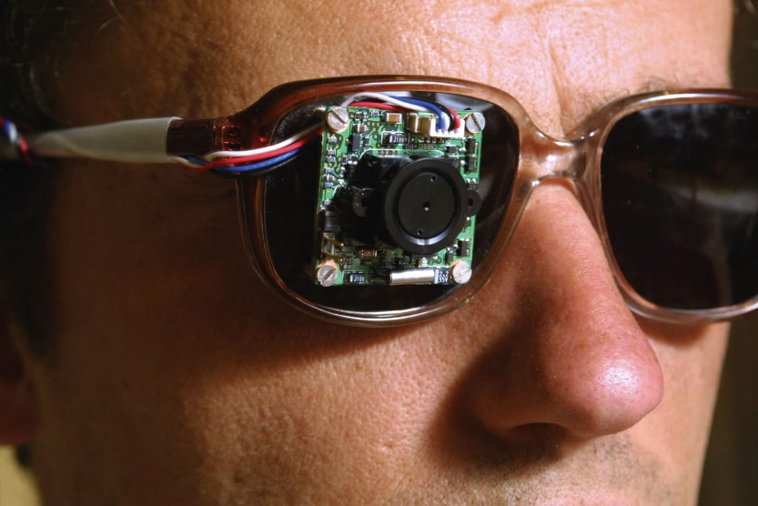
Chapter 18
Phys2120 Spring 2017
© A. Dzyubenko
Direct Current Circuits
© 2003 Thomson – Brooks/Cole
an artificial vision device

Slide 2
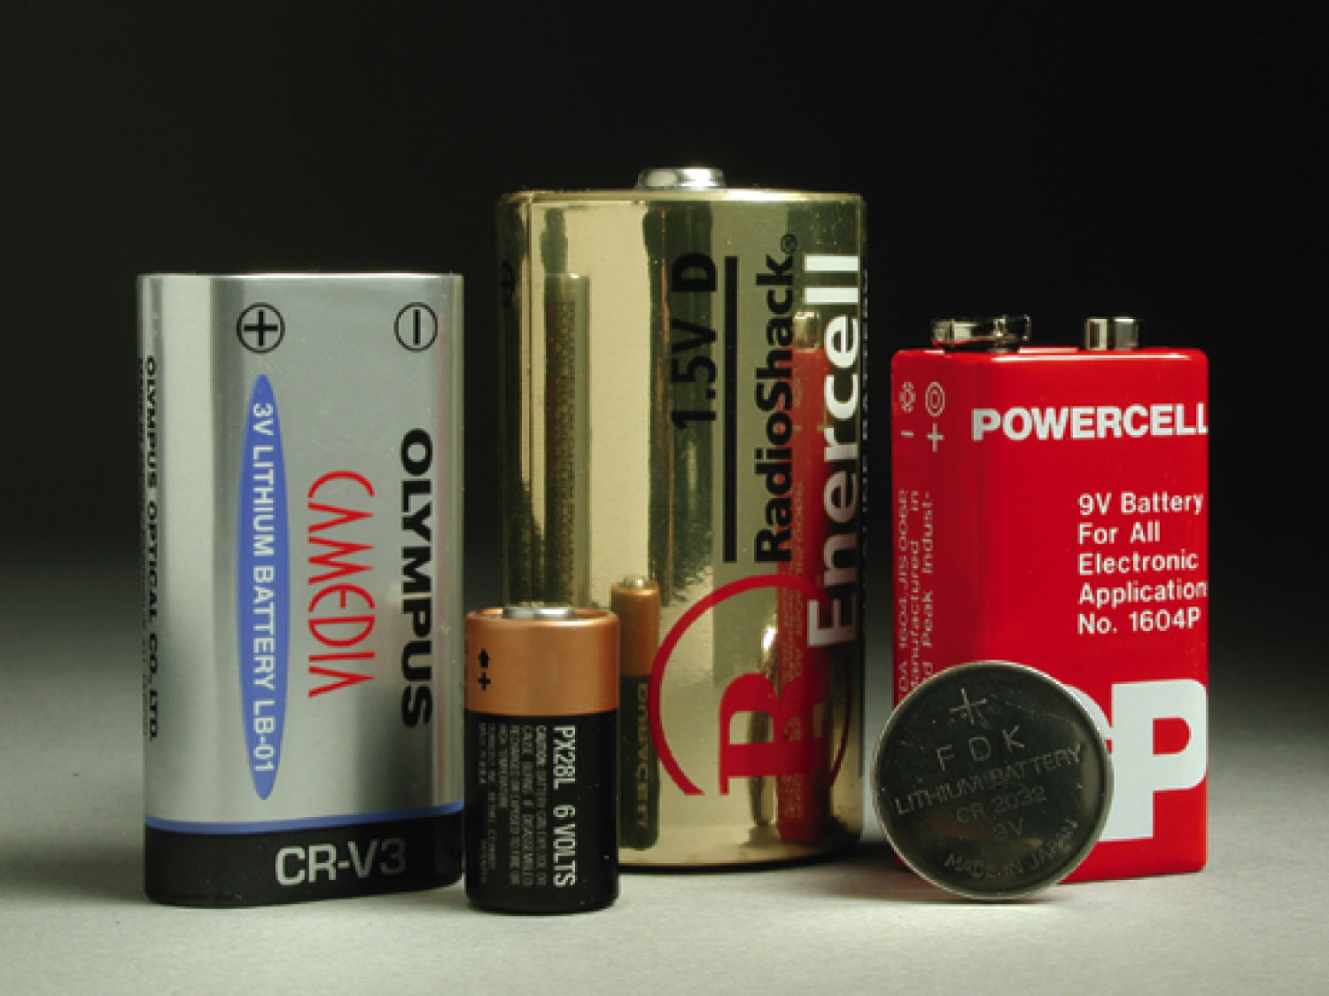
Batteries provide a voltage with a fixed polarity, resulting in a direct current in a circuit
The current constant in magnitude and direction is called direct current, DC

Slide 3
Sources of emf
The source that maintains the current in a closed circuit is called a source of emf (electromotive force)
Any devices that increase the potential energy of charges circulating in circuits are sources of emf
Examples include batteries and generators

Slide 4
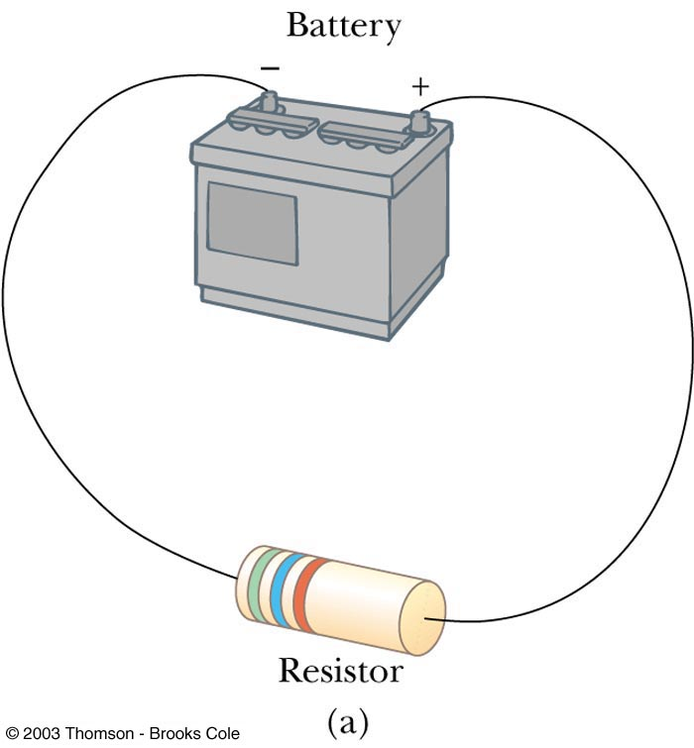
Emf and Internal Resistance
The emf ε of a battery is the maximum possible voltage that the battery can provide between its terminals
A real battery has some internal resistance, that is resistance to the flow of charge within the battery
Therefore, the terminal voltage is not equal to the emf

Slide 5
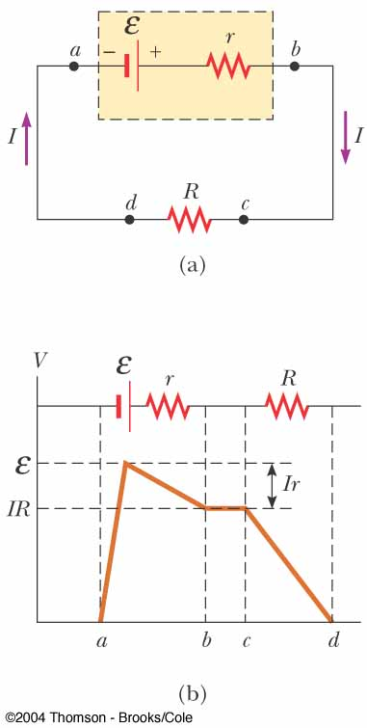
Emf and Internal Resistance
The real battery can be presented by an ideal resistance-free emf ε in series with an internal resistance r
ΔV across the battery is
ΔV across the R is

Slide 6
Internal Resistance and emf
ε is equal to the terminal voltage when the current is zero
Also called the open-circuit voltage
R is called the load resistance
The current depends on both the resistance external to the battery and the internal resistance

Slide 7
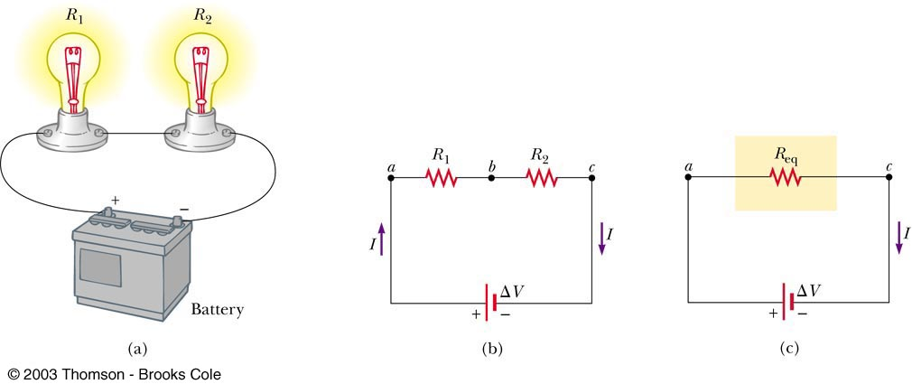
Resistors in Series

Slide 8
Resistors in Series
When two or more resistors are connected end-to-end, they are said to be in series
The current is the same in resistors because any charge that flows through one resistor flows through the other
The sum of the potential differences across the resistors is equal to the total potential difference across the combination

Slide 9
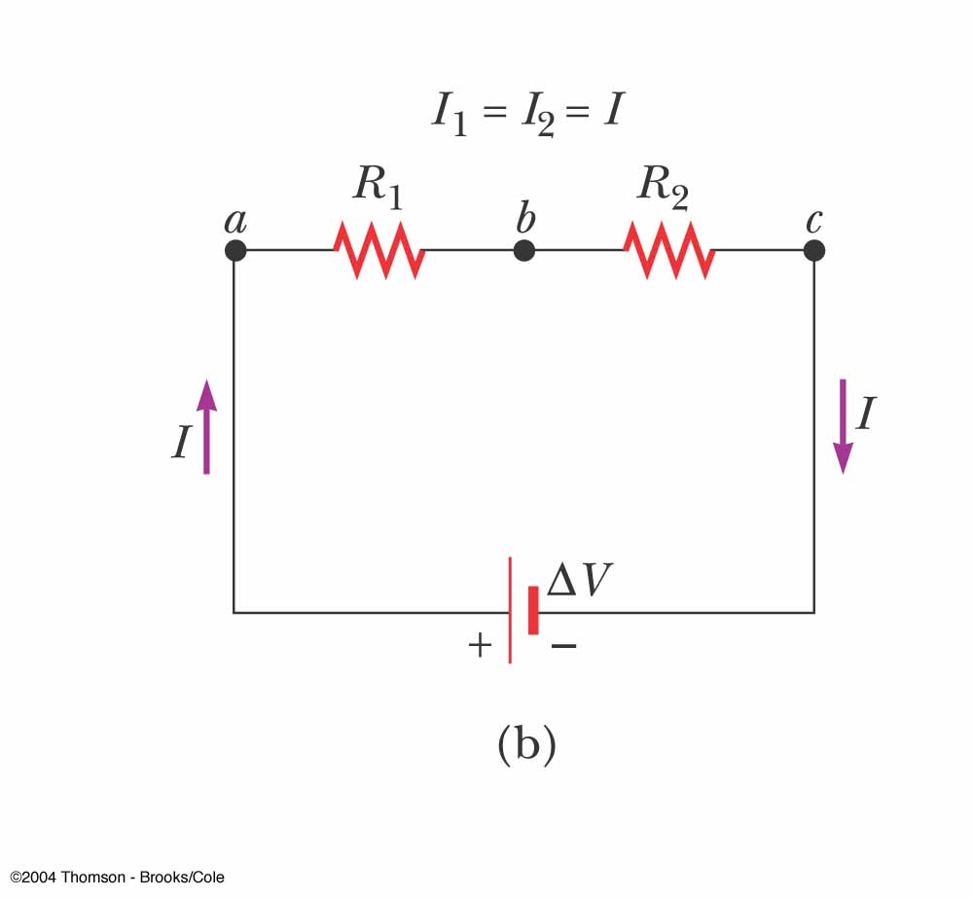
Resistors in Series
Potentials add:
ΔV = IR₁ + IR₂ = I (R₁+R₂)
ΔV = IR_{eq} R_{eq} = R₁ + R₂
Consequence of Conservation of Energy
The equivalent resistance R_{eq} has the effect on the circuit as the original combination of resistors

Slide 10
Equivalent Resistance: Series
R_{eq} = R₁ + R₂ + R₃ + …
The equivalent resistance of a series combination of resistors is the algebraic sum of the individual resistances.
It is always greater than any of the individual resistance.

Slide 11
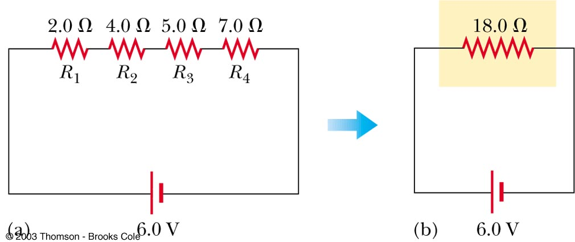
Equivalent Resistance – Series An Example
Four resistors are replaced with their equivalent resistance

Slide 12
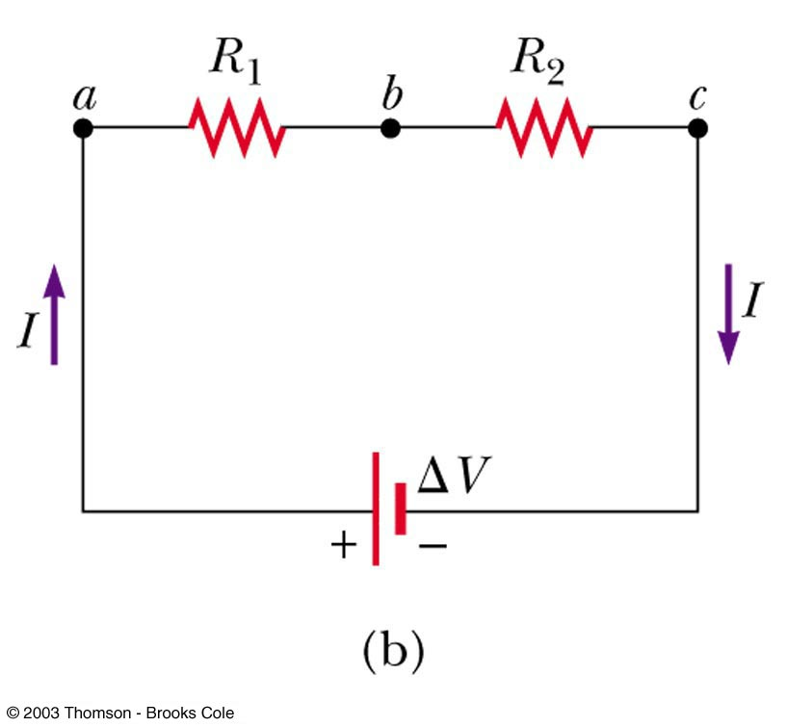
A piece of wire is used to connect points b and c . The brightness of bulb R₁ (a) increases, (b) decreases, (c) stays the same? The brightness of bulb R₂ (a) increases, (b) decreases, or (c) stays the same?
QUICK QUIZ

Slide 13
R₁ becomes brighter. Connecting a wire from b to c provides a nearly zero resistance path from b to c and decreases the total resistance of the circuit from R₁ + R₂ to just R₁. The current passing through bulb R₁ increases, causing this bulb to glow brighter. Bulb R₂ goes out because essentially all of the current now passes through the wire connecting b and c and bypasses the filament of bulb R₂.
QUICK QUIZ ANSWER

Slide 14
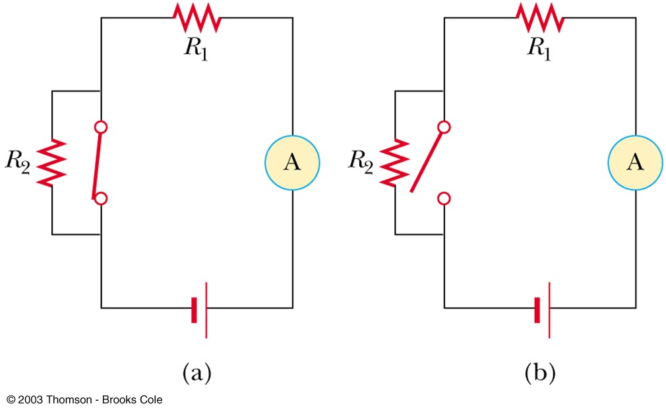
With the switch in this circuit (figure a) closed, no current exists in R₂ because the current has an alternate zero-resistance path through the switch. Current does exist in R₁ and this current is measured with the ammeter at the right side of the circuit. If the switch is opened (figure b), current exists in R₂. After the switch is opened, the reading on the ammeter (a) increases, (b) decreases, (c) does not change.
QUICK QUIZ

Slide 15
(b). When the switch is opened, resistors R₁ and R₂ are in series, so that the total circuit resistance is larger than when the switch was closed. As a result, the current decreases.
QUICK QUIZ ANSWER

Slide 16
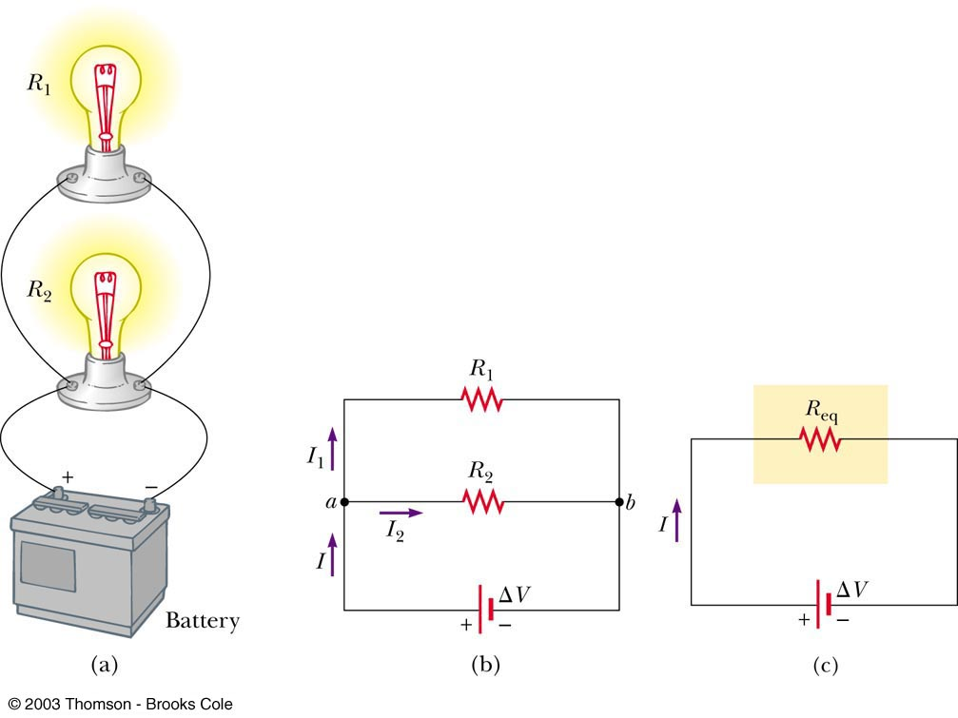
Resistors in Parallel
Junction a
I = I₁ + I₂

Slide 17
Resistors in Parallel
The potential difference across each resistor is the same because each is connected directly across the battery terminals
The current, I, that enters a point (junction) must be equal to the total current leaving that point (junction)
I = I₁ + I₂

Slide 18
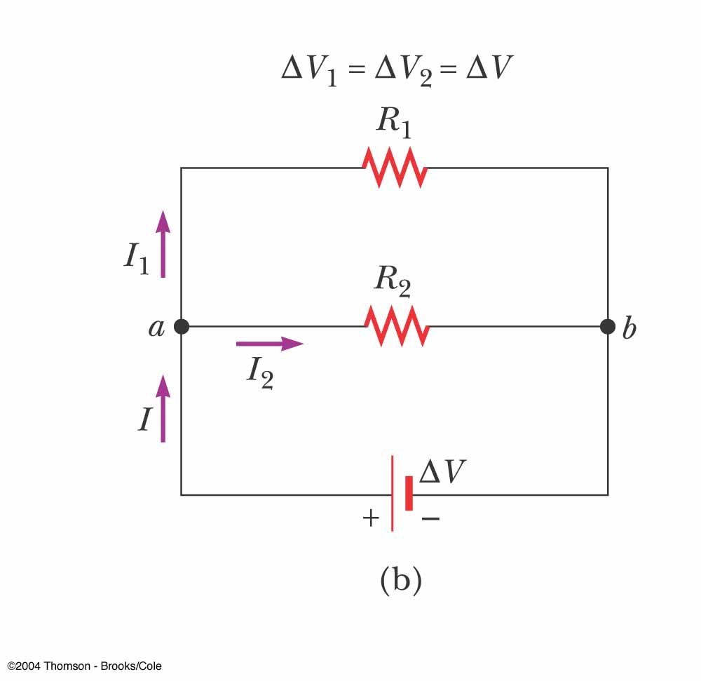
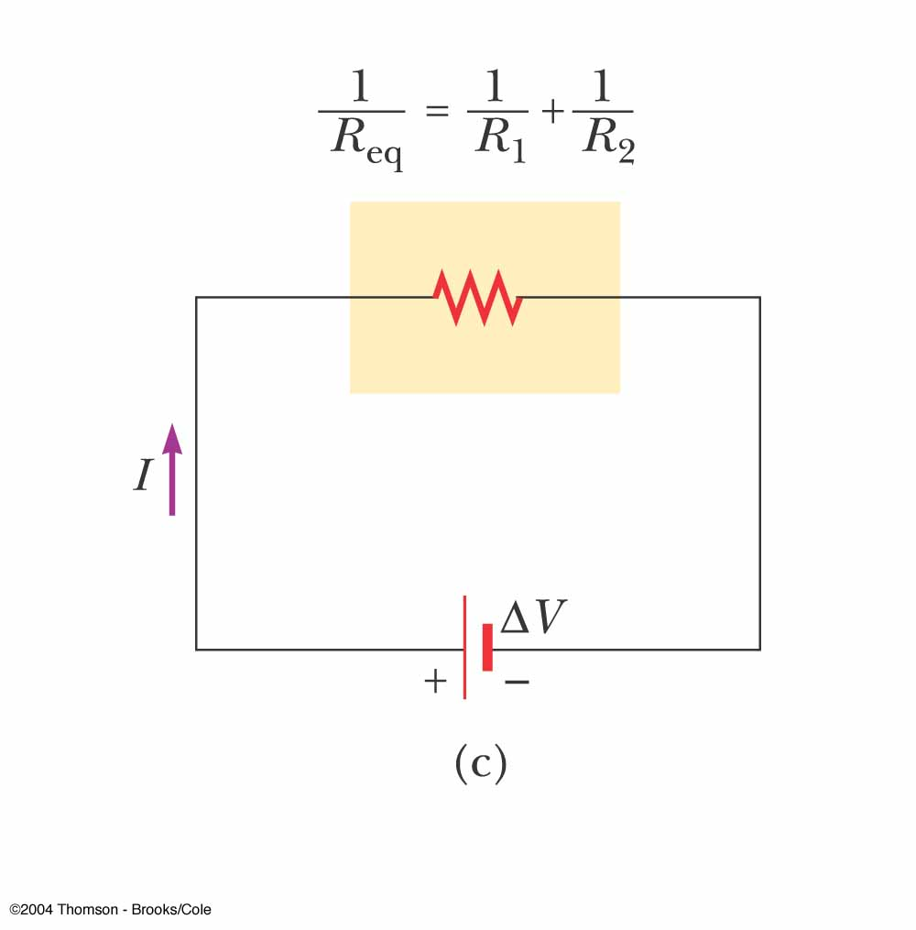
Resistors in Parallel, cont
The equivalent resistance R_{eq} has the effect on the circuit as the two resistors in parallel

Slide 19
Equivalent Resistance – Parallel
Equivalent resistance is
The inverse of the equivalent resistance of two or more resistors connected in parallel is the algebraic sum of the inverses of the individual resistance
The equivalent is always less than the smallest resistor in the group

Slide 20
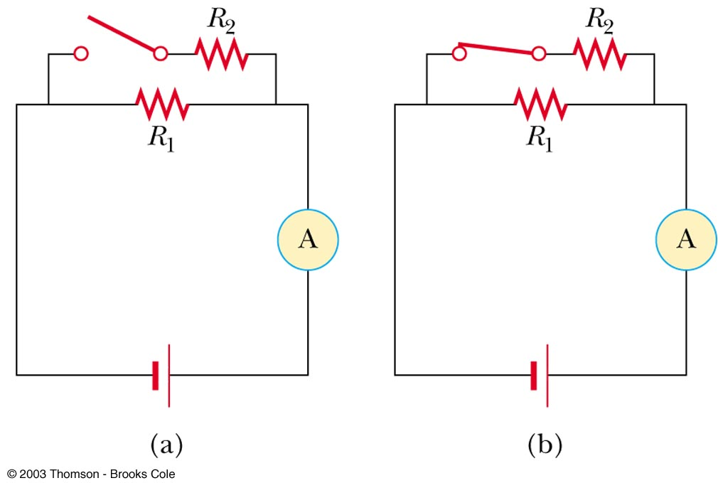
With the switch in this circuit (figure a) open, there is no current in R₂. There is current in R₁ and this current is measured with the ammeter at the right side of the circuit. If the switch is closed (figure b), there is current in R₂. When the switch is closed, the reading on the ammeter (a) increases, (b) decreases, or (c) remains the same.
QUICK QUIZ

Slide 21
(a). When the switch is closed, resistors R₁ and R₂ are in parallel, so that the total circuit resistance is smaller than when the switch was open. As a result, the total current increases.
QUICK QUIZ ANSWER

Slide 22
Problem-Solving Strategy, 1
When two or more unequal resistors are connected in series, they carry the same current, but the potential differences across them are not the same.
The resistors add directly to give the equivalent resistance of the series combination
R_{eq} = R₁ + R₂ + R₃ + …

Slide 23
Problem-Solving Strategy, 2
When two or more unequal resistors are connected in parallel, the potential differences across them are the same. The currents through them are not the same.
The equivalent resistance of a parallel combination is found through reciprocal addition
The equivalent resistance is always less than the smallest individual resistor in the combination

Slide 24
Problem-Solving Strategy, 3
A complicated circuit consisting of several resistors and batteries can often be reduced to a simple circuit with only one resistor
Replace any resistors in series or in parallel using steps 1 or 2.
Sketch the new circuit after these changes have been made
Continue to replace any series or parallel combinations
Continue until one equivalent resistance is found

Slide 25
Problem-Solving Strategy, 4
If the current in or the potential difference across a resistor in the complicated circuit is to be identified, start with the final circuit found in step 3 and gradually work back through the circuits
Use ΔV = IR and the procedures in steps 1 and 2

Slide 26
You have a large supply of lightbulbs and a battery. You start with one lightbulb connected to the battery and notice its brightness. You then add one lightbulb at a time, each new bulb being added in parallel to the previous bulbs. As the lightbulbs are added, what happens (a) to the brightness of the bulbs? (b) to the current in the bulbs? (c) to the power delivered by the battery? (d) to the lifetime of the battery? (e) to the terminal voltage of the battery? Hint: Do not ignore the internal resistance of the battery.
QUICK QUIZ 18.4

Slide 27
(a) The brightness of the bulbs decreases (b) The current in the bulbs decreases (c) The power delivered by the battery increases (d) The lifetime of the battery decreases (e) The terminal voltage of the battery decreases
QUICK QUIZ 18.4 ANSWER

Slide 28
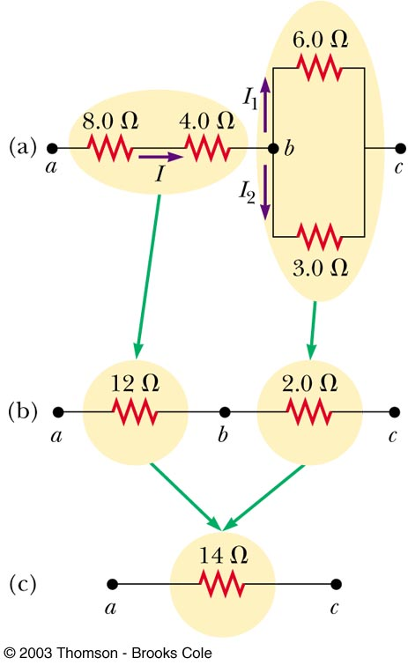
Equivalent Resistance – Complex Circuit

Slide 29
Kirchhoff’s Rules
There are ways in which resistors can be connected so that the circuits formed cannot be reduced to a single equivalent resistor
Two rules, called Kirchhoff’s Rules can be used instead

Slide 30
Statement of Kirchhoff’s Rules
Junction Rule. The sum of the currents entering any junction must equal the sum of the currents leaving that junction
A statement of Conservation of Charge
Loop Rule. The sum of the potential differences across all the elements around any closed circuit loop must be zero
A statement of Conservation of Energy

Slide 31
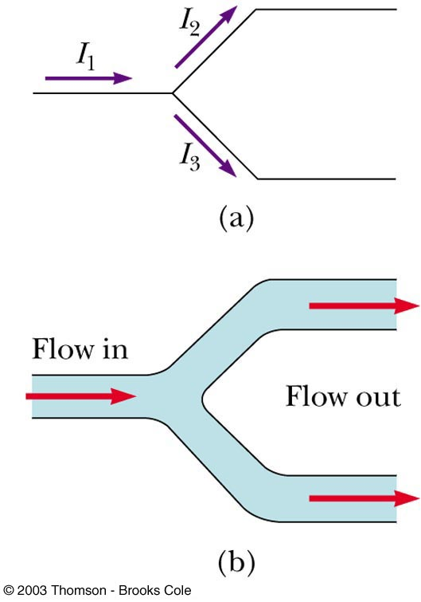
More About the Junction Rule
I₁ = I₂ + I₃
From Conservation of Charge
Diagram (b) shows a mechanical analog of the junction rule

Slide 32
Setting Up Kirchhoff’s Rules
Assign symbols and directions to the currents in all branches of the circuit
If a direction is chosen incorrectly, the resulting answer will be negative, but the magnitude will be correct
When applying the loop rule, choose a direction for transversing the loop
Record voltage drops and rises as they occur

Slide 33
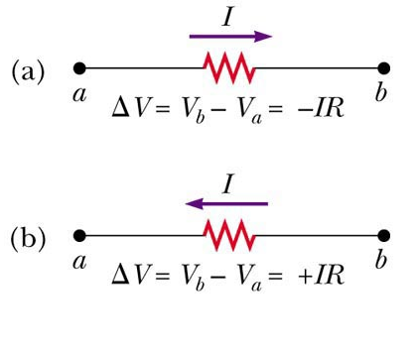
More About the Loop Rule
Traveling around the loop from a to b
In (a), the resistor is transversed in the direction of the current, the potential across the resistor is –IR
In (b), the resistor is transversed in the direction opposite of the current, the potential across the resistor is +IR

Slide 34
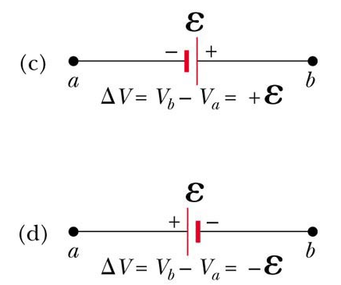
Loop Rule
In (c), the source of emf is transversed in the direction of the emf (from – to +), the change in the electric potential is +ε
In (d), the source of emf is transversed in the direction opposite of the emf (from + to -), the change in the electric potential is -ε

Slide 35
Junction Equations from Kirchhoff’s Rules
Use the junction rule as often as needed so long as, each time you write an equation, you include in it a current that has not been used in a previous junction rule equation
In general, the number of times the junction rule can be used is one fewer than the number of junction points in the circuit

Slide 36
Loop Equations from Kirchhoff’s Rules
The loop rule can be used as often as needed so long as a new circuit element (resistor or battery) or a new current appears in each new equation
You need as many independent equations as you have unknowns

Slide 37
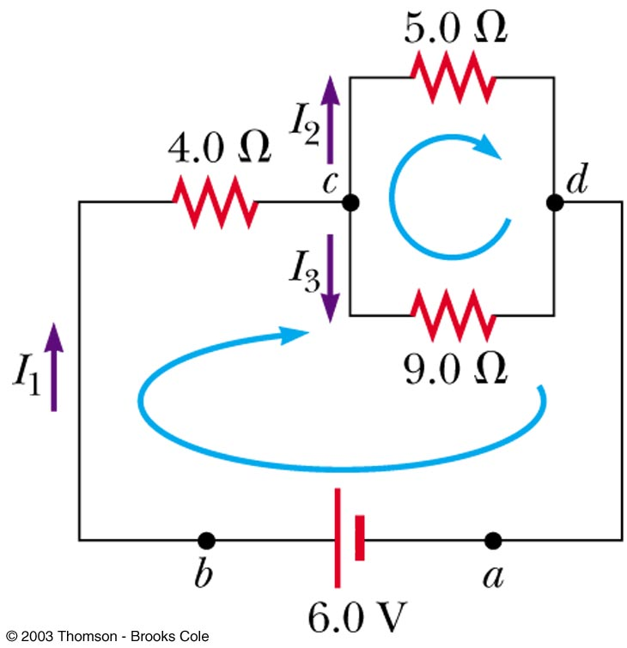

Slide 38
Problem-Solving Strategy – Kirchhoff’s Rules
Draw the circuit diagram and assign labels and symbols to all known and unknown quantities. Assign directions to the currents.
Apply the junction rule to any junction in the circuit
Apply the loop rule to as many loops as are needed to solve for the unknowns
Solve the equations simultaneously for the unknown quantities.

Slide 39
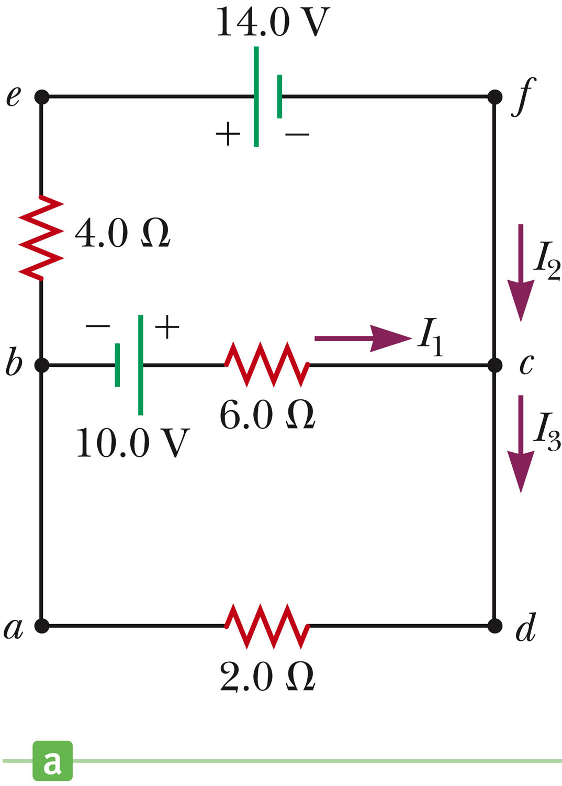
Example

Slide 40
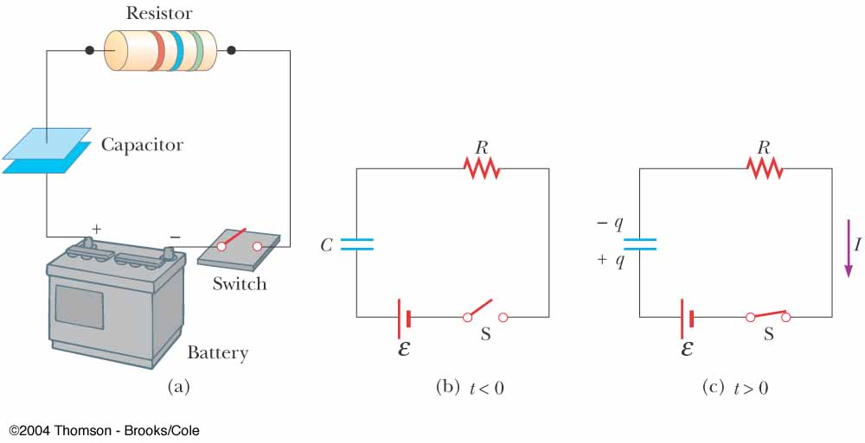
RC Circuits:Charging a Capacitor
A circuit containing a series combination of a resistor and a capacitor is called an RC circuit

Slide 41
RC Circuits
A direct current circuit may contain capacitors and resistors, the current will vary with time
When the circuit is completed, the capacitor starts to charge
The capacitor continues to charge until it reaches its maximum charge (Q = Cε)
Once the capacitor is fully charged, the current in the circuit is zero

Slide 42
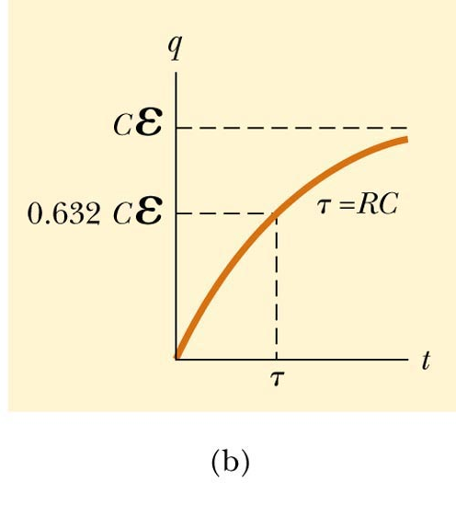
RC Circuits: Charging a Capacitor

Slide 43
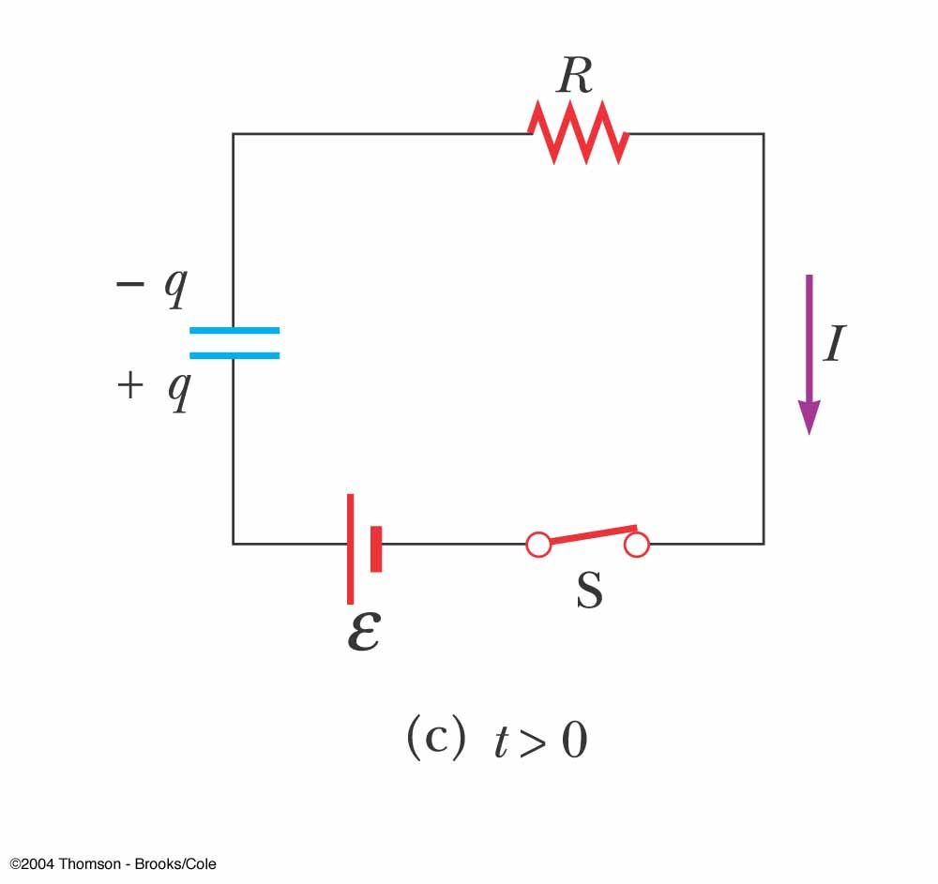
RC Circuits:Charging a Capacitor
Traveling the loop clockwise gives:
The initial current I₀ in the circuit is
(current at t = 0)
The maximum charge (current I = 0) is
What is the time dependence of the charge and current?

Slide 44
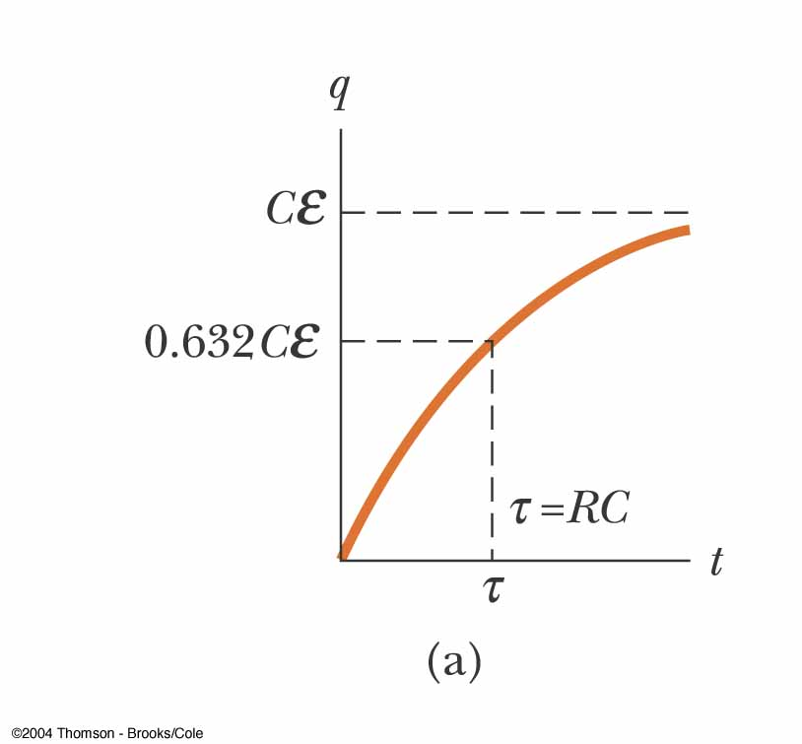
Time Dependence of Charge
Quantity RC is called the time constant τ of the circuit and represents the time required for the charge to increase from zero to [1- e ⁻¹] = 0.632 of its maximum

Slide 45
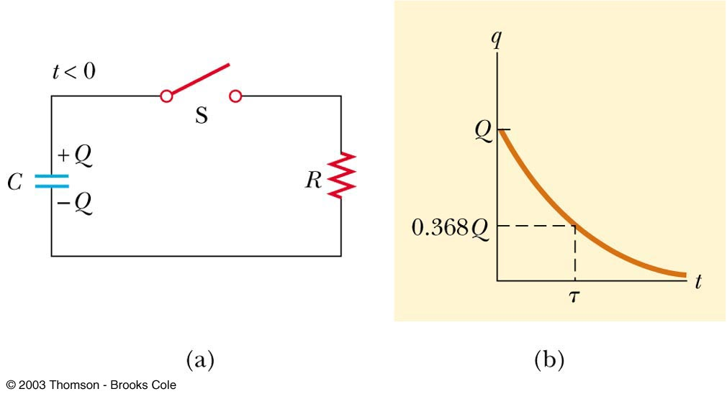
RC Circuits: Discharging a Capacitor

Slide 46
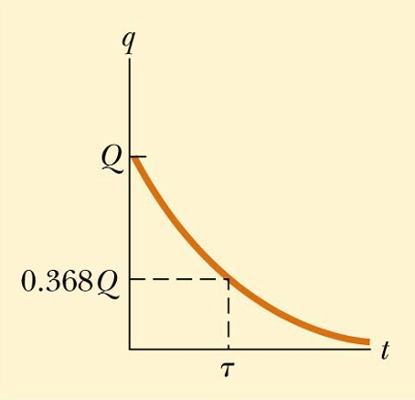
Discharging Capacitor in an RC Circuit
When a charged capacitor is placed in the circuit, it can be discharged
q = Qe^{-t/RC}
The charge decreases exponentially
At t = τ = RC, the charge decreases to 0.368 Q_{max}
in one time constant, the capacitor loses about 63% of its initial charge
e = 2.718…
e⁻¹ = 0.368…
q=Qe⁻¹

Slide 47
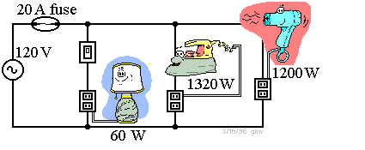
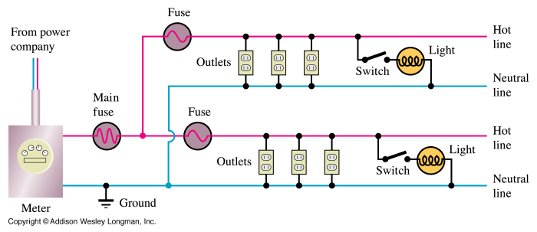
Household Wiring

Slide 48
Electrical Safety
Electric shock can result in fatal burns
Electric shock can cause the muscles of vital organs (such as the heart) to malfunction
The degree of damage depends on
the magnitude of the current
the length of time it acts
the part of the body through which it passes

Slide 49
Effects of Various Currents
5 mA or less
can cause a sensation of shock
generally little or no damage
10 mA
hand muscles contract
may be unable to let go of a live wire
100 mA
if passes through the body for 1 second or less, can be fatal

Slide 50
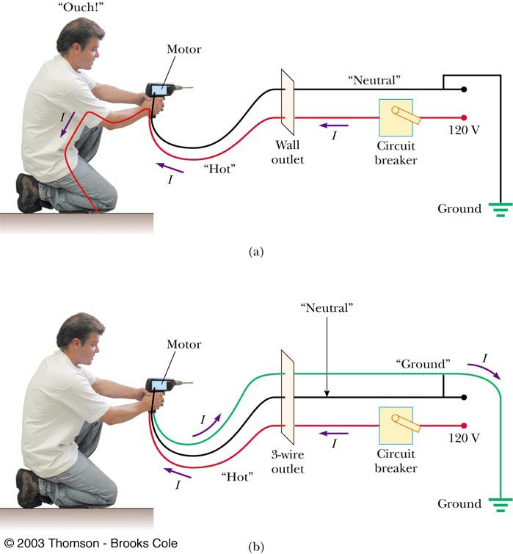
Ground Wire
Electrical equipment manufacturers use electrical cords that have a third wire, called a ground
Prevents shocks

Slide 51
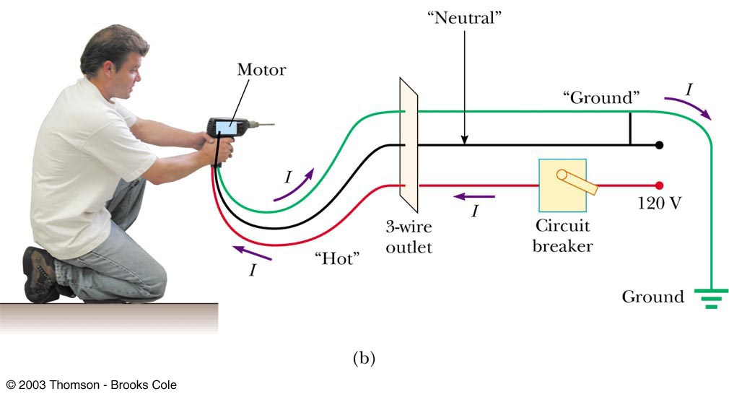
Ground Wire

Slide 52
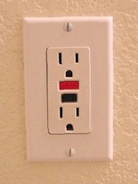
Ground Fault Interrupters (GFI)
Special power outlets
Used in hazardous areas
Designed to protect people from electrical shock
Senses currents (of about 5 mA or greater) leaking to ground
Shuts off the current when above this level

Slide 53
Electrical Signals in Neurons
Specialized cells in the body, called neurons, form a complex network that receives, processes, and transmits information from one part of the body to another
Three classes of neurons
Sensory neurons
Receive stimuli from sensory organs that monitor the external and internal environment of the body
Motor neurons
Carry messages that control the muscle cells
Interneurons
Transmit information from one neuron to another

Slide 54
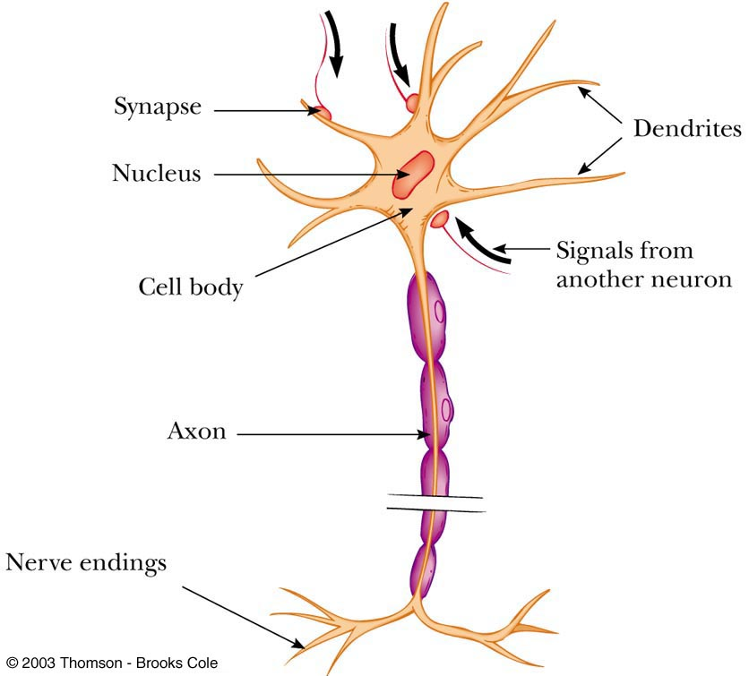
Diagram of a Neurons

Slide 55
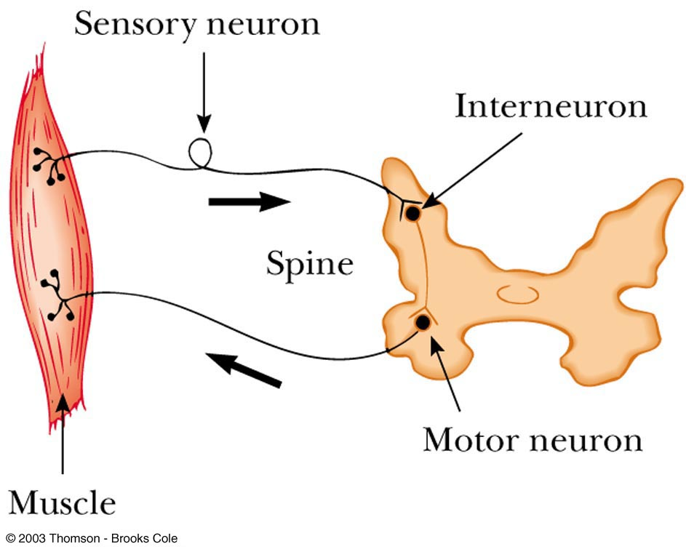
A simple neural circuit

