Slide 1
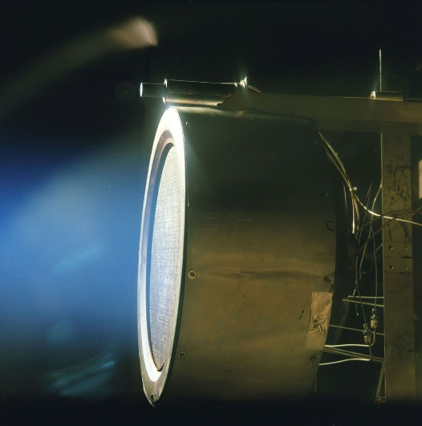
Chapter 17
Phys2120 Spring 2017
A. Dzyubenko
Current and Resistance
an ion engine prototype
© 2003 Thomson – Brooks/Cole

Slide 2
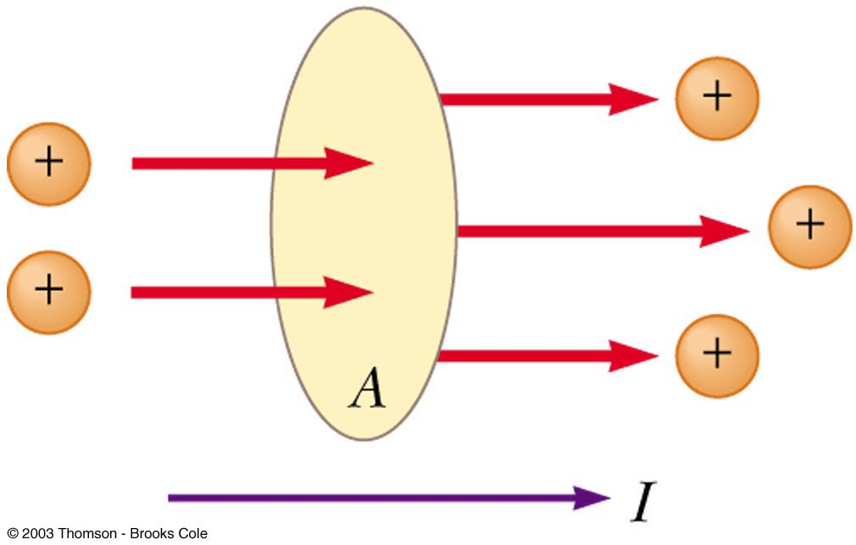
Electric Current
Positive charges as current carriers

Slide 3
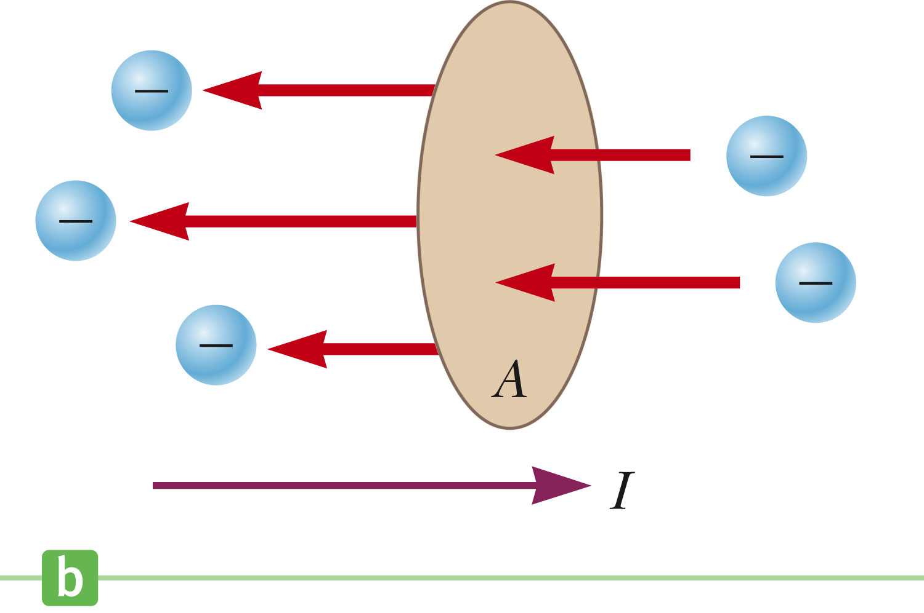
Electric Current
Negative charges as current carriers

Slide 4
Electric Current
Whenever electric charges of like signs move, an electric current is said to exist
The current is the rate at which the charge flows through this surface
Look at the charges flowing perpendicularly to a surface of area A
The SI unit of current is Ampere (A)
1 A = 1 C/s

Slide 5
Electric Current
The direction of current flow is the direction positive charge would flow
This is known as conventional current flow
In a common conductor, such as copper, the current is due to the motion of the negatively charged electrons
It is common to refer to a moving charge as a mobile charge carrier
A charge carriers can be positive or negative or both

Slide 6
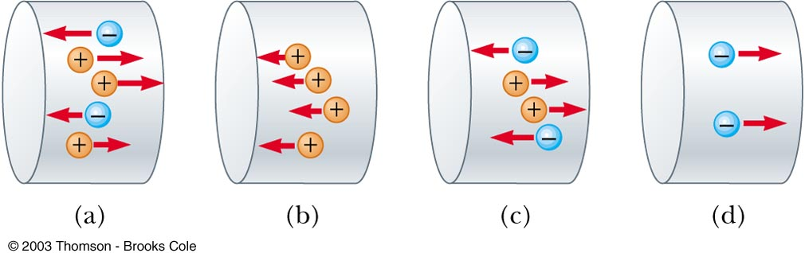
Consider positive and negative charges moving horizontally through the four regions in Figure 17.2. Rank the currents in these four regions, from lowest to highest.
QUICK QUIZ 17.1

Slide 7
QUICK QUIZ 17.1 ANSWER
d, b = c, a. The current in (d) is equivalent to two positive charges moving to the left. Parts (b) and (c) each represent four charges moving in the same direction because negative charges moving to the left are equivalent to positive charges moving to the right. The current in (a) is equivalent to five positive charges moving to the right.

Slide 8
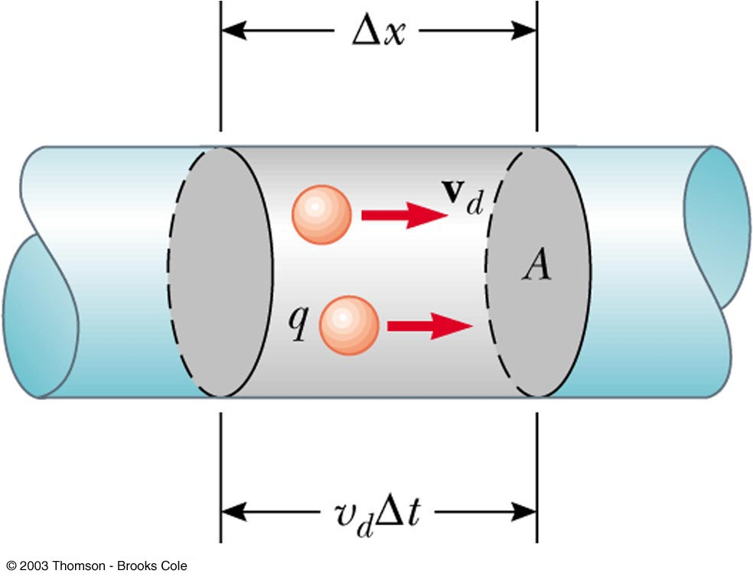
Current and Drift Speed
Charged particles move through a conductor of cross-sectional area A
n is the number of charge carriers per unit volume
nAΔx is the total number of charge carriers

Slide 9
Current and Drift Speed
The total charge is the number of carriers times the charge per carrier, q
Δ Q = (n A Δx) q
The drift speed, v_{d}, is the speed at which the carriers move
v_{d} = Δ x/Δ t
Rewritten: ΔQ = (n A v_{d} Δ t) q
Finally, current I = Δ Q/Δt = nqv_{d}A

Slide 10
Current and Drift Speed
If the conductor is isolated, the electrons undergo random motion
When an electric field is set up in the conductor, it creates an electric force on the electrons and hence a current

Slide 11
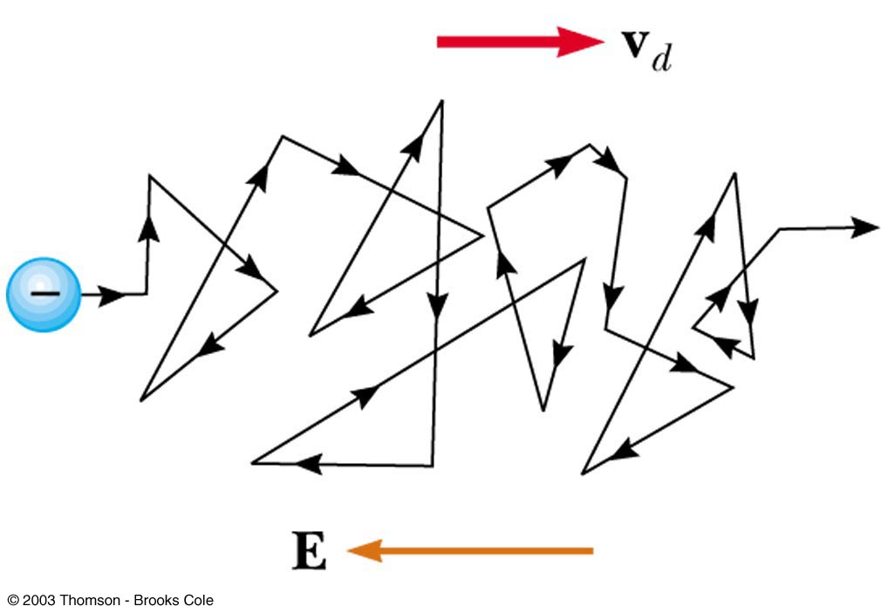
Charge Carrier Motion in a Conductor
The zig-zag black line represents the motion of charge carrier in a conductor
The net drift speed is small
The sharp changes in direction are due to collisions
The net motion of electrons is opposite the direction of the electric field

Slide 12
Electrons in a Circuit
The drift speed is much smaller than the average speed between collisions
When a circuit is completed, the electric field travels with a speed close to the speed of light
Although the drift speed is on the order of 10⁻⁴ m/s the effect of the electric field is felt on the order of 10⁸ m/s

Slide 13
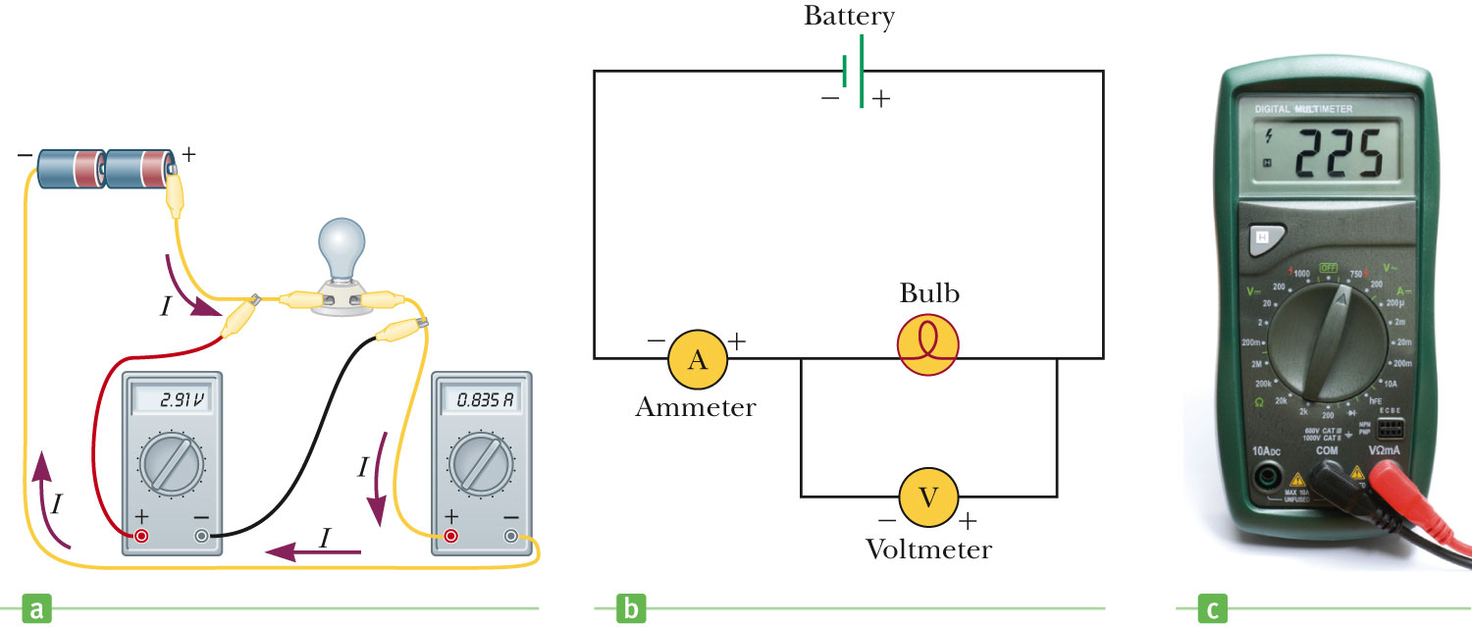
Meters in a Circuit -- Ammeter
I
An ammeter is used to measure current
In line with the bulb, all the charge passing through the bulb also must pass through the meter

Slide 14
Meters in a Circuit -- Voltmeter
A voltmeter is used to measure voltage = potential difference
Connects to the two ends of the bulb, in parallel
ΔV

Slide 15
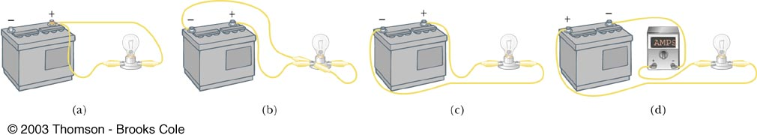
Look at the four “circuits” shown below and select those that will light the bulb.
QUICK QUIZ 17.2

Slide 16
Neither circuit (a) nor circuit (b) applies a difference in potential across the bulb. Circuit (a) has both lead wires connected to the same battery terminal. Circuit (b) has a low resistance path (a “short”) between the two battery terminals as well as between the bulb terminals.
QUICK QUIZ 17.2 ANSWER
(c) and (d)

Slide 17
Resistance
In a conductor, the voltage applied across the ends of the conductor is proportional to the current through the conductor
The constant of proportionality is the resistance of the conductor

Slide 18
Resistance
Units of resistance are Ohms (Ω)
1 Ω = 1 V / A
Resistance in a circuit arises due to collisions between the electrons carrying the current with the fixed atoms inside the conductor

Slide 19
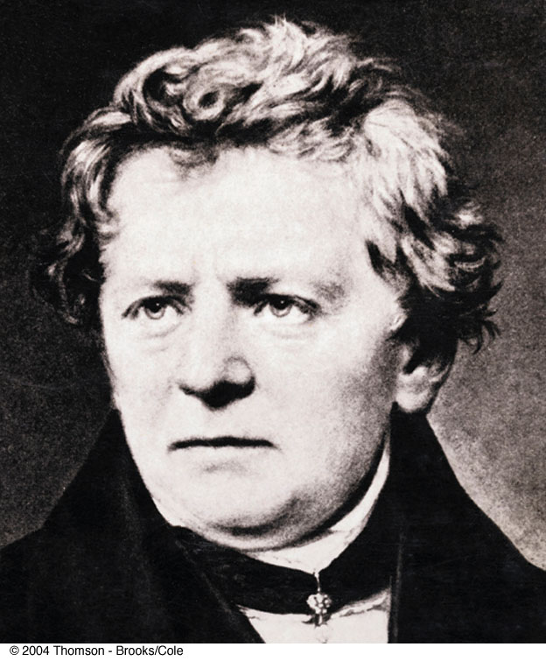
Ohm’s Law
Experiments show that for many materials, including most metals, the resistance remains constant over a wide range of applied voltages or currents
This statement has become known as Ohm’s Law
ΔV = I R
Ohm’s Law is an empirical relationship that is valid only for certain materials
Materials that obey Ohm’s Law are said to be ohmic

Slide 20
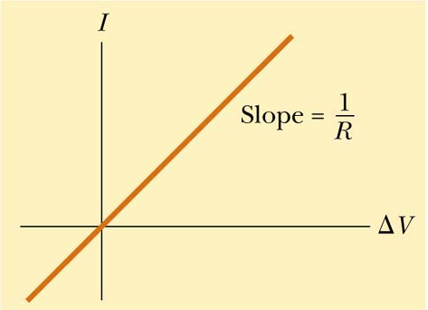
Ohmic Material
The resistance is constant over a wide range of voltages
The relationship between current and voltage is linear
The slope is related to the resistance

Slide 21
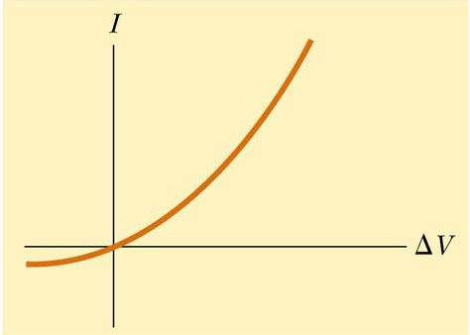
Non-Ohmic Material
Non-ohmic materials are those whose resistance changes with voltage or current
The current-voltage relationship is nonlinear
A diode is a common example of a non-ohmic device

Slide 22
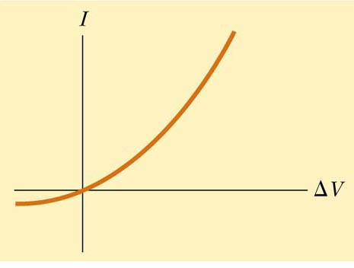
In the figure below, does the resistance of the diode (a) increase or (b) decrease as the positive voltage ∆V increases?
QUICK QUIZ 17.3

Slide 23
The slope of the line tangent to the curve at a point is the reciprocal of the resistance at that point. Note that as ΔV increases, the slope (and hence 1/R) increases. Thus, the resistance decreases.
QUICK QUIZ 17.3 ANSWER
(b) Decrease

Slide 24
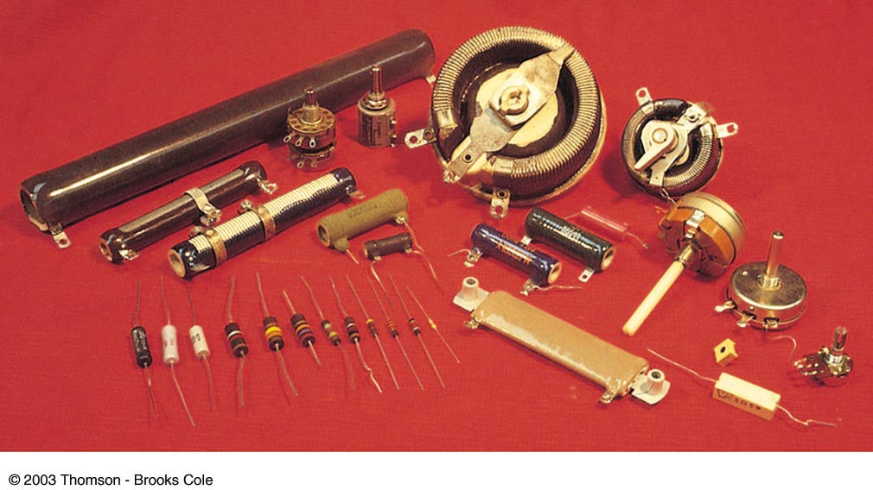
Resistors

Slide 25
Resistivity
The resistance of an ohmic conductor is proportional to its length, L, and inversely proportional to its cross-sectional area, A
ρ is the constant of proportionality and is called the resistivity of the material
See table 17.1

Slide 26
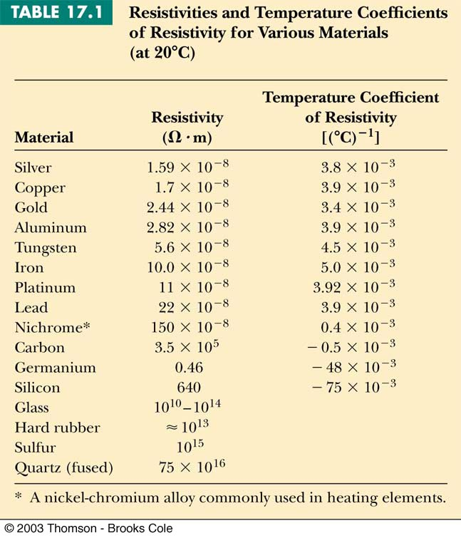
Resistivity
!
metals
semiconductors
isolators

Slide 27
Aliens with strange powers visit Earth and double every linear dimension of every object on the surface of the Earth. Does the electrical cord from the wall socket to your floor lamp now have (a) more resistance than before, (b) less resistance, or (c) the same resistance? Does the light bulb filament glow (d) more brightly than before, (e) less brightly, or (f) the same? (Assume the resistivities of materials remain the same before and after the doubling.)
QUICK QUIZ 17.4

Slide 28
(b), (d). The length of the line cord will double in this event. This would tend to increase the resistance of the line cord. But the doubling of the radius of the line cord results in the increase of the cross-sectional area by a factor of 4. This would reduce the resistance more than the doubling of length increases it. The net result is a decrease in resistance. The same effect would occur for the lightbulb filament. The lowered resistance would result in a larger current in the filament, causing it to glow more brightly.
QUICK QUIZ 17.4 ANSWER

Slide 29
A voltage ΔV is applied across the ends of a nichrome heater wire having a cross-sectional area A and length L. The same voltage is applied across the ends of a second heater wire having a cross-sectional area A and length 2L. Which wire gets hotter? (a) the shorter wire, (b) the longer wire, or (c) not enough information to say.
QUICK QUIZ 17.5

Slide 30
(a). The resistance of the shorter wire is half that of the longer wire. The power dissipated, P = (ΔV)²/R, (and hence the rate of heating) will be greater for the shorter wire. Consideration of the expression Π = Ι²Ρ might initially lead one to think that the reverse would be true. However, one must realize that the currents will not be the same in the two wires.
QUICK QUIZ 17.5 ANSWER

Slide 31
Temperature Variation of Resistivity
For most metals, resistivity increases with increasing temperature
At a higher temperature, the metal’s constituent atoms vibrate with increasing amplitude
The electrons find it more difficult to pass the atoms = experience more collisions

Slide 32
Temperature Variation of Resistivity
For most metals, resistivity increases approximately linearly with temperature over a limited temperature range
ρ_{o} is the resistivity at some reference temperature T_{o}
T_{o} is usually taken to be 20° C
α is the temperature coefficient of resistivity

Slide 33
Temperature Variation of Resistance
Since the resistance of a conductor with uniform cross sectional area is proportional to the resistivity, you can find the effect of temperature on resistance

Slide 34
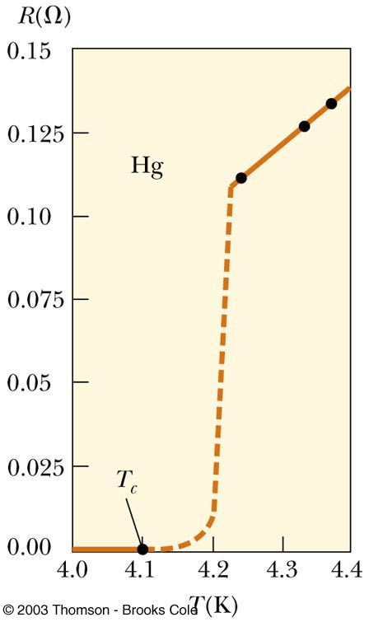
Superconductors
A class of materials and compounds whose resistances fall to virtually zero below a certain temperature, T_{C}
Resistance suddenly drops to zero at T_{C}
T_{C} is called the critical temperature

Slide 35
Superconductors
The value of T_{C} is sensitive to
Chemical composition
Pressure
Crystalline structure
Once a current is set up in a superconductor, it persists without any applied voltage.
Because R = 0!

Slide 36
Superconductor Timeline
1911
Superconductivity discovered by H. Kamerlingh Onnes
1986
High temperature superconductivity discovered by Bednorz and Müller
Superconductivity near 30 K
1987
Superconductivity at 96 K and 105 K
Current
More materials and, hopefully, more applications

Slide 37
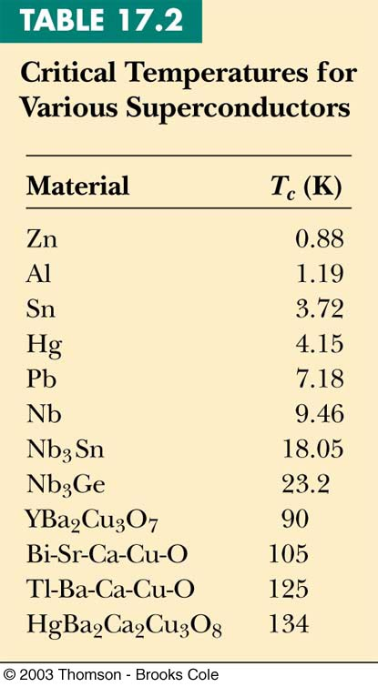
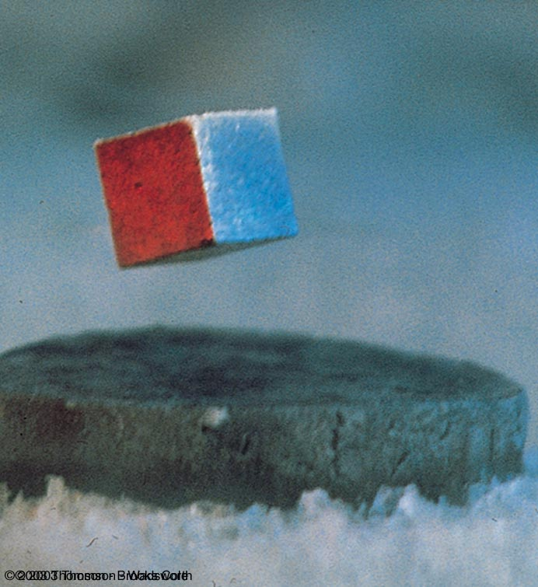
Superconductor
Magnet
Magnetic
levitation

Slide 38
Electrical Energy and Power
In a circuit, as a charge moves through the battery, the electrical potential energy of the system is increased by ΔQΔV
The chemical potential energy of the battery decreases by the same amount
As the charge moves through a resistor, it loses this potential energy during collisions with atoms in the resistor
The temperature of the resistor will increase

Slide 39
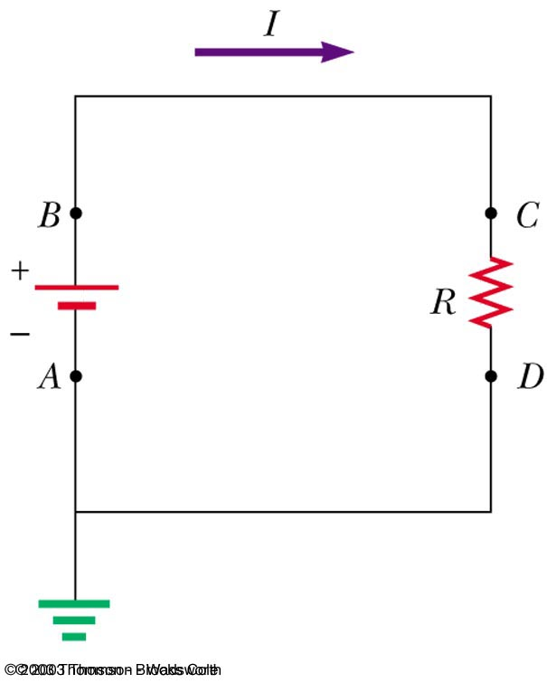
Electrical Energy and Power
The rate at which the energy is lost is the power
From Ohm’s Law,
alternate forms of power are

Slide 40
Electrical Energy and Power
The SI unit of power is Watt (W)
I must be in Amperes, R in Ohms and V in Volts
The unit of energy used by electric companies is the kilowatt-hour
This is defined in terms of the unit of power and the amount of time it is supplied
1 kWh = 3.60 x 10⁶ J

Slide 41
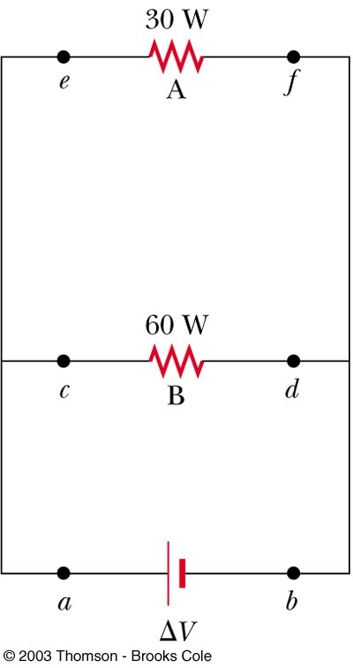
For the two resistors shown here, rank the currents at points a through f, from largest to smallest.
QUICK QUIZ 17.6

Slide 42
I_{a} = I_{b} > I_{c} = I_{d} > I_{e} = I_{f} . Charges constituting the current I_{a} leave the positive terminal of the battery and then split to flow through the two bulbs; thus, I_{a} = I_{c} + I_{e}. Because the potential difference ΔV is the same across the two bulbs and because the power delivered to a device is P = I(ΔV), the 60–W bulb with the higher power rating must carry the greater current. Because charge does not accumulate in the bulbs, all the charge flowing into a bulb from the left has to flow out on the right; consequently I_{c} = I_{d} and I_{e} = I_{f}. The two currents leaving the bulbs recombine to form the current back into the battery, I_{f} + I_{d} = I_{b}.
QUICK QUIZ 17.6 ANSWER

Slide 43
Two resistors, A and B, are connected across the same potential difference. The resistance of A is twice that of B. (a) Which resistor dissipates more power? (b) Which carries the greater current?
QUICK QUIZ 17.7

Slide 44
B, B. Because the voltage across each resistor is the same, and the rate of energy delivered to a resistor is P = (ΔV)²/R, the resistor with the lower resistance exhibits the higher rate of energy transfer. In this case, the resistance of B is smaller than that for A and thus B dissipates more power. Furthermore, because P = I(ΔV), the current carried by B is larger than that of A.
QUICK QUIZ 17.7 ANSWER

Slide 45
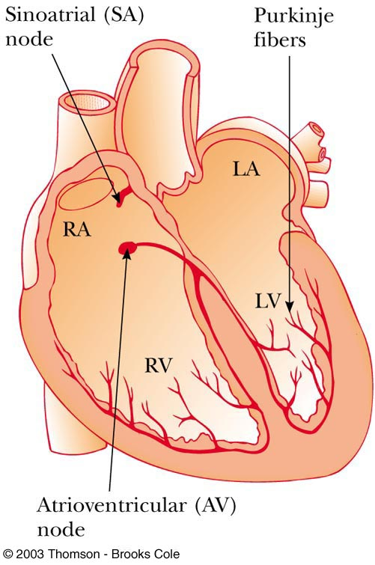
Electrical Activity in the Heart
Every action involving the body’s muscles is initiated by electrical activity
Voltage pulses cause the heart to beat
These voltage pulses are large enough to be detected by equipment attached to the skin

Slide 46
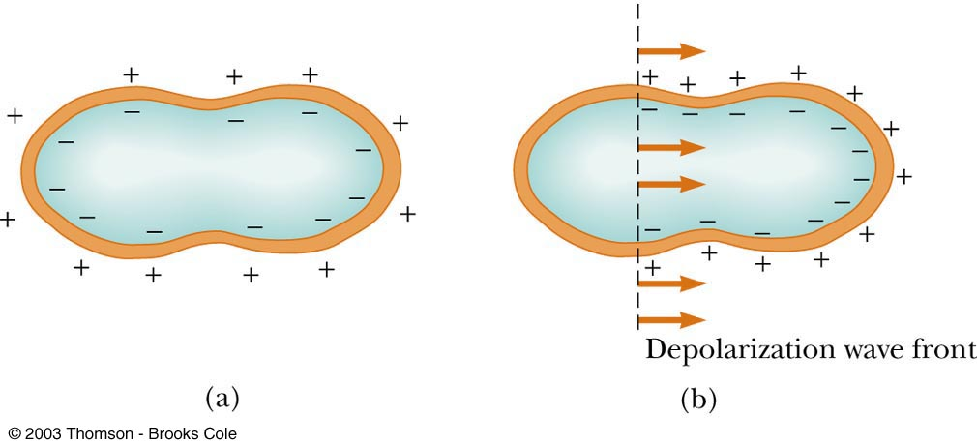
Electrical Activity in the Heart

Slide 47
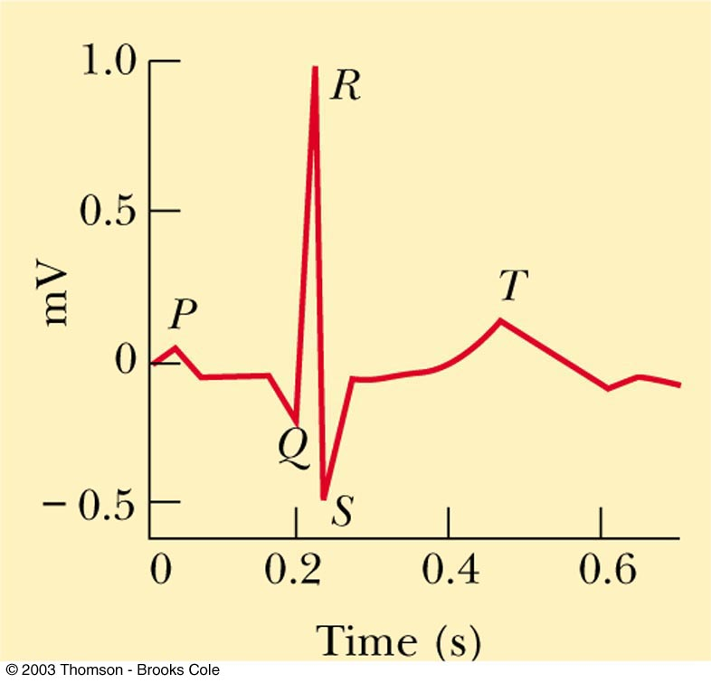
Electrocardiogram (EKG)
A normal EKG
P occurs just before the atria begin to contract
The QRS pulse occurs in the ventricles just before they contract
The T pulse occurs when the cells in the ventricles begin to recover

Slide 48
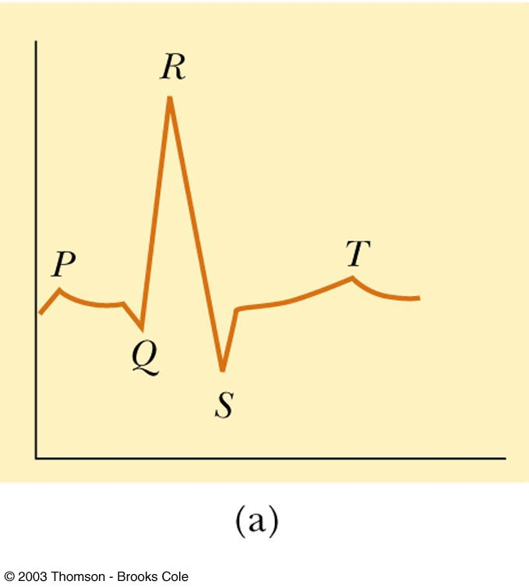
Abnormal EKG, 1
The QRS portion is wider than normal
This indicates the possibility of an enlarged heart

Slide 49
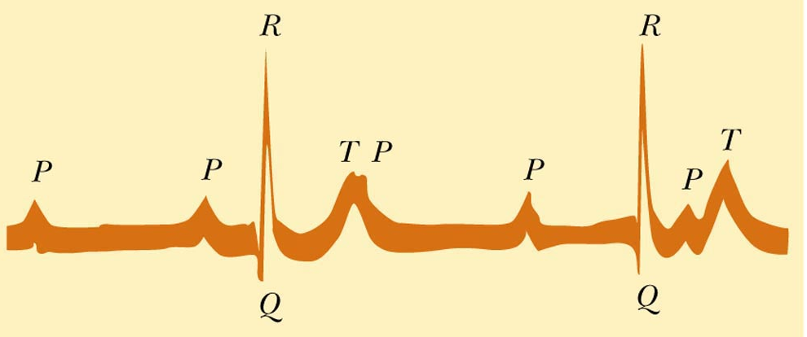
Abnormal EKG, 2
There is no constant relationship between P and QRS pulse
This suggests a blockage in the electrical conduction path between the SA and the AV nodes
This leads to inefficient heart pumping

Slide 50
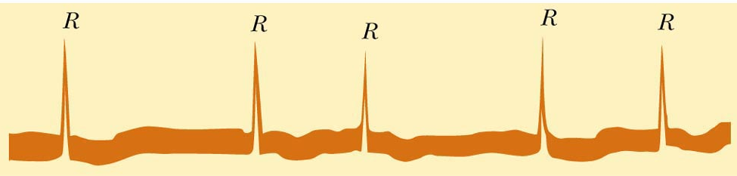
Abnormal EKG, 3
No P pulse and an irregular spacing between the QRS pulses
Symptomatic of irregular atrial contraction, called fibrillation
The atrial and ventricular contraction are irregular

Slide 51
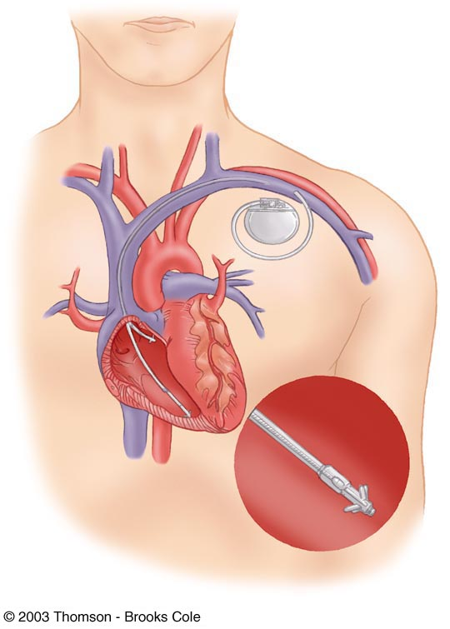
Implanted Cardioverter Defibrillator (ICD)
Devices that can monitor, record and logically process heart signals
Then supply different corrective signals to hearts that are not beating correctly

