Slide 1
Chapter 16
Phys2120 Spring 2017
© A. Dzyubenko
Electric Energy
and
Capacitance
© 2003 Thomson – Brooks/Cole

Slide 2
Electric Potential Energy
The electrostatic force is a conservative force
It is possible to define an electrical potential energy function corresponding to this force
Work done by a conservative force is equal to the negative of the change in potential energy: W = -ΔPE

Slide 3
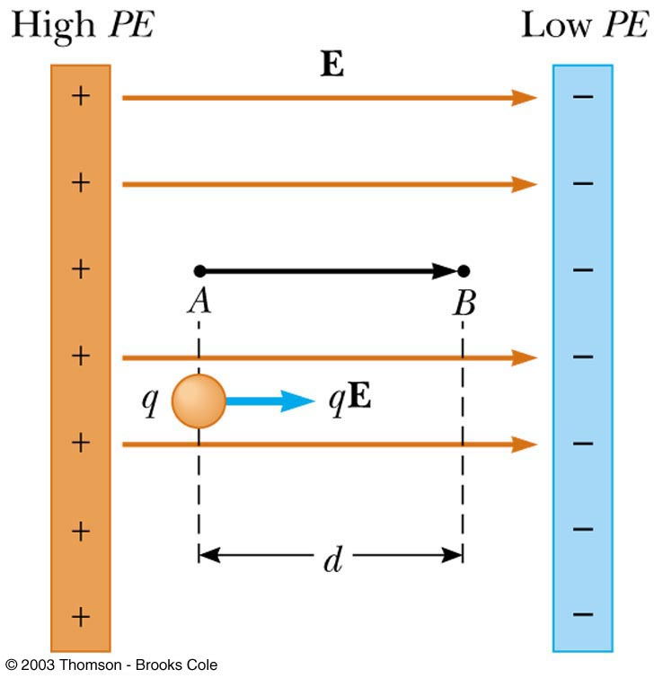
Work and Potential Energy
There is a uniform field between the two plates
As the charge q moves from A to B, work is done on it by electric field

Slide 4
Work and Potential Energy
The change in the potential energy, ΔPE, of a system consisting of an object of charge q moving through a displacement x in a constant electric field E is given by
    where E_{x} is the x-component of the electric field and Δx = x_{f} -x_{i} is the displacement of the charge along the x-axis

Slide 5
Notes about Potential Energy
The equation is valid only for the case of
a uniform electric field , for a particle that undergoes a displacement along a given axis
The electric field is conservative => the change in potential energy ΔPE does not depend on the path

Slide 6
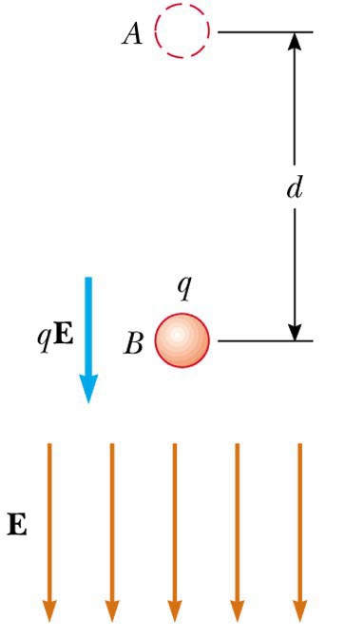
Electric PE and Gravitational PE
An object of mass m moves in the direction of the gravitational field g, the gravitational PE decreases
m
mg
g
    The object gains kinetic energy equal in magnitude to the loss of gravitational PE

Slide 7
Electric PE and Gravitational PE
A positive charge q at point A falls in the direction of the electric field
    In falling from A to B positive charge gains kinetic energy equal in magnitude to the loss of electric PE

Slide 8
Potential Difference
The potential difference ΔV between points A and B is defined as the change in the potential energy (final value minus initial value) of a charge q moved from A to B divided by the charge q
    Potential difference is not the same as potential energy

Slide 9
Potential Difference
Another way to relate the energy and the potential difference:
ΔPE = q ΔV
Both electric potential energy and potential difference are scalar quantities
Units of potential difference:
    1V = 1J/C

Slide 10
Potential Difference: a Uniform Electric Field
For the special case of a uniform electric field
V_{B} < V_{A} : Electric field lines always point in the direction of decreasing electric potential
    Gives more information about units:
    1 N/C = 1V/m

Slide 11
Summary of Positive Charge Movements and Energy
When a positive charge is placed in
an electric field
    It moves in the direction of the field
    It moves from a point of higher potential to a point of lower potential
    Its kinetic energy increases
    The charge-field system loses an equal amount of electric potential energy

Slide 12
Summary of Negative Charge Movements and Energy
When a negative charge is placed in
an electric field
    It moves opposite to the direction
    of the field
    It moves from a point of lower potential to a point of higher potential
    Its kinetic energy increases
    Its electric potential energy decreases

Slide 13
If an electron is released from rest in a uniform electric field, the electric potential energy of the charge-field system (a) increases, (b) decreases, or (c) remains the same.
QUICK QUIZ 16.1

Slide 14
QUICK QUIZ 16.1 ANSWER
(b). The field exerts a force on the electron, causing it to accelerate in the direction opposite to that of the field. In this process, electrical potential energy is converted into kinetic energy of the electron. Note that the electron moves to a region of higher potential, but because the electron has negative charge this corresponds to a decrease in the potential energy of the electron.

Slide 15
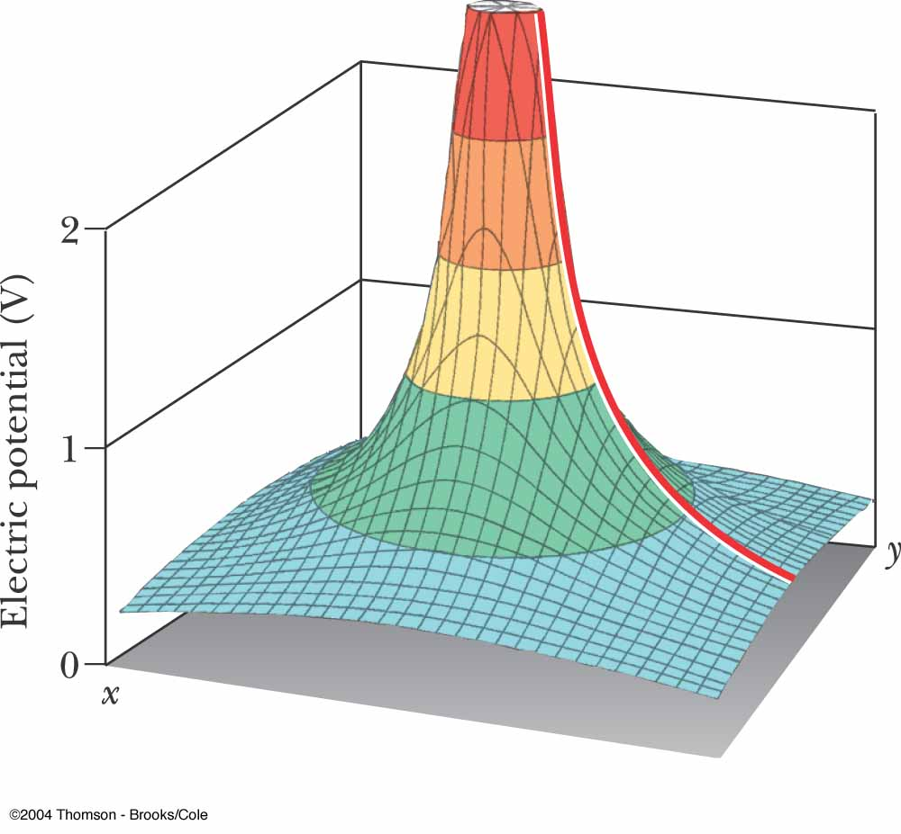
Electric Potential of a Point Charge
The point of zero electric potential is taken to be at an infinite distance from the charge
The potential created by a point charge q at any distance r from the charge is
A potential exists at some point in space whether or not there is a test charge at that point

Slide 16
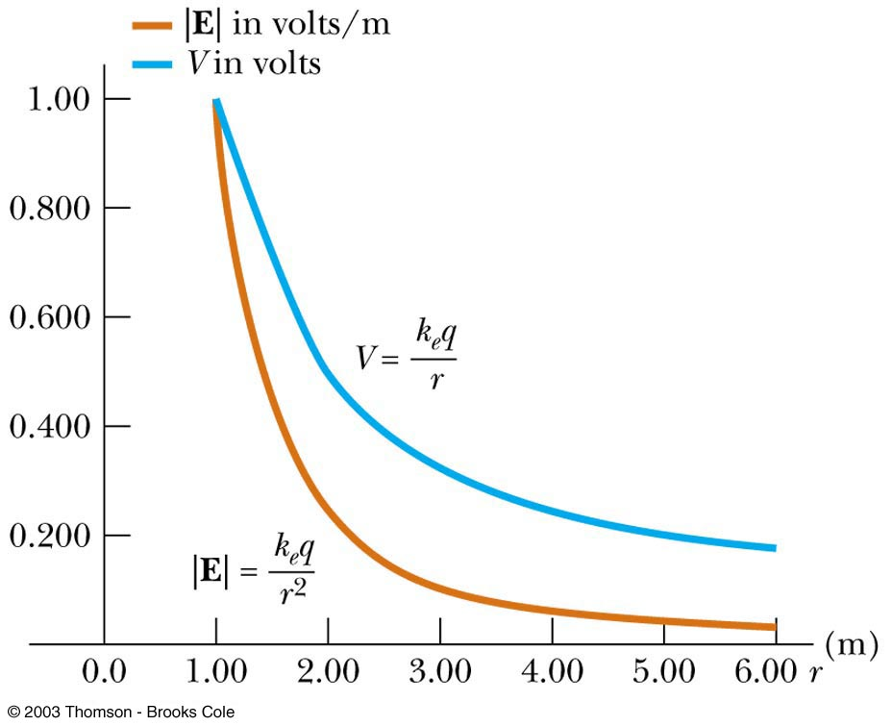
A Point Charge: Electric Potential V
and Electric Field E

Slide 17
Electric Potential of Multiple Point Charges
Superposition principle applies:
The total electric potential at some point P due to several point charges is the algebraic sum of the electric potentials due to the individual charges
    The algebraic sum is used because potentials are scalar quantities

Slide 18
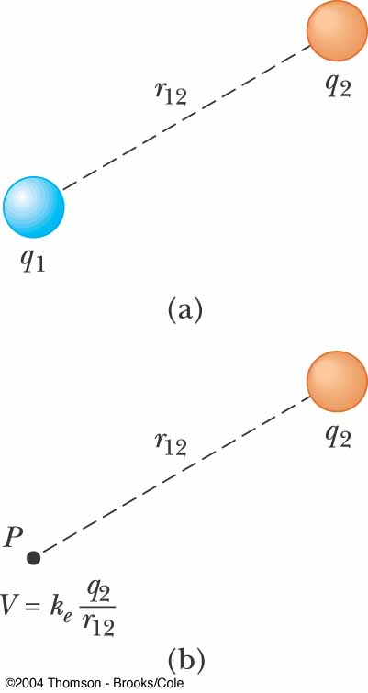
Electrical Potential Energy of Two Charges
V is the electric potential due to q₂ at some point P
The work required to bring q₂ from infinity to P without acceleration is q₁V
This work is equal to the potential energy of the two particle system

Slide 19
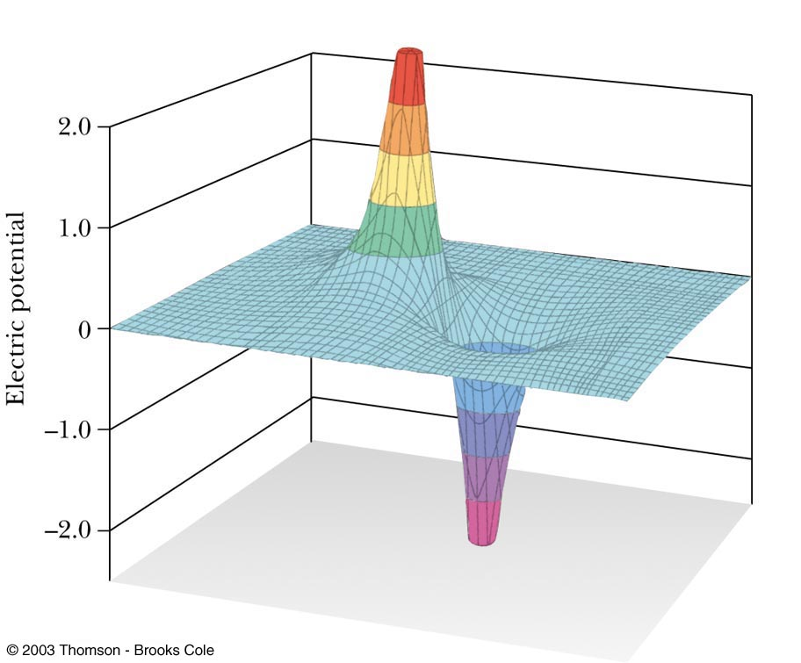
Electrical Potential of
Two Unlike Charges
at a point R
in space

Slide 20
Notes About Electric Potential Energy of Two Charges
If the charges have the same sign, PE is positive
    Positive work must be done by the external agent to bring the two charges near one another
    The like charges would repel
If the charges have opposite signs, PE is negative
    The force would be attractive
    Work must be done to hold back the unlike charges from accelerating toward each other as they are brought close together

Slide 21
Problem Solving with Electric Potential (Point Charges)
Remember that potential is a scalar quantity
    So no components to worry about
Use the superposition principle when you have multiple charges
    Take the algebraic sum
Keep track of sign
    The potential is positive if the charge is positive and negative if the charge is negative

Slide 22
If the electric potential at some point is zero, you can conclude that (a) no charges exist in the vicinity of that point, (b) some charges are positive and some are negative, or (c) all charges in the vicinity have the same sign. Choose each correct answer.
QUICK QUIZ 16.2

Slide 23
Either (a) or (b), but not both. The absence of any electrical charges within a finite distance from the point would produce an electric potential of zero at the point. Thus, (a) could be a true statement. If electrical charges exist at finite distances from the point, then (b) must be true. Both positive and negative charges must be present in the vicinity so their contributions to the electrical potential at the observation point may cancel each other.
QUICK QUIZ 16.2 ANSWER

Slide 24
A spherical balloon contains a positively charged particle at its center. As the balloon is inflated to a larger volume while the charged particle remains at the center, which of the following changes? (a) the electric potential at the surface of the balloon, (b) the magnitude of the electric field at the surface of the balloon, (c) the electric flux through the balloon.
QUICK QUIZ 16.3

Slide 25
(a) and (b). Both the electric potential and the magnitude of the electric field decrease as the distance from the charged particle increases.
QUICK QUIZ 16.3 ANSWER

Slide 26
Potentials and Charged Conductors
Since W = - q(V_{B} – V_{A}), no work is required to move a charge between two points that are at the same electric potential
    W = 0 when V_{A} = V_{B}
All points on the surface of a charged conductor in electrostatic equilibrium are at the same potential
Therefore, the electric potential is a constant everywhere on the surface of a charged conductor in equilibrium

Slide 27
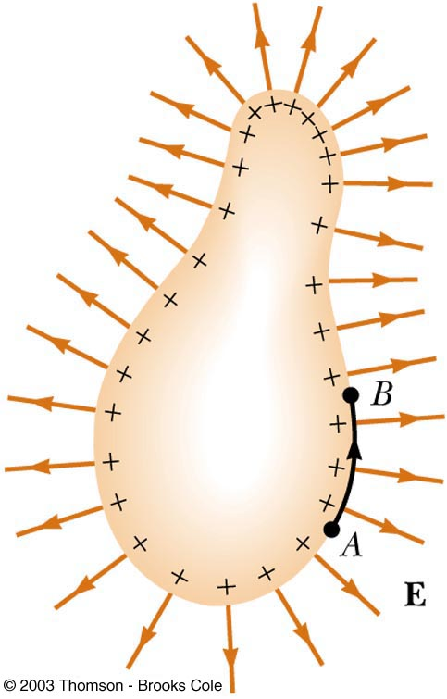
Conductors in Equilibrium
The conductor has an excess of positive charge
All of the charge resides at the surface
E = 0 inside the conductor
The electric field just outside the conductor is perpendicular to the surface
The potential is a constant everywhere on the surface of the conductor
The potential everywhere inside the conductor is constant and equal to its value at the surface

Slide 28
The Electron Volt
The electron volt (eV) is defined as the energy that an electron (or proton) gains when accelerated through a potential difference of 1 V
    Electrons in normal atoms have energies of 10’s of eV
    Excited electrons have energies of 1000’s of eV
    High energy gamma rays have energies of millions of eV
1 eV = 1.60 x 10 ⁻¹⁹ J

Slide 29
Equipotential Surfaces
An equipotential surface is a surface on which all points are at the same potential
    No work is required to move a charge at a constant speed on an equipotential surface
    The electric field at every point on an equipotential surface is perpendicular to the surface

Slide 30
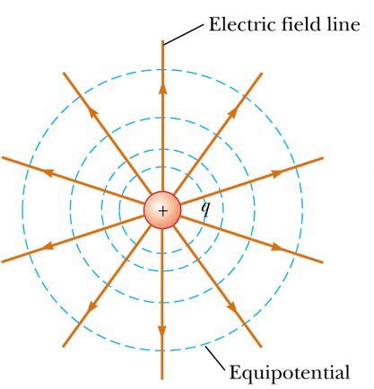
Equipotentials and Electric Fields Lines – Positive Charge
The equipotentials for a point charge are a family of spheres centered on the point charge
The field lines are perpendicular to the electric potential at all points

Slide 31
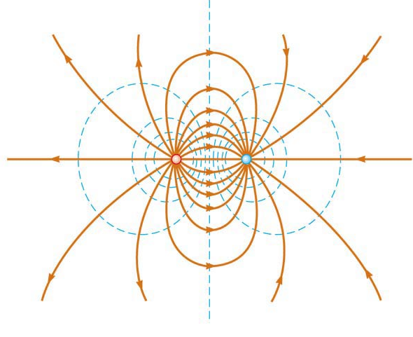
Equipotentials and Electric Fields Lines – Dipole
Equipotential lines are shown in blue
Electric field lines are shown in red
The field lines are perpendicular to the equipotential lines at all points

Slide 32
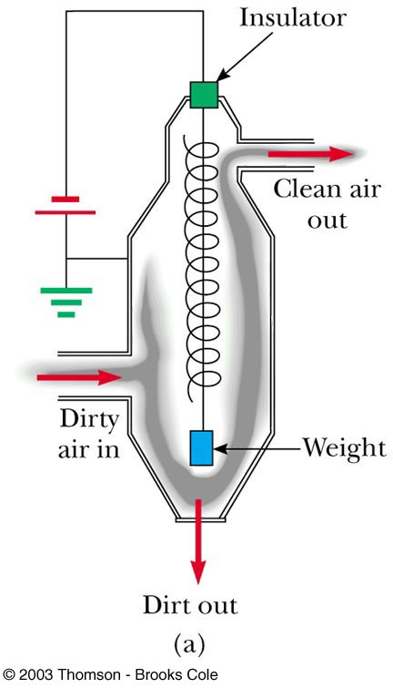
Application – Electrostatic Precipitator
It is used to remove particulate matter from combustion gases
Reduces air pollution
Can eliminate approximately 90% by mass of the ash and dust from smoke

Slide 33
Application – Electrostatic Air Cleaner
Used in homes to relieve the discomfort
of allergy sufferers
It uses many of the same principles as the electrostatic precipitator

Slide 34
Application – Xerographic Copiers
The process of xerography is used for making photocopies
Uses photoconductive materials
  A photoconductive material is a poor conductor of electricity in the dark but becomes a good electric conductor when exposed to light

Slide 35
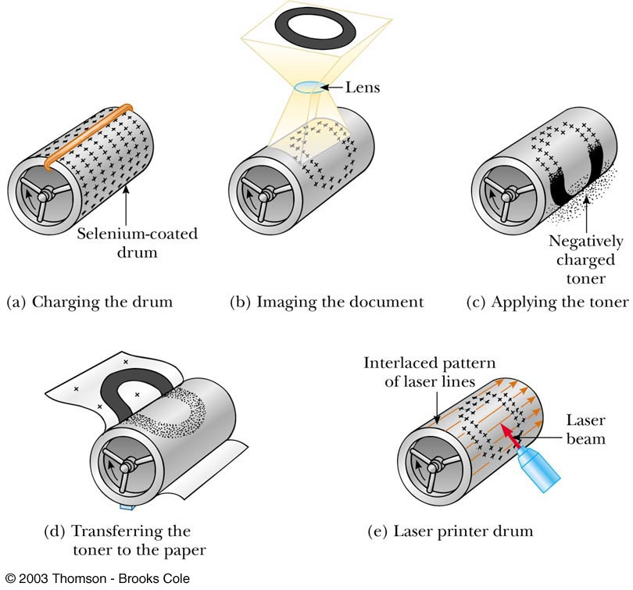
The Xerographic Process

Slide 36
Application – Laser Printer
The steps for producing a document on a laser printer is similar to the steps in the xerographic process
  Steps a, c, and d are the same
  The major difference is the way the image forms of the selenium-coated drum
    A rotating mirror inside the printer causes the beam of the laser to sweep across the selenium-coated drum
    The electrical signals form the desired letter in positive charges on the selenium-coated drum
    Toner is applied and the process continues as in the xerographic process

Slide 37
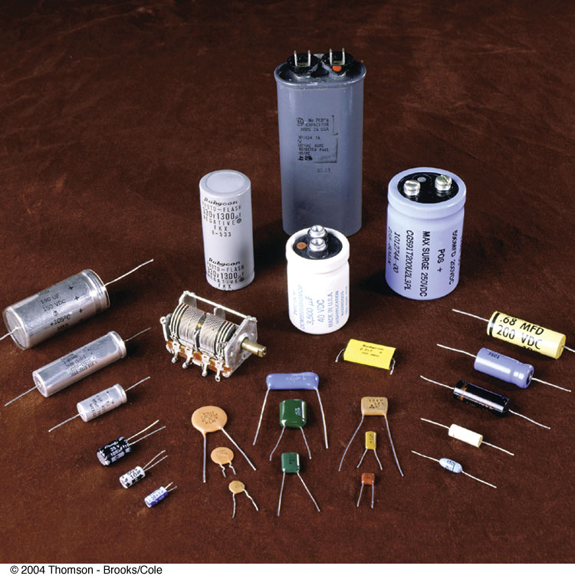
Capacitors – devices that store electric charge
Capacitors are simple circuit elements
They are commonly used to tune the frequency of radio receivers, as filters in power supplies etc.

Slide 38
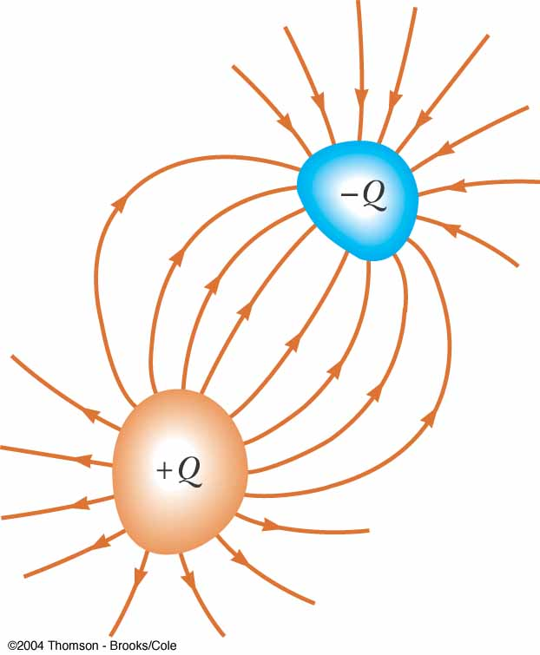
A Capacitor
A capacitor consists of two conductors separated by an insulator (called dielectric)
When the capacitor is charged, the conductors carry charges of equal magnitude and opposite sign
The conductors are called plates
A potential difference ΔV exists between the conductors due to the presents of the charges

Slide 39
Definition of Capacitance
Experiments show that the quantity of charge on a capacitor is linearly proportional to the potential difference ΔV between the conductors, Q ~ ΔV
We can write: Q = C ΔV =>
The capacitance C is the ratio of the magnitude of the charge Q on either conductor to the magnitude of the potential difference ΔV between the conductors:

Slide 40
SI Units of Capacitance
Farad (F) named in honor of Michael Faraday 1F = 1C/V
The Farad (F) is a very large unit
Typical devices have capacitances ranging from microfarads 1μF =10⁻⁶ F to picofarads 1pF= 10⁻¹² F

Slide 41
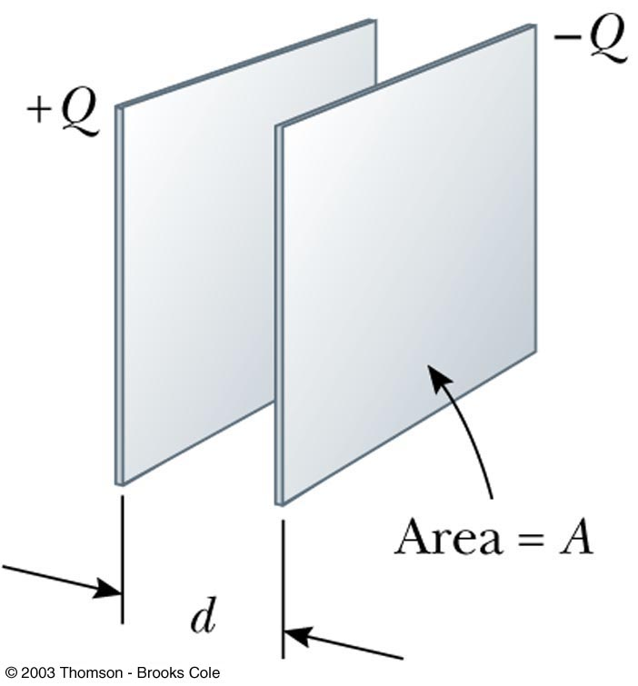
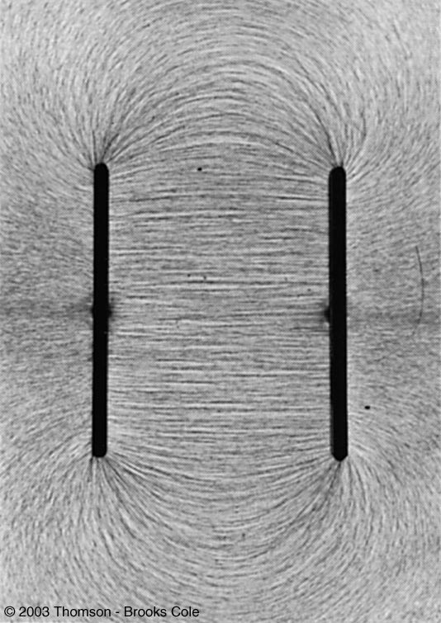
Parallel-Plate Capacitor
The electric field between the plates of a parallel-plate capacitor is uniform near the center but nonuniform near the edges

Slide 42
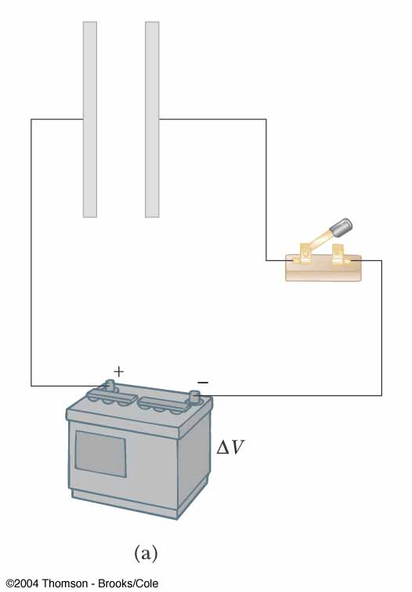
How the Capacitor is Charged?
Consider a capacitor consisting of two parallel conducting plates
A capacitor is charged when the plates are connected to the terminals of a battery: the electric field of the battery causes electrons to move from the left plate into the wire and into the right plate from the wire
A separation of the charge exists on the plates
Chemical energy in the battery has been transformed to the electric potential energy in the system

Slide 43
A capacitor is designed so that one plate is large and the other is small. If the plates are connected to a battery, (a) the large plate has a greater charge than the small plate, (b) the large plate has less charge than the small plate, or (c) the plates have charges equal in magnitude but opposite in sign.
QUICK QUIZ 16.6

Slide 44
(c). The battery moves negative charge from one plate and puts it on the other. The first plate is left with excess positive charge whose magnitude equals that of the negative charge moved to the other plate.
QUICK QUIZ 16.6 ANSWER

Slide 45

Capacitance of a Parallel-Plate Capacitor
Two parallel metallic plates of equal area A are separated by a distance d and carry a charge Q
The value of electric field between the plates is

Slide 46
Capacitance of a Parallel-Plate Capacitor
The capacitance of a parallel-plate capacitor is proportional to the area of its plates and inversely proportional to the plate separation

Slide 47
Applications of Capacitors – Camera Flash
The flash attachment on a camera uses a capacitor
    A battery is used to charge the capacitor
    The energy stored in the capacitor is released when the button is pushed to take a picture
    The charge is delivered very quickly, illuminating the subject when more light is needed

Slide 48
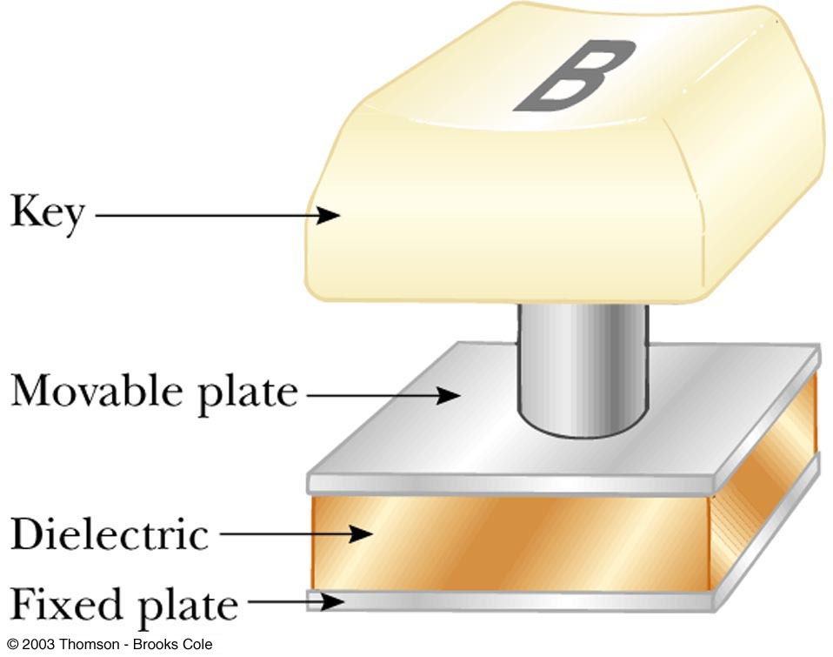
Applications of Capacitors – Computer Keyboards
    Some keyboards use capacitors at the bases of the keys
    When the key is pressed, the capacitor spacing decreases and the capacitance increases
    The key is recognized by the change in its capacitance

Slide 49
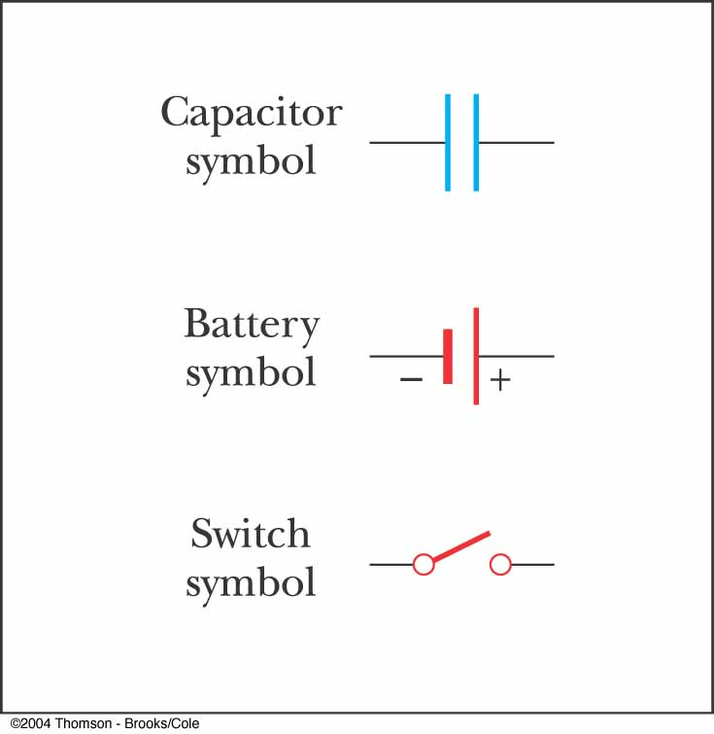
Capacitors in Circuits
An electric circuit is a collection of objects usually containing a source of electrical energy (such as a battery) connected to elements that convert electrical energy to other forms
A circuit diagram can be used to show the path of the real circuit

Slide 50
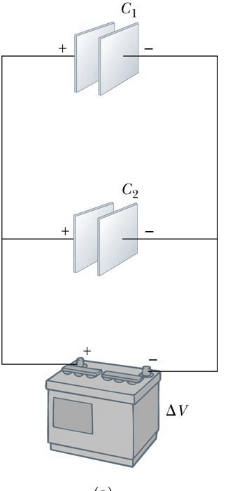
Capacitors in Parallel
The left plates of the capacitors are connected to the positive terminal of the battery
The right plates of the capacitors are connected to the negative terminal of the battery

Slide 51
Capacitors in Parallel
When capacitors are first connected in the circuit, electrons are transferred between the wires and the plates
The flow of charges ceases when the voltage across the capacitors equals that of the battery
The capacitors reach their maximum charge when the flow of charge ceases

Slide 52
Capacitors in Parallel
The individual potential differences across capacitors connected in parallel are the same and are equal to the potential difference applied across the combination

Slide 53
Capacitors in Parallel
The total charge on capacitors connected in parallel is the sum of the charges on the individual capacitors

Slide 54
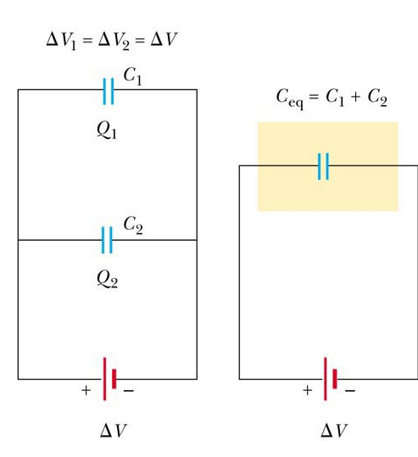
More About Capacitors in Parallel
The capacitors can be replaced with one capacitor with a capacitance of C_{eq}
    The equivalent capacitor C_{eq}
    must have exactly the same external effort on the circuit as the original capacitors

Slide 55
Capacitors in Parallel
C_{eq} = C₁ + C₂
The equivalent capacitance of a parallel combination of capacitors is greater than any of the individual capacitors

Slide 56
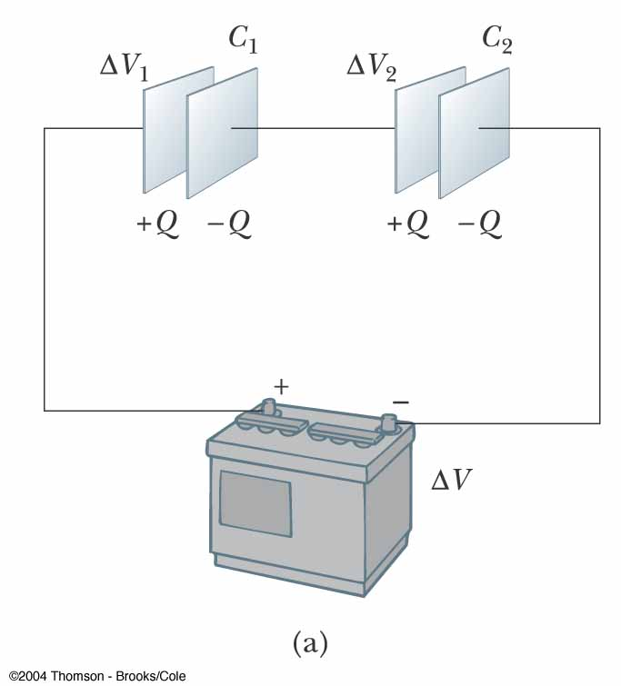
Capacitors in Series
When a battery is connected to the circuit, electrons are transferred from the left plate of C₁ to the right plate of C₂ through the battery
As this negative charge accumulates on the right plate of C₂, an equivalent amount of negative charge is removed from the left plate of C₂, leaving it with an excess positive charge
All of the right plates gain charges of – Q and all the left plates have charges of +Q

Slide 57
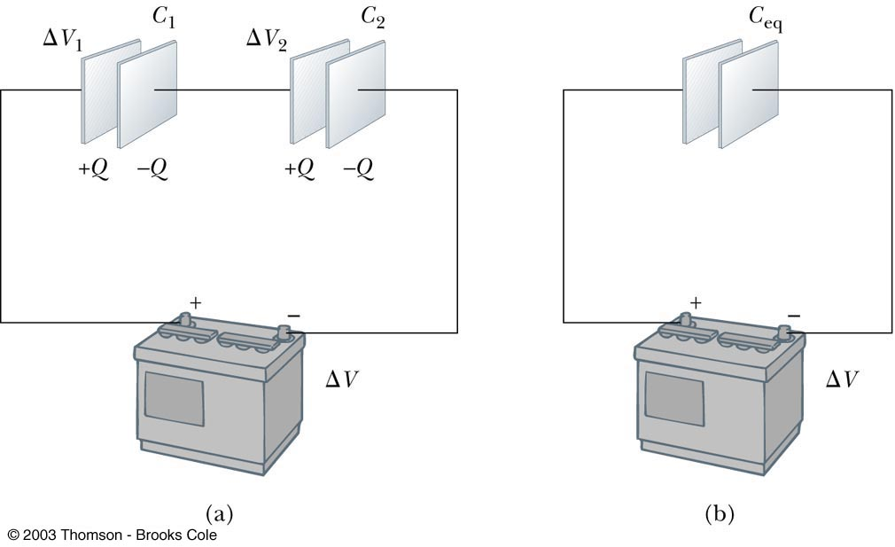
More About Capacitors in Series
An equivalent capacitor can be found that performs the same function as the series combination
The potential differences add up to the battery voltage

Slide 58
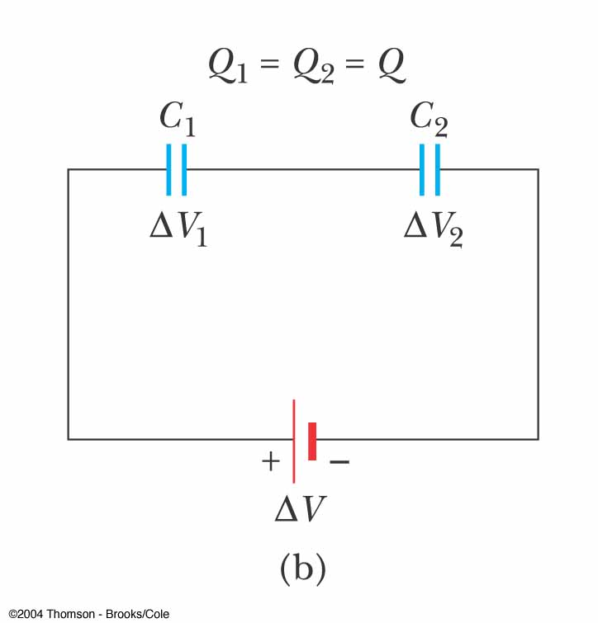
More About Capacitors in Series
The charges on capacitors connected in series are the same
The total the potential difference across any number of capacitors connected in series is the sum of the potential differences across the individual capacitors

Slide 59
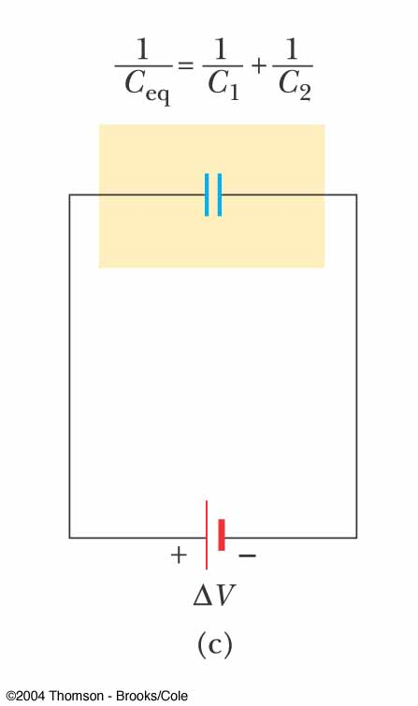
Capacitors in Series
The equivalent capacitance of a series combination is always less than any individual capacitor in the combination

Slide 60
Problem-Solving Strategy
When two or more unequal capacitors are connected in series, they carry the same charge, but the potential differences across them are not the same
    The capacitances add as reciprocals and the equivalent capacitance is always less than the smallest individual capacitor

Slide 61
Problem-Solving Strategy
When two or more capacitors are connected in parallel, the potential differences across them are the same
    The charge on each capacitor is proportional to its capacitance
    The capacitors add directly to give the equivalent capacitance

Slide 62
Problem-Solving Strategy
A complicated circuit can often be reduced to one equivalent capacitor
    Replace capacitors in series or parallel with their equivalent
    Redraw the circuit and continue
To find the charge on, or the potential difference across, one of the capacitors, start with your final equivalent capacitor and work back through the circuit reductions

Slide 63
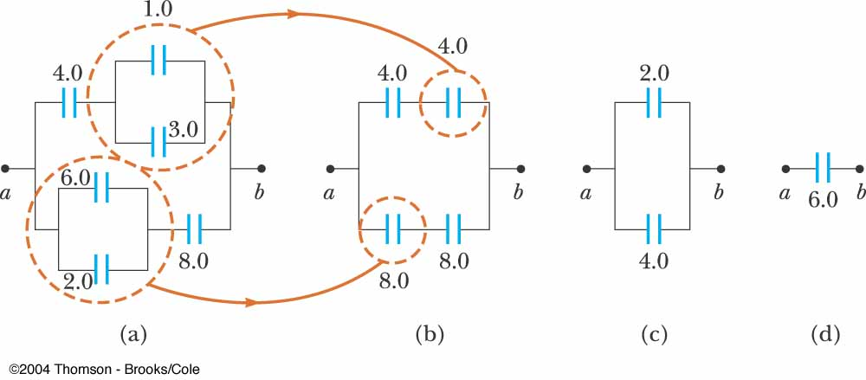

Slide 64
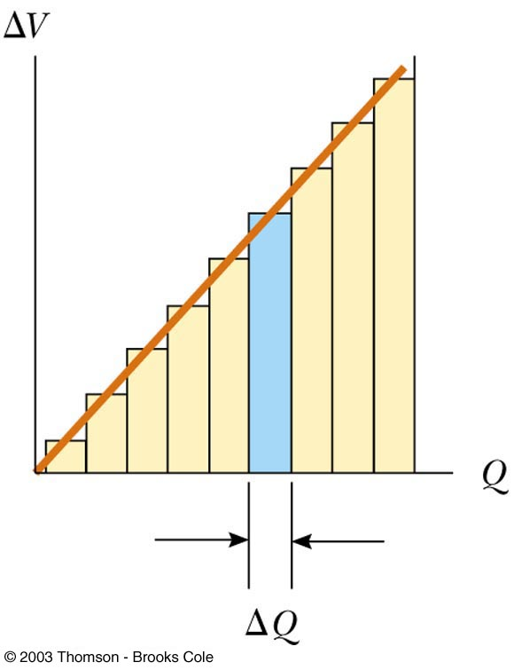
Energy Stored in a Capacitor

Slide 65
Energy Stored in a Capacitor cont
Energy stored = ½ Q ΔV
From the definition of capacitance, this can be rewritten in different forms

Slide 66
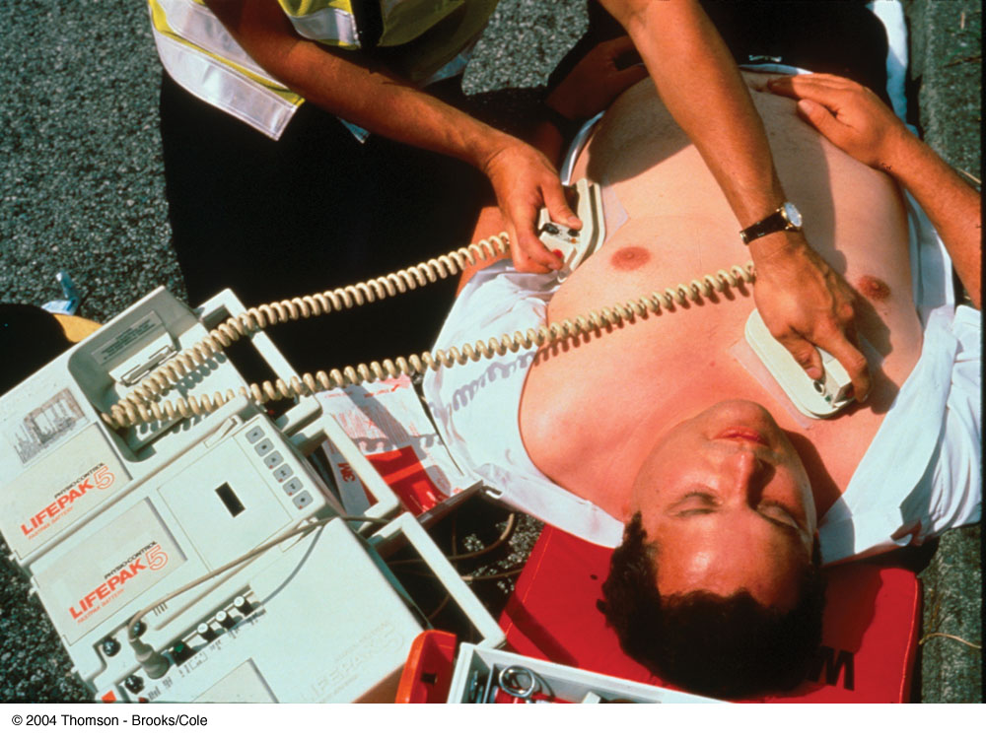
Applications
Defibrillators
    When fibrillation occurs, the heart produces a rapid, irregular pattern of beats
    A fast discharge of electrical energy through the heart can return the organ to its normal beat pattern
In general, capacitors act as energy reservoirs that can slowly charged and then discharged quickly to provide large amounts of energy in a short pulse

Slide 67
QUICK QUIZ 16.7
You charge a parallel-plate capacitor, remove it from the battery, and prevent the wires connected to the plates from touching each other. When you pull the plates farther apart, do the following quantities increase, decrease, or stay the same? (a) C; (b) Q; (c) E between the plates; (d) ΔV; (e) energy stored in the capacitor.

Slide 68
(a) C decreases
(b) Q stays the same
(c) E stays the same
(d) ΔV increases
(e) The energy stored increases.
QUICK QUIZ 16.7 ANSWER

Slide 69
Capacitors with Dielectrics
A dielectric is an insulating material that, when placed between the plates of a capacitor, increases its capacitance.
  Dielectrics include rubber, plastic, or waxed paper …
C=kC₀=kε₀(A/d)
  The capacitance is multiplied by the factor κ when the dielectric completely fills the region between the plates.
Dimensionless factor κ is called dielectric constant

Slide 70
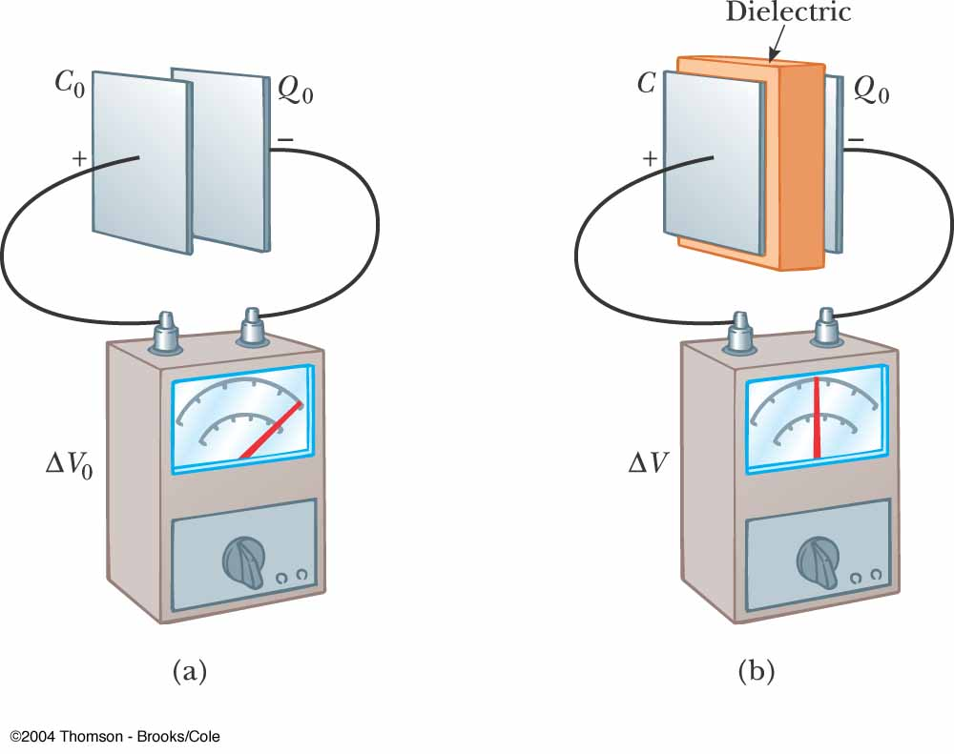
Capacitors with Dielectrics
Consider a parallel-plate capacitor that without dielectric has a charge Q₀ and a capacitance C₀ , ΔV= Q₀ / C₀
After insertion of the dielectric the charge on the plates remains unchanged (no battery), but the potential difference decreases ΔV= ΔV₀ / k , k>1
The capacitance must changes to the value

Slide 71
Dielectric Strength
For any given plate separation, there is a maximum electric field that can be produced in the dielectric before it breaks down and begins to conduct
This maximum electric field is called the dielectric strength

Slide 72
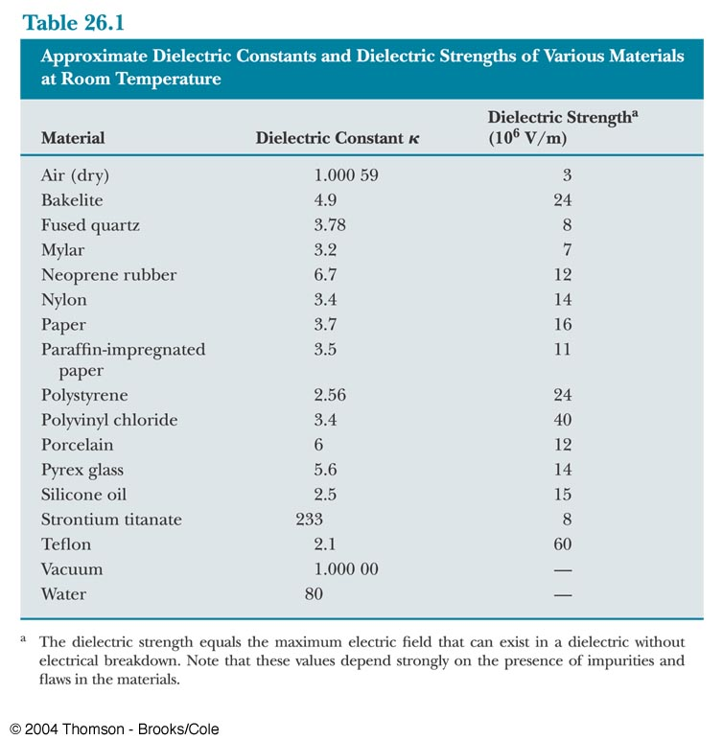

Slide 73
Capacitors with Dielectrics
A dielectric provides the following advantages:
Increases in capacitance
Increases in maximum operating voltage
Possible mechanical support between the plates, which allows the plates to be close without touching , thereby decreasing d and increasing C
What is the microscopic origin of these?

Slide 74
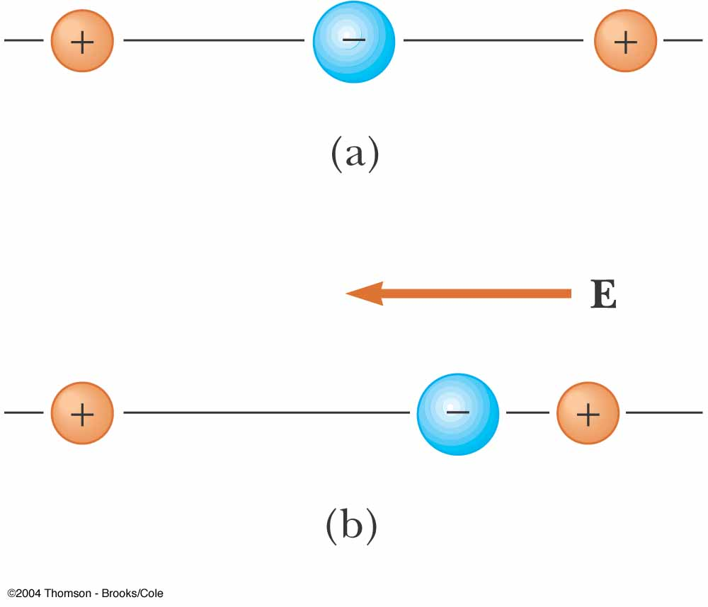
Polarization
Molecules are said to be polarized when a separation exists between the average position of the negative charges and the average position of the positive charges in the molecule
In some molecules,such as water, this condition is always present. Such molecules are called polar molecules
Nonpolar molecules do not possess a permanent polarization
Polarization can be induced by placing the molecule in an electric field: induced polarization

Slide 75
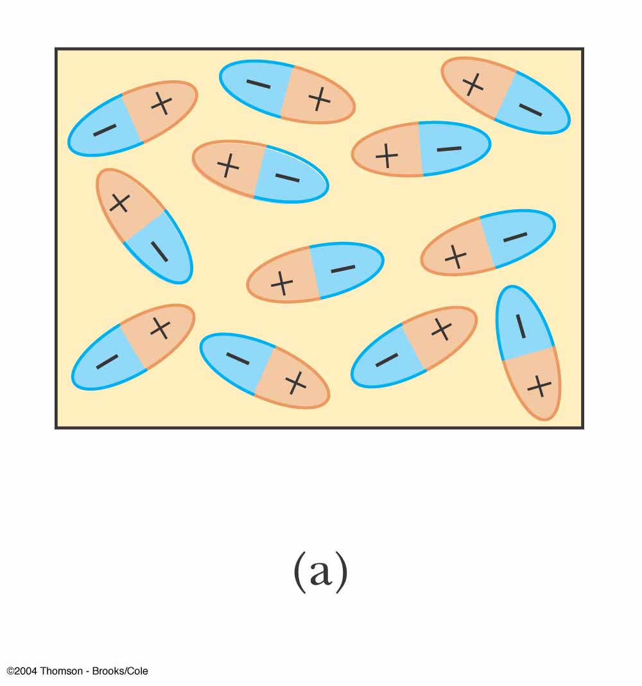
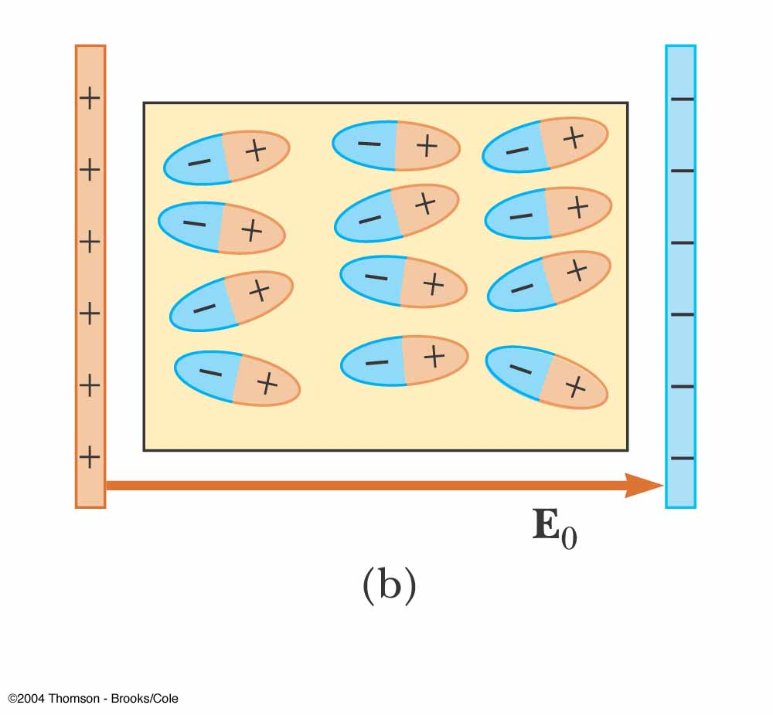
An Atomic Description of Dielectrics
The polar molecules are randomly oriented in the absence of an electric field
In the external electric field molecules partially align with the field => the dielectric is polarized
The electric field in the presence of a dielectric is

Slide 76
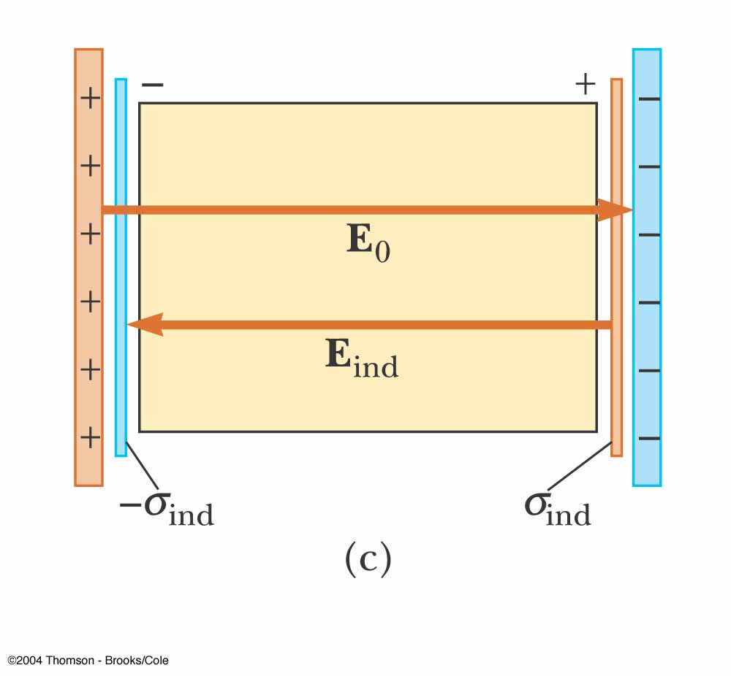
An Atomic Description of Dielectrics
The charged edges of the dielectric can be modeled as an additional pair of parallel plates establishing an electric field E_{ind} in the direction opposite to that of E₀

Slide 77
QUICK QUIZ 16.8
A fully charged parallel-plate capacitor remains connected to a battery while you slide a dielectric between the plates. Do the following quantities increase, decrease, or stay the same? (a) C; (b) Q; (c) E between the plates; (d) ΔV; (e) energy stored in the capacitor.

Slide 78
(a) C increases
(b) Q increases
(c) E stays the same
(d) ΔV remains the same
(e) The energy stored increases
QUICK QUIZ 16.8 ANSWER

