Slide 1

Graduation is Everyone’s Business
Larry Abele
CSU-Bakersfield

Slide 2
Our Challenges
LOW GRADUATION RATE
TOO MUCH TIME TO A DEGREE
EXCESS HOURS
HIGH COSTS
TOO MUCH DEBT
EDUCATIONAL INEQUALITY
Notes:
We are facing these four challenges and, I hope to show, that Academic Maps will provide a partial solution to each one.

Slide 3
The Education Gap by income has increased significantly since 1970
http://www.postsecondary.org/last12/221_1110pg1_16.pdf

Slide 4
The advantages of parents’ educational levels are transferred to their children
% Children Attaining Bachelor’s
Degree or Better
Educational Level of Parents
Source: Chronicle of Higher Education, August 27, 1999

Slide 5
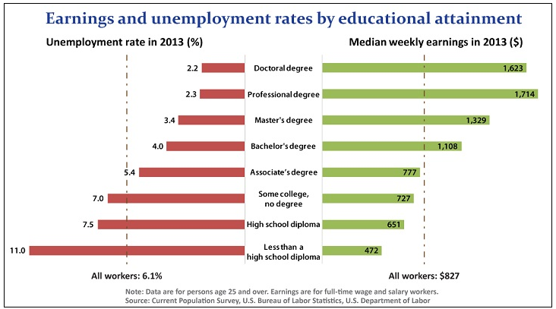
A college degree is a huge economic advantage

Slide 6
Some data on CSU-Bakersfield
Cohort | Total | Same | Different | Still enrolled | Not enrolled | % female | %Pell | %FT
FTIC | 43.70% | 38.60% | 5.10% | 24.40% | 31.90% | 61% | 66/% | 90%
Nat’l | 61.16% | 48.44% | 12.72% | 14.20% | 24.64% | 56% | 45.8% | 77%
Trans. | 70.80% | 62.6% | 8.2% | 8.70% | 20.50%

Slide 7
The six-year graduation rate for all US baccalaureate institutions* is distressingly low
*2013 IPEDS, n=1570, institutions with <50 in cohort excluded

Slide 8
Institutional policies have a large effect on graduation rates*
2011-IPEDS retention and graduation rates for public universities with an entering class >200, n=525

Slide 9
Twelve variables used to compare universities
Standardized test score
High school gpa,
% Pell
Selectivity.
Size
Commuter or residential
Expenditures per student
Carnegie classification
Age structure of students
Public or private
% STEM degrees
% Part-time

Slide 10
Universities with similar characteristics can differ significantly in graduation rates
15 similar institutions based on 12 variables: standardized test score, high school gpa,
% Pell, selectivity. Size,commuter or residential, expenditures per student,
Carnegie classification, age structure, public, % STEM degrees ,%PT

Slide 11
Why are attrition rates high and graduation rates low?
Lack of Policy Focus or Attention:
Until recently almost all states funded enrollment or student credit hours.
Rankings either do not include graduation rates or give them little weight.
Focusing on Retention/Graduation has not been part of our culture.

Slide 12
Cultural disconnect
‘To become a premier public research university …with a focus on world class research…’ (Strategic plan 2014)
  Graduation rate: 9.6% (4-yr) 31% (6-yr)
  Your success as a faculty member depends on your personal performance, primarily in research.

Slide 13
Three Critical Elements of a
Retention/Graduation Program
(Creating a Culture of Success)
An individual, by status or personality, must drive the process and have access to human and financial resources.
A process based on detailed data must be established and maintained for at least five years.
There must be a team of individuals from across campus committed to student success who meet weekly to assess progress.

Slide 14
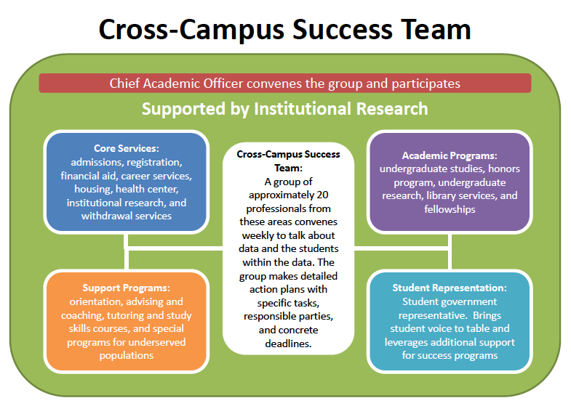

Slide 15
The team met weekly to address key questions, make decisions, and sustain momentum.
Diagnose Problems
  Which students are progressing as planned? Which students are not? Why?
  What seems to be impeding student progress or performance?
Followed by an ACTION-oriented line of questioning
WHO will take responsibility for intervening?
WHEN will that happen?
HOW will our
progress be assessed?
WHERE we will see results?
Problem-
Solutions
  Where should we intervene?
  What can we do that might make a difference?
  What additional supports can we put in place?
  What changes to our policies, programs or practices might we make that would be helpful?
Plan
  Are our efforts having the impact we intended?
  Do we have the right strategies and supports in place?
Evaluate
  What have we accomplished since our last meeting?
  What achievements or accomplishments can we celebrate?
Report
Notes:
Stories Dr. Abele might tell: How he called people in to the meeting to debunk notions or test questionable hypotheses.
How members of the group raised questions about students (like transfer students, for example)
and what was happening to them.
How team members raised questions about institutional practices. (Why do we let them leave before
registering for the next semester? Why are we making people mad when they leave the parking lot?)

Slide 16
Example of team role and responsibility
Office | Financial Aid
Individual | Joseph Needy
Role | Student financial aid data
Responsibility | Report on packaging of financial aid; how many students need repackaging; report on sources and balances of aid; report on analysis of unallocated funds in the university foundation. Focus on Pell students.
Why | (1) List of students by unmet financial need with an analysis of progress toward degree and gpa; compare non-retained students by unmet need. (2) Present analysis of packaged aid compared to funds on hand to cover students for four-years; Report on Work Study and other student employment to be sure that we are maximizing on-campus employment.

Slide 17
The team developed a series of action steps tied to every month of the academic calendar:
~100 in the fall and ~93 in the spring
Month | Time frame | Action | Responsibility
January | By end of January | Emails to students with 35 attempted hours who have not been accepted into a major | Individual Responsible
January | Ongoing | Update department Degree Audit reports | Individual Responsible
January | Ongoing | Individual contact with students who have been placed on probation | Academic Section
January | Ongoing | Individual contact with students who have been placed on warning | Academic Section
February | 1st week | Offer Workshop: Students Taking Exploratory Paths to Success | Advising First
February | 1st week in the month | Email to all F coded students w/100+ hours inquiring about graduation plans; email to all H coded students w/100+ hours inquiring about finishing/graduation plans | Individual Responsible
February | 6th week of term | New transfer—How are you doing— deadlines | Individual Responsible

Slide 18
Success Team Discussion
Who would you have on your team?
How would you define the role of each individual?
How would accountability be maintained?
What other issues do you think should be included in building a team?
Do you agree that weekly, rather than some other frequency, meetings are important?

Slide 19
Effective student success efforts are dependent on having the right information
DATA
Are we collecting the right information?

Slide 20
NOTE THAT THE GREATEST ATTRITION OCCURS DURING YEAR I BUT THE MAJORITY OF THOSE LEAVING DO SO DURING YEARS 2-6

Slide 21
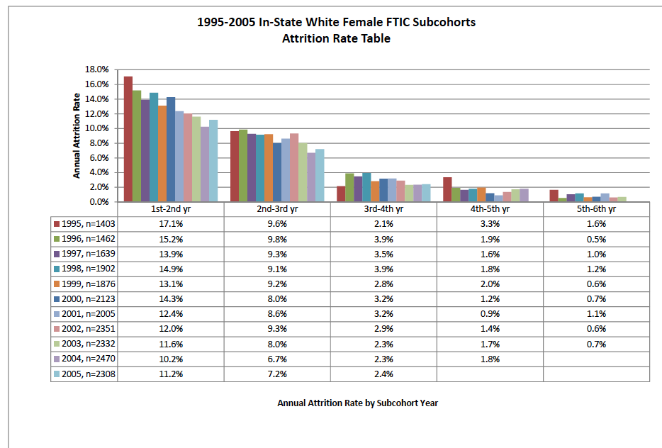
In looking at attrition rates, there is a range of rates at different points in time related to student background characteristics.
Yearly Attrition Rates by Cohort: White, Female, First-Time In-State Students
Traditional students experience the largest attrition rates in the first year.
MIN
MAX
10.2%
17.1%
6.7%
9.8%
2.1%
3.9%
0.9%
3.3%
0.5%
1.6%
Notes:
Stories Dr. Abele might tell:

Slide 22
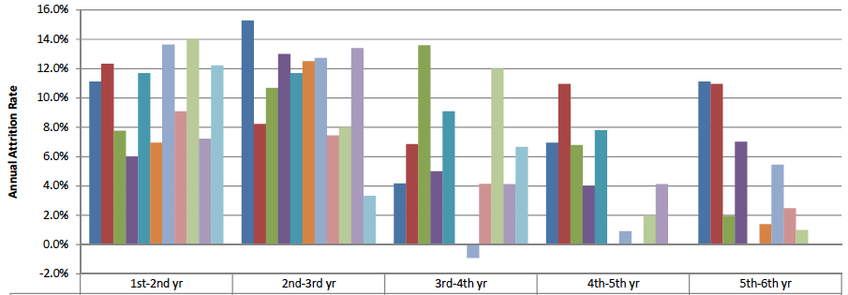
African American male Pell recipients exhibited very different attrition rate patterns, suggesting the need for continued support during their college career.
Yearly Attrition Rates by Cohort: Black, Male, Pell Recipient, First-Time In-State Student
MIN
MAX
6.0%
14.0%
3.3%
15.3%
-0.9%
13.6%
0%
11.0%
0%
11.1%
Notes:
Stories Dr. Abele might tell:

Slide 23
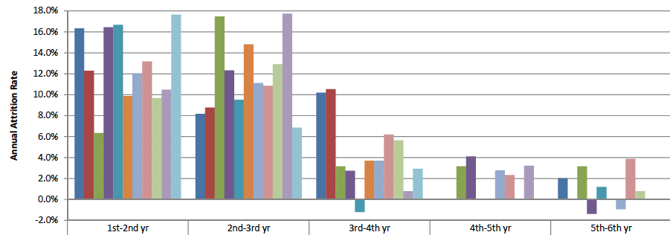
Hispanic female Pell recipients exhibited another attrition pattern, suggesting the need for close interaction with the students and their families.
Yearly Attrition Rates by Cohort: Hispanic, Female, Pell Recipient, First-Time In-State Students
MIN
MAX
6.3%
17.6%
6.9%
17.7%
-1.2%
10.5%
0%
4.1%
-1.4%
3.9%
Notes:
Stories Dr. Abele might tell:

Slide 24
Most students who leave college are in good academic standing and many graduate elsewhere but changing schools lowers success: encourage students to remain on campus
GPA | No Record | AA/Cert. | BA/BS + | Cohort %
0-1.99 n=1137 | 66.1% | 23.2% | 10.7% | NA
2.0-2.99 n=1136 | 46.4% | 16.1% | 37.5% | 67%
3.0-4.0 n=842 | 16.3% | 9.7% | 74.0% | 82%
Total n=3115 | 45.4% | 16.9% | 37.5% | 74%
*2004, 2005 Entering Cohorts, Student Data Clearinghouse, n=3115

Slide 25
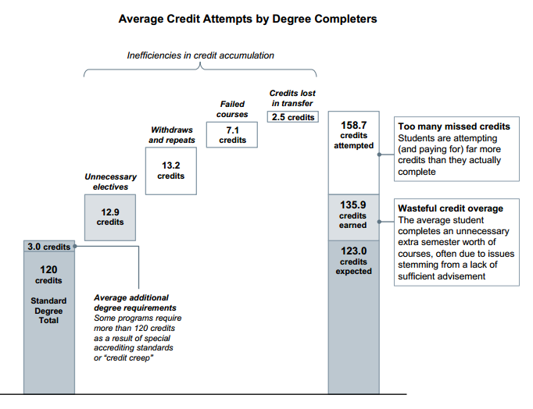
Nationally, students who do graduate often take extra years and extra credits
Credit: “Building Guided Pathways to Success,” Education Advisory Board

Slide 26
Institutions have a large effect on excess hours and the cost to students is huge*
*~54,600 students graduating from the SUS in 2011, ~1 million excess hours at a cost of over
$200 million to students in tuition alone, at 2011 rates.

Slide 27

Why excess hours?
Catalogs are difficult to understand
General Education requirements are confusing
Cannot enroll in the required class: not offered, time conflicts with other classes, etc.
Do not understand course prerequisites and/or course sequencing
Insufficient advising
Course withdrawals, repeats and failures
Changing majors late in academic career

Slide 28
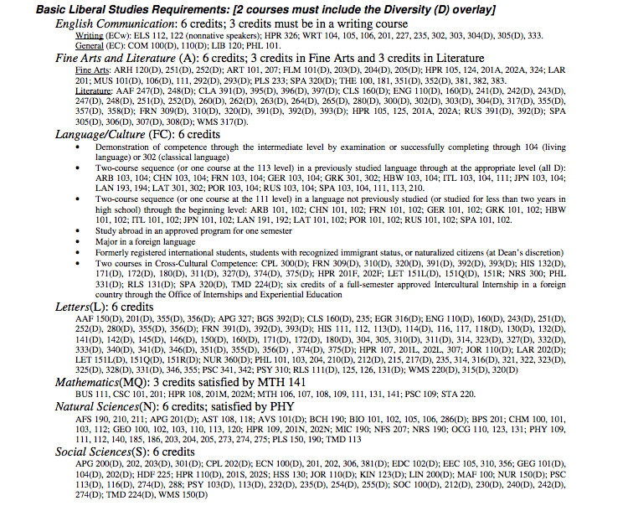
GENERAL EDUCATION REQUIREMENTS

Slide 29
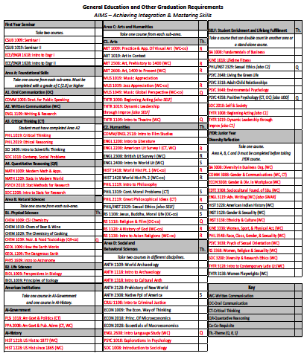
CSU-Bakersfield General Education requirements (page 1)
http://www.csub.edu/ge/_files/new%20ge%20requirements%205-6-16%20red.pdf

Slide 30
Without guidance or barriers students begin college without enrolling in the appropriate courses accumulating excess hours right from the start
40% of STEM majors do not take any mathematics during their first year in a four-yr. college (n~7,800)
49% of STEM majors do not take any mathematics during their first year in a two-yr., college (n~5,600)
Source: STEM attrition: college students paths into and out
of STEM fields. NCES 2014-001. Figure 4

Slide 31
Over half of excess hours (and time) are repeats, withdrawal and failures
State University System of Florida Report on 2002-03 baccalaureate graduates, n=28,673
(15,178 FTIC and 13,495 AA transfer)

Slide 32
High enrollment. low success courses (high D/W/F)
COURSE | % D/W/F | Enroll
Analytical geometry and trigonometry-MAC 1114 | 44.37% | 604
Analytical geometry and calculus MAC 2312 | 31.86% | 317
Calculus with analytical geometry MAC 2311 | 28.41% | 785
Calculus for business MAC 2233 | 26.86% | 577
Pre-calculus and algebra MAC 1140 | 21.46% | 1109
Chemistry I CHM 1045 | 17.31% | 1132
College algebra MAC 1105 | 17.09% | 1714
Analytical geometry and calculus III MAC2313 | 16.61% | 283
Chemistry II CHM 1046 | 16.38% | 458
General biology II BSC 2011 | 14.30% | 464

Slide 33
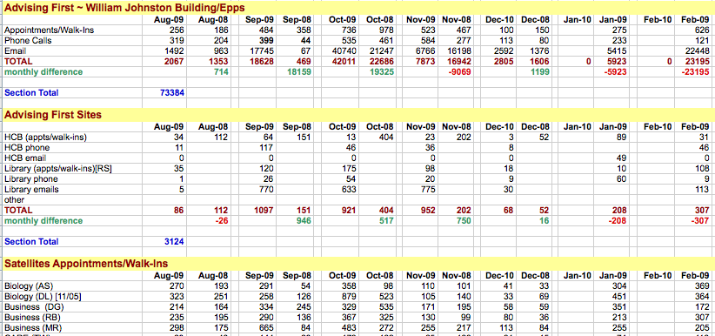
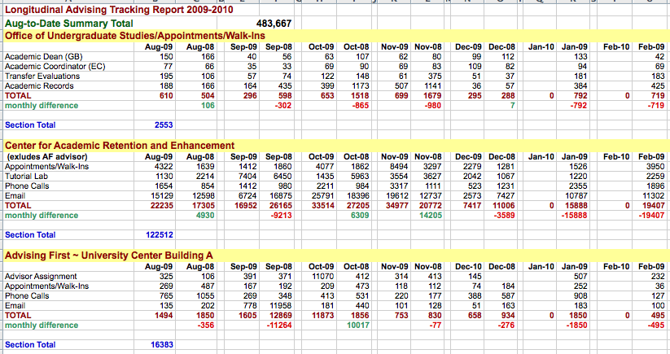
It is important to know when, where and why students met with an advisor
Extent of advising outreach activity
per month
Advising activity and where it took place on campus
Number of student contacts made by advisors

Slide 34
DATA DISCUSSION
Who is responsible for getting the data to the people who need it?
Are we able to obtain the data we need?
What data are currently available?
Are we using the data that is available?
What other data might be useful in guiding our analyses? Attendance information?
Are we using all of the information available through technology, such as Predictive Analytics?

Slide 35
Effective student success efforts are dependent on the right institutional strategies
Elements to Increase Student Success
Strategies
Are we doing the right things?

Slide 36
There is no silver bullet.
You increase retention literally one student at a time.
There is no silver bullet.
You increase retention literally one student at a time.

Slide 37
Academic Maps are the solution to almost all of our challenges: excess hours, time to degree, high costs and low graduation rates
BUT only if academic policies are implemented and followed.

Slide 38
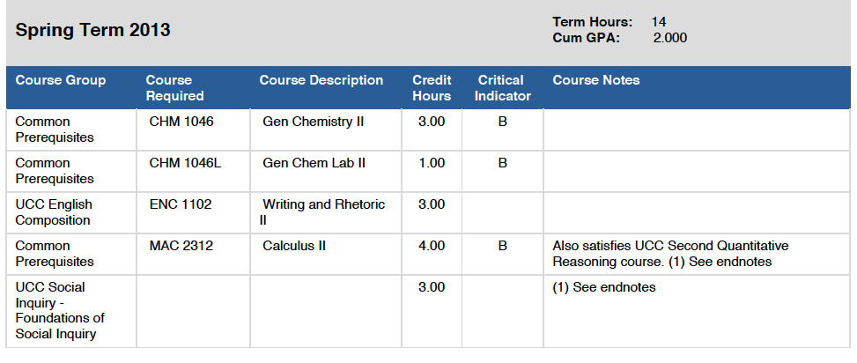
Florida International University lists milestone courses with critical grades
Note Critical Grade Based on
Predictive Analytics
Source:http://mymajor.fiu.edu/browse?area=PHSCEN&campus=MMC&go=Browse

Slide 39
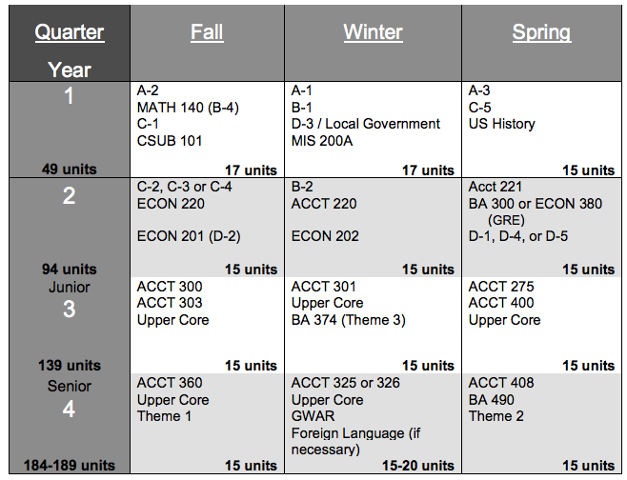
Accounting Road Map
(Full time student, 4 years)
http://www.csub.edu/bpa/_files/Road%20Maps/BSAccountingConcentration2013-2015.pdf

Slide 40
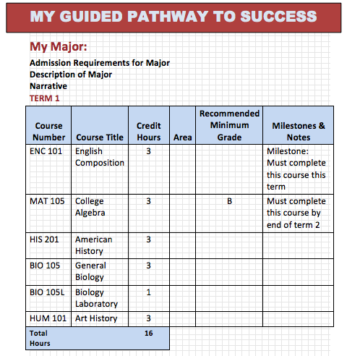
Academic Maps: Four essential components—the narrative, sample schedule, milestones, and employment opportunities
The narrative explains the use of academic maps and any specific information about degree requirements, including admissions requirements.
The sample schedule outlines which courses should be taken in which specific term in order to satisfy all requirements.
The milestones identify critical courses for timely progress and the last semester in which they can be completed for on-time graduation. Critical grades for Milestone courses may be included.
Links to Employment Information
Employment Information
National Association of Colleges and Employers
http://naceweb.org/salary-resources/index.aspx
Occupational Outlook Handbook http://www.bls.gov/ooh/
Build your Future http://www.onetonline.org/

Slide 41
A student’s grade in their first biology course is predictive of success in biology but not for other majors
GRADE | A | B | C | D | F | W
% graduating in biology | 68.4% | 49.3% | 27.5% | 9.8% | 7.% | 17.1%
% graduating with any major | 87.8% | 86.1% | 74.8% | 78.0% | 40.7% | 65.7%
Source: Florida State University Institutional Research; cohorts 2004-05 and 2009-10

Slide 42
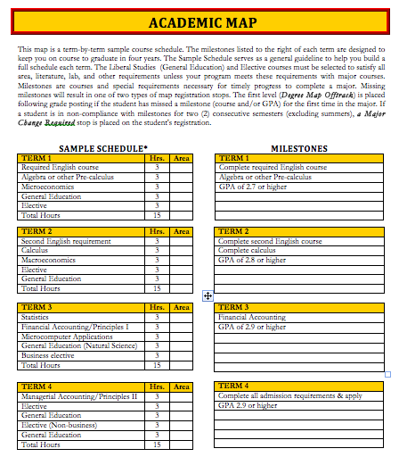
Business Meta-Major Map

Slide 43
Policies must accompany Academic Maps
Academic Policies
  Early declaration of major or meta-major
  Establish and offer Milestone courses
  Rationalize General Education requirements
  Advising Policies
  Offer Choosing a Major workshops
  Monitor student progress and intrude when necessary
  Meet with every student who is “Off Map”
  Communication Polices
  Earning a degree is a two or four year process
  Maps must be integrated into every aspect of the academic experience

Slide 44
Providing students with a clear path to graduation reduces excess hours, significantly reduces costs, and improves time to graduation
Year | Students with Excess Hours | 4-year Graduation Rate
2000 | 7,382 | 44.2%
2006 | 3,011 | 53.2%
2009 | 1,540 | 61.2%
Source: Florida State University

Slide 45
All students benefit from Academic Maps and Intrusive Advising
Students | 1994 cohort (6-yr rate) | 2007 cohort (6-yr rate)
All | 60.7% | 79.6%
African Americans | 56.00% | 78.6%
Hispanic | 50.8% | 79.2%
Source: College Navigator:http://nces.ed.gov/collegenavigator/
f?q=florida+state+university&s=all&id=134097#retgrad; for 2007 cohort
IPEDS data center for 1994 cohport

Slide 46
Milestone Courses by Major and by Term
Major | Lower-Division Students | Term 1 | Term 2 | Term 3
Accounting | 588 | Algebra | Calculus | Statistics
Biology | 1307 | Algebra | Calculus | Statistics
Chemistry | 188 | Algebra | Calculus | Finite Math
Criminology | 405 | Algebra | Mathematics | Statistics
Dietetics | 617 | Algebra | ------------- | Statistics
Economics | 93 | Algebra | Statistics | Trigonometry
Psychology | 637 | Algebra | Statistics | Mathematics

Slide 47
Benefits of first year residence on campus
persist to graduation
 | High risk living on campus | Low Risk living off campus
First Year Retention | 93.3% | 83.4%
Four-year Retention/ Graduation | 81.1% | 73.9%
Grade Point Average | 2.82 | 2.62
Avg of 2004,05,06,07 cohorts; Housing Study

Slide 48
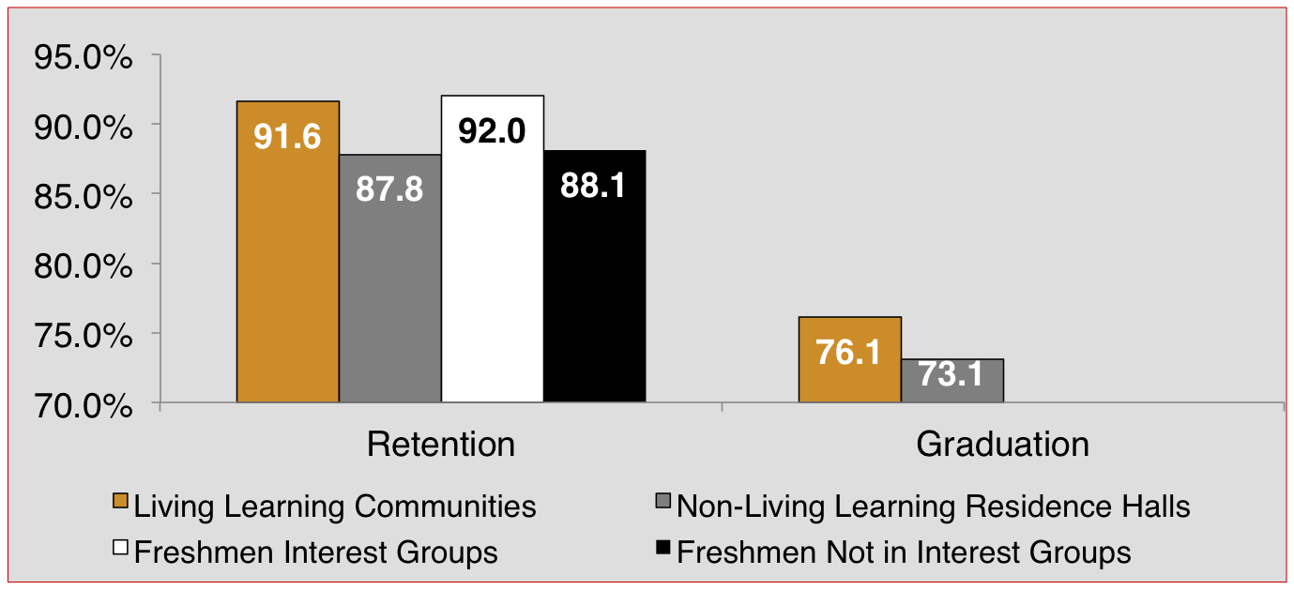
Every strategy was regularly monitored and evaluated for its overall impact on student success.
Living Learning Communities & Freshman Interest Groups
Improve Student Retention & Graduation

Slide 49
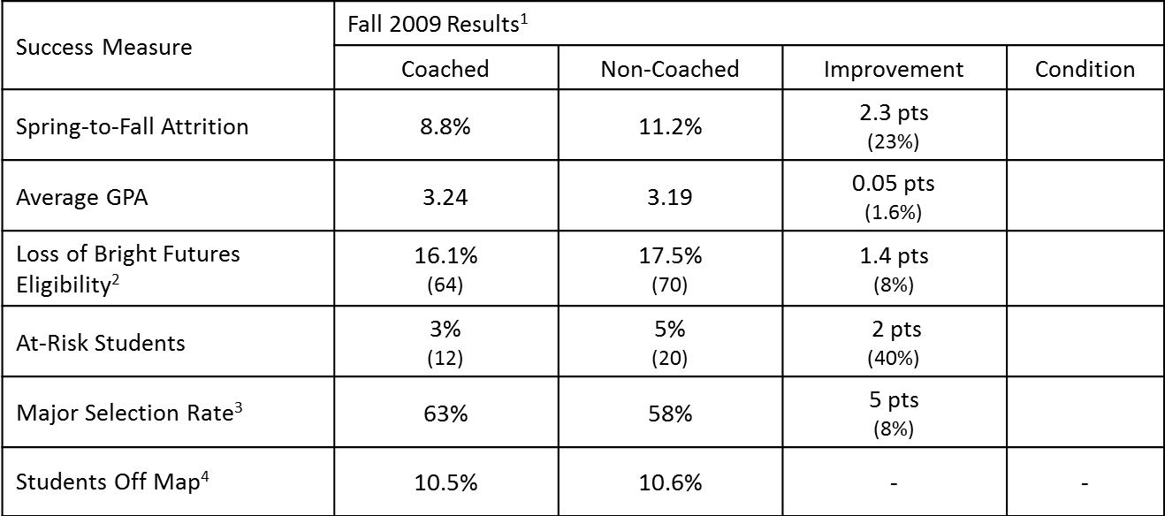
Every strategy was measured against important progress metrics such as term-to-term attrition, grade point average, and major selection rate
Impact of a Success Coaching Program
Program that provides support for students around these 7 “soft” factors that influence retention and graduation:
Commitment to graduation
Managing commitments
Finances
School community
Academics
Effectiveness
Health & Support
Source: Florida State University

Slide 50
The team also conducted retrospective analyses to better understand how different groups of students progressed to graduation
Example of Florida State University Retrospective Analyses
Retrospective analysis of all non-retained students, term by term
Retrospective analysis of all possible subgroups of students
Matched the two analyses and designed interventions to address the observed patterns
Discovered summer students who have a GPA of 2.0 or below have an attrition rate greater than 50% during the next two terms
Randomly assigning half of the students to a mandatory “success” course. Improved year to year by retention by 10% and reduced the number of students on academic probation.
Notes:
Stories Dr. Abele might tell:

Slide 51
Overview of the Course
Course Topics:
  Choosing Success (HS vs. college & resources)
  Memory & Learning
  Time Management & Procrastination
  Note Making
  Learning Styles & Test Prep
  Grades & Other Feedback
  Active Reading
  Critical Thinking

Slide 52
Impact of the Course
Among course completers, the first-year retention rate is increasing over time.
First-Year Retention Rate of Course Completers
2007-2012 Cohorts
 | Cohort | 2006 | 2007 | 2008 | 2009 | 2010 | 2011 | 2012
 | % | 54% | 63% | 65% | 71% | 70% | 74% | 73%
 | +/- | -- | -- | 2% | 6% | -1% | 4% | -1%

Slide 53
Successful Strategies
Low Cost General Strategies
Higher Cost General Strategies
Strategies for High Risk Students
Strategies for High End Students

Slide 54
Low Cost Effective Strategies - I
Academic Mapping for each Degree: term by term course schedule with must take Milestone courses required.
Action steps with student contact aligned with the academic calendar.
Moving Advisors to where the students are at the time when they are there, recording all interactions/questions by time-of-day by day-of-week.

Slide 55
Low Cost Effective Strategies - II
Place High Risk Students in Residence Halls
Hire students for on-campus jobs
W.E.B. Du Bois Honor Society
Oscar Arias Honor Society
Freshmen Interest Groups (FIGS)
Learning Communities in Residence Halls
Use technology to monitor attendance and to develop Early Alerts
Intervene at critical points in the attrition process

Slide 56
Higher Cost Effective Strategies
Re-engineer Low Success Courses
Add programs for High Risk students
Add Advisors
Purchase/utilize Predictive Analytics to guide students in course selection and in selecting a major
Add Tutors in selected courses
  Drop in tutoring
  Tutoring by appointment
Add “Successful Learning Strategy” course
Add Success Coaches

Slide 57
One Strategy for High Risk Students: CARE
  Recruits First Generation students primarily of low socioeconomic status
  Operates Summer Bridge Program
  Early arrival a week before classes
  Mandatory activities
  Students sign a contract to follow program policies
  On-campus housing with CARE counselors as well as traditional RAs
  Tracks, assists and mentors students

Slide 58
Center for Academic Retention and Enhancement (CARE)
  CARE Retention Rate 94.2%
  All FTIC Retention Rate 90.7%
  CARE Graduation Rate 74.0%
  All FTIC Graduation Rate 69.7%
Academic year 2007-08

Slide 59
Strategies for High End Students
Expanded Honors Program
Expansion of Undergraduate Research
Undergraduate Research Symposia
Competitive Grants Program
Office of National Fellowships
Campus Lecture Series Run by Students

Slide 60
Strategies Discussion
Which of these or other succesful strategies can CSU-Bakersfield implement?
What is necessary to implement selected strategies?
Who will initiate them?
When will they be implemented?
How will you measure their effectiveness?

Slide 61
Improvement in retention is variable but steadily improves and yields significant new revenue in tuition collection

Slide 62
The Florida State University Return on Investment
First Time in College 6000 students
1994 attrition 16.5% (990)
2010 attrition 8.0% (480)
Gain in students over four years ~2040
Total investment $2,600,000
Gain in tuition alone* $6,120,000
(Currently $9,300,000)
Net gain $3,520.000 *Calculated at $3000 per student, excluding fees of ~$1500.

Slide 63
There is a steady improvement in graduation rate when Academic Maps and associated policies are implemented

Slide 64
Improving retention will yield a significant increase in degrees
+47.6%
Additional degrees =
2,544
Additional minority degrees =
783
+31.2%
+176.2%

Slide 65

Questions?

