Slide 1
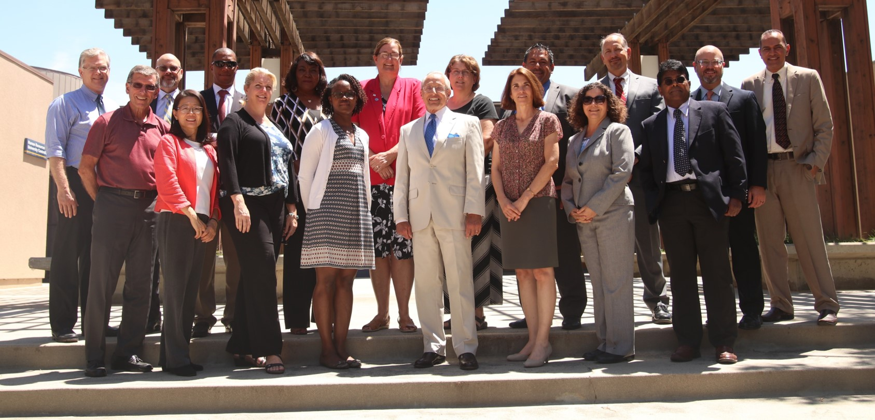
California State University, Bakersfield
Faculty Meeting
August 23, 2017
Provost Jenny J. Zorn, PhD

Slide 2
Provost Update on Academic Affairs
Budget
Student Success and Graduation Initiative
WSCUC aka WASC
Internationalization Efforts
Grants
Admissions
Enrollment Management
Institutional data
IT updates
President’s Initiatives
Faculty searches
Promotions and Tenure
Department Chairs
Library Management System, Faculty Hall of Fame, and Book Launch
Humanities office building and classroom building
Academic Preparation

Slide 3
General Fund 2016/17
 | A | B | A+B
Unit | SALARIES | O&E | TOTAL
Academic Senate | $38,208 | $1,847 | $40,055
Academic Ops & Supp | $338,447 | $3,820 | $342,267
Antelope Valley | $495,889 | $57,247 | $553,136
FTLC | $261,322 | $16,119 | $277,441
Provost/Faculty Affairs | $671,865 | $27,582 | $699,447
Academic Programs | $449,572 | $12,975 | $462,547
Grants & Contracts Admin | $649,902 | $7,749 | $657,651
IRPA | $499,026 | $7,750 | $506,776
Enrollment Mgmt | $3,234,104 | $352,803 | $3,586,907
Library | $1,633,945 | $555,610 | $2,189,555
A&H | $7,598,701 | $141,711 | $7,740,412
BPA | $4,731,658 | $251,568 | $4,983,226
NSME | $9,826,239 | $270,932 | $10,097,171
SSE | $9,105,671 | $308,378 | $9,414,049
Extended University | $17,697 | $698 | $18,395
Kegley Institute | $37,088 | $0 | $37,088
Instruction/Acad Affairs | $4,877 | $10,731 | $15,608
TOTAL ACADEMIC AFFAIRS | $39,594,211 | $2,027,522 | $41,621,733
Note: Salaries do not include benefits.
Benefits are centralized.

Slide 4
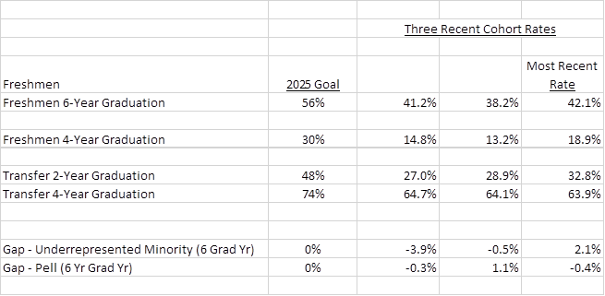
Student Success:
The CSUB Graduation Initiative Goals 2025

Slide 5
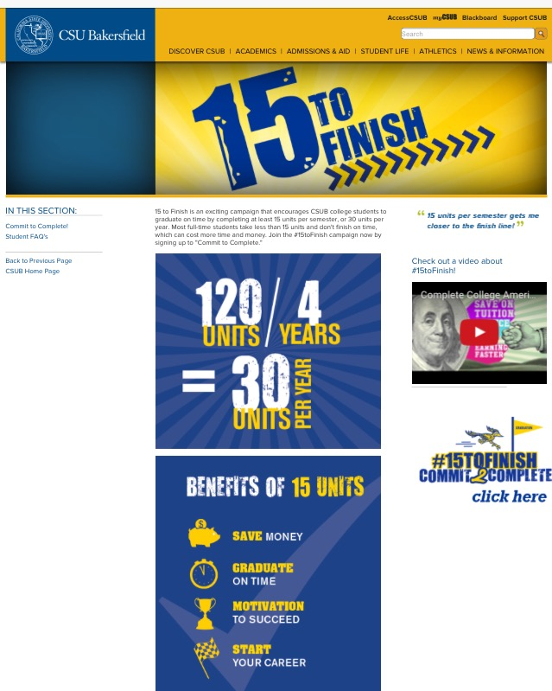
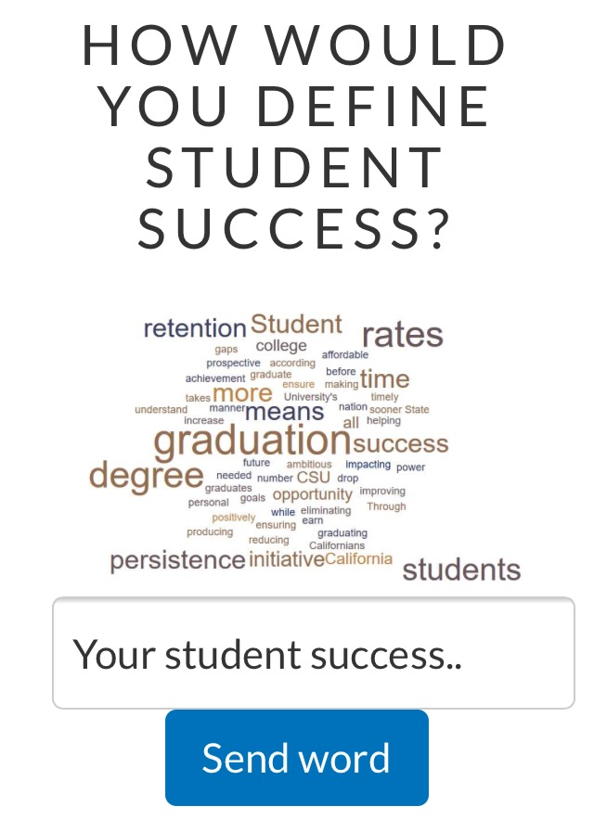
Student Success and Graduation Initiative
Student Success Website
https://www.csub.edu/success/
Faculty involvement
Transformation of 70% of majors
Transformation of General Education
Eliminated requirement for minor
Winter term
FYE
Midterm grades
Block Scheduling
BPA, A&H, Undeclareds
4-year pledge
GPAs decrease
15 to finish
Student Success newsletter
Parent Engagement
Roadrunner parents association

Slide 6
WASC Re-Accreditation Update
The WASC team will visit campus in the Fall of 2019
WASC Steering Committee is working steadily to prepare the campus’ Institutional Report
The Institutional Report will “Tell the story of CSUB now and in the future”
Last Spring, the WASC Steering Committee invited campus participation to serve on WASC Workgroups
Over 45 Faculty, Staff, and Students, from Bakersfield and AV campuses, are now participating on the WASC Workgroups, representing nearly every employee classification
12 Faculty and Administrators were selected to lead the 10 Workgroups
Timeline in Brief
Fall 2017: Workgroups will collect data relevant to the Institutional Report
Spring 2018: Workgroups will begin drafting sections of the Institutional Report
Fall 2018: Draft Institutional Report to be sent to campus and vetted by the Academic Senate
Spring 2019: After Cabinet approval, the Institutional Report will be sent to WASC

Slide 7
Disciplinary accreditations NASPAA accredited PPA programs through 2022-23 The Board of Registered Nursing 5 year Continuing Approval for the Department of Nursing ABET accreditation visit in November 2017

Slide 8
 | Fall 2014 | Fall 2015 | Fall 2016 | Spring 2017
International Student Applications | 214 | 345 | 281 | 402
percentage increase |  | 61% | -19% | 43%
Nationwide international student applications are down 40%.
CSUB international student applications are up 43% and climbing for Fall 2017.

Slide 9
 | Fall 2014 | Fall 2015 | Fall 2016 | Spring 2017
International Student Enrollment | 39 | 64 | 179 | 252

Slide 10
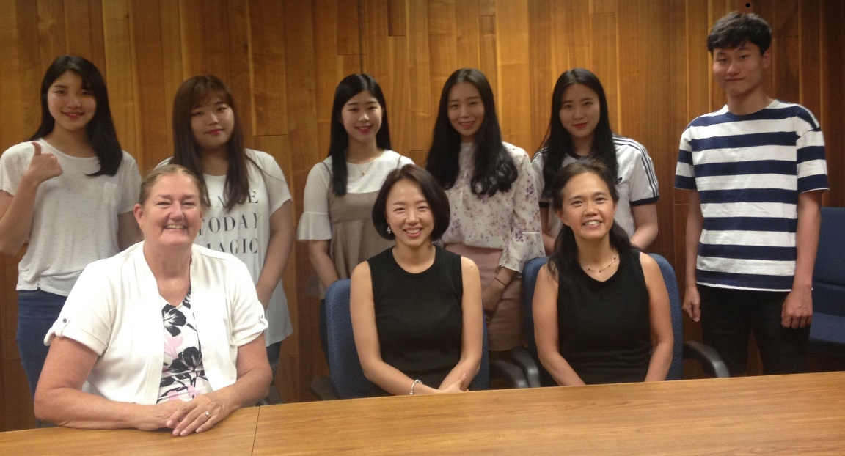
Study Abroad
Outgoing
IP (Chancellor’s Office one year program) students: 2016-17 = 15 students
Semester abroad (exchange) = 1 student for Spring 2017, 3 students for Fall 2017
Summer 2017 short programs = 20 students in 2017 (up from 9 students in 2016)
Incoming
Total of 40 students since 2016
exchange and Semester@ = 15 students for 2016-17
6 students for summer 2017
19 students for Fall 2017
Bucheon, SK students summer study at CSUB 2017.

Slide 11
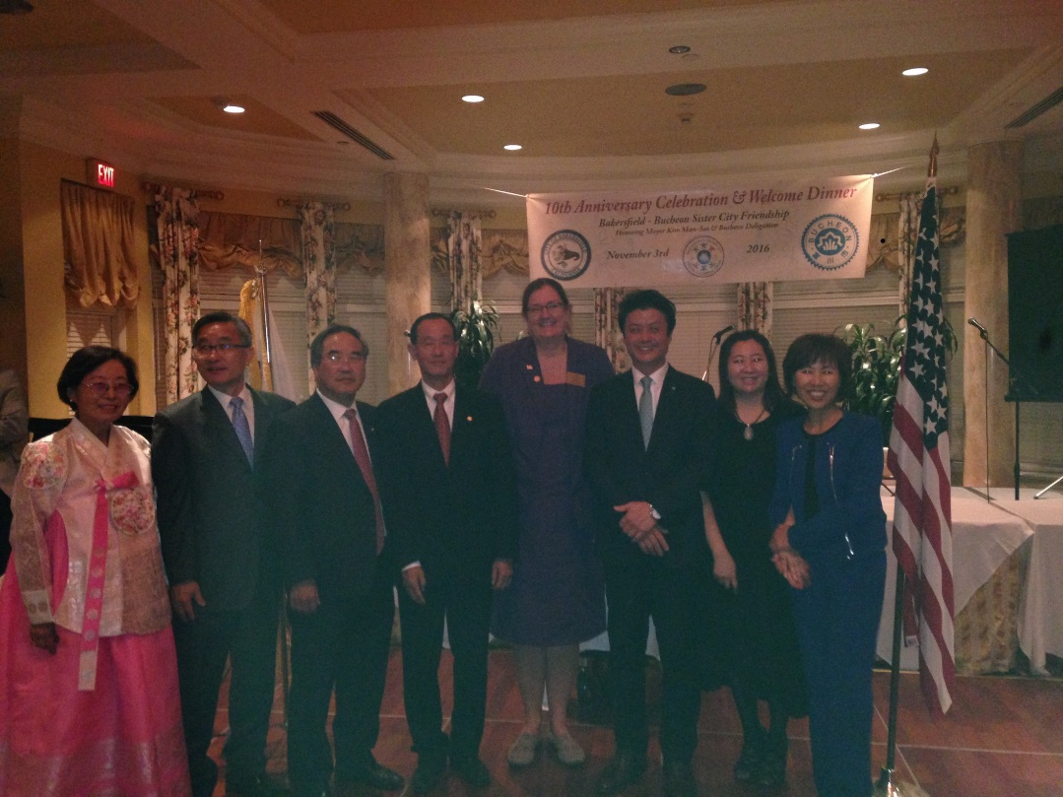
Internationalization of campus
Center for Global Outreach
Study Abroad Office
International articulation agreements
Hosting Visiting Scholars
Professors Across Borders
Phi Beta Delta Chapter: Theta Theta
Bakersfield Sister City
Bakersfield and Bucheon City, South Korea
Sister Cities

Slide 12
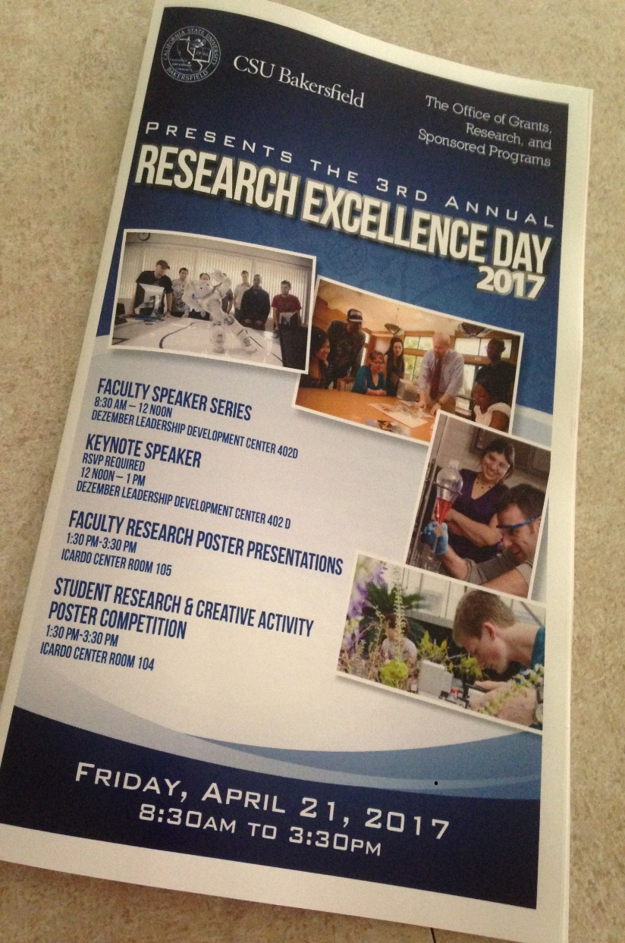
Research Grants
$14 million in 2016-17
Up from $13 million in 2015-16
Submitted 50 proposals in 2016-17
Currently 68 awards (19 are continuous)
#19 in the system in size, #4 in STEM research dollars

Slide 13
 | Fall 2010 | Fall 2011 | Fall 2012 | Fall 2013 | Fall 2014 | Fall 2015 | Fall 2016 | Fall 2017
Undergraduate Total Applications Received by term | 9,436 | 9,609 | 10,507 | 11,307 | 12,199 | 18,956 | 15,341 | 15,576
% change |  | 2% | 9% | 8% | 8% | 55% | -19% | 2%
 | 2010-11 | 2011-12 | 2012-13 | 2013-14 | 2014-15 | 2015-16 | 2016-17
Degrees awarded | 1,768 | 1,851 | 1,839 | 1,775 | 1,787 | 2,189 | 2,505
% change |  | 5% | -1% | -3% | 1% | 22% | 14%
Note: Fall 2015: received large number of redirects from other CSU’s.
Note: Fall 2017 conversion to semesters.

Slide 14
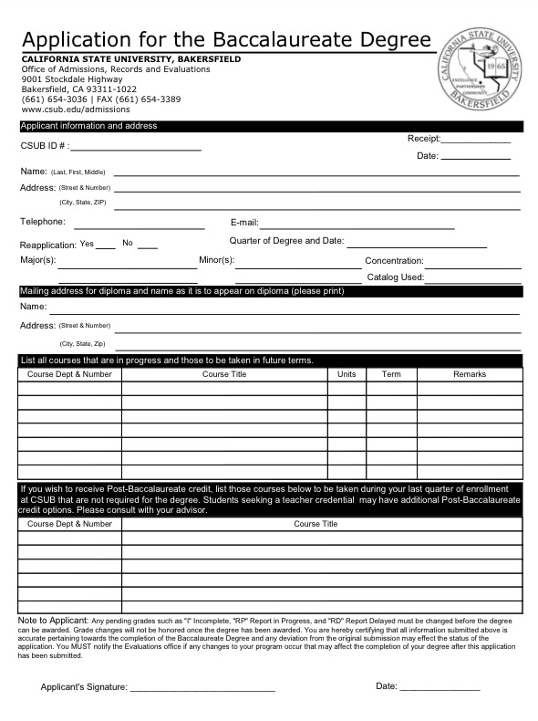
Grad Checks
1422 grad checks for Spring 2018 graduation were
submitted by the April 29, 2017 deadline and continue to be submitted.
1407 have been processed by August 17, 2017. All students who submitted by April 29 have been completed.
Transcript Evaluations for fall 2017
As of August 17, 2017
1293 Total New Transfers Admitted and Accepted
970 Enrolled
3 remaining to complete and post
22 final transcripts submitted in the last two weeks that will be completed ASAP

Slide 15
Institutional data
https://www.csub.edu/irpa/
CSUB ID and Password Required
Currently only available from the on-campus network
Click here for tableau infographic

Slide 16
ITS Accomplishments and Future Priorities
Faust Gorham
8-7-2017

Slide 17
2016 – 2017 Accomplishments
Faculty Refresh – replaced 36 computers
26 faculty workstations replaced in our Smart Classrooms
298 computers upgraded or installed across 10 labs in our Computer Labs
8 Smart Classroom projectors upgraded to our minimum standards
Student Printing – web based, supports all file formats, print to any location
Managed Print Services (Multi-function copiers) – 70 copiers rolled out to departments
EduRoam – wireless access at most higher education institutions across the world
Offsite Disaster Recovery – data loss reduced from total loss to just last 24 hours
Doctoral program revenue tracking
Commencement 2017
Voice over IP Telephone system infrastructure
Two new conference rooms
Security
Perimeter Security
Email validation/ phishing reduction
Multi-factor authentication for key systems

Slide 18
2017 – 2018 Top Priorities
Zoom Video Conferencing for use by all staff, students, faculty
Secure Cloud Storage using Box or Dropbox for sharing of files
Mobile Application for CSUB
Student Engagement Dashboard – live data on student engagement in systems
Humanities Office Building Move and Voice over IP rollout
Automated course and roster updates from PeopleSoft to Blackboard
Grant Management System for pre-award and SPO
Professional Development for ITS on Customer Service, Service and Change Management, and technical skills
Guest Wireless
New campus content management system. Migrate 3-4 departmental websites
Upgrade 75% of our smart classrooms to all be capable of high definition TV and meet our minimum standards, student and learner expectations
Upgrade two of six of our distance/video conferencing classrooms to meet our minimum standards
Faculty Refresh – 40+ computers
A new ITS service and ticketing system making interactions with ITS simpler
Budget and Reporting system
Move 25% of our compute workloads to the cloud and start to offer cloud compute for researchers
Grow outdoor connectivity and in-building performance of wireless network
Cashnet Storefront and Mobile Payment solutions
Security
End point protection

Slide 19
President’s Initiatives 2017
1.Professional Development
Staff and Faculty
2.Student Employment
3.Classroom upgrades

Slide 20
Overview of Classroom Upgrades
Last 18 Months
Classrooms
1. Arranged to have custodial staff in all classrooms clean boards and sweep floors every day
2. MUS 114….removed the music staffs from 2 whiteboards
3. EDUC 127….modified wireless to eliminate connection problems
4. BDC 264….repaired screen; increased number of seats
5. BDC 163, 155….replaced damaged chairs
6. DDH 101H, 146H…remove damaged/old green and black boards with whiteboards
7. Got 90 new armchair desks to replace damaged desks
8. Re—arranged desks or tables/chairs in DDH classrooms to have only one style of desks or one style of tables/chairs in each room
9. Replaced broken/missing floor tiles in DDH classrooms
10. Replaced damaged ceiling tiles in DDH, CB, and SCI 2 classrooms
11. Removed and replaced damaged whiteboards in DDH classrooms
12. Removed all old blackboards and green boards from classrooms
13. Removed all phone cradles, cords and cables, TVs and stands, and other things from walls and ceilings in DDH classrooms

Slide 21
Computer Labs
Replaced 150 student computers in BDC 163 (47); WSL 7 (41); SCI 3-127 (36); DDH 102E (26)
Painted and made various repairs to WSL 14, 16 labs

Slide 22
Aug 2017-Sept 2017
Classrooms
1. Replace various tables and various chairs in Biology labs: Sci 2 208,
215, 221, 230, 308, 313, 410
2. In Sci 2 179 and 180--Replace 140 desks with 62 tables and 140 chairs
Re-orienting both rooms so they are wide, not deep; replacing old
podiums with new lower desk-style podiums; move projector screen
3. Replace tables and 185 chairs in BDC 154, 156, 264
4. Replace all 140 chairs in the three ITV classrooms
5. Replace desks with tables and 81 chairs in CB 104, 106, 108
6. Replace desks with tables and 52 chairs in DDH 103G, 107E
7. Replace 15 tables and 40 chairs in EDUC 225
8. At CSUB-AV, convert tutoring room to Smart classroom; add new tables and 24 chairs
Computer Labs
1. Replace 35 rolling chairs in both Sci 3 127 and 240

Slide 23
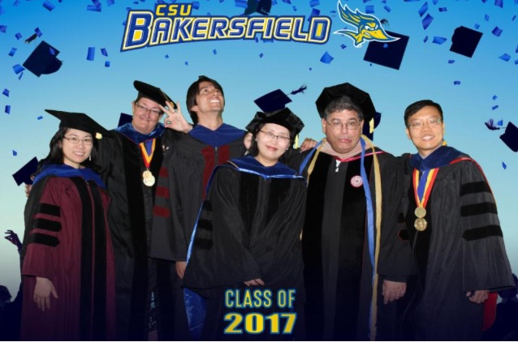
Faculty searches
28 new full time faculty arrived Fall 2017
39 Searches for 2017-18
17 faculty departures
4 repeated searches from last year
18 expansions (2 are lecturers)
39 faculty searches for 2017-18

Slide 24
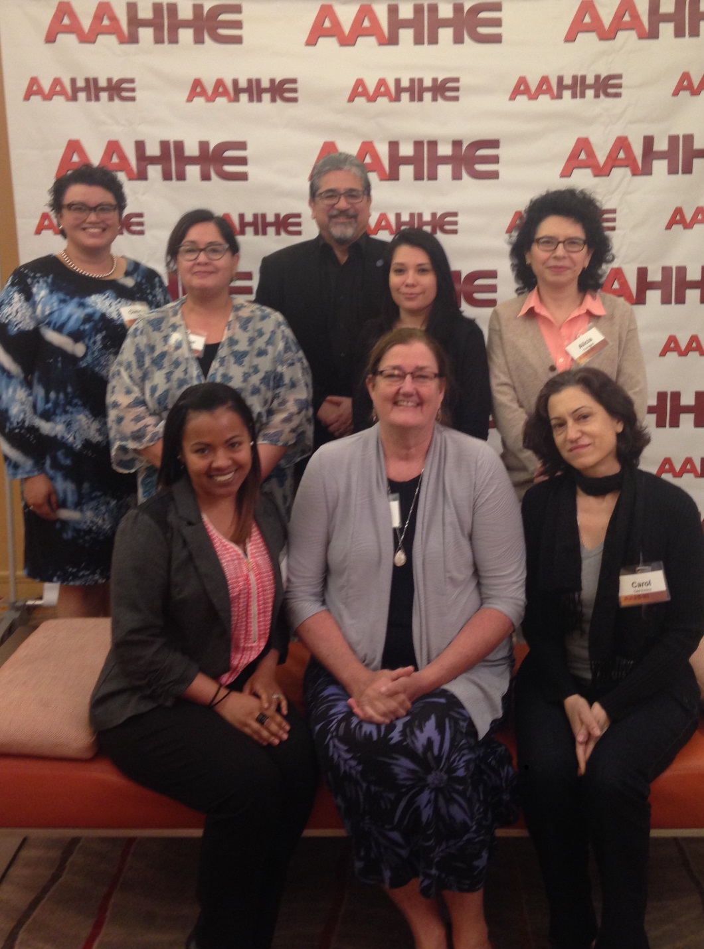
Promotions and Tenure Awards Fall 2017
Full Professor
Douglas Dodd, History
Alicia Rodriguez, History
Marit MacArthur, English
Jean West, Management and Marketing
Melissa Danforth, Computer and Electrical Engineering
and Computer Science
Roy LaFever, Chemistry
Debra Wilson, Nursing
Reem Abu-Lughod, Criminal Justice
Associate Professor and Tenure
Karlo Lopez, Chemistry
Yiannis Ampatzidis, Physics and Engineering
Luis Cabrales, Physics and Engineering
Dayanand Saini, Physics and Engineering
Phyllis Heintz, Nursing

Slide 25
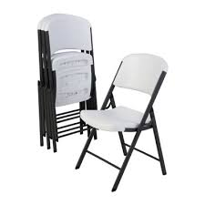
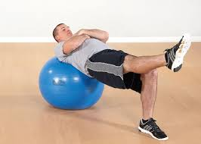
Outgoing Chairs from 2016-17
Incoming Chairs for 2017-18
Mary Slaughter
Steve Frye
Miriam Vivian
Anthony Rathburn
David Gove
Sasha Dzyubenko
Aaron Hegde
Annie Duran
Judith Pratt
Andy Troup
Cliona Murphy
Dirk Baron
Sophia Raczkowski
Jorge Talamantes
Mark Evans
Tanya Boone-Holladay
Interim Chairs who served in 2016-17
Jackie Kegley
John Tarjan
Jesse Sugarman
Annie Duran
Interim Chair for 2017-18
Jeff Moffit

Slide 26
Implemented the Unified Library Management System
Cloud based, resource sharing across campuses
Incorporates disparate library functions into a single system:
Acquisitions, cataloging, inventory, lending, borrowing, bookkeeping, searching, interlibrary lending
Collectively CSU campuses are paying $2.1 million for licensing individually, saves $500,000
C.O. paid for implementation and training
Larger campuses spend more per student on libraries. So, this will help bring equity
Data analytics will allow for better informed decision making, e.g., user usage data
Librarians can be more strategic in acquisitions because they will better know what others have
Enhances faculty recruitment
Helps student text book affordability with providing more access to textbooks
Improves student success for 2-year & 4-year graduation rates, retention, and success
Faculty Hall of Fame
Book Launch
Collaboration with Student Affairs
Celebration of CSUB Authors

Slide 27
A single search accesses books, articles, videos, images, government docs, and more
Ability to request books from any CSU campus with expedited shipping (CSU+)
CSUB students, faculty, and staff have “Visiting patron” privileges at all CSU libraries with ability to check out materials
Databases – You will still be able to access individual electronic databases from the library website
Resource Sharing – Interlibrary Loan will still be used for requesting journal articles or books not in the CSU system
Check your email for updates on training times and locations.

Slide 28
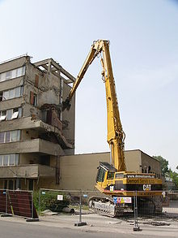
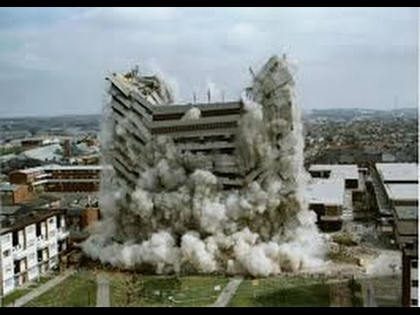
Humanities Office Building
Move in
Classroom Building
Completion during fall term
Grand Opening plans
Faculty Towers demolition
And Tennis courts building demolition
During fall term

Slide 29
Academic Preparation Changes for Student Success
http://www.calstate.edu/eo/EO-1110.html
Using multiple measures
no longer English Placement Test (EPT) and Entry Level Mathematics (ELM)
for fall 2018 admissions
Earning baccalaureate credit
“…This executive order supersedes Executive Order 1048 and elements of Executive Order 665 and reflects significant guidance and feedback from the Academic Senate CSU, discipline faculty, students and our educational partners. The order provides for the broadest utilization of multiple measures in assessing academic readiness and determining course placement for first-year students. The Early Start Program is recast to allow students to focus on a single discipline and acquire necessary foundational content at the same time they earn baccalaureate credit. The executive order also supports faculty innovation in curriculum and facilitates equitable opportunity for first-year students to succeed through existing and redesigned education models.
The timeline for implementation begins in fall 2018 with the introduction of new baccalaureate credit-bearing courses that strengthen skills development to facilitate achieving the appropriate general education student learning outcomes. Recognizing the engagement necessary for developing or reshaping curriculum, the effective term for implementation of all changes to the Early Start Program shall be summer 2019; however, campuses may pilot innovative instructional approaches to the Early Start Program prior to summer 2019….”

Slide 30
Academic Preparation Changes for Student Success
Frequently Asked Questions
https://www2.calstate.edu/csu-system/why-the-csu-matters/graduation-initiative-2025/files/academic-preparation-faq.pdf

