Slide 1
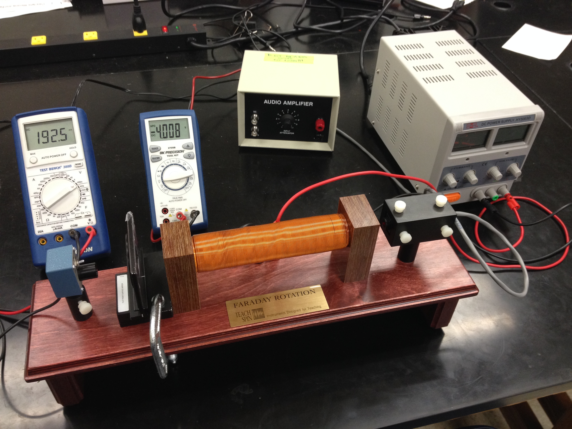
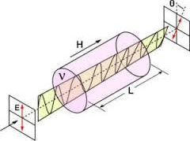
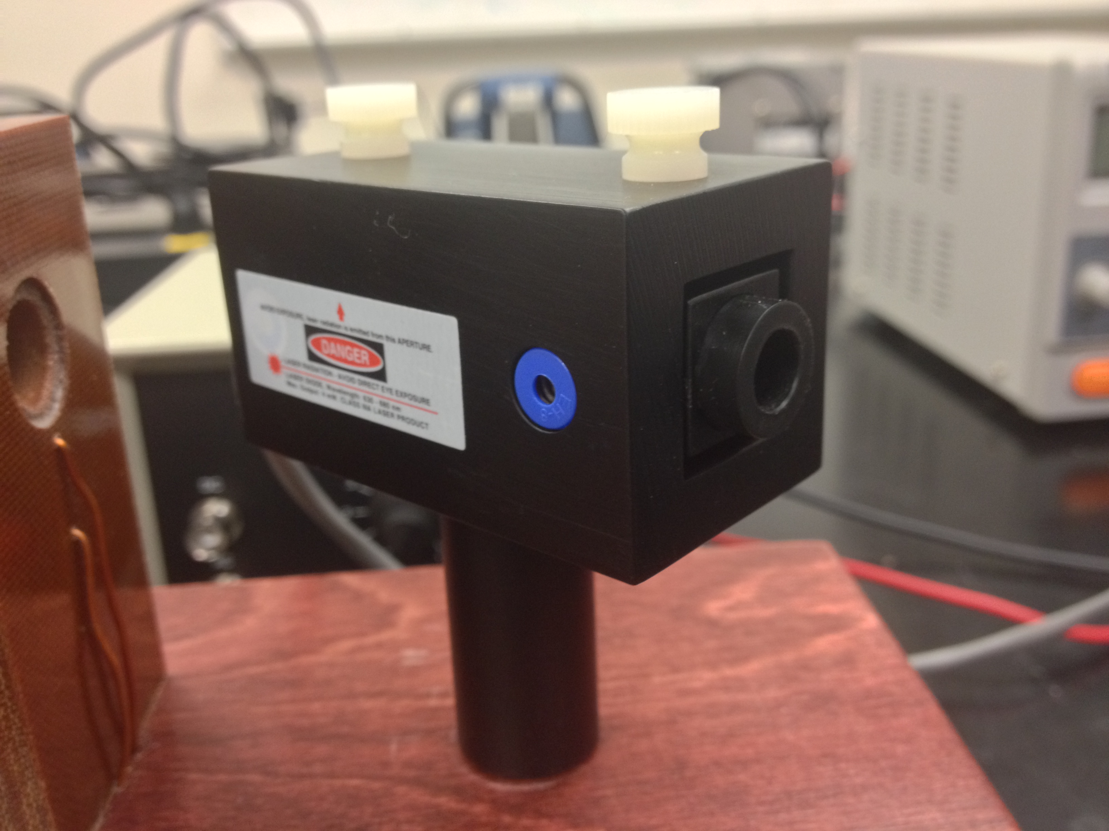
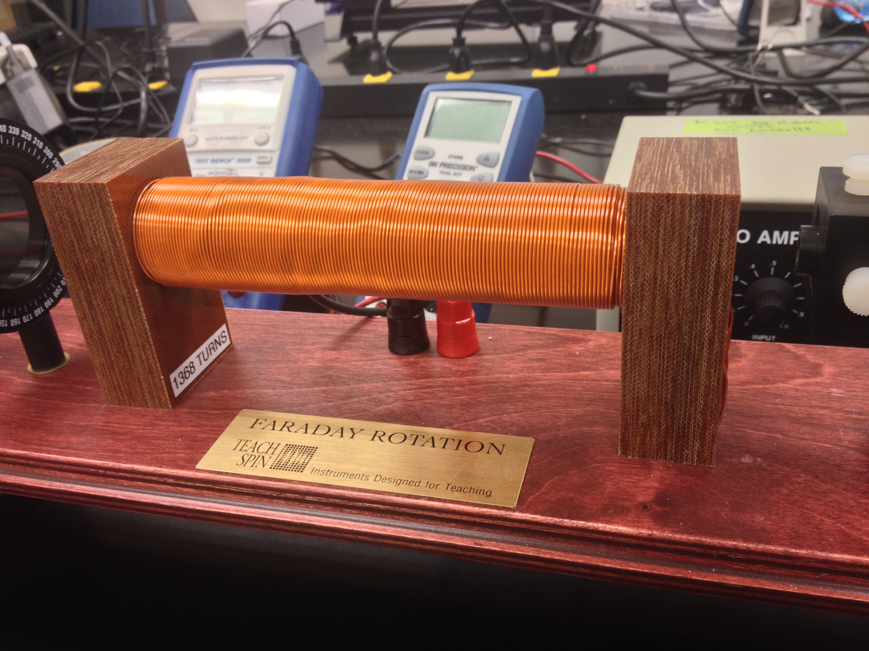
Physics Group: Geoffrey Bartz, Cesar Cabato, Padraic Castillo, Raven Dean, Tyler, Ferris, Jerod Moore, Kathryn Morales, Andrew Ramirez, Leslie Soledad, Jonathan Soto, Kian Talaei, Aime Torres, Josh Lofy, Michael Medrano Faculty Advisors: Vladimir Gasparyan, Thomas Meyer
Faraday Rotation: measurement of verdet constant
Objective: The rotation of the plane of polarization of polarized light is observed as the light passes through various materials inside a magnetic field. The Verdet constant for the materials is measured. We also tried to measure the wavelength dependence of the Verdet constant.
Introduction
Experimental Apparatus
Verdet Constant Wavelength Dependence
The Faraday effect was observed by Michael Faraday in 1845. This effect is evidence of light being an electromagnetic wave. Faraday rotation is a magneto-optical phenomenon that rotates the polarization of light. It occurs as an internal property of the medium when placed in an external magnetic field. The effect is widely used in optical isolators, phase modulators, spin dynamics, etc. Faraday rotation is observed also in astronomy and is used to measure magnetic fields in space.
A source of linearly polarized light is sent through a sample which is in an external constant magnetic field H. The polarization plane of the light rotates while it is traveling through the sample.
The rotational angle is related through the Verdet constant (specific to the material), length L of the sample, and the magnetic field H.
Eq. 1 is valid when there are no reflections from the boundaries of the sample. However, when we have multiple reflections, for example when we place two mirrors at the boundaries of the solenoid, Eq. (1) will no longer be valid as discussed below.
Different wavelengths of light are affected differently while traveling through an optical medium. Eq.1 can show this relationship, if it is rewritten as: $θ=πΔnL$/𝝀 (Δn is the difference of refractive indexes between left and right polarized light in an external magnetic field H). We expect therefore that there will be larger angles 𝜽 and larger values of V for shorter wavelengths.
We were not able to observe this effect because we only had a single wavelength laser available. Because of this we attempted to use different wavelengths of light using an incandescent bulb and several filters of different colors. Our hypothesis was that the filters were transmitting a wide spectrum of wavelengths, rather than a single wavelength of light. We verified this with a double slit and prism experiment.
1
.
2
3
4
5
Intensity With Multiple Reflection
In order to increase the Faraday rotation angle θ in Eq. (1) one must increase either the magnetic field H or the length L of the sample , assuming the Verdet constant does not change. We cannot increase the field much more due to current limitations; thus we looked for ways to increase the effective length of the sample. We added two mirrors on either side of the solenoid. The light is then reflected back and forth inside of the solenoid, effectively increasing the amount of time the light beam travels inside the sample. Instead of using fully reflective mirrors, we used beam splitter mirrors that reflect 50% and transmit 50% of the light. Taking the infinite sum of the reflected beams inside of the two mirrors, we analytically arrived at the equation
$θ=VHL$ .
Eq. 1
1) Multimeters – Measuring devices 2) Power systems for laser and solenoid 3) Photometer
4) Polarizing filter, ± 2° 5) Laser, solenoid, and sample (inside of solenoid)
Apparatus and Calibration
In our experiment we used the TeachSpin FR1-A. It consists of several components: the light source, a solenoid, and a photometer and analyzer.
The solenoid consists of a coil of 1368 windings and has a length of 14.8 cm. The magnetic field inside of the solenoid can be calculated from
where the current i is in Amperes, H is in mT and
the permeability constant is $μ_{o}=4π∗{10}^{−7}H/m$.
We used several samples to find different Verdet constants. These samples are:
1) A small flint glass rod with a refractive index between 2 and 1.8, 10 cm in length, known as SF-59.
2) Glass tubes for using liquids
To start with we confirmed Malus’ law measuring the transmission intensity of the laser through a polarizer. $I_{o}$ is intensity with the polarizer parallel to the polarization plane of the laser, and I is the measured intensity at the indicated angles
By using Malus’ law we re able to confirm that our light was linearly polarized in one direction. Earlier tests with randomly polarized light proved inconsequential (See REVS UP poster for ”Effects of Randomly Polarized Light” at this session).
Verdet Constants and Faraday Rotation
$I=I_{o}\frac{\left(16cos2θ−25\right)}{24cos4θ−51}\cos^{2}θ$.
Eq. (2)
The light source is a red laser pointer operating at a nominal wavelength of 650 nm with a power output of about 3 mw. It requires a voltage regulated supply of 4 volts and 40 mA. The light source is about 95% linearly polarized in one direction.
The Verdet constant is an optical "constant" that describes the strength of the Faraday effect for a particular material. To measure the Verdet constants of our samples we modified our apparatus to reduce our error in measuring θ. The polarizing filter had a degree marking every 5º. We modified this allowing us to measure the angle to within to about ±1º.
The magnet created a maximum magnetic field of 33.3mT, about 1000 times the Earths magnetic field. (Measured as 42μT by Revs Up poster, “The Construction of a Helmholtz Coil to Calibrate a Hall Probe”, 2013). Using Eq. 1 we found the Verdet constant by measuring the angle change through the second polarizing filter.
This experimentally found value is in good agreement with the well accepted value for the glass sample, V = 23 rad/Tm.
The next step was to find the Verdet constants for certain liquids (water, acetone, and ethanol). The Verdet constants we measured were too high compared to the accepted values. One of these reasons was the temperature increase in the water caused by the solenoid heating up. Bubbles can be formed that reflect the laser during the experiment increasing the effective length of the liquid column. To ensure our results were not negatively affected, we had to constantly watch temperature changes on the solenoid using an infrared thermometer, measuring temperatures over 323 ° K (122 ° F). Another reason was that error for our degree measurements were too large. For example, the accepted value for water is 1.5 rad/(T*m). The Verdet constant of water we found experimentally was 2.55rad/(T*m), near double the accepted value. On the other hand, by using equation (1), Malus’ law, and the accepted value for water we would expect a degree change of about 0.4°, which is much smaller than the experimental error of the mentioned apparatus.
The intensity dependence versus rotational angle is plotted below. The theoretical expectation is that this will enhance the Faraday angle from 4 to 9 degrees. We observed an increase in 𝜽 by about 2º consistent with this calculation.
Intensity
$H=\frac{μ_{o}N}{L}∗i=\left(\frac{11.1mT}{A}\right)∗i$ ,
$V=\frac{θ}{HL}=\frac{4.7\text{º}}{.00333∗0.1}=\frac{25rad}{T∗m}$ .
Degree
Conclusion
We were able to measure the Verdet constant for an SF-59 glass rod . The experimentally found values fit well with the accepted values. However, we were unable to measure the Verdet constants of liquids. These constants are very small and are well outside of the error range of the apparatus. We were also unable to verify the λ dependence of the Verdet constant, based in Eq (1), due to a lack of other monochromatic and linearly polarized light sources that can give us more than one wavelength. With two mirrors we were able to increase the effective length of the sample.
It is interesting to note that during the REVS UP program we were able to troubleshoot many different problems within our experiments, teaching us of other hurdles that we had to overcome. These challenges taught us about other aspects of the physics going on within our experiments.
$$I=I_{O}\cos^{2}θ$$
References:
1 – TeachSpin, http://www.teachspin.com/instruments/faraday/the_instrument.shtml
2 – Aloke Jain et al., Am. J. Phys. 67 (8), August 1999
3 – Thorlabs – Photo of Faraday Effect http://www.thorlabs.com/images/TabImages/IsolatorCylinderDWG.jpg
4 – Wolfram Mathematica
5 - Handbook of Optical Materials - Marvin J. Weber (http://books.google.com/books?id=6VpQDoef05wC&printsec=frontcover#v=onepage&q&f=false)

