Slide 1
Understanding University-wide Graduation Requirements
Faculty Advising Summer Institute
Tuesday, August 10, 2022, at 10a.m.
Presenter: Luis Vega

Slide 2
Focus of Session
Student Academic Success by Meeting Graduation Requirements
Overcoming Hardships Having Faculty as [tor]Mentors
Professor to student: It’s in the Syllabus University to Professor: It’s in the Catalog

Slide 3
Learning Objectives
1. Context/History of General Education
2. Policies, Processes, Programs, Procedures on Route to the Baccalaureate
3. When Things Don’t Go as Planned

Slide 4
1. General Education at CSUB
Other Approaches
-Classical Western Arts/ Rhetoric/ Critical thinking/ Math Reasoning
Thematic (CSUB) Theme Q: Quality of Life Theme Theme R: Revolutionary Ideas and Innovations Theme S: Sustainability and Justice
→ Skill Reinforcement – Capstone←
Outcome Assessment GE: Learning Driven by Goals/Objectives
Source: https://www.readinglength.com/book/isbn-0852295316

Slide 5
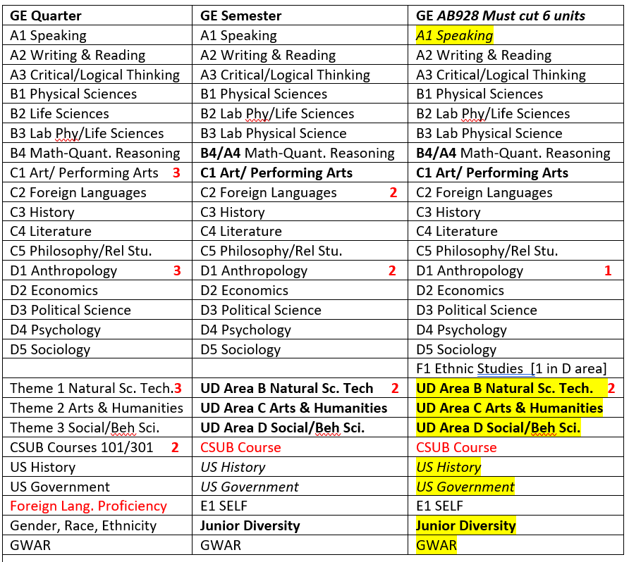
ONGOING UPDATES AND CHANGES TO REQUIREMENTS
GI 2025 Priorities for 2021-22 – technology, re-enrollment, DWF rates, returning students, equity issues
AB 102 (2021) Ethnic Studies requirement—Area F—AB 1460 CSU specific. Catalog rights Diagram below
AB 928 (2022) Transfer Alignment CC CSU UC, more ADTs, 34-units GE pathway
AB 927 (2021) Community College offering baccalaureate degrees for unmet needs
AB 1111 (2021) Common course number at CC by July 2024. CSU implications

Slide 6
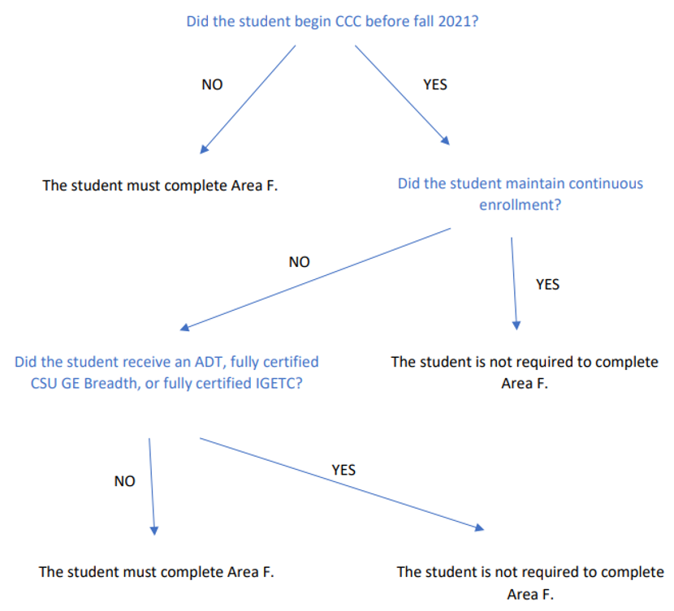
A Recent Case Study of New Requirement Implementation – Catalog Rights Issue
Area F (Ethnic Studies requirement) and Catalog Rights Memo from Chancellors Office “Implementation Guidance for CSU General Education Policy and Transfer” August 31, 2021
Simplified Diagram composed by Debra Jackson in email to CSUB Student Success Network

Slide 7
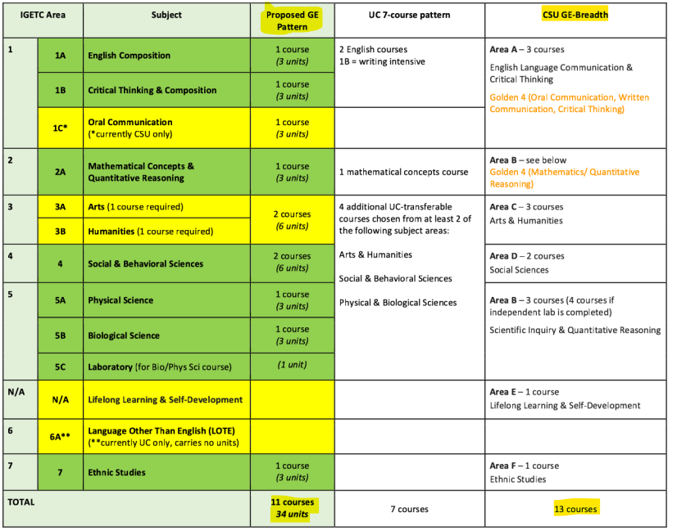
Forthcoming Changes to GE through AB 928
AB 928 (2022) Transfer Alignment CC CSU UC, more ADTs, 34-units GE pathway

Slide 8
2. Policies, Processes, Programs, Procedures on Route to the Baccalaureate Check mark if true: To Graduate
__ 120 total units are needed for the baccalaureate
__ 40 units need to be upper division
__ 70 are the max units accepted from a Comm College
__ 24 Units are the max units allowed from Ext. Ed.
__3rd time a course is repeated requires a petition __16 units with F grades but a student can still have a 4.0
__28 units and no more are allowed for course-repeat __1.90 GPA with academic renewal can allow earning the degree

Slide 9
POLICY AND PROCESSES THAT MUST BE FOLLOWED PER UNIVERSITY POLICY
GE Requirements—Student perspective, substitutions, waivers, scheduled courses, other… Departments & Programs -- Requirements for each major; attend to course descriptions
Registrar’s Office & Academic Policies—Enrollment, Registration, Eligibility “W” grade limits / Extension unit limits / max transfer CC units / min upper div. units/ max GSC units
Academic Affairs and Academic Programs – academic: requirements, standing, catalog, waivers/appeals Assessment and quality of programs
Senate Resolutions -- Monitor CSUB Policies, New, Revisions, Concerns (Res 212233 academic integrity)
GI 2025 Priorities for 2021-22 – technology, re-enrollment, DWF rates, returning students, equity issues
https://calstate.policystat.com/ Finding CSU Chancellor’s Executive Orders and CSU Policies
https://www.csub.edu/senate/university-handbook Policies like Grievances (Appendix D)
Title 5 Education (California) guidelines

Slide 10
3. ACADEMIC STANDING, DISMISSAL RISK, AND RETURN TO GOOD STANDING
Academic Petitions – When things do not go according to plan and academic standing is affected
Flow: Probation – [Jeopardy] -- Disqualification – [Appeal] -- Reinstatement
-Reinstatement different for students with 59- or less units versus 60+ units -Academic renewal – narrowly defined
-Repetition of course beyond 3rd attempt
-Return to earlier catalog
-No petition needed for course repeat up to 28 (16 units grade forgiveness / 12 units grade average)
-Appeals -- Role of the APC (Academic Petitions Committee)—1 faculty representative from each School
Executive Orders Relevant to Petitions: EO1037 – Grading, Repetition of courses, Academic Renewal, and Appeals

Slide 11
Preempting Calamity of Academic Disqualification through Advising
Hypothetical Scenarios and not guidelines
__Students misjudge consequences or are unaware, how to inform/educate?
__Honest advising– student wants to be an MD but not passing Chemistry courses
__Professor allows students performing poorly to drop course with W before deadline
__Course overloads and repeatedly getting W grades, Fs, WUs, and not seeing advisors __Where is the place and time to talk to students about grades and performance
__Student seeks term withdrawal by-passing professor’s signatures
__When/Where do we teach about professional responsibility, deadlines, etc.
Other Scenarios

Slide 12
ACADEMIC DUE PROCESS PROCEDURES –WHEN DIFFERENCES ARISE
Student Complaints and Grievances – limits: (a) Violation of policies/regulations, b) clerical error, (c) prejudicial evaluation, (d) arbitrary/capricious evaluation. Note different procedures for Student Discrimination, Harassment, and retaliation complaints.
Read about latest developments: https://edsource.org/2022/new-batch-of-csu-records-show-professors-disciplined-for-sexual-harassment/676217

Slide 13
Holistic Advising – Pipeline to Graduation for First-year and New Transfer Students
CAMPUS information that comes handy and should be consulted as needed
[ ] Admissions & Enrollment is Official: https://www.csub.edu/admissions/
[ ] Know Campus Map & Phone #s: https://www.csub.edu/campusmap/
[ ] Browse/Read Academic Catalog: https://www.csub.edu/catalog
[ ] Know Academic Calendar: https://www.csub.edu/calendar/
[ ] Understand Academic Advising: https://www.csub.edu/advising
[ ] Access Student Services Needed: https://www.csub.edu/studentservices
[ ] Know Student Rights and Responsibilities: https://www.csub.edu/osrr/
[ ] Applying for jobs and on-campus career guidance: https://www.csub.edu/cece/
[ ] University related: https://www.csub.edu/academicprograms/Undergraduate%20Studies/index.html
[ ] Counseling Center: https://www.csub.edu/counselingcenter/

Slide 14
MAJOR information that is actionable and needs ongoing attention
[ ] Know Requirements for your Major: https://www.csub.edu/catalog/departments-programs
[ ] Know Course Descriptions of Major & GE: https://www.csub.edu/catalog/course-descriptions
[ ] Use Academic Advising & Learn Process: https://www.csub.edu/advising
[ ] Learn Networking Opportunities in Major: Clubs / Honor Societies, do a search
[ ] Consider Student Government, School Newspaper, Greek Life: do a search
[ ] Runner Alumni Mentor Program: https://www.csub.edu/alumni/runner-alumni-mentor-program
CLASS activities and practices in need of attention and developmental mode
[ ] Read class syllabi thoroughly, note due dates, readings required, outside of class work
[ ] Form study groups and exchange information with trusted classmates in case you miss class
[ ] Work with the writing center to brainstorm, outline topics, research evidence, edit drafts
[ ] Learn library resources and references: https://library.csub.edu
[ ] Improve your oral and written communication, seek opportunities

Slide 15
RECORD BUILDING and dossier development to highlight accomplishments
[ ] Search & Engage in the following activities early in your academic experiences
[ ] Approach Professors for Research/Graduate School Advice & Career Counseling
[ ] Take Research Experience Courses/Independent Studies
[ ] Take Applied Experience Courses/Volunteer
[ ] Participate in Student Academic Competitions
[ ] Apply for Scholarship Opportunities: https://www.csub.edu/camp/Scholarships/index.html
GETTING READY TO APPLY TO GRADUATE SCHOOL that are a must and most not be delayed
[ ] Obtain 3 letters of recommendation from professors
[ ] Compose a personal statement
[ ] Prepare your resume and/or curriculum vitae
[ ] Be prepared for graduate school interviews
[ ] Have clear graduate school objectives
[ ] Know how graduate school and career goals intersect [ ] Graduate Student Center Workshops: https://www.csub.edu/graduatestudentcenter
-See workshops and activities in our website; talk to professors and graduate students

Slide 16
Thank You

