Slide 1
Understanding Our Diverse Students
Alicia Rodriquez, Professor of History
August 11, 2022

Slide 2
Great conversations are based on*:
Mutual Respect – recognizing that everyone has valuable and important contributions to make and are valued for what they bring to the conversation.
Trust – having the ability to rely on each other because a safe environment exists in which dialogue can be shared freely without judgment or negative consequences.
Responsibility – recognizing the duty to uphold mutual respect, building trust, making contributions, and listening to colleagues.
Contribution – sharing your thoughts, experiences, and knowledge with others to enhance the conversation by providing various points of view, exploring many options, and highlighting potential solutions.
Listening - paying attention to the person speaking, giving everyone the opportunity to speak, and seeking clarity by asking questions to gain understanding.
* source: adapted from ¡Excelencia in Education!

Slide 3
Today’s key ideas:
Diversity:
Our students are diverse in many ways and reflect the regional community.
Communication:
Communication – negative or positive – affects our advisees. We should strive to be mindful of language and terminologies, and of the power of words.
Empowerment:
Creating a safe and welcoming environment for our advisees is essential to empower them for success.

Slide 4
We are busy!
And some of us are busier than others, as the number of students we advise varies by school, discipline, program.
Resources: professional/staff advisors.
Notes:
Counseling Center, for assistance with relevant issues.

Slide 5
How do your advisees schedule an appointment?
Notes:
Sign-up Genius?
Doodle? Runnerconnect?
Other resources?

Slide 6
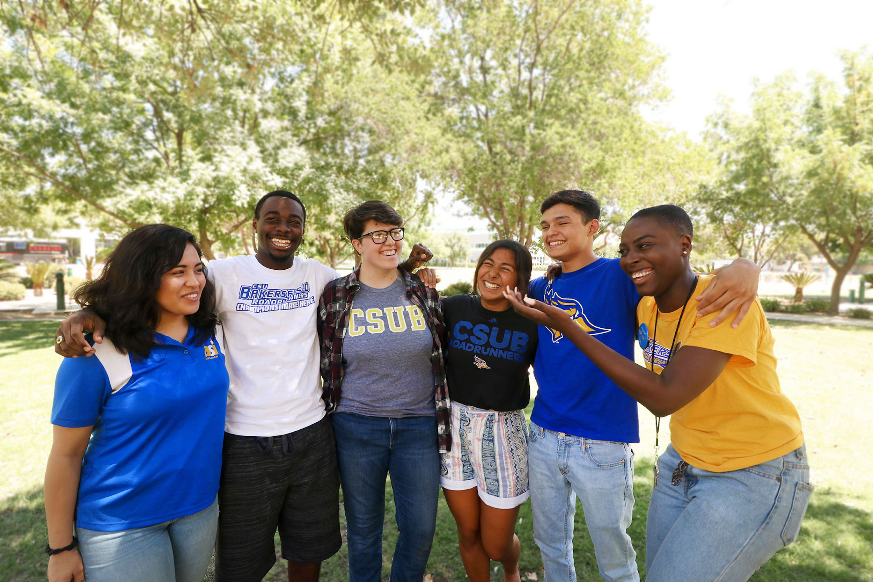
Who are our students?
Notes:
Photo from 2018!

Slide 7
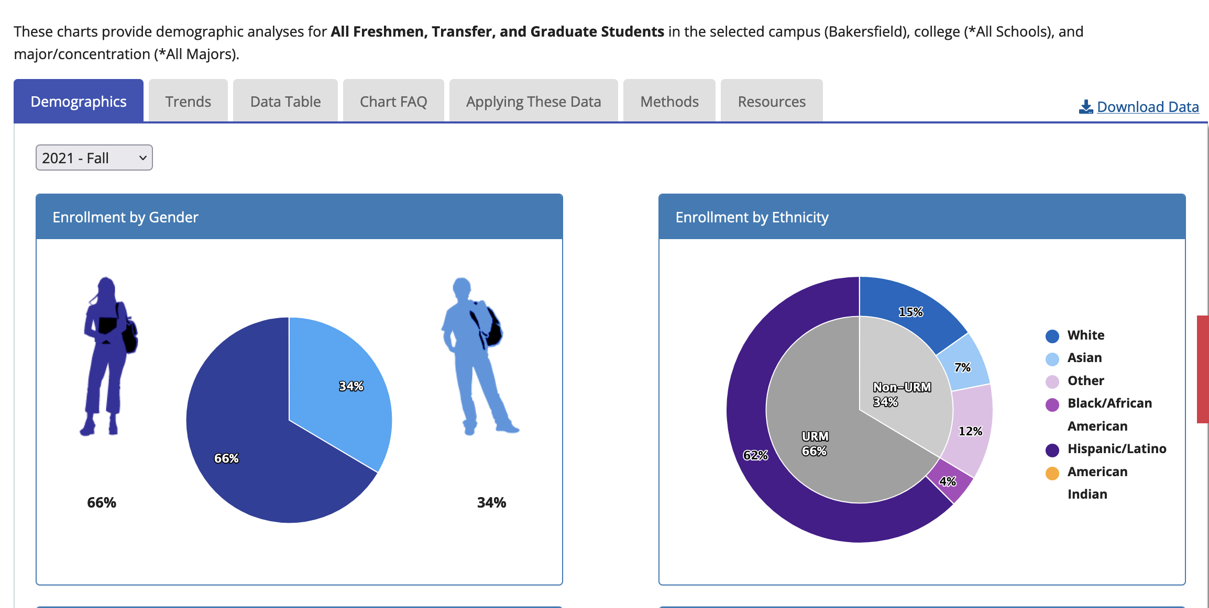
Who are our students?
CSU Dashboard
Source: CSU Dashboard

Slide 8
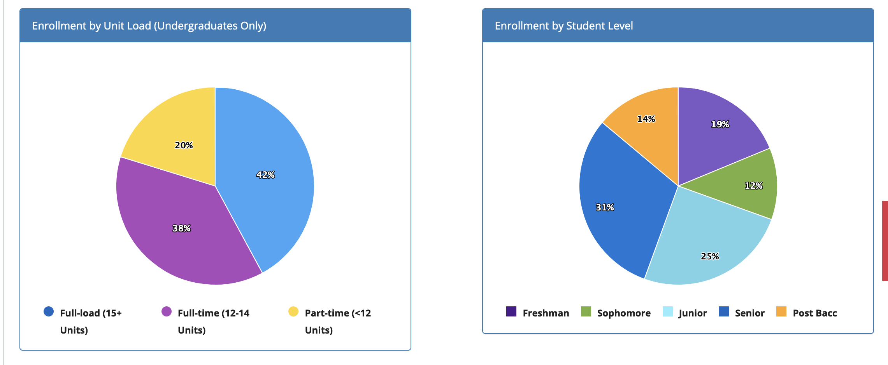
Who are our students?
Source: CSU Dashboard

Slide 9
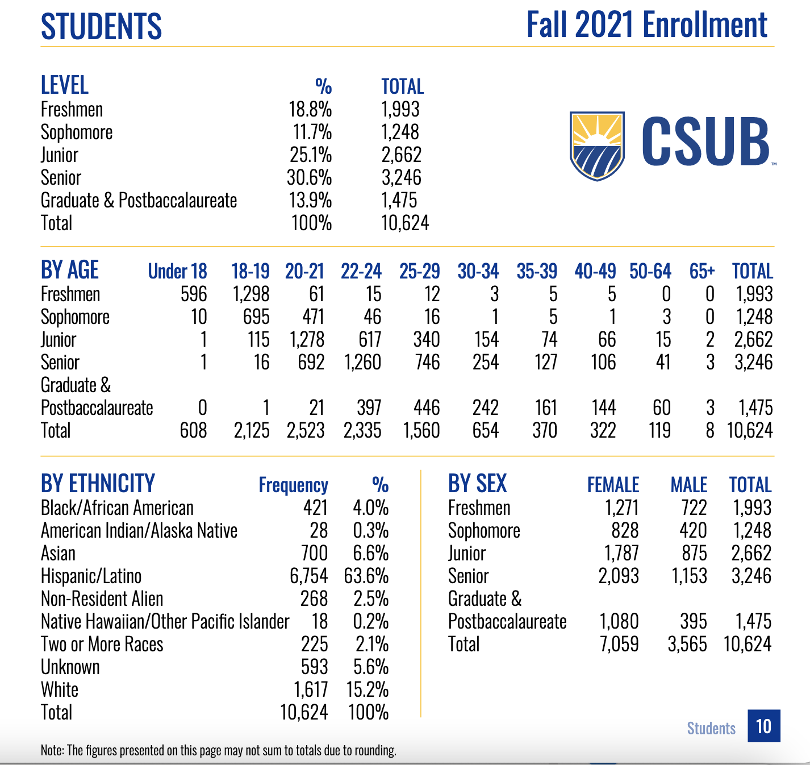
U.S. Census Kern Co demographics
Who are our students?

Slide 10
Who are our students?
• Race, ethnicity, LGBTQ+, cultural identity, class, socio-economic status
• Pronouns, language, student athletes
• Veterans, parents, first generation
• First-time freshmen students, transfer students, post-baccalaureate students
• And more.

Slide 11
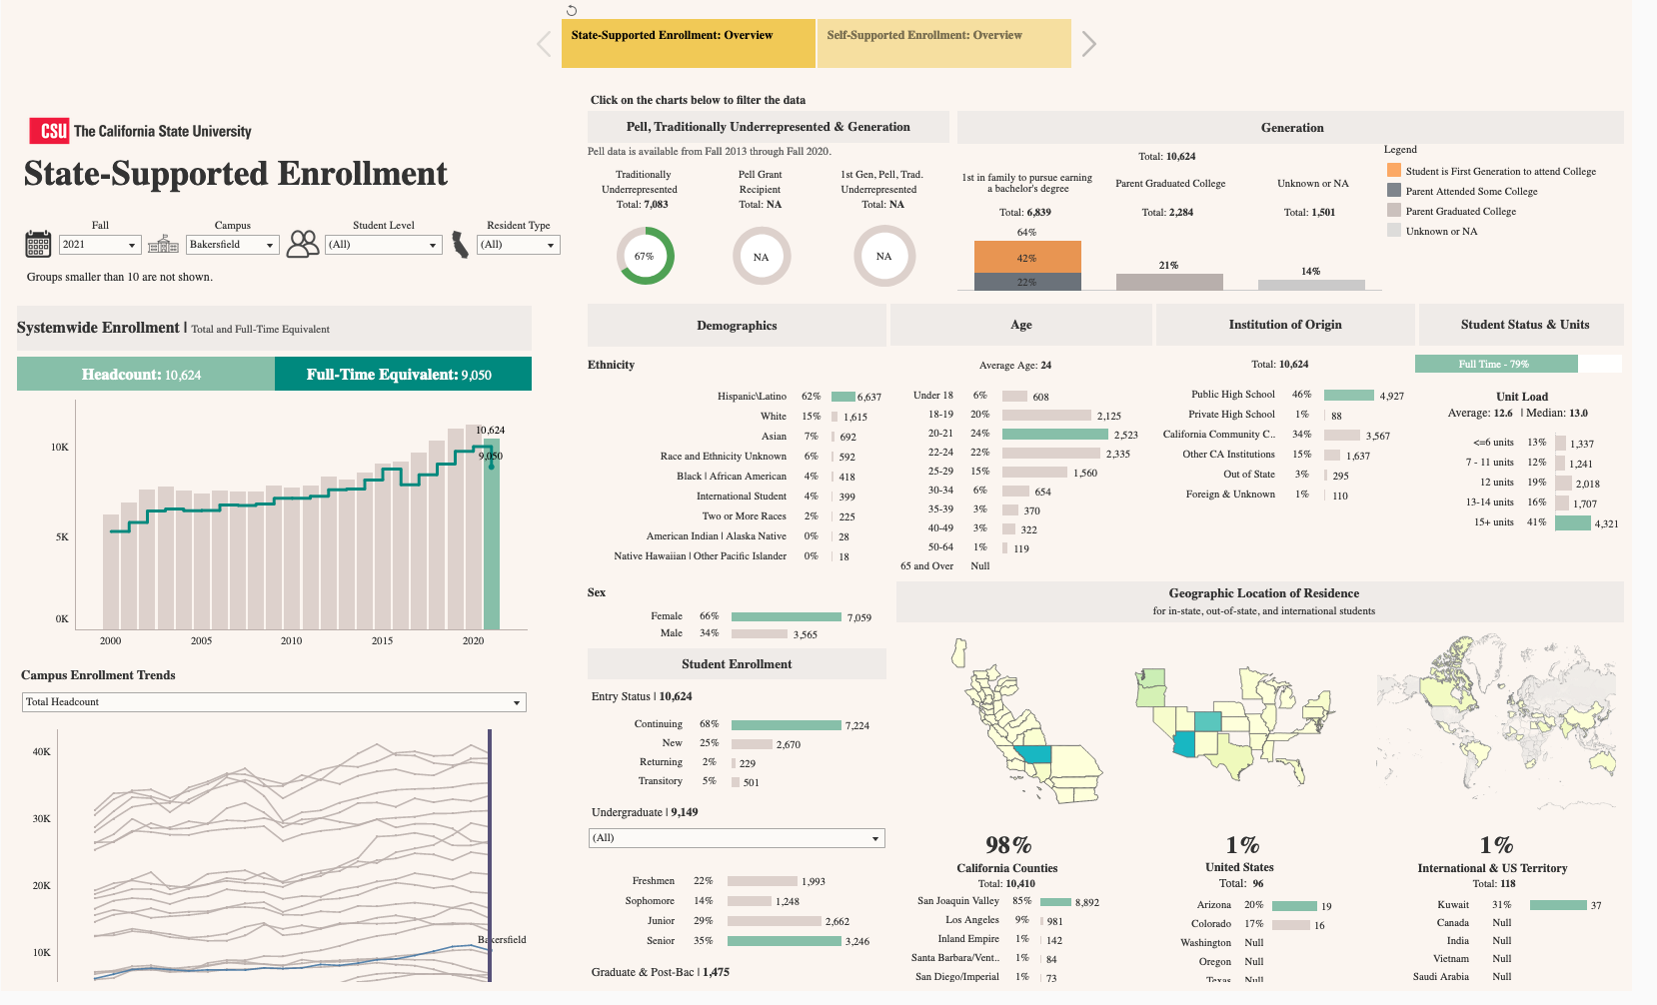
Notes:
All students

Slide 12
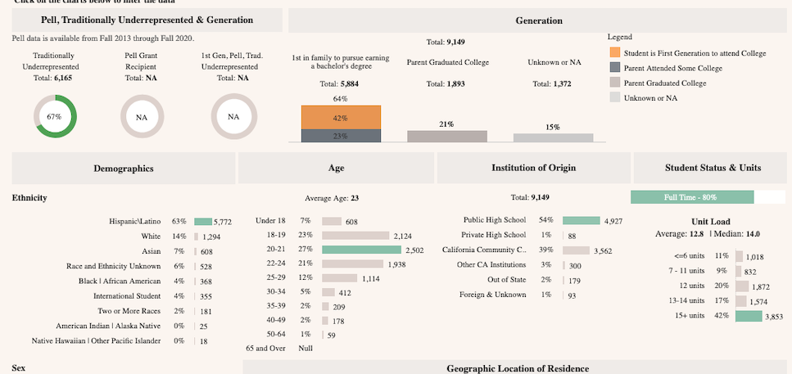
Notes:
Undergraduate snapshot

Slide 13
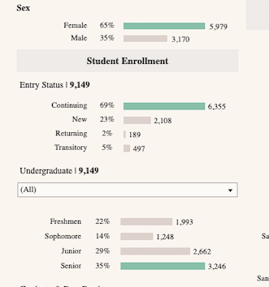
Tableau
Notes:
Undergraduates

Slide 14
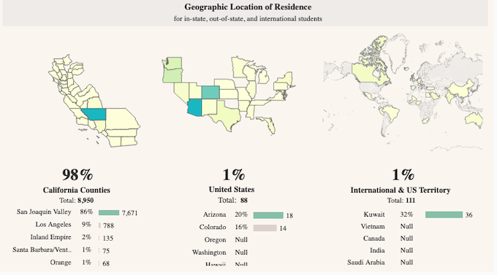
Notes:
Undergraduates

Slide 15
We must continually strive to be mindful of the wonderful diversity of our students. At the same time, we must remember that there are many layers of diversity among our students No one is monolithic in their identity.

Slide 16
Breakout sessions:

Slide 17
Reflection and discussion:
Think of a time when a superior (unequal power dynamic), responded to your idea or request in a negative or unhelpful way.
– What impact did their response have on you?
– How did it affect your performance?
– Propose a better way that the superior could have phrased the criticism or provided feedback.
– Consider how students may perceive what you say to them during advising.

Slide 18
Reflection and discussion:
Recall a time when you felt judged because of a superficial characteristic or your social identity?
– What was the situation? With whom and in what context?
– How did you feel? What was the impact?
– What could have helped in the moment?

Slide 19
Reflection and discussion: Statement of advising philosophy
What is your advising philosophy?
1. Think consciously about what you practice when you advise students.
2. How do you empower students to exercise agency as they make choices that affect their time in the university, and their longer-term career prospects?

Slide 20
Reminders/recap:
Advisors should recognize our student diversity and demonstrate respect and sensitivity by approaching students with as few preconceived notions as possible.

Slide 21
Reminders/recap:
2. Advisors should use affirming language and terminology, while recognizing that terminology is always evolving.
Notes:
Note the concept of “terminology anxiety”

Slide 22
Reminders/recap:
3. Advisors should practice and exercise grace and kindness when we meet with students and empower them to become proactive in making choices that suit their goals and interests.

Slide 23
Sources and Resources:
University of California, Berkeley, Advising Strategy + Training:
https://advisingmatters.berkeley.edu/resources/foundations-practice
2. NACADA (National Academic Advising Association): The Global Community for Academic Advising:
https://nacada.ksu.edu/

Slide 24
Thank You

