Slide 1


Faculty Advising Summer Institute
2022
DAY 2: Following Academic Policies and Procedures
S. Aaron Hegde
Chair, Economics
Chair, General Faculty
Chair, Academic Senate

Slide 2
Outline
RES 212229: Change of Department Name from CAFS to HDCAFS
  CSU System – BOT
  Academic Senate
  Shared Governance
  Academic Senate Leadership
  Academic Affairs Committee (AAC) Charge
  AAC Membership
  AAC Resolutions

Slide 3
Board of Trustees
Oversight of the CSU
Authority over curricular development, use of property, development of facilities, and fiscal and human resources management.
State law requires 25 trustees
  5 ex officio members: Governor, Lieutenant Governor, Speaker of the Assembly, State Superintendent of Public Instruction, and the Chancellor.
  Sixteen trustees appointed by the governor, confirmed by the State Senate, and serve eight-year terms.
  CSU Alumni Council appoints an alumni trustee (two-year term)
  Governor appoints a faculty trustee (two-year term) from nominees proposed by the Academic Senate of the California State University.
  Two student trustees, nominated by CA State Student Association (two-year staggered term)

Slide 4
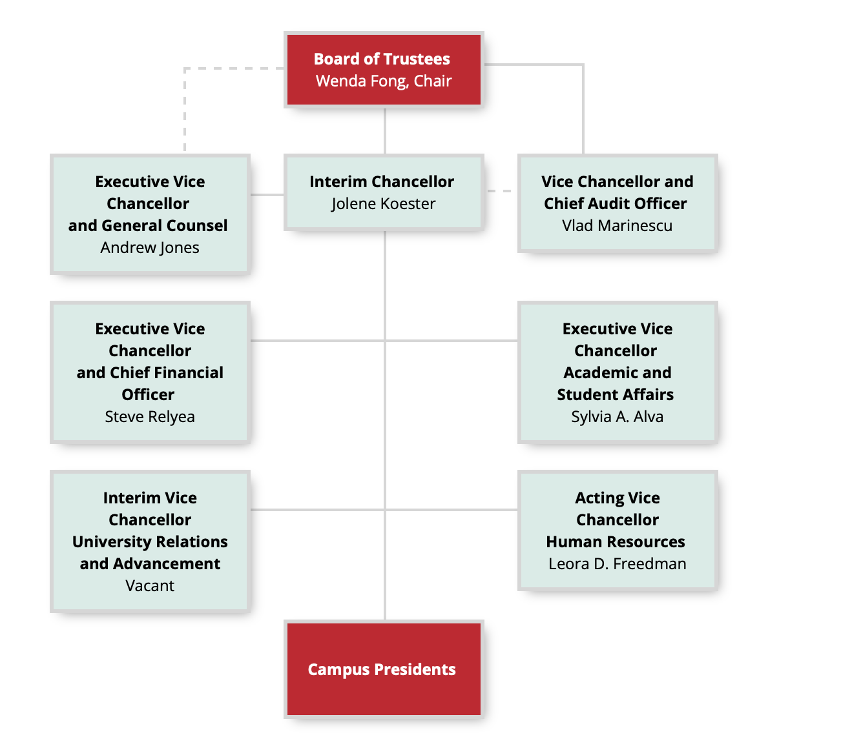

Slide 5

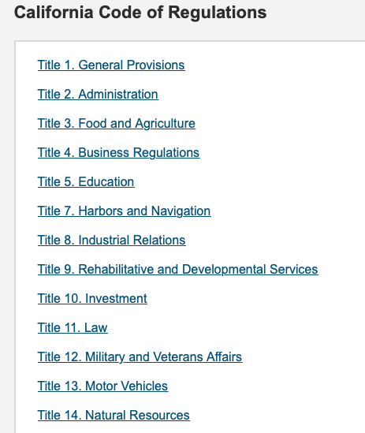
Board of Trustees
Currently there are nine standing committees of the Board: Audit; Campus Planning, Buildings and Grounds; Collective Bargaining; Educational Policy; Finance; Governmental Relations; Institutional Advancement; Organization and Rules; and University and Faculty Personnel.
The Donahoe Higher Education Act of 1960 structured state colleges and individual campuses into the nation’s largest system of four-year higher education
Title 5 of the CA Code of Regulations governs the CSU

Slide 6
Academic Senate Organizational Chart

Slide 7
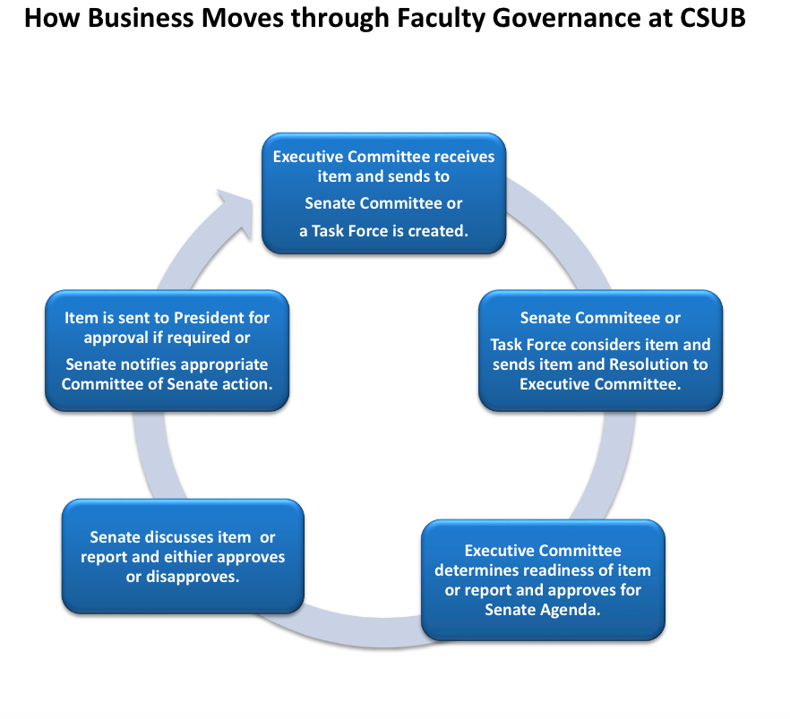

Slide 8
Academic Senate Leadership –
Executive Committee, 2022-23
Chair of the Academic Senate (and General Faculty) – Aaron Hegde
Vice-Chair of the AS (and General Faculty) – Melissa Danforth
Chair, Academic Affairs Committee – John Tarjan
Chair, Academic Support and Student Services Committee – Elaine Correa
Chair, Budget and Planning Committee – Charles Lam
Chair, Faculty Affairs Committee – Mandy Rees
Statewide AS Reps (2) – Janet Millar, Mark Martinez
Provost – Ex-Officio, Non-Voting – Vernon Harper
Support – Administrative Analyst Katie Van Grinsven

Slide 9
Academic Affairs Committee
Shall review and report to the Academic Senate its recommendations regarding:
All new academic policies, procedures, programs, and curricula having inter-school or all-university impact;
Proposed changes to the University Catalog that have inter-school or all-university impact;
The Academic Plan; and
Proposed changes in the implementation of the General Education Program.
In addition, the Academic Affairs Committee shall
  serve as the University Curriculum Committee for inter-school programs that have required courses for majors and/or minors (i.e., not electives) in more than one school; and
  shall recommend to the Academic Senate action to be taken when there is disagreement among faculty involved in proposed changes to the Catalog and/or to academic policies, procedures, programs and curricula having inter-school or all-university impact.

Slide 10
AAC Membership: 2022-23
Arts and Humanities | Mary Slaughter
Business & Public Administration | John Tarjan (Chair)
Natural Sciences, Mathematics & Engineering | Dani Solano
Social Sciences & Education | Janet Armentor
At-Large | Heidi He
At-Large | Maureen Rush
At-Large | Michael Szolowicz
One Student (ASI VP Univ. Affairs) | TBD
Ex-Officio, Non-Voting Members
AVP Academic Affairs | Debra Jackson
Academic Operations | TBD

Slide 11
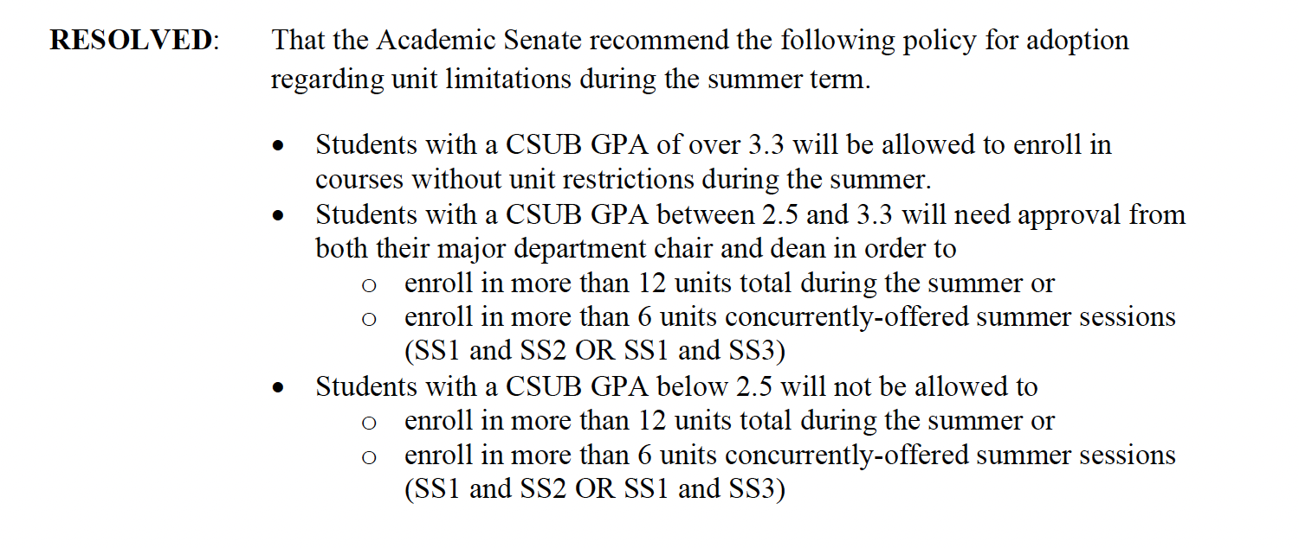
AAC Resolutions: 2021-22
RES 212213: Unit Cap During Summer Term

Slide 12
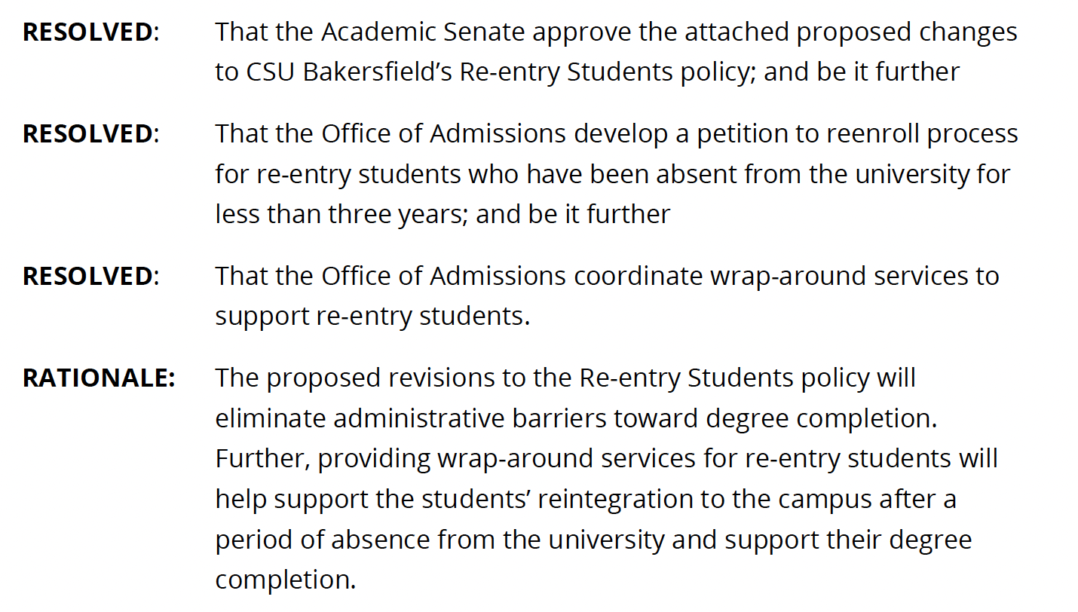
AAC Resolutions: 2021-22
RES 212228: Re-Entry Students Policy

Slide 13
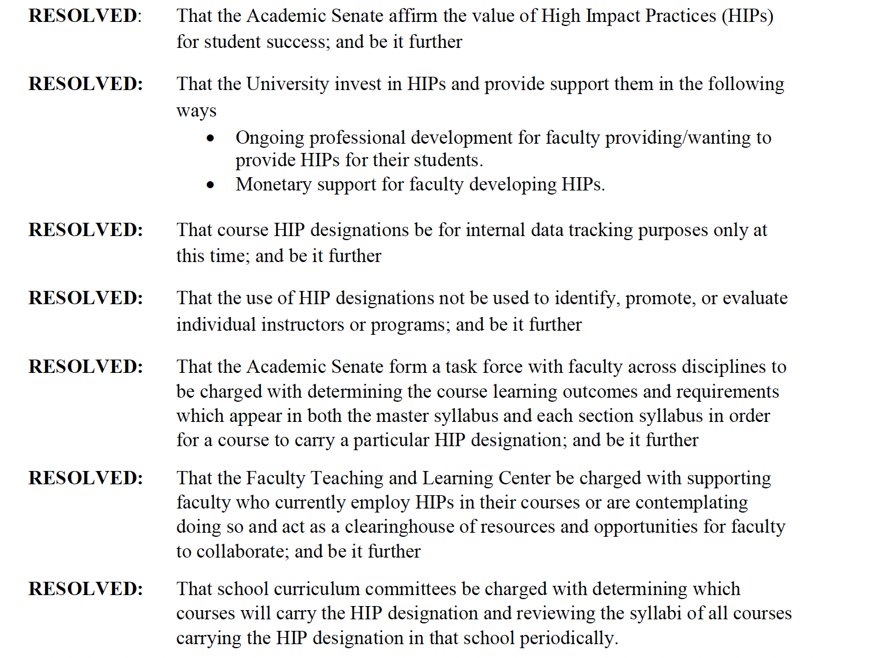
AAC Resolutions: 2021-22
RES 212212: High Impact Practice (HIP) Designation and Tracking

Slide 14
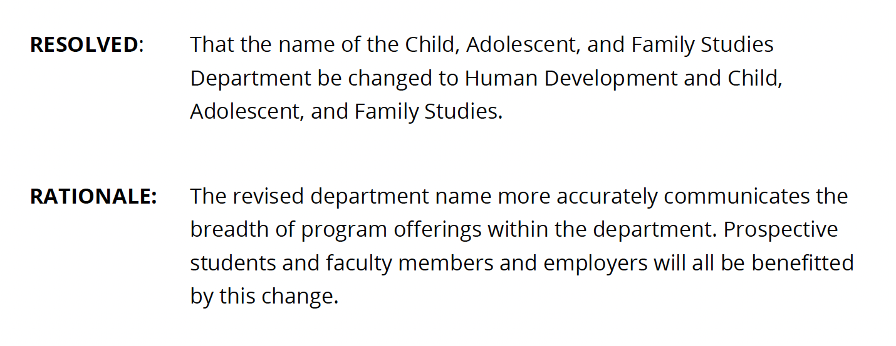
AAC Resolutions: 2021-22
RES 212229: Change of Department Name from CAFS to HDCAFS

Slide 15
Thank You

