Slide 1
Using Asset-Based Language to Foster Belonging and Improve Outcomes
Dr. Bre Evans-Santiago
Chair and Associate Professor
Teacher Education
bevans9@csub.edu

Slide 2
Overview
Asset-based v. Deficit-based approaches
What does it mean to belong?
Putting it all together

Slide 3
Asset Based vs. Deficit Language
Asset Based
Focuses on strengths
Acknowledges opportunity
Affirms diversity as attributes
Deficit
Pinpoints the weaknesses
Highlights the inadequacies
Empasizes “differences”
Examples of language activity

Slide 4
Asset Based vs. Deficit Language
Asset-Based language
Promotes resilient behaviors
Develops a growth mindset
Builds hope
Provides a safer space for taking chances

Slide 5
Notes:
Funds of knowledge is what students bring in that we can us to shape how we support, communicate, teach, etc.
1st generation students bring so many assets! But a lot is new to them. We have to tap into that. NOT EVERYONE DID IT LIKE WE DID. CHALLENGES ARE DIFFERENT. STORIES ARE DIFFERENT

Slide 6
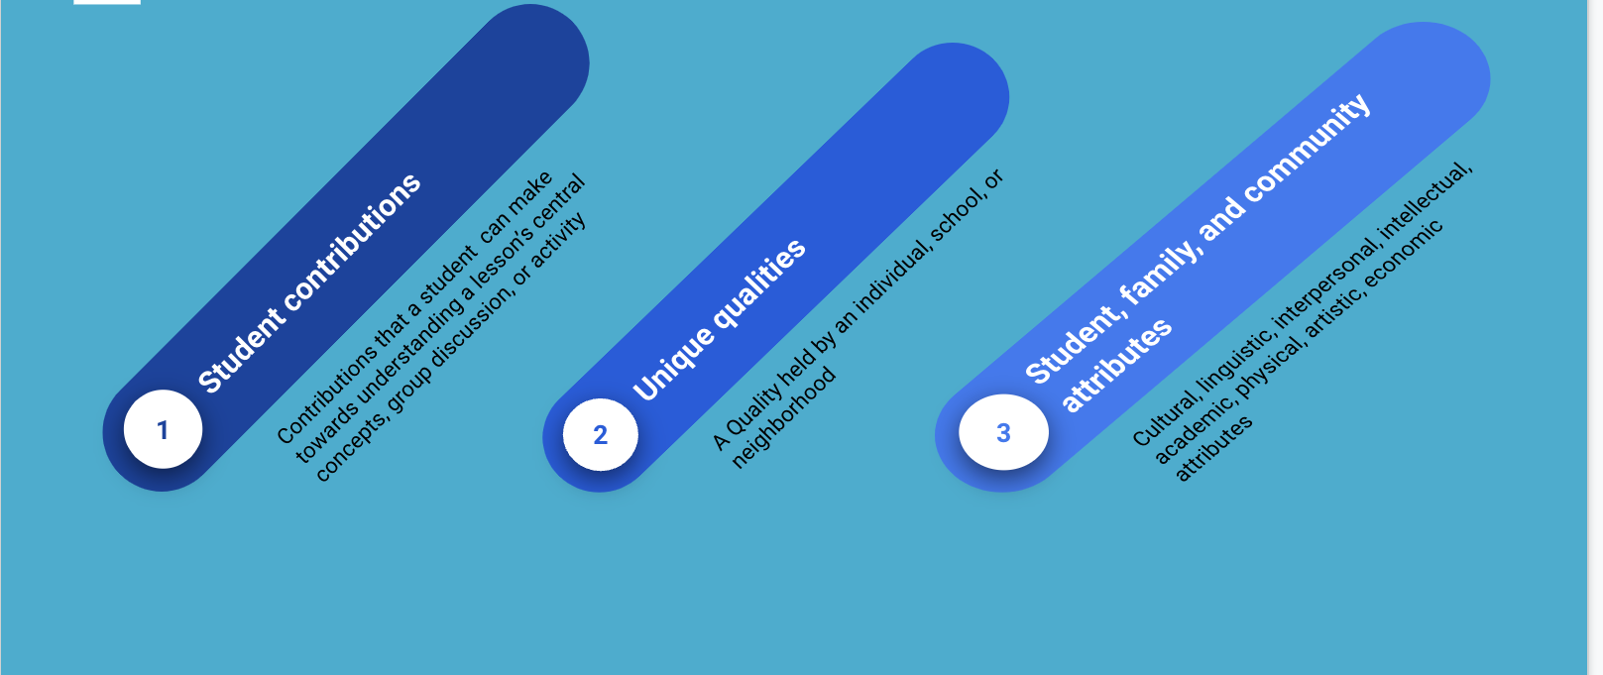
What are Considered Student Assets?
How can I learn about various cultures?

Slide 7
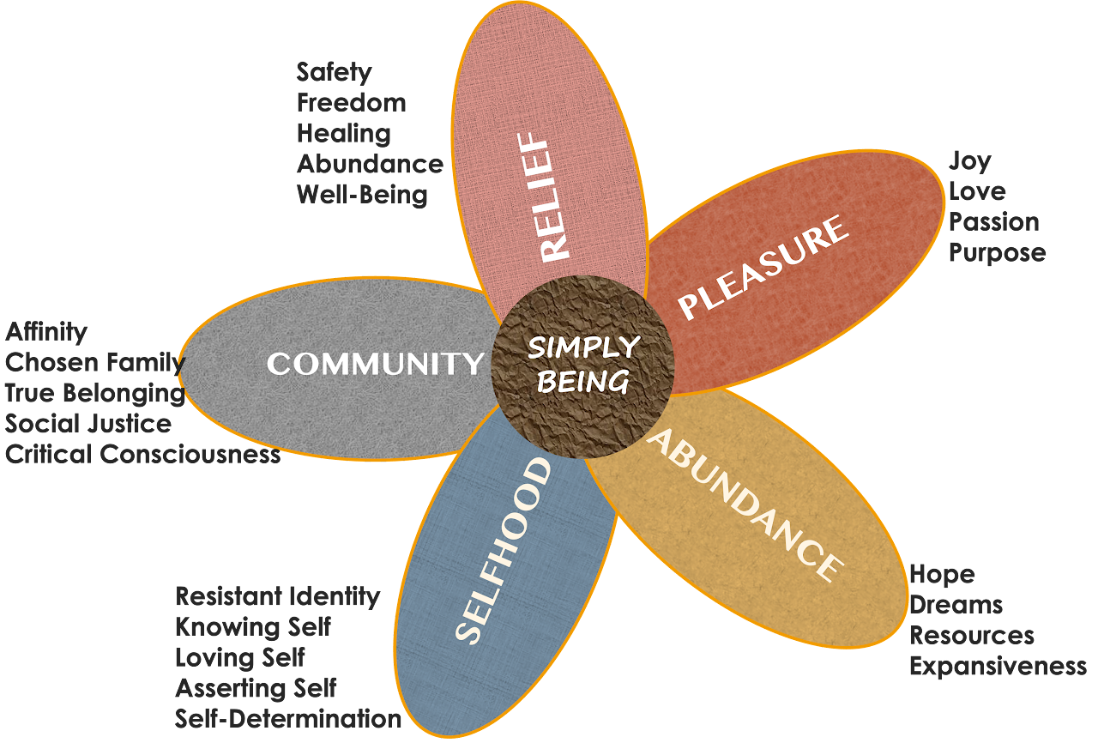
Belonging
Bridge to Thriving Framework (Darling-Hammond, 2021)
Notes:
Counter-stories; Having opportunities to

Slide 8
Belonging
What do we at CSUB contribute to students “simply being?”
Bridge to Thriving Framework (Darling-Hammond, 2021)
Notes:
Counter-stories; Having opportunities to discuss ideas

Slide 9
Putting it All Together
When Advising…
What else should we know before we “accuse” students of being “lazy” or lacking care?
How might we communicate with students once we understand cultures a bit more?
What asset-based approaches might I use when solving academic issues with students?
What do I have to change about myself (mindset, biases, deficit perspectives) when helping students who need more time/effort?
What is the reward when we use asset-based and thriving approaches?

Slide 10
Putting it All Together
When Advising…
Example for language changes
Do This | Not That
“The students makes attempts. What are barriers or other strengths we can tap into to help them through this?” | “The student doesn’t try hard enough”
“I’m so happy you are here! Tell me about your journey.” or “Being admitted is a great first step. Let’s get you to the finish line. It may not be easy, but you can do it.” | ”Why are they here?” or “How did they even get into CSUB?”

Slide 11
Our goal is here! Let’s do this together

Slide 12
References/Further Readings
Axel-Lute, M. (2019). The opposite of deficit-Based language isn’t asset-based language. It’s truth-telling. https://shelterforce.org/2019/11/12/the-opposite-of-deficit-based-language-isnt-asset-based-language-its-truth-telling/
Ellison, T.L. & Soloman, M. (2019). Counter-storytelling vs. deficit thinking around African American children and families, digital literacies, race, and the digital divide. Research in the Teaching of English 53(3)
Gonzales, N., Moll, L.C., & Amanti, C. (2005). Funds of knowledge: Theorizing practices in households, communities and classrooms. Routledge.
Paris, D. (2012). Culturally sustaining pedagogy: A needed change in stance, terminology, and practice. Educational Researcher, 41(3), 93–97

Slide 13
Thank You

