Slide 1
Documenting Advising Efforts in RunnerConnect & OnBase
Faculty Advising Summer Institute
Tuesday, August 9, 2022 at 10a.m.
Presenter: Dr. Melissa Danforth

Slide 2
Focus of Session
Effective use of RunnerConnect and OnBase for faculty advising and collaboration with faculty and staff advisors
Demo focused on best practices, rather than a training session

Slide 3
Learning Objectives
Understand major features of each platform
Use platforms to facilitate & document advising efforts
Use platforms to collaborate with faculty and staff advisors

Slide 4
Feature Overview: OnBase
Transcripts – including those not on myCSUB
External test scores
Advising checklists – depends on school & student

Slide 5
Accessing OnBase
Link: https://onbase.csub.edu/
Must be on campus or campus VPN to log in
Access form required to use OnBase
Desktop app also available – contact ITS

Slide 6
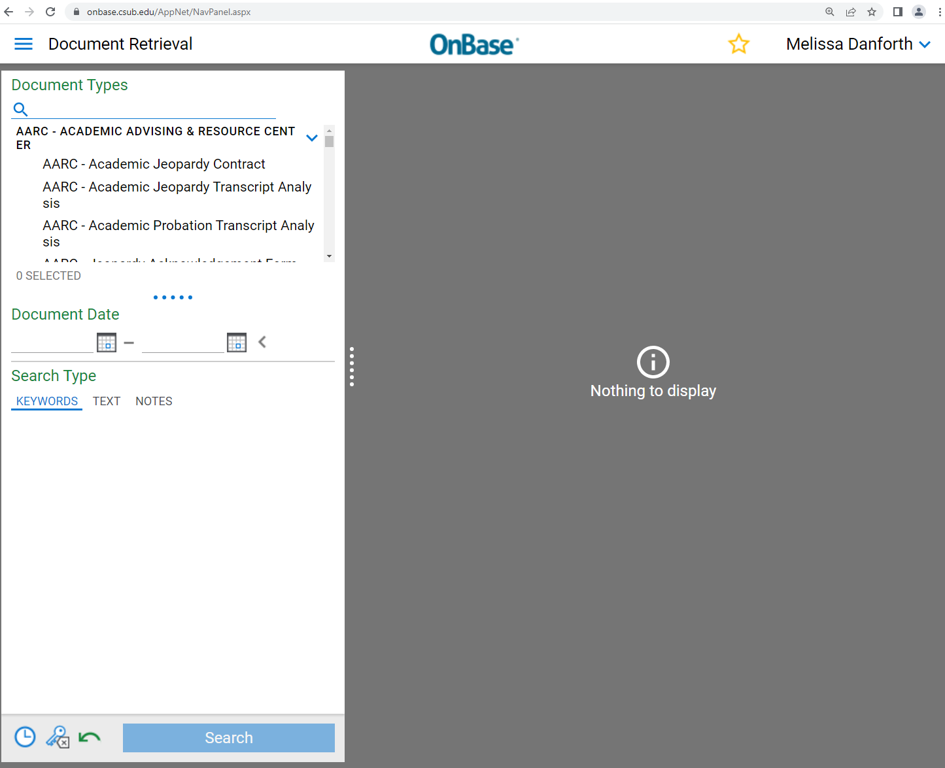
OnBase Home Screen
Provides extensive list of document searches
Exact list depends on your access level (chairs will typically see more)

Slide 7
Feature Overview: RunnerConnect
Self-serve appointment scheduling & campaigns
Advising notes & course progress reports
Analytics & tracking – e.g., utilization of tutoring

Slide 8
Accessing RunnerConnect
Link: https://runnerconnect.csub.edu
Can be accessed from on-campus or off-campus
Requires access form for full advisor functionality

Slide 9
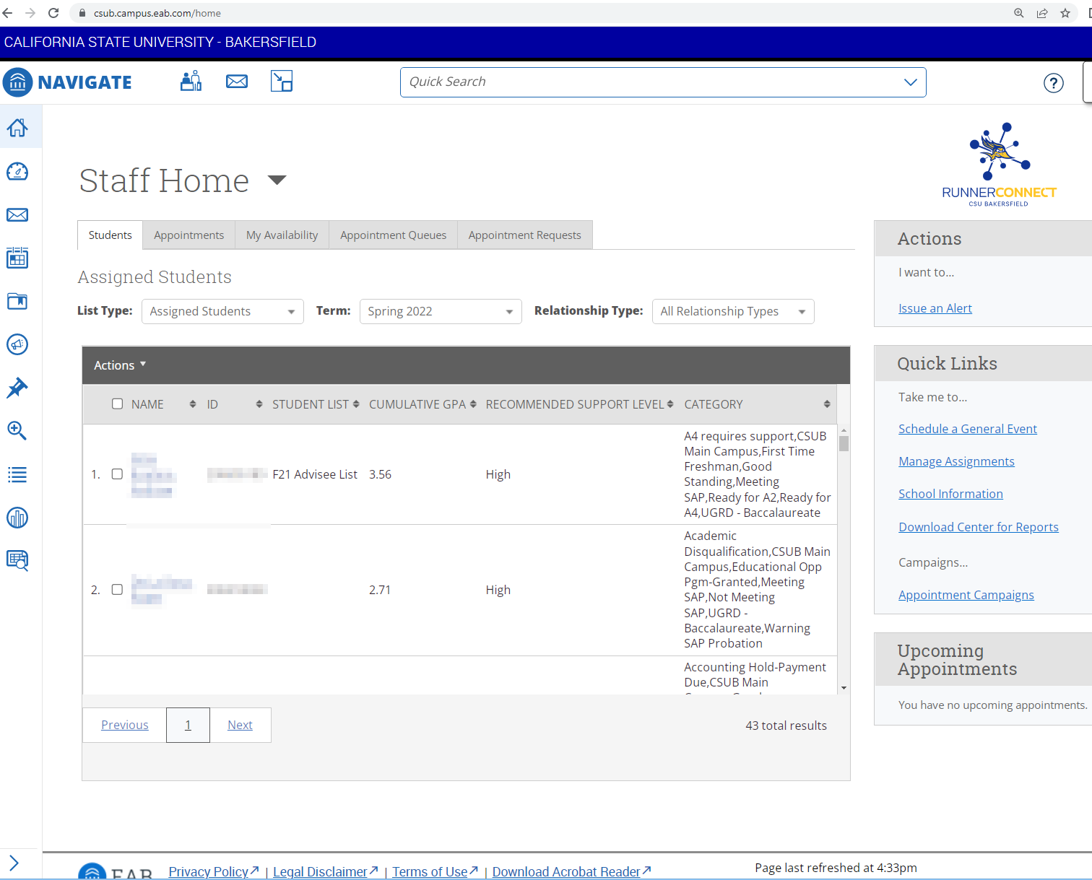
RunnerConnect Advisor Home
Main Features:
Advisee List
Appointments
Availability

Slide 10
Facilitating Advising with OnBase & RunnerConnect
OnBase:
Research tool for student records
RunnerConnect:
Appointment management
Research, documentation, & collaboration

Slide 11
Before Advising Weeks: RunnerConnect Appointment Setup
If applicable, use Outlook calendar sync
Set up Availability with date and time restrictions
Can be broad if using Outlook calendar sync
TIP: Remember to give yourself breaks and time before class!
NOTE: Students can make appointments outside advising campaigns but (usually) not outside of your availability settings
If applicable, set up appointment campaign (advanced)

Slide 12
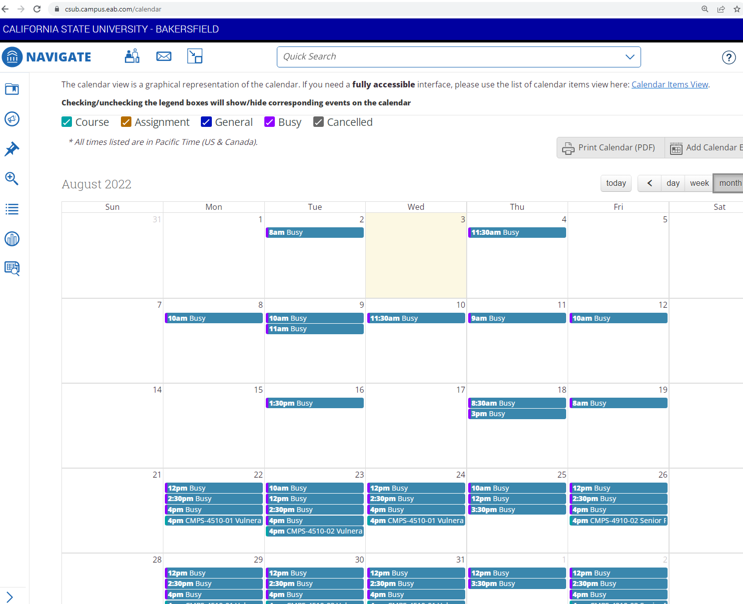
Outlook Calendar Integration for Appointments
Main Features:
Outlook entries block out availability (“busy”)
Appointments sync to Outlook calendar

Slide 13
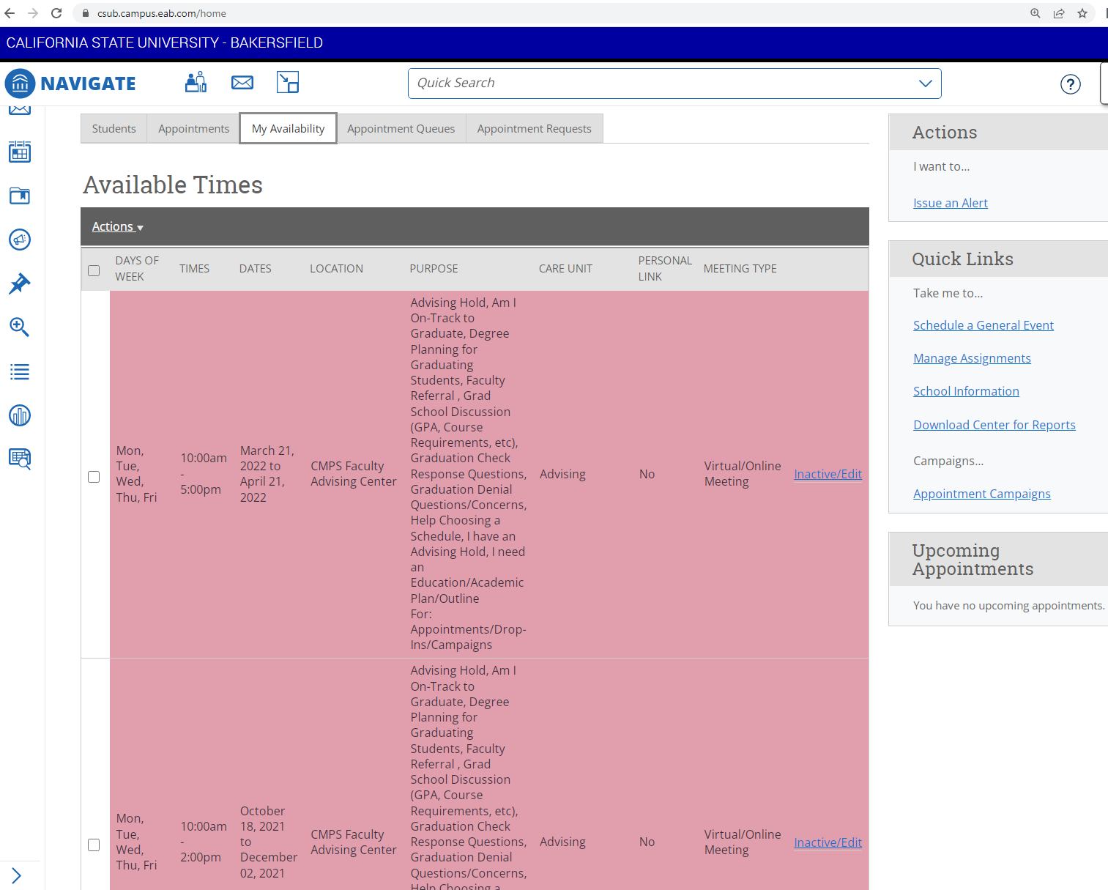
Availability Screen
Defines time blocks and services for self-service appointments and appointment campaigns
Tip: Set date range according to advising and registration weeks in academic calendar

Slide 14
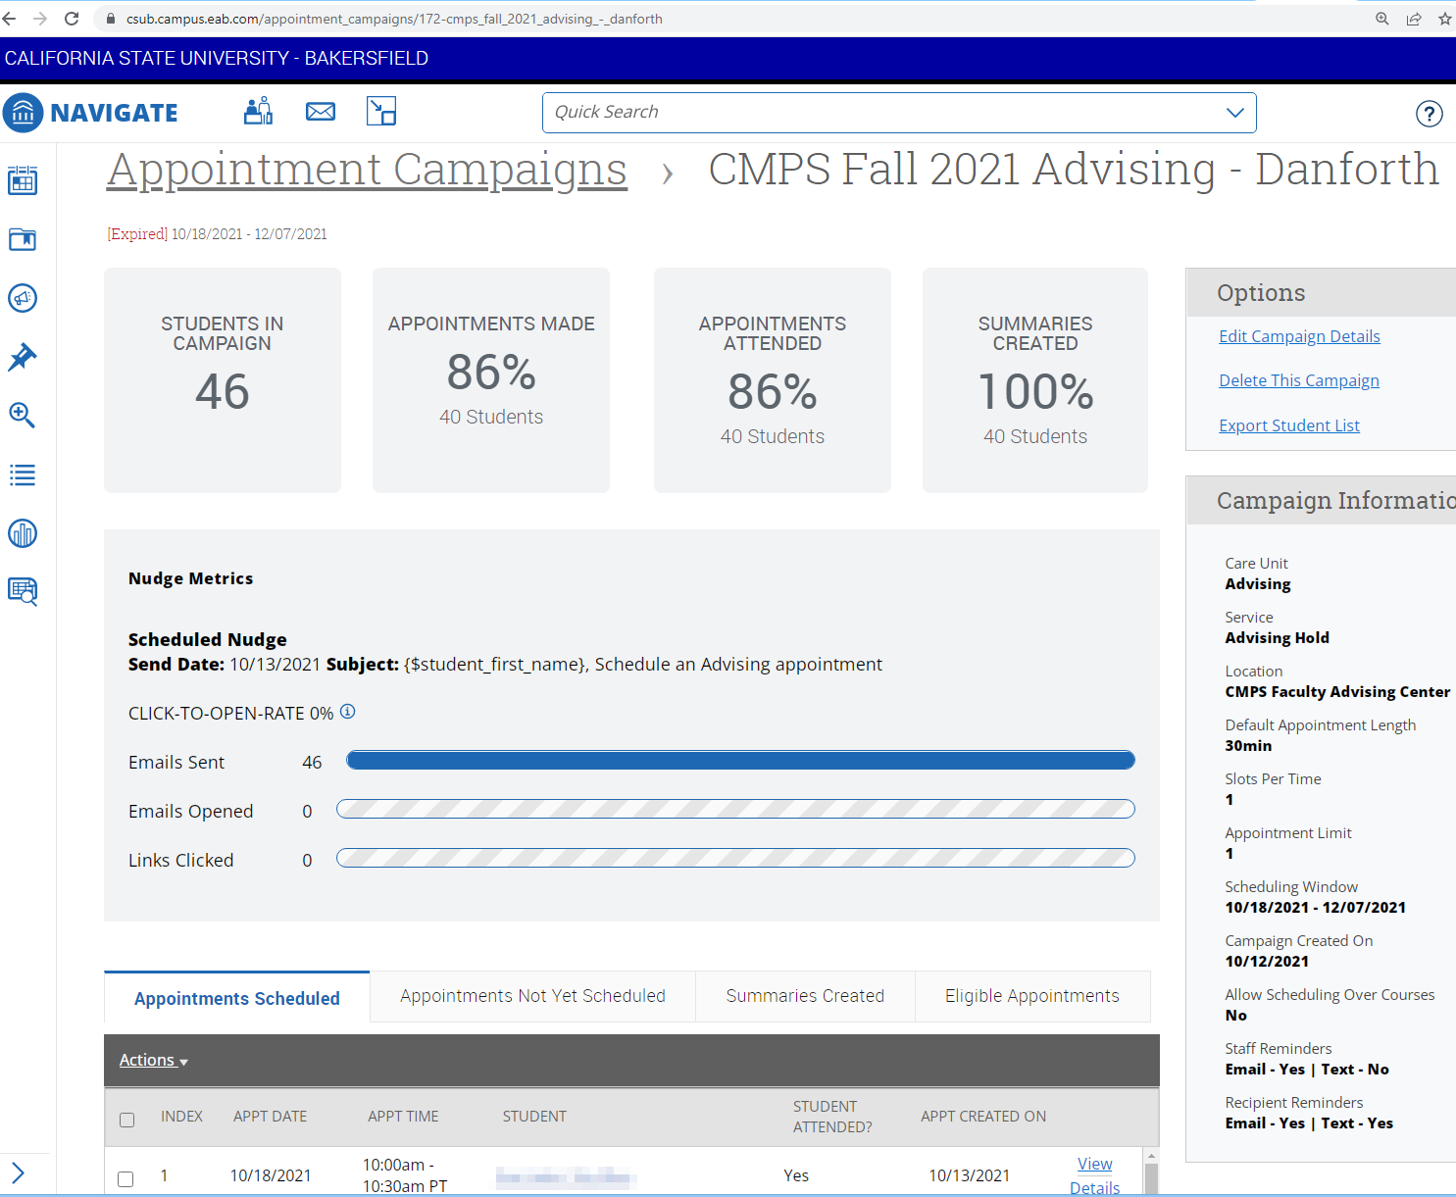
Appointment Campaigns
Location must be set up in RunnerConnect with Enrollment Management
Campaigns can be individual or for whole department

Slide 15
Before/During Advising Weeks: Monitor Appointments
Review RunnerConnect appointments on a regular basis
For “lost” students, redirect to appropriate location
Common causes: Changed major but still has you as advisor; Incoming student schedules with faculty instead of staff advisor
For rescheduling, email/phone is usually more efficient
Use email/phone to select new time with student
Edit the appointment in RunnerConnect for new time

Slide 16
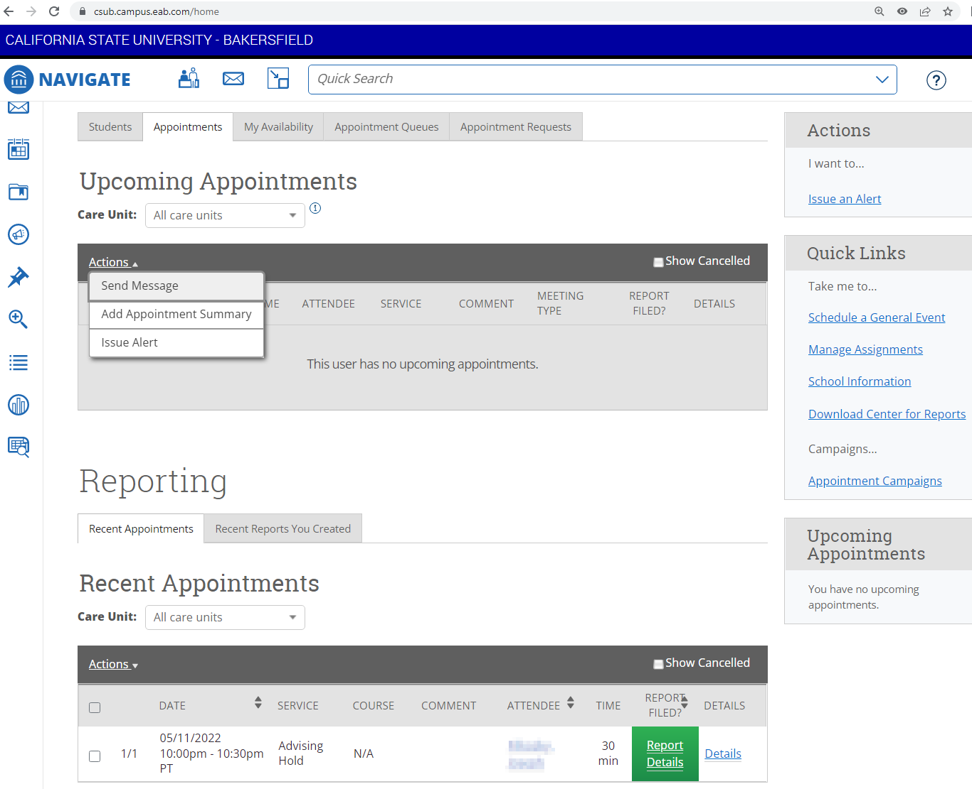
Appointments Overview
Main Features:
Upcoming appointments
Recent appointments
Tip: Reports can be edited from Recent list

Slide 17
Before Appointment: Research Student Record
Review previous advising notes from you and others
Look at grades/progress on myCSUB and RunnerConnect
Review list of holds on myCSUB
Check midterm progress reports for any issues
Review other RunnerConnect info (metrics, tutoring, etc.)
If applicable, use OnBase to look up student record

Slide 18
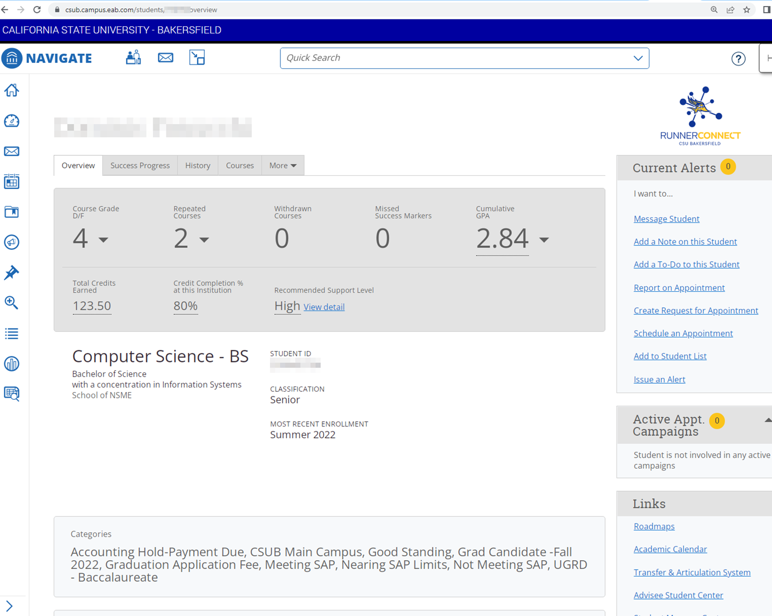
RunnerConnect Student Detail Screen
Items of Interest:
Previous advising notes
Midterm progress reports
Tutoring check-ins
Success metrics

Slide 19
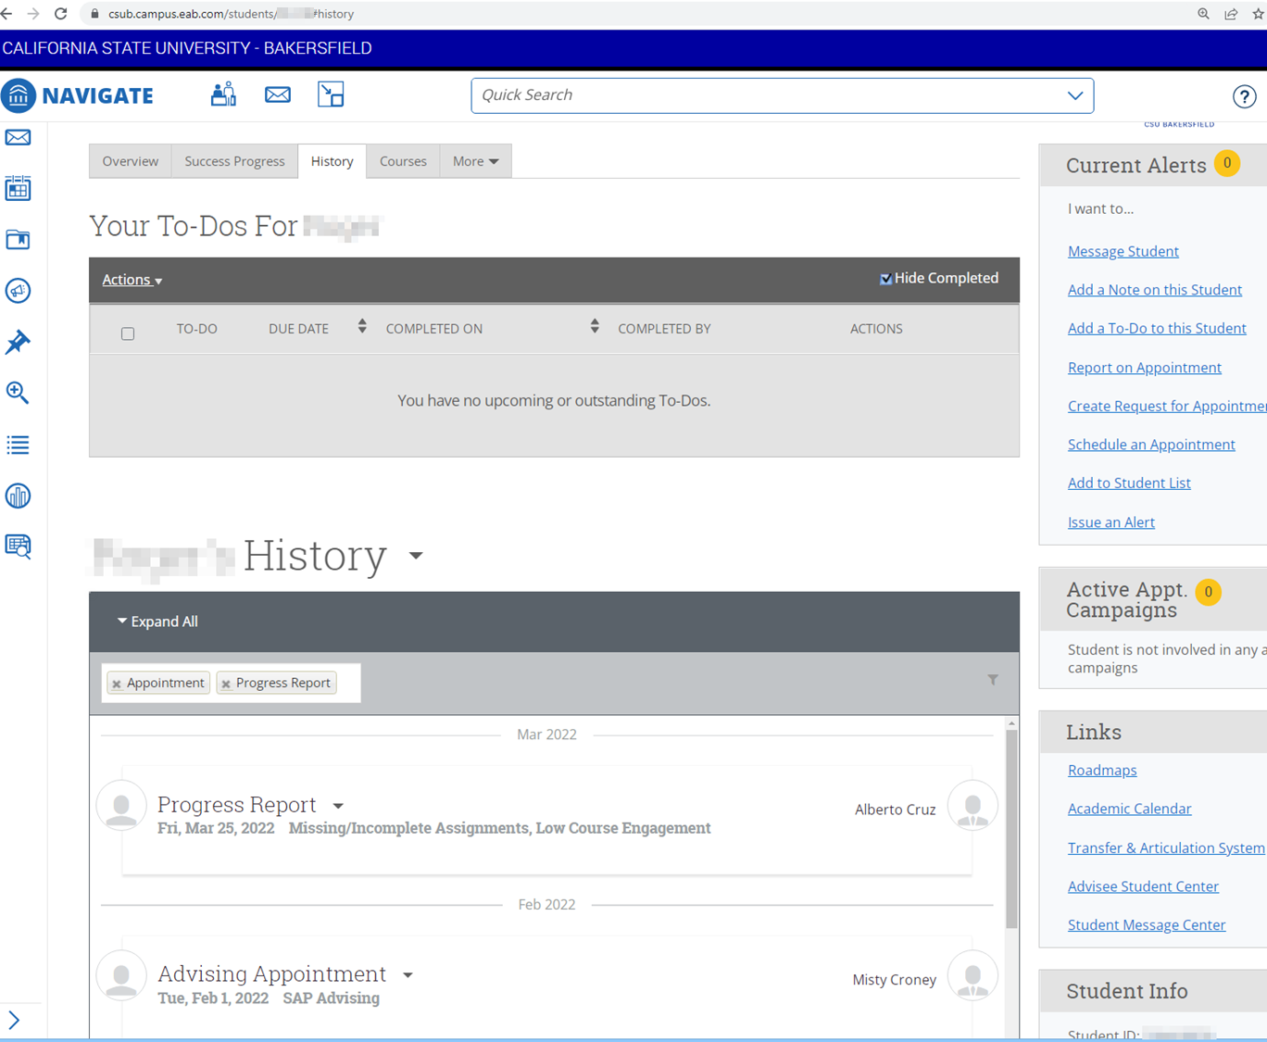
Student History Tab
Lists all reports, check-ins, alerts, to-dos, etc.
Filters can be used to look at items of interest
Hint: Start here and then look at other tabs

Slide 20
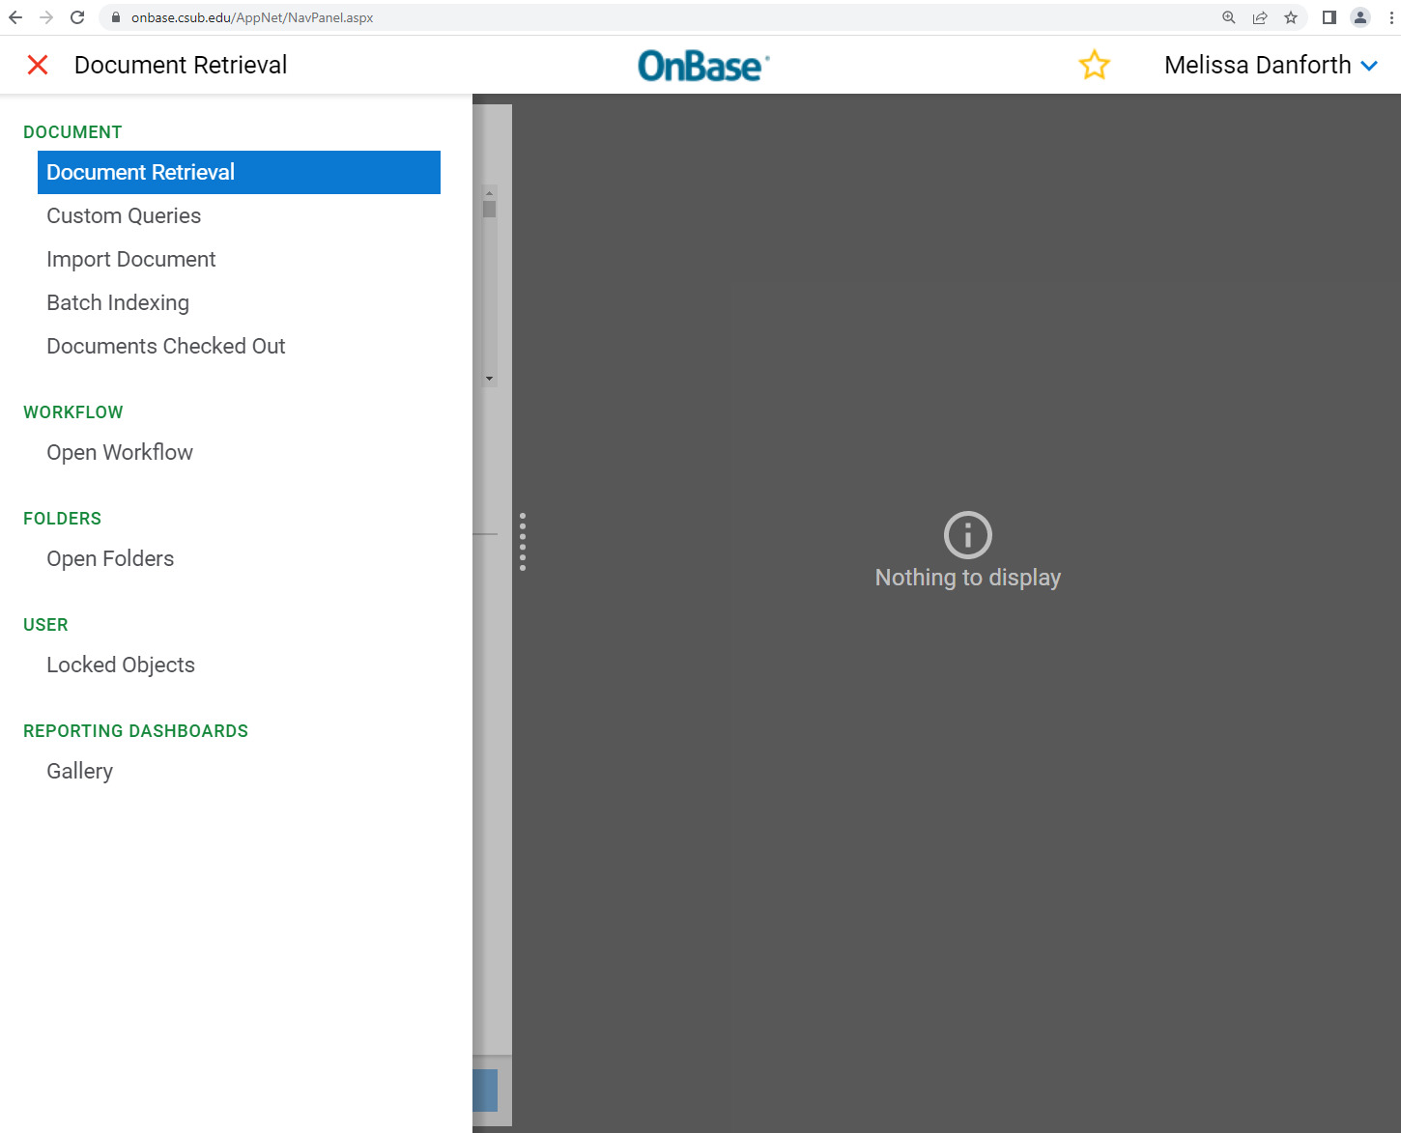
OnBase Custom Searches
Use menu icon to navigate to Custom Queries to pull all documents for a given student ID number

Slide 21
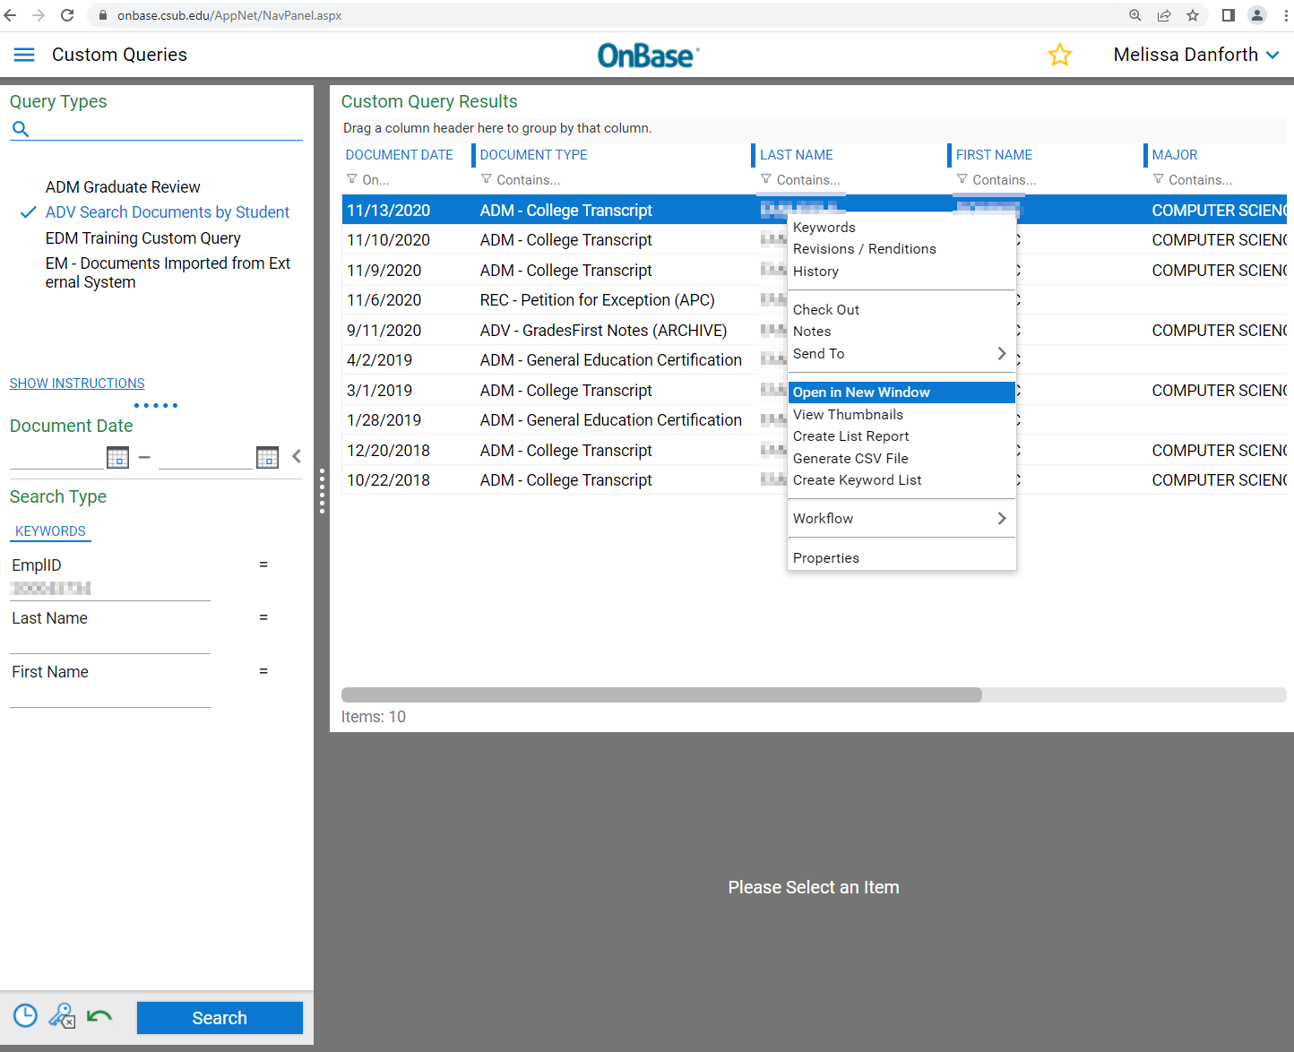
OnBase Student Record Search
Finds transcripts, test scores, and other relevant records for advising
Hint: Right click to get option to open document in new window

Slide 22
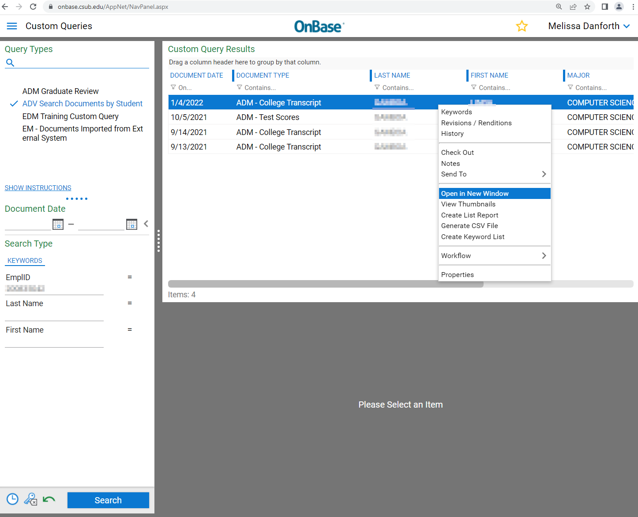
OnBase Student Records: Post-bac Example
PBAC students won’t have transcripts or test scores in myCSUB from work completed before entering CSUB
OnBase is critical to see those records in order to determine remaining coursework for program

Slide 23
Before Appointment: Reach Out to Staff/Faculty
If research has left you with questions, reach out
Example: Student is marked as at-risk to fail a course
Ask instructor what they’d like you to reinforce during advising
Example: Transfer intake advising report but no advising checklist
Ask staff advisor if they have a checklist with transfer credits noted
Advantages:
Avoids duplication of effort
Creates a united advising front between staff and faculty advisors

Slide 24
During Appointment: Use Tools to Facilitate
Scheduled appointments:
Use tools if more research is needed during session
Example: Student asks about transfer credit that isn’t showing
Walk-in appointments:
Quickly review research items
Tip: Select “Report on Appointment” at start and close at end to automatically record time. You can edit later for more details.

Slide 25
After Appointment: Complete Appointment Report
Add summary of session that will help you, other faculty advisors, and staff advisors with continuity of care
Summary should be factual and respect privacy of session
Tip: Focus on recommended courses, advising checklists, ed plans, tutoring referrals, research needed by staff advisors, forms discussed, and similar academic information
Hint: Block out time in Availability for completing reports

Slide 26
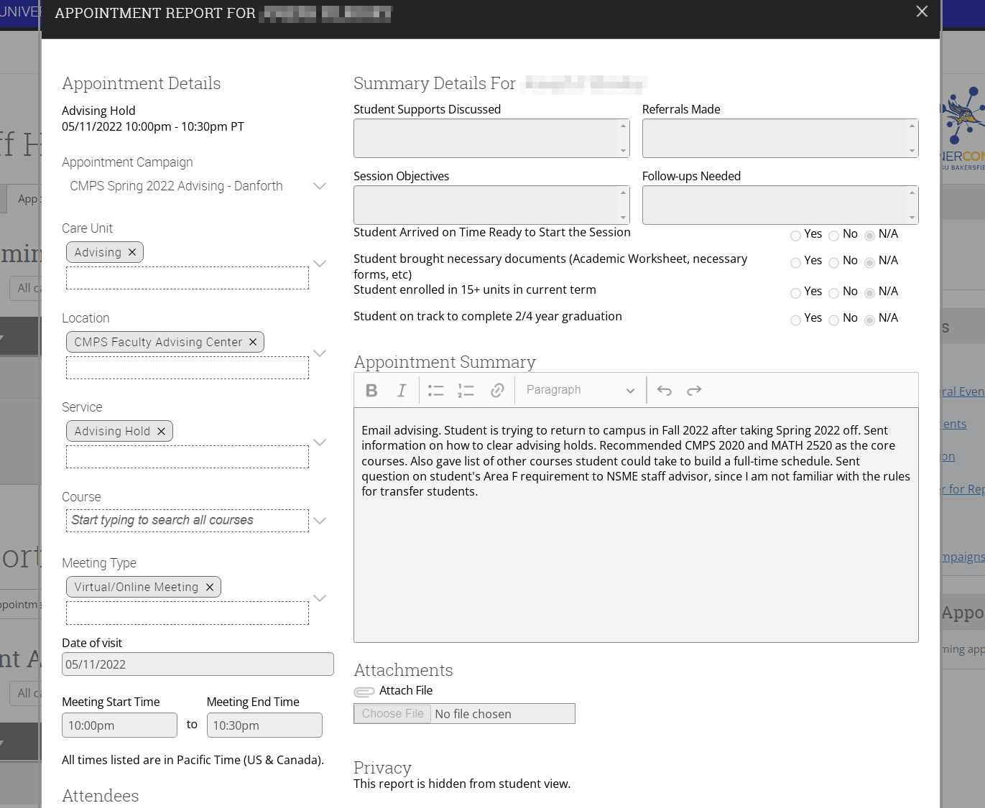
Appointment Report Screen
Report can be created for appointments or walk-ins
If appointment is part of a campaign, some details will be prepopulated from the campaign details

Slide 27
Other Collaboration and Communication Features
Use RunnerConnect in addition to traditional collaboration and communication tools (phone calls, emails, etc.)

Slide 28
Any Time: RunnerConnect Messaging
RunnerConnect provides messaging platform
Sends message via email and/or text
Access via Conversations menu icon or via Student page
Students can use this to message you as well
By default, messages will send to your CSUB email
You can reply by email or via RunnerConnect

Slide 29
After Appointment: Staff Advising Referrals
Some school advising centers allow faculty advisors to refer students to staff advisors
Check with your school advising center to see what they support
Common referral areas in NSME:
Research possible transfer credit for GE or in other departments
Clarify if test scores give course/GE credit
Assist student with filling out paperwork (petitions, forms, etc.)

Slide 30
After Appointment: Communication and Follow-up
If referral is made, check RunnerConnect for status
If an issue noted in your advising report is resolved, make sure resolution is documented in RunnerConnect
Example: If a subwaiver is accidentally lost, notes on who approved it and when can help it to be recreated & resubmitted
Documentation may also be useful for specialty accreditation

Slide 31
Session Summary
Features intended to facilitate faculty advising
OnBase: Research tool
RunnerConnect: Research, documentation, and collaboration tool

Slide 32
Thank You

