Slide 1
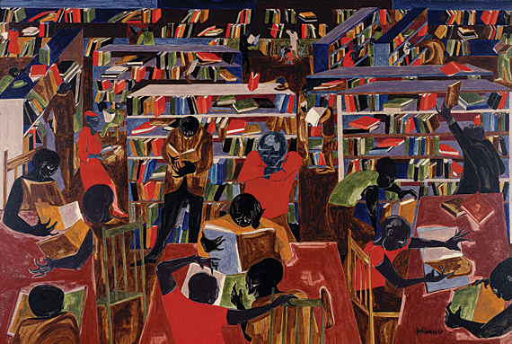
Common Core and RIAP
Putting It All Together
Carol Jago cjago@caroljago.com
Notes:
Jacob Lawrence, The Library
Dream series #5, 1967

Slide 2

“The world is passing through troublous times. The young people of today think of nothing but themselves. They have no reverence for parents or old age. They are impatient of all restraint. They talk as if they knew everything, and what passes for wisdom with us is foolishness with them. As for the girls, they are forward, immodest and unladylike in speech, behavior and dress.”

Slide 3
“The world is passing through troublous times. The young people of today think of nothing but themselves. They have no reverence for parents or old age. They are impatient of all restraint. They talk as if they knew everything, and what passes for wisdom with us is foolishness with them. As for the girls, they are forward, immodest and unladylike in speech, behavior and dress.”
- Peter the Hermit, 1274

Slide 4

Teenagers are sending on average 100 text messages a day – 3,000 a month.

Slide 5

Academic reading and writing requires single-tasking, an unbroken and unbothered focus. Students need to “downshift” in order to do this work.
- Mark Bauerlein, “Too Dumb for Complex Texts?” Educational Leadership, February 2011
Teaching Screenagers

Slide 6

A Nation at Rest
83% of students spend fewer than 5 hours a week doing homework.
Notes:
NAEP data analyzed by Brian Gill, RAND, 2003 “A Nation at Rest: The American Way of Homework

Slide 7
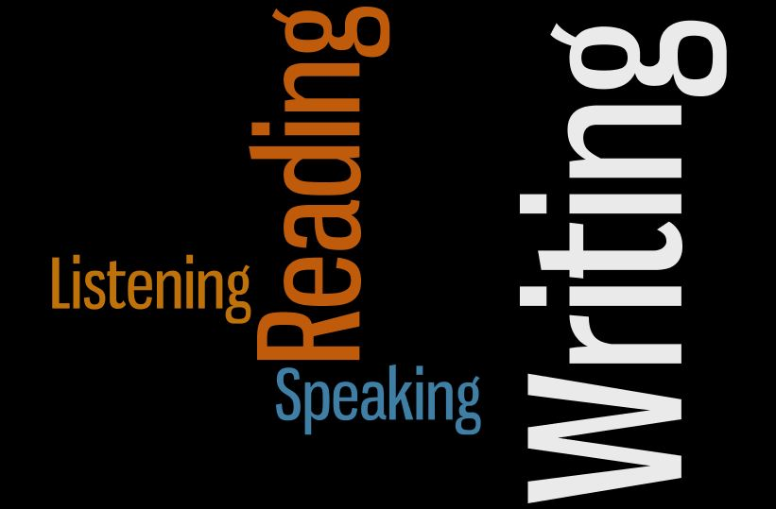
Notes:
Writing floats on a sea of talk – James Britton
Good writing flows from good reading, mentor texts
INTEGRATED language arts curriculum, cumulative effects

Slide 8

College and Career Readiness Anchor Standards
Read the CCR Anchor standards putting a check mark next to skills that you practice in your professional life.
Notes:
Read through the lens of a parent.

Slide 9
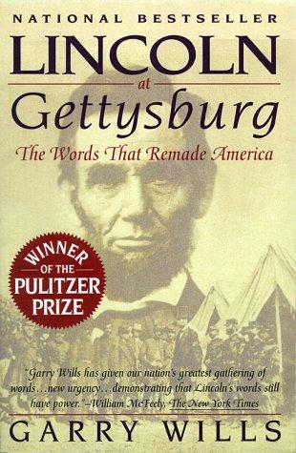
Shared responsibility for literacy
Common Core Standards insist that instruction in reading, writing, speaking, listening, and language be a shared responsibility within the school.
K-5 standards include expectations for reading, writing, speaking, listening, and language applicable to a range of subjects, including but not limited to ELA.
Grades 6-12 standards are divided into two sections, one for ELA and the other for history/social studies, science, and technical subjects.
Notes:
WE CAN’T DO IT ALONE.

Slide 10

Common Core Instructional Shifts for ELA/Literacy
Building knowledge through content-rich nonfiction and informational texts

Slide 11
Why Read Literature?
Literature is the most astonishing technological means that humans have created to capture experience.
- Steven Greenblatt, author of Will in the World and The Swerve: How the World Became Modern
Notes:
Read David Coleman and Sue Pimental’s defense of literature in the ELA classroom.

Slide 12

“Districts Gird for Added Use of Nonfiction”
Education Week
Notes:
We need to embrace, not gird for nonfiction. Will require different approaches. Reading rhetorically – Whom do you trust? What do you think? How do you feel?

Slide 13

Elementary school students spend on average 3.6 minutes a day reading nonfiction.
Only 10% of books in classroom libraries are nonfiction.
- Nell Duke

Slide 14

NAEP Reading Framework
Distribution of literary and informational texts in the 2009 NAEP Reading Framework.
Grade | Literary | Informational
4 | 50% | 50%
8 | 45% | 55%
12 | 30% | 70%

Slide 15


Slide 16


Slide 17

Notes:
Includes Einstein’s 1939 letter to FDR

Slide 18
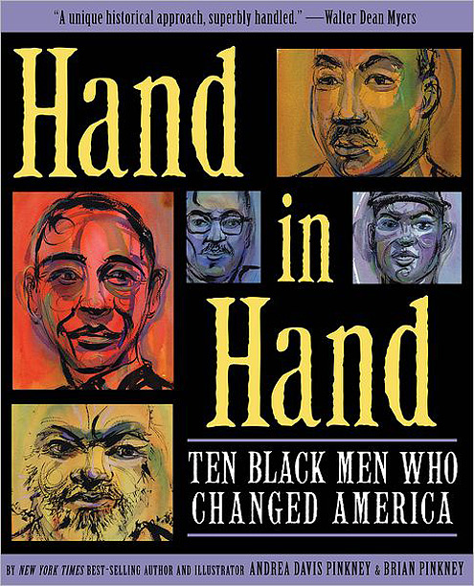

Slide 19
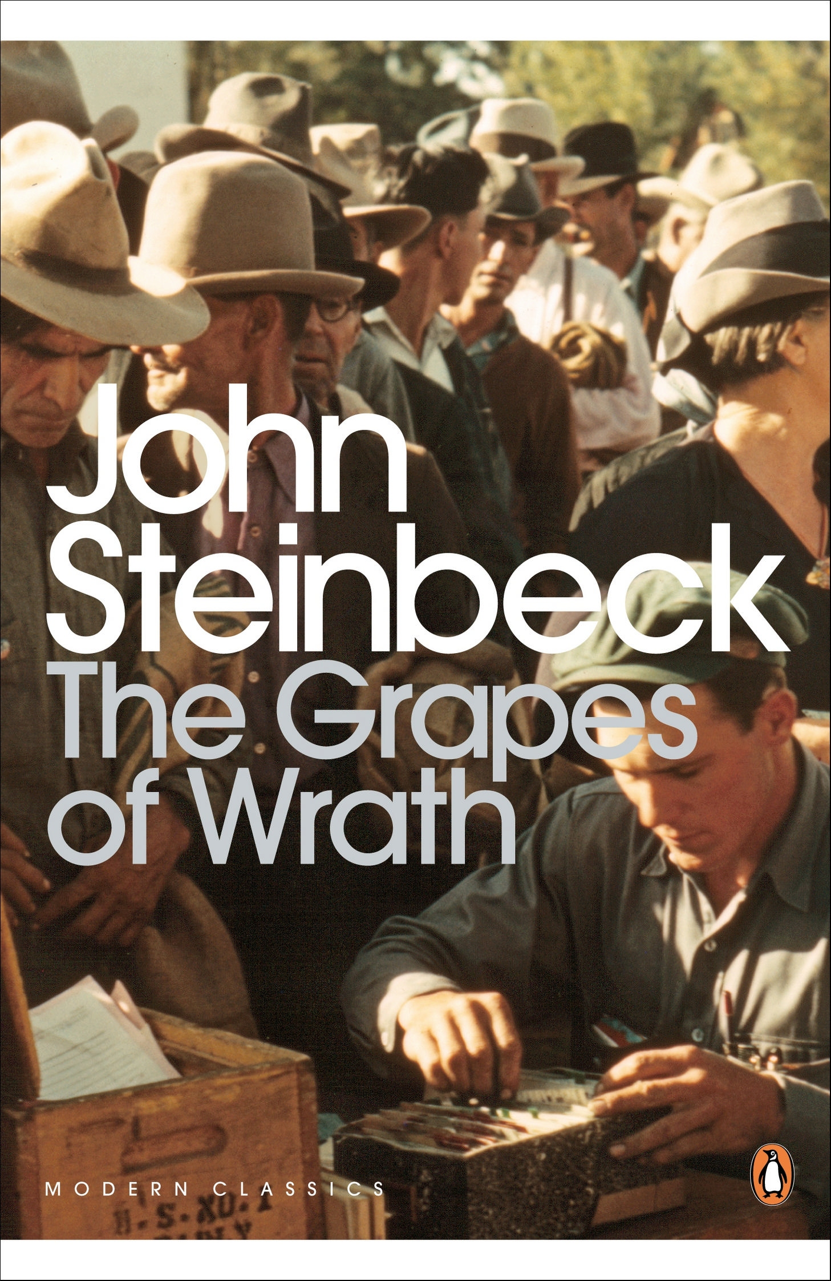
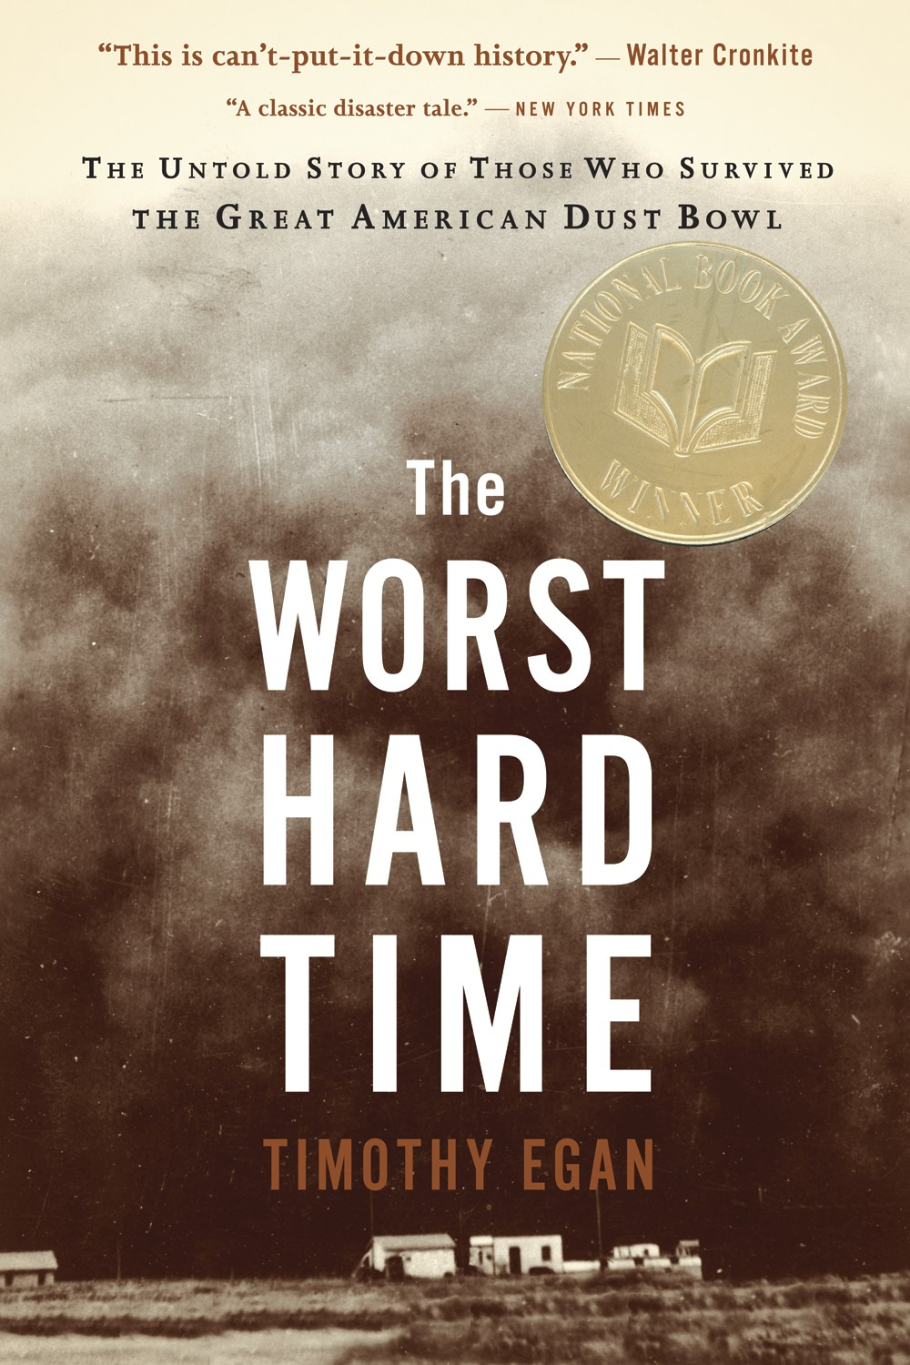

Slide 20
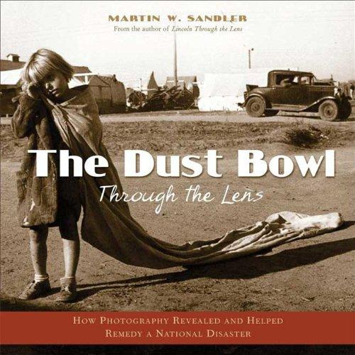

Slide 21
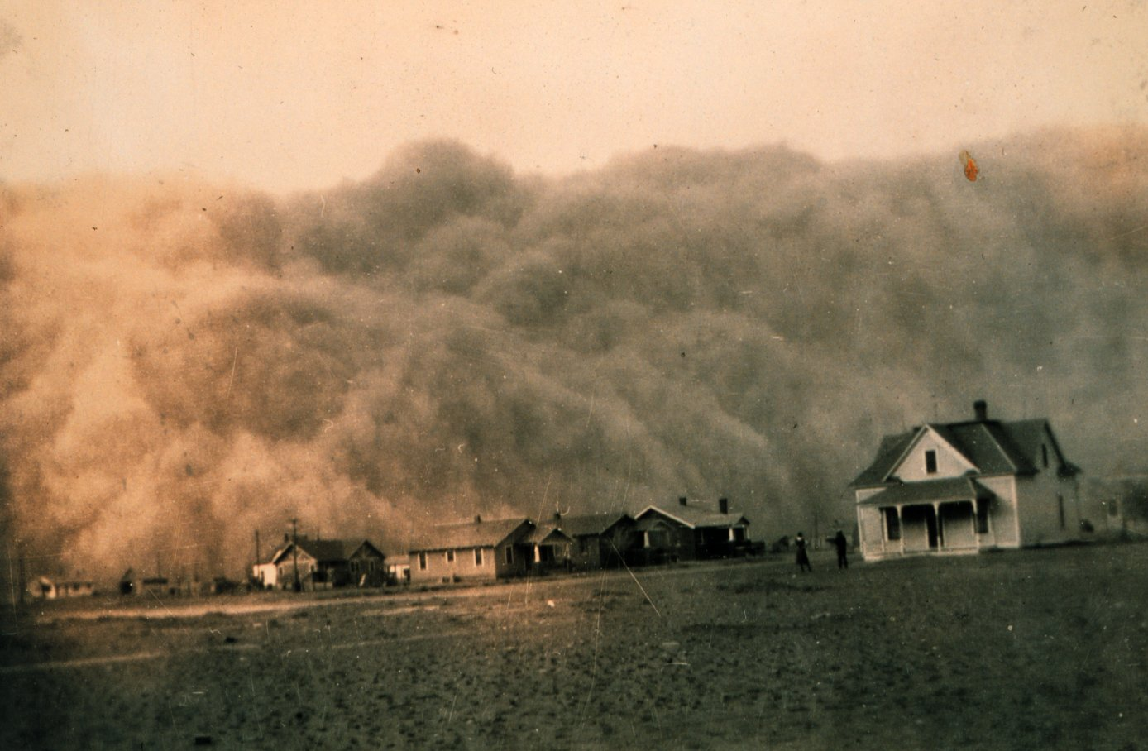

Slide 22

Time to Go
They left a couple weeks after the baby came,
All of them crammed inside that rusty old truck.
I ran half a mile in their dust to catch them.
I didn’t want to let that baby go.
“Wait for me,” I cried.
Choking on the cloud that rose behind them.
But they didn’t hear me.
They were heading west.
And no one was looking back.
February 1935

Slide 23
Common Core Instructional Shifts for ELA/Literacy
Building knowledge through content-rich nonfiction and informational texts
Reading and writing grounded in evidence from text

Slide 24
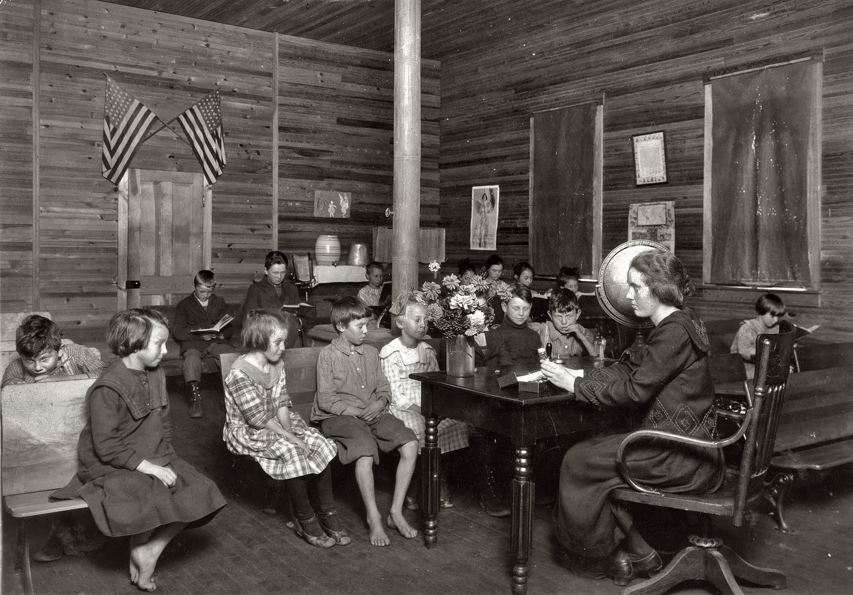
Notes:
Lewis Hine photograph, Sunset School, Marey, West Virginia, 1921
What has changed and what has stayed the same in education since 1921? Respond using evidence from the photo.

Slide 25
Writing in America’s Schools
Learning to write effectively within a discipline is part of that discipline’s knowledge base – not simply another context to practice English language arts.
Students are not writing very much. Typical secondary student expected to produce 1.6 pages of writing per week in English and 2.1 pages for all other subjects combined.
40% of 12th graders report hardly ever being asked to write a paper of 3 or more pages.
Writing Instruction that Works
Applebee and Langer, 2013

Slide 26

Politics of the Internet
Your post should be based on the readings in the syllabus and be about 500 words.
Summarize at least one of the key arguments made in those readings and analyze and evaluate that argument, explaining why you agree or disagree with it, using relevant material from those readings, class discussion, or your own work, experiences and/or research.
Creativity, use of relevant outside sources, and compelling arguments will all improve how these posts are graded.

Slide 27
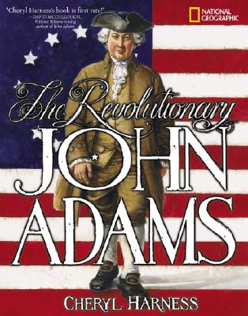
Notes:
Grades 3 – 5

Slide 28
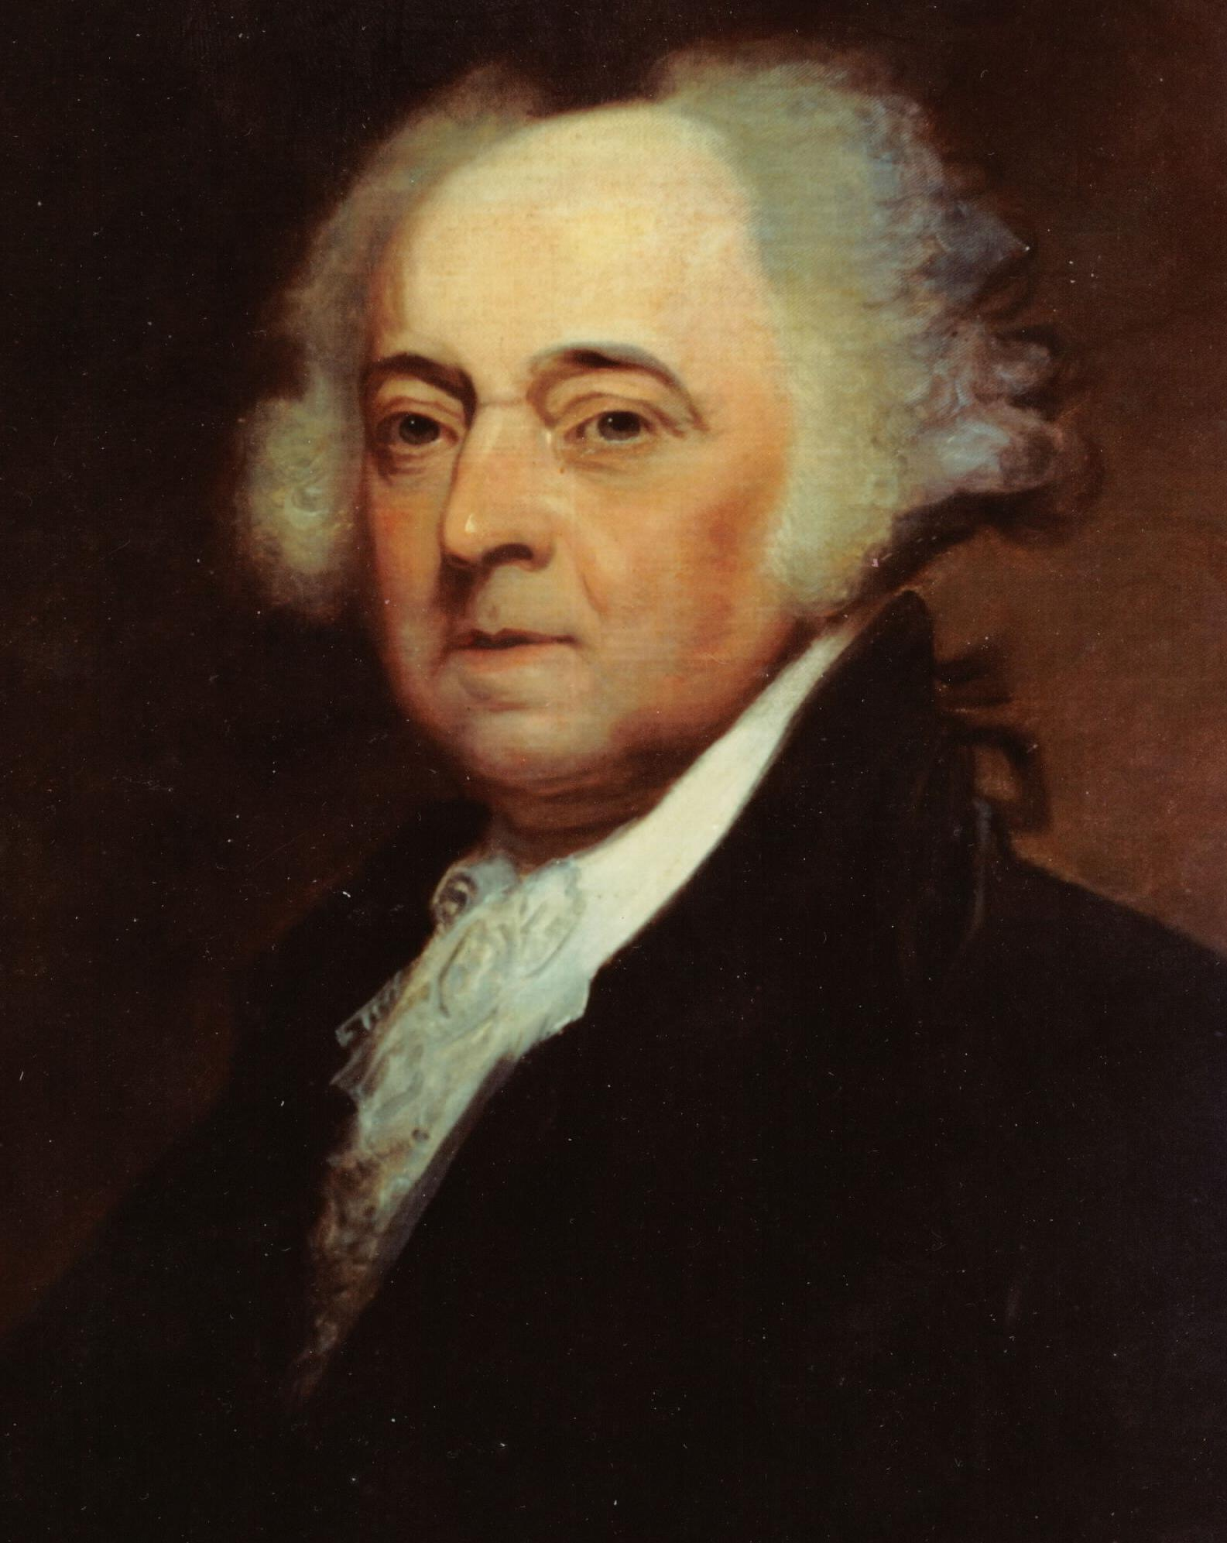
A Note from the Author
There stands John Adams, the stout, stubborn New Englander eternally bookended and overshadowed by tall, glamorous Virginians. On one side, the reserved, heroic General George Washington, “first in the hearts of his countrymen.” Imagine having to take up the Presidency — and keep a fragile republic in business — after that fellow! On the other is the cool, complicated genius of Monticello, Thomas Jefferson.
The Revolutionary John Adams
by Cheryl Harness

Slide 29
Text-dependent Questions
How does the author characterize each of the first three presidents?
Explain what the phrase, “eternally bookended and overshadowed” suggests about John Adams.
Why do you think the author ended her note to readers with a quotation from John Adams?
What claim is the author making about John Adams in this note? What evidence does she offer?
Notes:
Such questions help students develop the habits of mind for making claims and analyzing arguments. Rhetorical reading.

Slide 30
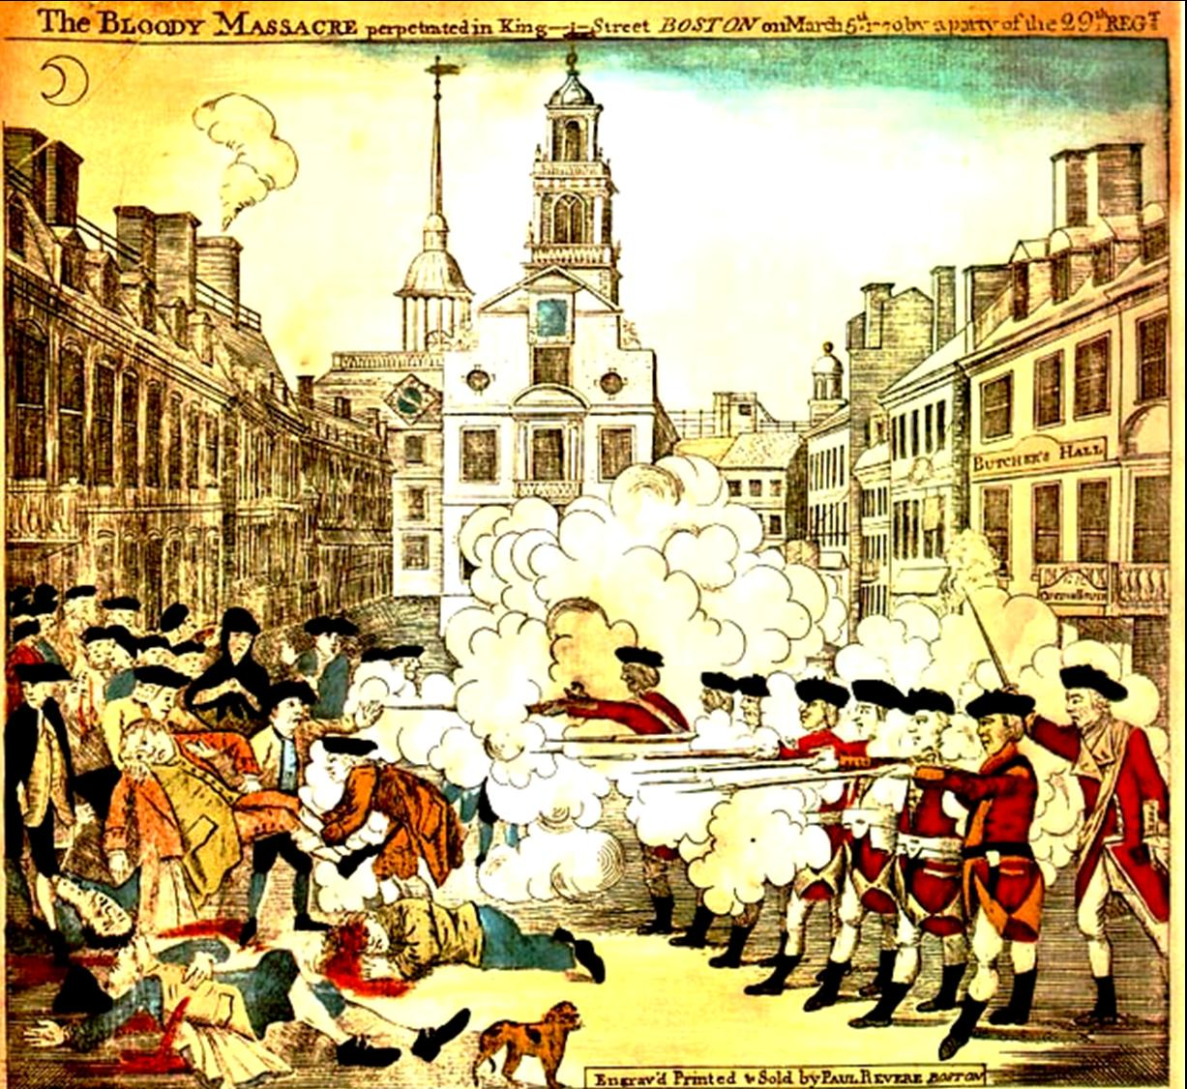
Notes:
Engraving commissioned by John Adams of Paul Revere to spread word of the Boston Massacre. Primary document.
How is this a persuasive text? How did Revere employ the tools of ethos, logos, and pathos in his drawing?
Propaganda from the founding fathers.

Slide 31
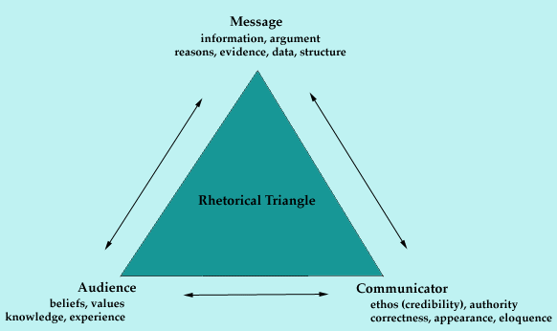

Slide 32
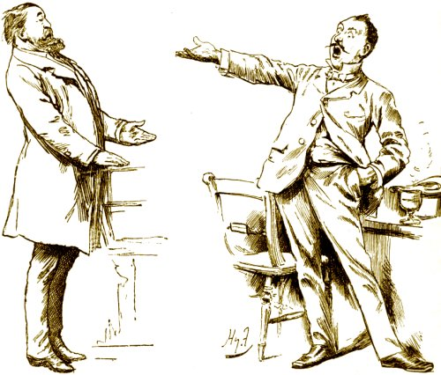
Argumentation
Making a Claim and Citing Evidence

Slide 33
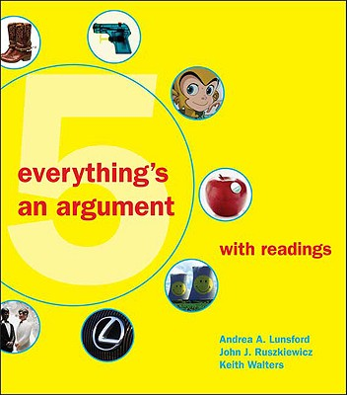
All language, including the language of visual images, is persuasive, pointing in a direction and asking for a response.
Notes:
In order to be a rhetorically effective writer, students need to learn how to READ rhetorically.

Slide 34
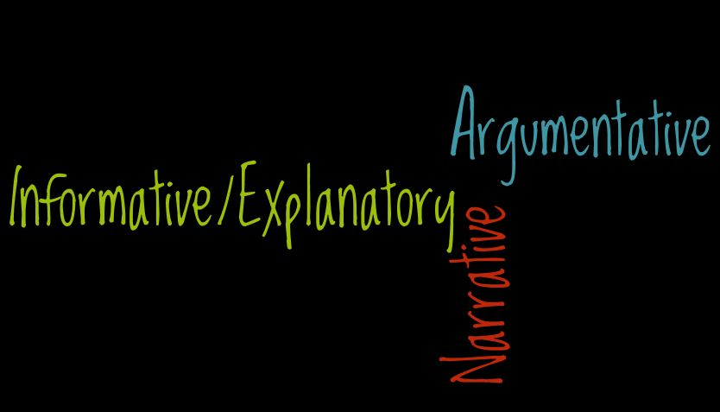
Notes:
Read Common Core writing standard 1, K-12 from K through 12
Note how the standard develops across the grades.
Implications for instruction: less personal narrative, more argumentative and explanatory writing.

Slide 35
Common Core Instructional Shifts for ELA/Literacy
Building knowledge through content-rich nonfiction and informational texts
Reading and writing grounded in evidence from text
Regular practice with complex text and its academic vocabulary

Slide 36
Text Complexity Issues
Many of the books that students read became easier after 1962. College books have not.
In middle and high school, instruction is heavily scaffolded. In college students are expected to read independently.
The amount of reading in college is substantially more that what students typically experience in high school. It can be up to 8 times greater.
Notes:
Karen Wixen, IRA 2011
For every 100 9th graders, 69 graduate from hs, 42 go to college, 28 return for sophomore year, 20 earn a BA in 6 years.

Slide 37
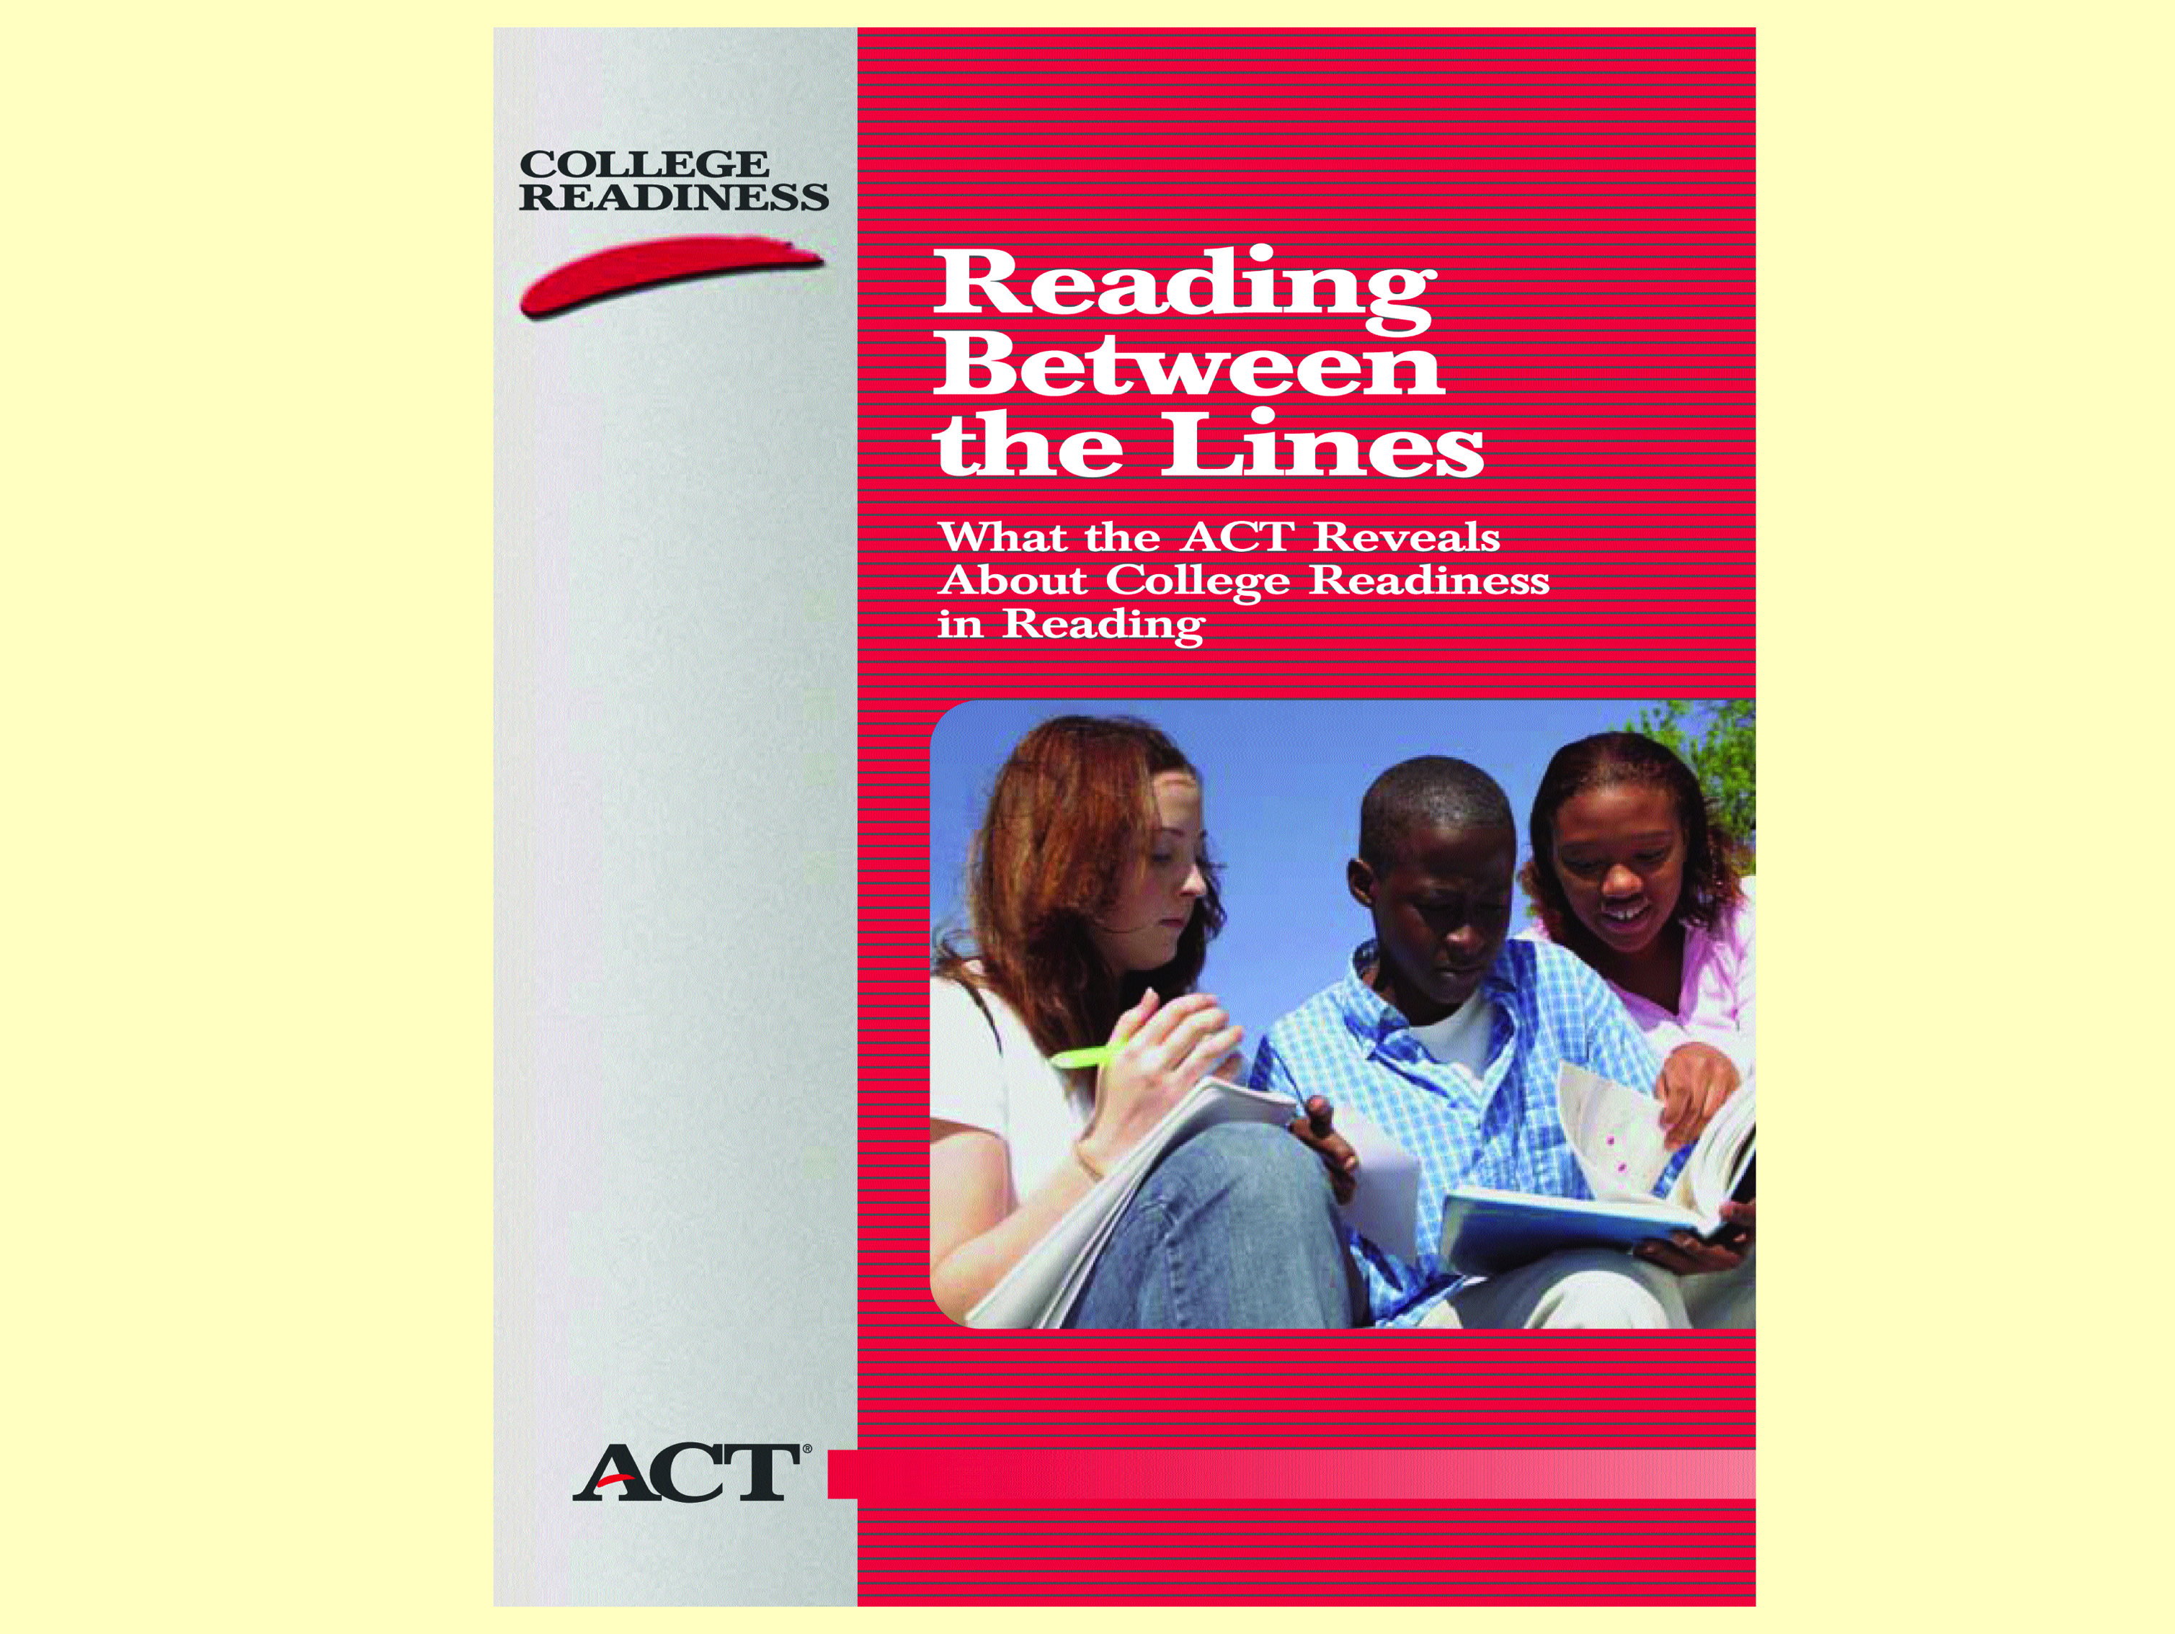
ACT cover

Slide 38
Reading Between the Lines
ACT report on college readiness in reading
Performance on complex texts is the clearest differentiator in reading between students who are more likely to be ready for college and those who are less likely to be ready.

Slide 39
Reading Between the Lines
ACT report on college readiness in reading
A complex text will contain multiple layers of meaning, not all of which will be immediately apparent to students upon a single superficial reading. Such texts require students to work at unlocking meaning by calling upon sophisticated reading skills and strategies.

Slide 40

Chapter One
I woke to the sound of a mosquito whining in my left ear and my mother screeching in the right.
“Rouse yourself this instant!”
Mother snapped open the shutters and heat poured into our bedchamber. The room above our coffeehouse was not large. Two beds, a washstand, and a wooden trunk with frayed leather straps nearly filled it. It seemed even smaller with Mother storming around.
“Get out of bed, Matilda,” she continued. “You’re sleeping the day away.” She shook my shoulder. “Polly’s late and there’s work to be done.”
The noisy mosquito darted between us. I started to sweat under the thin blanket. It was going to be another hot August day. Another long, hot August day.
Notes:
Lexile 580
Grades 2-3 updated range! Used to be a grade 7 range

Slide 41

Saturday, August 3, 1793. The sun came up, as it had every day since the end of May, bright, hot, and unrelenting. The swamps and marshes south of Philadelphia had already lost a great deal of water to the intense heat, while the Delaware and Schuykill Rivers had receded to reveal long stretches of their muddy, root-choked banks. Dead fish and gooey vegetable matter were exposed and rotted, while swarms of insects droned in the heavy, humid air.
In Philadelphia itself an increasing number of cats were dropping dead every day, attracting, one Philadelphian complained, “an amazing number of flies and other insects.” Mosquitoes were everywhere, though their high-pitched whirring was particularly loud near rain barrels, gutters, and open sewers.
Notes:
Lexile 1130
Grades 7-9 (updated range)

Slide 42
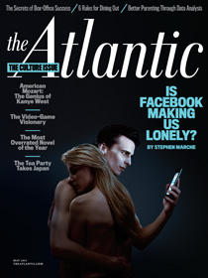
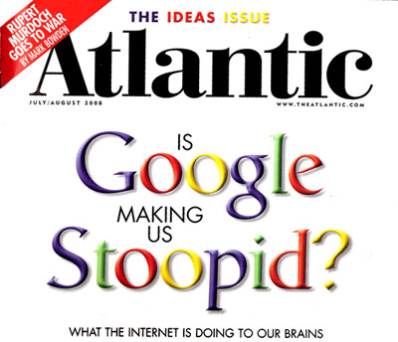

Slide 43
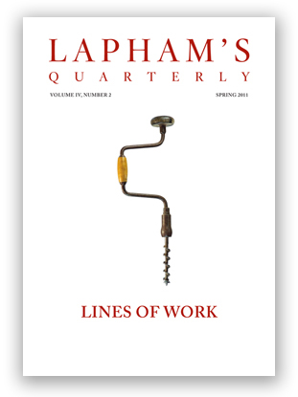



Slide 44


Slide 45

How many words do students need to know?
96% of spoken language made up of 4,000 words.
To read written text, you need a vocabulary of one million words.
Notes:
Impossible to inoculate students against meeting words they don’t know when they read.
Need to help them know WHAT to do when they meet an unfamiliar word.
Marilyn Adams, 2011 IRA

Slide 46
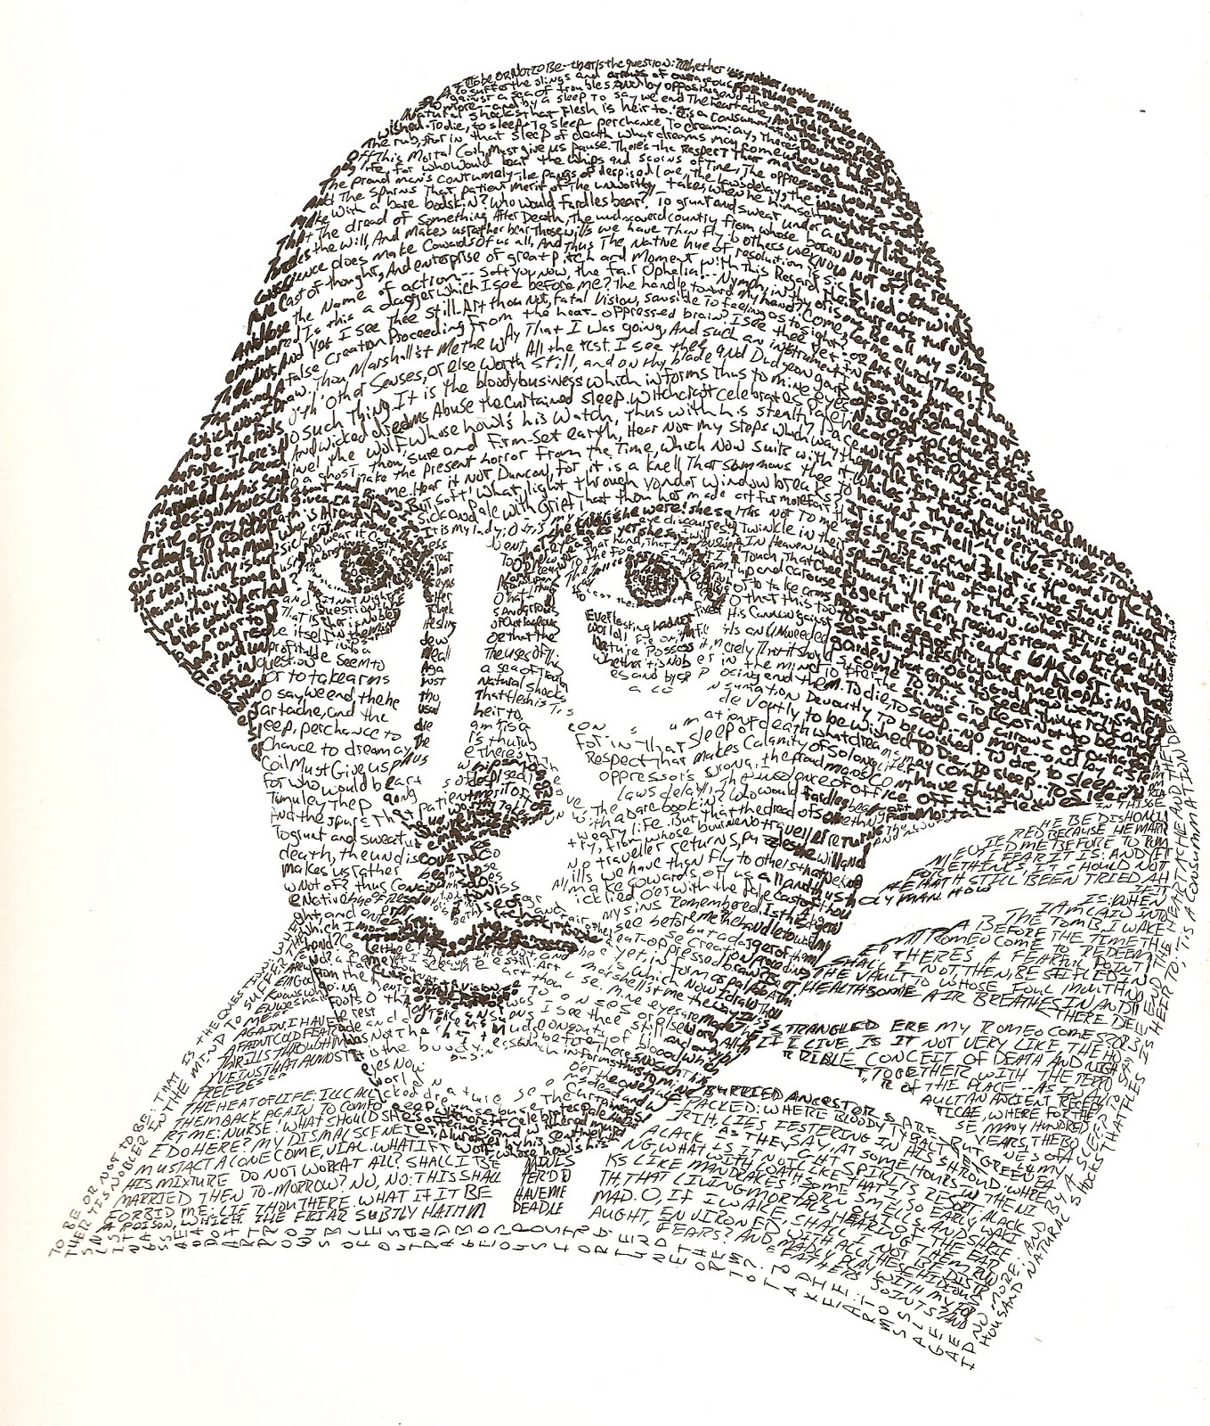
Vocabulary Acquisition
Knowledge of a word is a memory residue of several meaningful encounters with the word in diverse contexts.
Almost all the word meanings that we know are acquired indirectly by intuitively guessing new meanings as we get the overall gist of what we’re hearing or reading.
E.D. Hirsch, City Journal, winter 2013

Slide 47
Common Core and RIAP
Putting It All Together
Carol Jago cjago@caroljago.com
Notes:
Jacob Lawrence, The Library
Dream series #5, 1967

Slide 48
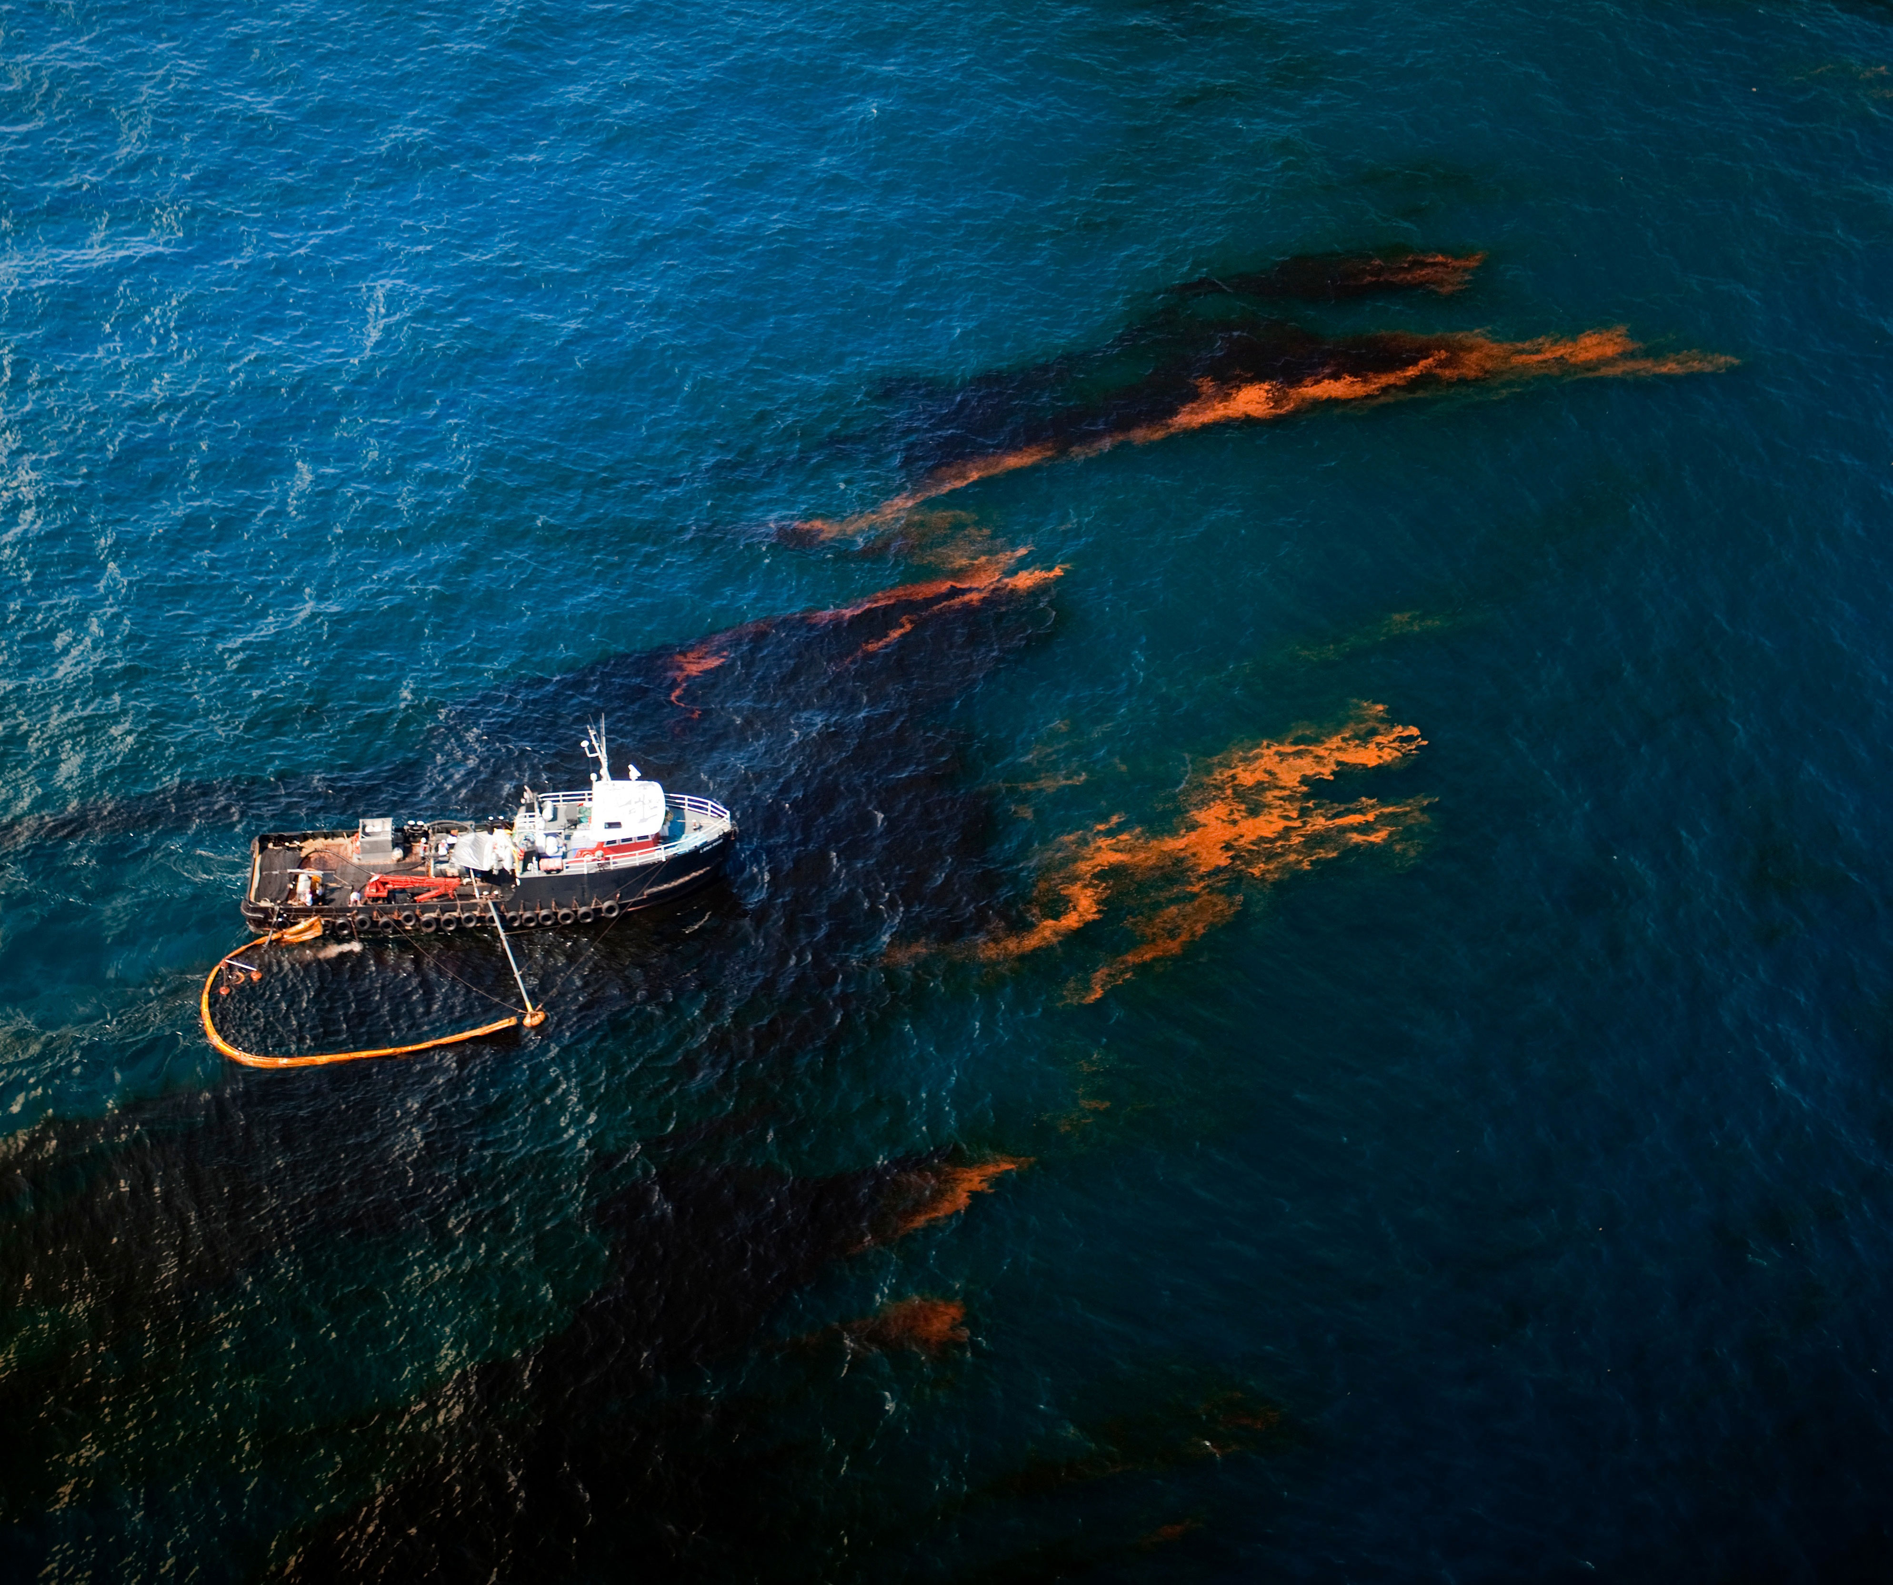
CCSS Instructional Shift #2
Reading and writing based on evidence from the text
Notes:
Skimming the Gulf, 2010
Deepwater Horizon Spill. The largest accidental marine spill in the history of the petroleum industry. Oil flowed unabated for 3 months.
Caused by the April 10, 2010 explosion of the Deepwater Horizon drilling on the BP Macondo Prospect.

Slide 49
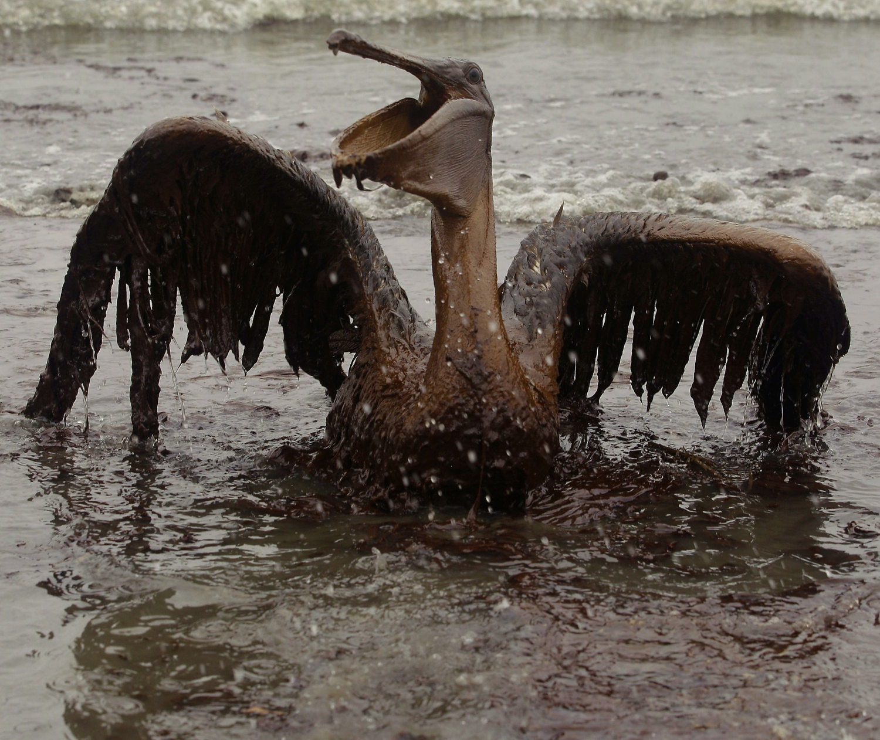
Notes:
Iconic photograph from the BP oil spill, also called the Deepwater Horizon oil spill on April 20, 2010
Pathos, appeals to emotion, story of AP photographer

Slide 50
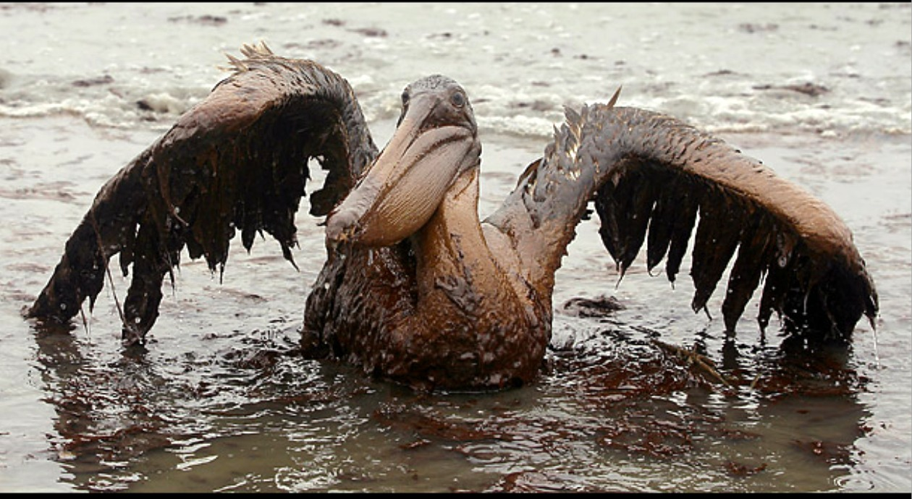
Notes:
Iconic photograph from the BP oil spill, also called the Deepwater Horizon oil spill on April 20, 2010
Pathos, appeals to emotion, story of AP photographer

Slide 51
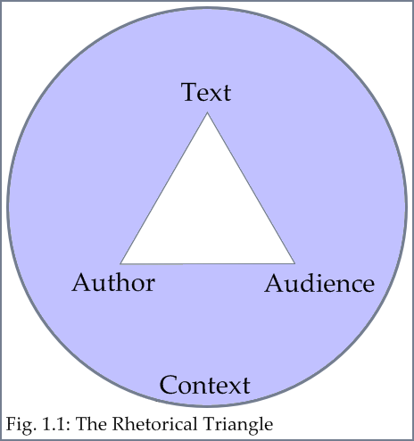

Slide 52
From the BP Website
http://www.bp.com/sectionbodycopy.do?categoryId=41&contentId=7067505
Infographic http://www.bpgulfupdate.com/go/doc/4699/1332115/
Writing Task
Analyze the sea gull photograph along with the BP video and infographic in terms of their purpose, message, sources, and effectiveness.
Notes:
Skimming the Gulf, 2010
Deepwater Horizon Spill. The largest accidental marine spill in the history of the petroleum industry. Oil flowed unabated for 3 months.
Caused by the April 10, 2010 explosion of the Deepwater Horizon drilling on the BP Macondo Prospect.

Slide 53
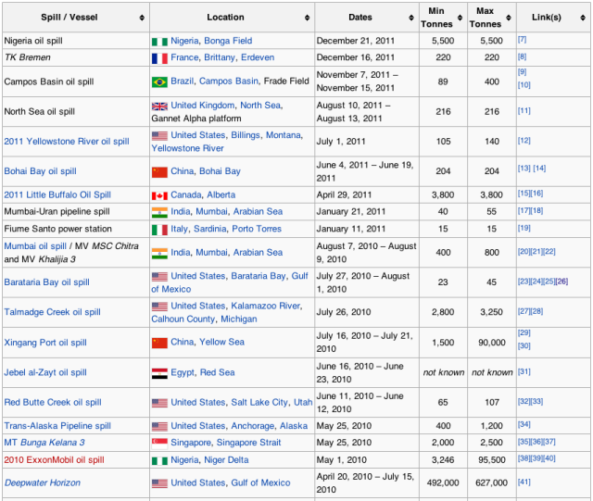
Oil spills around the world since the
2010 BP spill in the Gulf of Mexico
Notes:
Oil spills which have occurred since the BP oil spill in the Gulf from Wikipedia
Links for ethos

Slide 54

http://www.smarterbalanced.org/smarter-balanced-assessments/
Delivered adaptively by computer during last 12 weeks
45-60 computer-adaptive selected response, constructed response, and computer enhanced items
Complex performance assessments, 90-120 minutes long
Combination of human and machine scoring
Notes:
Smarter Balanced performance assessments are integrated reading and writing tasks. Both assessment consortia have created simulated research tasks (Writing Standard 7. 8. and 9) which offer readings, multimedia texts, data displays from which students can draw the evidence they need to support their claims.
Assessments worth teaching to. No more teaching students how to answer goofy multiple choice questions about writing. Proxies.

Slide 55
Issues
Keyboarding
Time constraints for composing, revising, and editing
Movement away from personal narratives for assessment purposes
Evidence-based writing
http://sampleitems.smarterbalanced.org/itempreview/sbac/ELA.htm
Grade 11 Nuclear Power performance task
http://www.smarterbalanced.org/wordpress/wp-content/uploads/2012/09/performance-tasks/nuclear.pdf
Notes:
Evidence-based narrative writing will be new to most teachers. We are going to have to rethink some of our current approaches to narrative writing and figure out ways to make this work less dependent upon imaginative leaps and insights (A box just landed on your roof from Mars. Write about what happened next.)

Slide 56
Rubrics
4-point scale
Smarter Balanced employs different rubrics for each of the 3 writing types.
Smarter Balanced will create task-specific scoring guides for every prompt.

Slide 57
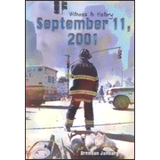
Writing an Argumentative Essay
What claims do the following texts make about the events of September 11, 2001? Write an essay that analyzes the strength of the argument each of these texts posits. Use textual evidence to support your analysis.
Notes:
Narrative
Read this collection of narrative, informational, and visual texts considering the author, the context, and their message.

Slide 58
Witness to History: September 11, 2001
By Brendan January
The dawn of September 11 was clear and bright over New York City and Washington, D.C. It promised to be a beautiful autumn day. There was no mist or fog, and visibility was excellent.
At about 8 a.m. American Airlines Flight 11 took off from Logan International Airport in Boston. Eighty-one passengers and eleven crew were on board the plane, which was headed for Los Angeles. The air traffic controller told the pilots to turn right and climb to 35,000 feet (10,668 meters). After fourteen minutes, however, the plane was flying at only 29,000 feet (8,839 meters) and was no longer answering radio calls.
Notes:
Narrative Description
Read this collection of narrative, informational, and visual texts considering the author, the context, and their message.

Slide 59
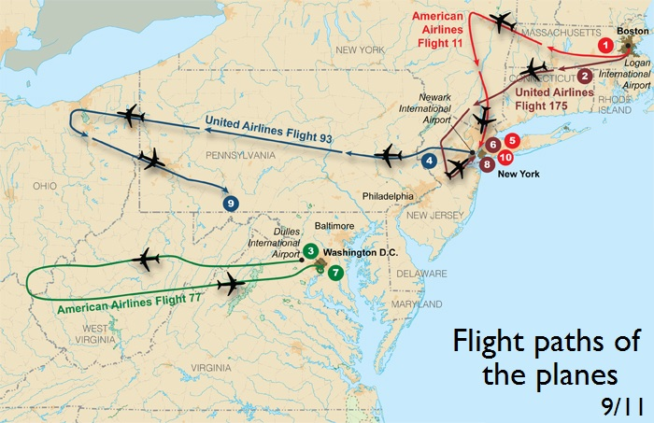
Notes:
Informational text: map and timeline

Slide 60
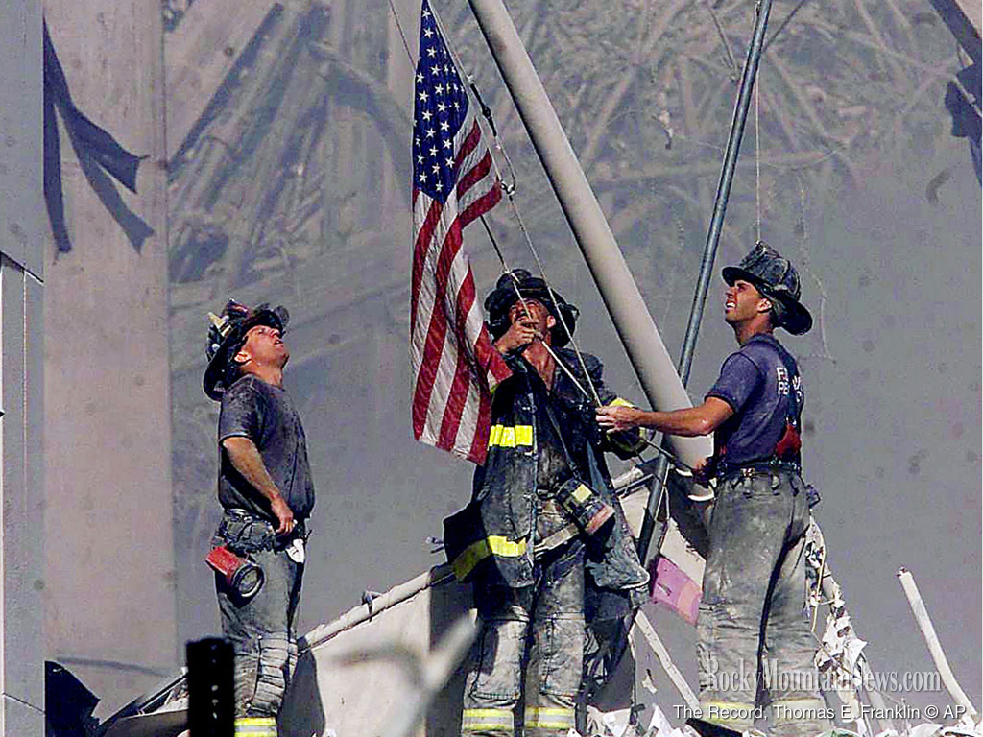
Notes:
Photograph taken on September 11, 2001 by Thomas E. Franklin

Slide 61
Text-dependent questions
Describe the context for this photograph taken by Thomas E. Franklin on September 11, 2001.
What role did these men play on 9/11? How can you tell?
What effect does the flag have on the photo? How does it provide a clue to the photographer’s message?
Notes:
#2 evidence

Slide 62
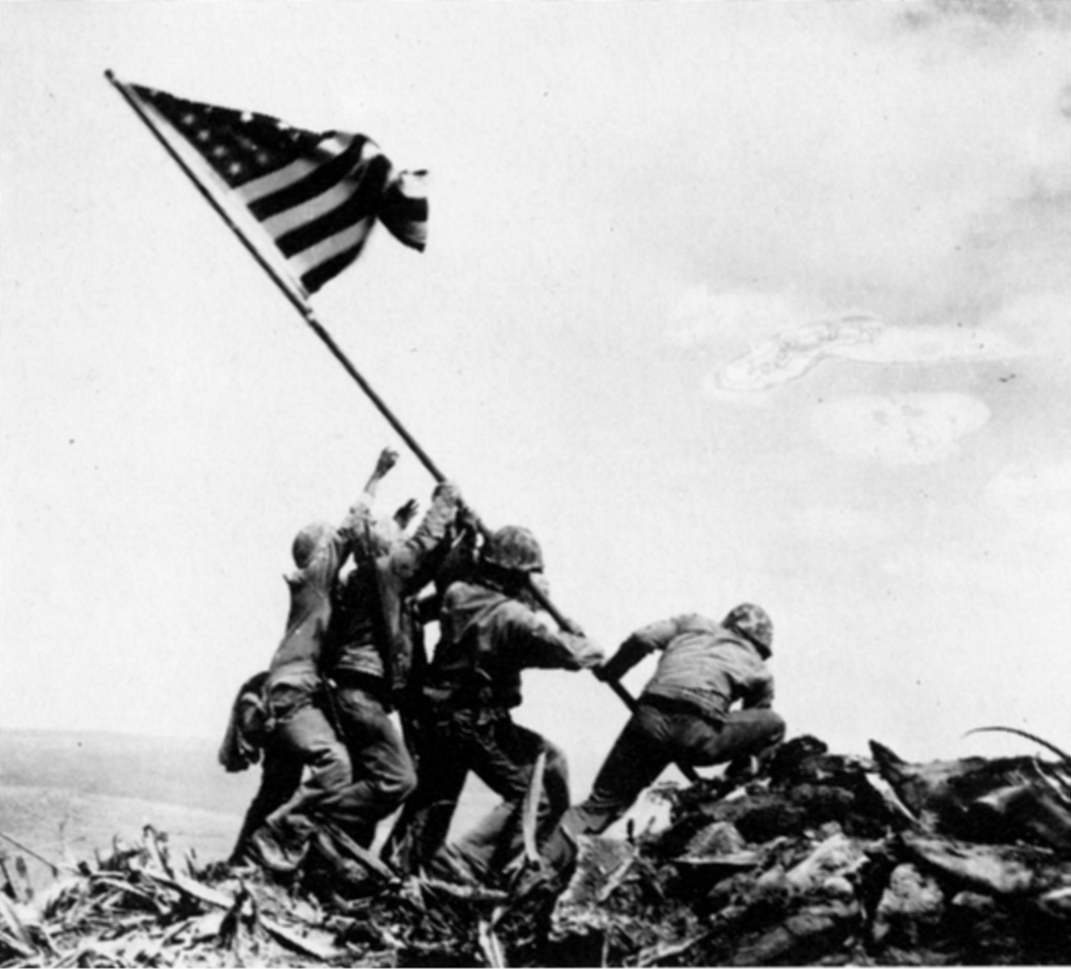
Notes:
Flag raising at Iwo Jima, February 19, 1945 by photographer Joe Rosenthal.
Only 3 of these soldiers survived. Inspired patriotism throughout the country.
Do you think

Slide 63

September 12, 2001
Writer Mir Tamim Ansary was born in Afghanistan and lived there until he moved to the U.S. at the age of 18. After the September 11 attacks, he wrote an e-mail to some friends.
His message went viral.
Notes:
Argumentative text: author, context, message

Slide 64
Text-dependent questions
How does Tamim Ansary establish his credibility?
Why is the date of this email message significant?
What claim does he make?
What evidence does he offer to support his claim?
Notes:
Argumentative text

Slide 65
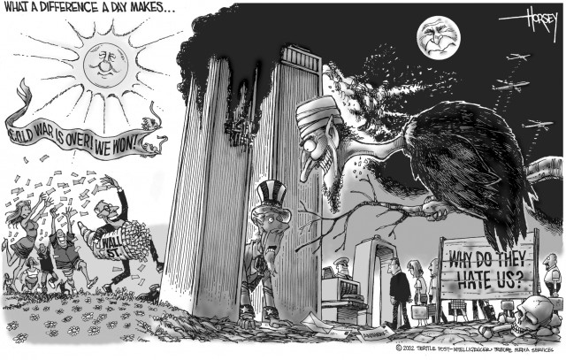
Notes:
David Horsey, syndicated Pulitzer-prize winning cartoonist for the Los Angeles Times, September 8, 2002
What claim is David Horsey, Pulitzer Prize winning political cartoonist, making about September 11, 2001?
Cite details from the cartoon that support Horsey’s claim.

Slide 66
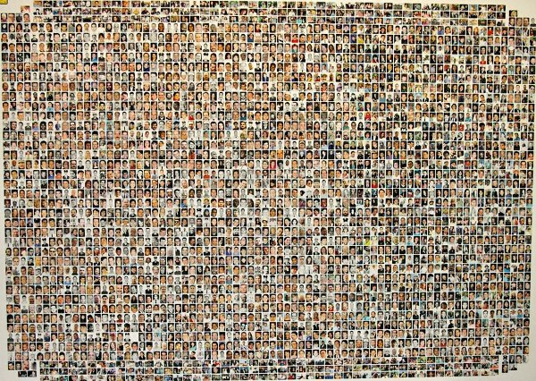
A Quilt of a Country by Anna Quindlen
Newsweek, September 26, 2001
Notes:
CCSS exemplar text, Grades 9-10
What textual challenges does this argumentative text pose for students?

Slide 67
Textual Challenges
background knowledge
vocabulary
figurative language
syntax
unfamiliar allusions
organizational structure
length
A Quilt of a Country by Anna Quindlen
Newsweek, September 26, 2001
Notes:
CCSS exemplar text, Grades 9-10

Slide 68
Critical Vocabulary
mongrel
notion
abet
coalescing
A Quilt of a Country by Anna Quindlen
Newsweek, September 26, 2001
Notes:
CCSS exemplar text, Grades 9-10

Slide 69
Writing Arguments
What claims do the texts you have read in this lesson make about the events of September 11, 2001?
Write an essay that analyzes the strength of the argument each of these texts posits. Use textual evidence to support your analysis.

Slide 70
Common Core and RIAP
Putting It All Together
Carol Jago cjago@caroljago.com
Notes:
Jacob Lawrence, The Library
Dream series #5, 1967

Slide 71
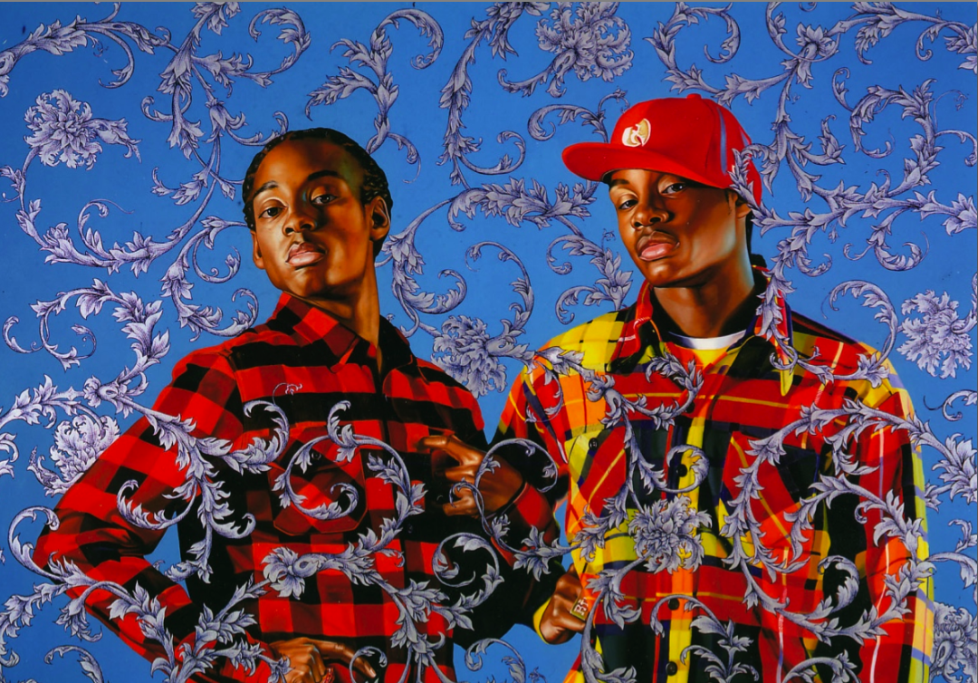

Slide 72
If We Must Die
If we must die, let it not be like hogs
Hunted and penned in an inglorious spot,
While round us bark the mad and hungry dogs,
Making their mock at our accursèd lot.
If we must die, O let us nobly die,
So that our precious blood may not be shed
In vain; then even the monsters we defy
Shall be constrained to honor us though dead!
O kinsmen! we must meet the common foe!
Though far outnumbered let us show us brave,
And for their thousand blows deal one death-blow!
What though before us lies the open grave?
Like men we’ll face the murderous, cowardly pack,
Pressed to the wall, dying, but fighting back!
by Claude McKay

Slide 73
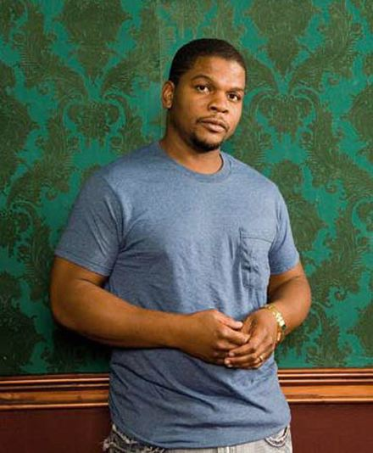
Kehinde Wiley
http://www.youtube.com/watch?v=3jNKBOMOTPA&feature=youtu.be

Slide 74
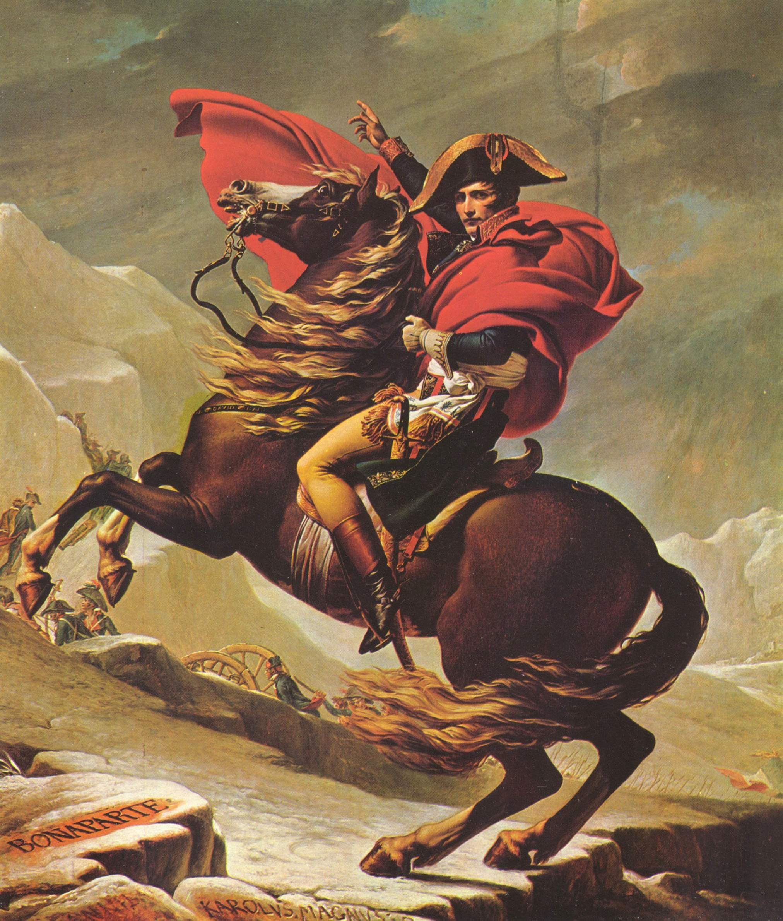
Notes:
Teaching visual rhetoric
Jacques-Louis David, “Napoleon Crossing the Alps” 1804

Slide 75
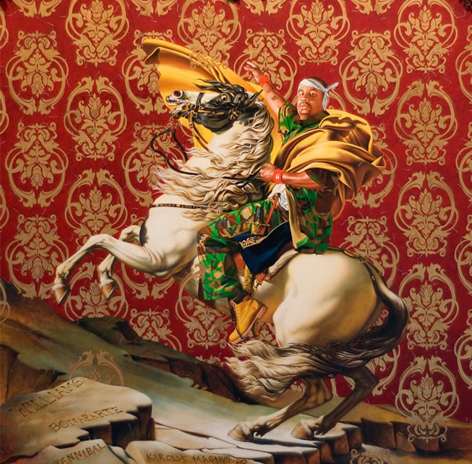
Notes:
Kehinde Wiley 2005 “Napoleon Leading His Army Over the Alps” from Rumors of War series

Slide 76

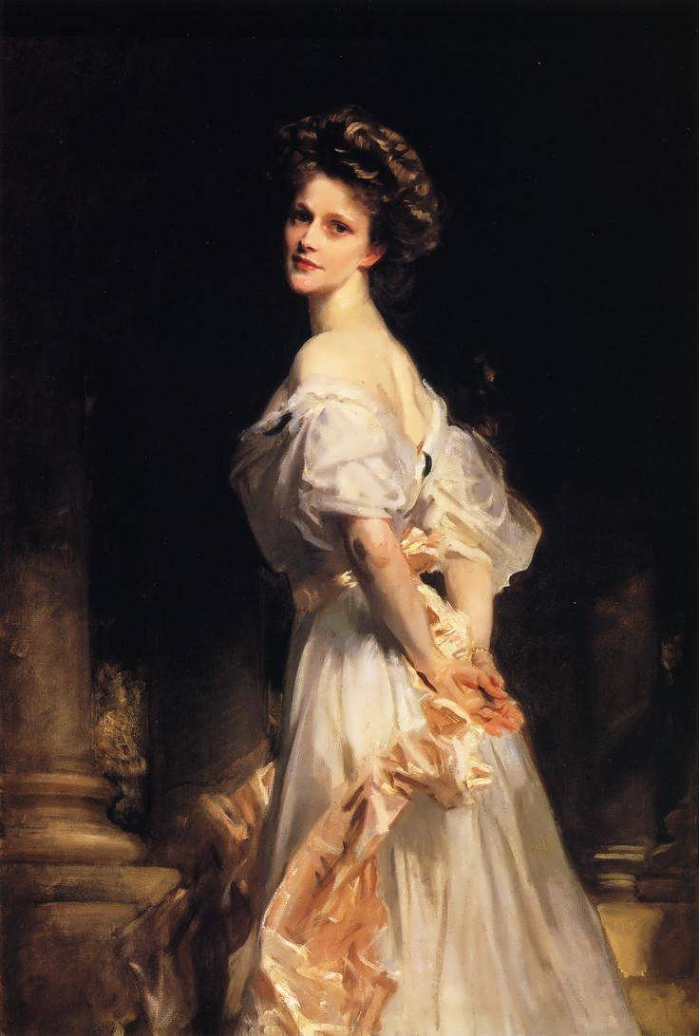

Slide 77
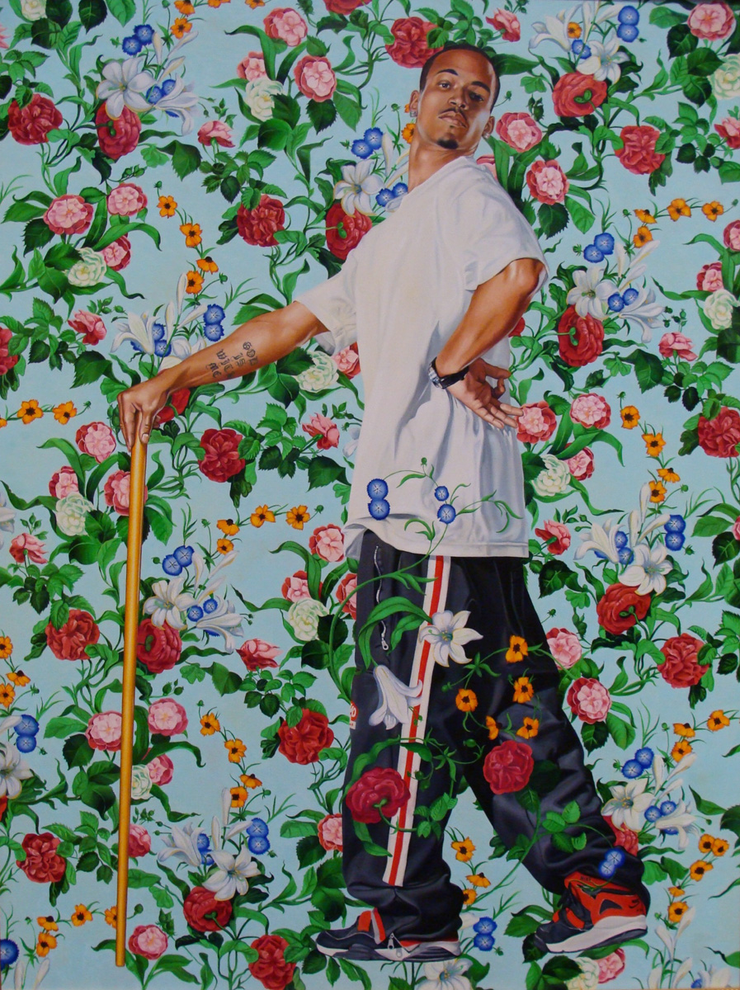
Notes:
La roi a la chasse (the king on the hunt)

Slide 78
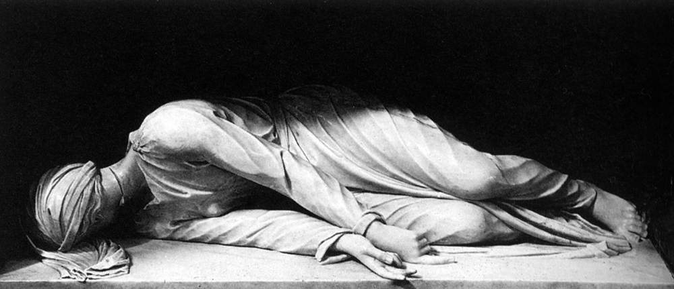

Notes:
The Virgin Martyr St. Cecilia, Kehinde Wiley, 2008
Gwendolyn Brooks, “The Boy Died in My Alley”
Compare the two poems. How are the claims the speakers in the poems are making different? What evidence can you point to to support your view? (text-dependent questions, not sharing personal stories)

Slide 79
The Boy Died in My Alley
to Running Boy
The Boy died in my alley
without my Having Known.
Policeman said, next morning,
"Apparently died Alone."
"You heard a shot?" Policeman said.
Shots I hear and Shots I hear.
I never see the Dead.
The Shot that killed him yes I heard
as I heard the Thousand shots before;
careening tinnily down the nights
across my years and arteries.
Policeman pounded on my door.
"Who is it?" "POLICE!" Policeman yelled.
"A Boy was dying in your alley.
A Boy is dead, and in your alley.
And have you known this Boy before?"
by Gwendolyn Brooks
Notes:
The Virgin Martyr St. Cecilia, Kehinde Wiley, 2008
Gwendolyn Brooks, “The Boy Died in My Alley”
Compare the two poems. How are the claims the speakers in the poems are making different? What evidence can you point to to support your view? (text-dependent questions, not sharing personal stories)

Slide 80
I joined the Wild and killed him
with knowledgeable unknowing.
I saw where he was going.
I saw him Crossed. And seeing,
I did not take him down.
He cried not only "Father!"
but "Mother!
Sister!
Brother."
The cry climbed up the alley.
It went up to the wind.
It hung upon the heaven
for a long
stretch-strain of Moment.
The red floor of my alley
is a special speech to me.
have known this Boy before.
I have known this boy before,
who ornaments my alley.
I never saw his face at all.
I never saw his futurefall.
But I have known this Boy.
I have always heard him deal with death.
I have always heard the shout, the volley.
I have closed my heart-ears late and early.
And I have killed him ever.
Notes:
The Virgin Martyr St. Cecilia, Kehinde Wiley, 2008
Gwendolyn Brooks, “The Boy Died in My Alley”
Compare the two poems. How are the claims the speakers in the poems are making different? What evidence can you point to to support your view? (text-dependent questions, not sharing personal stories)

Slide 81
Read Gwendolyn Brooks’ poem “The Boy Died in My Alley”
Compare this poem with Claude McKay’s sonnet.
Read and discuss article from Chicago Tribune.
Notes:
The Virgin Martyr St. Cecilia, Kehinde Wiley, 2008
Gwendolyn Brooks, “The Boy Died in My Alley”
Compare the two poems. How are the claims the speakers in the poems are making different? What evidence can you point to to support your view? (text-dependent questions, not sharing personal stories)

Slide 82
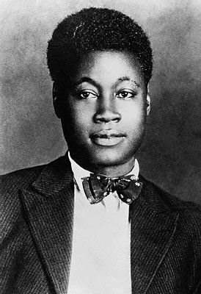
Claude McKay reading “If We Must Die”
http://media.sas.upenn.edu/afilreis/McKay-Claude_If-We-Must-Die.mp3
RL.9-10.7: Analyze the representation of a subject or a key scene in two different artistic mediums, including what is emphasized or absent in each treatment.

Slide 83
Common Core and RIAP
Putting It All Together
Carol Jago cjago@caroljago.com
Notes:
Jacob Lawrence, The Library
Dream series #5, 1967

Slide 84
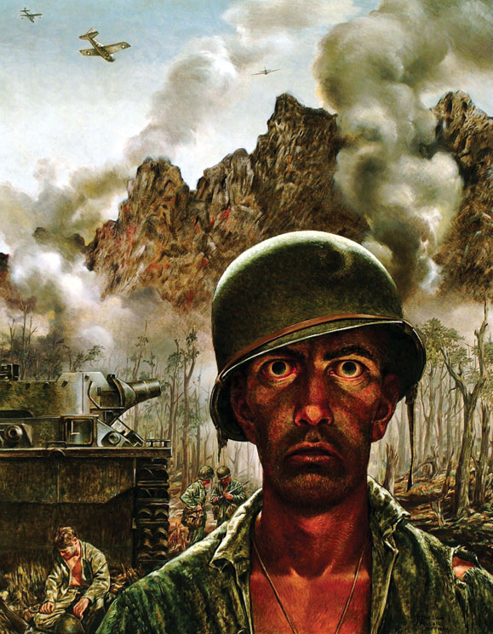
Notes:
Tom Lea, “That 2,000-Yard Stare,” 1944
[Tom] Lea was one of the artists put into the field by Life after their takeover of the defunct [Army Corps of Engineers war art unit's] program. Various of his works appeared in the magazine, and up until the time he went into Peleliu, most of them could be pretty well classified as excellently done but high-grade propaganda. There was very little American blood, very little tension, very little horror. Mostly, it was what could be called the Bravo America! and This Is Your Boy type of war art. His almost photographic style easily lent itself to that type of work, as did the styles of Rockwell and others.
But something apparently happened to Lea after going into Peleliu. The pictures painted out of his Peleliu experience show a new approach. There is the tension of terror in the bodies here, and the distorted facial expressions of the men under fire show it, too. If the propagandistic style has not changed, his subject matter certainly has.
One of the most famous, of course, is the Two-Thousand Yard Stare portrait of a young marine who has had all, or more than, he can take. The staring eyes, the slack lips, the sleepwalker's stance

Slide 85
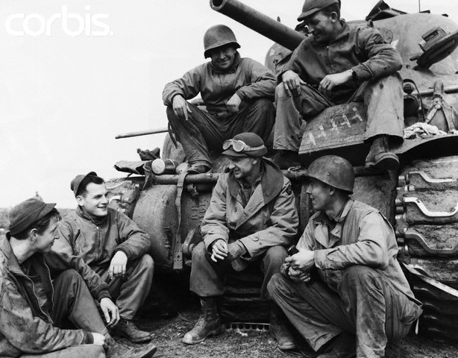
War correspondent Ernie Pyle
“The Death of Captain Waskow”
Notes:
Ernie Pyle with tank crew

Slide 86
The Death of the Ball Turret Gunner
By Randall Jarrell
From my mother's sleep I fell into the State,
And I hunched in its belly till my wet fur froze.
Six miles from earth, loosed from its dream of life,
I woke to black flak and the nightmare fighters.
When I died they washed me out of the turret with a hose.
Notes:
Written in 1945

Slide 87
Writing Arguments
What claims do the Tom Lea painting, the Ernie Pyle
dispatch, and the Randall Jarrell poem make about
war?
Write an essay that analyzes the strength of the
argument each of these texts posits. Use textual
evidence to support your analysis.

Slide 88
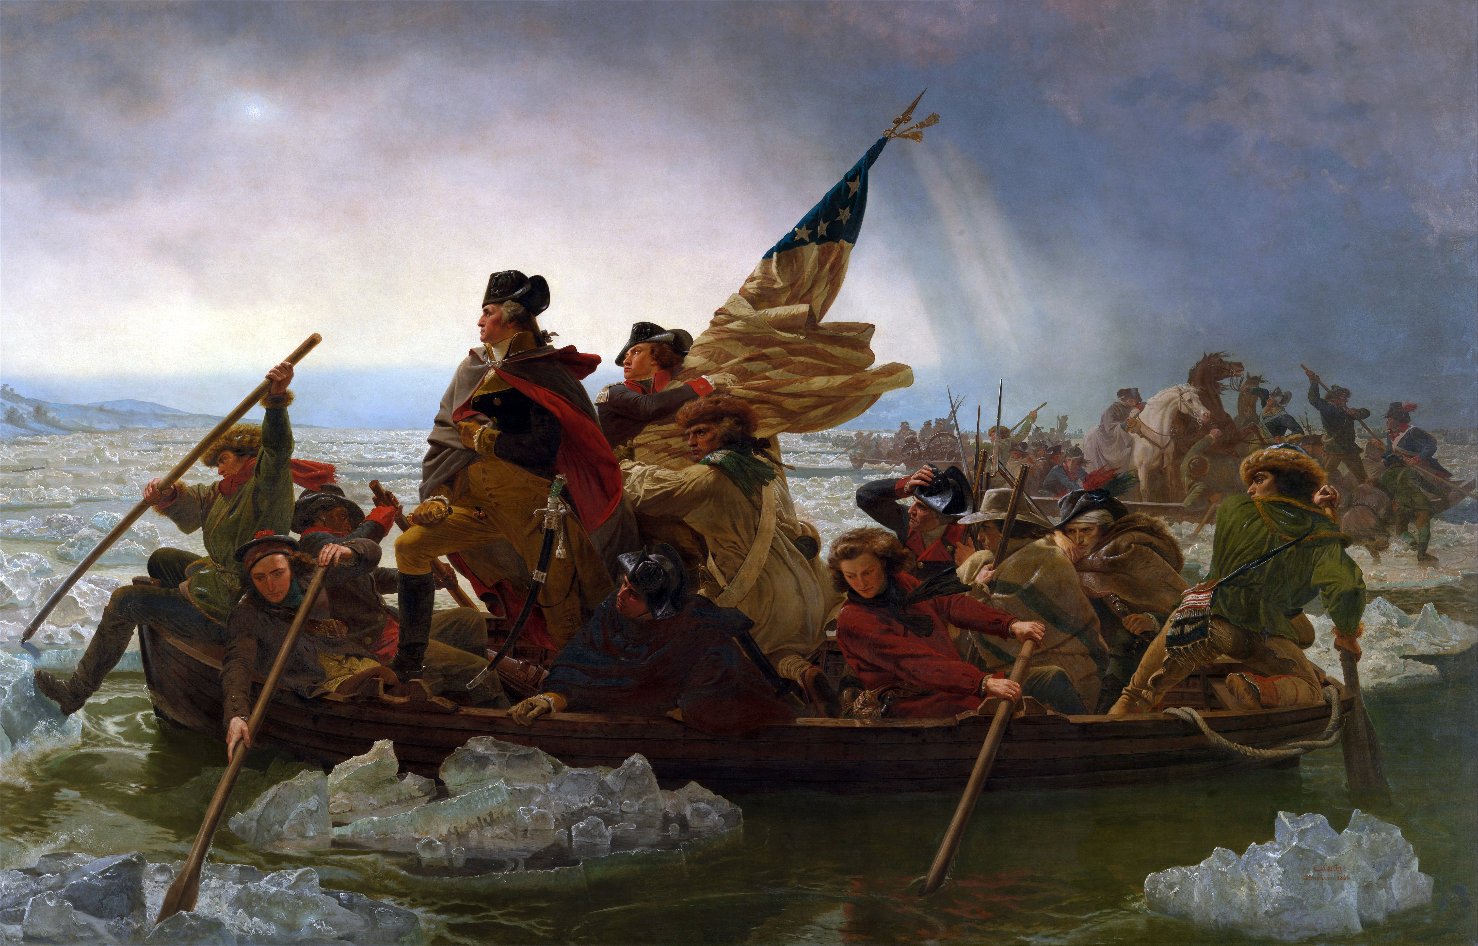
Notes:
Emmanuel Leutze, Washington Crossing the Delaware, 1851
Sentimental realism, enormously popular and enormous

Slide 89
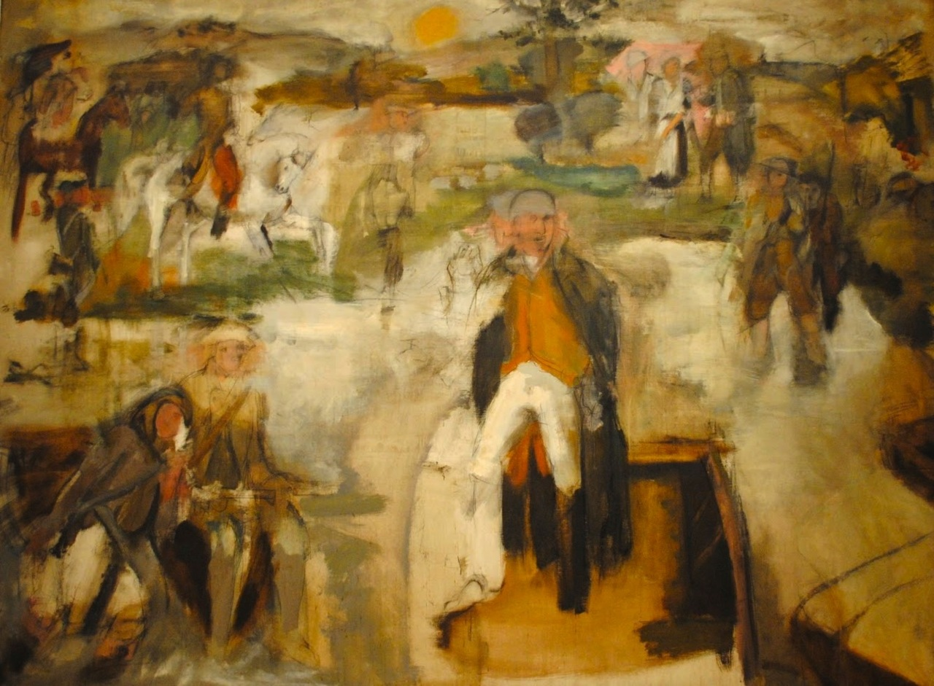
Notes:
Larry Rivers, “Washington Crossing the Delaware” 1953
Rivers denied that his painting was specifically a parody of Emmanuel Leutze’s painting at the Met. He maintained that his true inspiration derived from the patriotic grade school plays he had acted in or watched as a boy. This explanation made the picture no less heretical in an art world that had given up on representation and was bound to consider a patriotic theme as either hopelessly corny or retrograde.
The painting undermined the heroism, masculinity and patriotism of the original. It appeared the year after the Leutze was in the public eye in the celebrations for the 175th anniversary of the river crossing. At that time the Cold War and McCarthyism were at their height, and patriotism had become a national obsession. Rivers’s painting undercuts the heroic Napoleonic stance of Washington in the Leutz and humanizes it. Washington becomes only one of many going about their business; he seems isolated and his stance is much less heroic and purposeful than in the original. He takes Washington off his heroic pedestal. Rivers was reading War and Peace at the time.

Slide 90
To be more revolutionary than a nun
is our desire, to be secular and intimate
as, when sighting a redcoat, you smile
and pull the trigger. Anxieties
and animosities, flaming and feeding
on theoretical considerations and
the jealous spiritualities of the abstract
the robot? they're smoke, billows above
the physical event. They have burned up.
See how free we are! as a nation of persons.
Dear father of our country, so alive
you must have lied incessantly to be
immediate, here are your bones crossed
on my breast like a rusty flintlock,
a pirate's flag, bravely specific
and ever so light in the misty glare
of a crossing by water in winter to a shore
other than that the bridge reaches for.
Don't shoot until, the white of freedom glinting
on your gun barrel, you see the general fear.
On Seeing Larry Rivers' Washington Crossing the Delaware at the
Museum of Modern Art
by Frank O'Hara
Now that our hero has come back to us
in his white pants and we know his nose
trembling like a flag under fire,
we see the calm cold river is supporting
our forces, the beautiful history.
Notes:
Larry Rivers, “Washington Crossing the Delaware” 1953

Slide 91
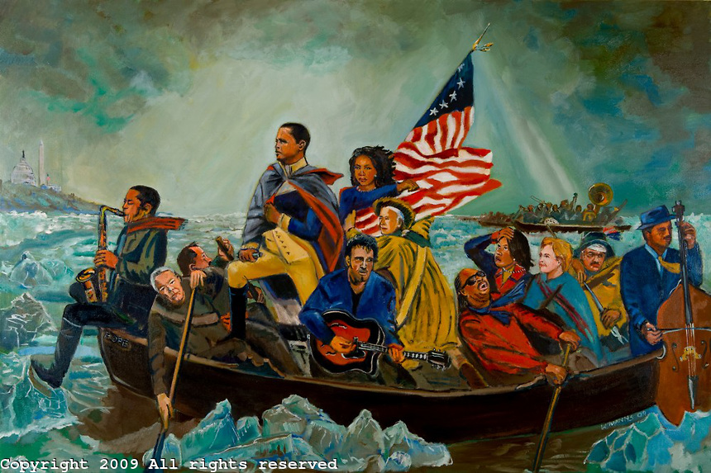
Notes:
Wayne Mann’s “The Crossing”

Slide 92

Contrary to what we usually believe, the best moments in our lives are not the passive, receptive, relaxing times — although such experiences can also be enjoyable if we have worked hard to attain them. The best moments usually occur when a person’s body or mind is stretched to its limits in a voluntary effort to accomplish something difficult and worthwhile.
- Mihaly Csikszentmihalyi

Slide 93

“The nation is in thrall to testing and basic skills.”
- Still at Risk, Common Core report

Slide 94
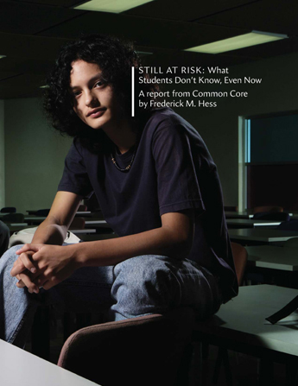
WHAT WE NEED is an educational system that teaches deep knowledge, that values creativity and originality, and that values thinking skills.

Slide 95
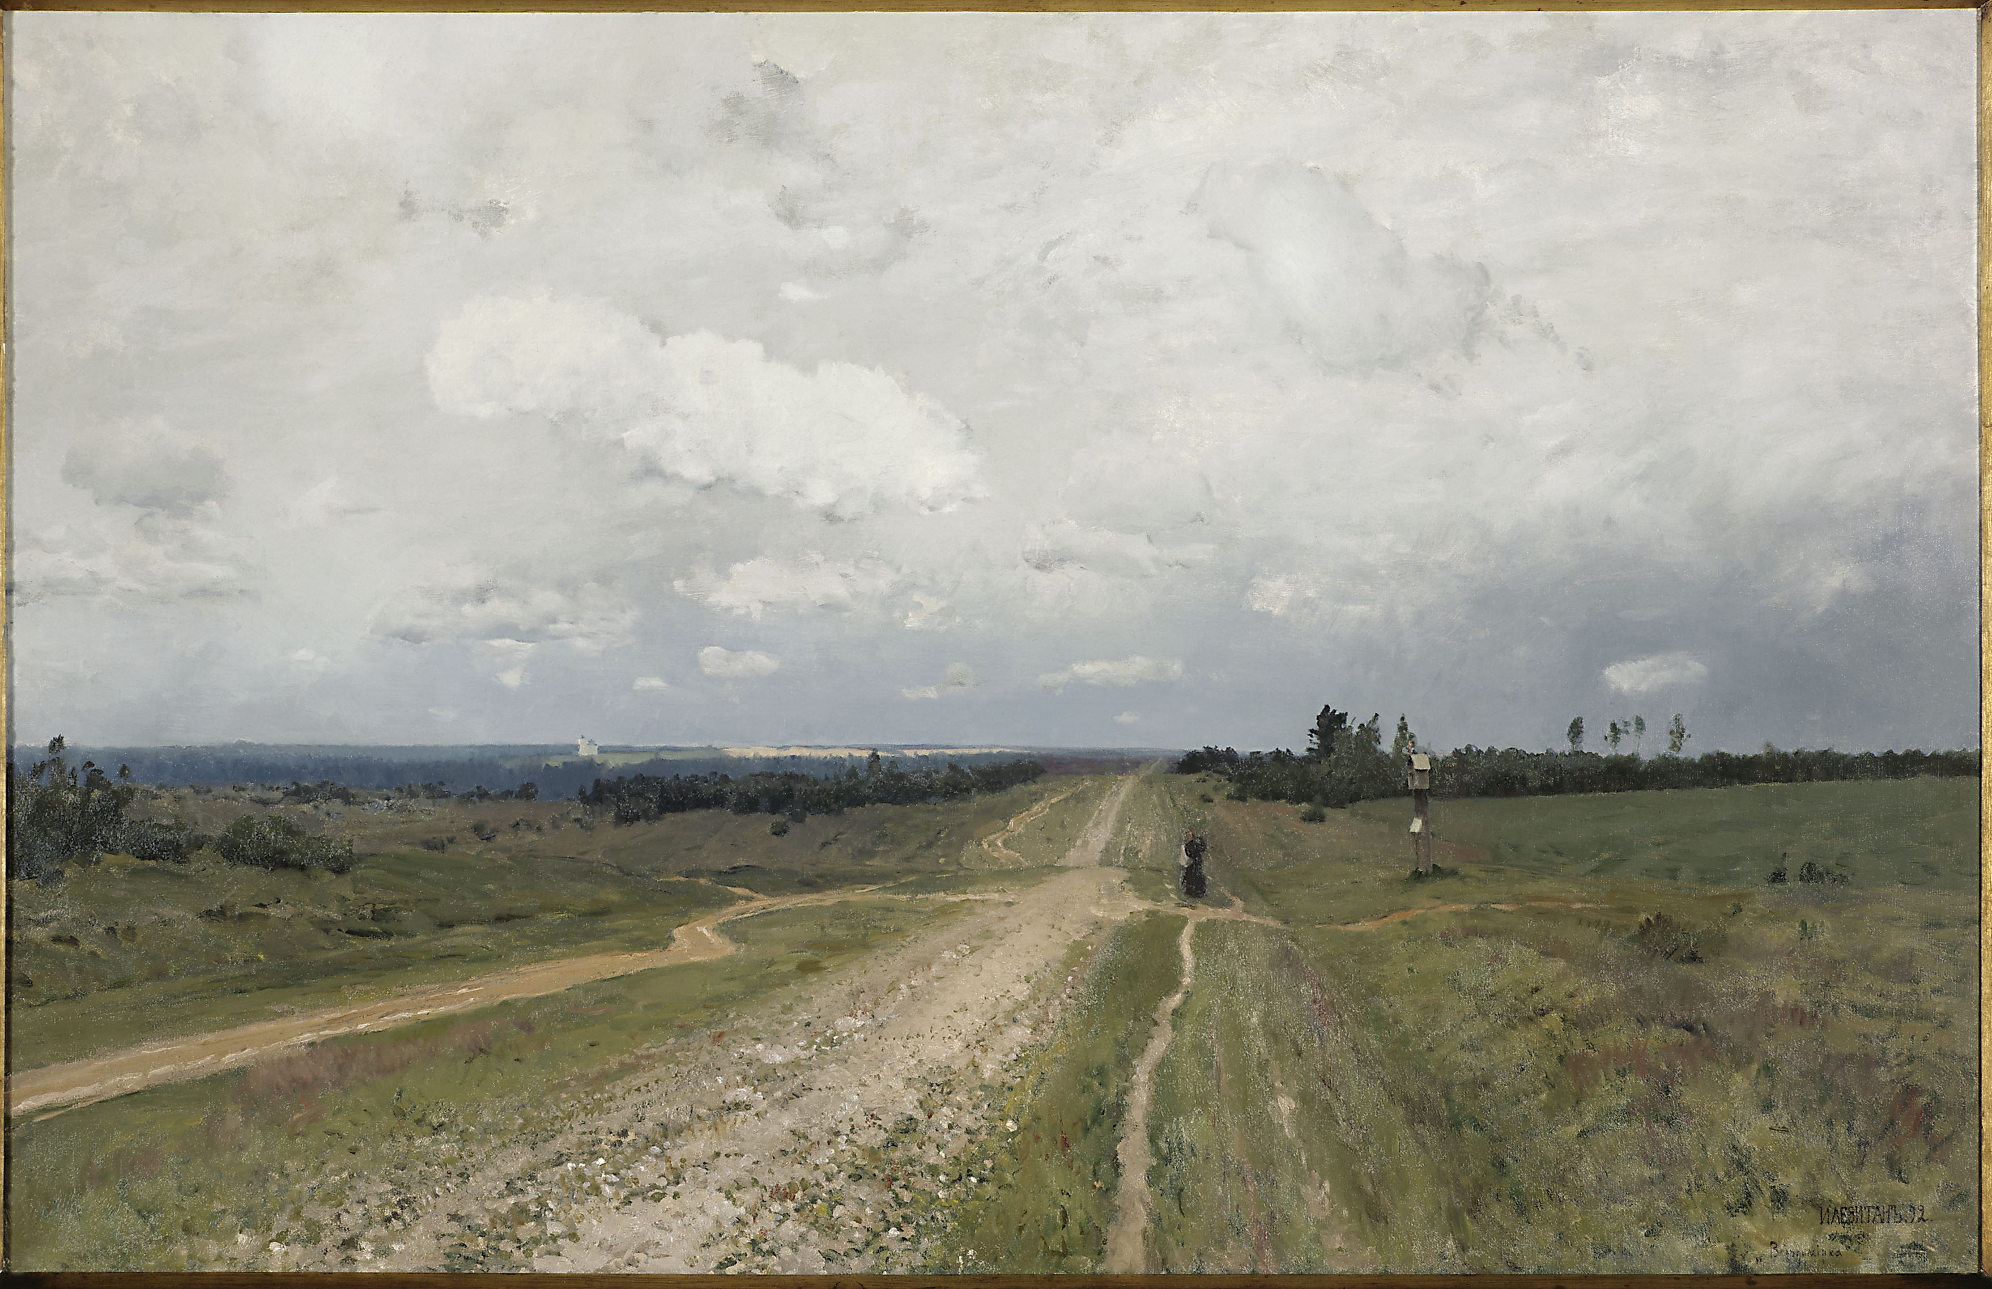
We make the road by walking.
- Antonio Machado
Notes:
“The Wanderer” by Caspar David Friedrick

