Slide 1
CSU TRAVEL POLICY UPDATES 2024
CSUB
Payment Services

Slide 2
Agenda
Key Changes – January 1, 2024
New per diem travel claim forms for non-Concur travelers
How to enter per diem for travel claims in Concur
Review the new CSUB travel policy for 2024
Questions.

Slide 3
Key 2024 Changes
The CSU updated its travel policy effective 1/1/2024 and CSUB has taken the opportunity to make a couple of related changes.
Meals and incidentals for staff, faculty, and students are now paid on a location-based per diem basis (no receipts).
Meals and incidentals for non-employees (guests, including speakers & and candidates) are now paid a flat $59 per diem (no receipts).
Receipts are no longer required for certain travel expenses under $75.
If a traveler doesn’t repay an “excess advance amount” within 120 days of the end of travel, that amount is taxable per the IRS. This includes cash advances, unallowable expenses paid by CSUB (such as on a ProCard or travel credit card), and any amount over the approved amount of the related travel claim.
Travel expense claims are due 30 days after the end of travel and
Claims submitted more than 60 days after the end of travel must be approved by the appropriate Vice President or his designee and may be taxable per the IRS.
A traveler who attends an approved conference where the prearranged conference lodging rate exceeds the $275 per night limit may stay at the conference hotel without additional approval, but the claim must include a notation that the conference is being held at the hotel where the traveler is staying.

Slide 4
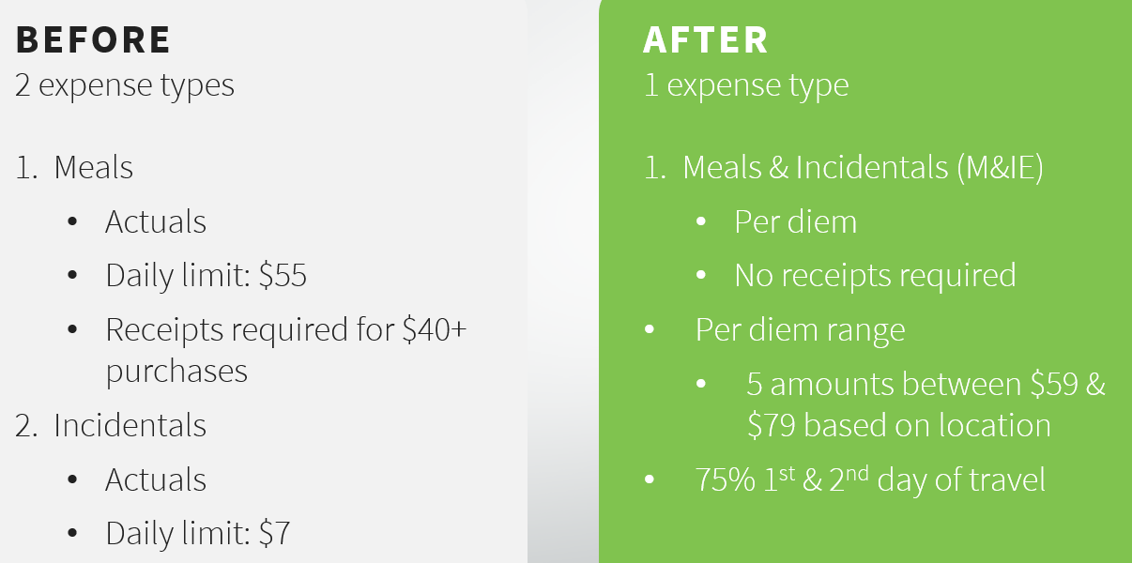
Changes are effective January 1st, 2024
Available on the CSU Policy Library
Affects travel with a start date of January 1st, 2024 or after.
Travel with a start date prior to January 1st, 2024, shall be expensed based on prior policies
Submit 2023 claims by January 31, 2024.
The 2023 claim forms will be deleted from the Campus Forms Gateway approximately at the end of February because CSU policy is to submit claims within 60 days of the end of travel. (That isn’t new.)

Slide 5
Per Diem Types
EMPLOYEE /STUDENT TRAVEL
Location-based per diem according to GSA rates
Rates are automatically updated in Concur
The amount is higher for cities with higher cost-of-living
If not using Concur, use a paper claim from the Campus Forms Gateway.
NON-EMPLOYEE (GUEST) TRAVEL
$59 fixed rate per diem
Advantages:
It is easy to communicate to non-employees
Decreases data entry & review time for users
Non-employee travel policies are loaded in Concur
If not using Concur, use a paper claim from the Campus Forms Gateway.

Slide 6
Receipts
If you use a ProCard to pay any travel expenses, you must provide a detailed receipt as part of your ProCard reconciliation report.
For your travel claim, follow the CSUB Travel Policy and the rules below.
Hospitality, airfare, hotel, and car rental expenses will always require an itemized receipt as part of the travel claim, regardless of amount
All other expenses (ex: ground transportation, parking tolls, etc.) only require receipts with amounts of $75+
All transportation must have a comment stating the starting and ending destination (ex: Uber from the airport to the hotel)
Since meals are now paid to the traveler on a per diem basis, no meal expenses require a receipt.
Even travel meals on the Concur card will not require a receipt because you’re paid the per diem amount for M&IE in Concur.

Slide 7
Continental U.S. - GSA M&IE Breakdown
5 per diem amounts
Provides a value for each meal. It’s easy to deduct a meal if it was provided.
The first & last day of travel is paid at 75% of the per diem rate per the GSA.
M&IE Total | Continental Breakfast/Breakfast | Lunch | Dinner | Incidental Expenses | First & Last Day Of Travel
$59 | $13 | $15 | $26 | $5 | $44.25
$64 | $14 | $16 | $29 | $5 | $48.00
$69 | $16 | $17 | $31 | $5 | $51.75
$74 | $17 | $18 | $34 | $5 | $55.50
$79 | $18 | $20 | $36 | $5 | $59.25

Slide 8
Travel forms (plus all Accounts Payable and ProCard forms) should be accessed only from the Campus Forms Gateway.
Delete all forms that you have saved elsewhere and use a fresh form each time to ensure that you are using the newest form. Old forms will be rejected.
For Payment Services policies and other information, reference the Payment Services site.
If you have questions, please check first with your coworkers to see if they know the answer. Payment Services has only 2 travel technicians. Feli is dedicated in January to running the vendor tax forms (1099’s) and will not be available, and Sally is retiring on February 8th and we haven’t hired her replacement yet. We need campus to help! Please attend as many online trainings as you want and take notes.
If your department/school wants to have a training, please contact Tina tlivingston@csub.edu or Becky blappin@csub.edu.

