Slide 1
2019/2020 TR2019/2020 2023-2024 Year-end Training Q&A
___________________________ Business and Administrative Services
Financial Services

Slide 2
Overview and Introduction
Overview: Heather Macaulay, Controller and Chief Accounting Officer
Financial Reporting: Liz Gamez, Director of Accounting and Reporting, Campus
Budget: Natasha Hayes, Assistant Vice President and
Chief Budget Officer
Sponsored Programs Rosalba Flores, Director of Budgeting, Accounting and
Post Award: Reporting, Academic Affairs
Foundation: Jassica Gauna, Director of Budgeting, Accounting and Reporting, University Advancement
Payment Services: Tina Livingston, Payment Services Manager
Human Resources: Linda Lara, Position Control Analyst
Procurement: Marina Manzano, Director Procurement, Contract and Distribution Services
Student Financial Services: Elizabeth Walker, Director of Accounting and Reporting, Student Financial Services

Slide 3
Campus Accounting & Reporting Services
Campus Expenditure Transfers
Year End Deadlines to Remember:
May 2, 2024 – Last day to submit transfers for all transactions through April 2024.
June 3, 2024 – Last day to submit transfers for transactions for May 2024.
No expenditure transfers for June, these must be corrected at the time of transaction is processed.
Journal Entries submitted for processing must:
Email accounting@csub.edu with attached Excel JE form.
Include explanation and justification that properly explains transfer.
Include proper description on each line of journal entry.
Use the same description as shown on Datawarehouse. New requirement this year.
Include authorized signatures.
Approval must be obtained from the Department accepting the expenditure transfer.
Include name of approver. We can’t always read signatures.
For all transfers involving Hospitality expenses, include new Hospitality justification form.
Contact:
Liz Gamez - accounting@csub.edu

Slide 4
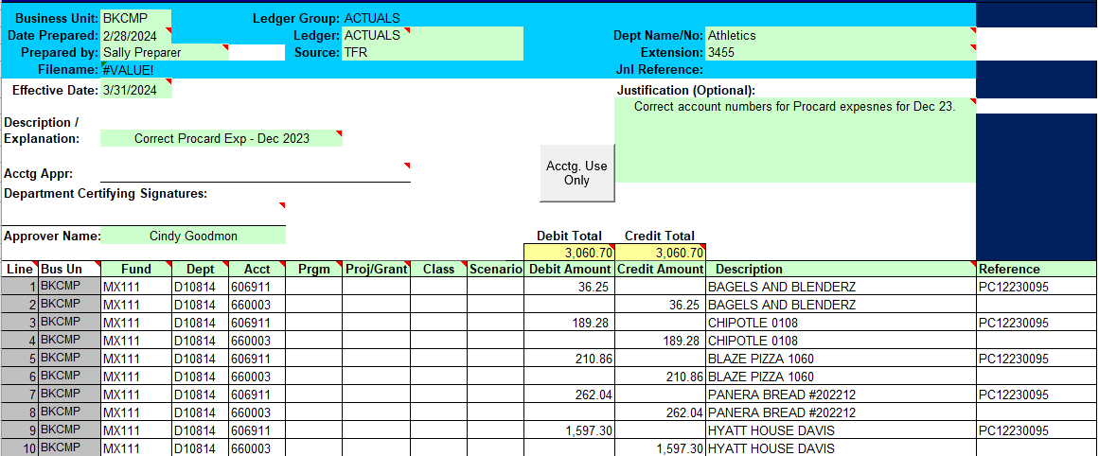
Campus Accounting & Reporting Services
Expenditure Transfer Example
Contact:
Liz Gamez - accounting@csub.edu

Slide 5
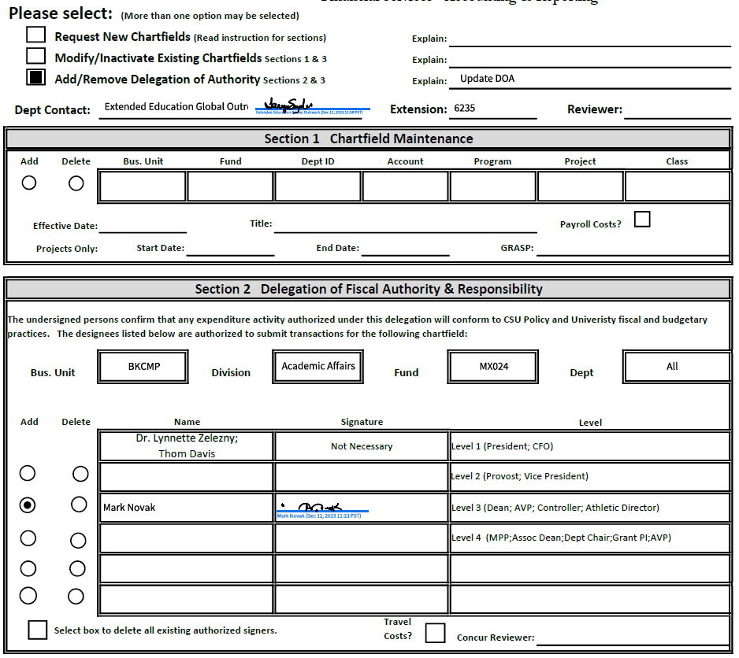
Campus Accounting & Reporting Services
Delegation of Authority & Chartfield Request Form
New DOA & Chartfield Request Form Requirements
New DOA form must be submitted as a Powerform in Adobe Sign. No longer accept form as an email attachment.
Section 2 is only for adding or removing signers. This section is not for approving requests.
List either fund or department in Section 2, but not both.
Section 3 Request Approvals
Follow instructions so you know what sections to complete.
Incomplete or incorrect sections will cause form to be rejected, resulting in processing delays.
Contact:
Liz Gamez - accounting@csub.edu

Slide 6
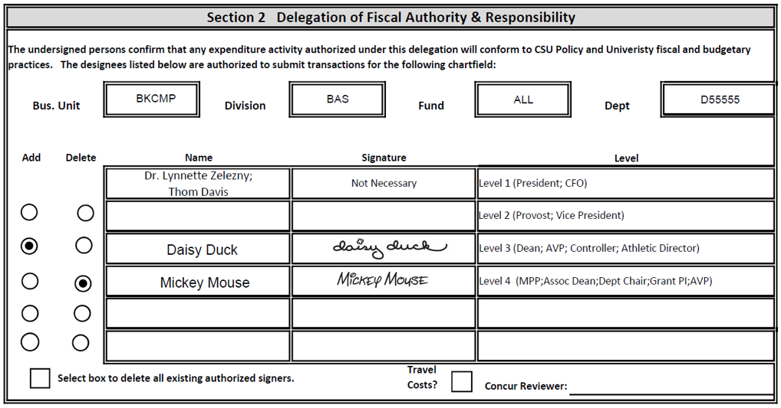
Campus Accounting & Reporting Services
Delegation of Authority & Chartfield Request Form
Section 2 – Delegation of Authority
Complete section to update signers only. This section is not preapprovals.
BKCMP
Department-Only DOA (Fund=ALL)
BK001
BKC02
BKCPO
BKCST
BKGRD
Fund-Only DOA (Dept=ALL)
All M Funds, remaining BK funds not listed above
All Capital/Construction Funds
BKASI, BKFDN, BKSTU, BKSPA
Fund-Only DOA (no department numbers)
Contact:
Liz Gamez - accounting@csub.edu

Slide 7
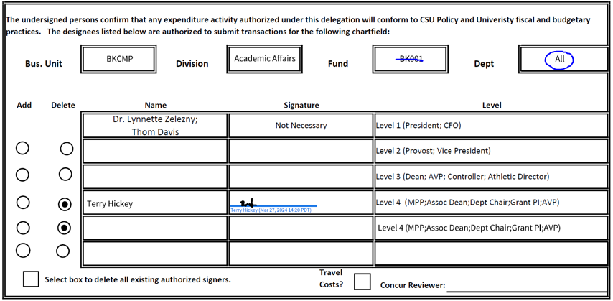
Campus Accounting & Reporting Services
Delegation of Authority & Chartfield Request Form
Section 2 – Incorrect Sample
Do not use BK001, must use “ALL”. Valid exception, signer updates for Concur.
List the department number when using any of these
BK001
BKC02
BKCPO
BKCST
BKGRD
If you are updating multiple chartfields, use “List” in chartfield box. Attach list of multiple chartfields to update.
Contact:
Liz Gamez - accounting@csub.edu

Slide 8
Campus Accounting & Reporting Services
Delegation of Authority & Chartfield Request Form
Section 3 – Approving Authority
This section must always be completed for all types of requests.
Campus President, Vice-Presidents, AVPs, Deans, or other MPP/Administrators can sign in this section.
Department chairs, Grant Directors, and grant investigators cannot be granted approving authority and cannot not sign in this section.
If request preapprovals are needed, DO NOT USE SECTION 2. Use the review signature on top of form. Section 2 should be used for changes to Signature Authority only.
Contact:
Liz Gamez - accounting@csub.edu

Slide 9
Budget Office
FY 2023-24 Budget Transfers
Final day to submit Thursday, June 20, 2024
Questions??
ORG-Budget@csub.edu
Contact:
Natasha Hayes- ORG-Budget@csub.edu

Slide 10
Sponsored Programs Post Award
SPA Grants
Deadline to turn in all SPA FY 2023-24 invoices to SPA
Accounting.
SPA Accounting will manually accrue all FY 2023-24
invoices submitted to Post Award by noon July 8th.
(All grant-related paperwork is due in Post Award by
July 03, 2024)
Manual accrual list must be submitted to the Grants
Accountant for all individual FY 2023-24 invoices greater
than $100 that were not submitted to Post Award by
July 3rd deadline.
Monday
Sixto Solis
07/08/2024
X2579
Noon
Thursday
07/11/2024
Note: To avoid a duplication, invoices submitted to Post Award for payment should not be on the June 10 accrual list.
Contact:
Rosalba Flores– spaaccounting@csub.edu

Slide 11
Foundation
Org Inbox Contact: foundationaccounting@csub.edu
Donations/Deposits
All donations (checks, cash, credit cards) must run through Gift Processing in UA Accounting for proper recording, document retention, and tax receipting
Drop off to UA or contact for pick up
Fundraising Events Sponsorships
Sponsorship packets must be reviewed by UA Accounting to evaluate benefits provided to sponsors for tax deductibility
Fundraising event approval form required per CSU policy
Contact:
Jassica Gauna- jgauna@csub.edu

Slide 12
Foundation
Gift-in-Kind Acceptance
Non-cash donations (i.e. goods, equipment, property, services)
GIK form must be submitted and approved by Foundation Executive Director before accepting and receiving the gift
Memo to campus with additional information
Contact:
Jassica Gauna- jgauna@csub.edu

Slide 13
Payment Services
All communication should be submitted to accounts_payable@csub.edu (not to an individual)
May 1: Direct Pays and invoices through April 26th are due
May 8: Travel claims for travel ending through April 26th are due
June 3: May AP paperwork due
June 6: All FY23/24 AP paperwork due
June 6: May & early June travel claims due
June 6: *Accruals for travel due. A Year-end Travel Accrual Form must be submitted using the PowerForm on the Payment Services forms website. Old forms emailed to us will be rejected; only the Adobe Sign PowerForm will be accepted, so that we can track them.
*No travel ending before April 7, 2024 will be accrued because CSU policy requires travel claims to be submitted no later than 60 days after the end of travel. No exceptions.
Paperwork must be submitted early enough to be received by accounts_payable@csub.edu by June 6th.
Paperwork received after the deadlines may not be accrued or paid before year-end.
Contact:
Tina Livingston tlivingston@csub.edu

Slide 14
Payment Services
Completed AP paperwork received by the deadlines on the previous page will be either paid or accrued in FY23/24.
Paperwork received after the deadlines may be paid or accrued in FY23/24, but it’s not guaranteed.
If you submit a travel claim before June 30th that was submitted on a Travel Accrual Form, please note that prominently on the claim & attach a copy of the accrual form as the first page of the attachment.
Only use the forms from the forms gateway (all forms except the Travel Charge Request and the Travel Advance are Adobe Sign PowerForms) and contact us at accounts_payable@csub.edu with questions.
If a department has paperwork that they don’t want to be charged against the FY23/24 budget,
don’t submit it until July.
Contact:
Tina Livingston tlivingston@csub.edu

Slide 15
Payment Services
Procurement Card (ProCard)
The ProCard billing cycle for June is May 11- June 10, 2024.
The reconciliation period in PeopleSoft for the June statement is June 11-20, 2024 (7 business days). When the reconciliation period ends, the charges for June will be final. They can’t be transferred before year-end and can’t be transferred in the following year.
Please tell your ProCardholders how important it is for them to log in from June 11-20 and reconcile their statements.
Starting in May 2024, ProCard reconciliations may only be submitted by using the ProCard Reconciliation & Approval Form (PowerForm) on the forms gateway. This is so that we can track forms that are being routed and to prevent forms getting lost in the “mail”.
Use tax chargebacks for purchases made in the June 2024 billing cycle will be posted to the FY 2024-25 budget.
Contact:
Becky Lappin blappin@csub.edu or procard@csub.edu

Slide 16
Labor Cost Distribution (LCD)
Please refer to the year-end memo for specific deadlines.
All Payroll Move Request and PCAR forms with grant related funding must be submitted to Post Award
(previously known as GRASP) for review and approval prior to sending to HR.
Additional Assistance / Q&A Opportunities
Labor Cost Distribution (LCD) User Support Group
Contact Linda Lara to be added to the group
LCD/PC Open Lab sessions (via Zoom)
Calendar invitations have been sent out to the LCD User Support Group:
March 11th April 8th May 13th June 10th
Contacts:
Human Resources – hr@csub.edu | Tina Williams – twilliams@csub.edu | Linda Lara – llara3@csub.edu

Slide 17
Payroll
All monthly June Payroll dated on or before July 1, 2024
will be charged to FY 2023-24 budget.
Employees that are paid for month of June on July 12, 2024
will be charged to the FY 2023-24 budget
(this includes prior pay period late time).
Hourly and Special Consultant Payroll for Grant programs ending June 30, 2024
must be submitted to HR/Payroll by June 13, 2024 for these transactions to be charged to FY 2023-24.
Contacts:
Human Resources – hr@csub.edu | Tina Williams – twilliams@csub.edu

Slide 18
Procurement and Contract Services
Critical Deadlines
Requisitions $25,000 and greater must be submitted in CSUBUY Procure-to-Pay (P2P) with required approvals by April 26, 2024
Requisitions under $25,000 must be submitted in CSUBUY P2P with required approvals by May 10, 2024
Requisitions for Public Work Projects must be submitted in CSUBUY P2P with required approvals by May 23, 2024
Note: Any requisitions not meeting the above due dates will be held for processing in FY 2024-25.
Procurement cannot guarantee any requisitions submitted by the due date will be processed in FY 2023-24 if additional approvals are needed or processes required, such as contract creation or bid process.
Contact: Procurement@csub.edu

Slide 19
Procurement and Contract Services
FY 2024-2025 Requisitions
Requisitions for the new fiscal year may be submitted in CSUBUY P2P starting on June 3 (do not submit before this date). Please be sure to input an Accounting Date of 7/1/2024 and add a comment that PO is for “FY 2024-25.”
POs processed will be held for release until 7/3/24 unless there is a critical need to release early. All requisitions submitted early for FY 2024-25 will go to Procurement for processing, including punchout catalog items (i.e. Staples, Amazon) that are low risk and low dollar that normally would not go through Procurement.
Contact: Procurement@csub.edu

Slide 20
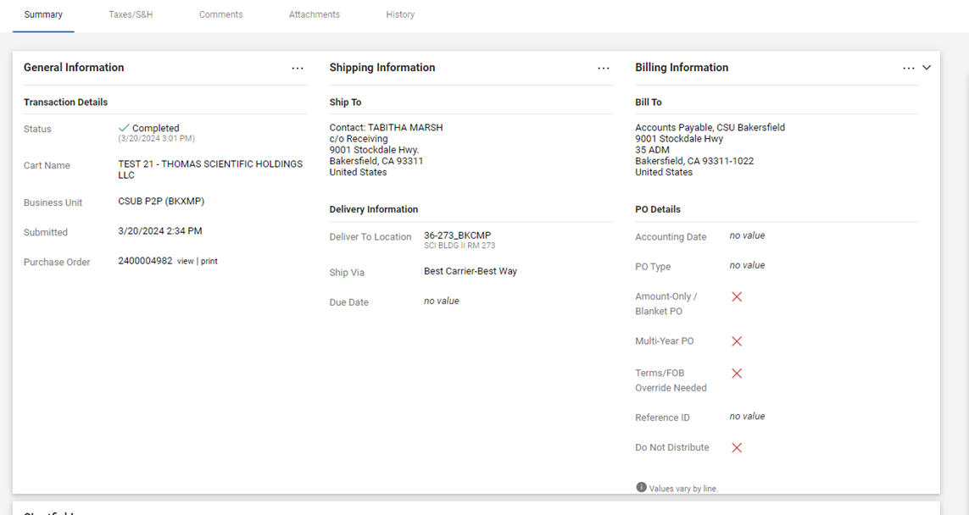

Slide 21
Procurement and Contract Services
Annual Renewals and Blanket Purchase Orders
Annual renewals and blanket PO requisitions can be submitted on or after Monday, June 3, 2024 with an Accounting Date of 7/1/24 or later and a comment that PO is a blanket or annual renewal for FY 2024-25.
After July 1, the accounting date and comment is no longer necessary.
Procurement will provide the annual renewal/blanket spreadsheet this year only as requestors will have visibility for all their POs in P2P and the ability to run reports to collect this data.
Annual renewals and blanket PO information will be posted on the following website on May 1, 2024: Fiscal Deadlines & Renewals | California State University, Bakersfield (csub.edu)
Contact: Procurement@csub.edu

Slide 22
Student Financial Services
Preferred Contact:
University Accounts Receivable: accounts_receivable@csub.edu
A staff member will respond within 2 business days.
University Centralized Billing
The CO has mandated that University billing be centralized (non-student).
All third party billing, including billing to any Auxiliary, has to be processed by the University Accounts Receivable (AR) Accountant.
Contact:
Student Financial Services- sfs@csub.edu

Slide 23
Student Financial Services
AR CRITICAL DATES TO REMEMBER
May 6: All Billing Request Forms through 4/30/2024 are due from departments.
June 6: All Billing Request Forms through 5/31/2024 are due from departments.
June 6: All Billing Request Forms for June are due from departments.
Deposits & Petty Cash Amy Polston...............6204
Accounts Receivable (Off Campus) Valeria Rodriguez.......3975
Accounts Receivable (Student & On Campus) Ricky Bravo................3226
Contact:
Student Financial Services- sfs@csub.edu

Slide 24
Journal Entries and Expense Transfers,
Journal entries including expense transfers should be sent to the following departments whose business unit is initiating the journal entry and/or expense transfer:
BKCMP – Liz Gamez or accounting@csub.edu
BKASI - Heather Macaulay or studentaffairsaccounting@csub.edu
BKFDN - Jassica Gauna or foundationaccounting@csub.edu
BKSTU - Heather Macaulay or studentaffairsaccounting@csub.edu
BKSPA - Rosalba Flores or spaaccounting@csub.edu

Slide 25
April 2024
Deadlines for Transactions Relating to months through Fiscal Year 2023-2024
(All state-side grant-related paperwork listed below is due in Post Award by April 18, 2024).
April 19, 2024 – Labor Cost Distribution (LCD) payroll moves related to the month of March 2024.
April 26, 2024 – Procurement: Requisitions $25,000 or greater submitted in CSUBUY Procure-to-Pay (P2P) with all appropriate approvals.
May 1, 2024 – Direct Pays and invoices through April 26, 2024.
May 2, 2024 – Chargebacks through April 30, 2024.
May 2, 2024 – Journal entries for transactions up through April 30, 2024.
May 6, 2024 – Billing request forms for activity related to the month of April 2024.
May 8, 2024 – Travel claims for travel ending through April 26, 2024
NOTE: No travel ending before April 7, 2024, will be accrued, so departments need to submit the claims by the deadlines to be charged against the FY23-24 budget.
May 2024
Deadlines for Transactions Relating to Fiscal Year 2023-2024
(All state-side grant related paperwork listed below is due in Post Award by May 17, 2024).
May 10, 2024 -Procurement: Requisitions less than $25,000 submitted in CSUBUY P2P with all appropriate approvals.
May 20, 2024 - Labor Cost Distribution (LCD) payroll moves related to the month of April 2024.
May 23, 2024 -Procurement: Public Works Project Requisitions submitted in CSUBUY P2P
with all appropriate approvals.
June 3, 2024 - Direct Pays and invoices through the month of May 2024.
June 3, 2024 - Journal entries for the month of May 2024.
June 3, 2024 - Chargebacks for the month of May 2024.
June 6, 2024 - Billing request forms for activity related to the month of May 2024.
June 6, 2024 - Travel claims through May 2024.
June 2024
Deadlines for Transactions Relating to Fiscal Year 2023-2024
(All state-side grant-related paperwork listed below is due in Post Award by May 23, 2024).
June 6, 2024 - Billing request forms for activity related to the month of June 2024.
June 6, 2024 - Direct Pays and invoices for the month of June 2024.
June 6, 2024 - Travel claims through June 5, 2024.
June 6, 2024 - Travel claims estimate for June (thru June 30, 2024)
June 19, 2024 - Labor Cost Distribution (LCD) payroll moves related to the month of May 2024.
Key Deadline Summary

Slide 26
Departmental Email Addresses
Financial Services:
Campus Accounting : accounting@csub.edu
Cashiering: cashiersoffice@csub.edu
Foundation accounting: foundationaccounting@csub.edu
Student Affairs Accounting: studentaffairsaccounting@csub.edu
Student Financial Services: sfs@csub.edu
Sponsored Programs Post Award spaaccounting@csub.edu
Budget and Payroll:
Budget: ORG-Budget@csub.edu
Payroll: hr@csub.edu
Businesses Services:
Payment Services (A/P & Travel): accounts_payable@csub.edu
Procurement & Contracts: procurement@csub.edu
ProCard: procard@csub.edu

Slide 27
Questions and Answer Session from Campus

