Slide 1
Database1
Database Creation and Management

Slide 2
Microsoft Access Lectures…
Not about learning Microsoft Access
  Just a small easy to use DB tool
About learning very basic concepts & theories of Relational Database System”
  A lot easier to understand using a tool
  Help understand advanced topics such as data modeling (ERD)

Slide 3
Basic DB Terms
Data: Meaningful facts, text, graphics, images, sound, video segments
  A collection of individual responses from a marketing research
Information: Data processed to be useful in decision making
  Pattern of geographical buying habit based on analysis of a marketing research
Metadata: Data that describes data

Slide 4
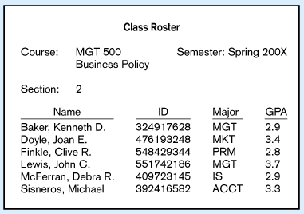
Data in Context
Large volume of facts, difficult to interpret & make decisions

Slide 5
Information
Useful for decision making / interpretation

Slide 6
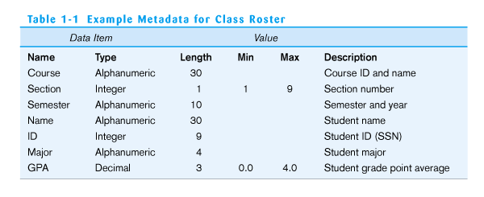
Metadata
Descriptions of the properties or characteristics of the data, including data types, field sizes, allowable values, and documentation (Data Dictionary)
ideal employee for developing Mktg metadata for the Mktg table?

Slide 7
Purpose of Database
The purpose of the database system is to keep track of things digitally such as orders
The database system store data that is more complicated than a simple list in a spreadsheet SW tool (i.e., Excel)
  Excel: As data increases, complexity of data organization increases…...not linearly.

Slide 8
Database
Organized collection of electronic data
Data Stored in a standardized form
Allow data to be easily accessed, manipulated and updated

Slide 9
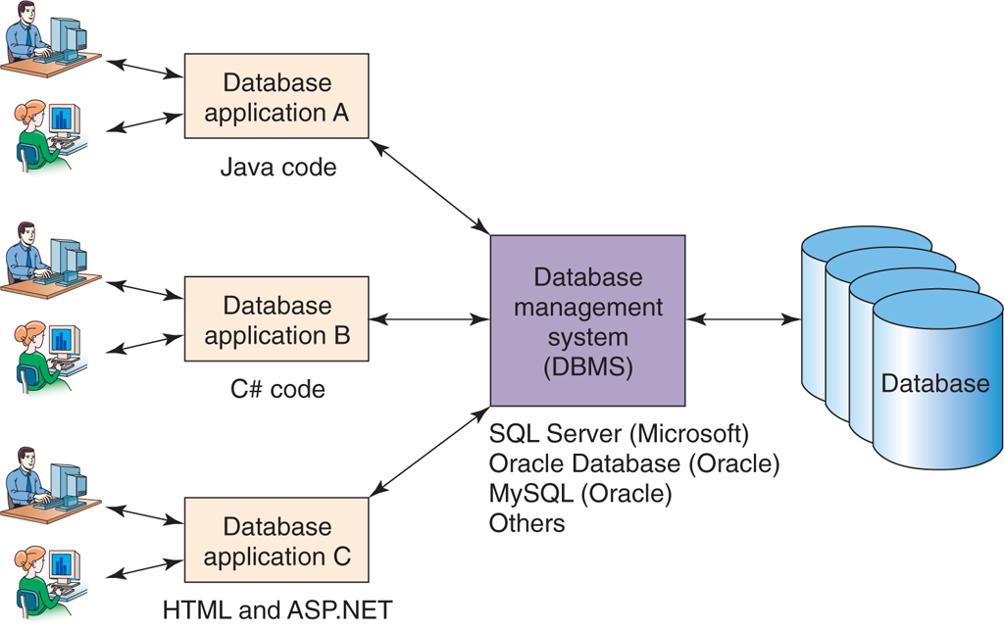
Organizational Database Systems

Slide 10
Database Management System (DBMS)
System software for creating and managing databases.
The DBMS provides users and programmers with a systematic way to create, retrieve, update and manage data.
It also serves as an intermediary (bridge) between database applications and the database.

Slide 11
Overview of Access
One of the Relational DBMS.
  Access, SQL Server, Oracle, DB 2
MS Access is a RDBMS and designed for managing and controlling RDS (relational database system).
  “Relation” means “Table.”
  “Field” means “Column.”

Slide 12
Relational Database System
A collection of tables that are related to one another based on a common field.
  Primary key and foreign key
RDS theory
  Developed based on predicate logic and set theory from mathematics.

Slide 13
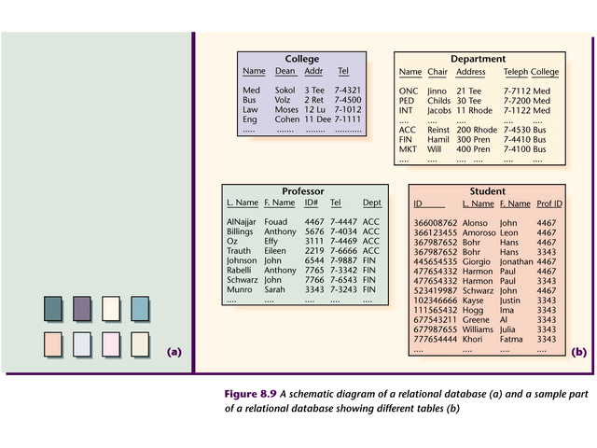
Relational Database System
A schematic diagram of a relational database (a) and a sample part of a relational database showing different tables (b)

Slide 14
Property of RDS
Based on the set theory
1. There are no duplicate rows.
  The body of the relation is a mathematical set (i.e., a set of rows), and sets in mathematics by definition do not include duplicate elements.
  If a "relation" contains duplicate rows, then it is not a relation.

Slide 15
Property of RDS
2. Rows are unordered (top to bottom) and columns are unordered (left to right).
  Sets in mathematics are not ordered. So, even if a relation (table) A's rows are reversely ordered, it is still the same relation.
  Thus, there is no such thing as "the 5th row/column" or the last row/column. In other words, there is no concept of positional addressing.

Slide 16
Property of RDS
3. No two or more columns of the same table can have the same name
  The relational model requires every attribute to be referenceable.
  Otherwise, it cannot be referenced because of the obvious (duplication) ambiguity.

Slide 17
Property of RDS
4. Every value is atomic.
  At every row-and-column position within the table, there always exists precisely one value, never a list of values. Or equivalently, relations do not contain repeating groups.

Slide 18
Example RDS Table (Relation)
EmployeeNumber | FirstName | LastName
104 | Mary | Abernathy
101 | Jerry | Cadley
100 | Alex | Copley
107 | Megan | Jackson
No Order and atomic value in each cell

Slide 19
Not a RDS Table Example 1
Cells of the table hold multiple values
EmployeeNumber | Phone | LastName
100 | 335-6421, 454-9744 | Abernathy
101 | 215-7789 | Cadley
104 | 610-9850 | Copley
107 | 299-9090 | Jackson

Slide 20
Not a RDS Table Example 2
No two rows can be identical
EmployeeNumber | Phone | LastName
100 | 335-6421 | Abernathy
101 | 215-7789 | Cadley
104 | 610-9850 | Copley
100 | 335-6421 | Abernathy
107 | 299-9090 | Jackson

Slide 21
Open an existing database
To open an existing database, you must first start Access.
Download and save “Restaurant 1” database.
  DO NOT JUST OPEN!
And then, simply double-click the existing database (Restaurant 1) to open.

Slide 22
How to create and save a new Access database
Create a new database
  Assign your database name as you create
  Specify saving location
  Database name: your last name + initial of your first name
When you press the Save button in Access, you are saving the design of the Access objects and NOT the database itself!
  The Save function in Access differs from the Save function in other Windows programs.

Slide 23
Valle Coffee’s Restaurant DB
Valle company sells inexpensive coffee beans to various restaurants. Barbara Hennessey, the Director of CRM, and her staff use Access to maintain company data such as customer orders and billings. Barbara has recently developed Restaurant 1 database to track orders and billings. However, she has not been able to develop the database fully to track and maintain other important company data. So, she is asking for your help in completing and maintaining the Valle database.

Slide 24
Descriptions of Restaurant DB
Valle coffee’s Restaurant 1 database will contain five tables:
  Customer table, which Barbara already has.
  Order table, which you will create soon.
  Product and Order Detail tables, which you will import from FineFood database.
  Billing Address table that is in Excel format and you will import it, and then convert to Access table.

Slide 25
Billing Address Table
CustomerNum
BillingName
Street
City
State
Zip
129
Sandy Lookout Restaurant
PO Box 2800
Grandville
MI
49468
Customer Table
CustomerNum
CustomerName
Street
City
State
ZipCode
OwnerName
Phone
FirstContact
000
Choi
COB 105
CSUB
CA
93311
Scott Choi
5348
09/20/2001
Order Table
OrderNum
CustomerNum
Paid
InvoiceAmt
BillingDate
201
107
No
854.00
01/15/2001
Order Detail Table
OrderNum
ProductCode
Qty
201
2834
11
Product Table
ProductCode
CoffeeName
Weight/Size
Price
Decaf
2301
Colombian Aged Crop
1 lb pkg
7.99

