Slide 1
Introduction to Information Systems
Yong Choi
BPA
CSUB

Slide 2
What is MIS?
is the study of people, technology, organizations, and the relationships among them for improving business operations.
Save cost (i.e., inventory management)
Improve productivity
Maximize profit

Slide 3
MIS vs. CS (transportation firm vs. semi-truck manufacturer)
Focus | Organization | Computer System
Objective | Achieve more efficient or effective business | Develop and improve technical capability and quality
Core Skill | Business Problem solving | Programming & Engineering
Core Task | Determine business requirements for information systems | Determine technical requirements for device
Generic Job Title | Analyst/Designer using IT | Technical computer architect and Tool Builder

Slide 4
Background of MIS
TECHNICAL
COMPUTER
SCIENCE
OPERATIONS
RESEARCH
MANAGEMENT
SCIENCE
MIS
SOCIOLOGY
PSYCHOLOGY
POLITICAL SCIENCE
BEHAVIORAL

Slide 5
Definition of Information Systems
is interrelated components to collect, process, store and distribute information to support decision makings in an organization.
Private and non-profit
Information technology (IT) describes the combination of computer technology (hardware and software) with telecommunication technology (data, image, and voice networks).
CBIS vs. Manual IS

Slide 6
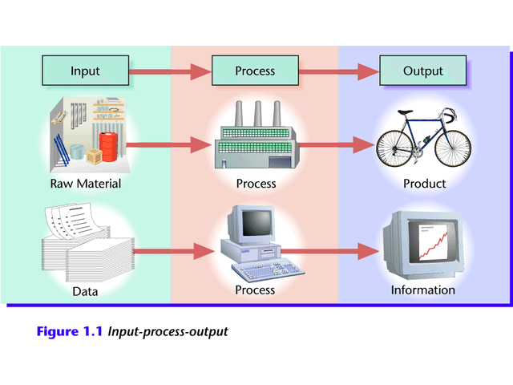
Functions of an information system
Notes:
System: A set of components that work together to achieve a common goal
Closed system: Stand-alone system that has no contact with other systems
Open system: System that interfaces with other systems (today’s IS)

Slide 7
Advantages of MIS
Provide relevant and timely data & information for facilitating effective business planning
Improve coordination between business units, functions, organizations, etc.
Enhance communication for internal and external stakeholders
Contribute for improving productivity and saving cost
1-7

Slide 8
Disadvantages of MIS
Constant update of HW & SW and training employees (high cost)
CSU moving to cloud-based computing
Projecting precise benefit and budgeting
Difficult to hire well trained professional
Privacy and Security
Tracking Employees (1:59)
A Cyber Privacy Parable (3:27)
Online Scams Watch (4:42)
Cyber security (2:50)

Slide 9
Why study MIS?
Micro view
Studying MIS can provide you with essential knowledge to ensure that how company manages information systems with the highest level of efficiency.
Macro view
Change of paradigm: information age

Slide 10
Living in Information Age
Bill Gates and Jeff Bezos
how much rich now? & compare with List of GDP
Information age phenomena
Major intangible product of Microsoft
Amazon – largest online retail store
Cash Cow: “Amazon Web Services (AWS)”
AWS: cloud computing service (generate big data!)
Industrial age: John Rockefeller (oil) & Andrew Carnegie (steel)
Facebook (2 B) vs, China (1.357 B)

Slide 11
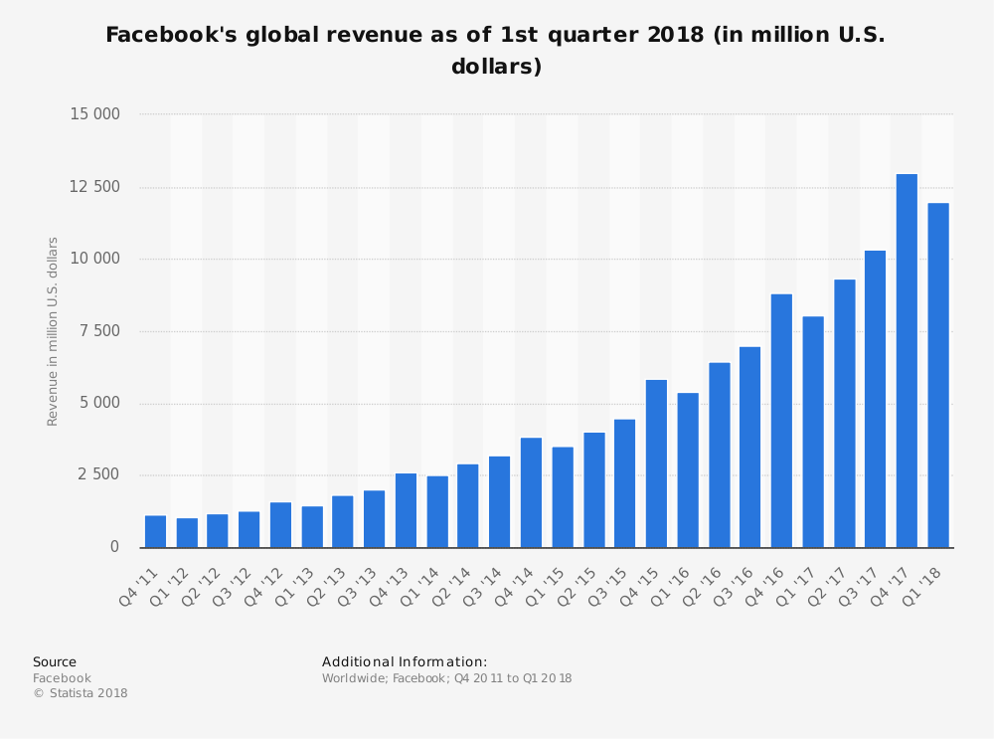

Slide 12
Job Security in Information Age
Based on nature of job design
Structured job
Unstructured job
Semi-structured job

Slide 13
Job Security in Information Age
Based on nature of job design
Structured
Routine & Repetitive
Small independent travel agencies
Problems are predictable
Problems can be solved by applying standard solutions

Slide 14
Job Security in Information Age
Semi-structured
Combination of non-routine and predictable problems (production Scheduling)
Production manager
Require a combination of standard solution procedure and individual judgment

Slide 15
Job Security in Information Age
Unstructured
Non-routine, Unpredictable, and Fuzzy
Business consultant (case by case)
Social Media consultant (new type of job)
Standard solutions are not applicable
Solve problems by individual judgment using various technologies.

Slide 16
Effect of Information Age
Acceleration of Globalization (example: Nike Corporation)
Global management thru IS
Organizational Change
Almost no traditional middle management : collect, process, store and distribute information for various decision makings
Cross functional (project based – virtual team or organization)

Slide 17
What’s ahead?
Post information age
IBM Watson (3:45)
IBM Watson as Cancer Specialist (2:50)
Artificial Intelligence (AI)
Not a new concept, started in 50s
Why booming now? & future stakeholder
Almost limitless application: self-driving car, senior companion, etc.

Slide 18
What’s ahead? Con’t
Happening now!
Amazon Go (1:49)
What about higher education industry?
CSU system unification
MOOC: massive open online course

Slide 19
Competitive Advantage Thru MIS: Classic Examples
Initiative # 1: Cost leadership
Achieve competitive advantage by providing lower cost than competitors
Wal-Mart: Always Low Price: lower price using computerized purchasing and inventory system
Initiative # 2: Differentiation
Achieve competitive advantage by providing more unique and value added products/services than competitors
First Online Order Tracking system by FedEx

Slide 20
Competitive Advantage Thru MIS: Classic Examples
Initiative # 3: Focus (Cost leadership + Differentiation)
Achieve competitive advantage by providing lower cost + unique and value added products/services
Amazon.com (others: SW, DVD, games and extra value added information for each product)
Initiative #4: Create new products and services
E*Trade.com

Slide 21
Risks of IS success
IS can be easily copied by competitors.
IS can bring on litigation or regulation
SABRE by AA: first computer-based online reservation system.
Monopolization of the entire market by monopolizing information
Bad timing
on-line home banking in the early 1980s by chemical bank
Fail to integrate system: WorldCom (i.e., KP)

Slide 22
Manager’s job in information age
Monitor competitors IS usage
Monitor change of government regulations
Review competitor’s web sites
Information about new products and projects
Trend in budgeting (e.g., annual report)
Advertising strategies
Analyze competitor’s newsgroup on the Internet
Newsgroup participants discuss what they like or dislike about competitor’s products or services

Slide 23
Next Class
Make sure to try the online Microsoft Access Tutorials on the class website!
Especially, 2013 tutorial

