Slide 1
Database 3
Database Creation and Management

Slide 2
What is an Access query?
You can create a query when you need ONLY a portion of the data from a table or tables and a query or queries.
A list of customers who live in Bakersfield, CA
The response would be to display only the records whose state field matches with Bakersfield, CA

Slide 3
What is an Access query? Con’t
Multiple tables or queries can be used.
If necessary, conditions can be applied
Comparison operators
The design view is used to specify the fields and records you want to see.

Slide 4
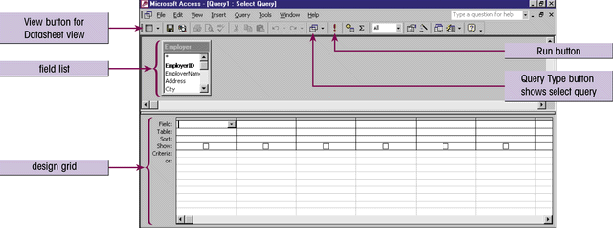
The Query Design view window
Fields used in the query are selected from the field list and added to the design grid.
You can run the query at any time by clicking the Run button.

Slide 5
Before Creating Query
Review each table
Identify necessary information such as data type, PK, FK, and so on.
Figure it out manually (improve accuracy)
Review relationships
Identify primary and related tables: select data items only from “primary table”
Identify corresponding fields

Slide 6
Billing Address Table
CustomerNum
BillingName
Street
City
State
Zip
129
Sandy Lookout Restaurant
PO Box 2800
Grandville
MI
49468
Customer Table
CustomerNum
CustomerName
Street
City
State
ZipCode
OwnerName
Phone
FirstContact
000
Choi
COB 105
CSUB
CA
93311
Scott Choi
5348
09/20/2001
Order Table
OrderNum
CustomerNum
Paid
InvoiceAmt
BillingDate
201
107
No
854.00
01/15/2001
Order Detail Table
OrderNum
ProductCode
Qty
201
2834
11
Product Table
ProductCode
CoffeeName
Weight/Size
Price
Decaf
2301
Colombian Aged Crop
1 lb pkg
7.99

Slide 7
Creating a Sample Query
Kim Carpenter (director of marketing) wants a list of all restaurant customers because her staff can call customers to check on their satisfaction with Valle coffee’s services and products. She wants to have only followings; CustomerName, City, State, OwnerName, and Phone.
Use restaurant 3 database
Save the query as First Customer List.

Slide 8
More about a Query
In Access, we are generating a query using Query By Example (QBE).
Do not include any unnecessary data items (tables or queries) in Design View of the query.
Otherwise, you have to deal with unexpected problems.
You will be penalized if you include unnecessary tables or queries.
Conditions can be applied.

Slide 9
Creating Queries using Multiple Tables
There have been some major changes in the Restaurant database. To test reliability, Barbara wants you to generate a query for testing the database. The query must include following fields: Order Number, Coffee Name, Quantity, Price, and Weight/Size.
Save as Test
Select “OrderNum” from the primary table
Make sure to select only required tables. If selected a wrong table, Just delete it.

Slide 10
Querying and Sorting of multiple Tables
Barbara wants to have followings for the upcoming quarterly report: CustomerName, City, State, BillingDate, InvoiceAmt, Paid, and First Contact.
At same time, Barbara wants to sort the records by the InvoiceAmt field in ascending order.
Barbara also wants to move the Paid field between the State and BillingDate field.
Save as Customer Orders

Slide 11
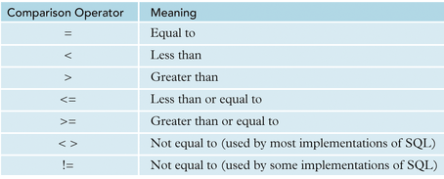
Expressions
LIKE operator with Wildcard character “*”
Word begin or end with a: LIKE a* or LIKE *a
Find between values: (NOT) BETWEEN 45000 AND 78000
Find exact match value: 1/10/2013

Slide 12
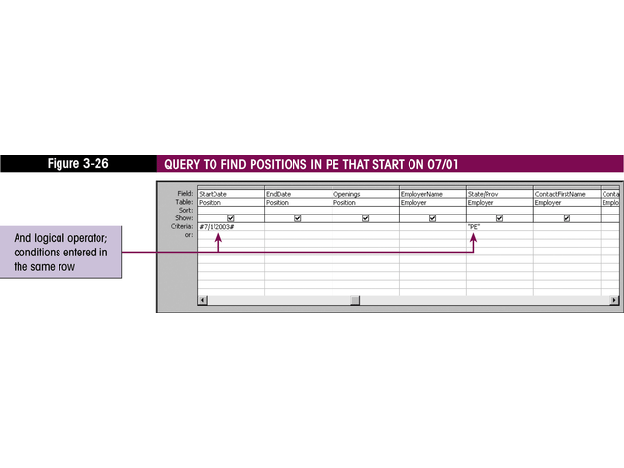
Stating Query Condition
And conditions stated on the “Criteria” line.

Slide 13
Applying Exact Condition
Barbara would like to have a list of all orders billed on 01/15/2013.
The list must include following fields; OrderNum, Paid, InvoiceAmt, BillingDate, CustomerName, State, OwnerName, and Phone
Save as Jan Orders

Slide 14
Using Like a*
Barbara wants to know a list of all Customer Names that begins with M. The list must include following fields; Customer Name, Order Number, First Contact and Billing Date. In addition, the Order Number must be sorted in ascending order.
LIKE operator and Wildcard character “*”
Save as Customer Name Begins With M

Slide 15
Using Between ** and **
Barbara wants to know a list of all Product Code between 2465 and 2763. The list must include following fields; Product Code, Coffee Name and Price.
There should a space between number and word
Save as Product Code Between 2465 And 2763.

Slide 16
Using Greater than (>)
Barbara wants to know those records whose InvoiceAmt exceeds $2,000.
Use the Customer Orders query.
The query must include only following fields; Customer Name, Invoice Amount, and Billing Date.
Save as High Invoice Amounts

Slide 17
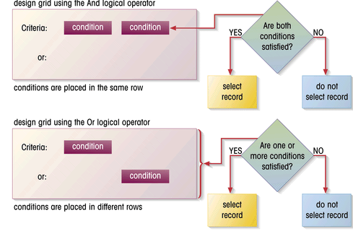
Using And and Or Operators
The And condition.
The Or condition.

Slide 18
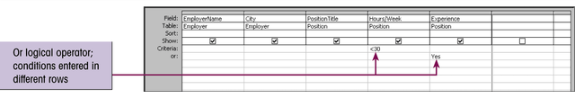
Creating And and Or conditions in the design grid
And conditions must be specified on the same line.
Or conditions must be specified on different lines.

Slide 19
Using AND
Leonard asks Barbara for a list of orders billed on 01/15/2013 that are still unpaid. He wants to know which customers are slow in paying their invoices.
Use the Customer Orders query again and make sure that this query includes following fields; CustomerName, Paid, BillingDate, and InvoiceAmt.
01/15/2013 AND unpaid (No)
Save as Unpaid Jan Orders

Slide 20
Using OR
Leonard wants to determine which restaurant customers are most valuable to Valle Coffee. Specifically, he wants to see a list of customers whose first contact date is earlier than 01/01/2004. OR who has been placed orders for greater than $2,000, so that he can call the customers personally and thank them for their business.

Slide 21
Using OR
Make sure that this query includes following fields; CustomerName, InvoiceAmt, and First Contact.
He also wants to have a sorted output in ascending order based on the customer name.
If you want, you can use the Customer Orders query again
Save as Top Customers

Slide 22
Performing Calculation
Leonard wants to add a 2% late charge to the unpaid invoices. He only wants to include following fields; Customer Name, Paid, Billing Date, and Invoice Amount.
Set paid field to “No”

Slide 23
Performing Calculation
And he wants to know exactly what these charges would be. He wants to create a new field “Late Charge” right after InvoiceAmt field and then use it to calculate late charge.
Late charge formula: InvoiceAmt*0.02
Save as Unpaid With Late Charge

Slide 24
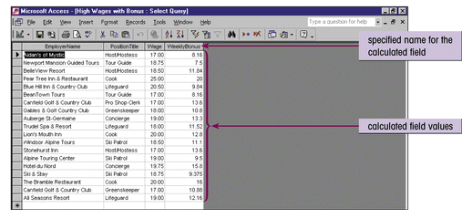
A calculated field in the query datasheet
Expression Builder adds your calculated field to the query design grid. You can then assign it a name, which will display in query datasheet view when the query is run.

Slide 25

Manually…..

Slide 26
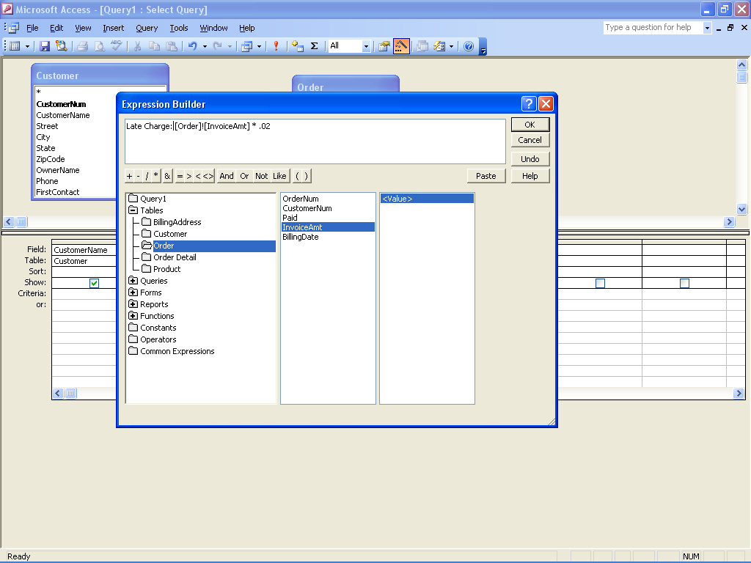
Use of “Build” Function

Slide 27
Using Aggregate Functions
Barbara prepares a report of Valle coffee’s restaurant business for Leonard on a regular basis. The information in the report should include a summary of the restaurant invoice statistics: the total invoice amount for all orders, the average invoice amount, and the number of orders (same as number of invoice amount). She asks you to create these statistics.

Slide 28
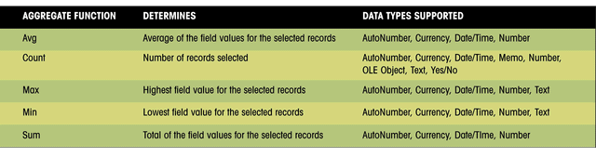
Using Aggregate Functions
Access has several Aggregate Functions that can be used to calculate various statistical information.
Aggregate functions are specified in the Total row of the design grid. They can be assigned by clicking the Totals button on the Query Design toolbar.

Slide 29
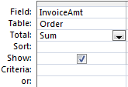
Access Aggregate Function

Slide 30
Using Aggregate Functions
She also wants you assign a new field as follows;
Total of Invoices ( total invoice amount for all orders)
Average of Invoices (average invoice amount)
Number of Orders (number of invoice amount)
Save as Invoice Statistics

Slide 31
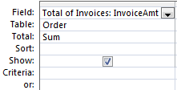
Change Title

Slide 32
Using Record Group Calculations
Barbara’s another report to Leonard also includes the same invoice statistics (total, average, and count). Because Valle Coffee sends invoices to its customers each month (Jan invoice, Feb Invoice, and March invoice), each invoice has the same billing date. Barbara asks you to display the invoice statistics for each month (billing date).
Grouping by each month

Slide 33
Using Record Group Calculations
Calculate statistics for groups of records
Average salary by the position
Number of employees in each department
Group By operator
Divides the selected records into groups based on the values in the specified field
Those records with the same value for the field are grouped together.
Save as By Billing Date

Slide 34
Query Practice: Generating Queries
Download a database: “Roadrunner”
1. I would like to have a query that includes following fields; Employee Number, Instructor Last Name, Instructor First Name, Course Name and Time.
Save as Your Course Info.

Slide 35
Query Practice: Generating Queries
2. I would like to know a list of all members whose last name begins with P using following fields; First Name, Last Name, City, and State.
Save as Last Names begin with P.

Slide 36
Query Practice: Generating Queries
3. I would like to know ONLY the Employee Number, Instructor Last name, Instructor First name, and the Salary Amount for only those employees who make between $39,500 and $55,000. In addition, the resulting salaries must also be placed in order from high salary to low salaries.
Save as Between Salaries.

Slide 37
Query Practice: Generating Queries
4. I would like to know the Class Number, Last Name, and Member Number for each member who has a class number greater than or equal to 8900. In addition, sort last names in ascending order.
Save as Greater than or equal to 8900.

Slide 38
Query Practice: Generating Queries
5. I would like to have a query that ONLY includes the male members who live in Burbank using following fields; First Name, Last Name, Gender, City, and State.
Save as Males in Burbank.

Slide 39
Query Practice: Generating Queries
6. I would like to know a list of all members whose last name that begins with A or a first name that begins with R including the following fields: First Name, Last Name, City, and State.
Save as Names with A or R.

Slide 40
Query Practice: Generating Queries
7. I would like to know an instructor who teaches handball and students who are taking handball course. Following fields must be appear on the query: Instructor First Name, Instructor Last Name, Course Name, Member Last Name and Member First Name. In addition, the member last names should be sorted in alphabetical order.
Save as Handball Listing

Slide 41
Query Practice: Generating Queries
8. I would like to know a whole list of the Instructor Last name, Instructor First name, and the Salary Amount. Since instructors have worked hard, I would like to increase their salary by 15%. So, I’d like to calculate 15% salary increase for each instructor.
Save as Salaries Increase

Slide 42
Query Practice: Generating Queries
9. I would like to know the Sum, Average, Max. and Min. of employees salary (These four items must all appear in the same query).
Save as Salary Calculations
10. I would like to know the Sum, Average, Max. and Min. of employees salary based on Employee Type.
Save as Employee Type

