Slide 1
ABC Company 401(k) DSS Development
Yong Choi
School of Business
CSU, Bakersfield

Slide 2
Decision Support System
What is a DSS?
interactive information systems that are designed to support decision makings.
DSS Examples
investment portfolios
www.expedia.com
See the textbook for more examples

Slide 3
Model driven DSS
Use models (e.g., financial model using Excel)
Sensitivity Analysis as a main technique
What-If analysis
Goal Seek Analysis

Slide 4
What-if analysis
Attempt to check the impact of a change in the assumptions (input data) on the proposed solution
What will happen to the market share if the advertising budget increases by 5 % or 10%?
Try the example on the class website

Slide 5
Goal-seek analysis
Attempt to find the value of the inputs necessary to achieve a desired level of output
Use “backward” solution approach
A DSS solution yielded a profit of $2M
What will be the necessary sales volume to generate a profit of $2.2M?
Try the example on the class website

Slide 6
Data Driven DSS
Many current and newest DSS
Discover previously unknown patterns by analyzing large pools of data
Data mining as main technique

Slide 7
Data Mining
Help companies to find hidden patterns and relationships in large databases to predict future behavior
“If a house is purchased, then new refrigerator will be purchased within two weeks 65% of the time.”

Slide 8
Model Driven DSS vs. Data Driven DSS
A Model Driven DSS uses a model: statistical model, simulation model, financial model, etc for decision makings. So, decisions are based on models.
A Data Driven DSS emphasizes access to and manipulation of a time-series of internal company data and sometimes external data to aid decision makings. So, decisions are based on analyzed data.

Slide 9
Develop 401k DSS using Excel
Not about learning Excel
As a MBA, you must know Excel fairly well!
A lot of online Excel training courses
Or try at CSUB (MIS 2000 - online)
About having little taste of an information system development process

Slide 10
What is 401(k) plan?
A retirement savings program that allows an employee to deduct funds from his or her monthly salary (usually before taxes).
Employees can have various options for their 401k investment plan.
Stocks
Mutual funds
bonds

Slide 11
Design Guidelines of the 401(k) Plan
Develop a 401K DSS (model driven) that shows how different contribution amounts will affect employees’ retirement savings over the next five to 30 years.
The DSS must be user-friendly because most employees are not familiar with the spreadsheet software like Excel.
The DSS must be able to prevent a user’s mistake by providing input/error messages.

Slide 12
Design Guidelines of the 401(k) Plan
The 401k DSS must allow each user (employee) to view and analyze the information numerically and graphically by including a line chart.
The 401k DSS must be utilized repeatedly to serve various employees by applying macro.

Slide 13
ABC’s 401(k) Policy
An employee can contribute up to total of 20% of their salaries.
The ABC company will match, whatever employee contribute, up to 4% of the employee’s salary.
For example, if an employee contribute 2% of his/her salary, the company (employer)'s contribution is 2%.
Maximum contribution of employer: 4%

Slide 14
What calculations do we need to perform?
Total monthly contributions = monthly employee contribution + monthly employer contribution
Calculate value of investment at 5, 10, 15, 20, 25, and 30 years.
NOTE: Need to use FV(monthly rate of return, number of periods, total monthly contribution) to compute value of investment

Slide 15
What output do we want to have?
Total monthly contribution
Table showing future of investment at 5, 10, 15, 20, 25, and 30 years
Line chart displaying future value of investment

Slide 16
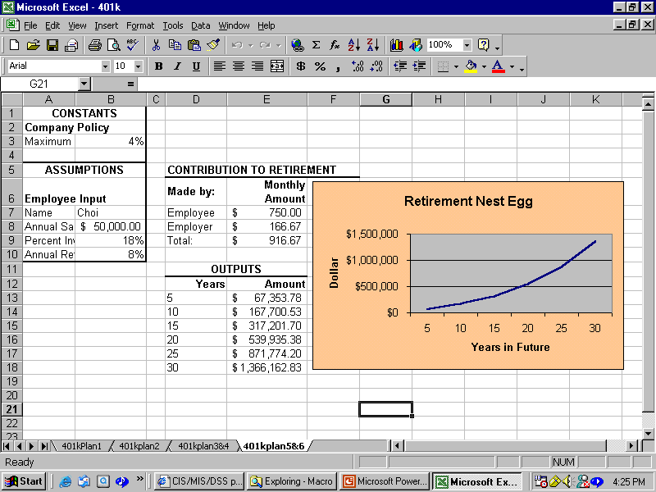

Slide 17
The Order of Tasks
Step 1: Worksheet Design
Step 2: Validating Data Entry
Step 3: Using Define name
Step 4: Building a Conditional Formula Using IF Function
Step 5: Computing the Retirement Fund
Step 6: Creating Line Chart
Step 7: Creating Macro

Slide 18
Step 1: Designing a Worksheet in sections
There are three sections:
Input section for users
Two output sections
monthly total contribution
future of investment at 5, 10, 15, 20, 25, and 30 years
Line chart for future investment.

Slide 19
Step 2: Validating Data Entry
Do not accept invalid data
Company’s contribution: less than equal to 4%.
Employee’s contribution: less than equal to 20%.
Display input messages that provide guidelines for valid entries.
Display error message when invalid data entered

Slide 20
Step 2: Validating Data Entry
Change B8 to Currency
Apply 2 decimal points
Change B3, B9, and B10 to Percentage
Apply 2 decimal points for each cell
B3: up to 4% (company contribution)
See hand out (test your rule)
B9: from 0% to 20% (employee contribution)
See hand out (test your rule)
Notes:
B3: up to 4% (company contribution)
Data → Validation → Settings tab → Decimal → less than or equal to from the Data list arrow → Type 0.04 in the Maximum text box
Input message tab(make sure the check box is checked) → Title text box → Type Valid Data → Input Message text box → Type Percent of salary invested by employer cannot exceed 4%
Error Alert tab (make sure the check box is checked) → Style list arrow → Stop → type Invalid Data in the Title text box → type You entered a value above 4%. A Valid percentage is 4% or less in the Error message text box
B9: from 0% to 20% (employee contribution)
Data → Validation → Settings tab → Decimal → less than or equal to from the Data list arrow → Type 0.2 (employee contribution) in the Maximum text box
Input message tab(make sure the check box is checked) → Title text box → Type Valid Data → Input Message text box → Type Percent of salary invested by employee cannot exceed 20%
Error Alert tab (make sure the check box is checked) → Style list arrow → Stop → type Invalid Data in the Title text box → type You entered a value above 20%. A Valid percentage is 20% or less in the Error message text box

Slide 21
Step 3: Using Define Name
A define name is a descriptive name you assign to a cell or range of cells that can be used to reference the cell or range of cells in formulas.
Using of range names allows;
Easier formula construction and entry
Improve documentation and clarification of the meaning of formulas
Navigation of large worksheets simply by using the Go To commend to move the pointer to a named range

Slide 22
Step 3: Using Define Name (Already done by the instructor)
Assign Name for B7: “Employee”
Formulas →Define Name→ Define Name→ the “New Name” window will appear and then type Employee
If any, ignore default name: Annual_Salary
Define names are case sensitive.
B8 (Salary), B3 (MaxMatch), cell B9 (Invested), cell B10 (Return), and cell E9 (TotContribution).
Apply first formula using range names in cell E7 - Salary*Invested/12 (calculates each employee’s contribution)

Slide 23
Step 4: Building a Conditional Formula Using IF Function
The ABC company’s policy is to match dollar for dollar up to 4% of employee’s salary and nothing above 4% of employee’s salary.
Two Scenarios:
If an employee is investing more than 4% of his or her salary, then the company will only match 4% of the salary.
If an employee is investing less than 4%, the company will contribute an amount equal to the employee contribution.

Slide 24
Step 4: Building a Conditional Formula Using IF Function
IF (logical_test, value_if_true, value_if_false)
False
Invested > MaxMatch
True
Salary*Invested/12
Salary*MaxMatch/12
Apply match percentage
Apply maximum percentage (4%)

Slide 25
Step 4: Building a Conditional Formula Using IF Function
E8: See hand out
E9: apply AutoSum function to calculate the total contribution
Apply currency style to E7:E9
Apply 2 decimal points for E7:E9
Take a test drive!!
Notes:
E8 → Paste Function button → select Logical → IF
type Invested>MaxMatch in the Logical_test text box
type Salary*MaxMatch/12 in the Value_if_true text box
type Salary*Invested/12 in the Value_if_false text box
E13 → Paste Function button → select Financial → FV
type Return/12 in the Rate(interest rate per period) text box
type D13*12 in the Nper(number of periods) text box
type TotContribution in the Pmt(payments made each period) text box

Slide 26
Step 5: Building a Formula for Future Value Using FV Function
E13: See hand out
In E13
By default, Excel displays negative value.
Insert negative sign to the right of the equal sign (=) to make value positive so that users will not be confused
Copy the formula in cell 13 to E14:E18

Slide 27
Step 6: Creating Line Chart
Chart range
D12:E18 (future investment at 5, 10, 15, 20, 25, and 30 years)
Click the chart to highlight, then “Layout” will be available
Line chart: select first sub-type
Series in: columns
Select “Chart Title”: Retirement Nest Egg
Select “Horizontal Title”: Years in Future
Select “Vertical Title”: Dollar

Slide 28
Step 6: Creating Line Chart
Delet the Legend tab
Enhance the chart
Change the number of decimal places to 0
Thicken the line
Apply background color
Change font size, style, and color

Slide 29
Step 7: Creating Macro
Why Macro?
Efficiency: automatically clear the values in the input section and place the cell pointer in cell B7
Security: the next user does not see confidential financial information
Make sure that Macro security is Medium.
Note: whenever you open this 401k DSS, make sure to select “enable macro” option. Otherwise, your macro will not work.
Notes:
Recording a Macro Action
Make cell A1 the active cell
Tools → Macro → Record New Macro → type ClearInputs in the Macro name box → select “This Workbook” in the Store macro in list box → assign a “m” in the Shortcut key box → click OK
Select the range B7:B10 → press the delete key → click the Stop Recording → Save

Slide 30
Step 7: Creating Macro
Recording a Macro Action
Make cell A1 the active cell
Click the View tab on the Ribbon >> Click Macros >> Click Record New Macro >> type “ClearInputs” in the Macro name box >> select “This Workbook” in the Store macro in list box >> assign a “m” in the Shortcut key box >> click OK
Select the range B3:B10 >> press the delete key >> Click the Stop Recording >> Save
Running the Macro: Click Macros>> Click View Macros>> Choose the Macro and click Run

Slide 31
Step 7: Creating Macro
After recording of the macro, click “edit” button from the Macro window, and then, see what happens?
Test “ClearInputs” Macro
Smith, 45000, 0.02, 0.06
Press macro shortcut key (Ctrl+m), What happens?

