Slide 1
Capital Credit Union
Issue: Analyze the credit card balances by gender of the card holder.
Data File is Capital.xls

Slide 2
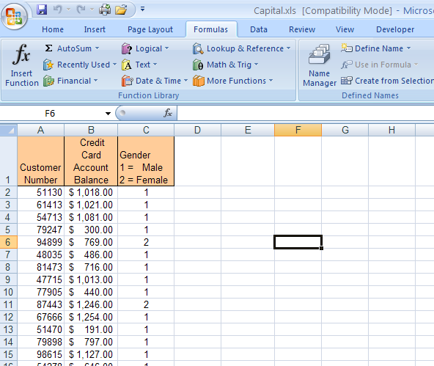
Capital Credit Union
Open the Excel file called Capital.xls
The file contains 300 observations. The last row is 301.
Column 2 (B) contains the balances.
Column 3 (C) contains the gender codes

Slide 3
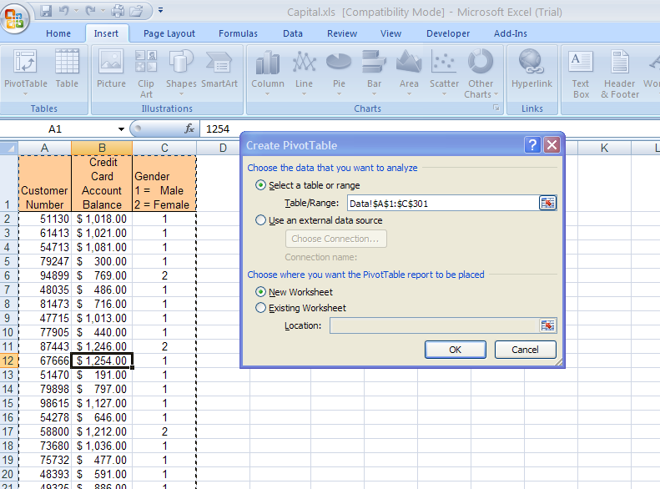
Capital Credit Union
\
Select Insert
Select Pivot Table
Table/Range selected automatically
Place on New Worksheet
1. Place the cursor in any data cell

Slide 4
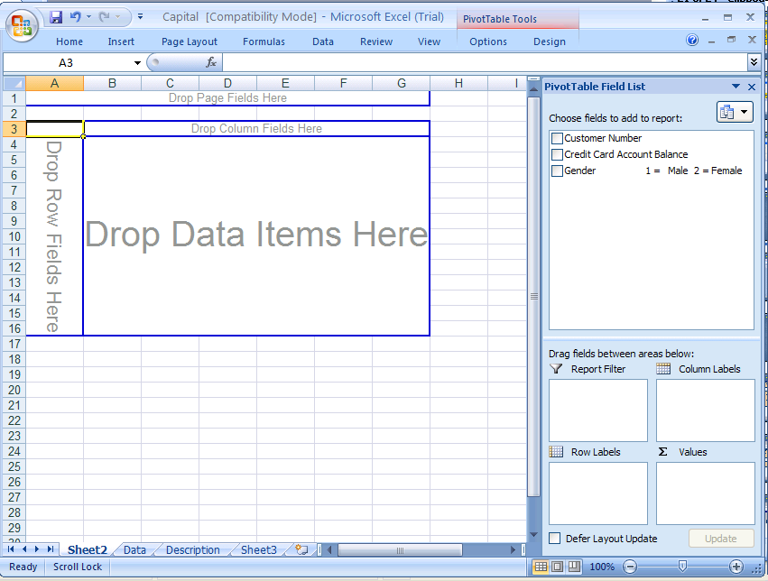
Capital Credit Union
Drag Gender to the “Drop Column Fields Here” box
Drag Gender to the “Drop Data Items Here” box
Drag “Credit Card Account Balance” to the “Drop Row Fields Here”

Slide 5
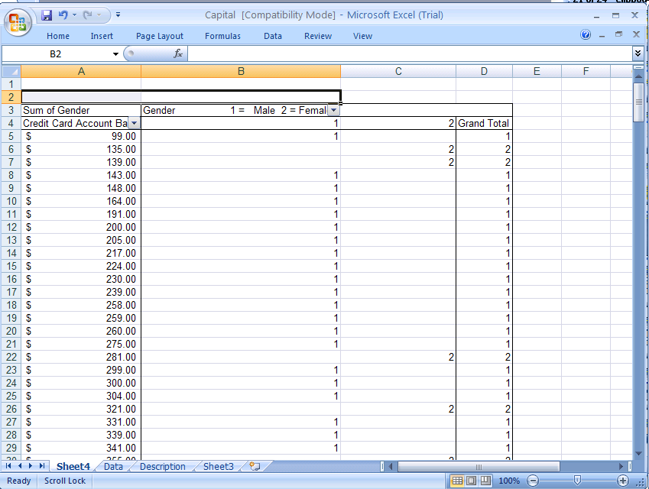
Capital Credit Union
Yielding!
However we need to group the balance Information and change the Sum of Gender to Count of Gender

Slide 6
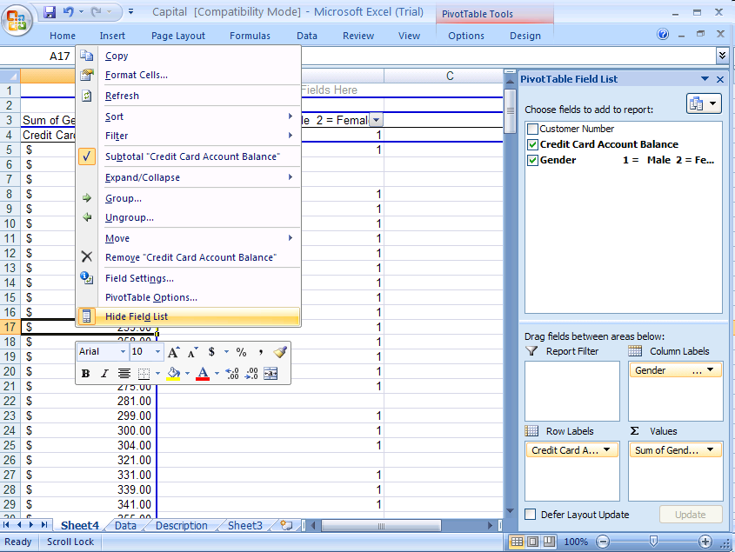
Capital Credit Union
Place the cursor in any Balance Cell
RIGHT click and select Group

Slide 7
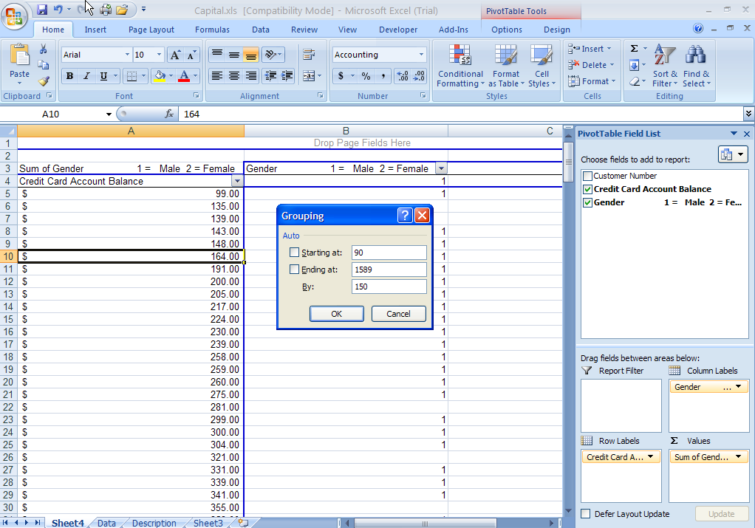
Capital Credit Union
Starting at: 90
Ending at: 1589
By: 150

Slide 8
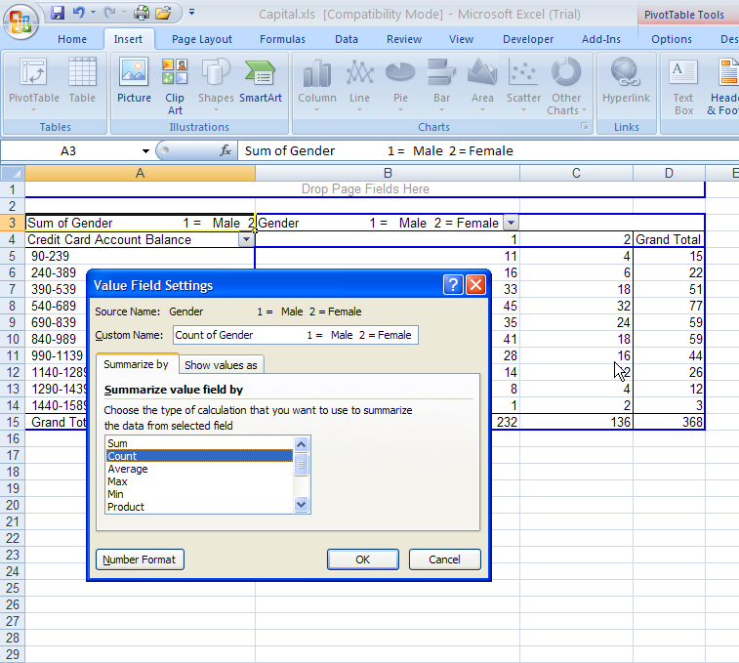
Capital Credit Union
Right click Sum of Gender
Select Value Field Setting to Open Value Field Setting dialog box
In dialog box, select Count

Slide 9
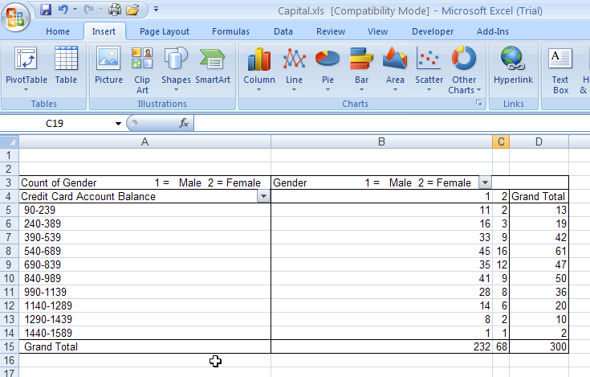
Capital Credit Union
Complete!

Slide 10
Capital Credit Union
Objective: The credit card balances by gender in percentage. Data File is Capital.xls
Note: See Previous Example for Pivot Table Instructions.

Slide 11
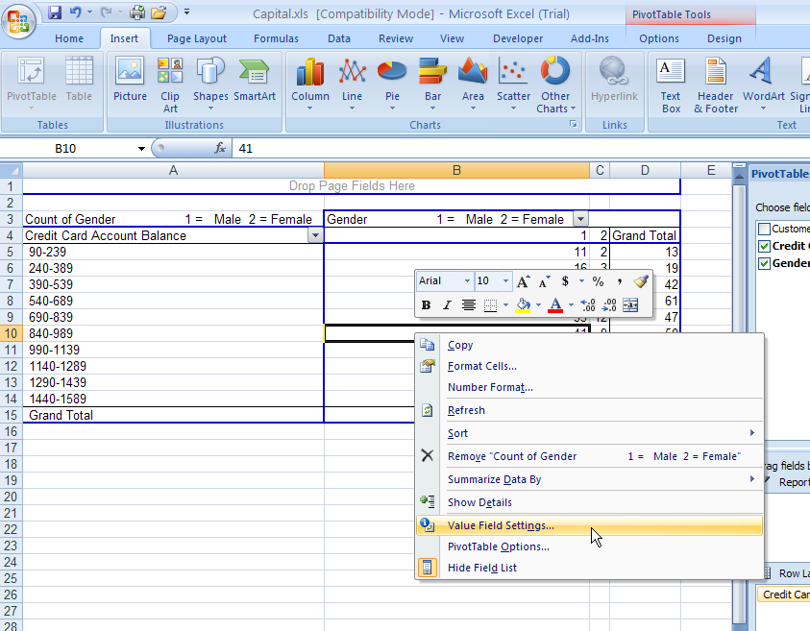
Capital Credit Union
Right-mouse click anywhere in the values of the pivot table.
Select Value Field Settings

Slide 12
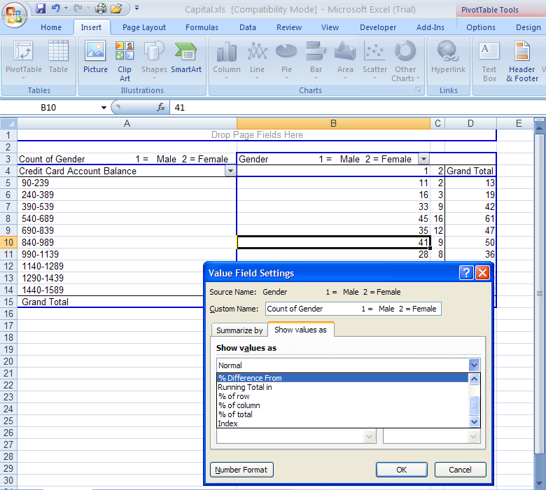
Capital Credit Union
Select the Show Values as tab
Scroll down and click % of total (2010: grand total)

Slide 13
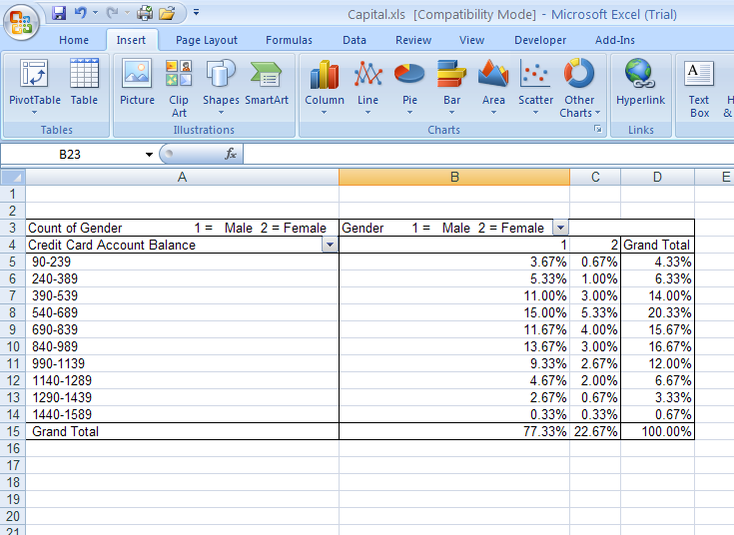
Capital Credit Union
Now displayed as percentages rather than values

