Slide 1
Use Case Diagram (UCD)
Yong Choi
BPA

Slide 2
What is UCD?
A use case is a set of scenarios that describing an interaction between a user and a system.
What a system does…rather than how a system does
A use case diagram displays the relationship among actors and use cases.
The two main components of a use case diagram are use cases and actors.

Slide 3
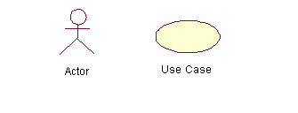
Actor and Use Cases
An actor represents a user or another system that will interact with the system you are modeling.
A use case is an external view of the system that represents some action the user might perform in order to complete a task.

Slide 4
When to Use: Use Cases Diagrams
The use-case model can be used to drive the entire system development effort (the biggest benefit).
Use cases are used in almost every project.
The are helpful in exposing requirements and planning the project.
During the initial stage of a project most use cases should be defined, but as the project continues more might become visible.

Slide 5
How to Draw: Use Cases Diagrams
Use cases are a relatively easy UML diagram to draw.
Following example (next slide) is a very simplified example.
The example is only meant as an introduction to the UML and use cases.

Slide 6
Example: Placing Order
Start by listing a sequence of steps a user might take in order to complete an action. For example a cuatomer placing an order with a sales company might follow these steps.
Browse catalog and select items.
Call sales representative.
Supply shipping information.
Supply payment information.
Receive conformation number from salesperson.

Slide 7
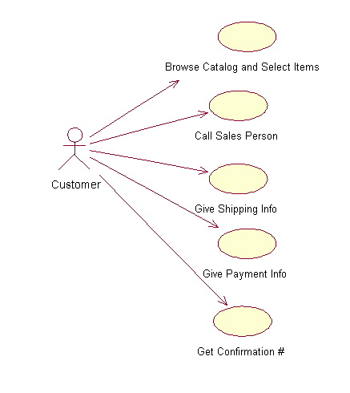
Source: http://atlas.kennesaw.edu/~dbraun/csis4650/A&D/index.htm

Slide 8
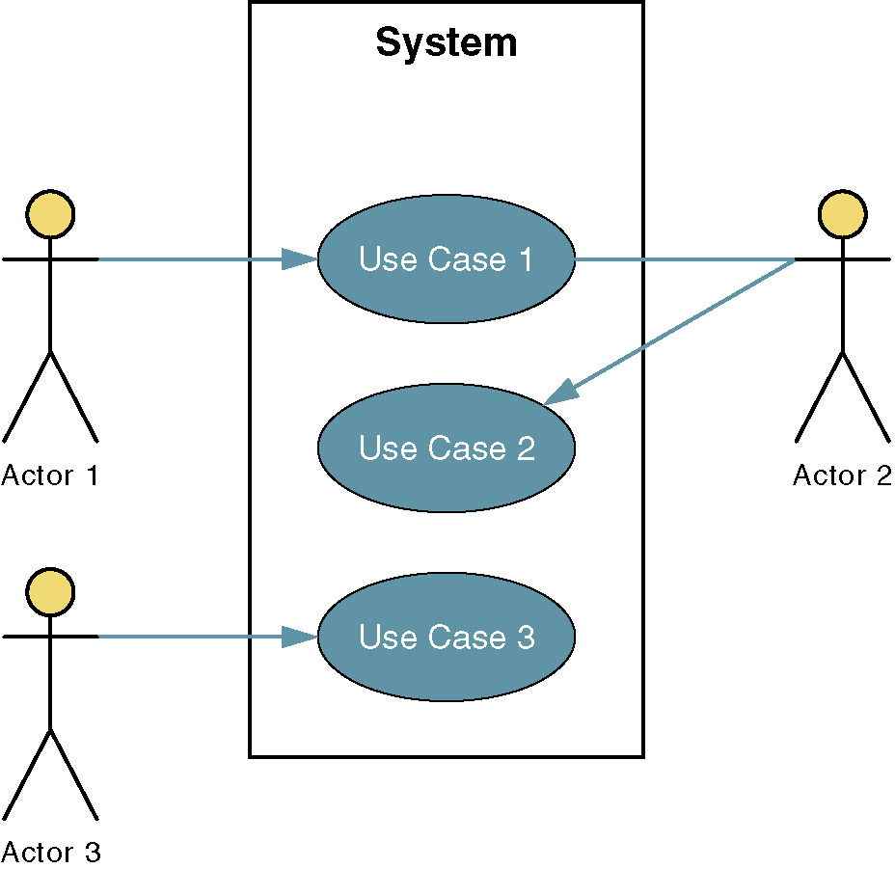
Sample Use-Case Diagram
Three Elements
1. Use case: results of decomposition
2. Actor
3. Relationship
Use-Case = business event

Slide 9
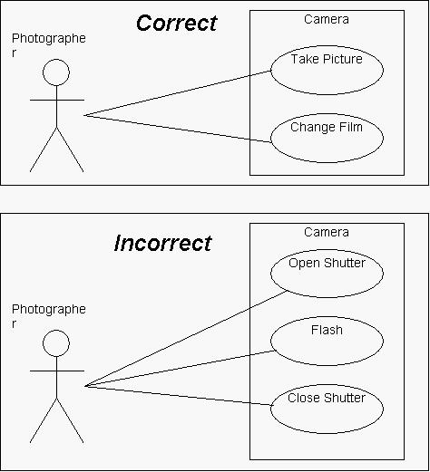
What to put in the "System" box?
Notes:
The following represents the use cases for a camera.
No photographer would ever pick up their camera, open the shutter, and then put it down, satisfied with their photographic session for the day.
The crucial thing to realize is that these behaviors are not done in isolation, but are rather a part of a more high-level use case, "Take Picture". (Note that it does make sense for a photographer to "Take Picture" just once during a session with their camera.)

Slide 10
Use Cases
Use case – a behaviorally related sequence of steps (events) for the purpose of completing a single business task.
Identify and describe the systems functions
Represented graphically by a horizontal ellipse with the name of the use case appearing above, below, or inside the ellipse.

Slide 11
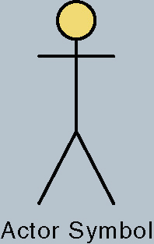
Actors
Actor – anything that needs to interact with the system to exchange information.
Could be a human, an organization, another information system, an external device, or even time.
Ex) College student enrolling for the fall semester’s course
Actor: student
Use case (business event): enrolling in course

Slide 12
Relationships
1. Association – a relationship between an actor and a use case in which an interaction occurs between them.
Association modeled as a solid line connecting the actor and the use case.
Association with an arrowhead touching the use case indicates that the use case was initiated by the actor.
Associations may be bidirectional or unidirectional.
Notes:
No additional notes.

Slide 13
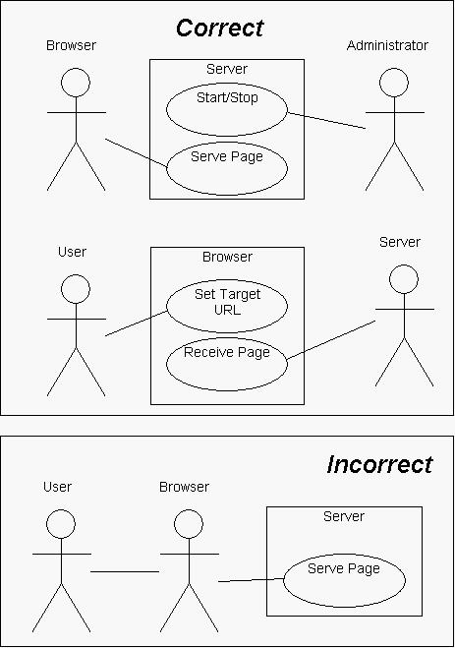

Slide 14
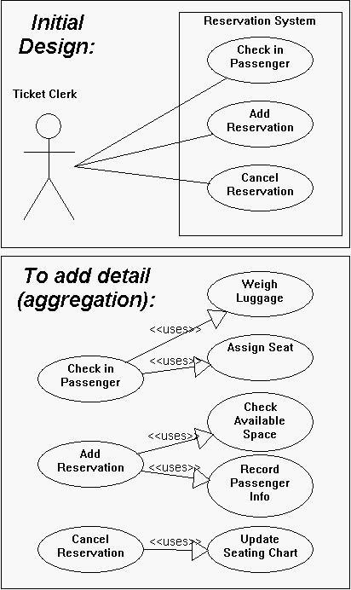

Slide 15
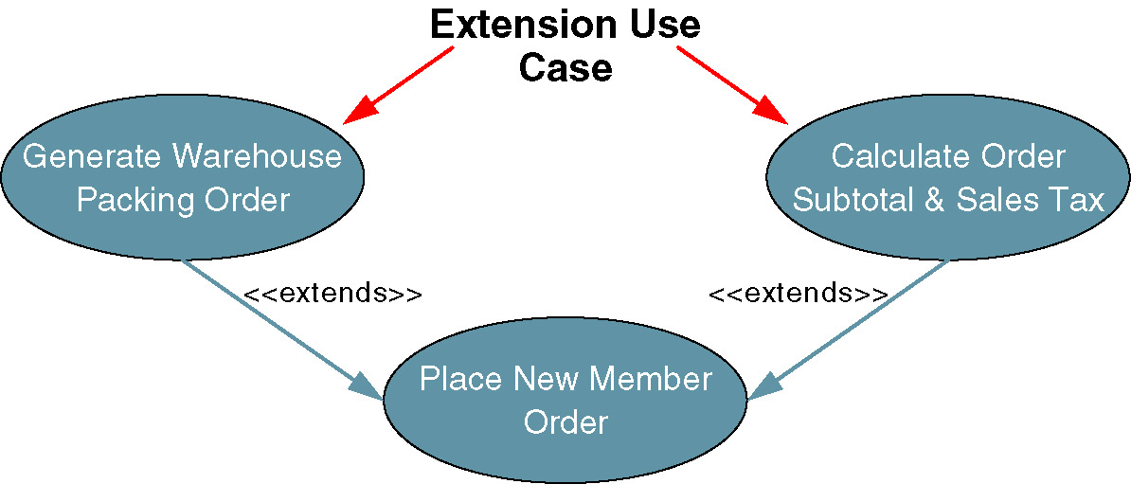
Relationships
2. Extension use case – a use case consisting of steps extracted from a more complex use case in order to simplify the original case and thus extend its functionality.
Relationship between the extension use case and the use case it is extending is called an extends relationship.
Represented as an arrowheaded line beginning at the extension use case and point to the use case it is extending.
Each extends relationship line is labeled “<<extends>>.”
Notes:
No additional notes.

Slide 16
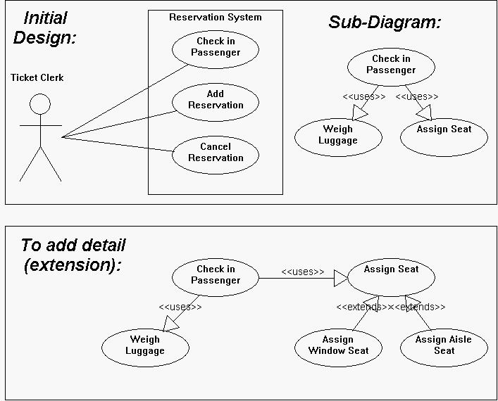

Slide 17
How is a UCD different from a traditional flow chart?
UCDs are meant to be a top-down, horizontal description of functionality
if functionality or behavior is added or deleted over the life of your project, the scope of the change you need to make is proportional to both the scope of the change in the system itself, and the maturity of your model.
This is useful because it means that when your model is very young (only high-level diagrams drawn) making sweeping changes to the system does not involve throwing very much work away.

Slide 18
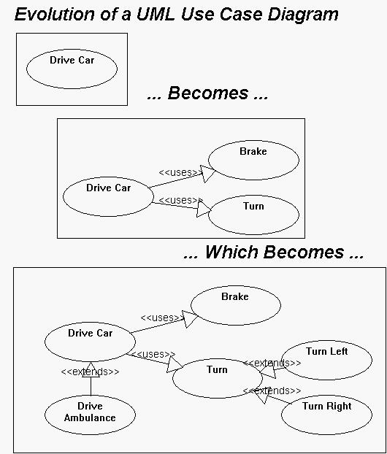

Slide 20
Steps for developing UCD
Should have a context diagram before step #1
Identify business actors
Identify business use cases (develop use-case glossary)
Construct use-case diagram
Document business requirements use-case narratives
Notes:
Teaching Notes
The individual steps will be discussed on the following slides.

Slide 21
SoundStage Member Services System Context Diagram

Slide 22
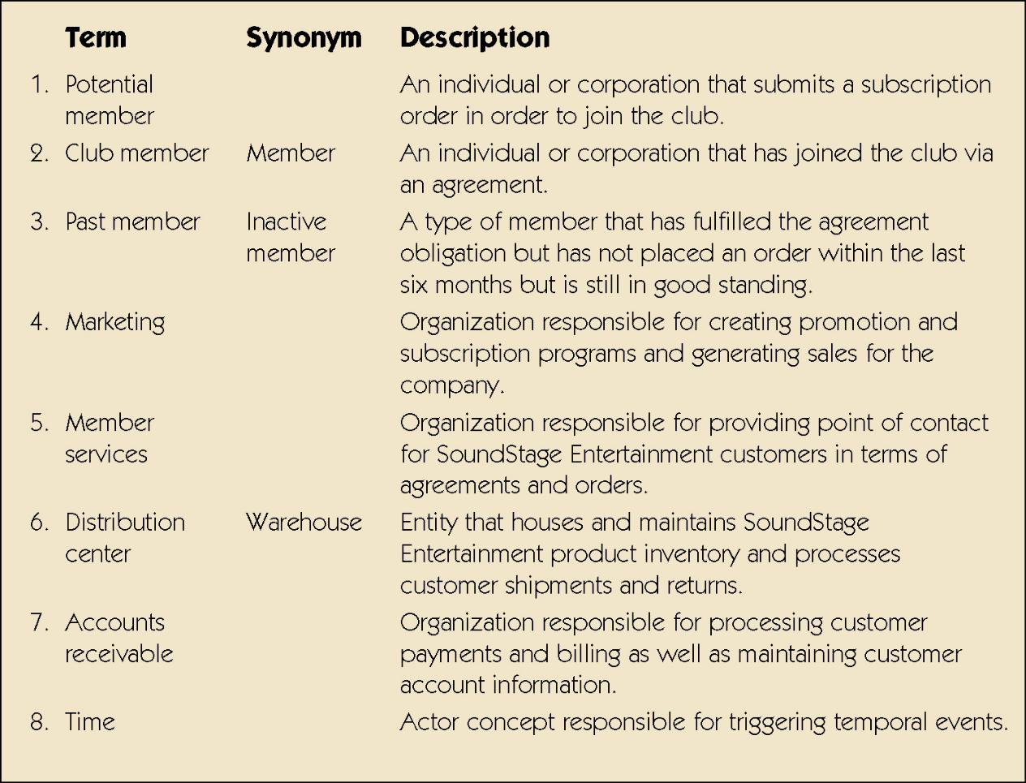
List of Actors
Notes:
No additional notes.

Slide 23
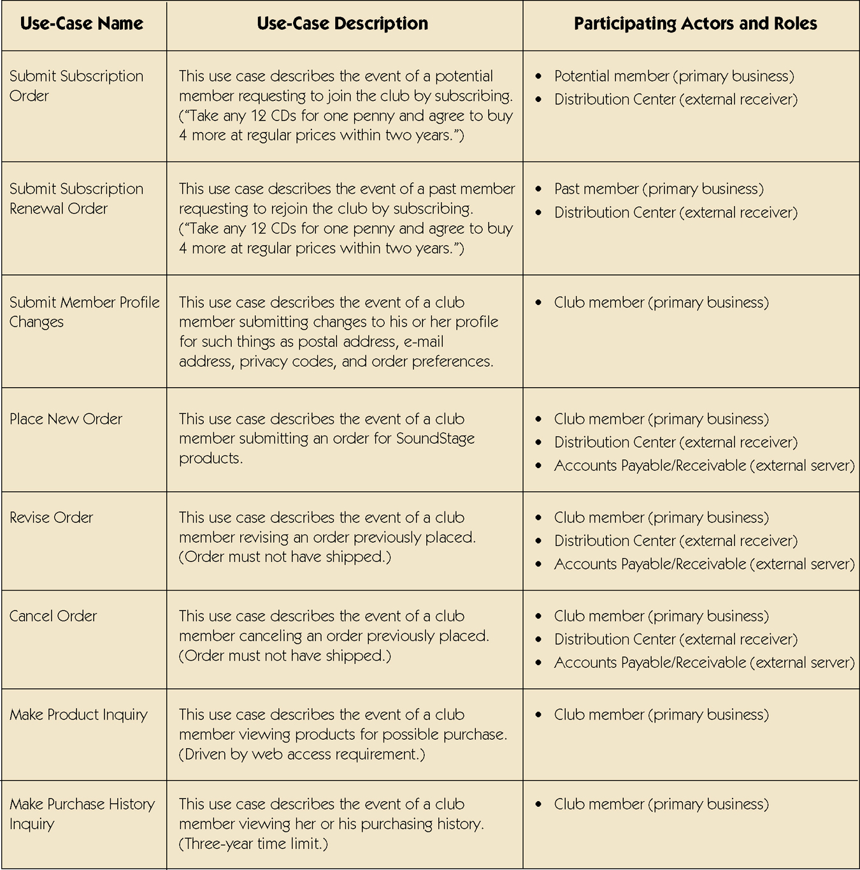
Use-Case Glossary
Using the context diagram of SoundStage Member Service
Notes:
No additional notes

Slide 24
Sample Use-Case Glossary (con’t)
Notes:
No additional notes

Slide 25
Sample Use-Case Glossary (con’t)
Notes:
No additional notes

Slide 26
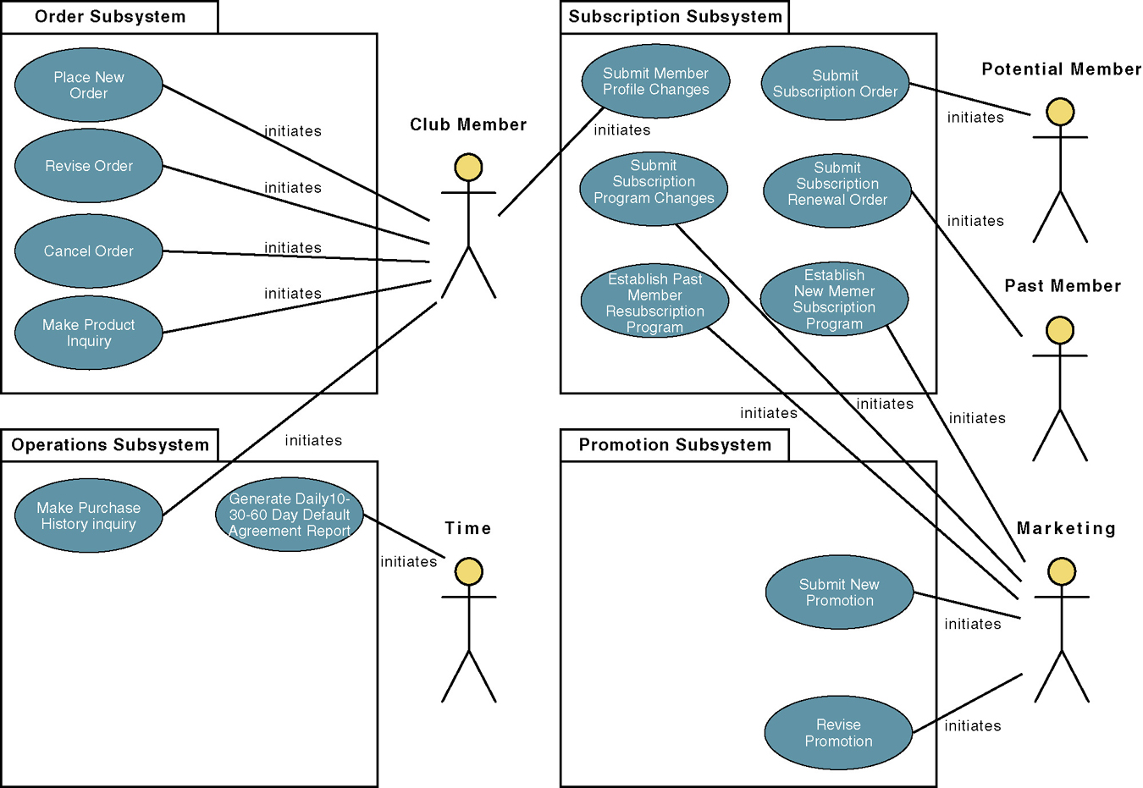
Construct Use-Case Diagram

Slide 27
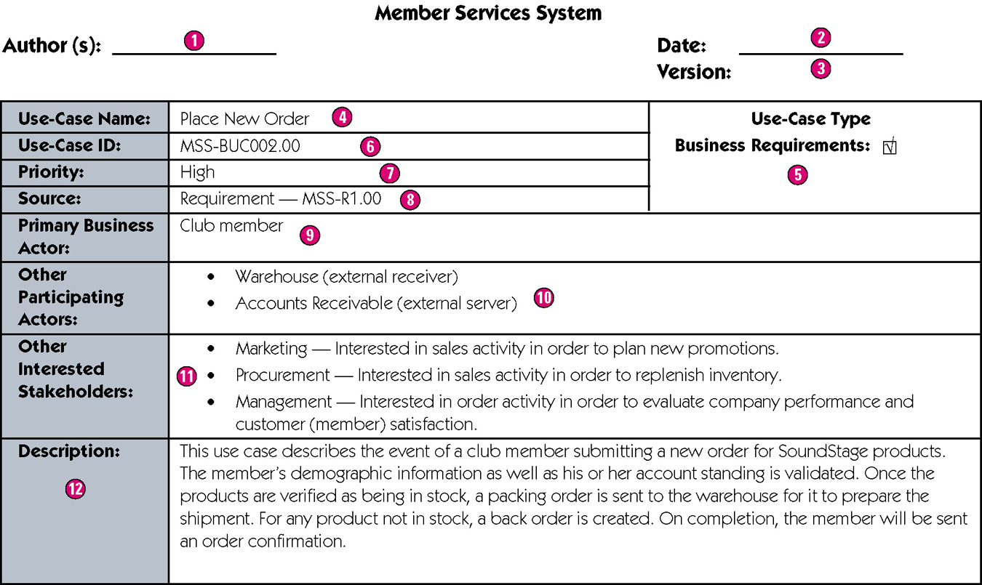
High-Level Version of a Use-Case Narrative
Notes:
Teaching Notes
Author – the persons who wrote the use case and provide a point of contact for anyone requiring additional information.
Date – the date the use case was last modified.
Version – the current version of the use case.
Use-case name – the use-case name should represent the goal that the use case is trying to accomplish. Should begin with a verb.
Use-case type – Business requirements use cases provide a general understanding of the problem domain and scope but don’t include detail to communicate to developers what the system should do.
Use-case ID – A unique identifier for the use case.
Priority – The priority communicates the importance of the use case (high, medium, or low).
Source – The source defines the entity that triggered the creation of the use case.
Primary business actor – The stakeholder that primarily benefits from the execution of the use case.
Other participating actors – Other actors that participate in the use case.
Interested stakeholders – A person (other than the actor) who has a vested interest in the goal of the use case.
Description – A short summary description of the purpose of the use case and its activities.

Slide 28
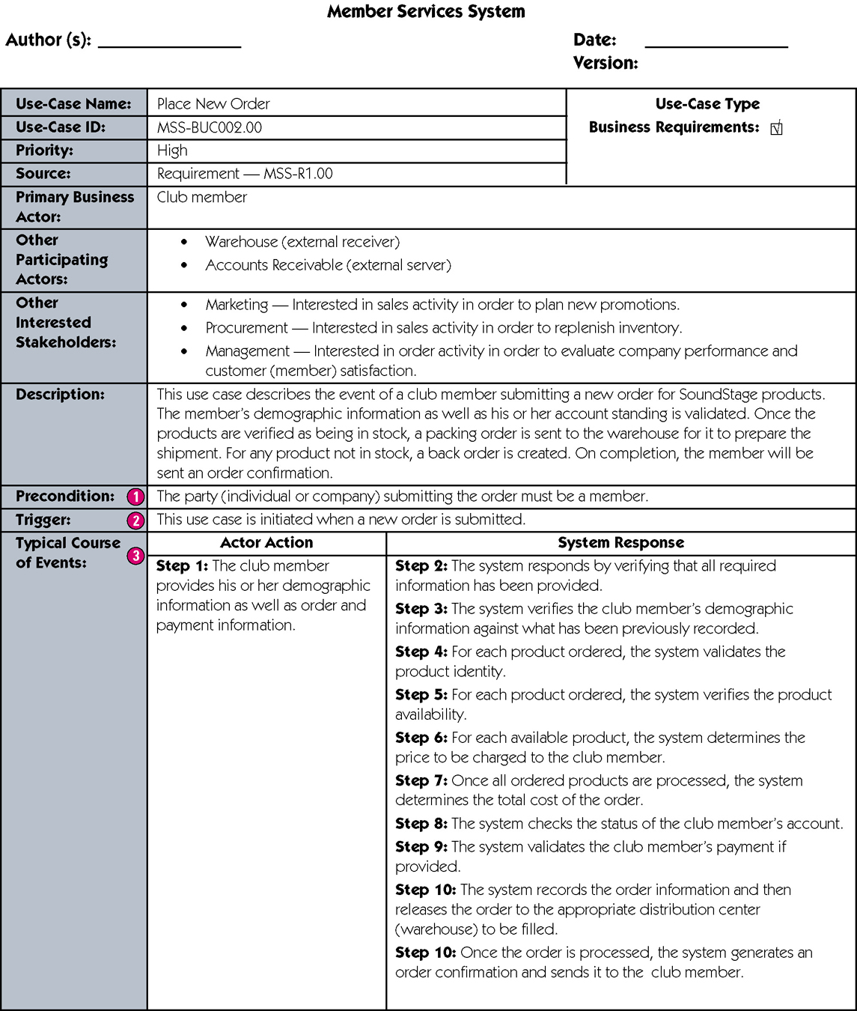
Expanded Version of a Use-Case Narrative
Notes:
Teaching Notes
Precondition – A constraint on the state of the system before the use case can be executed.
Trigger – The event that initiates the use case.
Typical course of events – The normal sequence of activities performed by the actor(s) and the system to satisfy the goal of the use case.
Alternate courses – The behaviors of the use case if an exception or variation to the typical course occurs.
Conclusion – When the use case successfully ends.
Postcondition – A constraint on the state of the system after the use case has successfully executed.
Business rules – Policies and procedures of the business that the system must abide by.
Implementation constraints and specifications – Any nonfunctional requirements that may impact the realization of the use case.
Assumptions – Assumptions made by the author.
Open issues – Issues that need to be resolved before the use case can be finalized.

Slide 29
Sample Expanded Version of a Use-Case Narrative (cont)
Notes:
Teaching Notes
Precondition – A constraint on the state of the system before the use case can be executed.
Trigger – The event that initiates the use case.
Typical course of events – The normal sequence of activities performed by the actor(s) and the system to satisfy the goal of the use case.
Alternate courses – The behaviors of the use case if an exception or variation to the typical course occurs.
Conclusion – When the use case successfully ends.
Postcondition – A constraint on the state of the system after the use case has successfully executed.
Business rules – Policies and procedures of the business that the system must abide by.
Implementation constraints and specifications – Any nonfunctional requirements that may impact the realization of the use case.
Assumptions – Assumptions made by the author.
Open issues – Issues that need to be resolved before the use case can be finalized.

Slide 30
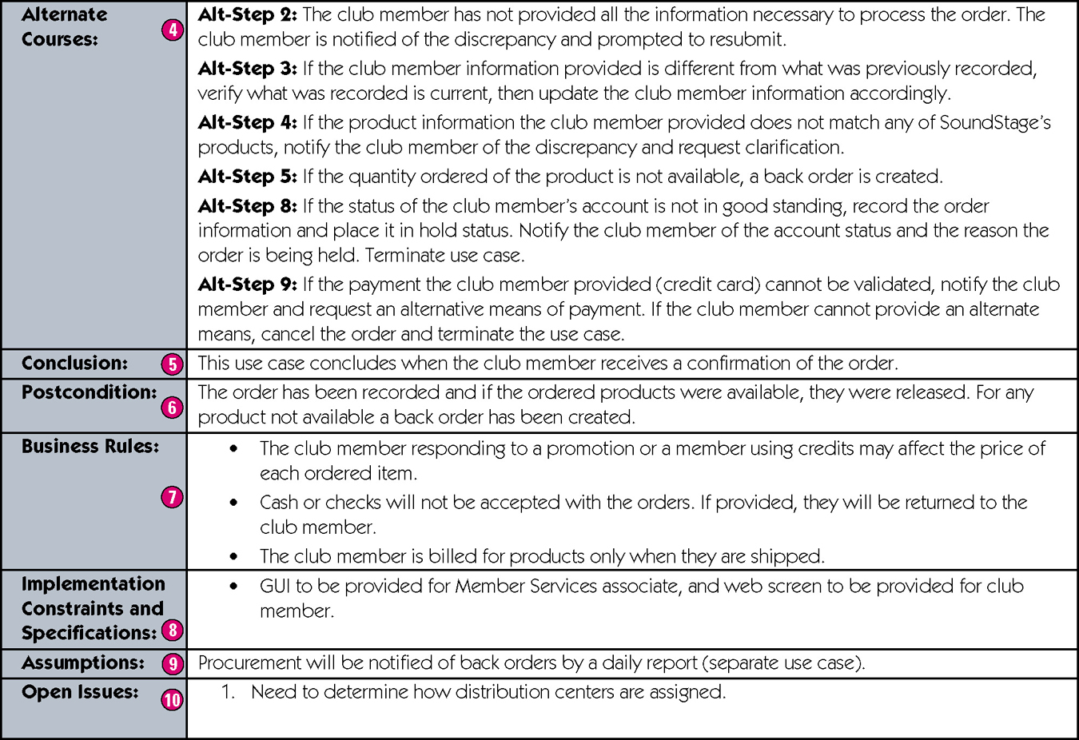
Sample Expanded Version of a Use-Case Narrative (cont)
Notes:
Teaching Notes
Precondition – A constraint on the state of the system before the use case can be executed.
Trigger – The event that initiates the use case.
Typical course of events – The normal sequence of activities performed by the actor(s) and the system to satisfy the goal of the use case.
Alternate courses – The behaviors of the use case if an exception or variation to the typical course occurs.
Conclusion – When the use case successfully ends.
Postcondition – A constraint on the state of the system after the use case has successfully executed.
Business rules – Policies and procedures of the business that the system must abide by.
Implementation constraints and specifications – Any nonfunctional requirements that may impact the realization of the use case.
Assumptions – Assumptions made by the author.
Open issues – Issues that need to be resolved before the use case can be finalized.

Slide 31
Use-Case Ranking and Priority Matrix
Use-case ranking and priority matrix – a tool used to evaluate use cases and determine their priority.
Evaluates use cases on a scale of 1 to 5 against six criteria.
Significant impact on the architectural design.
Easy to implement but contains significant functionality.
Includes risky, time-critical, or complex functions.
Involves significant research or new or risky technology.
Includes primary business functions.
Will increase revenue or decrease costs.
Notes:
No additional notes.

Slide 32
Sample Use-Case Ranking and Priority Matrix
Notes:
No additional notes

