Slide 1
Asking Better Questions
Data Presentation on Student Success at CSUB
Kris Krishnan, Ed.D
Vikash Lakhani

Slide 2
CSUB New Student Profile

Slide 3
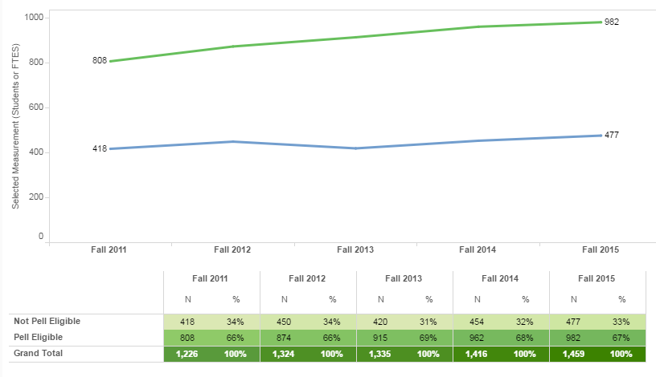
Pell Eligibility – First-Time Freshmen

Slide 4
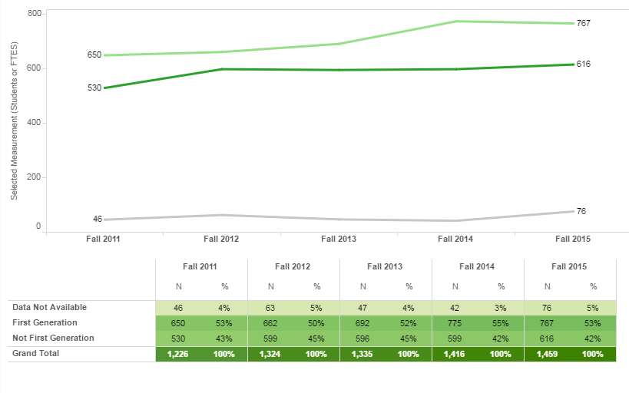
1st Generation Status – First-Time Freshmen

Slide 5
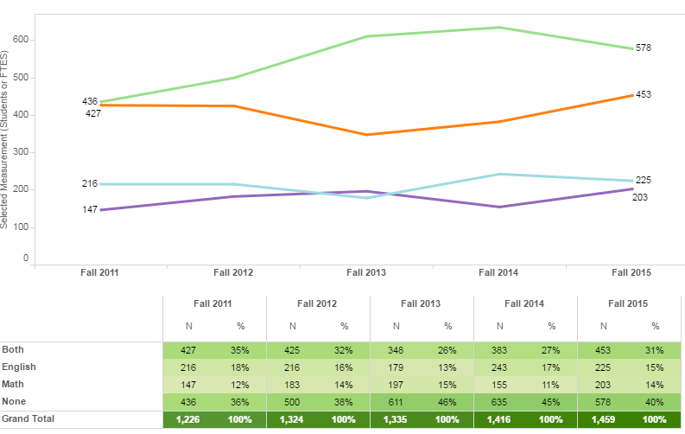
Remedial Status – First-Time Freshmen

Slide 6
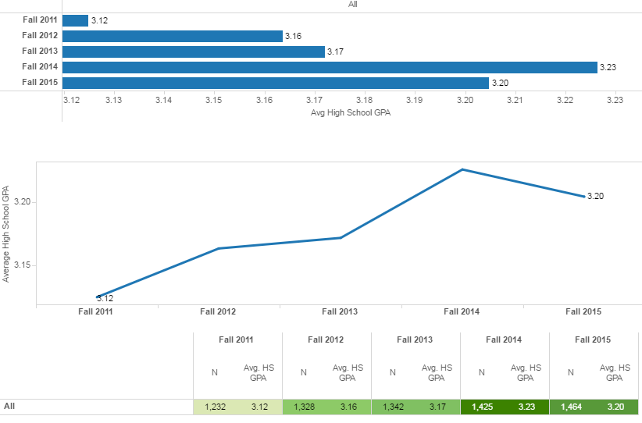
Average HS GPA- - First-Time Freshmen

Slide 7
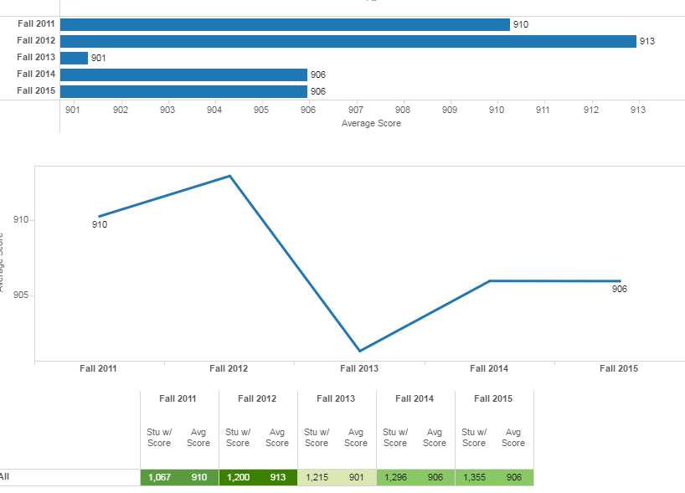
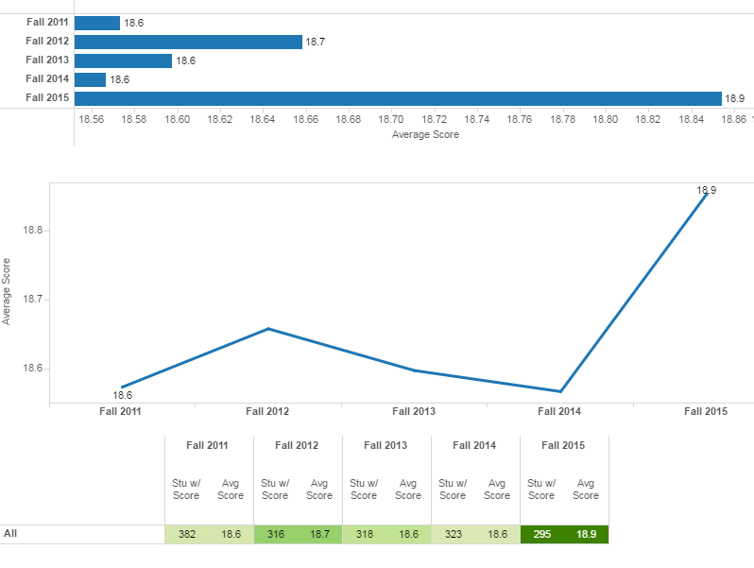
Test Scores (SAT/ACT) – First-Time Freshmen

Slide 8
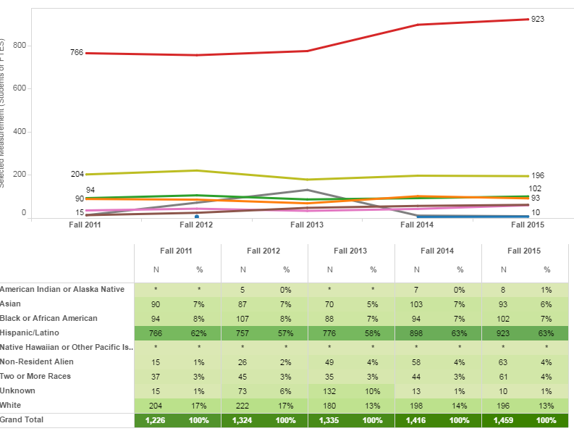
Race/Ethnicity– First-Time Freshmen

Slide 9
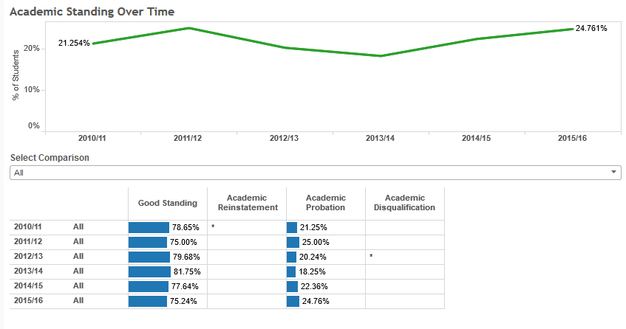
Academic Performance – First Time Freshmen

Slide 10
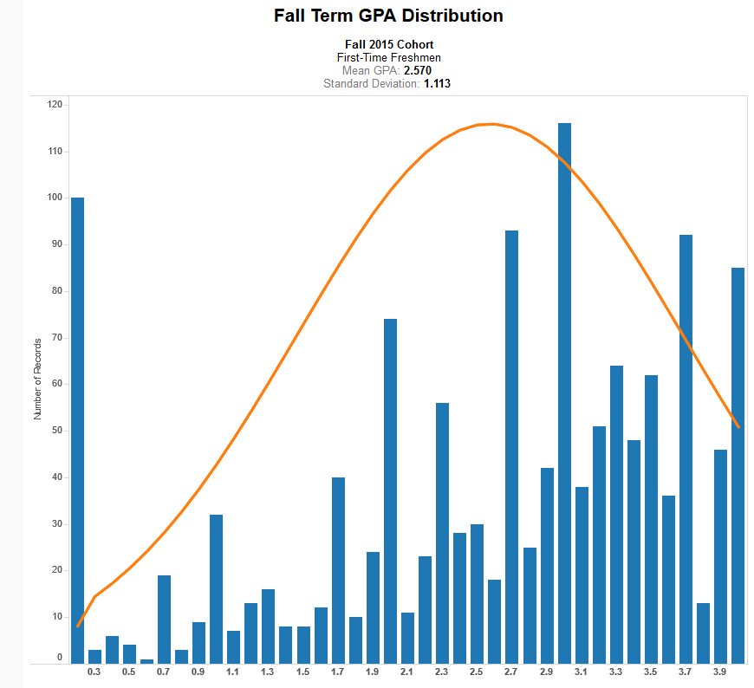
Average GPA - first time freshmen

Slide 11
Credit accumulation – first time freshmen

Slide 12
Student Success Dashboards

Slide 13
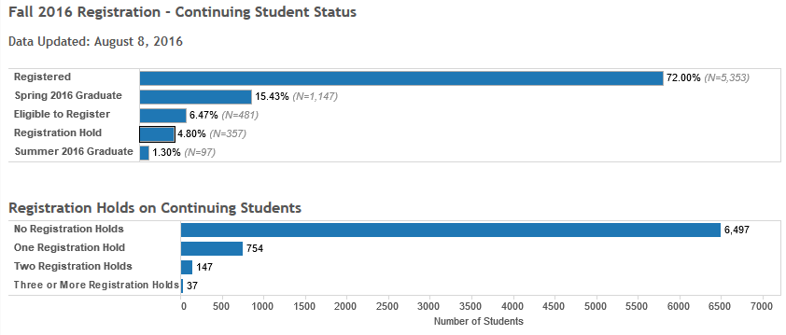
Registration Tracking

Slide 14
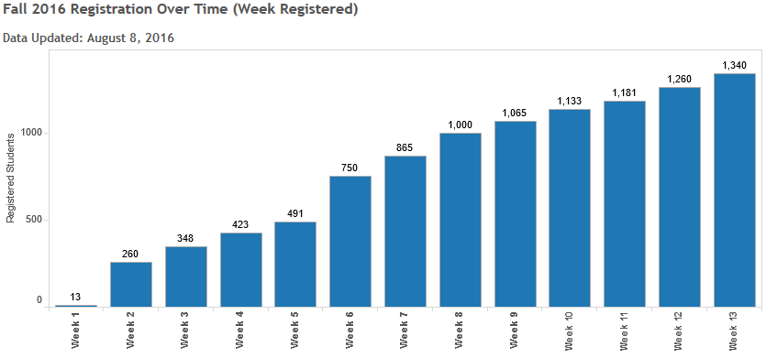
Registration Tracking

Slide 15
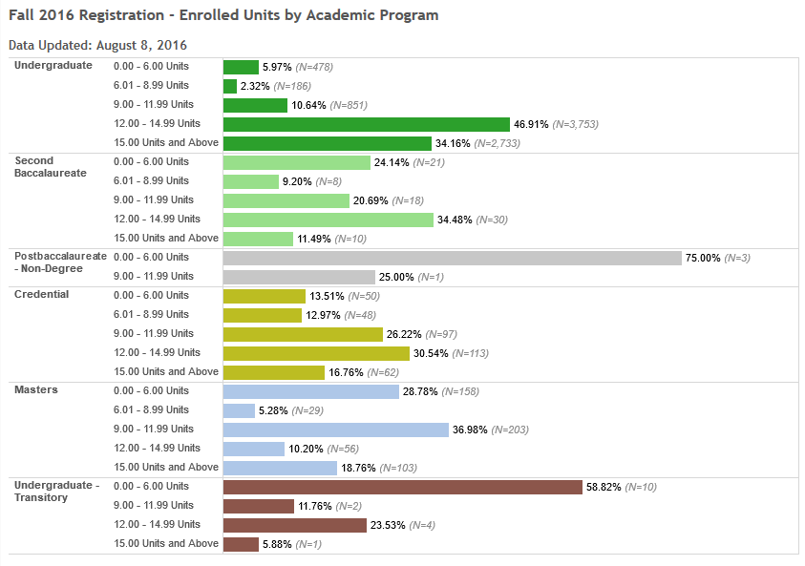
Registration Tracking

Slide 16
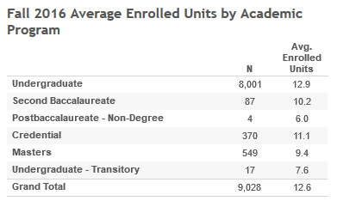
Registration Tracking

Slide 17
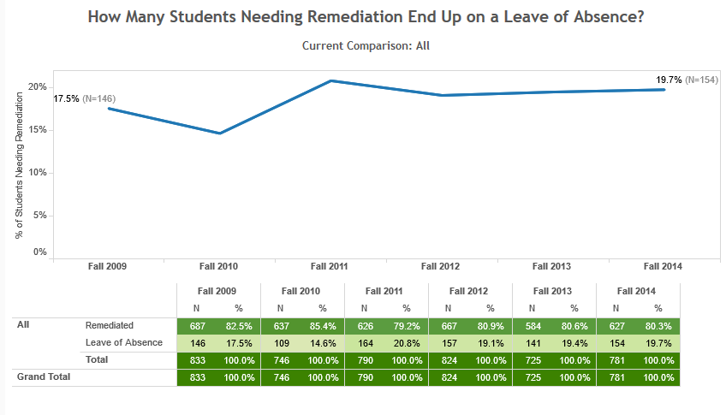
Tracking EO665 students

Slide 18
Student Attrition
Who leaves?
When do they leave?
Where do they go?

Slide 19
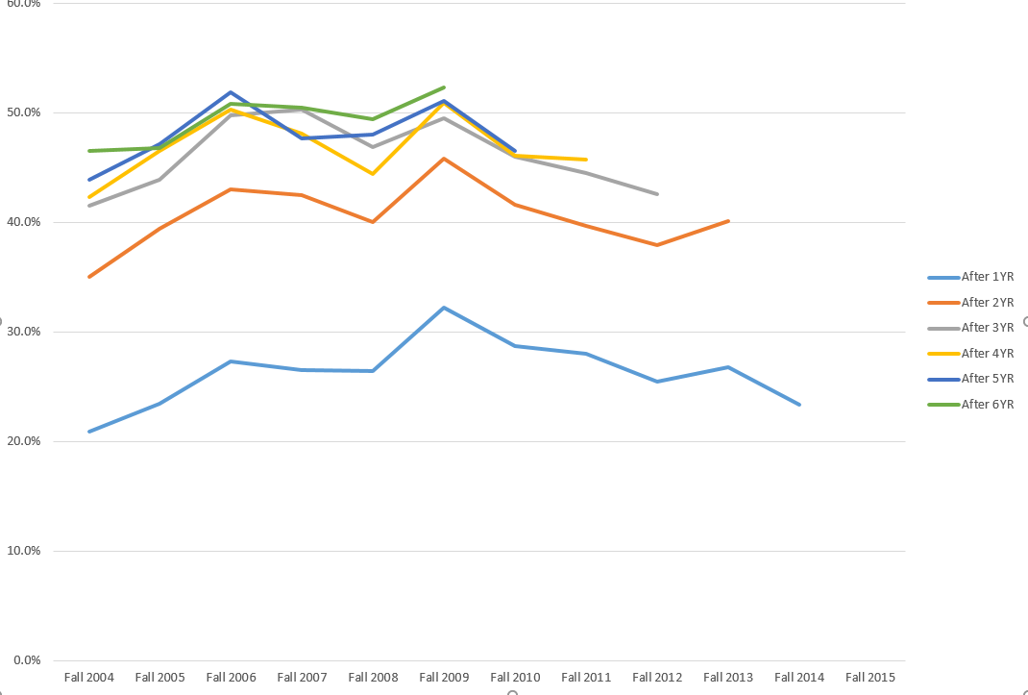
Attrition – First-Time Freshmen
 | Fall 2004 | Fall 2005 | Fall 2006 | Fall 2007 | Fall 2008 | Fall 2009 | Fall 2010 | Fall 2011 | Fall 2012 | Fall 2013 | Fall 2014 | Fall 2015
After 1YR | 20.9% | 23.5% | 27.3% | 26.5% | 26.4% | 32.2% | 28.7% | 28.0% | 25.5% | 26.8% | 23.4%
After 2YR | 35.0% | 39.4% | 43.0% | 42.5% | 40.0% | 45.8% | 41.6% | 39.7% | 37.9% | 40.1%
After 3YR | 41.5% | 43.9% | 49.8% | 50.3% | 46.9% | 49.5% | 46.0% | 44.5% | 42.6%
After 4YR | 42.3% | 46.5% | 50.3% | 48.1% | 44.4% | 50.9% | 46.1% | 45.7%
After 5YR | 43.9% | 47.1% | 51.9% | 47.7% | 48.0% | 51.1% | 46.5%
After 6YR | 46.5% | 46.8% | 50.8% | 50.5% | 49.4% | 52.3%

Slide 20
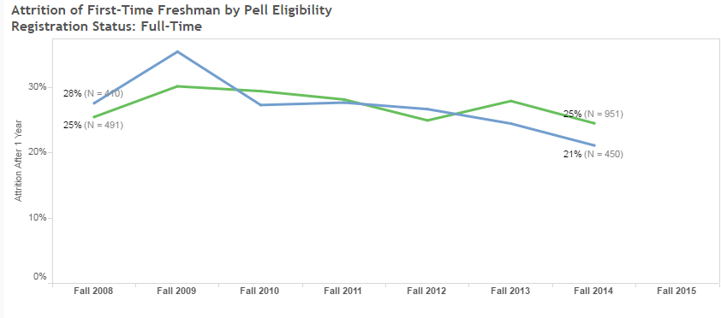

Slide 21
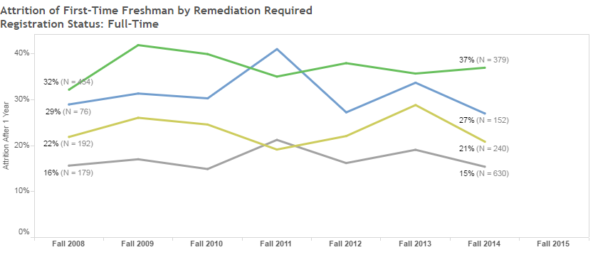

Slide 22
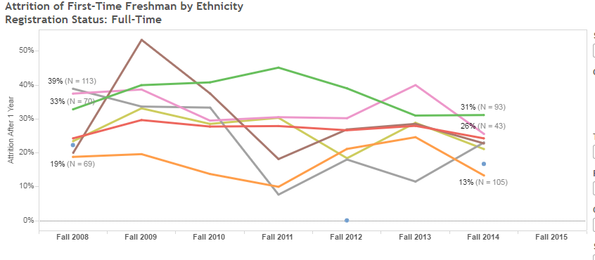

Slide 23
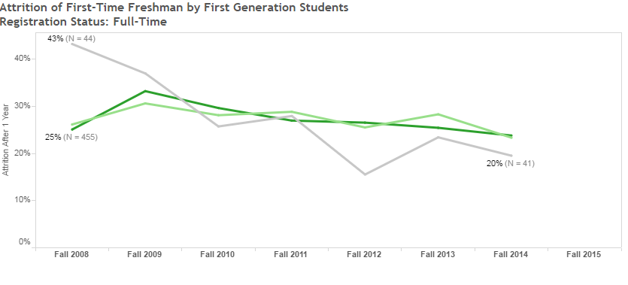

Slide 24
New CSU 2025 Graduation Initiative Goals

Slide 25
Predicting CSUB Graduation Rates

Slide 26
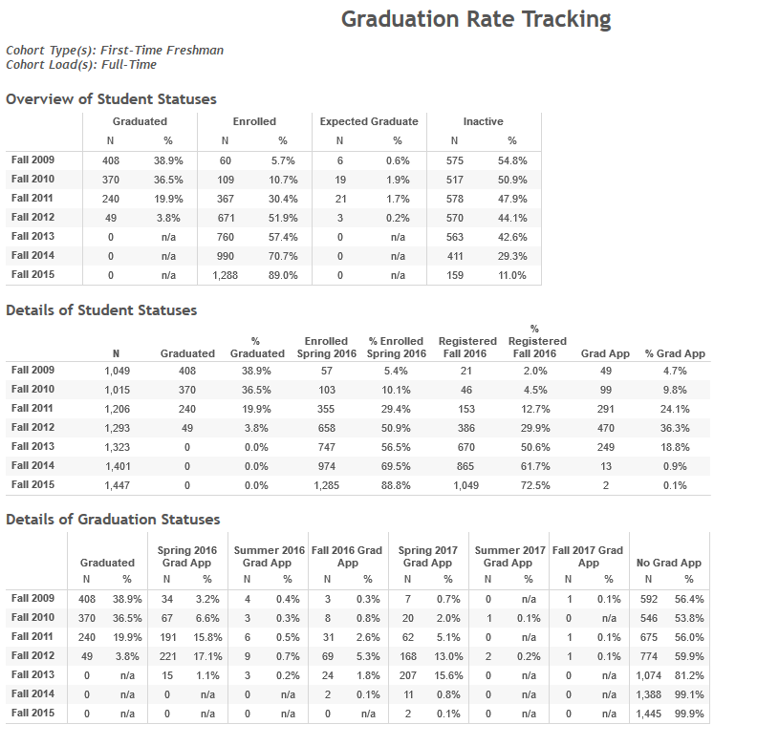

Slide 27
Questions
What role can faculty play in student success?
What do faculty need to help in student success?
What role can technology play in our efforts to improve student success?
What criteria do we use to determine at-risk students?
Who intervenes and when?
What resources do we have for students at-risk?
How do we improve success rates for students entering needing remediation?

Slide 28
Student Success Forum
Table Number | Table Topic
1 | College readiness (remediation)
2 | Academic Advising (Faculty and Staff)
3 | Student Affairs/Engagement
4 | Progress to Degree
5 | Data
6 | Student Support Programs
7 | College Access
8 | Pro-active intervention (At-Risk, Early Warning, etc.)
9 | Technology
10 | Faculty Intervention of At-Risk Students (General Education/FYS)
11 | Clear and Accurate Academic Roadmaps
12 | High Impact Practices
13 | Curriculum streamlining (removing barriers)
14 | Assessment/University Learning Outcomes
15 | Business Operations/Facilities/Safety
16 | University Advancement/Alumni

Slide 29
Discussion Questions
How would addressing (table topic) help CSUB improve on its 4-year and 6-year graduation rates?
What are our strengths/challenges around (table topic)?
What sort of data is available/needed around (table topic)?
Who or what areas on-campus and off-campus do we need to collaborate with to strengthen our efforts around (table topic)?
What top 2 steps can we take in 2016/2017 to address (table topic)?
What top 2 steps can we take in the long term to address (table topic)?
General question: What does “Student Success” mean to you as a group? (pick top 3 words/statements)
Instructions
For Discussions:
Select a table facilitator (if one hasn’t been assigned to you)
Select a note-taker
Use discussion questions provided at the table to guide discussions
Use flip-chart paper provided to record your thoughts around the discussion questions
For Report-Out:
Identify 3-5 major take-aways from your group and write them on the post-it note(s) provided
Identify top 3 words/statements that define “Student Success” for your group and write them on the post-it note(s) provided
Place the post-it note on the flip-chart paper arranged at the front of the room/on the wall

