Slide 1
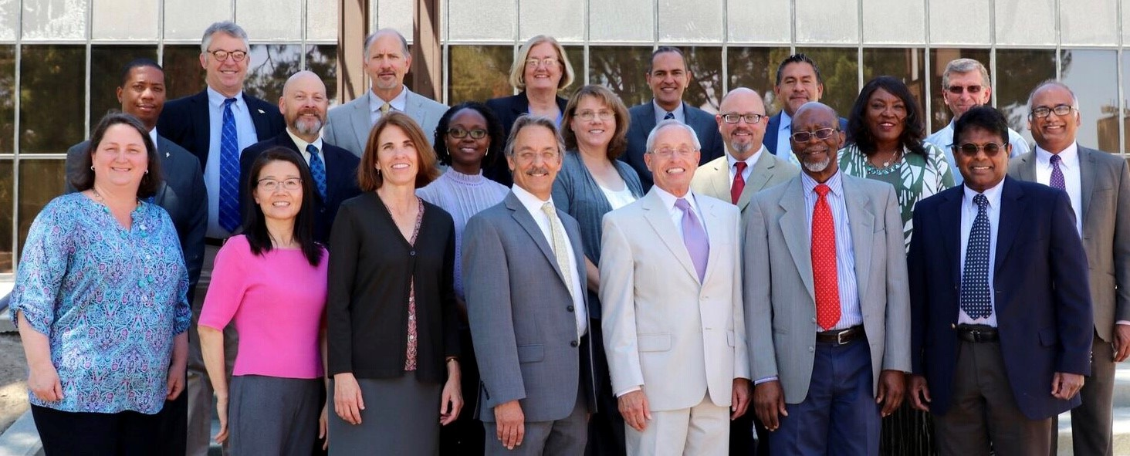
California State University, Bakersfield
Faculty Meeting
August 24, 2018
Provost Jenny J. Zorn, PhD

Slide 2
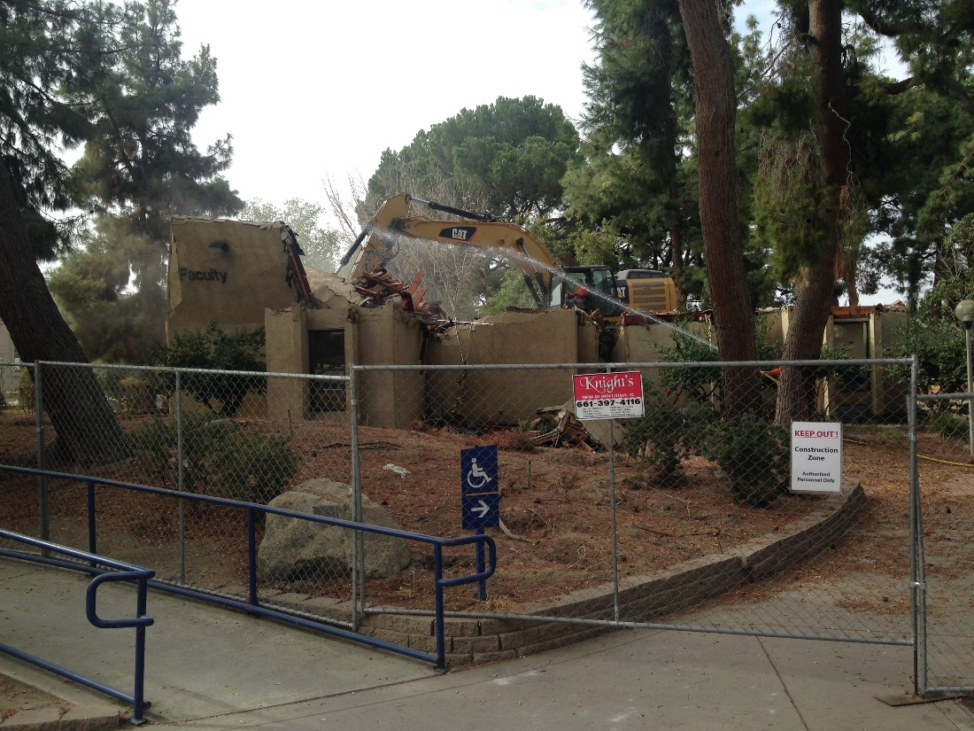
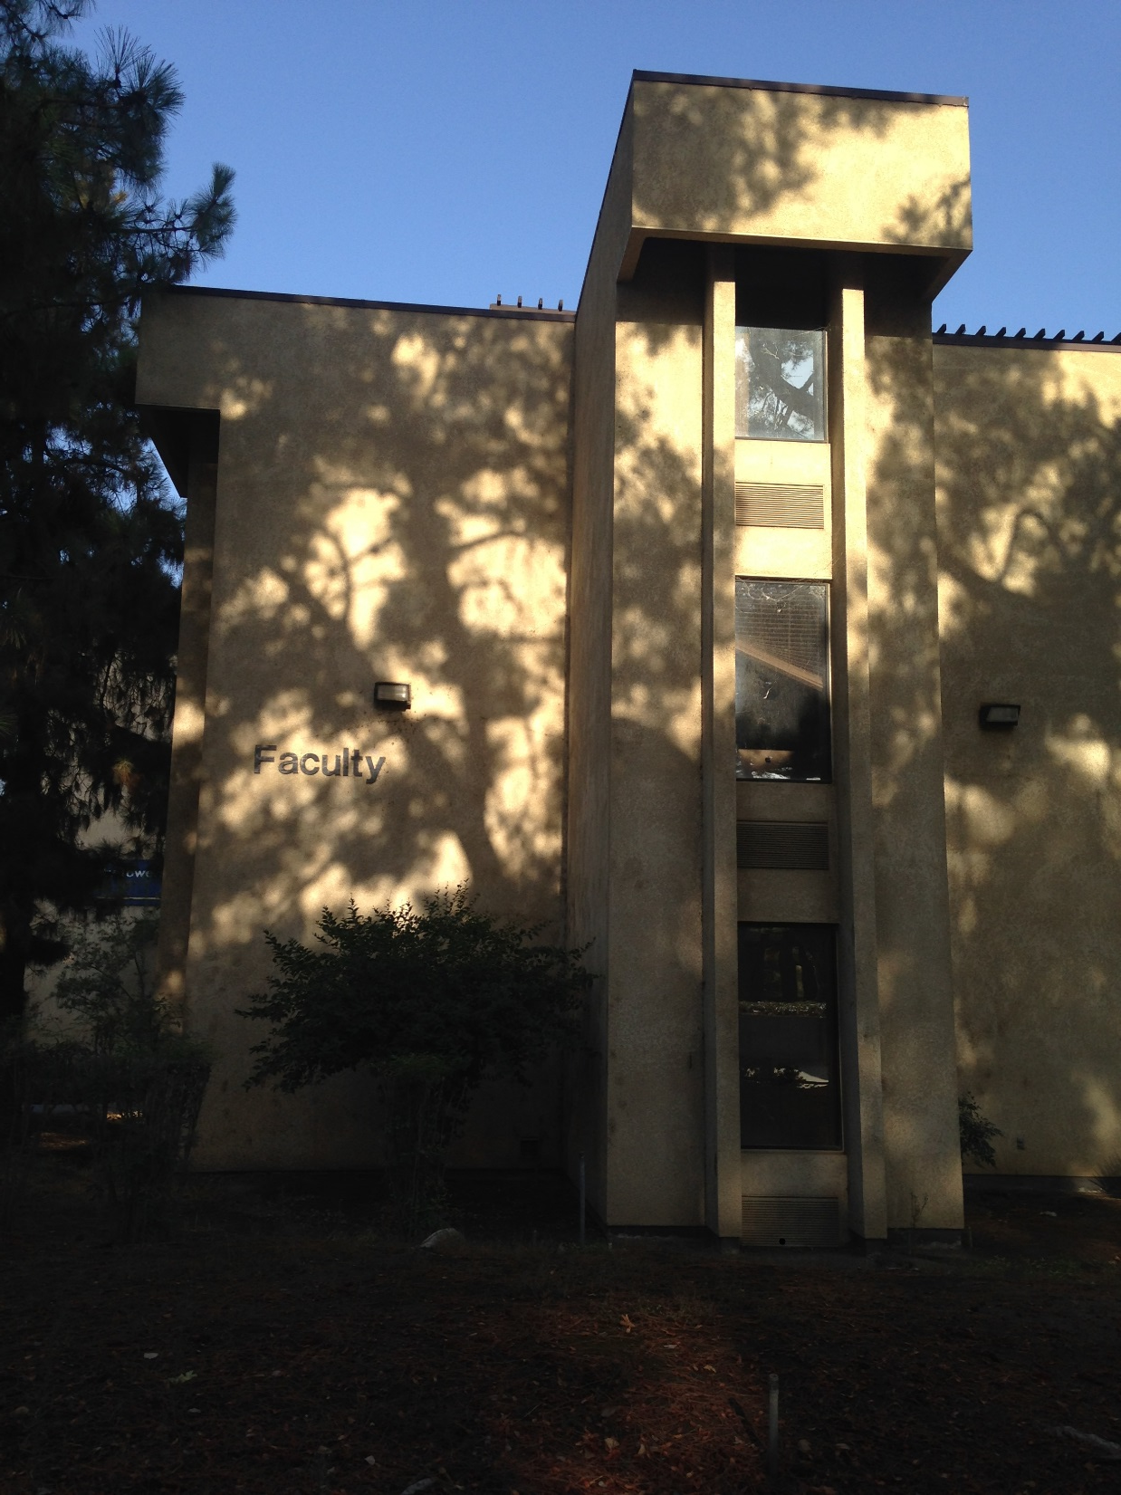
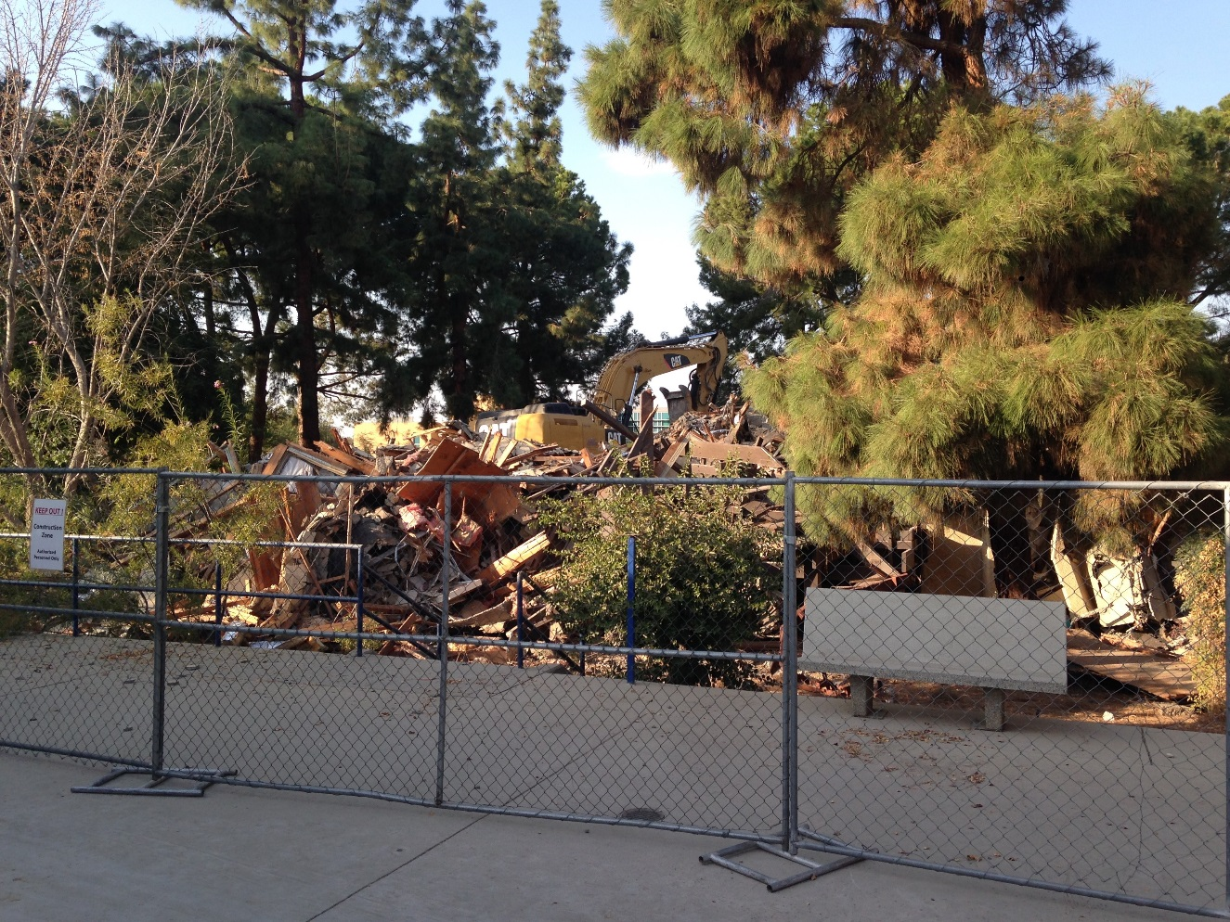
2017-18
Saw many changes

Slide 3
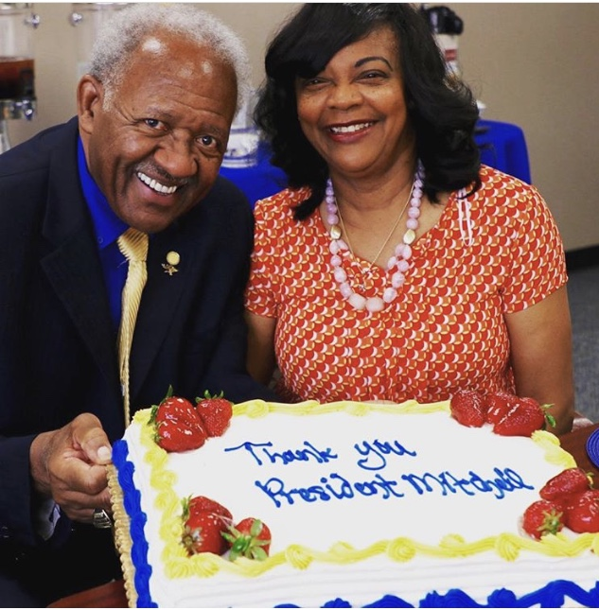
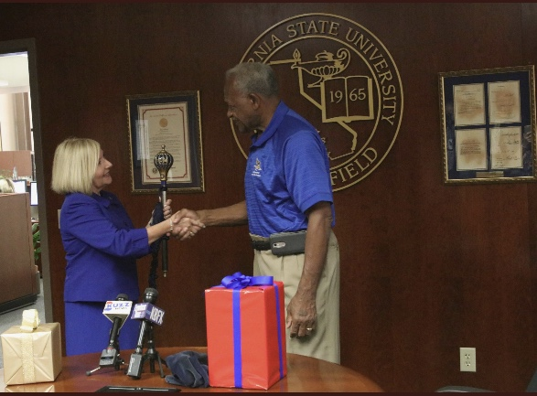
Overarching Priorities for 2018-19 Academic Affairs
1.Student Success and the Graduation Initiative
2.Academic Preparation Implementation
3.WASC/WSCUC
4.Transitioning the new President

Slide 4
Department/School | Total Actual Salaries | Operating & Expenses Actuals
Academic Senate | $47,619 | $4,576
Academic Operations & Support | $376,352 | $7,494
Antelope Valley | $565,785 | $32,154
Faculty Teaching Learning Center | $288,068 | $9,514
Provost/Faculty Affairs | $678,515 | $38,806
Academic Programs | $472,560 | $11,241
Grants & Contracts Admin | $709,037 | $7,961
Institutional Research, Planning, & Assessment | $502,302 | $35,296
Enrollment Management | $3,568,952 | $289,090
Library | $1,811,393 | $561,339
Arts & Humanities | $8,445,011 | $168,568
Business & Public Administration | $5,137,157 | $218,994
Natural Sciences, Mathematics, & Engineering | $10,675,235 | $394,189
Social Sciences & Education | $9,887,414 | $255,901
Extended Education & Global Outreach | $46,088 | $3,322
Kegley Institute | $52,646 | $0
Instruction/Academic Affairs | $134,559 | $155,559
TOTAL ACADEMIC AFFAIRS | $43,398,693 | $2,194,004 | $45,592,697
General Fund 2017-18
Academic Affairs
Increased from
$41.6m to
$45.6m
($4m or 9.5% increase)
Note: Salaries do not include benefits.
Benefits are centralized.

Slide 5
Student Success: Our Students are Succeeding
Our students:
win outstanding paper awards at conferences;
are admitted to graduate schools, law schools, and medical schools, including some of the best schools in the country;
are employed by the best companies in their industries;
provide the backbone of public service sector in Social Work, Nursing, Education, Psychologists, Law Enforcement, and Public Sector employees;
conduct research that is advancing knowledge and impacting our local region; and
are employed in their areas of expertise;
Our alumni:
make a difference in their communities where they live;
contribute to the industries where they work;
are governmental and community leaders who serve the needs of Kern County and beyond;
enrich our lives in creative ways that touch our souls and help us develop empathy; and
bring value to thinking creatively with curiosity.

Slide 6
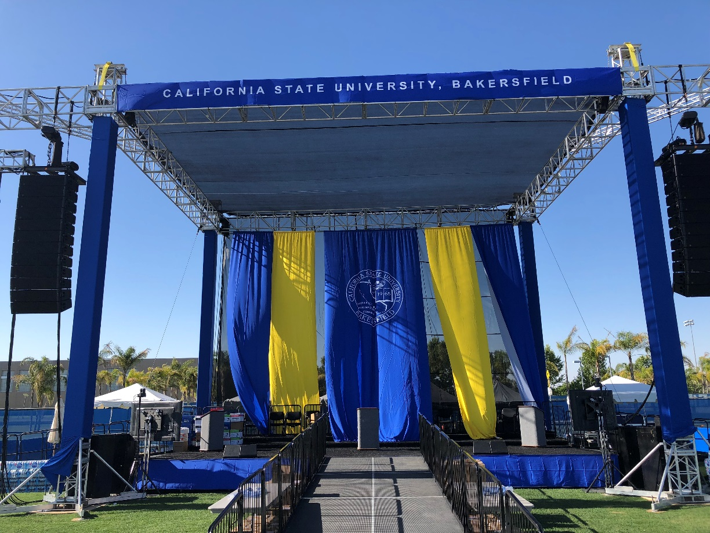
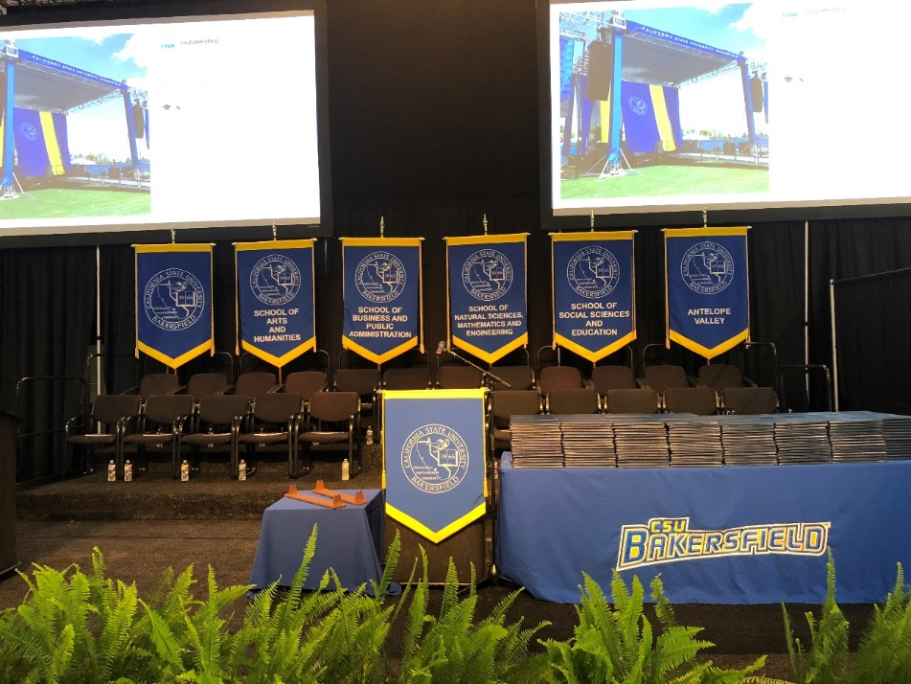
Graduation Initiative 2025
Goals are to raise:
4 year graduation rate for first-time students from 16.3% to 30%
6 year graduation rate for first-time students from 40% to 56%
2 year graduation rate for transfer students from 40% to 48%
4 year graduation rate from transfer students from 69% to 74%
Goals to bring gaps to 0:
Unrepresented Minority Students & non-Unrepresented Minority Students
(currently 3%)
Pell and non-Pell
(currently 0%)

Slide 7
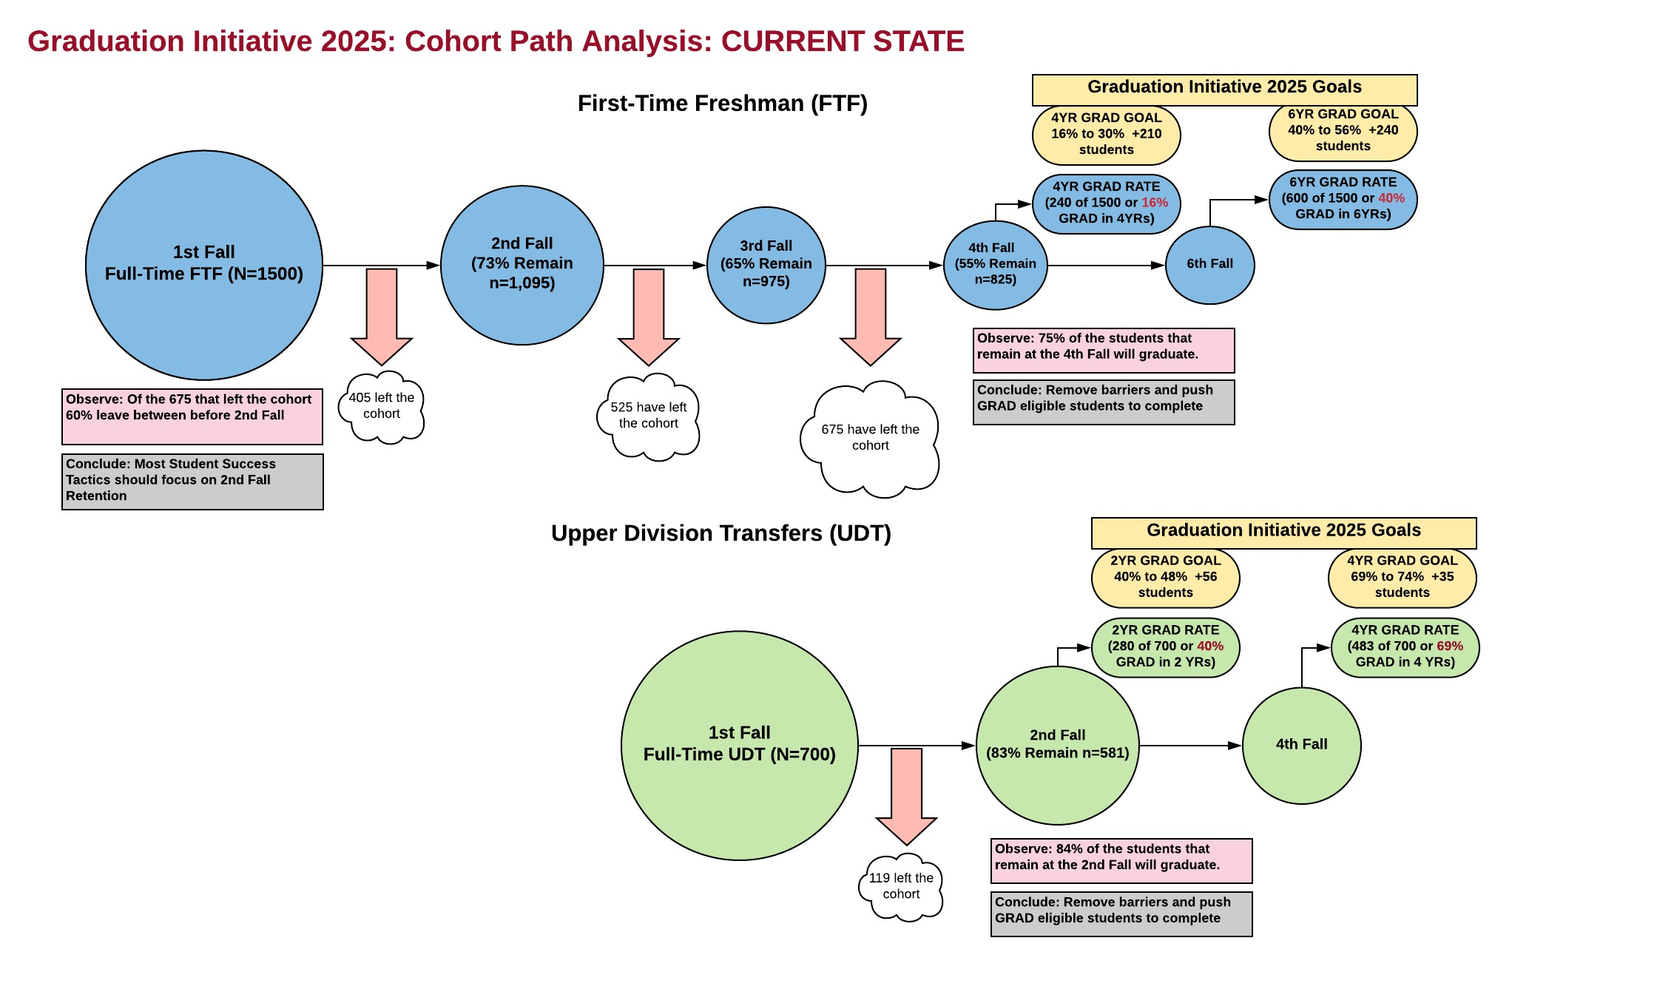

Slide 10
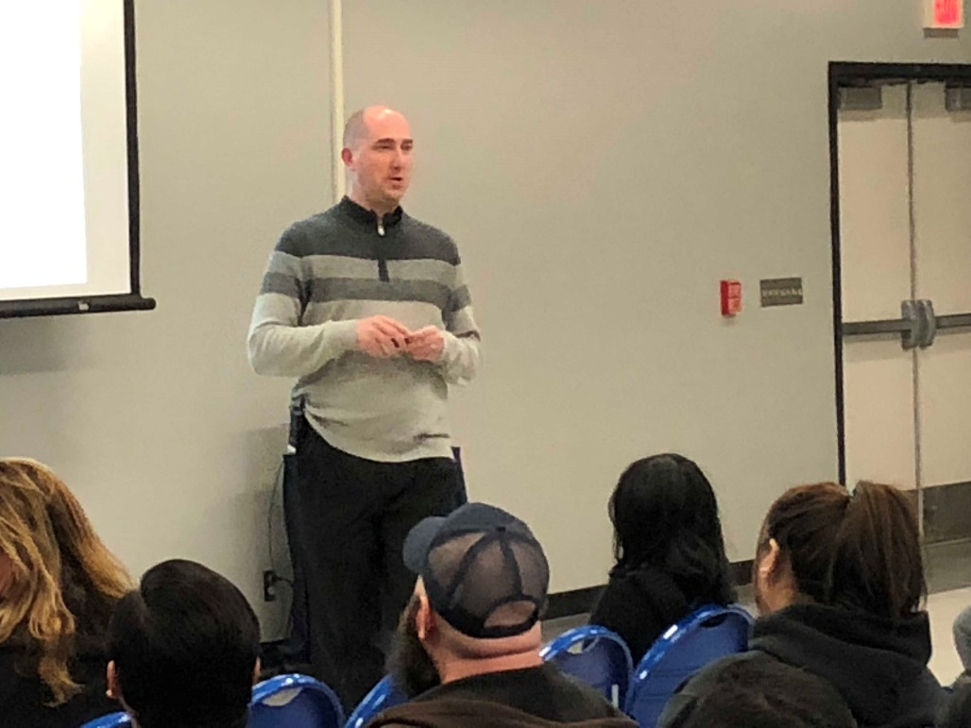
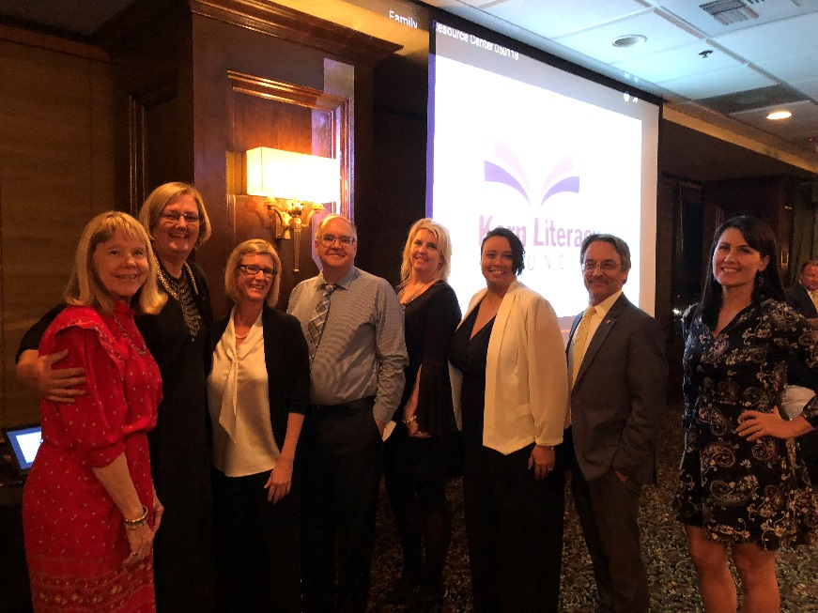
Where do we get our Transfer students?
43% Bakersfield College
11% Antelope Valley College
8% Taft College
6% Porterville College

Slide 11
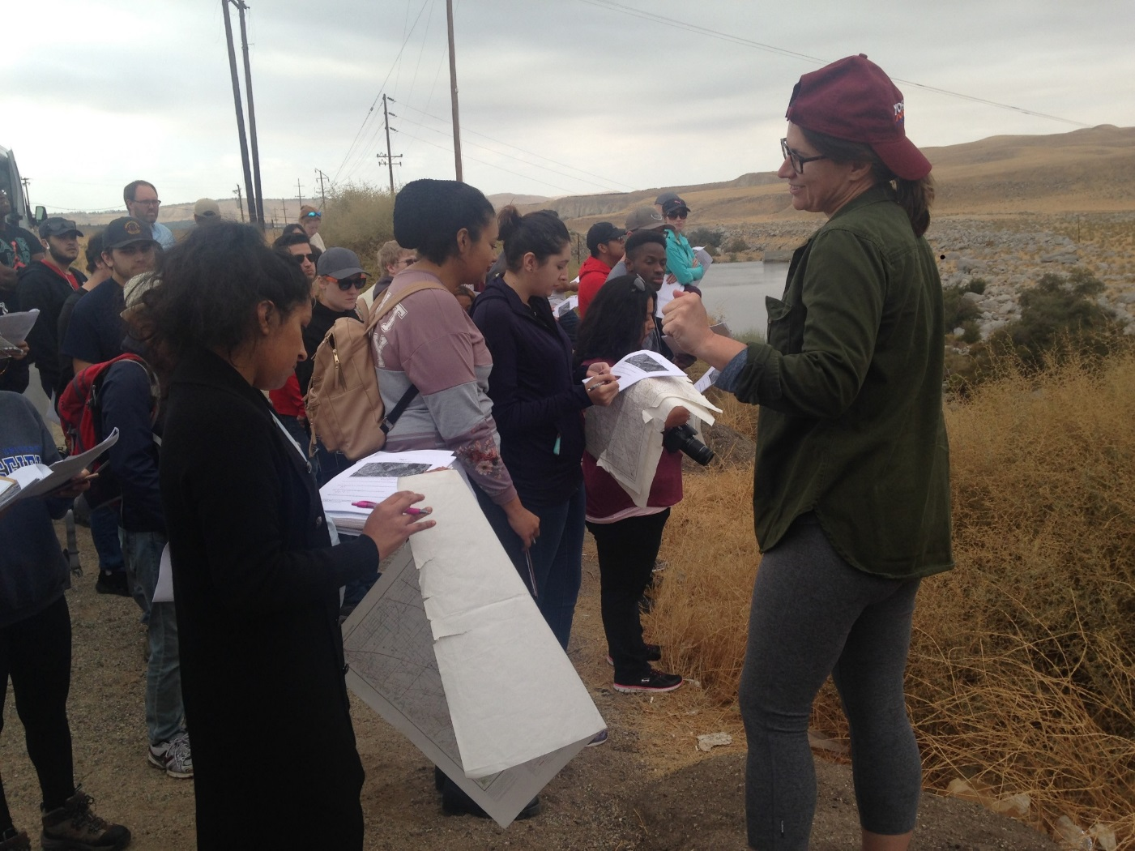
Graduation Initiative Taskforce
Tactics
Block Scheduling
Degree Road Maps
Four-Year Pledge
Supplemental Instruction
Advising Restructure
Academic Preparation for Developmental Support Courses
Winter Session
Summer Session (up 8% in 2018)
School based tactics focused on retention beyond year 2.
Graduation Acceleration
In progress units policy
Eliminating Holds

Slide 12
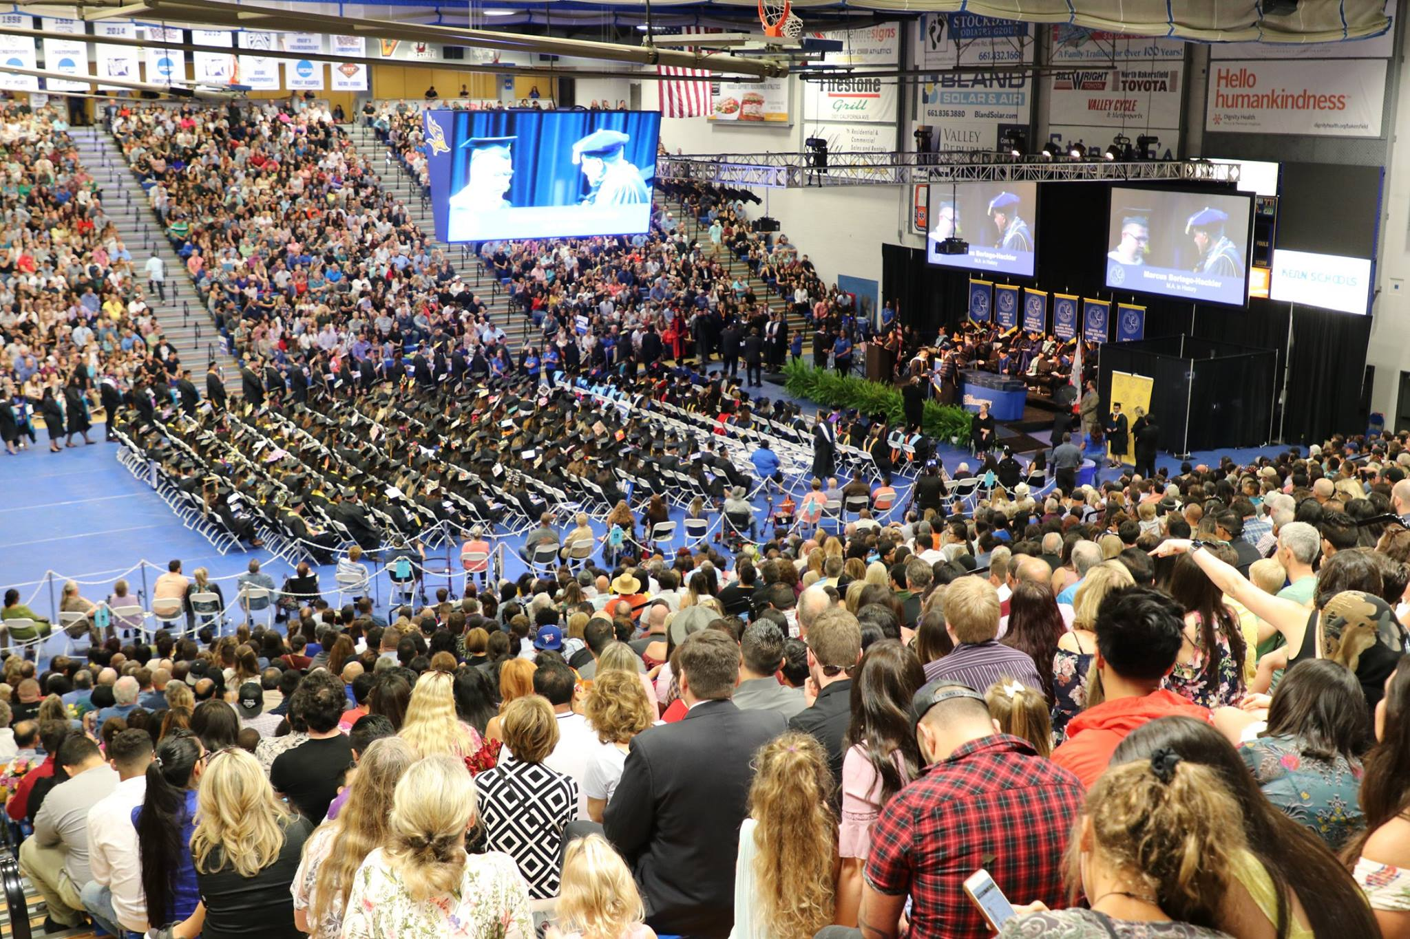
Advising update
Phase I: Staff Advising Centers established in the Schools, reporting to the Dean.
Phase II: Outside consultant review and campus conversation on advising resulting in a restructure of the Academic Advising Resource Center and the School Advising Centers.

Slide 13
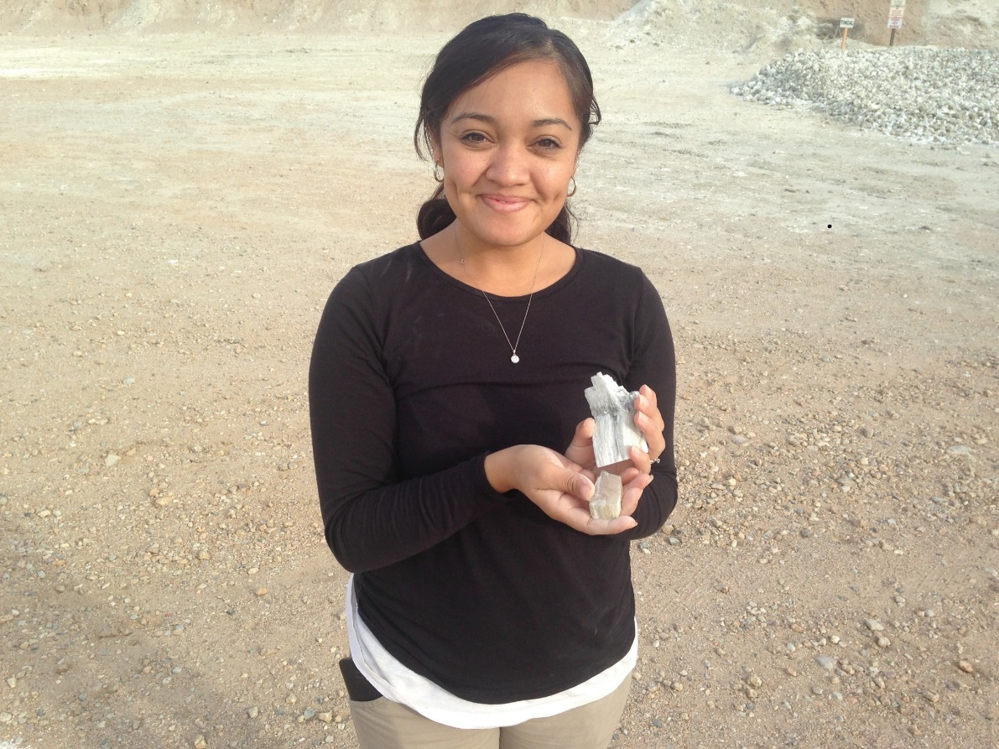
Summer 2018
Re-positioned staffing
Two staff advisors move from Academic Advising Resource Center to
Social Sciences and Education
One staff advisor move from Academic Advising Resource Center to
Natural Sciences, Mathematics, and Engineering
Restructured workloads
At Risk Advising – eliminated due to new
Developmental Academic Preparation
Facilitating Graduation Project – moved to Schools
Midterm Progress Reports – moved to Schools
Affinity Mentors – moved to Enrollment Management
Spring Preview – moved to Enrollment Management
Early Start – moved to Schools
Student Success Peer Mentor Program – moved to Schools
15 to Finish – moved to Enrollment Management

Slide 14
Academic Advising Resource Center
Workload
Academic Standing
Probation
Academic Jeopardy
Satisfactory Academic Progress
Undeclared Advising
Project Rebound initial advising
Reconstituted the Advising Leadership Team
AVP Vernon Harper, Chair
Associate Dean Liora Gubkin-Malicdem
Associate Dean Todd McBride
Associate Dean Tanya Boone-Holladay
Interim Associate Dean Mark Evans
Interim Director of Academic Operations Lisa Zuzarte
AVP Vikash Lakhani
Advisor Yvette Morones
Marta Ruiz, staff support

Slide 15
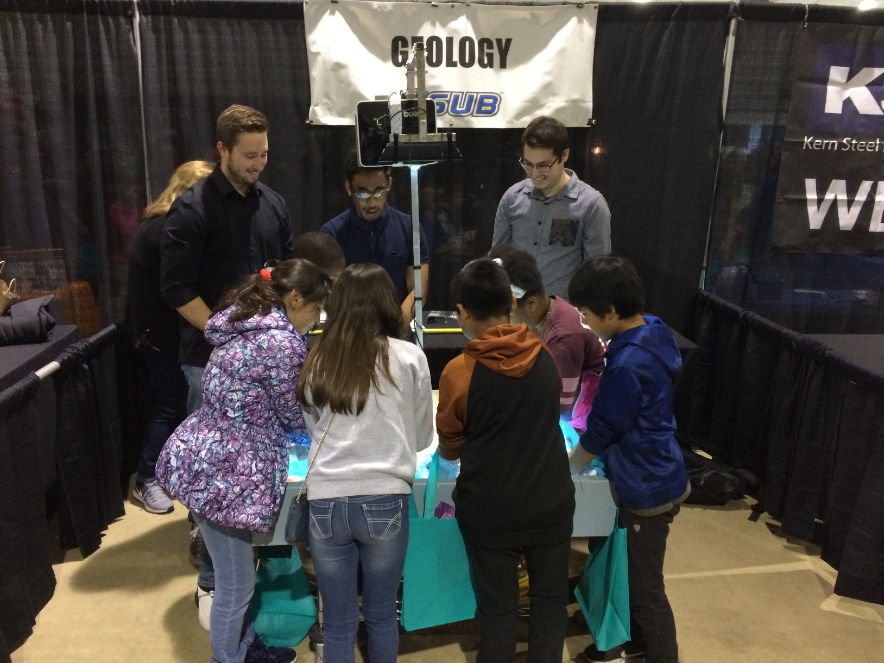
Fall 2018
Phase III: Statement on advising and the roles and responsibilities of faculty and staff advisers

Slide 16
Block Scheduling Pilot
Initial data points
August 2018 update
1.Blocked students had higher GPAs & lower probation than Non-Block students in fall 2017
Term GPA Blocked: 2.5 Non-blocked 2.3 (Non-blocked fall 2016 2.5)
Probation status Blocked: 20% Non-blocked: 30% (Non-blocked fall 2016 40%)
2.Blocked students took more units & passed more than Non-blocked students in fall 2017
Units taken Blocked 15.2 Non-blocked 14.6
Units passed Blocked 11.4 Non-blocked 10.2
3.Blocked students retained at higher rate than historical average
81% Enrolled as of Aug 1, 2018 for fall 2018
72% Historical retention
4.Blocked students enrolled in more units than incoming sophomores in fall 2018
Avg. units enrolled Blocked 14.15 All sophomores 13.4
% units 15 or above Blocked 57% All sophomores 45%
5.Blocked and other Graduation Initiatives, e.g., 15 to finish are increasing enrolled units
Fall 2016 13.8 Fall 2017 13.3 Fall 2018 14.7
(788 students in block this year, 50% of students)

Slide 17
Information Technology Services
Accomplishments for 2017-2018
Faculty
Zoom Video Conferencing – over 700 meetings held online, 125,000 meeting minutes, and 2670 participants – cost avoidance
New standards for technology computer refresh - 5-year refresh for labs, 4-year refresh for instructor stations, and 4-year refresh for faculty computers
One overall standard for our computer labs, smart classrooms, and ITV rooms.
Digital Measures for Business and Public Administration faculty
Six Computer Lab upgrades
13 Smartroom upgrades
36 tenure track faculty computer refreshes
Completion of Classroom Taskforce – analyzed all instructional spaces, provided report
Online Institution Research Board software for online processing using Cayuse
Organizational Excellence
Student System and Human Resource System Split and Upgrades
Online Job Applicant system – moved from paper to online
Started implementation of VoIP
Enterprise Document Management system – added Auxiliary Services and University Advancement
Move services to the Cloud – Federated Authentication
7 new websites – modern and responsive
Implemented HighPoint automation for financial aid making it easier to manage their workload
First ITS Townhall

Slide 18
Information Technology Services
Top Priorities for 2018-2019
Faculty
Invest $300,000 annually into instructional spaces (10-13 upgrades annually)
Standardize the instructional space experience
Canvas Pilot – easier management of the instructional online experience
Improve online Student Opinion of Curriculum and Instruction (SOCI) platform
Grant Proposal system – support faculty submission for grants
Automated Course and Roster integration into Blackboard & Canvas
Organizational Excellence
Box.com – Cloud File Storage and Collaboration – provide anytime, anywhere, on any device access.
Web CMS 2.0 – responsive, modern, website building and editing tool.
Unify our Document Management Systems – bring on Business and Public Administration, Extended Education and Global Outreach, and Enrollment Management – reduce complexity and reduce cost
Migrate to Systemwide Applicant Tracking System – reducing cost for CSUB.
Questica – Budget and Financial Reporting System – simplify and provide access to financial information.
Reduce Printers and moved to managed services partner – reduce cost and provide real operational costs to campus.
New Campus Training system – provide compliance and allow for education of campus employees.
Windows 10, SQL 2016, and Server 2016 migration
Concur – Travel and Expense Management System – simplify travel

Slide 19
WASC Re-Accreditation Update
The WASC team will visit campus in the Fall of 2019
WASC Steering Committee is nearing completion of the draft of the Institutional Report to be sent to campus by September 15, 2018 and discussed by campus
The Institutional Report will “Tell the story of CSUB now and in the future”
Over 45 Faculty, Staff, and Students, from Bakersfield and AV campuses, participated in the WASC Workgroups, representing nearly every employee classification
12 Faculty and Administrators were selected to lead the 10 Workgroups
Timeline in Brief
Fall 2018: Draft Institutional Report to be sent to campus and vetted by the Academic Senate
Spring 2019: After Cabinet approval, the Institutional Report will be sent to WASC
Fall 2019: On campus visit

Slide 20
Disciplinary accreditations ABET accreditation visit in November 2017. Responded to inquiries Spring 2018. Final decision Fall 2018.
AACSB
End of February 2019 Report due
End of April 2019 Visit

Slide 21
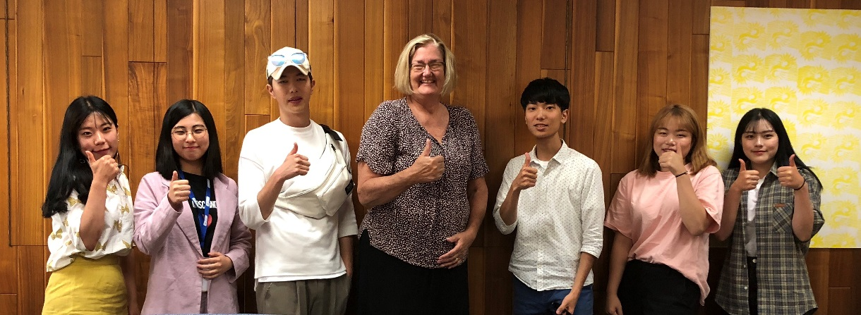
Study Abroad
Outgoing
Chancellor’s Office International Programs (1-year programs) for 2018-19:
5 students
Center for Global Outreach Semester Abroad Exchange for 2018-19:
6 students for Fall 2018 (increase from 1 student in 2017)
2 students for Winter 2019 (increase from 0 students in 2017)
3 applications received for Spring 2019
Center for Global Outreach Summer 2018 short programs
34 students in 2018 (up from 20 students in 2017)
Incoming
Exchange students from Summer 2017 - Spring 2018:
26 students (Up from 11 students last year)
Summer 2018:
11 students
Fall 2018:
11 students will begin their studies at CSUB
Bucheon, South Korea students summer study at CSUB 2018.
CSUB students studied in Bucheon summer 2018.

Slide 22
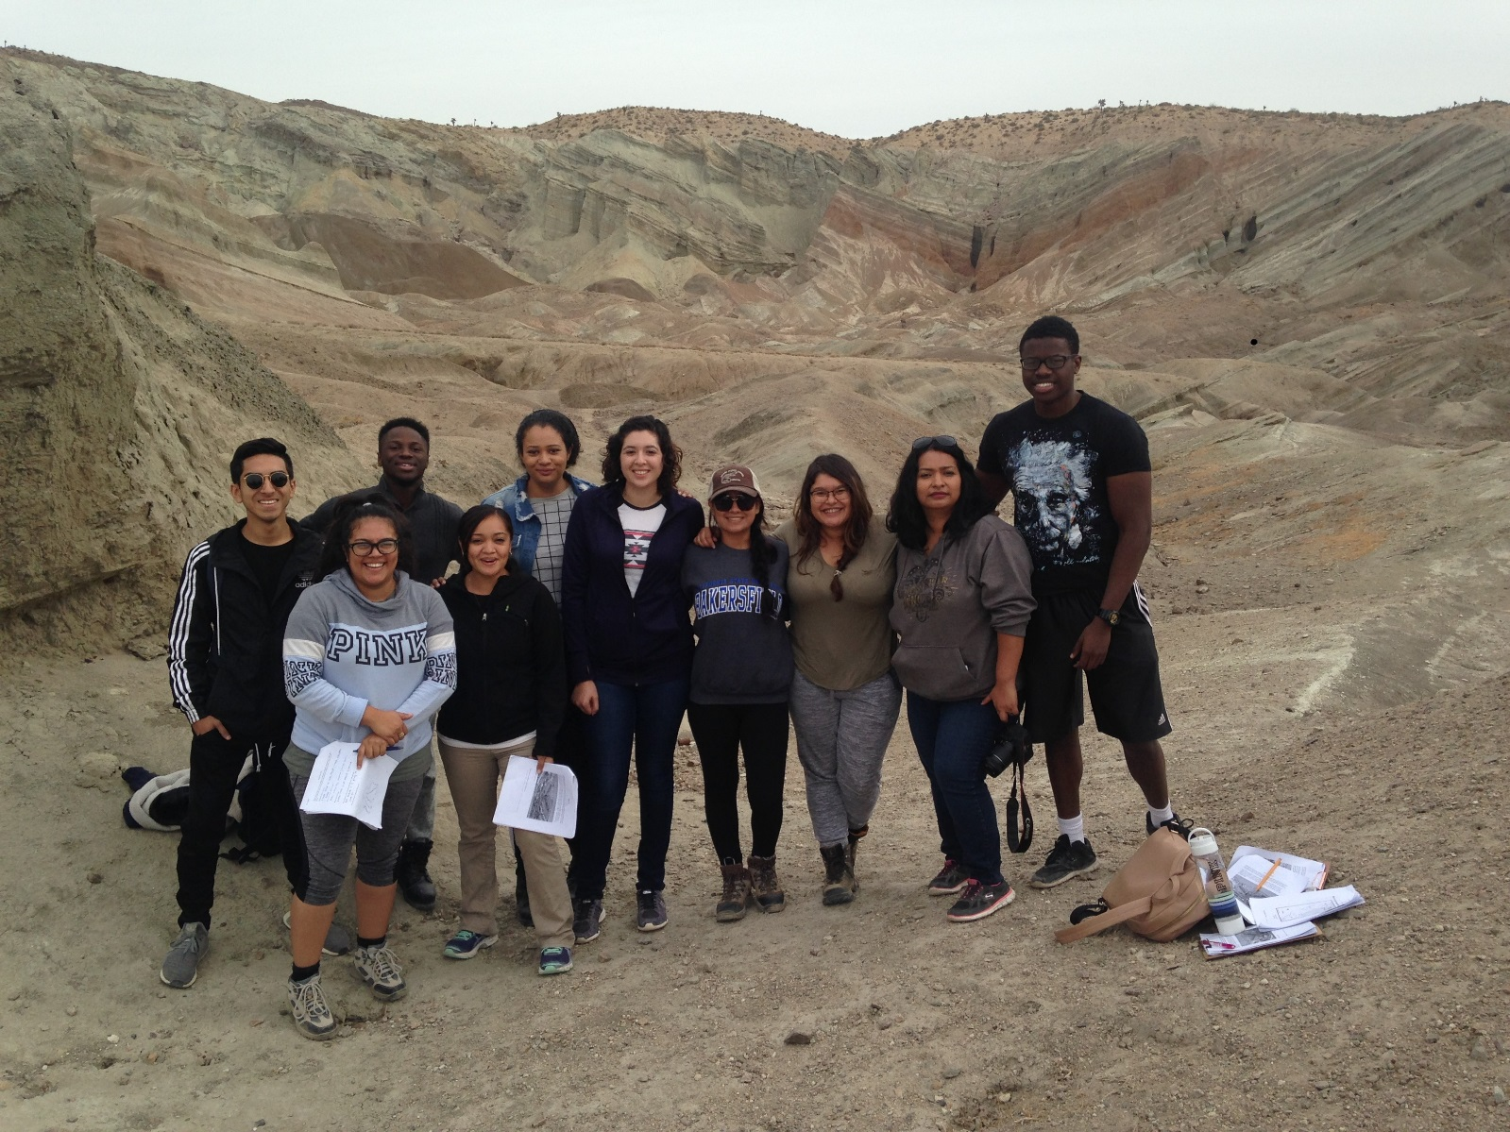
New Academic Programs
MSW hybrid at Antelope Valley
Natural Sciences, B.S. at Antelope Valley
Power and Energy Concentration
Programs under development
Currently Planned Implementation Year
MS Computer Science
2019 MS Applied Economics and Analytics
2019 BA Women’s, Gender, and Sexuality Studies
2019 BA Ethnic and Cultural Studies
2019 BA Latina/o Latin American Studies
2019 BS Public Health
2020 MS Kinesiology
2020 MS Accounting
2020 MS Finance
2021 MS Technology Management
2021 MS Logistics and Supply Chain Management

Slide 23
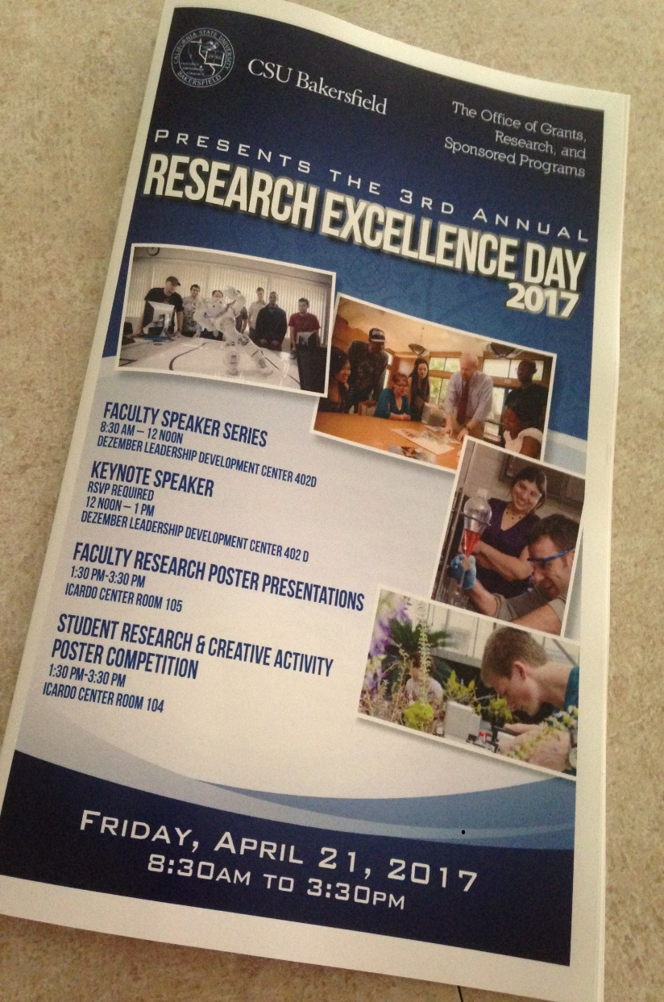
Research Grants
$11.6 million in 2017-18
Down from $14 million in 2016-17
Submitted 62 proposals in 2017-18
Up from 50 in 2016-17
Currently 58 awards (32 are continuous)
4 patent applications processed in 2017-18
Acquired Software (CAYUSE) for Grants Administration
IRB Module of CAYUSE in place

Slide 24
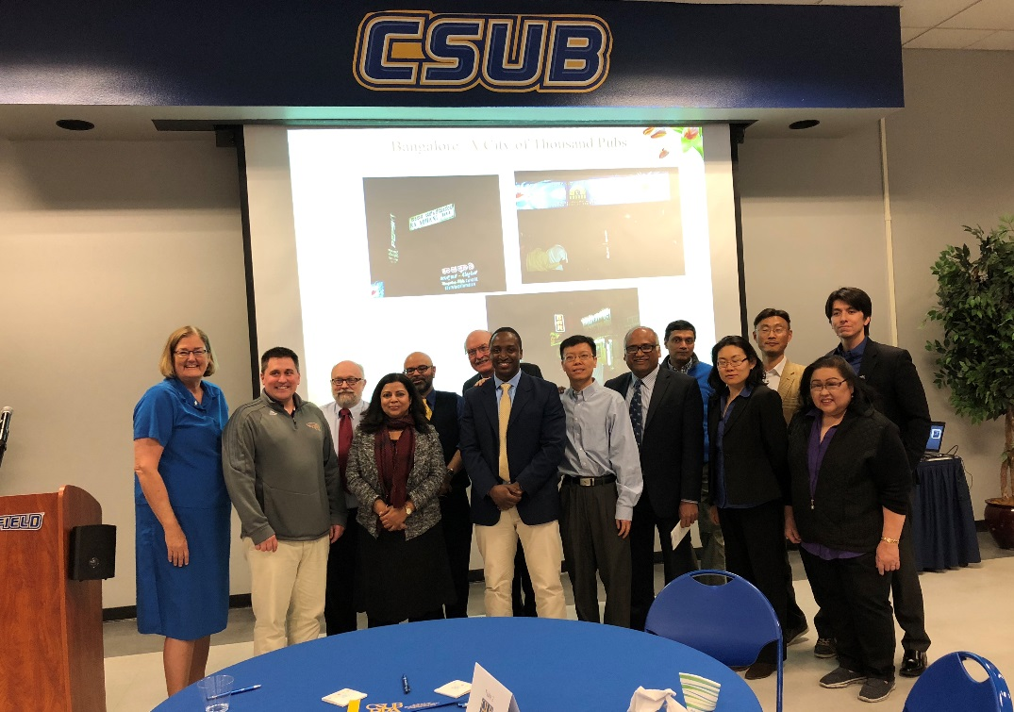
2017-18 2018-19
Chancellor’s Office
Research, Scholarship,
& Creative Activities
(RSCA) $48,840 $51,900
Provost
Mini-Grants $49,590 $50,000
Provost
Assigned Time Research $50,000
TOTAL $98,430 $151,900

Slide 25
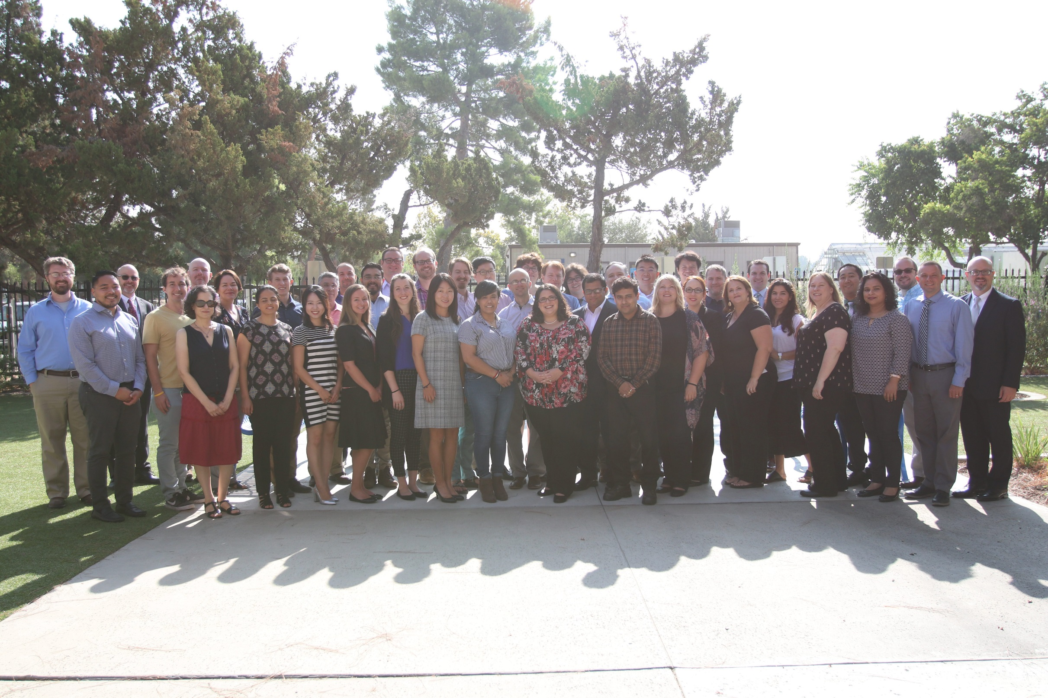
Faculty searches
38 new tenure track faculty arrived Fall 2018
15 Searches for 2018-19

Slide 26
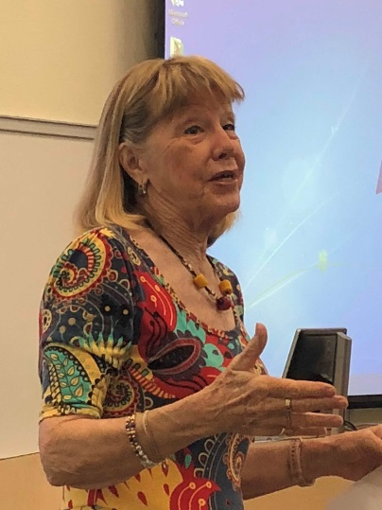
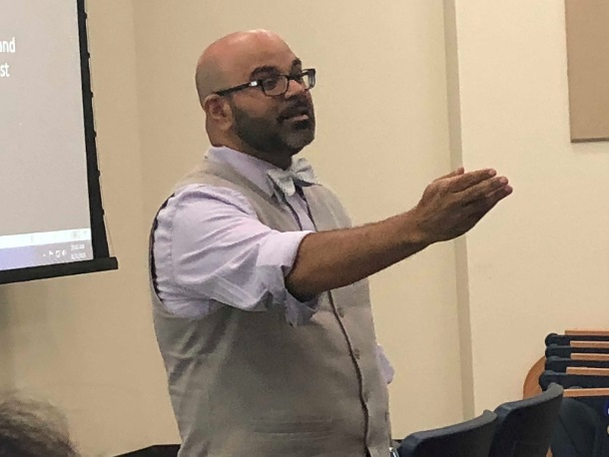
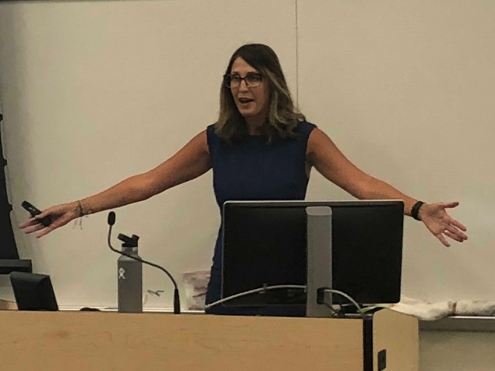
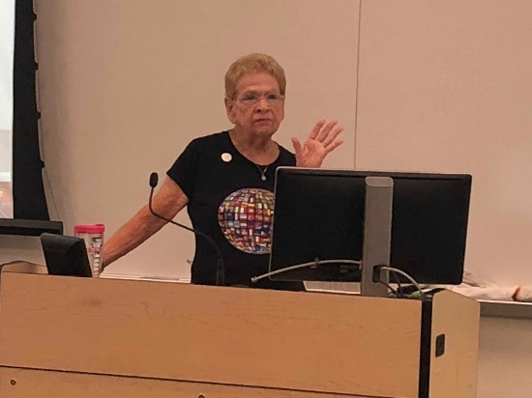
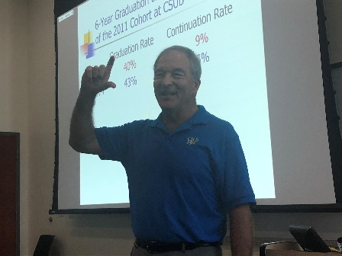
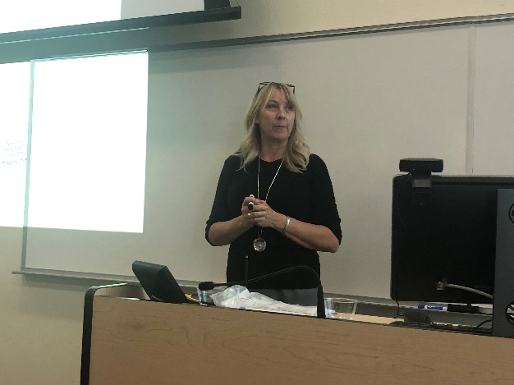
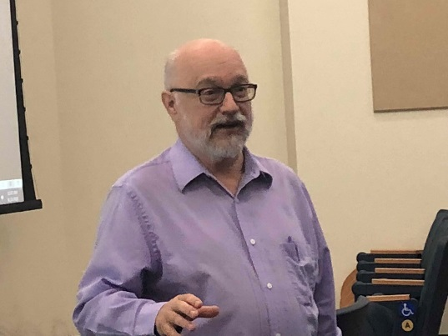
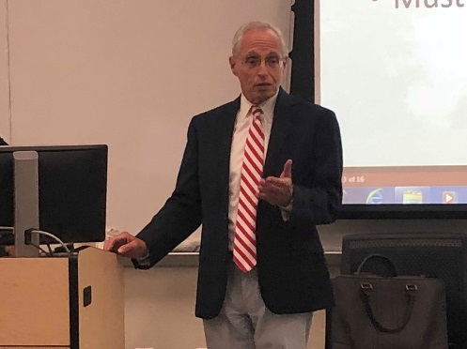
Faculty professional development workshops
Fall 2018
Reading and writing across the curriculum
Kim Flachmann
Teaching international students: Challenges & Satisfactions
Jackie Kegley & Mark Novak
Providing effective advising to students
Aaron Hegde & John Deal
Developing everyday heroes: The growth mindset
and developing students’ resilience
Allison Evans
Improving student performance & reducing the equity gap:
What can the faculty do to help students?
John Tarjan & Lori Paris

Slide 27
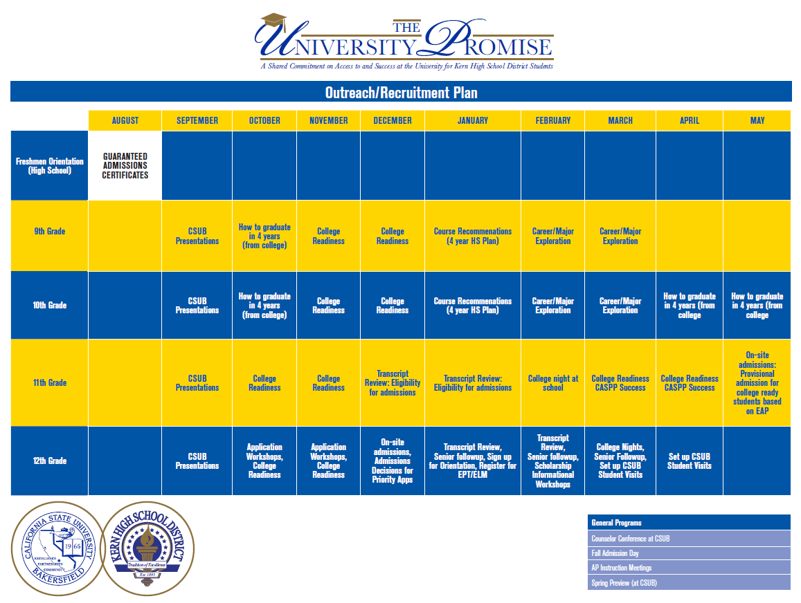
University Partnerships
Finish in 4 – Bakersfield College
Collaborative between CSUB and BC to help students earn their ADT at BC in 2 years and earn their Baccalaureate Degree in 2 years at CSUB.
Faculty (Chairs) from over 25 programs collaborated to develop a transfer roadmap showing students what their curriculum looks like in their 1st 2 years at BC and last 2 years at CSUB.
University Promise – Kern High School District
Guaranteed admission to KHSD students
Targeted outreach starting in the 9th grade
Goal to increase number of students enrolling at CSUB who are college-ready
Data Sharing Agreement

Slide 28
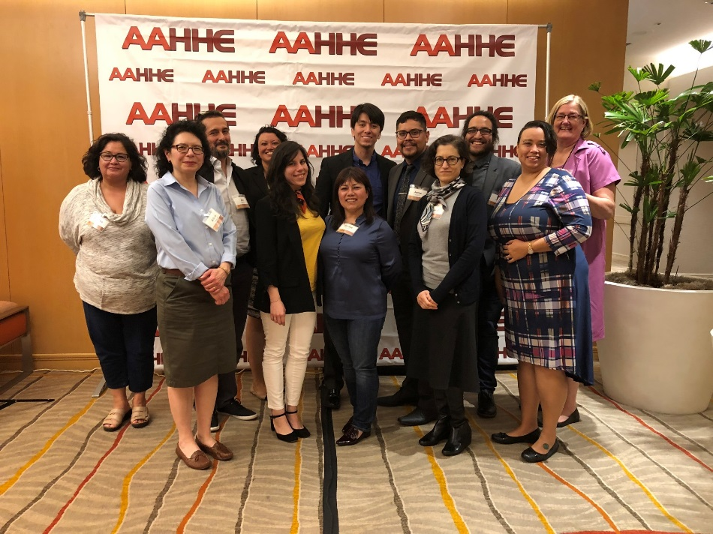
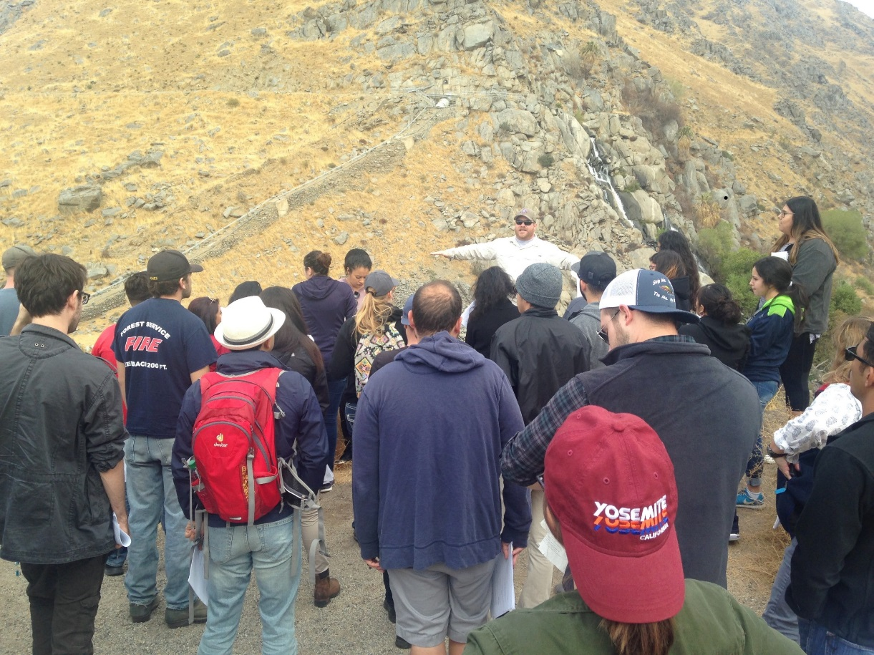
Promotions and Tenure Awards Fall 2018
Full Professor
Barbara Bartholomew, English
Chris Eicher, Music
Anna Jacobsen, Biology
Antje Lauer, Biology
Deborah Boschini, Nursing
Matthew Leon, Psychology
Janet Armentor, Sociology
Associate Professor and Tenure
Angel Vazquez-Ramos
Sandra Bozarth, Library
Saeed Jafarzadeh, Computer and Electrical Engineering
and Computer Science
William Krugh, Geology
Yvonne Ortiz-Bush, Advanced Education
El Hadidi Hager, Anthropology

Slide 29
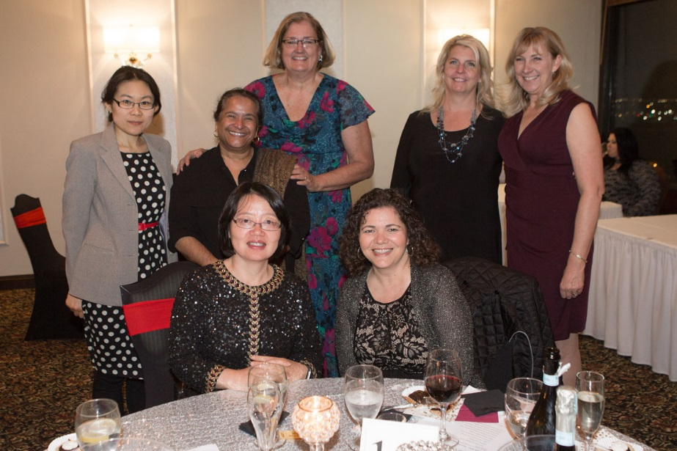
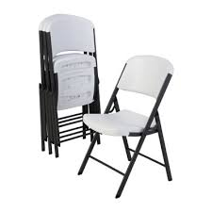
Outgoing Chairs from 2017-18
Incoming Chairs for 2018-19
Debbie Boschini
Paul Newberry
Phyllis Heintz
Dan Zhou
Lori Paris
Interim Chair for 2018-19
Jean West
Rhonda Dugan
Rose McCleary
Interim Chairs who served in 2017-18
1. Jeff Moffit

Slide 31
